Slide 1
ELECTRO-MECHANICAL PROPERIES of 650 MHz β=0.92 5-cells Dressed Cavity
I. GONIN, T. KHABIBOULLINE
June 25, 2013

Slide 2
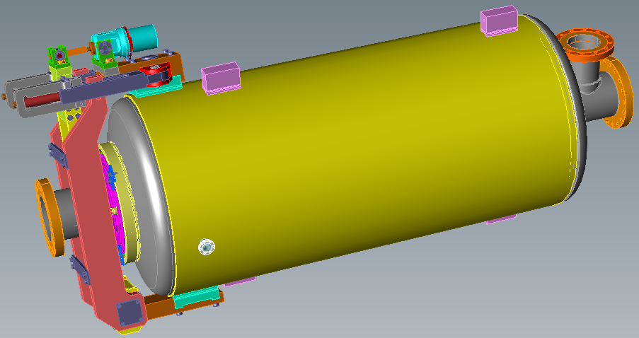
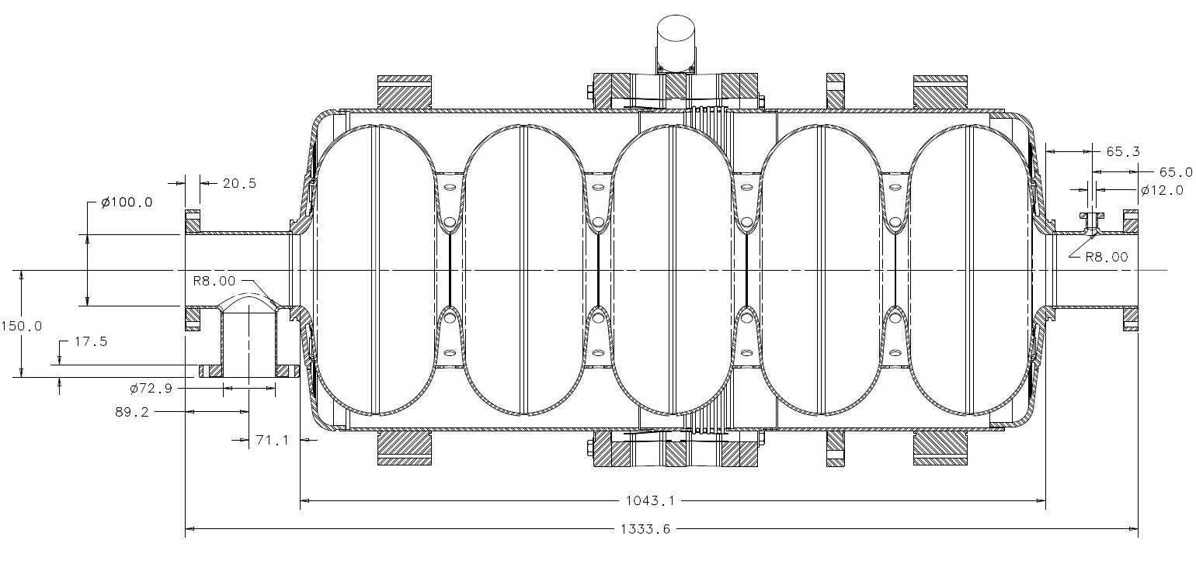
MECHANICAL DESIGN OF 650 MHz β=0.9 CAVITY
IPAC 2013 WEPWO056

Slide 3
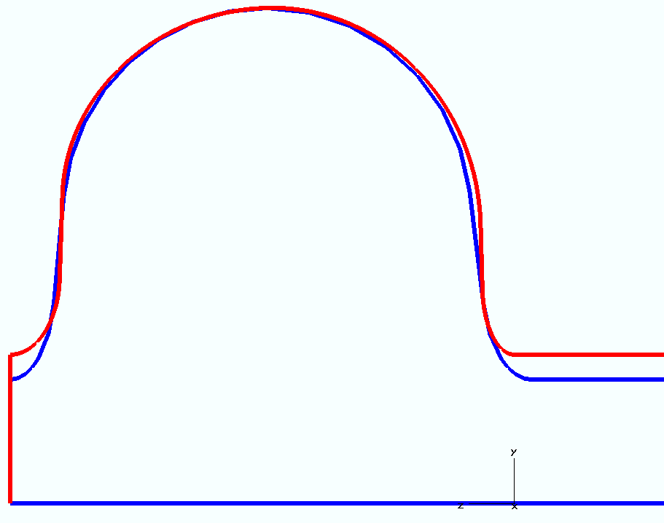
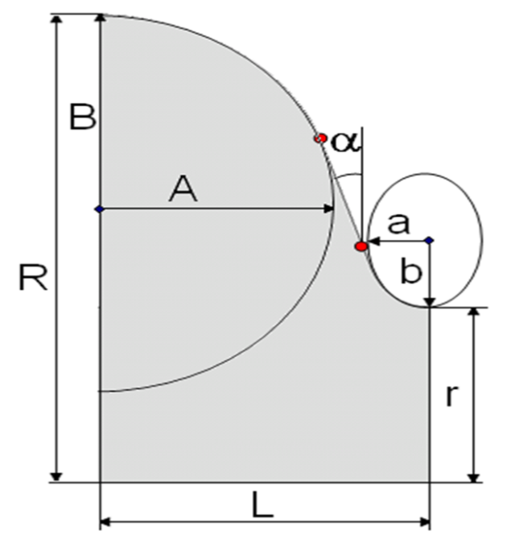
DIMENSIONS AND MAIN PARAMETERS OF β= 0.9&0.92 CAVIIES
Quantity | Old | New
G, Ω | 256 | 260
R_{sh}/Q₀ max, Ω | 638 | 609
β_{opt} | 0.95 | 0.97
E_{surf}/E_{acc}* | 2.08 | 2.04
B_{surf}/E_{acc}*, mT/MV/m | 3.81 | 3.85
K_{couple}, % | 0.75 | 1.29
Monopole HOM Q_{ext} | 10¹⁰ | 10⁶
Regular half-cell
End half-cell
 | OLD | NEW
r | 50 | 59
R | 200.3 | 200.052
L | 103.8 | 106.08
A | 82.5 | 85
B | 84 | 78
a | 18 | 20
b | 38 | 33
α | 5.2° | 1.9°
 | OLD | NEW
r | 50 | 59
R | 200.3 | 200.052
L | 107 | 97.555
A | 82.5 | 84
B | 84.5 | 90
a | 20 | 13
b | 39.5 | 28
α | 7° | 1.3°

Slide 4
The Scope of EM-Mechanical Design Issues
Minimize a sensitivity to microphonics due to He pressure fluctuations (df/dP) and mechanical vibrations
Minimize a Lorentz Force Detuning (LFD) coefficient
Tunability: tuning for correct frequency & for field flatness
Compromise between microphonics detuning (df/dP, LFD, microphonic noise) and cavity tunability (stiffness)
Enough strength to withstand atmospheric pressure
Stress analysis of cool-down from RT to cryogenic temperaure
ES&H manual requires that the cavity is rated at MAWP of 4 bars at 2 K and 2 bars in RT
Incorporate the slow and fast tuners design.

Slide 5
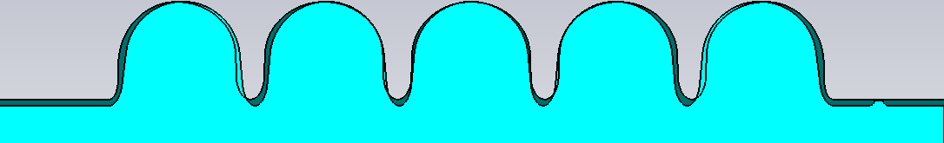
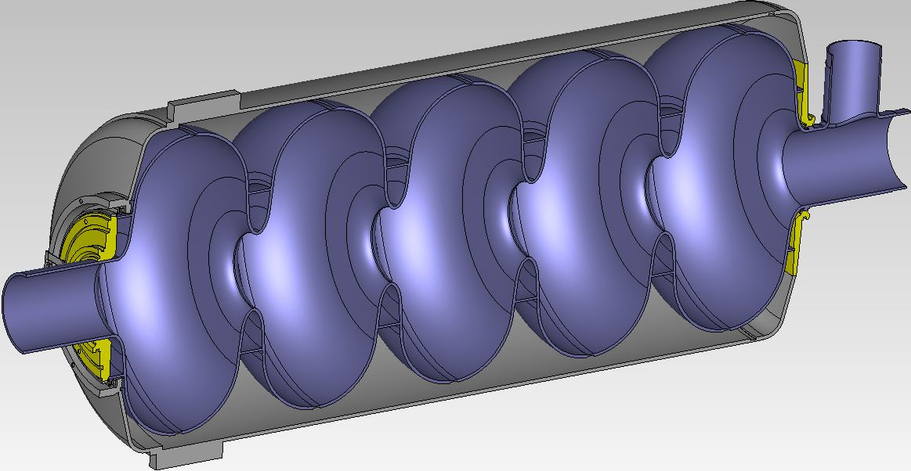
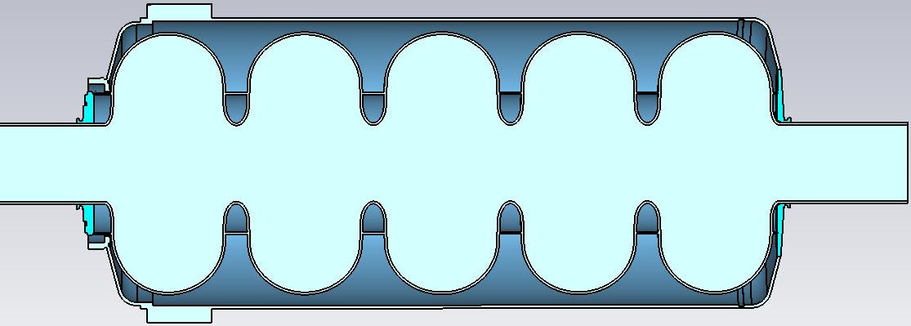
β=0.9&0.92 5 CELLS STRUCTURES AND HV’S MODIFIED MODEL
Li-i
50mm
59mm
1042.9/1043.8
1030mm
FIXED
1045mm
SPRING CONSTANT
Rend
Rreg
59mm

Slide 6
df/dP vs. Tuner Stiffnes
Stiffness of β=0.92 caviy kN/mmvs. Radius of the Regular stiffening ring
- Stiffness of β=0.9 cavity

Slide 7
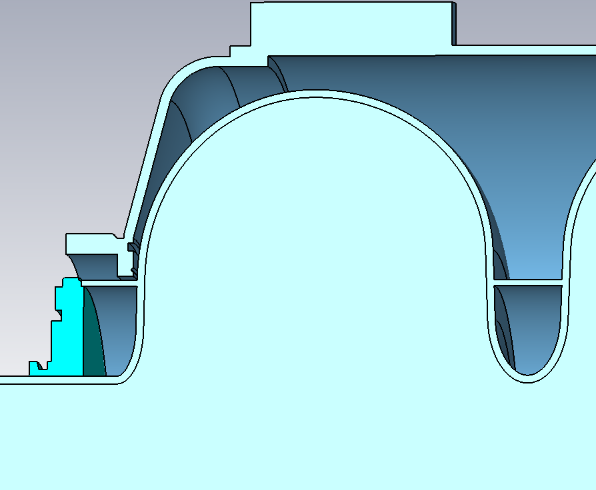
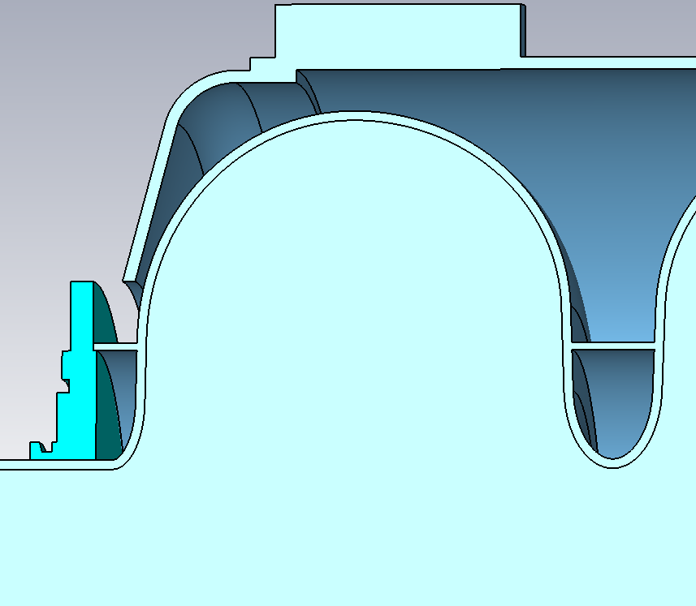
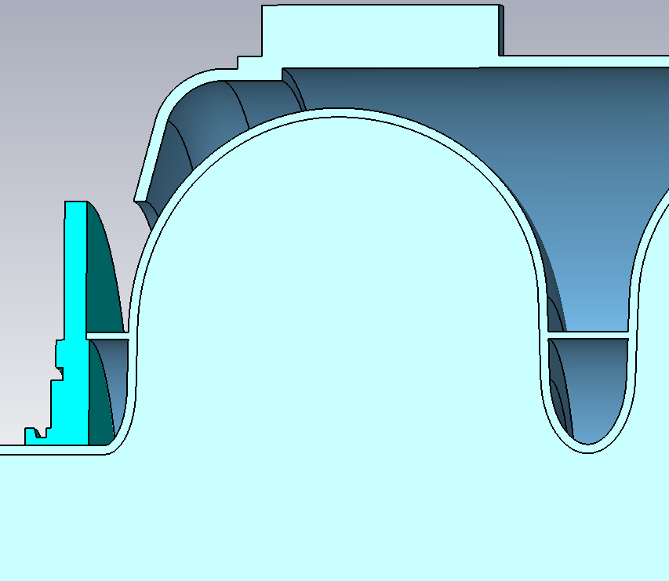
dF/dP vs. Bellows Radius, Rend=110mm, Rreg=110mm
R=135mm
R=115mm
R=165mm

Slide 8
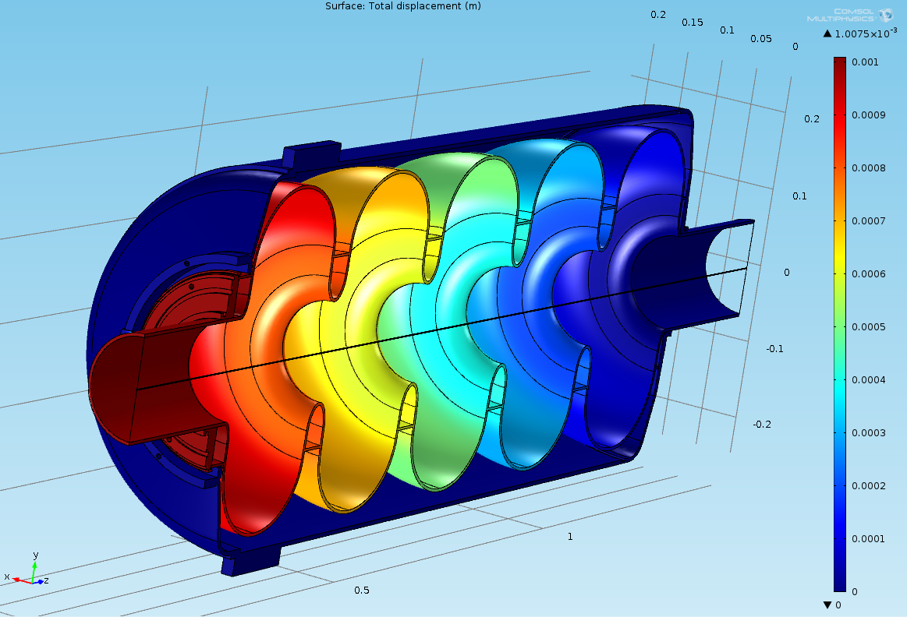
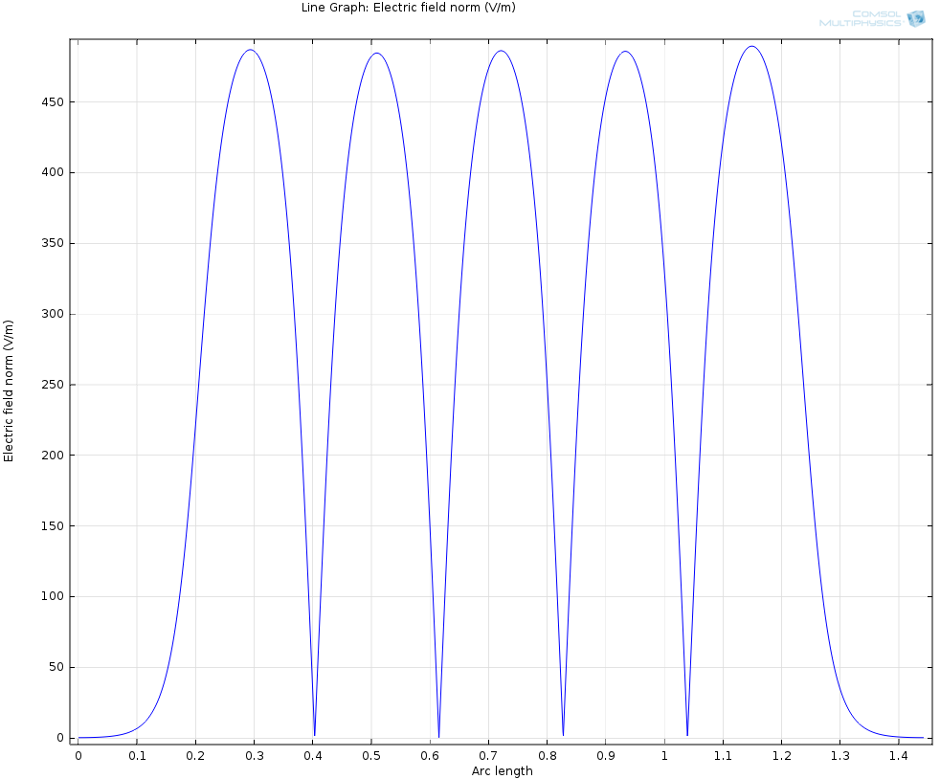
FIELD FLATNESS vs. RADIUS OF THE REGULAR STIFFENING RING
Cavity is deformed by tuner at 1 mm
FIXED
Ring Radius, mm | Flatness %
110 | 1.1
120 | 1.8
Ez(z) along axis

