Slide 1
Modular Cavity Status
168 k$ of the 229 k$ estimated cost has been spent
Only major parts still in fab are the waveguide channels and main body
Expect to be on budget and meet the Sept 30 completion date.
Daniel Bowring coordinating FNAL/SLAC interface
Chris Adolphsen, SLAC, 7/12/13

Slide 2
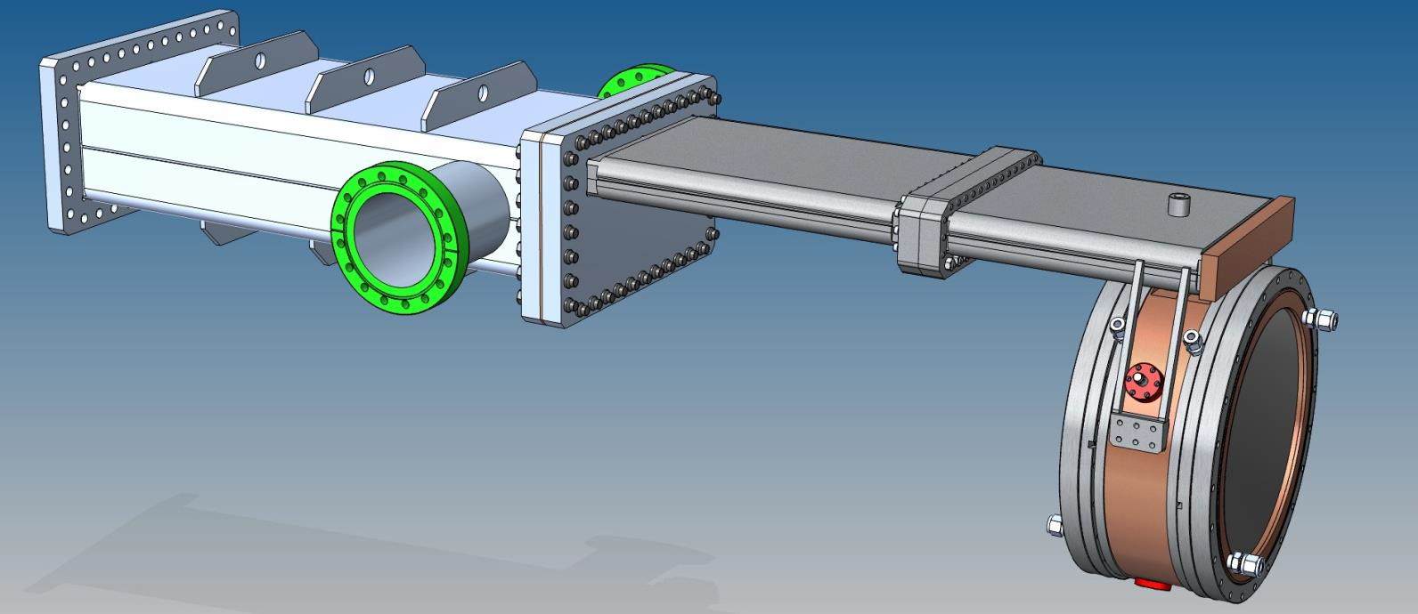
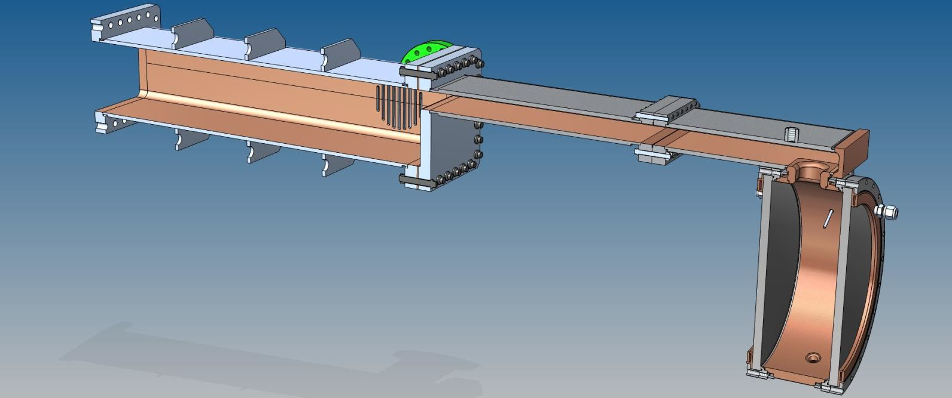

Slide 3
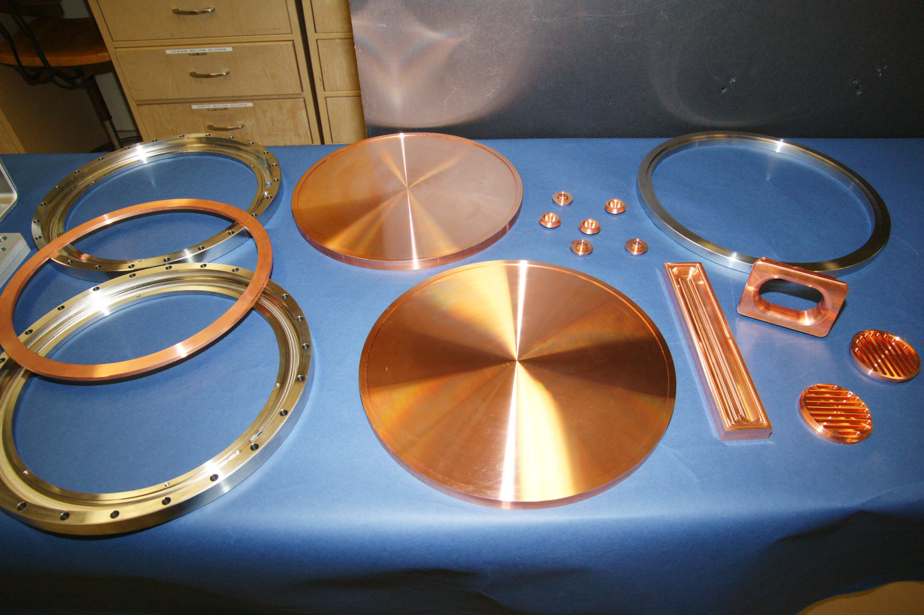

Slide 4
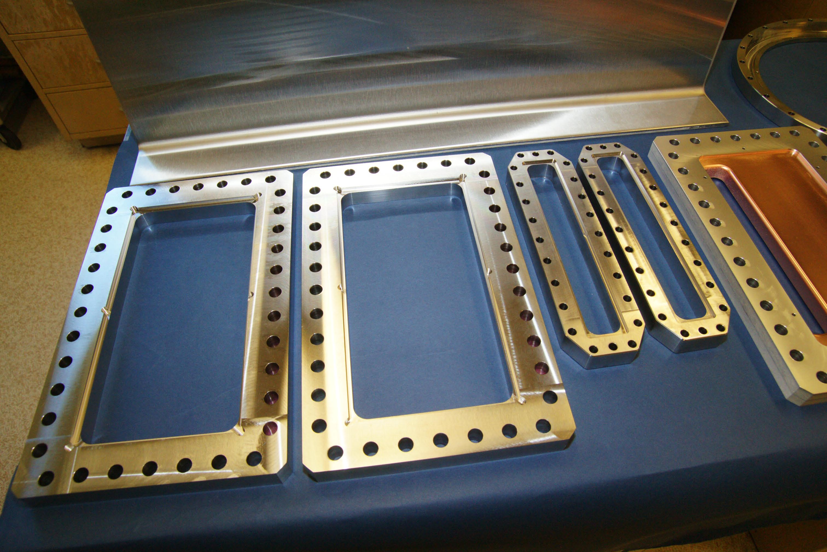

Slide 5
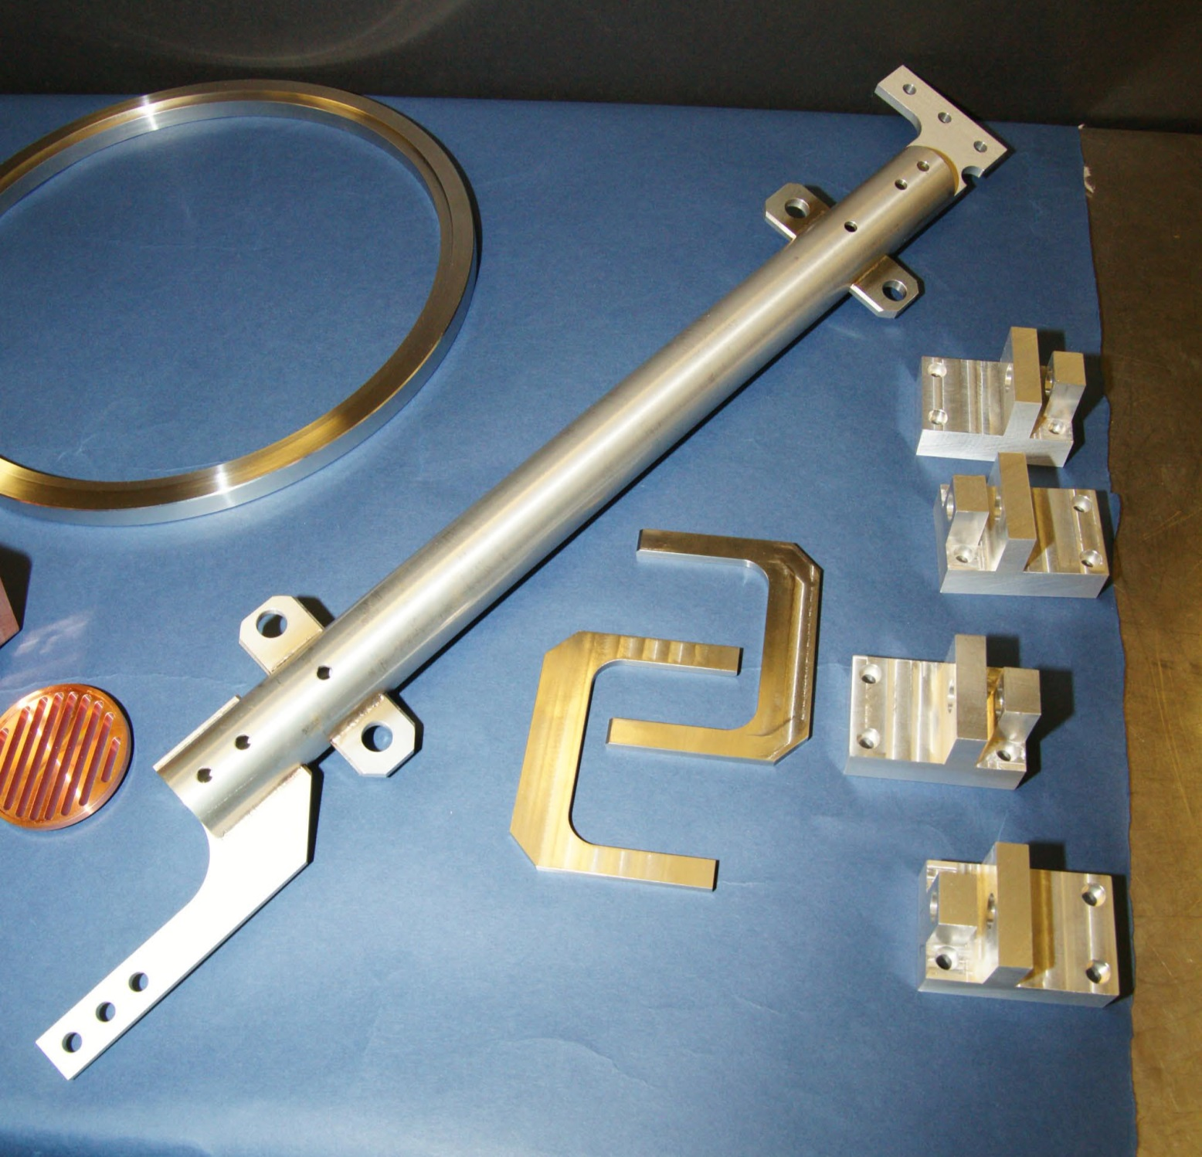

Slide 6
All Angle Cavity
Build an 805 MHz coaxial cavity such that E_rf is at all angles relative to the applied external magnetic field, H_ext
Map azimuthal breakdown dependence to assess E_rf x H_ext effects
Chris Adolphsen, Chris Nantista and Faya Wang
SLAC

Slide 7
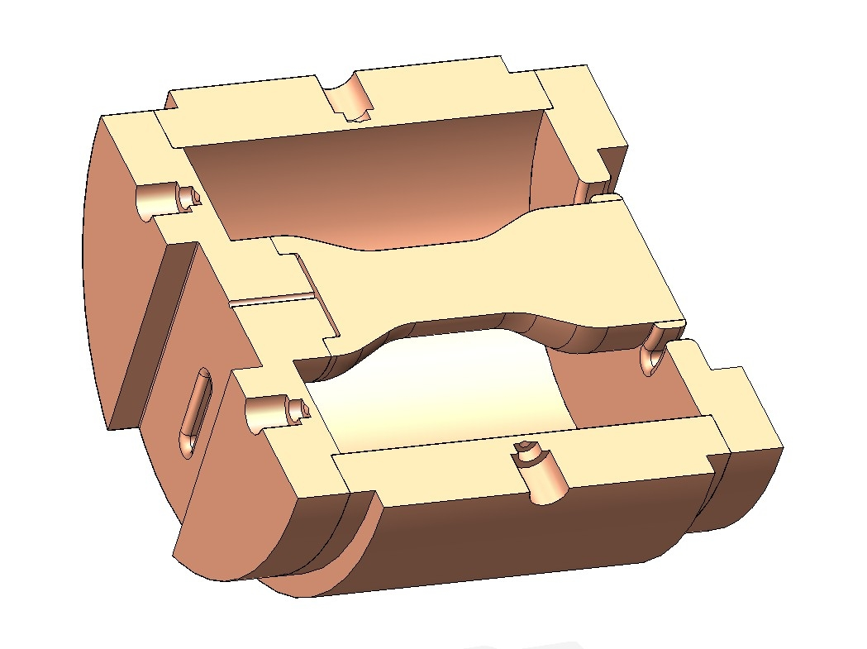
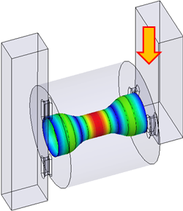
Inspired by Our X-band (11.4 GHz) Dual Mode Cavity
Designed to study effect of pulse heating on breakdown rate – excite two modes, TE011 (H only) and TEM3 (E and H) through two ports to vary the pulse surface heating for a fixed surface electric field (~ 200 MV/m)
TEM3 Electric Field

Slide 8
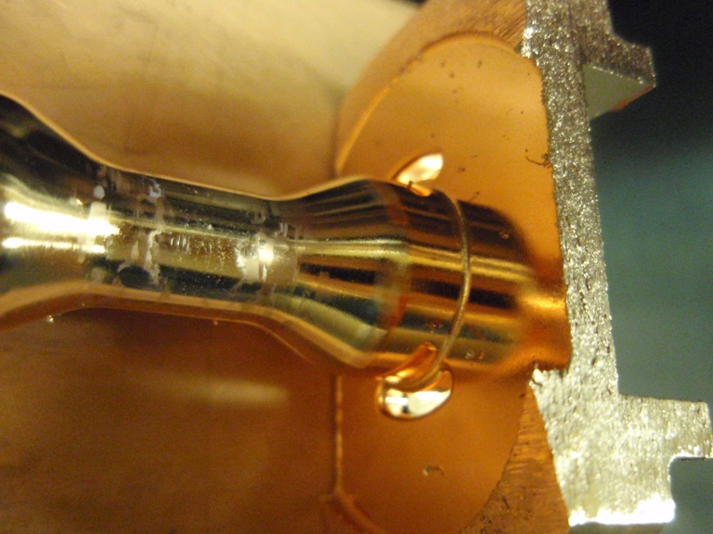

Slide 9
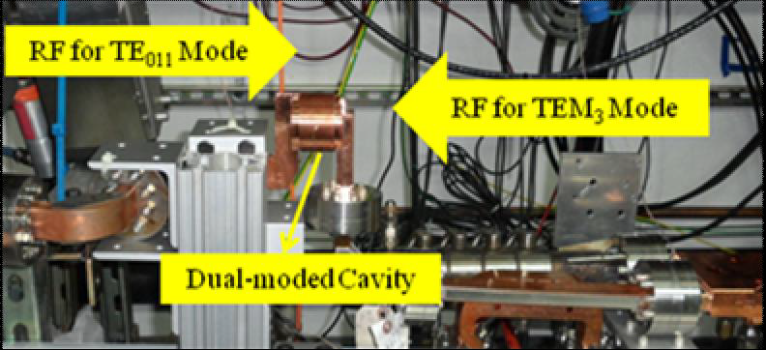
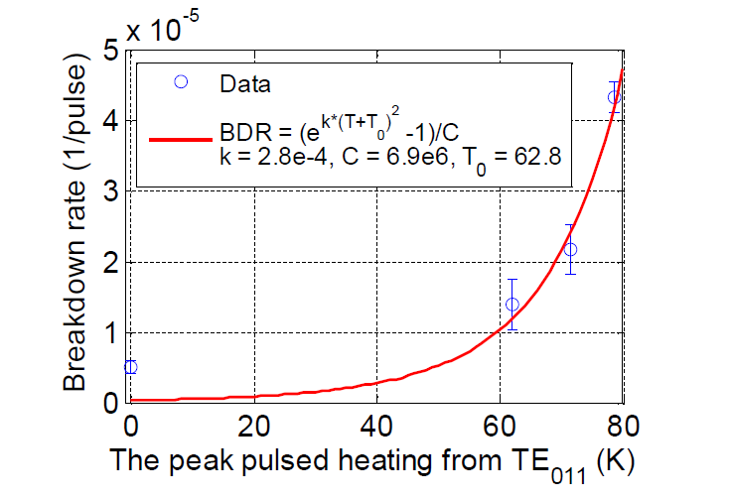

Slide 10
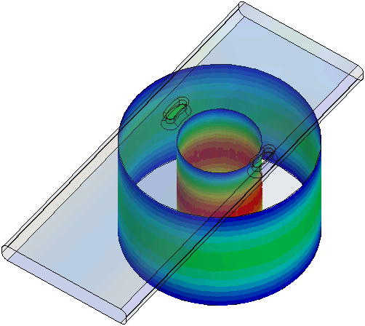
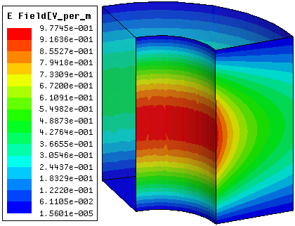


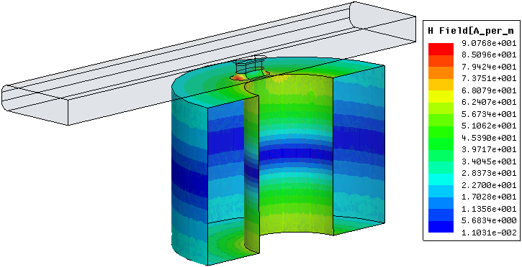
All Angle Cavity Design Example
Q_{L}
Q₀
(theor. 17,585)
In this case, choose inner radius, r1 = 2.34 in and outer radius, r2 =5.6 in so have same stored energy as Modular Cavity and same 805 MHz frequency
Chris Nantista

Slide 11
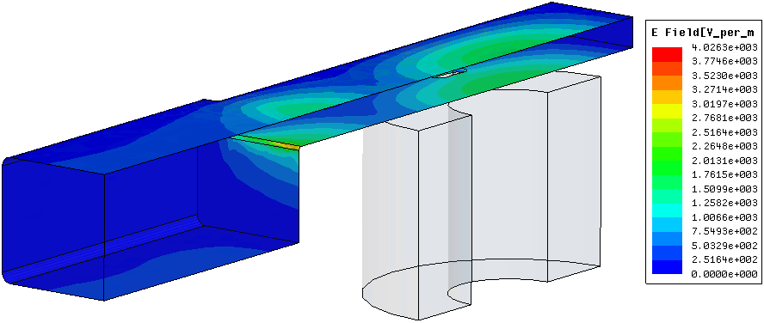
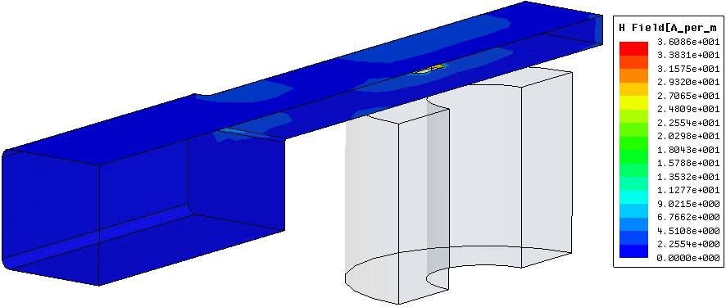
Match to Existing Waveguide (Beta ~ 1)
Matched at ~-18.3 dB level

Slide 12
Coaxial Cavity Design Options
r₂ = 5.600” (fixed for size constraints)
l = 7.331” (½-wavelength)
r₁ | U/U_{pillbox} | P_{d}/P_{d, pillbox} | Q₀ | E(r₂)/E(r₁)
1.000” | 0.360 | 0.527 | 17,735 | 0.179
1.674” | 0.708 | 1 | 18,355 | 0.299
2.342” | 1 | 1.475 | 17,585 | 0.418
initial choice:
fix dissipated power:
fix stored energy:
@ common |E_{s}|_{m}

Slide 13
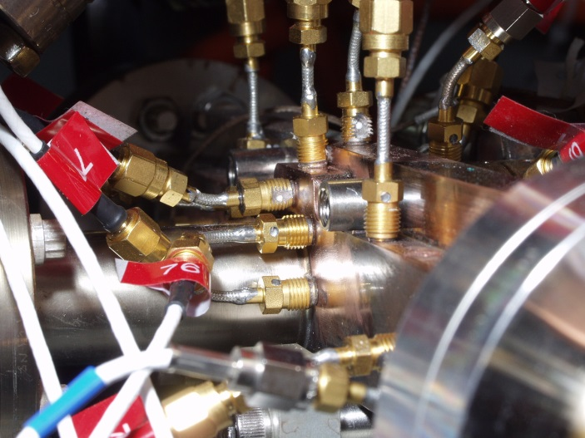
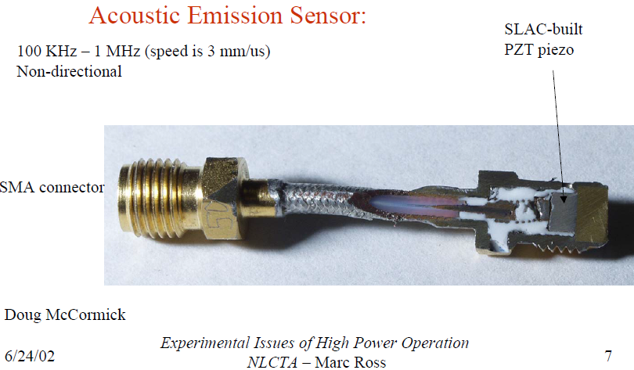
Use Acoustic Sensors to Map Azimuthal Breakdown Distribution

Slide 14
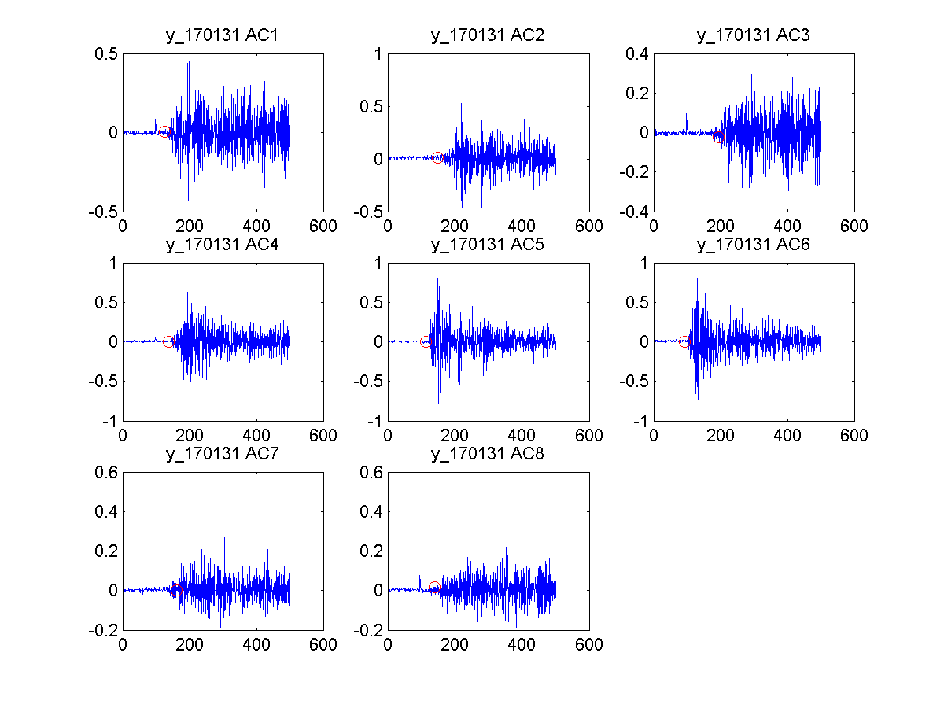
TTF RF Gun Breakdown Localization
Volts
Raw signals triggered by RE protection circuit
(35 Mev/m; 300 μs)
shows estimate of start time
μsec
M Ross et al

Slide 15

RF Breakdown in Gas Filled Cavities
Chris Adolphsen and Faya Wang
SLAC

Slide 16
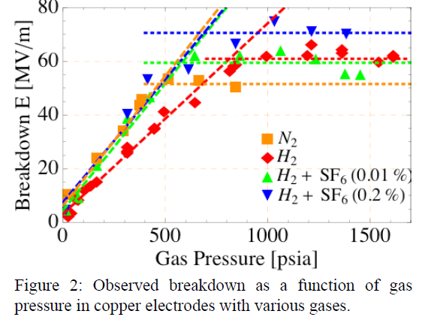
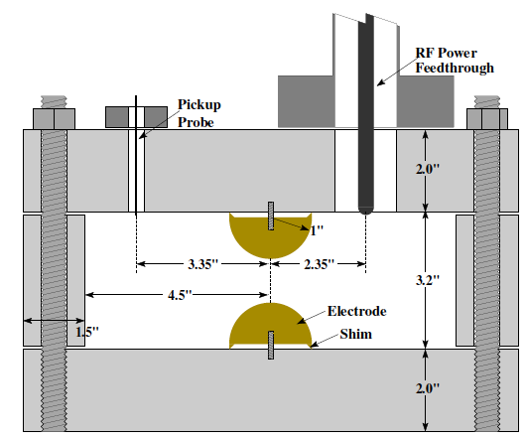
Muon HPRF Cavity N2 Breakdown Threshold
E/p ~ 20 V/cmTorr, E = E_{p}/sqrt(2)
Ionization rate
At pulsed breakdown threshold, diffusion loss rate << ionization rate
Faya Wang
[1] A. D. MacDonald, “Microwave Breakdown in Gases”, John Wiley & Sons, Inc., 1966.

Slide 17
Muon HPRF Cavity H2 Breakdown Threshold
E/p ~ 20 V/cmTorr, E = E_{p}/sqrt(2)
At pulsed breakdown threshold, diffusion loss rate << ionization rate
Faya Wang
[1] A. D. MacDonald, “Microwave Breakdown in Gases”, John Wiley & Sons, Inc., 1966.

Slide 18
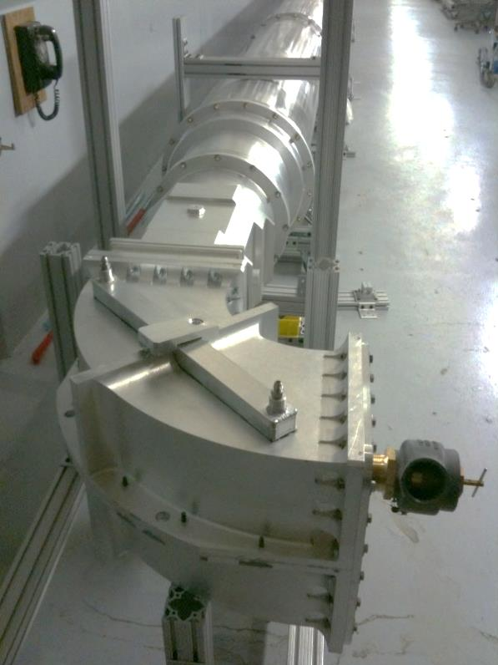
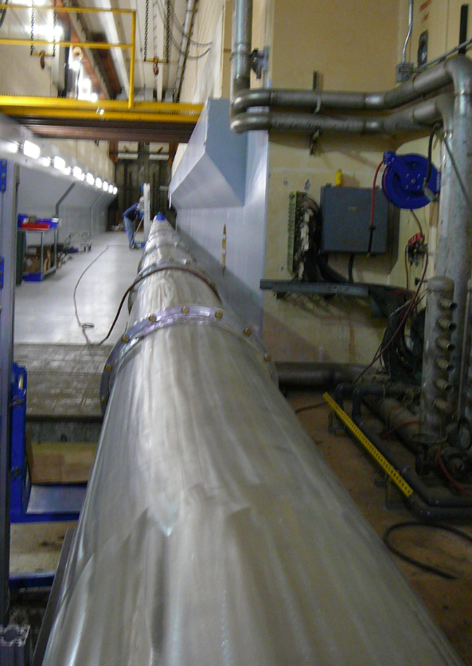
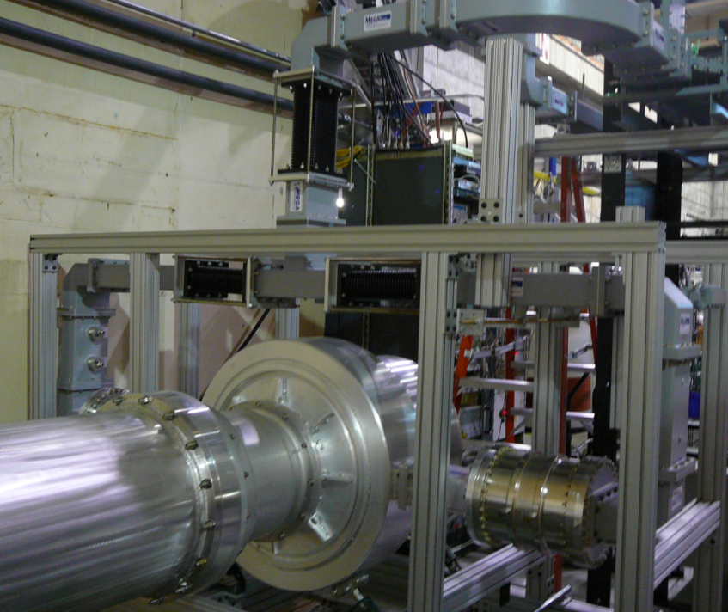
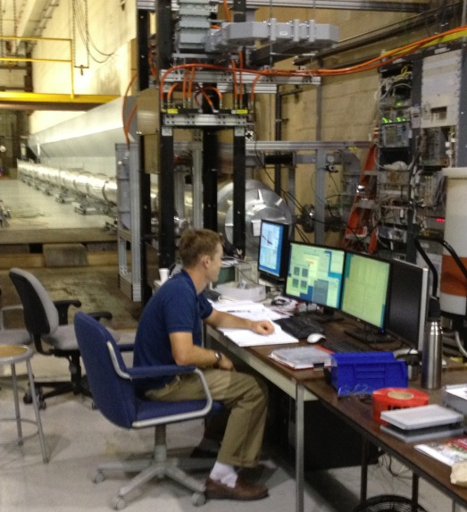
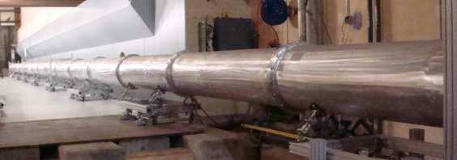
Forty Meter ‘Big Pipe’ Test Setup
Operated 100+ hours breakdown free at field levels that would be seen in the ILC KCS with the beam current upgrade
CTO coupling RF power from P1 Marx-driven Toshiba MBK into TE₀₁ mode in resonant line using KEK circulator.
40 m of pressurized (30 psig) , 0.48m diameter circular waveguide.
Shorted bend with input
mode converter at end of run.
Recording run data.

Slide 19
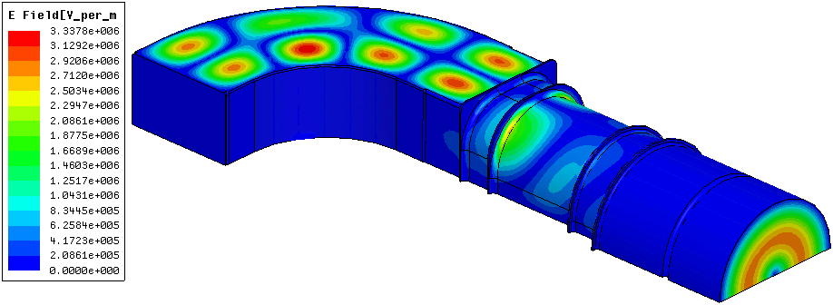
Surface Electric Field in 90 Degree Bend
|E_{s}|_{pk} = 3.34 MV/m for 37.5 MW input
(= 75 MW full geometry → 300 MW TW equiv. at SW anti-nodes)
Equivalent to 72 MW TW in WR650 !

Slide 20
Breakdown Rate at Various N₂ Pressures
18 psig
22 psig
26 psig
30 psig
Dotted lines: Predicted electron growth rate in the gas normalized to the 18 psig data
Faya Wang

