Slide 1
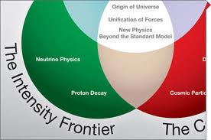
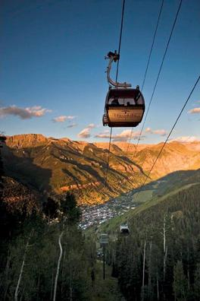
ART based package to
monitor physics relevant to
intensity frontier physics experiments
Muon Collider simulation status and plans
Hans Wenzel
Jul 18th 2013
Hans Wenzel
Fermilab
Feb. 22nd 2012

Slide 2
Charge
Extension of geant 4 validation effort but geared specifically towards the needs of the intensity frontier community.
develop an ART based package for monitoring of all identified physics plots relevant to intensity frontier experiments at the model and physics list level.
port elements of Julia’s (stand alone) tests to ART and in addition integrate both EM and HAD plots into this package.
explore the possibility to use the G4-ART interface.
Develop tools to facilitate tests and customization of physics lists.
The plots to monitor in this package will be associated with individual models (compared with thin target experiments aka first interaction) or physics lists, as well as with quantities to be validated with results from test beam and real experiments.
For more complex validation, simplified geometry may be used or real configurations from the experiments could be imported to this ART application.

Slide 3
CaTS: Calorimeter and Tracker Simulation
CaTS is a flexible and extend-able framework (based on geant4 and ROOT) for the general simulation of calorimeter and tracking detectors.
In the following look at CaTS to:
identify the features that we want,
features that should be replaced by services of Art,
extensions ??

Slide 4
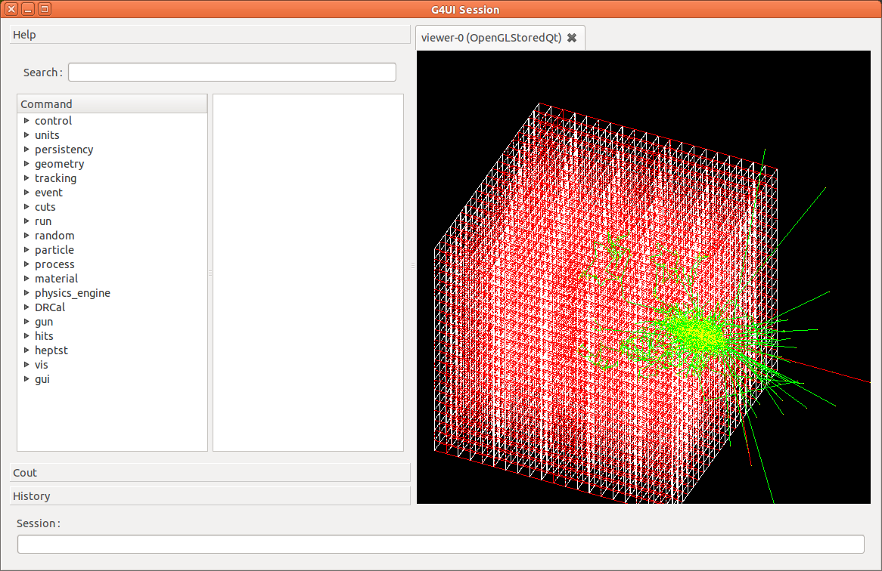
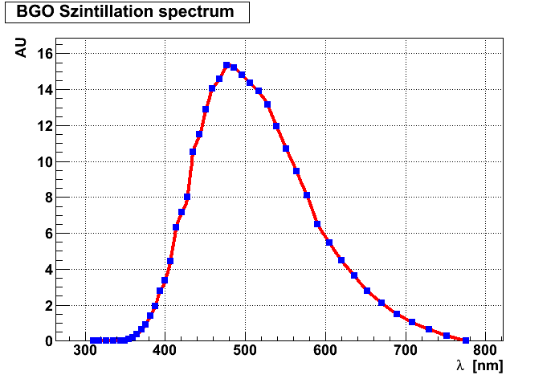
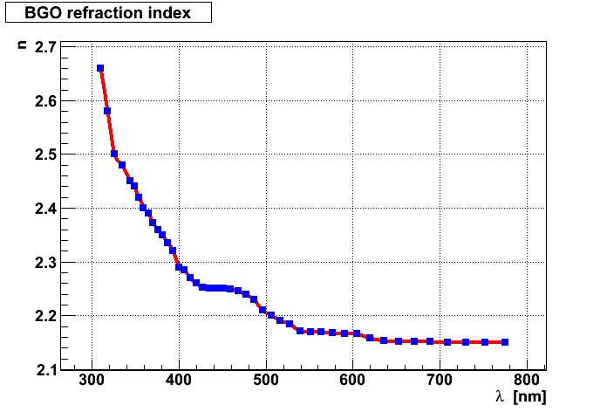
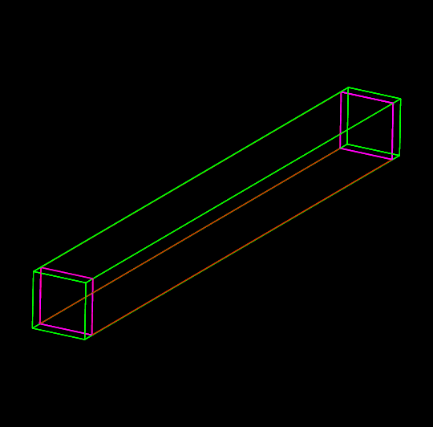
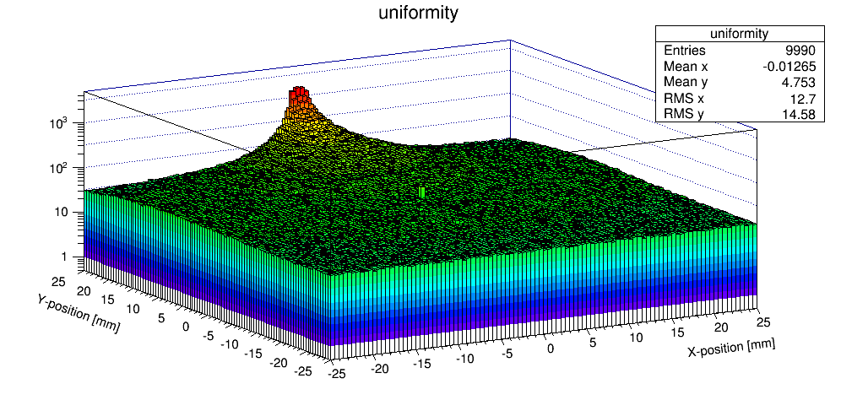
CaTS in Action: inputs and results
Crystal:
DRCalorimeterSD
PhotonSD

Slide 5
Elements of CaTS
Detector Description: | Xml based gdml input file (e.g. crystalcal.gdml) (Geometry, Materials, optical properties, sensitive detector), we provide working examples, no recompilation necessary (keep)
Persistency | uses Root reflexion (gccxml) to automatically, create dictionaries for all classes we want to write out (e.g. Hits) (Art)
Input modules: | GPS, Particle Gun, HEPMC (Pythia) (keep, extend to more file formats?)
Physics Lists: | choice of all Reference Physics Lists which can be extended to include optical physics processes (Cerenkov, Rayleigh, Scintillation etc.) (keep, allow it to be more modular)
Sensitive Detectors and Hits: | TrackerSD, CalorimeterSD, DRCalorimeterSD (also registers Cerenkov photons), DRTSCalorimeterSD (time slices), StoppingCalorimeterSD, PhotonSD: sensitive detector that registers optical photons. (keep)
User Actions: | examples of user actions (EventAction, RunAction, StackingAction,SteppingAction...) are provided (keep but need additional ones)
CVS Code repository, Redmine project & Instructions: | http://cdcvs.fnal.gov/cgi-bin/public-cvs/cvsweb-public.cgi/?hidenonreadable=1&f=h&logsort=date&sortby=file&hideattic=1&cvsroot=ilcdet http://home.fnal.gov/~wenzel/cvs.html#Optical
Histogram manager | Deals with analysis histograms created by various classes (e.g. sensitive detectors), Analysis enabled/disabled via compiler flag. (Art)

Slide 6
Remarks
clear separation of detector description (gdml) and run time configuration
Clear separation of physical volumes and sensitive detector classes
Sensitive Detector:
Knows how to create Hits and how to add hitlist to the event.
Is attached to a physical volume ( as specified in gdml file)
User Actions: configurable at runtime.
But: no scheme for segmentation (needed?)

Slide 7
gdml file (header+ definitions)
<?xml version="1.0" encoding="UTF-8" ?>
<gdml xmlns:xsi="http://www.w3.org/2001/XMLSchema-instance"
xsi:noNamespaceSchemaLocation=
"http://service-spi.web.cern.ch/service-spi/app/releases/GDML/schema/gdml.xsd">
<define>
<variable name="i" value="0"/>
<variable name="j" value="0"/>
<variable name="k" value="0"/>
<constant name="numlay" value="499"/>
<constant name="numcol" value="8"/>
<constant name="numrow" value="8"/>
<constant name="scalex" value="300"/>
<constant name="scaley" value="300"/>
<constant name="scalez" value="5"/>
<constant name="absoffsetz" value="-0.5"/>
<constant name="szoffsetz" value="2.0"/>
</define>

Slide 8
gdml file (materials)
<materials>
<element name="Oxygen" formula="O" Z="8."> <atom value="16.0"/> </element>
<element name="Nitrogen" formula="N" Z="7."> <atom value="14.01"/> </element>
<element name="Lead" formula="Pb" Z="82."> <atom value="207.20"/> </element>
<element name="Carbon" formula="C" Z="6."> <atom value="12.01" unit="g/mole"/>
</element>
<element name="Hydrogen" formula="H" Z="1."> <atom value="1.01" unit="g/mole"/>
</element>
<material name="Air">
<D value="1.290" unit="mg/cm3"/>
<fraction n="0.7" ref="Nitrogen"/>
<fraction n="0.3" ref="Oxygen"/>
</material>
<material name="Scintillator">
<D value="1.032" unit="g/cm3"/>
<composite n="9" ref="Carbon"/>
<composite n="10" ref="Hydrogen"/>
</material>
<material name="metalPb">
<D value="11.340" unit="g/cm3"/>
<composite n="1" ref="Lead"/>
</material>
</materials>

Slide 9
gdml file (solids)
<solids>
<box name="WorldBox" lunit="mm" x="5000" y="5000" z="5000"/>
<box name="CalorimeterCell" lunit="mm" x="300" y="300" z="4"/>
<box name="ScintillatorCell" lunit="mm" x="300" y="300" z="1"/>
</solids>

Slide 10
gdml file (structure,placing)
<structure>
<volume name="CaloVol">
<materialref ref="metalPb"/>
<solidref ref="CalorimeterCell"/>
<auxiliary auxtype="SensDet" auxvalue="DRTSCalorimeter"/>
<auxiliary auxtype="Color" auxvalue="Red"/>
</volume>
<volume name="ScintVol">
<materialref ref="Scintillator"/>
<solidref ref="ScintillatorCell"/>
<auxiliary auxtype="SensDet" auxvalue="DRTSCalorimeter"/>
<auxiliary auxtype="Color" auxvalue="Blue"/>
</volume>
<volume name="TOP">
<materialref ref="AIR"/>
<solidref ref="WorldBox"/>
<loop for="i" from="0" to="numrow" step="1">
<loop for="j" from="0" to="numcol" step="1">
<loop for="k" from="0" to="numlay" step="1">
<physvol>
<volumeref ref="CaloVol"/>
<position name="posijk" x="scalex*(i-numrow/2)" y="scaley*(j-numcol/2)" z="absoffsetz+scalez*(k-numlay/2)"/>
</physvol>
<physvol>
<volumeref ref="ScintVol"/>
<position name="posijk2" x="scalex*(i-numrow/2)" y="scaley*(j-numcol/2)" z="szoffsetz+scalez*(k-numlay/2)"/>
</physvol>
</loop>
</loop>
</loop>
</volume>
</structure>

Slide 11
gdml file (setup)
<setup version="1.0" name="Default">
<world ref="TOP"/>
</setup>
</gdml>

Slide 12
backup

Slide 13
Technical
Framework: Art → worked with it in the past
Code Repository: Redmine and Git since this is used by ART and artg4 → requested to create the project (CaTS). artg4: https://cdcvs.fnal.gov/redmine/projects/artg4
Detector description: options gdml e.g. used by noνa/CaTS extension of Geant4., fhicl: used by artg4, custom: used by mu2e
release management: relocatable ups???
build system: cmake (used by Geant 4, CaTS….)
environment setup: custom shell script
development machine: (something with art and artg4 installed) gm2gpvm → got an account still waiting for instructions to set up the environment.
Execution: for now use Geant 4 VO and (limited) grid resources to execute jobs

Slide 14
Technical (cont.)
Display of results: use geant 4 web application and database hosted here at fermilab (just create a new category)
Configuration of physics lists/ processes: → discuss with Robert, look how it’s done in G4

