Slide 1
Interferometric Residual Phase Noise Measurement System
Pakpoom Buabthong
Lee Teng Internship Program
Advanced Photon Source
Accelerator System Division, RF Group
Tim Berenc
Argonne National Laboratory

Slide 2
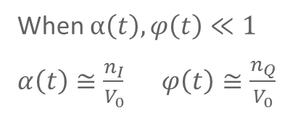
Noise Characterization of Radio Frequency (RF) Devices Phase & Amplitude noise of a RF Carrier
Frequency Spectrum
Carrier
Residual or noise added to carrier by a device
Signal Level
Device Under Test
Frequency
$$n_{Q}$$
$$v\left(t\right)=V_{0}[1+α(t)]cos\left(ω_{0}t+φ(t)\right)$$
ϕ
Polar
$α\left(t\right):$ amplitude noise
$$V_{0}$$
$$n_{I}$$
$φ\left(t\right):$ phase noise
$$v\left(t\right)=V_{0}\cos\left(ω_{0}t\right)+n_{I}\cos\left(ω_{0}t\right)−n_{Q}\sin\left(ω_{0}t\right)$$
When $α\left(t\right), φ\left(t\right)≪1$
$α\left(t\right)≅\frac{n_{I}}{V_{0}}$ $φ\left(t\right)≅\frac{n_{Q}}{V_{0}}$
Cartesian
$n_{I}:$ in-phase noise
$n_{Q}:$ quadrature noise
- Useful for characterizing noise added by a device or differential noise between devices (i.e. Short Pulse X-ray RF Cavities)

Slide 3
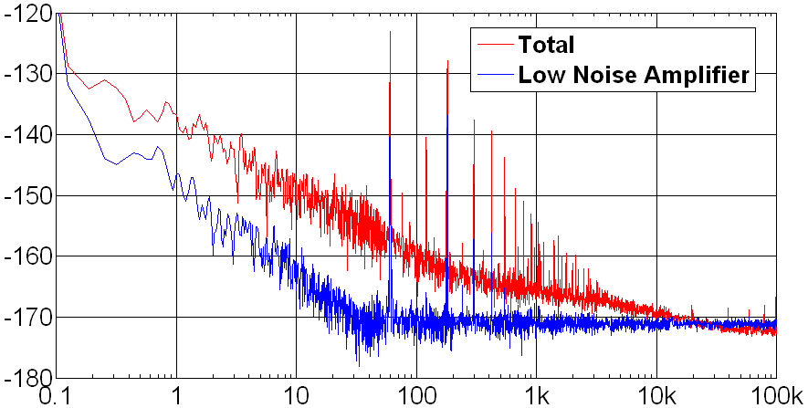
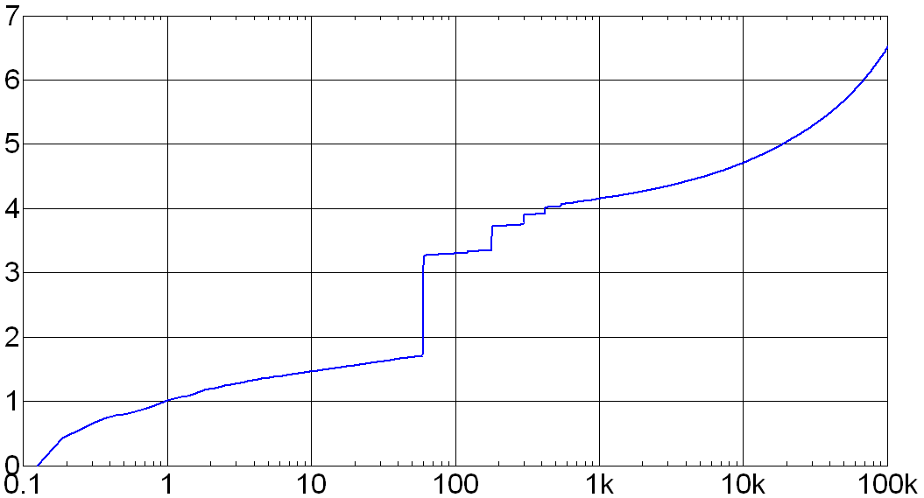
Noise Measurement Using Saturated Mixer
Source
V1
R(t)
V2
Low Noise Amplifier (LNA)
Low Pass Filter (LPF)
Fast Fourier Transform
90⁰ Phase Shift
$$R\left(t\right)=LPF \{{ V}_{1}\cos\left(ω_{0}t+φ\left(t\right)\right)×V_{2}\sin\left(ω_{0}t\right) \}$$
$≅k_{φ}φ(t)$ ($k_{φ}≅$ 0.3 V/rad)
Source phase noise ideally cancels
Usually limited by LNA-mixer noise floor and cable vibration
Phase Noise Power Spectral Density
Cumulative Integral
dBrad²/Hz
femto-sec rms
Frequency (Hz)
Frequency (Hz)

Slide 4
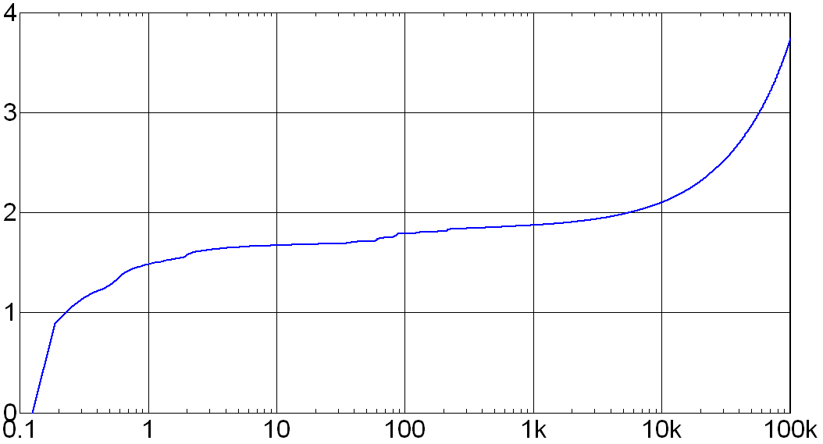
Interferometric Noise Measurement
180⁰ Combiner
RF Amp
Source
LO
90⁰ Phase Shift
Suppress Carrier
and Amplify Residual Noise
Carrier
DUT Noise
Signal Level
Signal Level
Frequency
Frequency
Increased sensitivity $k_{φ}≅$ 18 V/rad , Source noise cancels
Usually limited by noise of RF Amp and cable vibration
Phase Noise Power Spectral Density
Cumulative Integral
dBrad²/Hz
femto-sec rms
Frequency (Hz)
Frequency (Hz)

