Slide 1
Modeling of ATLAS’s EBIS
Kelsey O’Connor, Embry-Riddle Aeronautical University
Supervisor: Clayton Dickerson

Slide 2
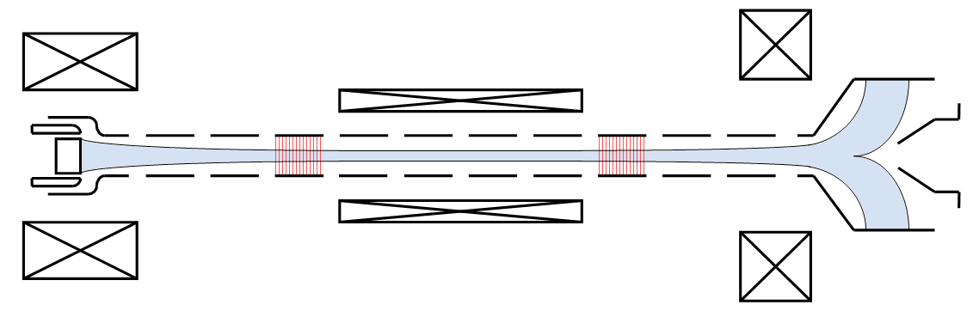
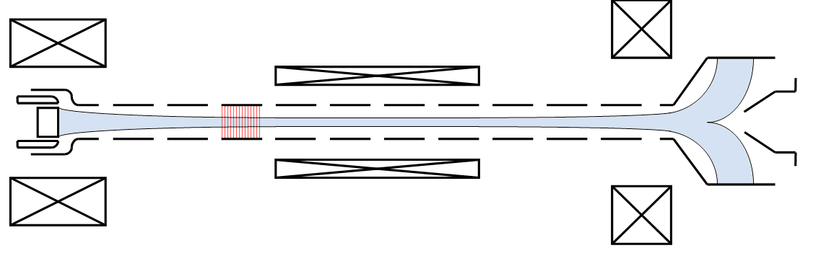
Background - EBIS
Electron
collector
Electron
collector
Solenoids
Solenoids
Electron gun
Electron gun
Drift tubes
Drift tubes
Ion bunch
Ion bunch
Electron beam
Electron beam
Cycle
Cycle
Extraction
Breeding
Injection

Slide 3
Project Overview
Drift tubes
Drift Tube Modeling
Identify how misalignments in the drift tubes effect beam
parameters such as emittance
Identify how these misalignments combine when more drift
tubes are added to the system
Identify how these changes depend on what part of the system
the drift tubes are located in
-ie. The how the gradient magnetic field outside the central
solenoid effects the changes

Slide 4
Project Overview
Turbo pump and Shield
6 Tesla Solenoid
Magnetic Field Modeling
Identify the force exerted on the turbo pump and shield
Identify the magnitude and direction of the magnetic field
induced by the central solenoid on the shield
Identify the necessary current*number of turns for a several
Helmholtz coil designs to compensate for the induced
magnetic field from the shielding

Slide 5
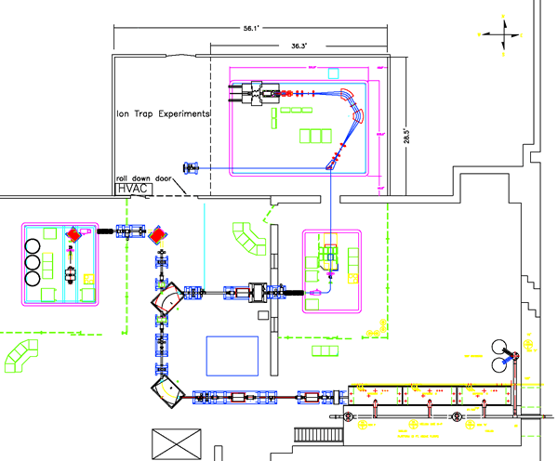
Motivation – CARIBU and EBIS
Californium Rare Isotope Breeder Upgrade
(CARIBU)
Used to produce neutron-heavy ions for
atomic physics experiments
Typically produces 1+ ions
Electron Beam Ion Source (EBIS)
-Charge breads the beam produced by CARIBU
-Can reach as high as +32 to +34

Slide 6
End Goals
Identify how to eliminate the effect of the turbo pumps on
the electron beam
Identify how much force will be exerted on the shields and
properly mount them
Identify the effect of drift tube misalignments will effect the
electron beam and the EBIS’s acceptance

