Slide 1
Microwave Measurement of eCloud using Resonant Cavity Technique in the Main Injector (MI)
Reynier Cruz Torres
Mentor : Charles Thangaraj
Notes:
eClouds are very important, yet very hard to study phenomena. Their significance in the limitation of accelerating capabilities in the Main Injector makes this work a very important step in the study and characterization of eClouds in the Main Injector pipe. For that, we employed Microwave Measurement using Resonant Cavity Technique.
Exponential growth of eCloud under appropriate beam conditions
Saturation effect due to space-charge
electron cloud happens during ramping and transition crossing where bunch length becomes shorter

Slide 2
Relevance of the study of eClouds in proton beam accelerators
Effect of eClouds in high energy proton beam accelerators:
Increase of vacuum pressure
Emittance growth
Tuning shift
Importance of the characterization of electron clouds
Importance of the measurement of electron cloud density (ECD) in the Main Injector at Fermilab
Use of dependence between the microwave phase shift and the ECD
Notes:
We will make use of the dependence between the microwave phase shift and the ECD to make measurements of the latter using the former
For that, we installed our equipment in a small section (~13 m) of the main injector
Non-disruptive technique
Phase shift is directly proportional to ECD under certain conditions
Use of TE₁₁ mode
Cut-off frequency (1.484 GHz)

Slide 3
Objectives of the project
Measurement of ECD in a small section (13m long) of MI using microwave technique
Use of ears to:
enhance the signal of the phase shift
Create a cavity-like space
protect the antennas from beam loss
Presence of two dipole magnets between the transmitter and receiver antennas that also enhance the signal of the phase shift

Slide 4
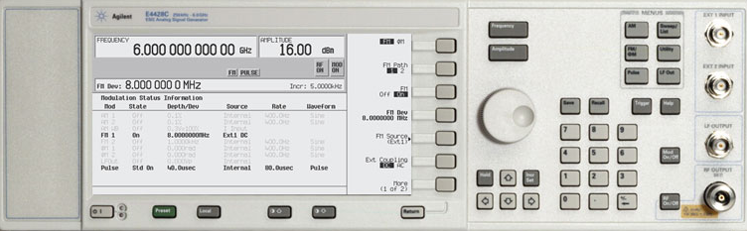
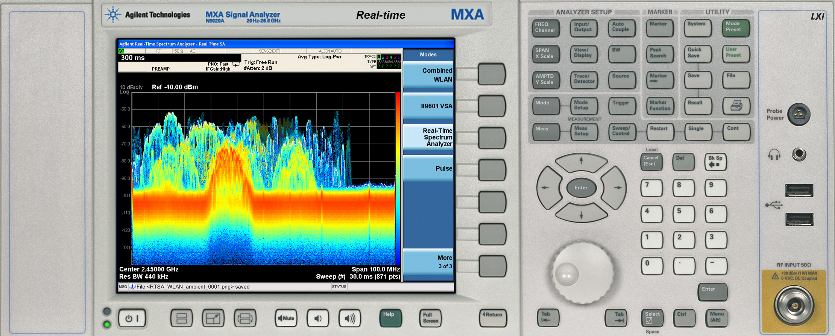
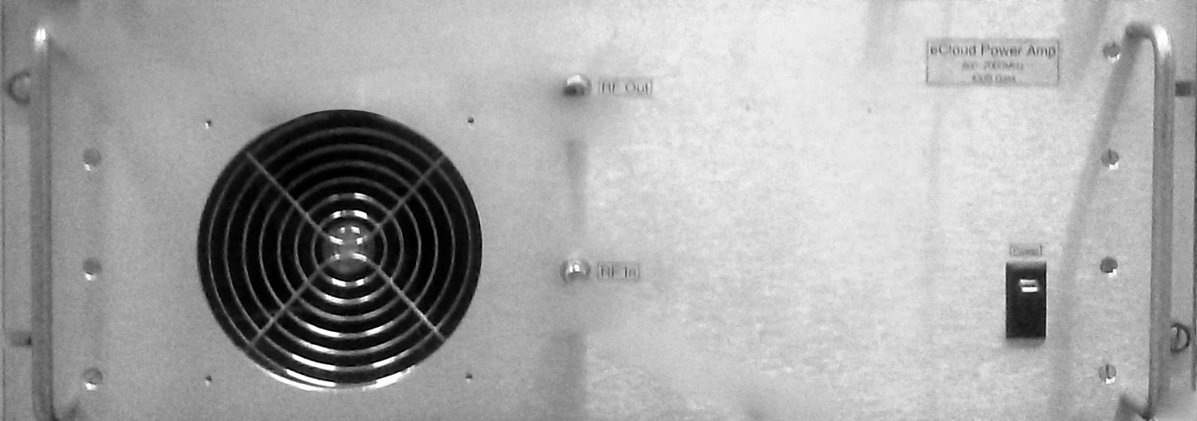
Schematic of the experimental setup
Signal Generator
Phase-shift proportional to ECD
Spectrum Analyzer
Microwave (~3.6 GHz)
Dipoles
Dipoles
Power Amplifier
Input Antenna
Output Antenna
X-ray skew view of the MI beam pipe (Not in scale)
Ears
12.80 m

Slide 5
References
[1] M. Backfish, “Electron Cloud in Steel Beam Pipe vs Titanium
Nitride Coated and Amorphous Carbon Coated Beam Pipes in Fermilab's Main Injector”. Masters Thesis
[2] H. Wang et al., “Microwave reflection technique for electron cloud density measurement”
[3] S. De Santis et al., “Measurement of Electron Clouds in Large Accelerators by Microwave Dispersion”, Phys. Rev. Lett. 100, 094801 (2008)
[4] J. Crisp et al., “Measurement of Electron Cloud Density with
Microwaves in the Fermilab Main Injector”

