Slide 1
Lauren Perez
Lee Teng Undergraduate Fellowship
in Accelerator Science and Engineering
Dr. Ali Nassiri
Argonne National Laboratory
Advance Photon Source
Accelerator System Division, RF Group

Slide 2
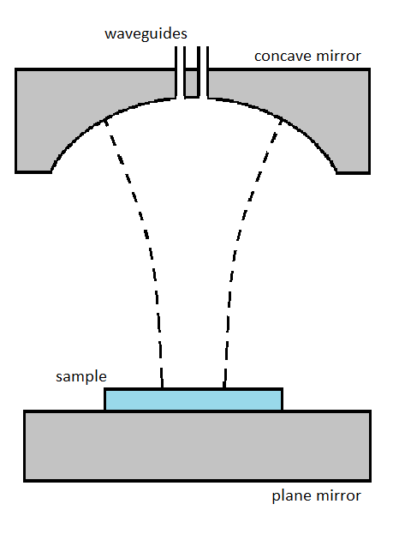
Designing a Hemispherical
Fabry-Perot Open Resonator for RF Frequencies
What is a Fabry-Perot open resonator anyway?
Using Computer Simulation Technology-Microwave Studio (CST-MWS) to simulate fields
Getting Fourier-transforms of solutions to determine validity in comparison to published papers
Parameterizing for best results.

Slide 3
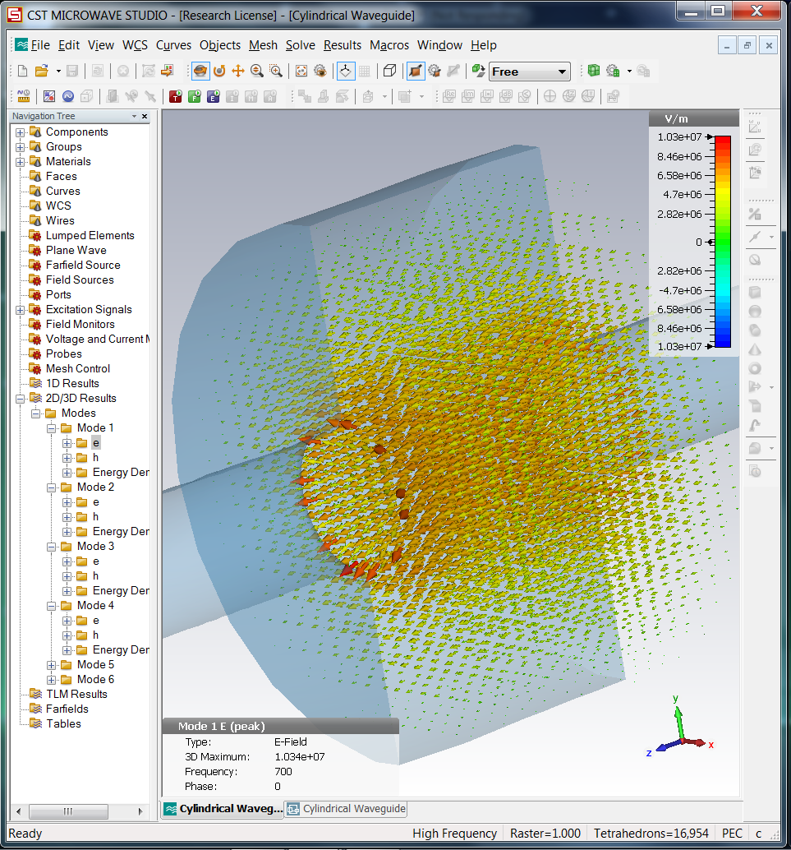
Why does this matter?
Thermal breakdown
Open vs. Closed Resonators
Critical Temperature of Niobium vs. MgB₂
Difficulties in fabrication
Use for test of high-T_{c} superconducting samples
Determine best method for the least imperfections
Next technological advancement in accelerators

Slide 4
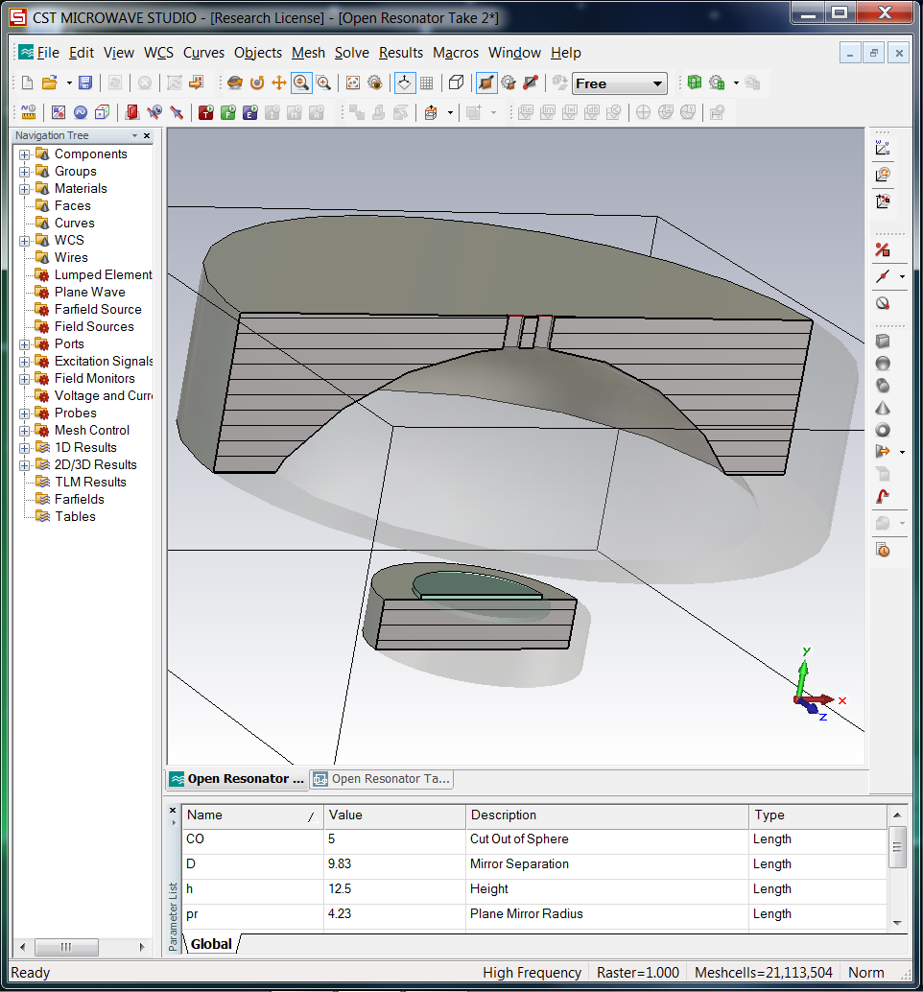
End Goal
Successfully model the resonators from published papers.
Determine the scaling factor to result in the correctly-sized resonator for the frequency we are pursuing (~2GHz)
Build the apparatus and begin to test 2cm samples of different substrate properties relative to Niobium

