Slide 1
ELECTRO-MECHANICAL SIMULATIONS of β=0.92 Dressed Cavity
(UPDATE)
I. GONIN
July 23, 2013

Slide 2
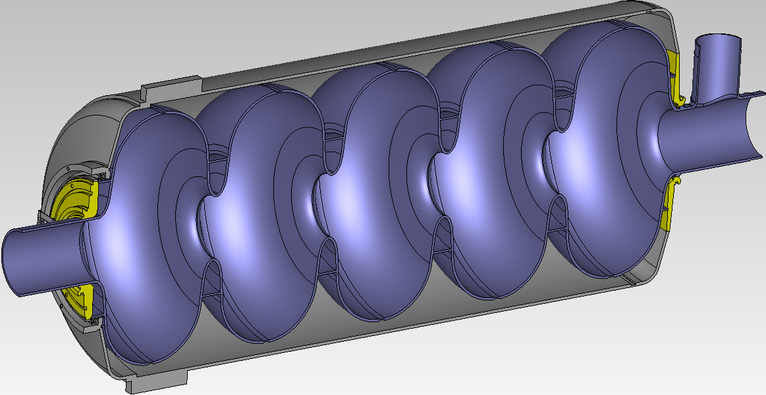
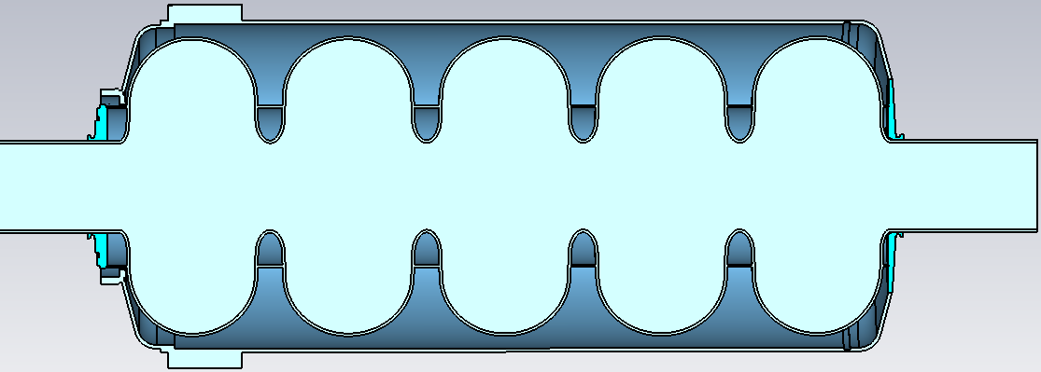
β=0.9&0.92 5 CELLS STRUCTURES AND HV’S MODIFIED MODEL
Li-i
50mm
59mm
1042.9/1043.8
1030mm
FIXED
1045mm
SPRING CONSTANT
Rend
Rreg
59mm

Slide 3
df/dP vs. Tuner Stiffnes
Stiffness of β=0.92 caviy kN/mmvs. Radius of the Regular stiffening ring
- Stiffness of β=0.9 cavity

Slide 4
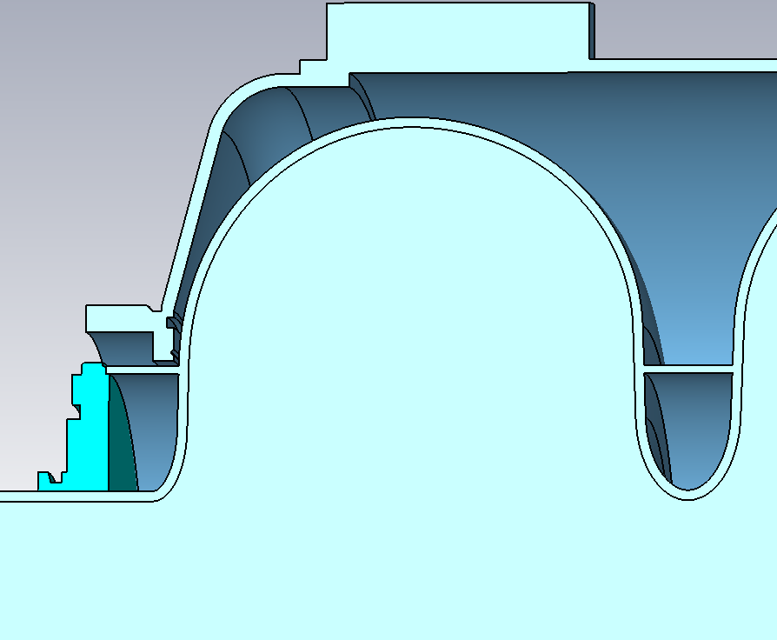
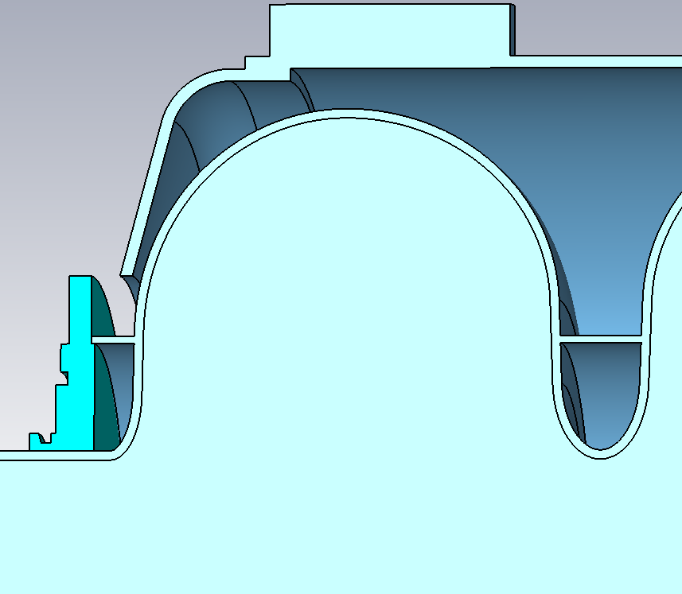
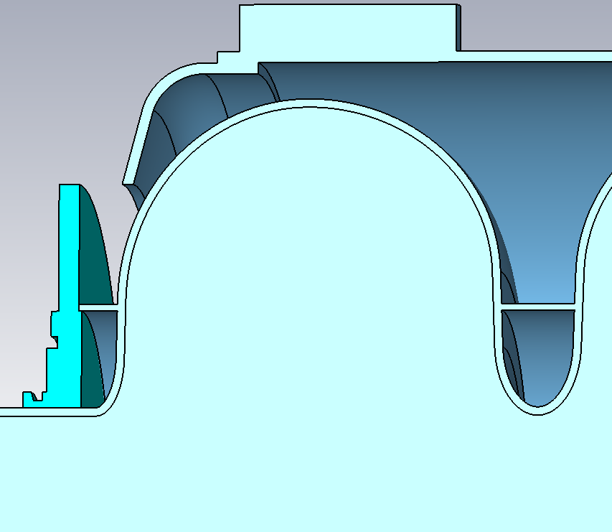
dF/dP vs. Bellows Radius, Rend=110mm, Rreg=110mm
R=135mm
R=115mm
R=165mm

Slide 5
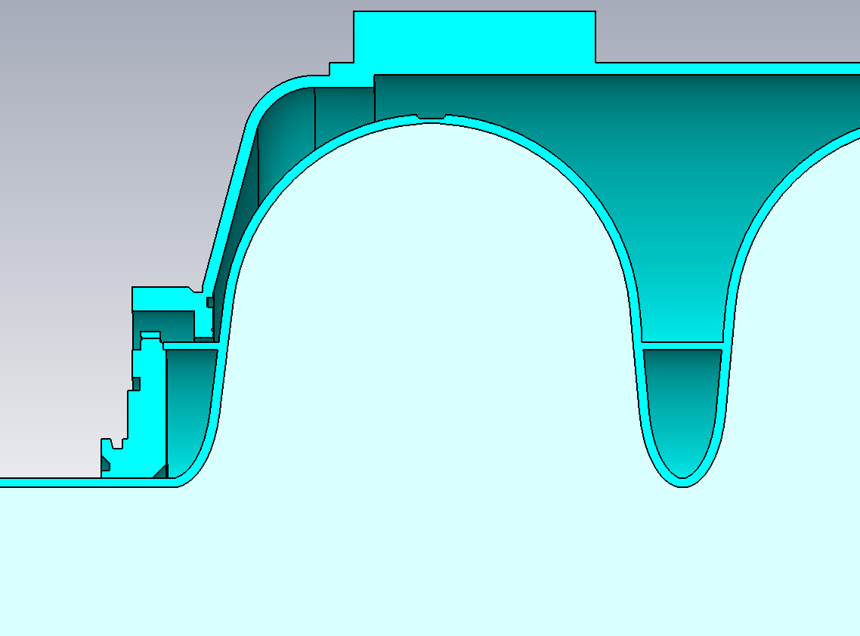
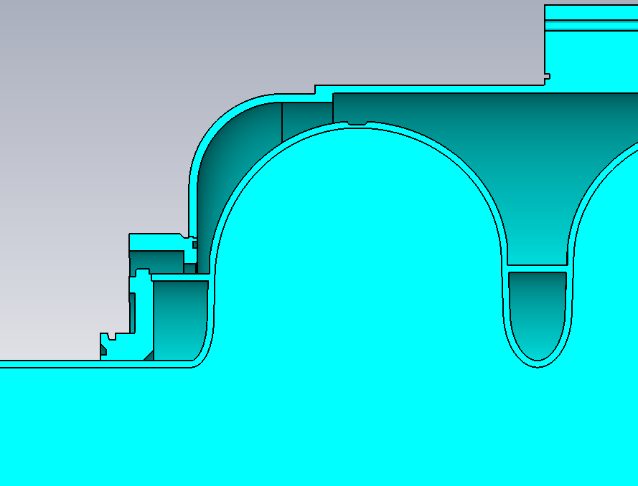
df/dP vs. Tuner Stiffnes, new HV design
Rend=110mm
Rbellow =115mm
Rend=110mm
Rbellow =120mm
Rreg=110mm
Rreg=115mm
Modern cryogenic systems achieve rms pressure stability
~0.2 mbar
CAVITY STIFFNESS
~ 7.8kN/mm

Slide 6
The Scope of EM-Mechanical Design Issues
Minimize a sensitivity to microphonics due to He pressure fluctuations (df/dP) and mechanical vibrations
Minimize a Lorentz Force Detuning (LFD) coefficient
Tunability: tuning for correct frequency & for field flatness
Compromise between microphonics detuning (df/dP, LFD, microphonic noise) and cavity tunability (stiffness)
Enough strength to withstand atmospheric pressure
Stress analysis of cool-down from RT to cryogenic temperature
ES&H manual requires that the cavity is rated at MAWP of 4 bars at 2 K and 2 bars in RT
Incorporate the slow and fast tuners design.

