Slide 1
14TeV CMS Simulations and Webtools
John Farmer (Clemson University)
Supervisor: Pushpa Bhat

Slide 2
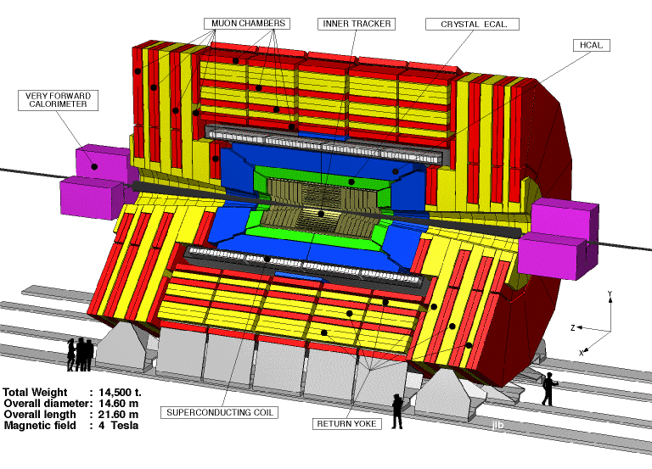
LHC Status
Operated at 8TeV and 5x10³³ cm⁻² s⁻¹ in 2012.
Upgrading to run at 14TeV and 10³⁴ cm⁻² s⁻¹ in 2015.
Increased radiation dose can damage electronics.
Silicon in the Tracker particularly sensitive

Slide 3
Solution: Simulations
Monte Carlo: mathematical experiment using theoretical models
Have simulation data in CMS geometry for proton-proton collisions at 14TeV
Uses a Monte Carlo simulation program called MARS

Slide 4
Dose/Fluence Calculator
Goal: create an easy-to-use way for physicists to create and view publication-quality graphs and maps of fluence and dose data generated by Monte Carlo simulation.
Authors: John Farmer and Jake Callahan
Former work: D. Haznar, P. Sharma

Slide 6
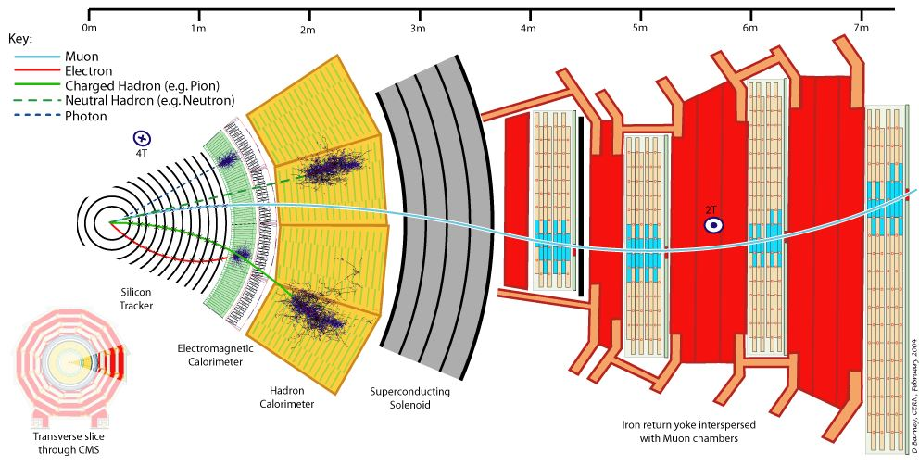
Calculator Design
Three data sets:
CMS full geometry
CMS tracker
CMS calorimeters
Three options:
point calculator
2D interactive maps
slice graphs
Languages used:
html/CSS/JavaScript/PHP (web tools)
C++/ROOT (plots)
MySQL (database)
Python (running jobs on grid, data analysis)
bash (data analysis)

Slide 7
(1) Point Calculator
Written in PHP.
Outputs a simple table of fluence or dose data for one (R, Z) point.

Slide 8
(2) 2D Interactive Maps
Uses a C++ program (plotFluence from the Fluence Package) originally written by Charles Dietz from CERN.
Heavily modified to suit the calculator.
Creates interactive fluence/dose maps over CMS geometry.

Slide 9
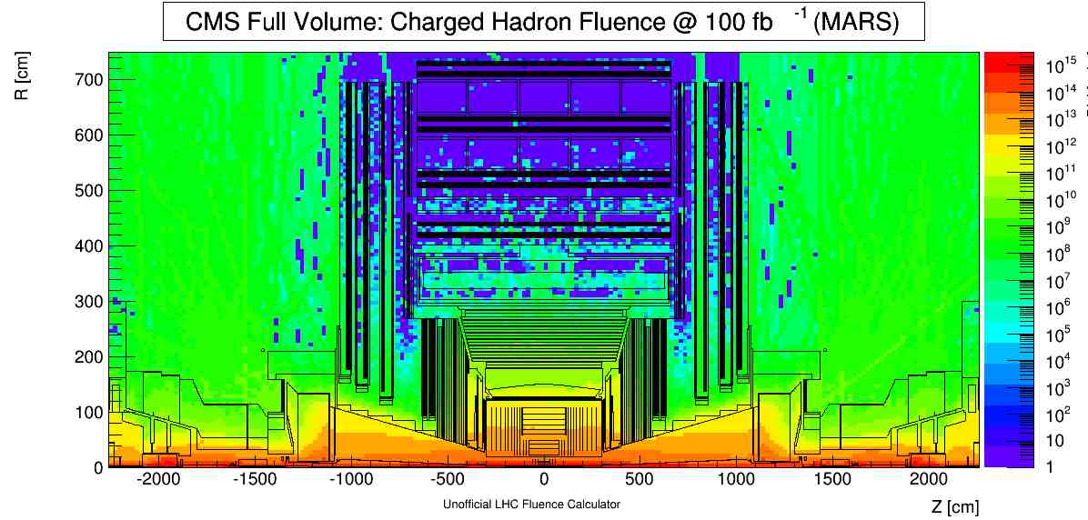

Slide 10
(3) Slice Graph
Creates a plot of fluence or dose values sliced along R or Z.
Uses lineGraph, a C++ Program written by John Farmer and Jake Callahan
Outputs:
Optional table of data
.txt file of data
ROOT line graph of data
.root file containing line graph
Graph options:
linear/logarithmic scaling
data point markers
curve fit or linear fits
Include data table

Slide 11
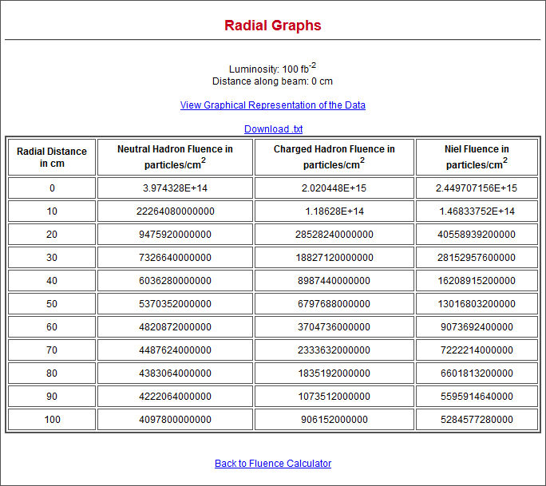

Slide 12
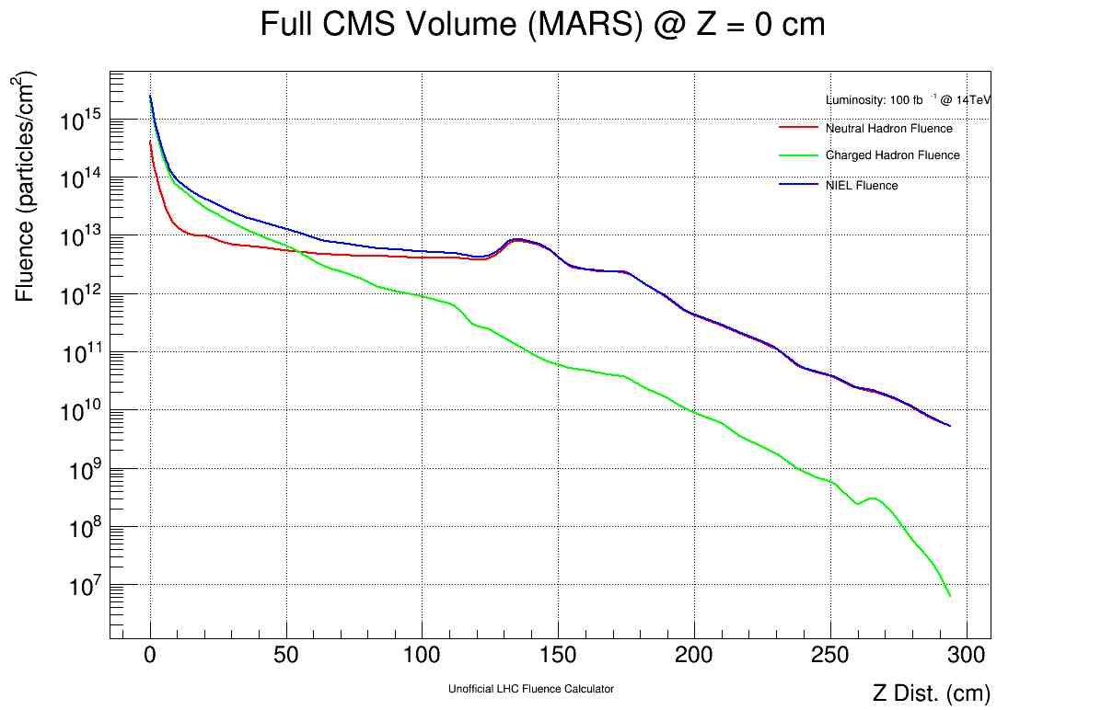

Slide 13
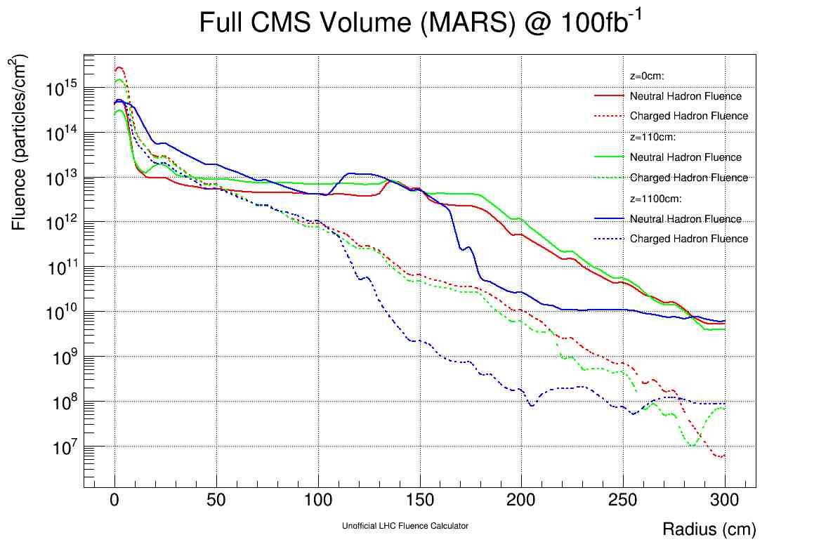
(3) Radial Graph cont.
Can also graphs up to 3 different fluences at 3 different z locations along the detector.

Slide 14
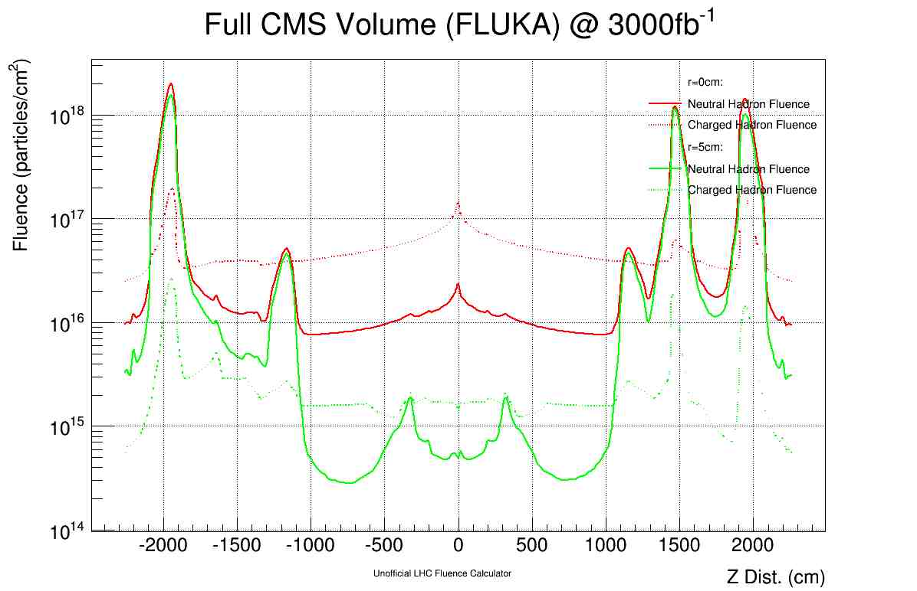
(3) Radial Graph cont.
Can also slice along the detector’s Z axis
Easy to see effect of geometry on fluence

Slide 15
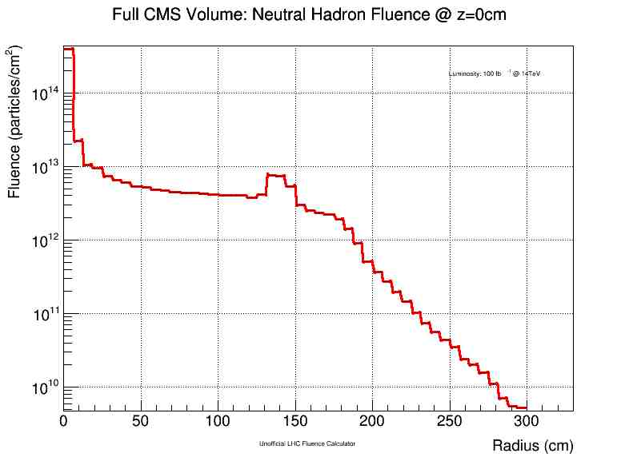
Limitations
Data granularity
Multi-user support

Slide 16
FLUKA simulations
Ran jobs on CMSLPC Batch cluster
Collected data from 183,975 collisions
Statistically more accurate
Finer granularity

Slide 17
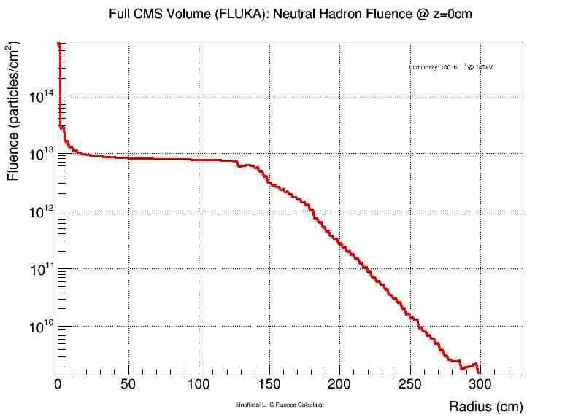

Slide 18
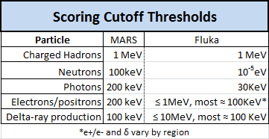
Thresholds: particles beyond which particle is no longer transported
The lower, the better, generally speaking
FLUKA:
excellent neutron/photon transportation
Electron/positron/delta ray thresholds vary over CMS geometry; generally comparable to MARS, but could be finer

Slide 19
Future Work
More statistics (greater number of collisions)
Trivially easy for a trained worker with our script architecture
Multi-user support on the calculator
Lower e-/e+ and δ-ray transport thresholds
(1,1) granularity in (R,Z)
Requires filling 3,395,271 bins
Break assumption of Φ-symmetry

Slide 20
Conclusions
Created webtools for graphical display of MARS simulations
Ran high-statistics FLUKA simulations
Support both datasets
Useful tools for detector design/upgrade

Slide 21
References
"The FLUKA code: Description and benchmarking" G. Battistoni, S. Muraro, P.R. Sala, F. Cerutti, A. Ferrari, S. Roesler, A. Fasso`, J. Ranft, Proceedings of the Hadronic Shower Simulation Workshop 2006, Fermilab 6--8 September 2006, M. Albrow, R. Raja eds., AIP Conference Proceeding 896, 31-49, (2007)
"FLUKA: a multi-particle transport code“ A. Ferrari, P.R. Sala, A. Fasso`, and J. Ranft, CERN-2005-10 (2005), INFN/TC_05/11, SLAC-R-773

Slide 22
Acknowledgements
Charles Dietz (Fluence Package)
D. Haznar and P. Sharma (original calculator)
Jake Callahan (coworker)
Patrick Gartung (technical support)
Pushpa Bhat and Leonard Spiegel (supervisors)
Alfredo Ferrari (Fluka lead developer)
SIST committee

