Slide 1
Parameters of a 100km Very Large Hadron Collider
M. Karl Medina—Intern: SIST
Supervisors: Dr. Chandra Bhat
Dr. Tanaji Sen
August 5, 2013

Slide 2
Outline
VLHC: The Plan
Progress in colliders
Important Parameters
Calculations
Methods
Time Evolutions
Results and comparisons

Slide 3
Physics central blog

Slide 4
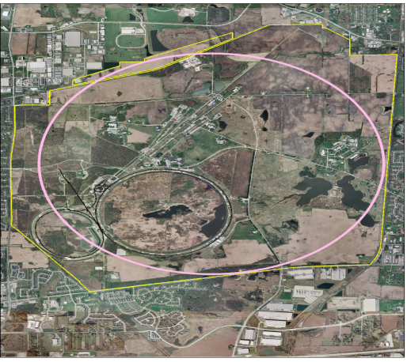
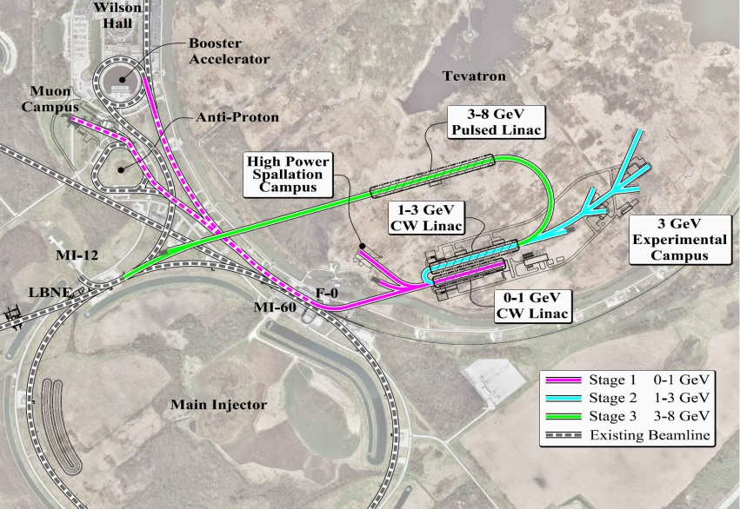
Injectors for the collider
Ion source, Linac, Booster, Main Injector, Tevatron
Project X for high intensity low emittance 8 GeV beam
Replace Linac and Booster
Main injector to deliver 150 GeV beam
New injector to accelerate from 150 to ~ 3 TeV
- Reuse Tevatron tunnel with 16 T magnets

Slide 5
Hadron Colliders - Wikipedia
Hadron colliders
Intersecting Storage Rings | CERN, 1971–1984
Super Proton Synchrotron | CERN, 1981–1984
ISABELLE | BNL, cancelled in 1983
Tevatron | Fermilab, 1987–2011
Relativistic Heavy Ion Collider | BNL, 2000–present
Superconducting Super Collider | Cancelled in 1993
Large Hadron Collider | CERN, 2009–present
High Luminosity Large Hadron Collider | Proposed, CERN, 2020–
Very Large Hadron Collider | Theoretical

Slide 6
Hadron Colliders
 | ISR | SPS | Tevatron | RHIC (pp) | LHC (2012)
Circumference [km] Energy [GeV] Number of bunches Bunch spacing [ns] Bunch intensity [x10¹¹ ] Particles/beam [x 10¹⁴] Trans. rms Emitt [ μm] Beam-beam tune shift Luminosity [x10³² cm⁻²s⁻¹] # of events/crossing Stored beam energy [MJ] | 0.94 31 dc - - 9.8 0.0035x8 1.3 0.005 | 6.9 315 6 1150 2.75 7.8/4.2 1.5/0.15 0.005x3 0.06 0.04 | 6.3 980 36 396 (3.1/1 ) 112/36 (3/1.5) 0.013x2 4.0 12 1.75/0.57 | 3.8 255 107 108 2.0 143 3.3 0.007x2 2.3 0.57 | 26.7 4000 1380 50 1.7 3089 2.5 0.01x2 77 37 140

Slide 7
VLHC Principles of Design
Early plans
233 km circumference
Stage 1 ring: (1 to 20) TeV
Stage 2 ring : (20 to 87.5) TeV
Super-ferric magnets for the 2 T low field, stage 1, Injection from Tevatron
Nb₃Sn magnets for 10T high field, stage 2. Injection from Stage 1
50 TeV in a 100 km ring with 16T dipoles.
Synchrotron radiation dominated hadron collider. Damping time ~ 1 hr; integrated luminosity is nearly independent of the initial emittance
All modules in units of half cell length
Cell length = integer multiple of bunch spacing. Ensures bunches collide in all detectors.
Bunch spacing = integer multiple of Tevatron 53 Mhz bucket length.

Slide 8
Design parameters
 | VLHC (2013) | LHC (design)
Circumference [km] Top Energy [TeV] Peak Luminosity [x10³⁴ cm⁻² s⁻¹] Bunch Intensity [x10¹¹] Number of Bunches | 100 50 4.6 0.15 17255 | 26.7 7 1 1.15 2808
β*_{x}/β*_{y} (m) | 0.5 / 0.05 | 0.55 / 0.55
Norm. rms. (ε_{x},ε_{y} ) [μm] | 1.5 , 1.5 (initial) | 3.75 , 3.75
Beam size at IP (x,y) [μm] | (3.8, 1.2) | 16.7, 16.7
Bunch length, rms (cm) Crossing angle [ μrad] | 2.7 90 | 7.5 255
Beam Current (A) Beam lifetime from pp [h] | 0.12 11.3 | 0.58 18.4
Stored energy (MJ) # of interactions/crossing | 2073 132 | 362 19 (37 in 2012 )

Slide 9
Luminosity
Quality measurement: how many interactions from the beams.
Luminosity expression
$$L= \frac{{N_{p}}^{2}∗M_{b}∗f_{rev}}{4π∗{σ_{x}}^{∗}{σ_{y}}^{∗}}∗R(ϕ_{c})$$
$$R\left(ϕ_{c}\right)=1/\sqrt{1+{(\frac{ϕ_{c}∗σ_{s, rms}}{2∗σ_{x, av}})}^{2}}$$
The crossing angle can be made dynamic for “luminosity leveling.”

Slide 10
Java Program
Considers
Synchrotron radiation damping
Intra-beam scattering
Crossing angle manipulation
Longitudinal emittance is kept constant by noise injection
Evaluates evolutions
Transverse emittance
Bunch Intensity
Luminosity
Average
Integrated
Leveling
Beam-beam tune shifts

Slide 11
Time Evolution
Transverse emittance
Bunch Intensity

Slide 12
Time evolution (cont)
Luminosity
Beam-beam tune shifts
Peak Luminosity ~ 4.5 x 10³⁰ cm⁻² s⁻¹
Optimal store time ~ 6 hours

Slide 13
Final Notes
50-50 TeV pp collider
Testing of theory at level beyond current technology
Future developments for the project and the advancement of physics (as well as the economy)
R&D on nonlinear optics, beam-beam compensation, novel diagnostics, radiation damage, new tunneling techniques, … to reduce cost.

Slide 14
Acknowledgements
Chandra Bhat
Tanaji Sen
Pushpa Bhat
SIST Program
Fermilab, DOE

Slide 15
pp design Parameters - 3
Lattice
Rf system
 | VLHC (2013) | LHC (design)
Cell Length [m] Main bend field [T] Phase advance /cell [deg] (β^{ma}x, β^{min}) in arc [m] (D_{x}^{max}, D_{x}^{min}) in arc [m] γ_{t} | 225.8 15.1 90 (385, 66) (2.5, 1.2) 95.5 | 106.9 8.3 90 180, 30 2.0, 0.95 55.7
 | VLHC (2013) | LHC (design)
Revolution frequency [kHz] Harmonic number Rf voltage Synchrotron frequency [Hz] Bucket area [eV-sec] Bucket half height /rms energy spread | 2.96 215214 80 7.25 20.8 5.3 | 11.25 35640 16 21.4 8.0 3.3

Slide 16
Beam-beam limits
Head-on : ξ achieved :
0.013 (Tevatron), ~ 0.01 (LHC)
Build a site filler tunnel (~ 16 km) with lower field magnets (slide 4)

Slide 17
Equations
Emittance diff eq
$$\frac{dε}{dt}=\left(\frac{1}{τ_{ibs}} − \frac{1}{τ_{rad}}\right)∗ε , \frac{τ_{ibs}}{τ_{ibs,0}}= {(\frac{ε}{ε_{0}})}^{2.2}$$
Intensity diff eq
$$\frac{dN}{dt} = −σ_{xsect,tot}∗L/M_{b}$$
$$L = \frac{{N_{p}}^{2}∗M_{b}∗f_{rev}}{4π∗{σ_{x}}^{∗}{σ_{y}}^{∗}}∗R(ϕ_{c})$$

