Slide 1
Mode-Locking in an Erbium-Doped Fiber Laser
Ethan Lane
Rose-Hulman Institute of Tech.

Slide 2
Overview
Purpose
Theory
Lasers
Mode locking
Piecewise testing of fiber laser parts
Amplifier
Enclosed laser
Mode locked laser
Conclusion

Slide 3
Purpose- Why Erbium?
~femtosecond pulses from large bandwidth
Erbium is cheaper due to the telecommunication industry
Erbium doping offsets dispersive effects from standard fiber

Slide 4
Theory
Parts to a laser
Pump
Lasing material
Optical cavity
Lasing occurs in the erbium-doped fiber as electrons are excited by pump light

Slide 5
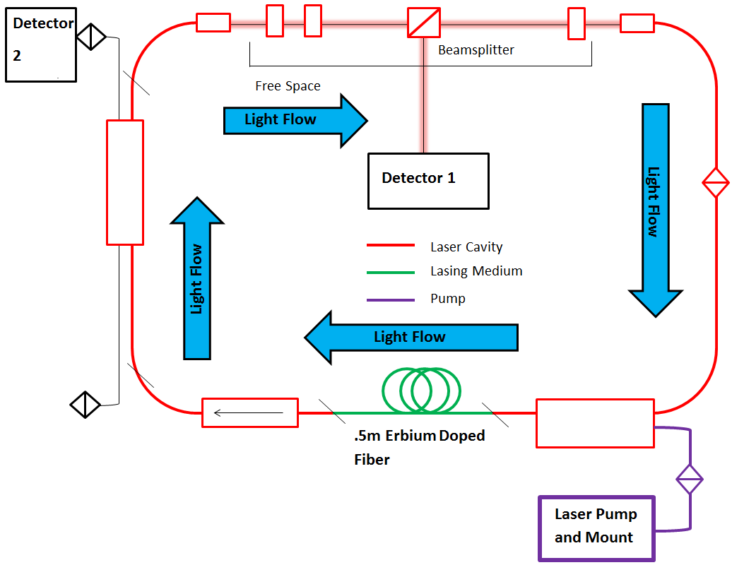
Laser Schematic

Slide 6
Mode Locking Intro
The most common way to get picosecond or smaller pulse durations is through mode locking
Mode locking works by locking all of the different modes within a laser cavity to a fixed phase
In our case, achieved with wave plates

Slide 7
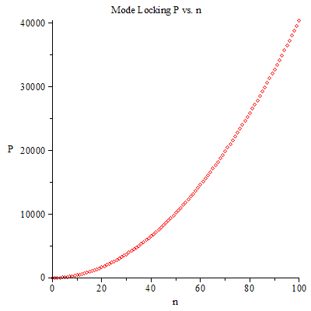
Mode Locking Continued
The sum of the time-domain powers of each mode reduces to: $P\left(t\right)=P_{0}\frac{\sin^{2}[\left(2n+1\right)∗π∗f_{rep}∗t]}{\sin^{2}[π∗f_{rep}∗t]}$
The top figure shows the normalized time-domain power for different n.
- Notice the decrease in peak width for increased n.
The bottom figure shows the power dependence on n at t=0 (the max power)
- This shows the large increases in peak power as more wavelengths are added.
MORE BANDWIDTH = MORE WAVELENGTHS = MORE POWER + SHORTER PULSES

Slide 8
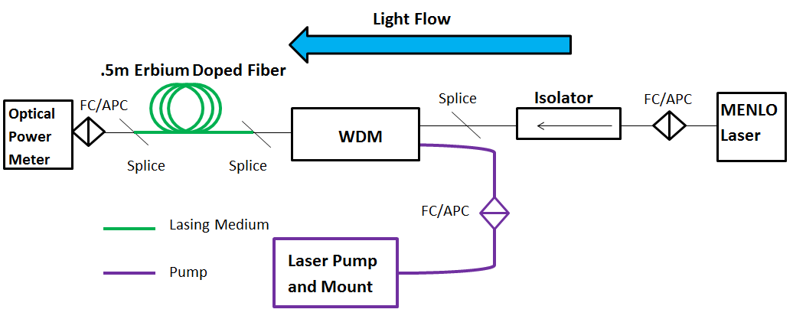
EDFA (Erbium-Doped Amplifier) Test
Use pump to excite erbium fiber and a 1550 nm Menlo laser to stimulate photon emission
Able to measure pump power vs. input current
Close to 15 dB theoretical value

Slide 9
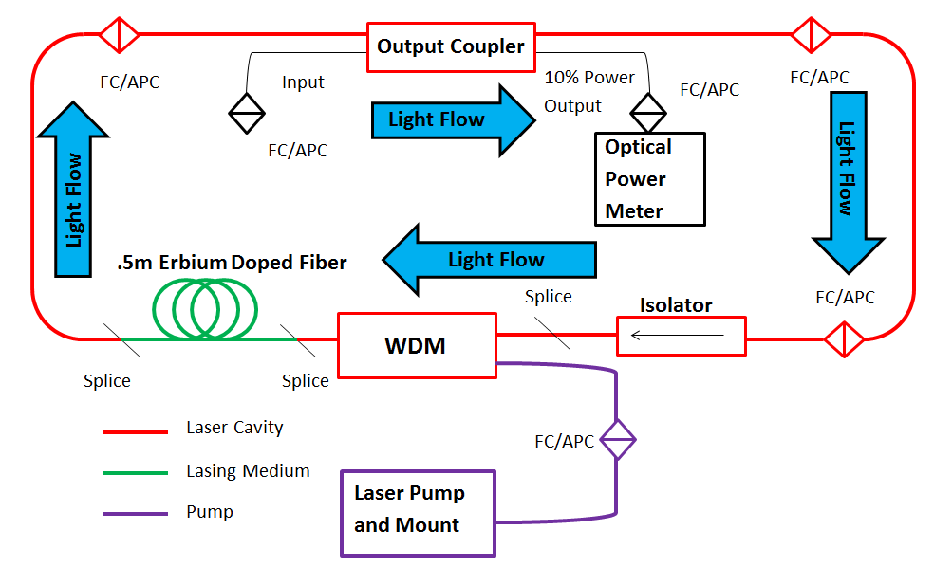
Enclosed Laser Schematic

Slide 10
Enclosed Laser Test
Output coupler installed and a loop created to make a laser cavity.
Creates a loop from the amplifier for amplification of power with every pass.
Limited in maximum power by gain saturation

Slide 11
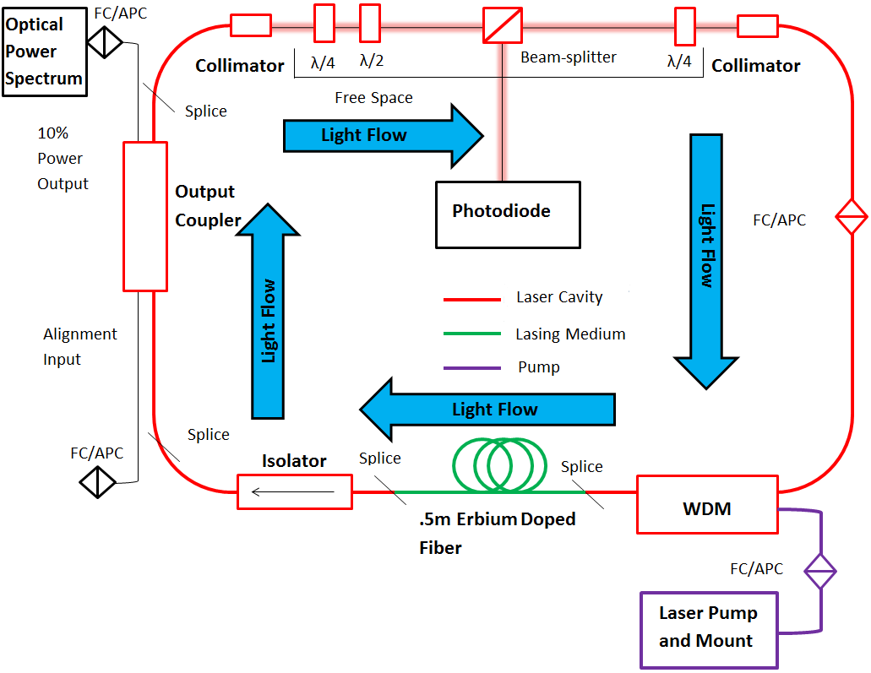
Mode-Locked Schematic

Slide 12
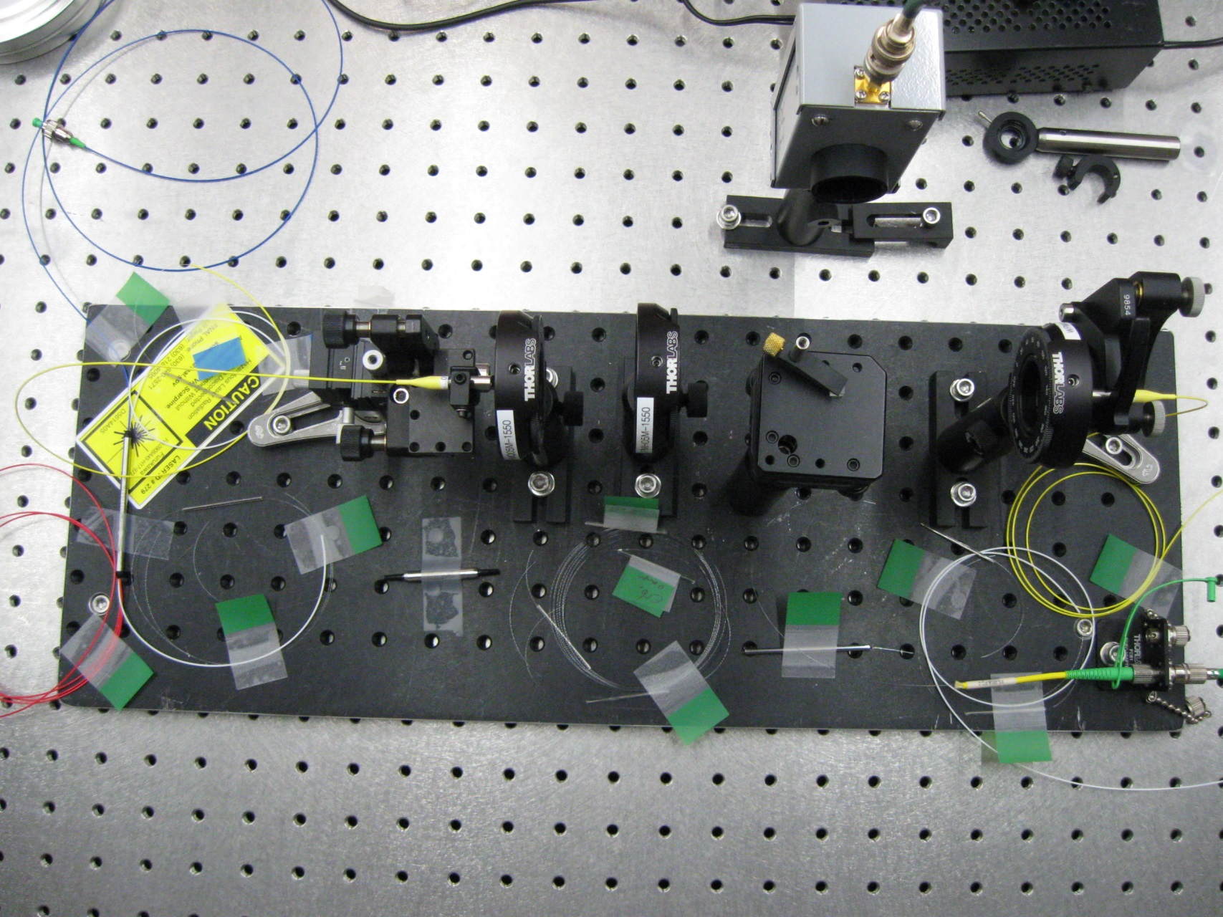
The Final Product

Slide 13
Mode Locking Tests
Polarizers installed and rotated to achieve mode locking
Broad optical spectrum consisting of many wavelengths
Oscilloscope output shows pulse travelling in cavity; depends on cavity length
Data taken at 254 mA of pump laser current
~400 femtosecond pulse width measured
~25 ns

Slide 14
Conclusion
Currently have a working mode locked erbium fiber laser with a 2.66 mW power output and pulse width of ~400 femtoseconds.
Future plans to optimize the system further to yield shorter pulse widths by attempting to get a broader optical spectrum.

Slide 15
Acknowledgments
Winter, Axel. Fiber Laser Master Oscillators for Optical Synchronization Systems.
Diss. Zugl.: Hamburg, Univ., Diss., 2008, 2008. N.p.: n.p., n.d. Print.
Special Thanks to Jinhao Raun, Andrea Saewert, Victor Scarpine, David Peterson, SIST program workers

Slide 16
Autocorrelation and Pulse Width
Achieving a small ~fs pulse width for this fiber laser is one of the main goals
Autocorrelator used to convert the small pulses into something measurable.
Works much like a Michaelson interferometer
Measured pulse width of ~400 femtoseconds

Slide 17
Autocorrelator Calculation
Conversion from mirror distance into time traveled:
$\frac{1}{v}=\frac{1}{c}=\frac{1}{{3∗10}^{14}}=3.33{∗10}^{−15}\frac{s}{µm}=3.33\frac{fs}{µm}$
Full-width half-maximum from autocorrelator is -19.839 µs
Slope from calibration is -27.369
$Pulse Length=\left(FWHM\right)\left(Slope\right)\left(.7\right)=\left(−19.839\right)\left(−27.369\right)\left(.7\right)=380.1 fs$

Slide 18
Radiofrequency (RF) Spectrum
Shows the frequency at which laser light circulates within the cavity
Peak location depends on the cavity length
This plot was obtained as a final optimization of the laser parameters.
A good RF spectrum will resemble a single, sharp peak and have no fringes

