Slide 1
Longitudinal Coupled-Bunch Oscillations in the Recycler Ring
Presented by: Muhed Rana
University of Maryland, Baltimore County (umbc), Baltimore, MD
Supervisor: David Wildman
Fermi National accelerator laboratory, Batavia, IL

Slide 2
Purpose
Measure the Shunt Impedance of the Higher Order Modes (HOMs) of our cavity
Measure the coupled bunched motion in our cavity
Measure the effectiveness of the dampers on the 154 MHz mode

Slide 3
Accelerator Physics
Particles are accelerated in “bunches” of approximately 10¹³ particles
Particles undergo acceleration inside of a synchrotron, hitting a waveform with f = 52.809 MHz every rotation
There are 588 bunches in the Recycler Ring
Further divided into 7 batches with 84 bunches each
  Our purposes: 1 batch with 84 bunches; 82 bunches with particles and 2 empty bunches. The other 6 batches are empty
  Typically: 6 of the above batches described with one empty batch. This empty batch is used for “slip stacking”

Slide 4
Separatrix
Separatrix is a “region of stability” (pictured below)
Particles in a bunch have varying energies and frequencies
  Reaching the waveform earlier = losing energy, reaches later on next cycle
  Reaching later = gaining energy, reaches earlier on next cycle
  Reaching exactly the right time = the ideal particle, “synchronous particle”
  Particles outside of this region are separated from the bunch

Slide 5

Modeling Pulses
Can be modeled as parabolas separated by approximately 18.9 seconds in time (52.809 MHz)
Normalized to $\frac{82}{588}$ A current when taking the area under all pulses
4 ns base width
A Fourier decomposition can be taken to find values of current at each of the harmonic frequencies (odd multiples of 52.809 MHz) for the entire set of 7 batches
Values of Fourier Coefficients as a function of a harmonic number (integer multiples of $\frac{1}{588}$) shown to the right in a log-log plot

Slide 6
Our Cavity
Schematic of our cavity to the right
Inner radius of 13.5”, outer radius of 16”
Length of 53”
Boundary conditions require a wave solution where it is zero at the top (shorted end) and maximum at the bottom
Solutions require periodic functions with odd integer multiples of quarter wavelengths with f = 52.809 MHz
These solutions are known as the “Higher Order Modes” (HOMs)

Slide 7
Identification of hom (Higher order modes)
Measurements taken using an Agilent 8753ES S-Parameter Network Analyzer
Measurements of Quality factor, phase, and loss were taken two different gap monitors at the MI-60 building
If those parameters matched up then we have identified a harmonic frequency
Other HOMs exist in the system, due to other reasons. These modes include Ring Modes and Coaxial/Power Amplifier Modes. These do not match up in phase or loss
HOMs measured were the following frequencies (in MHz): 52.809; 154.063; 247.595; 336.365; 475.141; 543.506

Slide 8
Identification of TEM modes (Cont.)
Similar phase, amplitude, and quality factor are required due to propagation of other modes parallel to the circular detector
The harmonic frequencies will line up with the detectors at equal phases
Ring modes and coaxial modes propagate perpendicular to the harmonic modes
Therefore they land at the detectors at different phases, therefore they will be measured in both gap monitors but they will not have the same values
Other TEM modes will exist in both gap monitors but they aren’t HOMs

Slide 9
Homs continued
Cavity is in the recycler ring and has a certain amount of response associated with each mode
Shunt impedance - a characteristic resistance associated with each of the HOMs
Equation for shunt impedance depends on the inverse of the square root of the harmonic number and the shunt impedance for the fundamental (as well as various other factors)
Shunt impedance was calculated both theoretically and through measurements (right)
They are TEM modes (Transverse Electromagnetic)

Slide 10

Shunt Impedance data table
Our measurement device includes a Magnetically Coupled Loop and Capacitative Pickup that displays 1 Volt for every 89.5 kV measured at 52.809 MHz
This was modeled as a resistor and capacitor in series (which would both have a total voltage drop of 1 V) with a capacitor in parallel to both (with a total voltage drop of 89.5 V) to adjust for different frequencies
Dampers applied to the 3rd harmonic compared to no dampers
Theoretical values calculated using this equation:
Frequency (MHz) | Theoretical (kΩ) | Experimental (kΩ)
52.809 | 77.8 | 75.8
154.063 | 45.0 | 20.4 (uda)/2.45 (da)
247.595 | 34.9 | 5.8
336.365 | 29.5 | 22.5
475.141 | 26.0 | 21.3
543.506 | 23.5 | 2.6

Slide 11
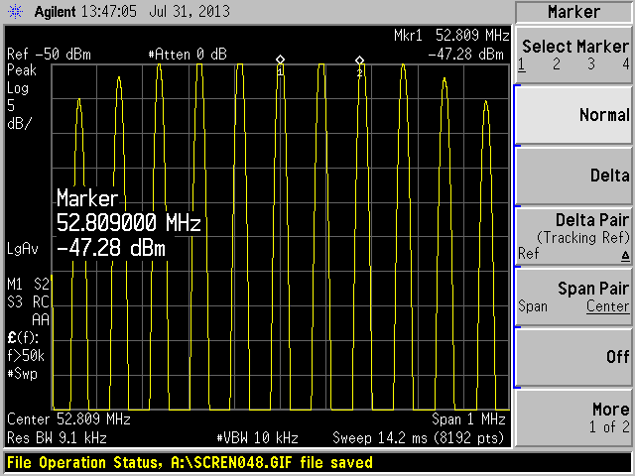
Voltage values and coupled Bunched Motion
Measurements taken by a Agilent 8753S S-Parameter Spectrum Analyzer operating at -12 dB, 16 ns cable, 1 Ω
Measurement result at the right; took that value of loss in dBm and converted it to power in Watts
Multiplied by 100 (2*50 due to a 50 Ω load resistor) then divided by 1 Ω to receive current
Multiplied current by shunt impedance to receive the voltage loss at each HOM

Slide 12
Additional Notes
Normalized all measured values so that the fundamental had 1 Amp of current (because we had only 5.4 mA of current going through both theoretically and experimentally
This required us to multiply all experimental values by around 200 (current measured @52.809 is .0054 mA) and theoretical values by around 4 (current predicted @52.809 is .25 mA)
Results in table on the right
Frequency (MHz) | Predicted (V) | Measured (V)
52.809 | 77800 | 77800
154.063 | 1504.0 | 65.5641
247.595 | 899.43 | 35.7079
336.365 | 1720.2 | 110.582
475.141 | 1263.1 | 1372.08
543.708 | 56.852 | 14.2224

Slide 13
Conclusions
There is very little voltage drop in the 154 MHz mode, meaning that it is heavily damped (and the 5th and 7th harmonics are also very highly damped)
The shunt impedances are in reasonable agreement between theory and experiment for all but the 11th harmonic and the 3rd and 5th harmonic
The voltage values are in disagreement in the 7th harmonic, meaning there is additional damping in that particular harmonic
Many of the losses in the beam occur in the fundamental

Slide 14
Further Study
Taking measurements more often for consistency due to drift in frequencies and various values
Being able to introduce beam more often operating at the voltage we obtained
Identifying some of the other modes we have measured

Slide 15
Acknowledgements
My supervisors, David Wildman and Robin Madrak
SIST Committee: Elliott McCrory, Dianne Engram, and Linda Diepholz
Dr. Davenport

Slide 16
QUESTIOns?

