Slide 1
Pulsed Linac Studies Updates
A. Vivoli, G. Cancelo, N. Solyak (FNAL)

Slide 2
Contents
Pulsed Linac Current Lattice
(Optimal) Settings
Detuning model
Simulation issues (Power)
LLRF parameters & references
Preliminary results
Outlook

Slide 3
PX Layout

Slide 4
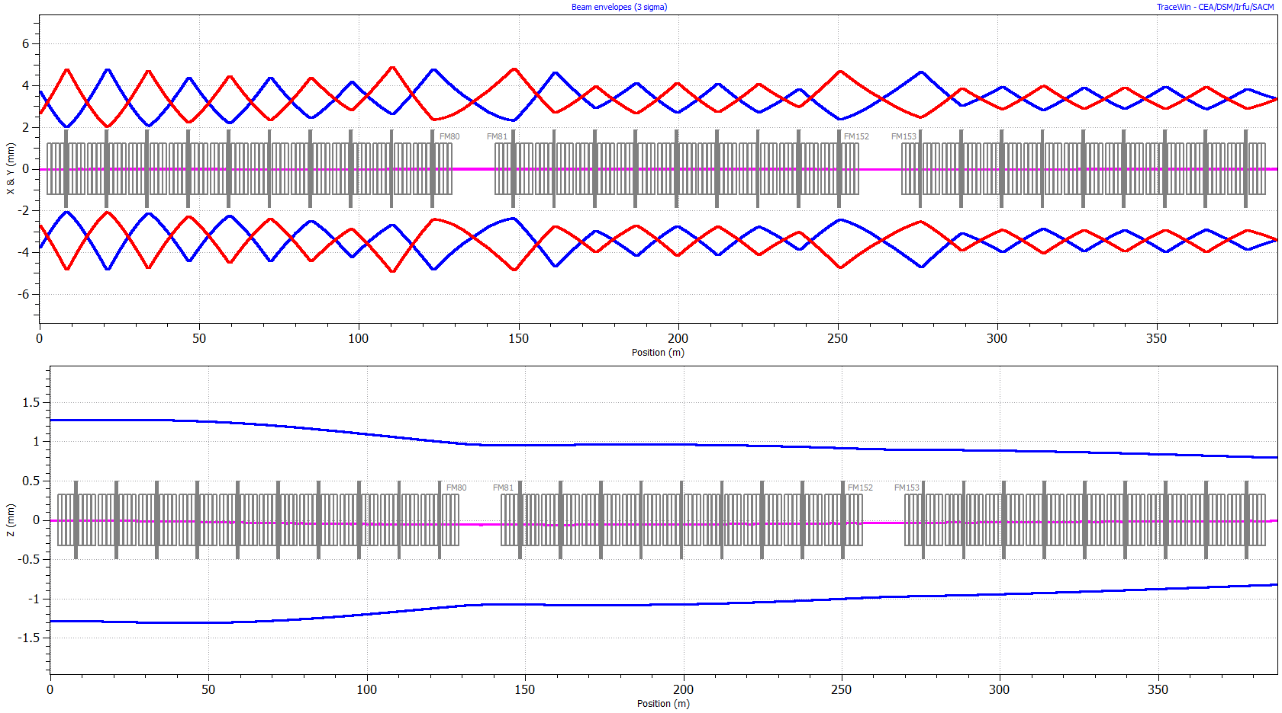
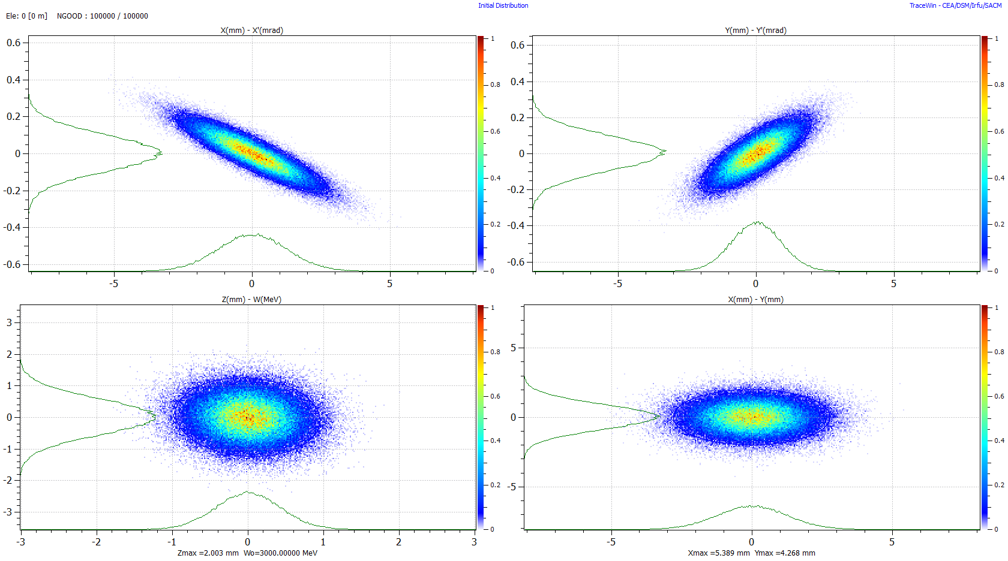
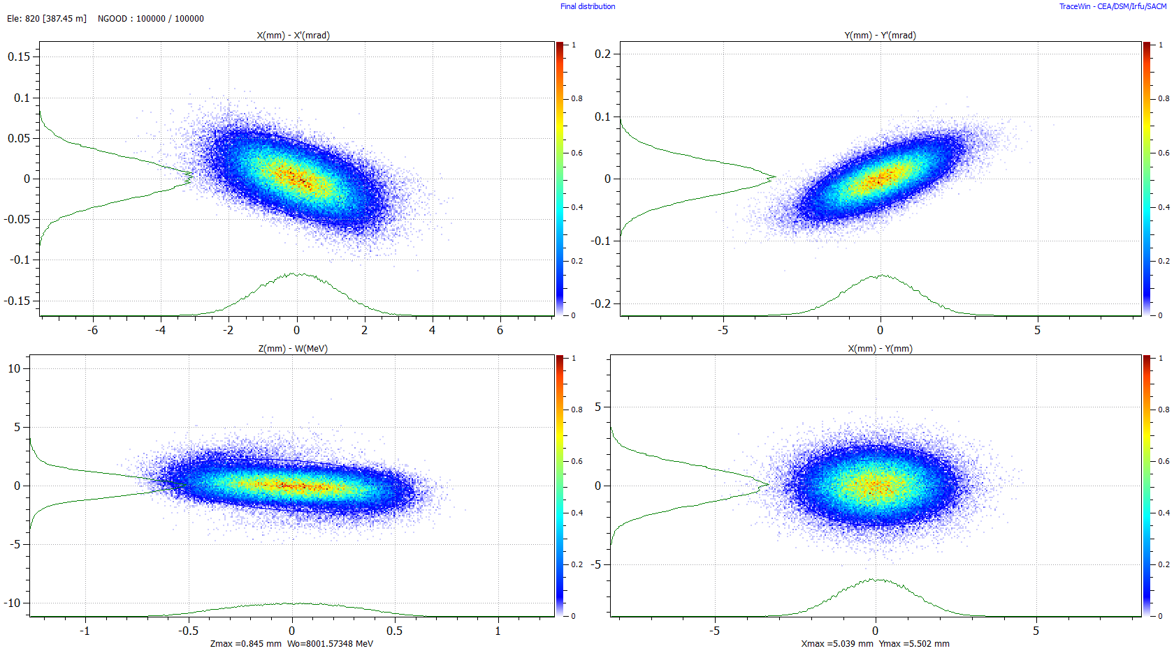
Pulsed Linac current Lattice

Slide 5
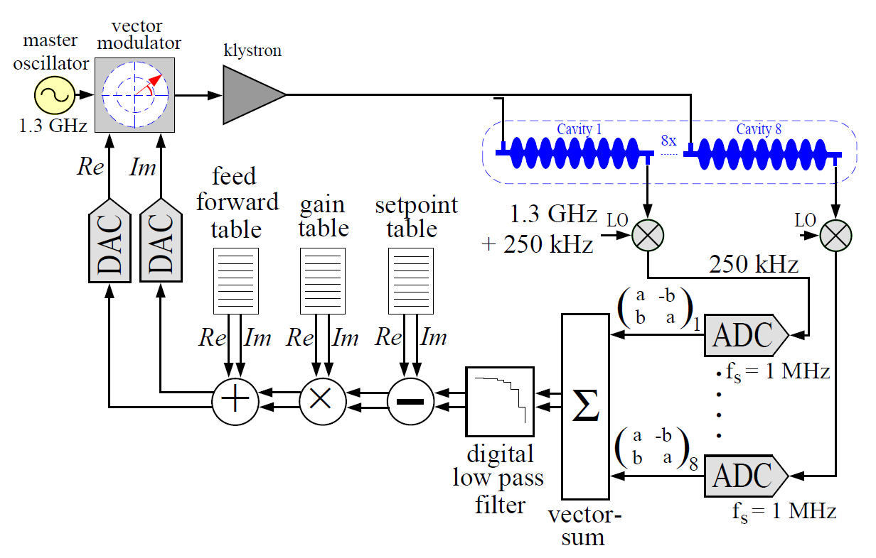
Longitudinal Phase space & RF system Simulation
Feedback algorithm used for TESLA Test Facility (TTF)

Slide 6
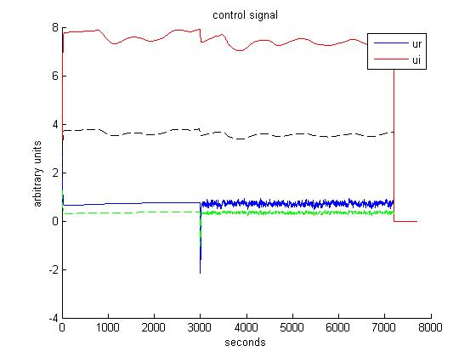
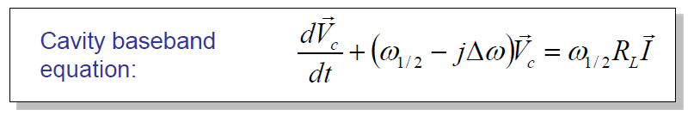
Feedback control system
Vrmeas(i,n) = Vrcav(i,n)*probe_noise_ampl
Vjmeas(i,n) = Vjcav(i,n)*probe_noise_phase
Vrsum(n)= Σ_{i} Vrmeas(i,n)
Vjsum(n)= Σ_{i} Vjmeas(i,n)
Error_r(n)=Vr_ref(n)-Vrsum(n)
Error_j(n)=Vj_ref(n)-Vjsum(n)
Ur(n)=Klystron_gain*p_gain*Error_r(n)
Uj(n)=Klystron_gain*p_gain*Error_j(n)
Descretized Baseband equation with control:
Vrcav(i,n) = (1-Δtω₁₂)*Vrcav(i,n-1) –ΔtΔω*Vjcav(i,n-1)+Δtω₁₂R_{l}I_{r}(n)+Δtω₁₂*Ur(n-1-cav_delay)
Vjcav(i,n) =(1-Δtω₁₂)*Vjcav(i,n-1) –ΔtΔω*Vrcav(i,n-1)+Δtω₁₂R_{l}I_{i}(n)+Δtω₁₂*Uj(n-1-cav_delay)

Slide 7


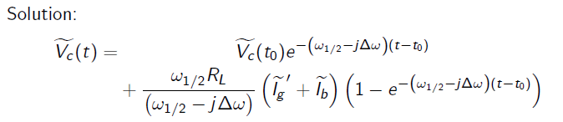

Cavity settings

Slide 8
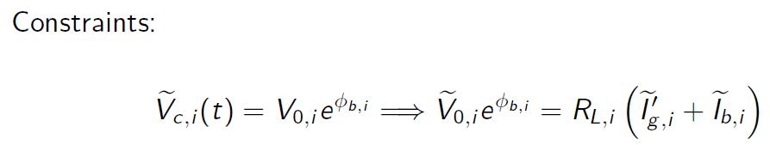
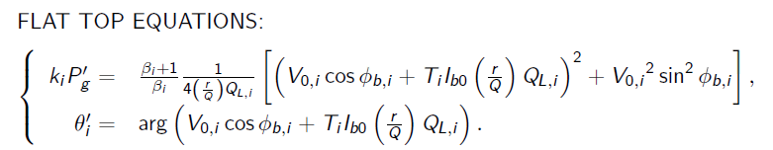
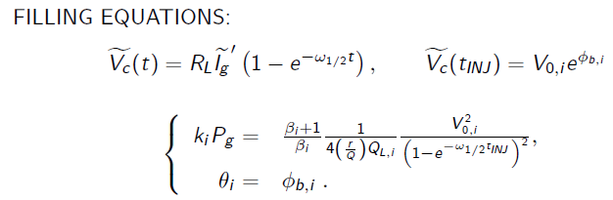
Cavity settings

Slide 9
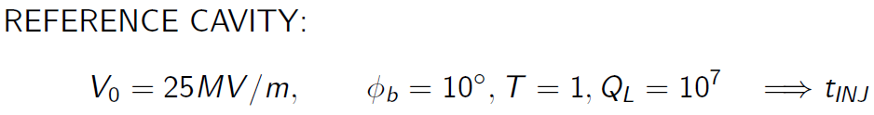
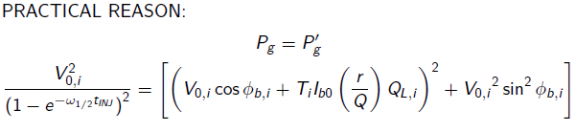
Cavity settings
Phase of generator:

Slide 10
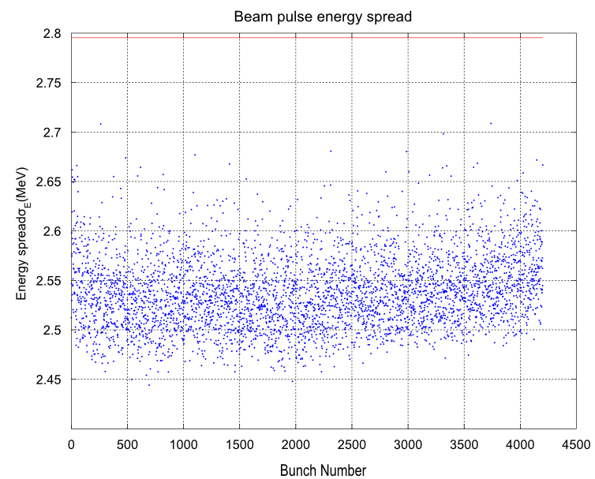
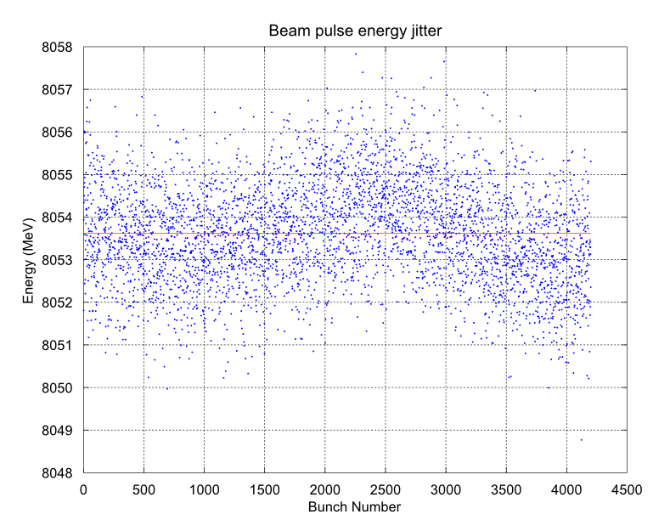
Multi-bunch(/multi-pulse) tracking simulation results

Slide 11
Longitudinal Phase space & RF system simulation with measured data
(mixing cavity detuning files)
Parameters list:
Parameter | Value
Setpoint Gradient (MV/m) | 25
Synchronous phase (deg) | -10
Gradient sigma (%) | 2.94
Cavities per RF station | 8/16
Initial σ_{z} (ps) | 2
Initial σ_{E} (MeV) | 0.9
Initial E (MeV) | 3000
Init. Time jitter (rms) (ps) | 1 (0.47 deg)
Initial En. jitter (rms) (MeV) | 0.25
Number of RF stations | 26/13
LFD + μphonics (Hz) | 0/10/…/90+2
Probe noise ampl. Error (rms) (%) (static/dynamic) | 0.3 / 0.3
Probe noise phase Error (rms) (rad) (static/dynamic) | 0.0001745/0.0001745 (0.01 deg)
Klystron gain | 1
Proportional gain | 250
Cavity Delay (μs) | 1
Generator ampl. Error (rms) (%) | 0.2*
Generator phase Error (rms) (rad) | 0.01745 (1 deg)*
Pulse to pulse intensity fluctuation (max-min) (%) | 3
Bunch to bunch intensity fluctuation (rms) (%) | 3
Pulsed Linac segmentation:
Similar to XFEL segmentation.
3 Cryostrings (CSs) separated by room temperature sections
28 Cryomodules (10-9-9) totals
8 acc. cav. and 1 quad per CM
6 Service boxes (2.5m length) for cryogenics
2 Room temperature sections (7.652m length)
Total separation between CS: 12.652m (CM length).
*Probe errors:
http://arxiv.org/ftp/arxiv/papers/1005/1005.5149.pdf
*klystron error:
http://tesla.desy.de/TTF_Report/CDR/pdf/cdr_chap8.pdf
*Probe errors can be reduced to 0.03% according to ILCTDR, vol. 3, part I, cap 2.6.7

Slide 12
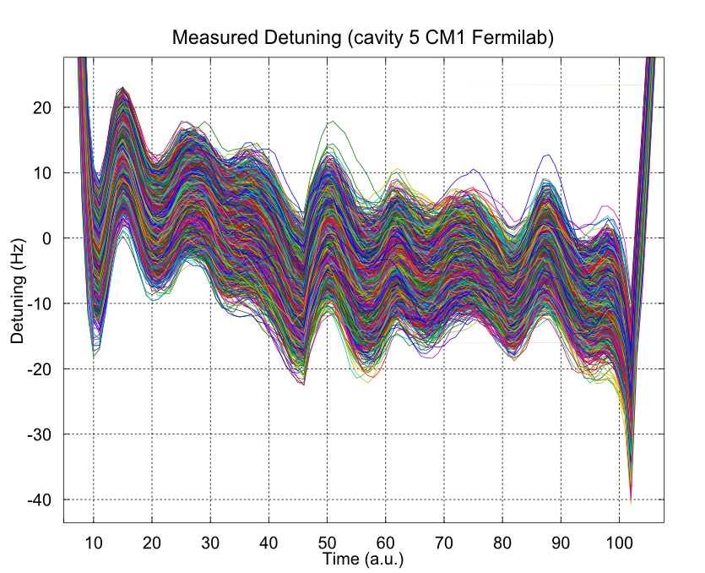

Slide 13
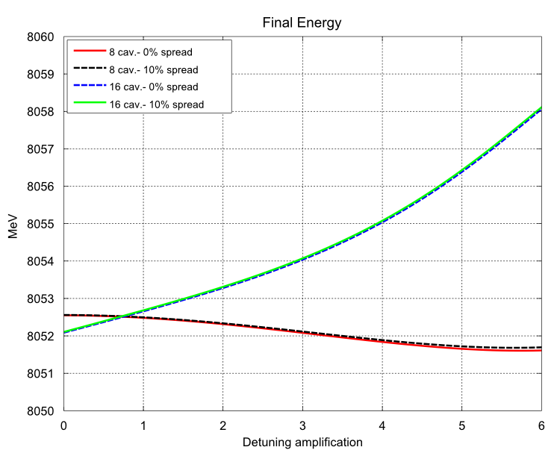
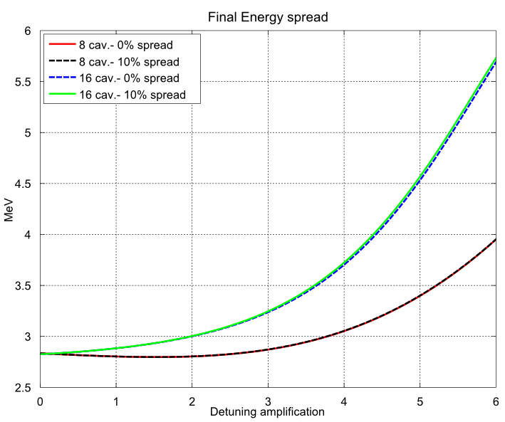
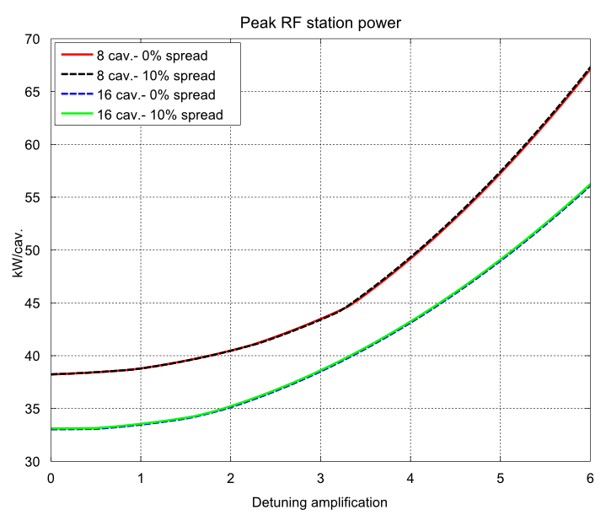
First choice of detuning readings

Slide 14
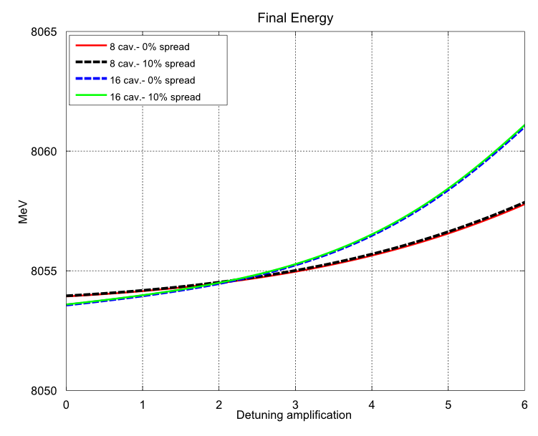
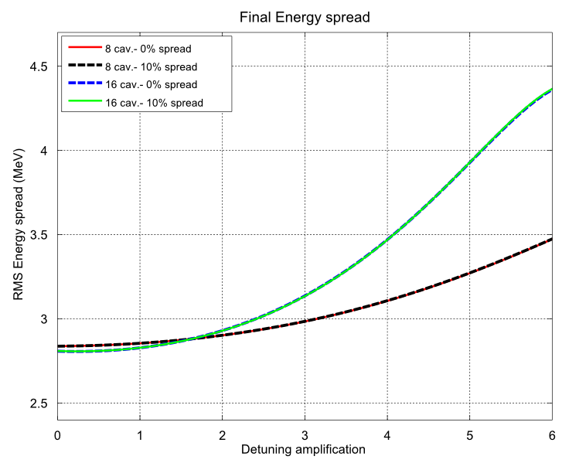
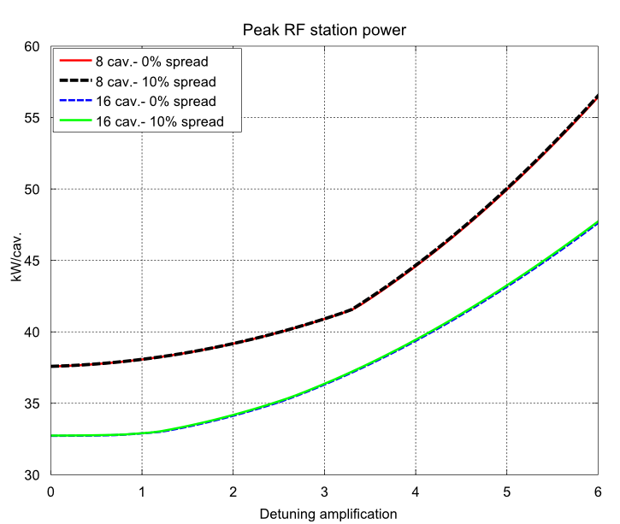
Second choice of detuning readings (very sensitive respect to the choice for high detuning)

Slide 15
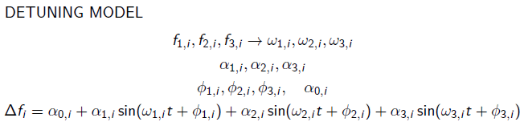
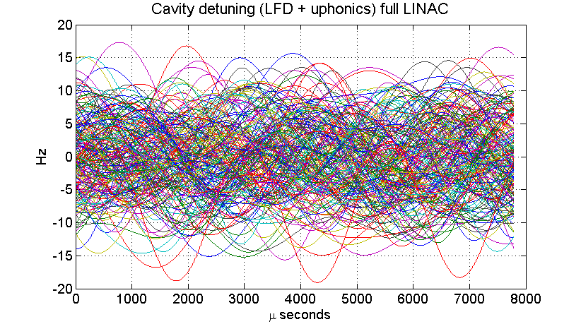

Slide 16
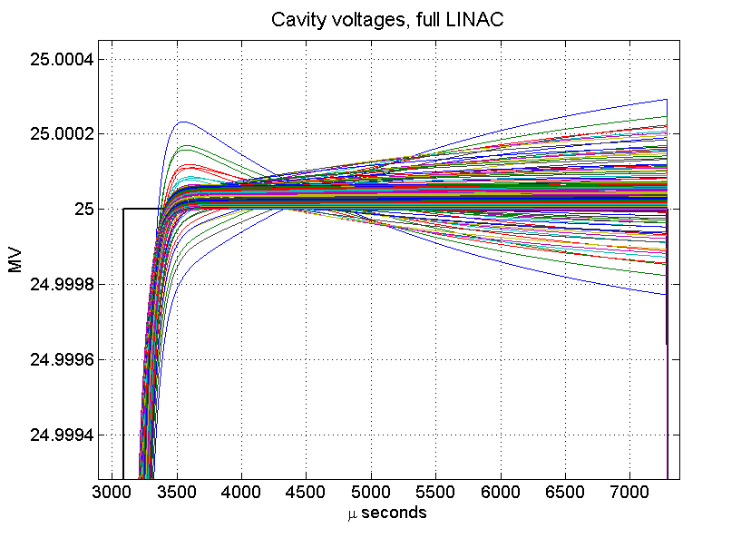
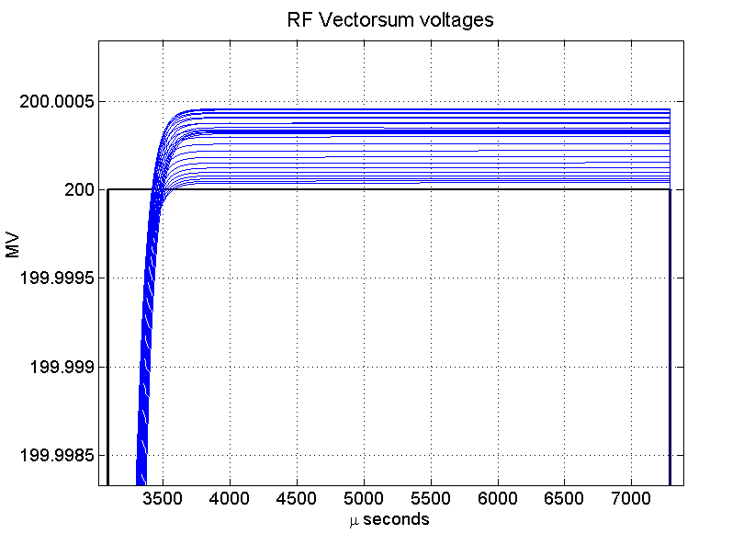
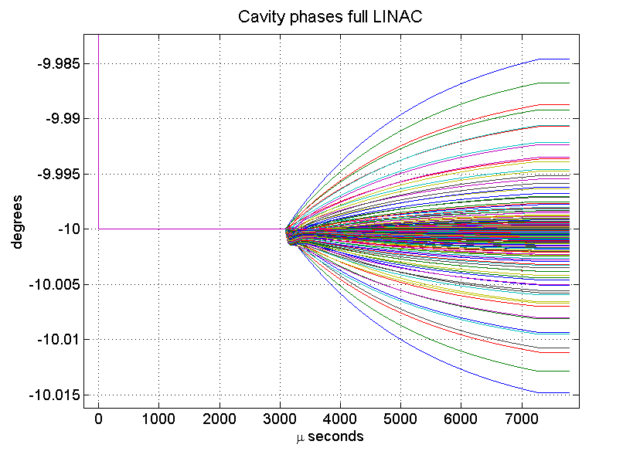
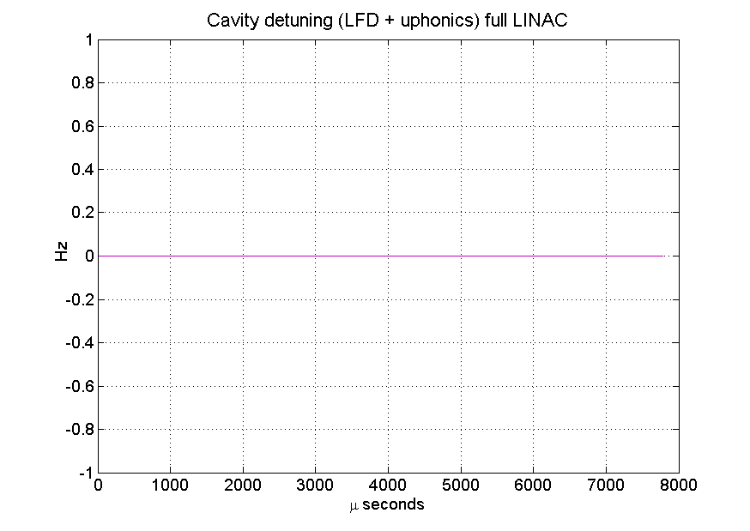
No detunig, no gradient spread, no ERR, TTF, CL

Slide 17
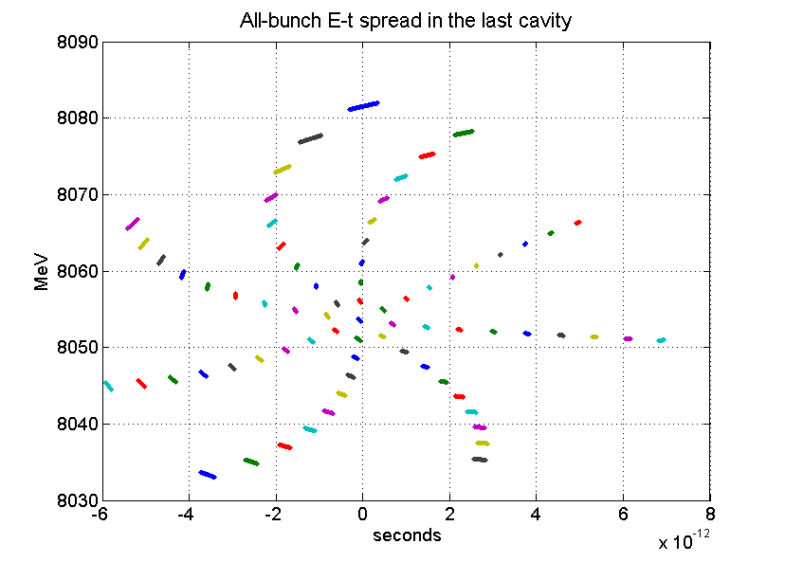
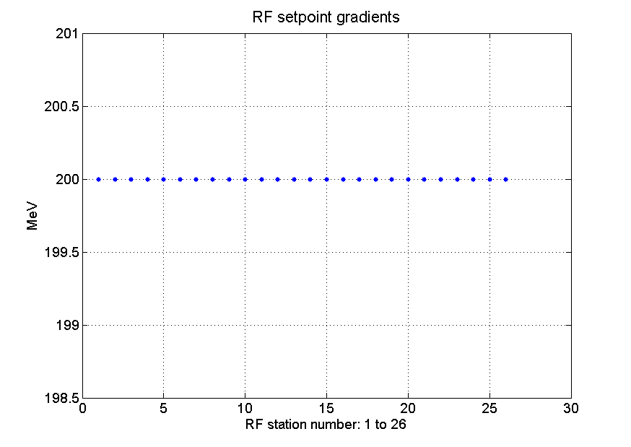
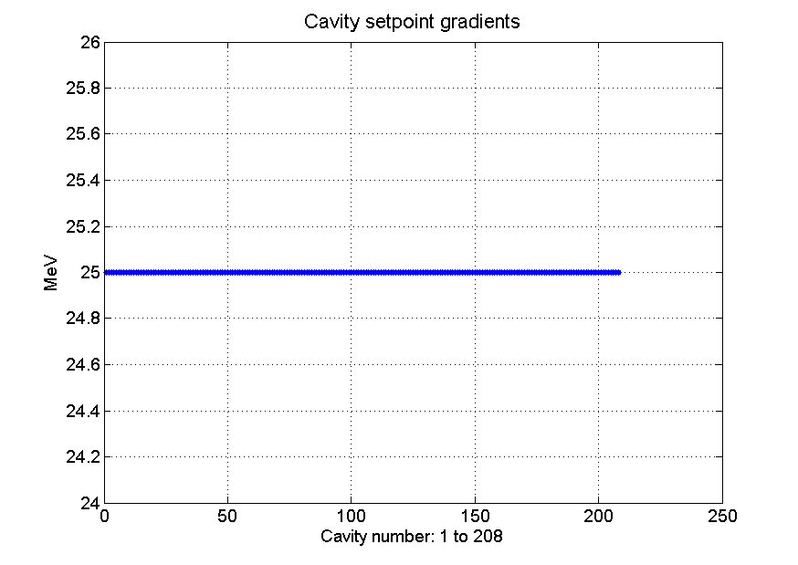
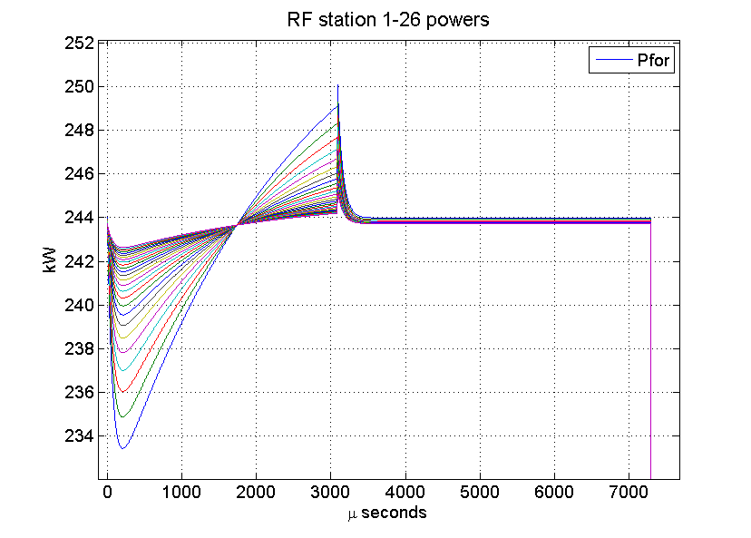
No detunig, no gradient spread, no ERR, TTF, CL

Slide 18
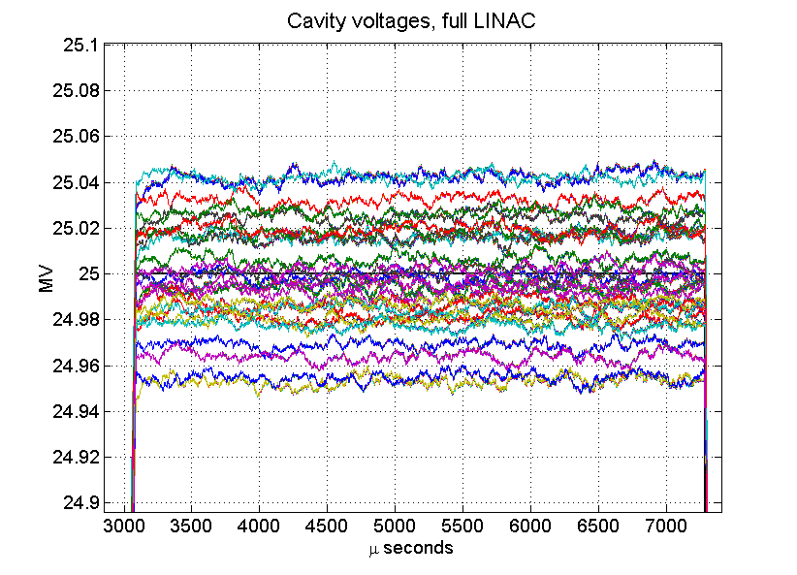
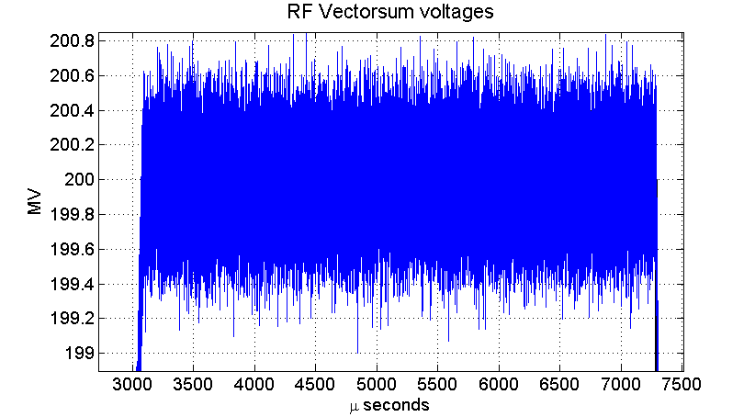
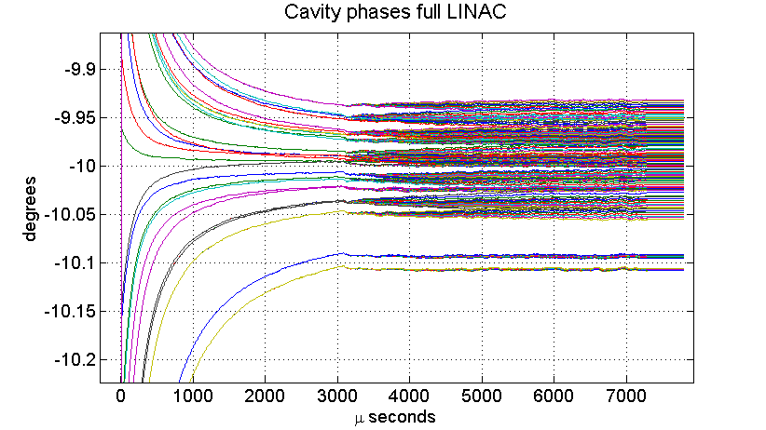
No detunig, no gradient spread, ERR, TTF, CL

Slide 19
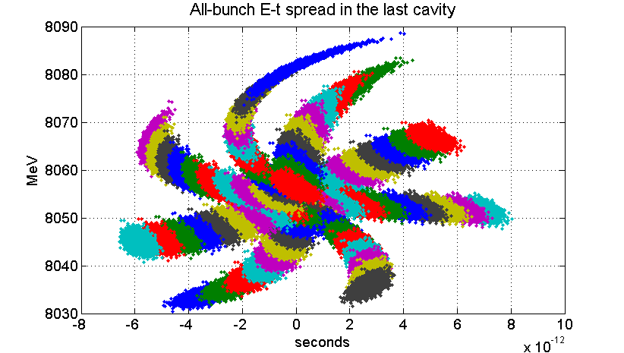
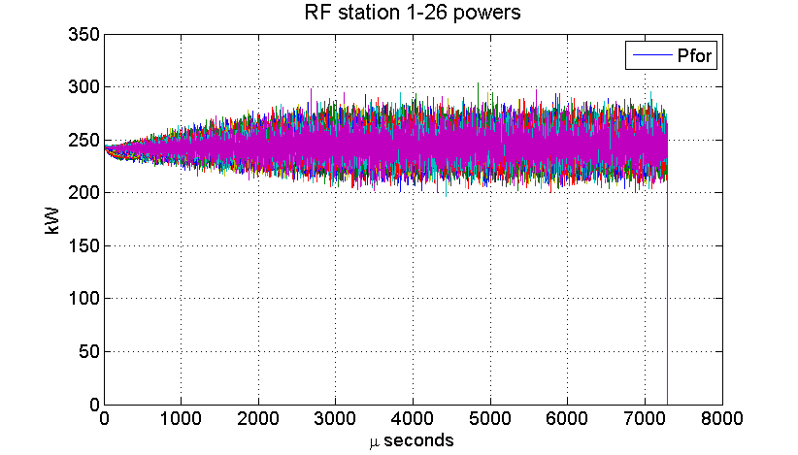
No detunig, no gradient spread, ERR, TTF, CL

Slide 20
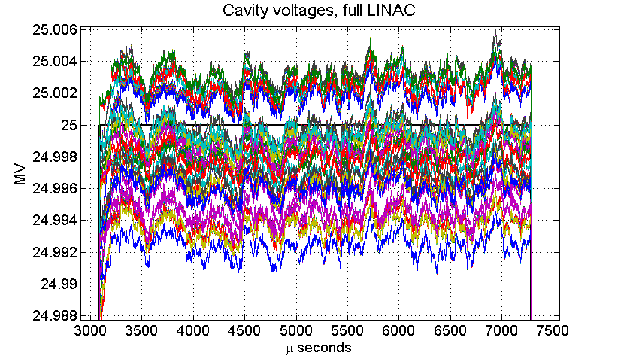
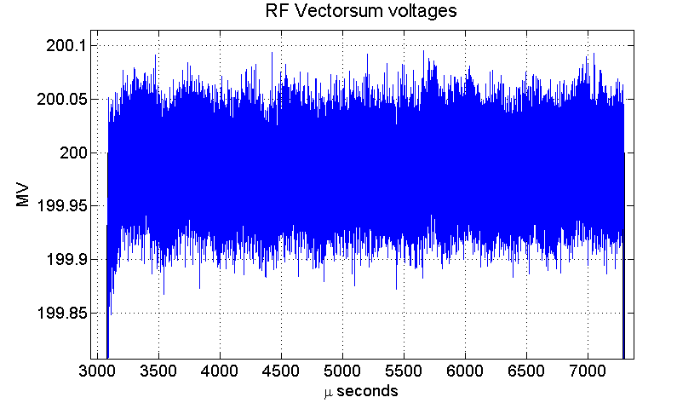
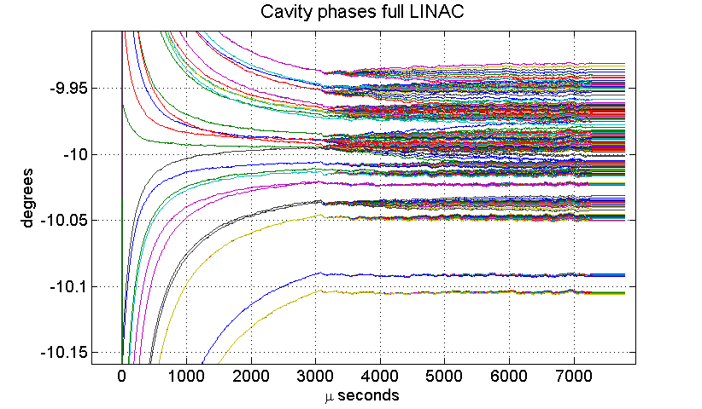
No detunig, no gradient spread, ERR, TTF, CL , probe noise amp. err.=0.03%

Slide 21

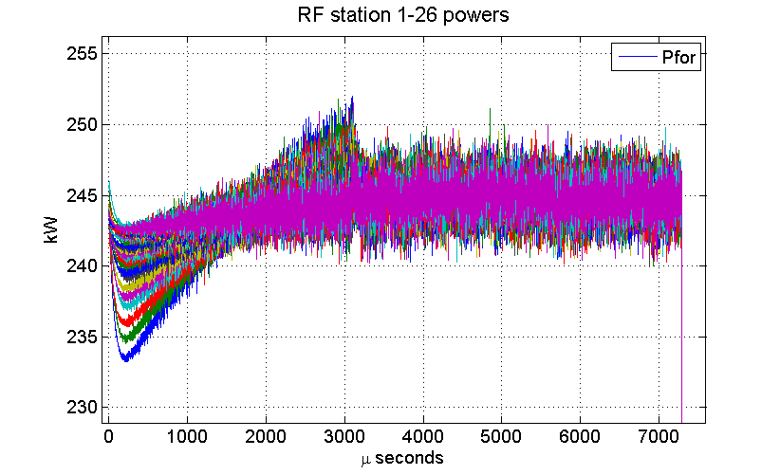
No detunig, no gradient spread, ERR, TTF, CL , probe noise amp. err.=0.03%

Slide 22
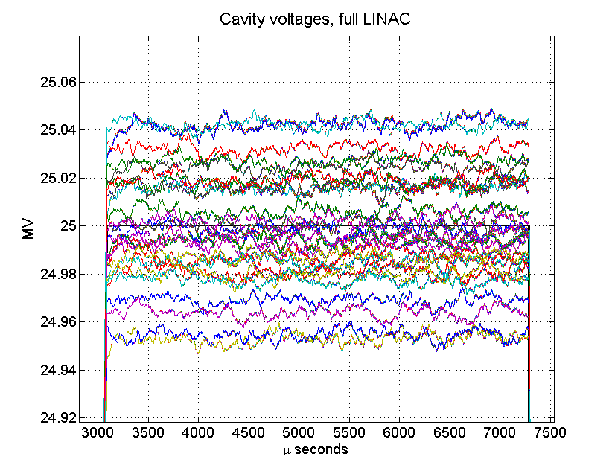
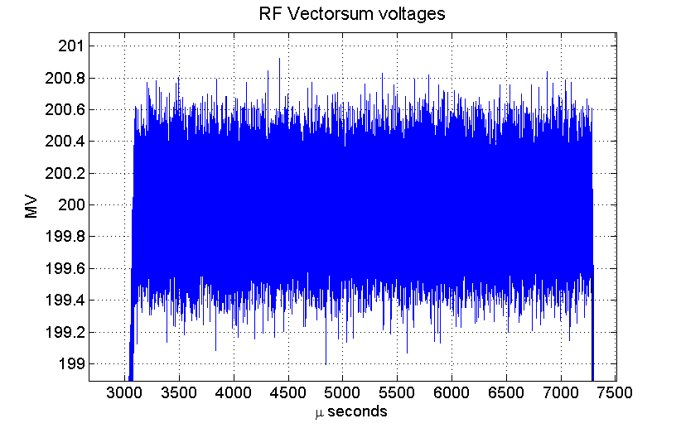
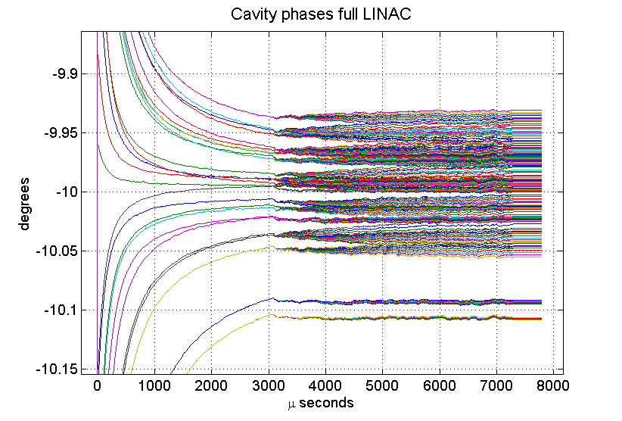
No detunig, no gradient spread, ERR, TTF, CL, average 10

Slide 23

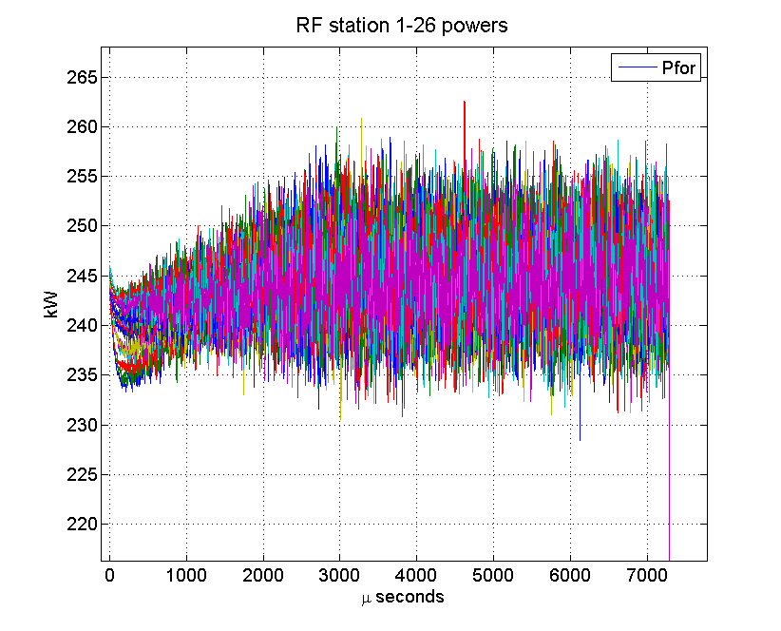
No detunig, no gradient spread, ERR, TTF, CL, average 10

Slide 24
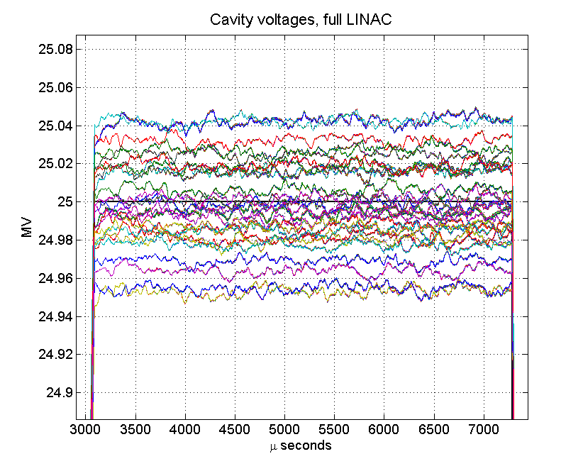
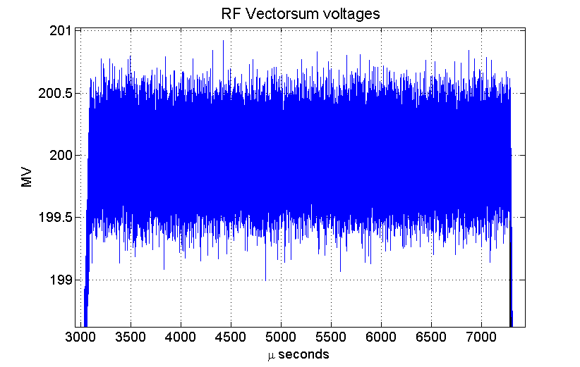
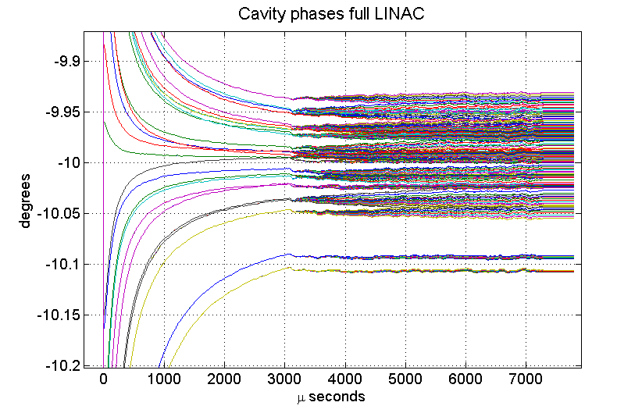
No detunig, no gradient spread, ERR, TTF, CL, average 20

Slide 25
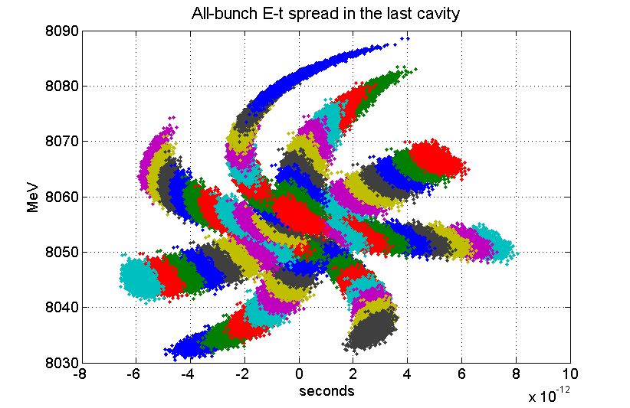
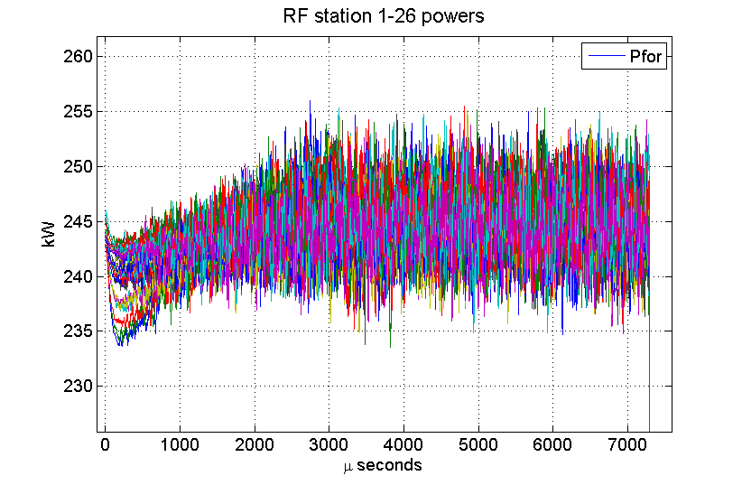
No detunig, no gradient spread, ERR, TTF, CL, average 20

Slide 26
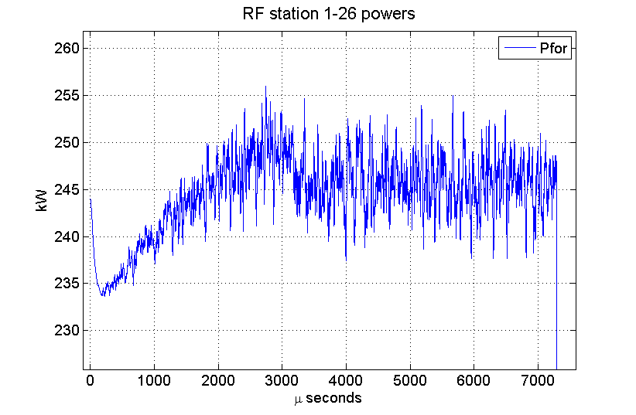
No detunig, no gradient spread, ERR, TTF, CL, average 20

Slide 27



No detunig, no gradient spread, ERR, TTF, CL, average 80

Slide 28


No detunig, no gradient spread, ERR, TTF, CL, average 80

Slide 29

No detunig, no gradient spread, ERR, TTF, CL, average 80

Slide 30




100+100 detunig, no gradient spread, ERR, TTF, CL, average 120

Slide 31


100+100 detunig, no gradient spread, ERR, TTF, CL, average 120

Slide 32

100+100 detunig, no gradient spread, ERR, TTF, CL, average 120

Slide 33
Outlook
The simulation code for longitudinal beam dynamics and RF system studies has been tested and understood.
Simulations to be performed to test bunch to bunch and pulse to pulse stability of the beam.
Understanding relation between final energy spread/jitter and power needed depending on LLRF parameters and their relation.
Fixing constraints for LLRF parameters and achievable performance for different configurations and optimal settings.
Improvement of code for more comprehensive results.

