Slide 1
Light Source Facilities: “Big Data”, Big Science
Craig E. Tull, PhD Computing Research Division
OSG All-Hands Meeting
April 09, 2014 @ SLAC, Menlo Park, CA

Slide 2
BES Light Sources entering a new era
Light source data volumes are growing much faster than Moore's law.
Light source luminosity, Detector resolution & speed, Sample automation
BES user facilities serve 10,000 scientists and engineers every year.
Mostly composed of many small (<10 FTE) groups with no SW experts.
but aggregate size comparable to an ATLAS/CMS/…
Simulation & analysis traditionally done on very small scale resources.
BES software landscape is largely ad-hoc and relies heavily on a limited number of experts to handle analysis.
Data are often very proprietary/secret
There are not widely accepted common formats, algorithms, or tools
No history of large scale computing
National Synchrotron Light (NSLS) at Brookhaven National Laboratory in Upton, NY
Stanford Synchrotron Radiation (SSRL) at SLAC National Accelerator Laboratory in Stanford, CA
Advanced Light Source (ALS) at Lawrence Berkeley National Laboratory in Berkeley, CA
Advanced Photon Source (APS) at Argonne National Laboratory in Argonne, IL
Linac Coherent Light Source (LCLS) at SLAC National Accelerator Laboratory in Stanford, CA
National Synchrotron Light Source-II (NSLS-II) under construction at Brookhaven National Laboratory in Upton, NY
Next Generation Light Source (NGLS) being proposed at Lawrence Berkeley National Laboratory in Berkeley, CA
"Past limitations of detector technology have been largely solved through recent DOE investment and that the present bottleneck for research throughput is the lack of availability of appropriate analysis software and modeling tools."¹
¹Advanced Data Analysis and Modeling Tools for Scattering Methods Workshop - Sept, 2010
Notes:
Accellerator Luminosity
Detector Resolution
Cycle Rates
Automation of Instruments

Slide 5
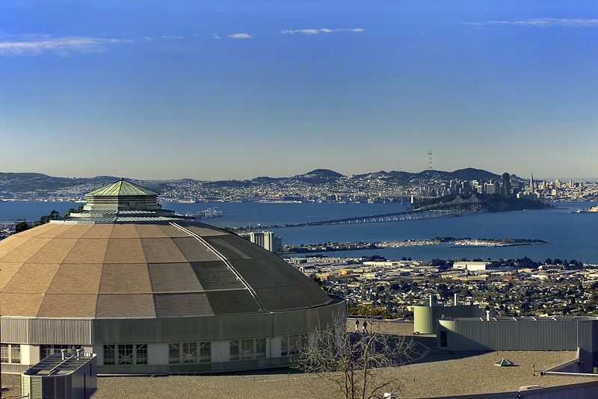
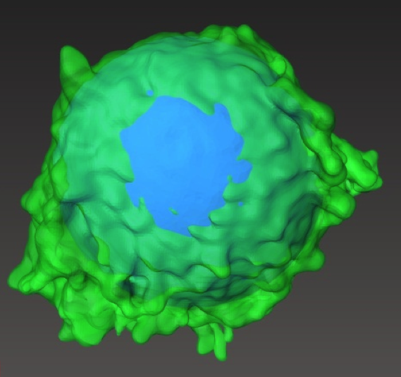
ALS Data – Variety, Volume, Velocity
Reciprocal Space
(Scattering)
100,000’s images per day
HipGISAXS/HipMC
parallel Scattering
Real Space (Tomography)
100’s of TB per year
Arec3d, QuantCT, ImgRec, GridRec
Spectroscopy (MicroXas)
100’s of TFlops of GPU/CPU
ShirleyXAS (MSD)
BerkeleyGW (NERSC)
ALS science is limited by software and data volumes (growing at 2x Moore’s).
* Lightsource brightness * Detector resolution & speed * Robotics for sample handling * Time-resolved, in-situ experiments
Hybrid
(COSMIC)
PB’s of data per year soon
Ptychographic reconstruction
Notes:
DOE’s national user facility, the world’s first third-generation synchrotron light source, built 1987-1993
40+ beamlines
2200+ Users Apply for beam time Visit on site
Employ 200+ scientists
600+ publications/year

Slide 6
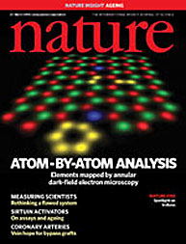
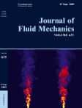
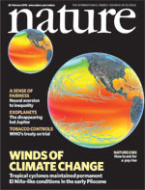
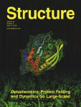
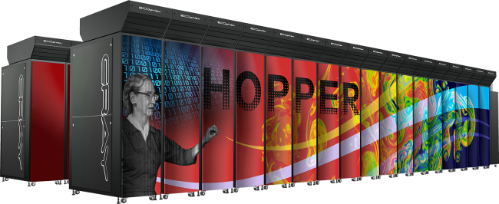
NERSC Facility Leads DOE in Scientific Computing Productivity *
NERSC computing for science
4000 users, 500 projects
1500 publications per year
Systems designed for science
>1PF Petaflop Cray systems, Edison, Hopper
2nd Fastest computer in US and one of 2 Petaflop systems in Office of Science
26 PB HPSS tape storage (150M files); 6 PB GPFS disk system
GPU (Dirac), capacity (Carver), and specialized systems (PDSF, JGI, Plank)
6
Notes:
6

Slide 7
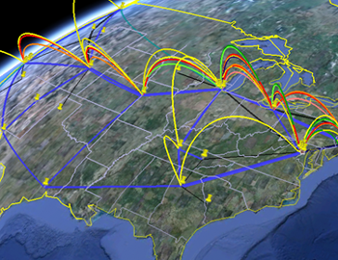
ESnet: DOE’s Leadership and Production Network
DOE Science Network:
72% annual traffic growth
International collaborations
Bandwidth reservations and monitoring
Advanced Networking Initiative (ANI):
100 Gbps network
ESnet+ANI, DOE will be the world leader in networking for science.
Notes:
7

Slide 8
Tomography Experimental Setup
Collect X-ray images of the sample as you rotate it through 180 degrees
Use this series of images to “reconstruct” the 3D object
Penetrating Power
Multiple Angles

Slide 9
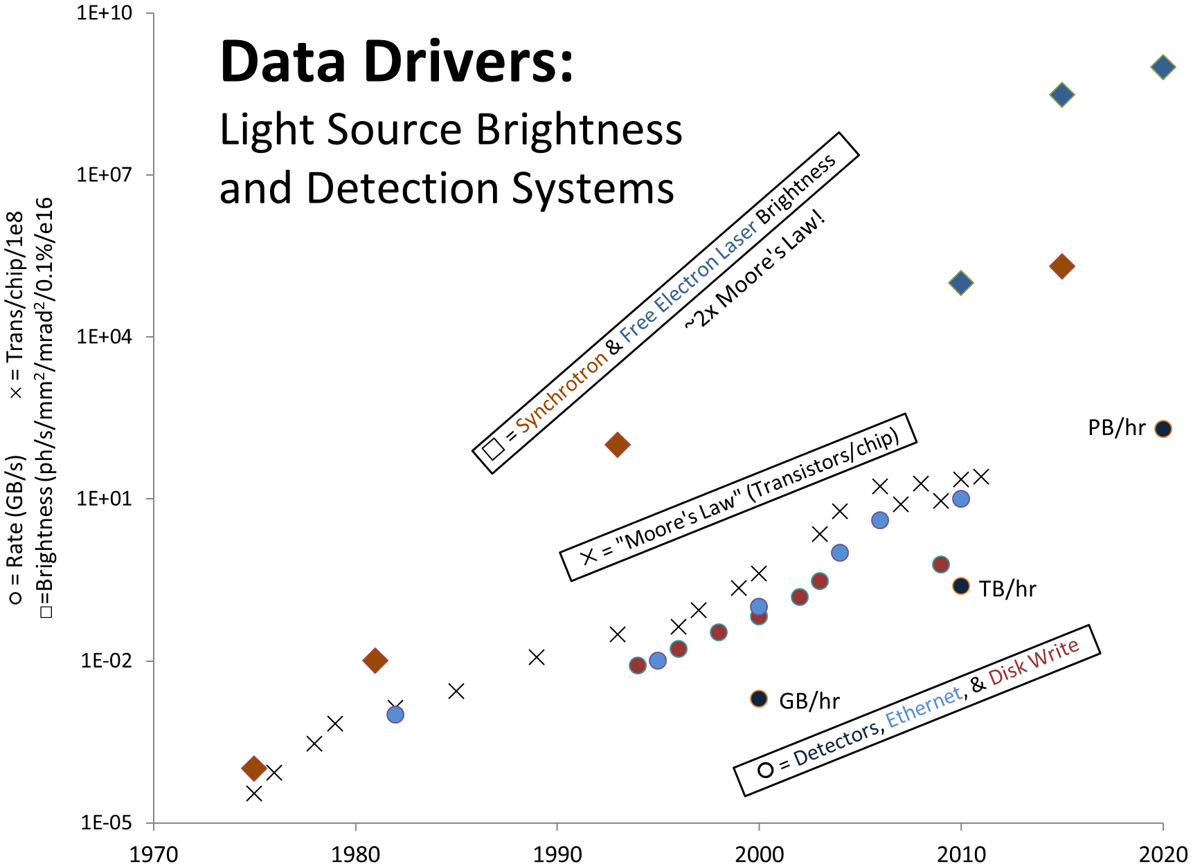
Lightsources are getting brighter…
Data compiled by Peter Denes

Slide 10
Detectors are getting faster…
2011
2012
2013
Notes:
Show movie of rate of data collection with pco.4000, edge, and dimax

Slide 12
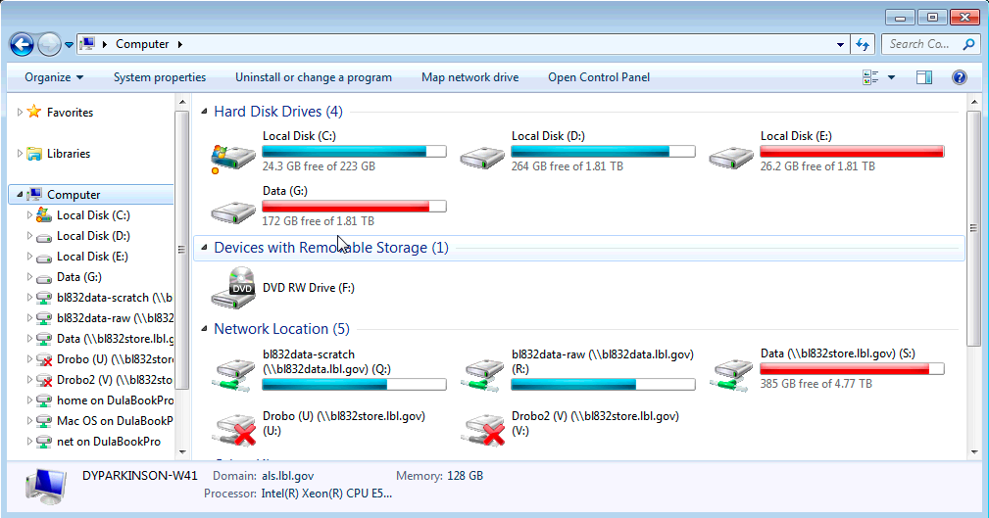
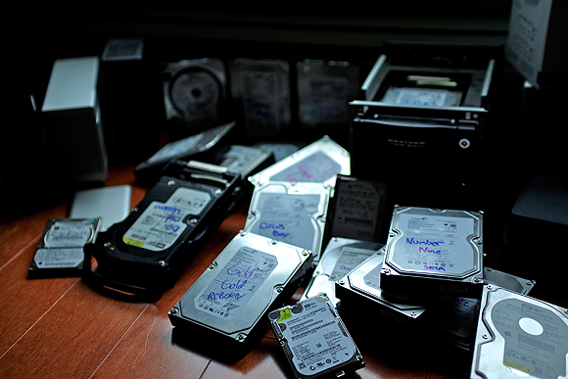
“My approach…”
Way too many hard drives
Multiple hours per week spent
manually copying/erasing data
EVERY BEAMLINE FOR ITSELF!
Notes:
Photo of a pile of hard drives, dvd’s, etc.
Piles of hard drives
Trying to figure out what to erase
Transferring data to people off-site (DVD story)
People not being able to copy data before they leave
screenshots

Slide 13
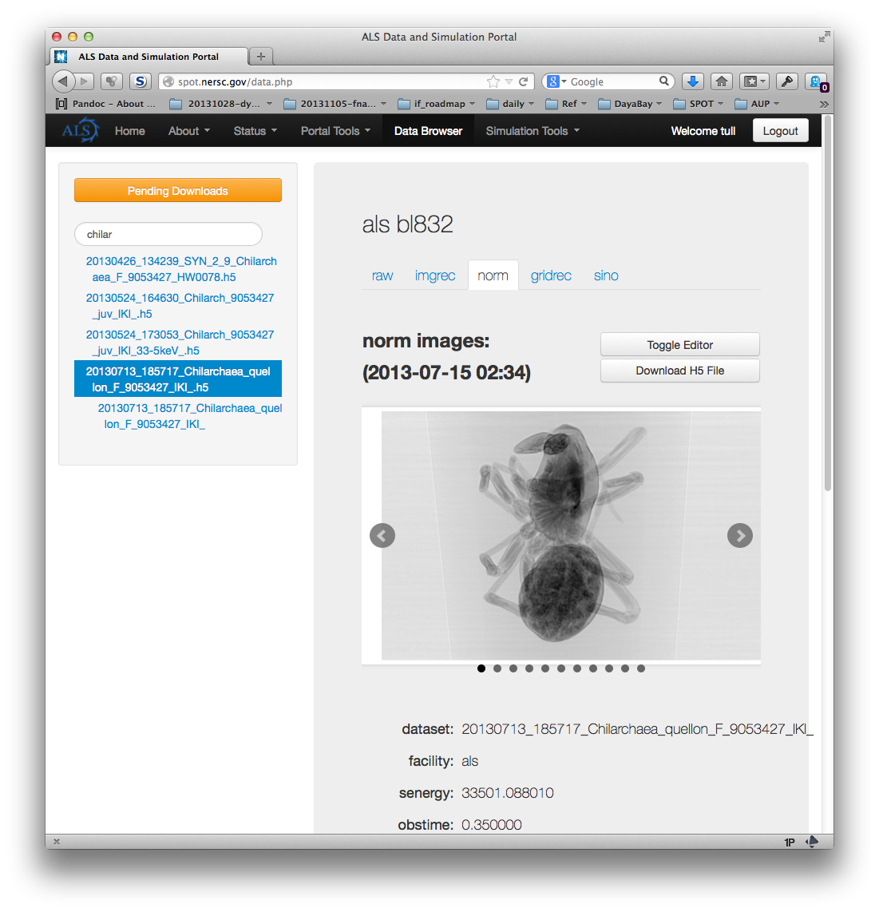
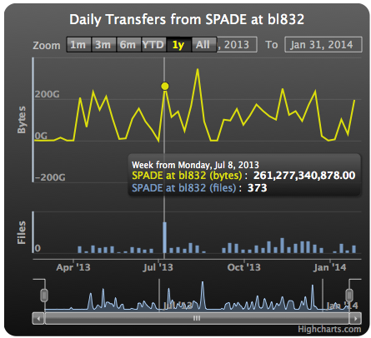
SPOT Suite:
Towards an End-to-End Solution for Light Source Data, Analysis, & Simulation
Multi-division team: CRD, ALS, ESNet, MSD, & NERSC.
6 Tomography codes ported and parallelized on NERSC
HPC-scale MBIR incorporated
Remote vizualization of data
Metadata usage for experiment optimization.
Micro-Diffraction & SAXS/WAXS beamlines incorporated.
Heterogeneous data, metadata, workflows.
Remote experiments now possible.
Coming year: realtime on HPC, Ptychography, Nick Sauter’s LCLS data stream, simulation, on-demand HPC, remote viz & data access, sharing
Working today 24/7 at ALS 3 beamlines (Tomography, SAXS/WAXS, Diffraction) Mar.2013-Feb.2014: 85 experiments; 61 users; 43,022* datasets; 343 TB of raw & processed data; 610,171 NERSC jobs delivered in realtime. (*now 72,605 datasets)
Notes:
FIJI-norm, FIJI-sino, GridRec, ImgRec

Slide 14
Capabilities the SPOT Suite Brings to the Beamline Scientist:
Beamline DTN: ESNet's DTN Reference Architecture
Data Suitcasing: Beamline specific HDF5 conversion code
SPADE Data Transfer: generic
MetaData DataBase: MongoDB at NERSC
Data Portal: browsing, monitoring, analysis, simulation, AAA
NERSC*: Carver, Hopper, Edison, NGFS, HPSS, SDG
HPC-optimized Photon Science Codes:
Fiji, GridRec, ImgRec, MBIR, XMAS, ShirleyXAS, HipGISAXS, …
MQ Job submission system: (in development)
Interruptible queues (NERSC testing)
Workflow System: (SDAV Data Pilot PostDoc hire)
WAN Data Access & Sharing: (Data Pilot PostDoc hire)
Notes:
SPOT Suite Components:
- Beamline DTN: Based upon ESNet's DTN Reference Architecture
- fasterdata.es.net
- Data Suitcasing: Beamline specific
- HDF5 file containing Beamline MetaData & Dataset Data
- SPADE Data Transfer: generic
- Setup on each DTN talking to single SPADE on NERSC DTN
- MetaData DataBase: MongoDB at NERSC
- Metadata, provenance, and dataset descriptors for all datasets
- Searchable, annotatable, queriable
- Permits heterogeneous beamlines
- SPOT Suite Data Portal: NERSC Science Data Gateway & NEWT
- Real/Reciprocal/Spectrum data browsing, system health, offline analysis
- Simulation tools: ShirleyXANS, GISAXS (soon), BerkeleyGW
- HPC-optimized Photon Science Codes:
- Mostly Tomography so far (plus XMAS - micro-Diffraction
- Rabbit-MQ Job submission system: (in development)
- synchronize and prioritize realtime work, offline work, multiple machine queues on NERSC floor
- Workflow System: (SDAV PostDoc hire)
- Drives multiple tasks and many jobs based on data source & type
- WAN Data Access & Sharing: (SDAV PostDoc hire)
- High performance, secure sharing and distribution of datasets

Slide 15
Time-resolved, in-situ Tomography
Use real-time reconstruction to study cracks as they form.
Use real-time reconstruction to control & QA experiment.

Slide 16
Material Failure Above 1700ºC
Bale, Ritchie et al, Nature Materials 2013

Slide 17
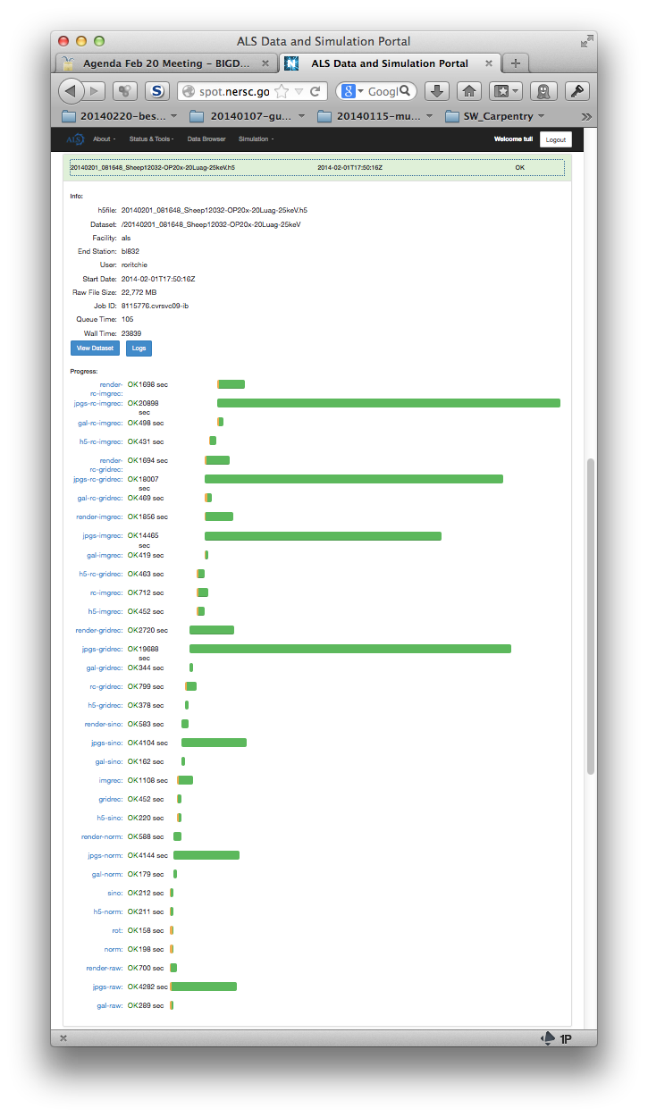
Common Theme: Workflow tools to manage complexity.
How the computer sees realtime Tomographic Reconstruction
How the Beamline Scientist sees Tomographic Reconstruction
Normalization
Sinograms
Reconstruction

Slide 18
Workflow – What do we need to do?
Scalability, Flexibility, Accessibility
Tomography in jBPM.
Tomography is only 1 methodology.
Workflow for developers.
Simple, composable workflows for end users?
Capture of provenance.
Composable, heirarchical workflows for multiple beamlines, concurrent processes, lifecycle mgt…

Slide 19
Computing intensive examples at ALS
HipGISAXS*: Reverse Monte Carlo for GISAXS (MPI or GPU/CUDA)
ShirleyXANS§: Simulation of near-edge x-ray absorption fine structure (NEXAFS) spectra using established methods based on constrained density functional theory (DFT) (Hopper/Edison)
MBIR✜: Model-Based Iterative Reconstruction – MPI tomographic reconstruction code (Hopper/Edison)
Ptychographic Reconstruction (GPU cluster)
Quant-CT*: Tomographic segmentation and automated quantitative analysis
Wide variety of science-specific simulations & analyses
One back-of-the-envelope calculation has 4 groups could use 400 TFlops dedicated CPU equivalent to keep up with data rates in 2015.
✜Purdue
§Molecular Foundry
*CAMERA

Slide 20
“Big Data” and Distributed Computing.
What is “Big Data”?
Volume, Velocity, Variety, Veracity, Value
“Whatever your own data challenges are.”
ALS will be generating >1 PB/year within 1 year.
“Big Data” is unclear, but we know that it takes professionals to deal reliably and robustly with PetaBytes…
…right?

Slide 21
April 5, 2014 premier most pirated TV episode of all time
HBO GO – Crashed
1,000,000 illegal downloads in 12 hours (BitTorrent, etc)
1.5 PB in 12 hours
Home equipment
HBO GO’s centralized, ⬆ professional servers fried.
Distributed, redundant, volunteer servers survived.

