Slide 1
Transcending the AAA data access patterns
Matevž Tadel
Talk outline:
Introduction: what is this really about
Pull out the guts of AAA monitoring data
Conclusion?
mtadel@ucsd.edu

Slide 2
The gist
Detailed monitoring data (ROOT trees):
25 GB of detailed monitoring data from June ’12
file-access-reports, more or less the same thing that goes to OSG Gratia and to Dashboard
41 GB of super-detailed data from Feb ’13
full detail on all reads (including vector), IOV monitoring option
all UCSD servers + one server at UNL
Nobody every really tried to dive into this
This should also help to steer:
the next generation of computing models
implementation and operation of caching-proxies

Slide 3
What’s there to transcend??!
A lot of AAA effort went into monitoring
Both to implement it and to use it in CMS
Should we (CMS) continue at this level?
Should we do something different?
It’s also a personal thing, longing for closure
Make a comprehensive review of what can be extracted from the monitoring data.
Understand it … ??? … profit!

Slide 4
So, how does one do it?
There’s about 2 months of work in this:
wrote 4 or 5 loopers / data extractors
at the end made a mini analysis framework
which got messy over the last two weeks …
it really wasn’t trivial
and we often give this work to new students, sigh
I’m guessing this was actually meant for me.
The story is as interesting as the results …

Slide 5
20 months of AAA file access reports
Data from 10,000 ft
Fun facts about it
How much of it is really worth looking at? (Hint: littlesome)
Results! And more of them …

Slide 6
STEP I. – What all is in this data
Count users, server/client sites, top directories, data tiers, … files
Fill loads of std::map<TString, struct Accumulate> then sort this by:
- # of accesses
- total transferred data
- total open duration
Plot overview histograms for some sub-selections

Slide 7
AAA FAR data overview I.
2012 Jun - 2014 Feb
5.3×10⁷s = 14,761 h = 88 weeks = 20.2 months
 | N (M) | Vol (PB)
All | 199.688 | 81.162
US | 169.924 | 74.457
local | 146.818 | 62.809
remote | 23.105 | 11.648
US srvs to X | 2.252 | 1.084
X srvs to US | 0.273 | 0.158
matevz@desire xrd-far> ls --format single-column –sh
total 25G
110M xmfar-2012-06.root
528M xmfar-2012-07.root
854M xmfar-2012-08.root
473M xmfar-2012-09.root
940M xmfar-2012-10.root
808M xmfar-2012-11.root
627M xmfar-2012-12.root
846M xmfar-2013-01.root
1.1G xmfar-2013-02.root
1.5G xmfar-2013-03.root
933M xmfar-2013-04.root
747M xmfar-2013-05.root
1.2G xmfar-2013-06.root
1.3G xmfar-2013-07.root
1.3G xmfar-2013-08.root
1.7G xmfar-2013-09.root
1.8G xmfar-2013-10.root
1.9G xmfar-2013-11.root
1.1G xmfar-2013-12.root
1.7G xmfar-2014-01.root
3.5G xmfar-2014-02.root
130 Bytes / record

Slide 8
AAA FAR data overview II.
1. All (200M):
91 M unauthenticated; Brian B. 10 M, Andrea S. 5.5 M
about 1200 different DNs
2a. USA, local access (147M):
72 M unauthenticated
transfers:
domains: 60% UW, 23% Purdue, 10% FNAL, 3.5% UNL, 2% MIT
tiers: 40% AOD, 23% AODSIM, 10% GEN-SIM, 3.7% GEN-SIM-RECO, 2.7% RECO, 1% RAW

Slide 9
AAA FAR data overview III.
2b. USA remote (23M):
open counts: about 40% is monitoring / testing / development
transfers: 6.6% production, 30% 15 top users
server: FNAL (60%), UNL (15%), UW, UCSD (10% each)
client: UW (25%), Caltech, Purdue, UCSD, UNL, ND (10 - 15%)
AOD, AODSIM most read by far (35% each)
above 5%: GEN-SIM-RAW, RAW, RECO
Curiosities:
the most accessed files (monitoring): 2.6 and 2.1 M-times!; next 830 k
about 100 files that are accessed more than 1000-times.
/store/user/ra2tau 4.7% transfers (450 madgraph pat-skim files, accessed 70-150 times!), two more users around 0.4%

Slide 10
AAA FAR data overview IV.
4. Access into USA from elsewhere (2.3M):
about 750 users
most transfers: pilot-cern/fnal (30/20%), 4 users at 5%
servers: FNAL (60%), UCSD (15%), UFL (10%)
clients: CNAF (30%), SINICS.TW (20%), CERN / DESY (15%), IC (10%)
tiers: AODSIM (25%), RAW/GEN-SIM (20%), GEN (15%), AOD (7%)
5. Access from USA to elsewhere (0.3M):
7% of traffic 4 min-bias GEN-SIM files, read from FNAL (3% of #)
about 400 users
cmspilot-cern, 50% of transfers, then 10 user between 2-10%
servers: CNAF (50%), IN2P3 (10%), UCL/RAL/Pisa (above 5%)
client: FNAL (75%), UW/Caltech (~10%)
tiers: GEN-SIM (60%), AODSIM (25%), AOD (8%)

Slide 11
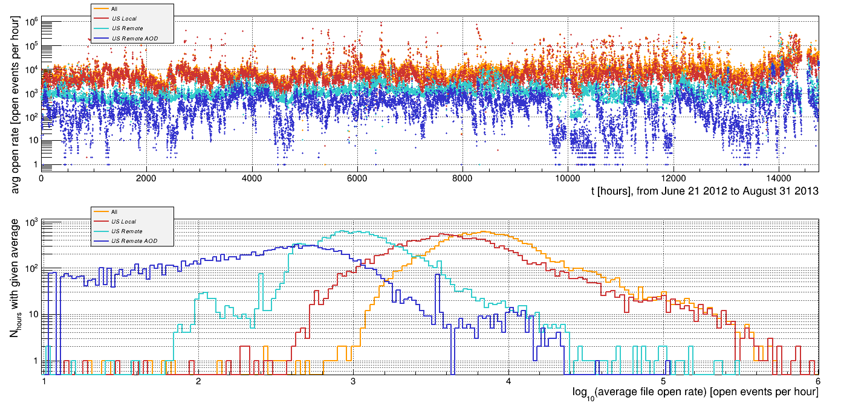
Total file-open rates

Slide 12
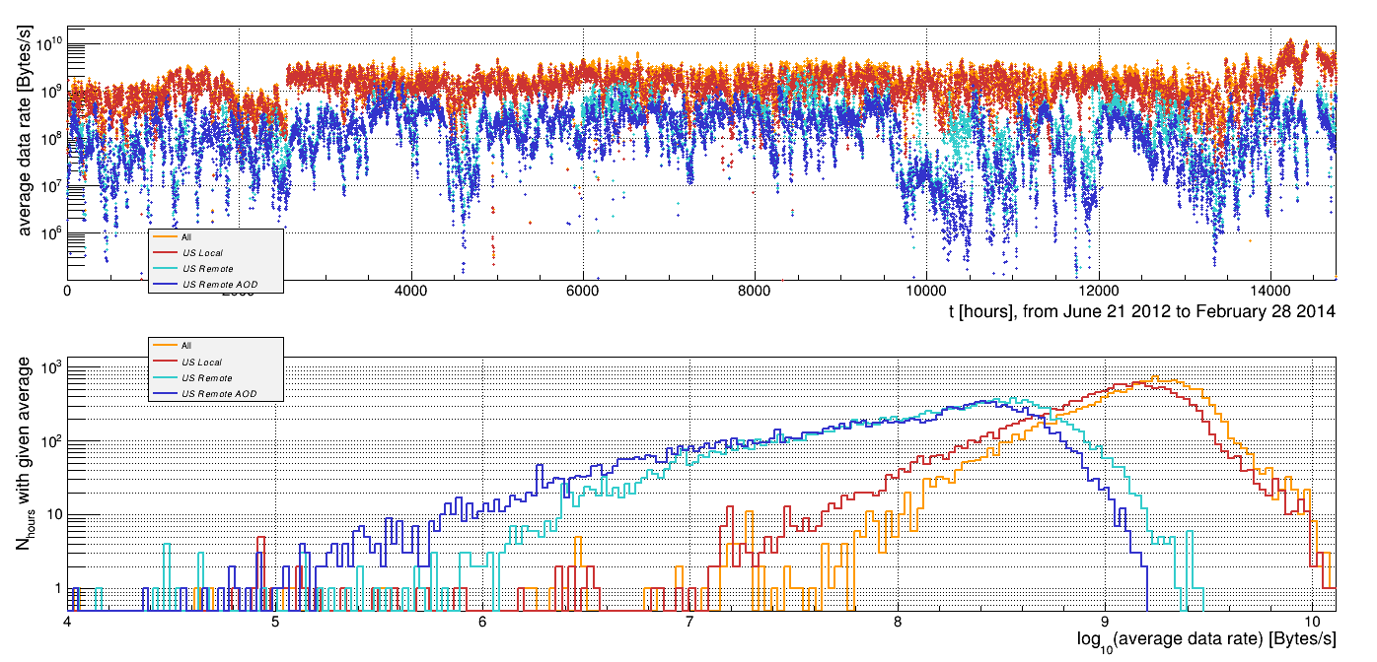
Total read rates

Slide 13
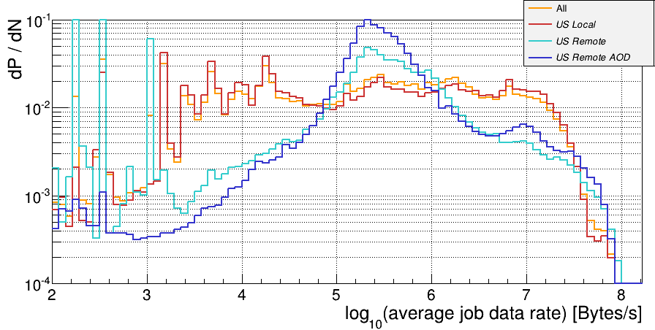
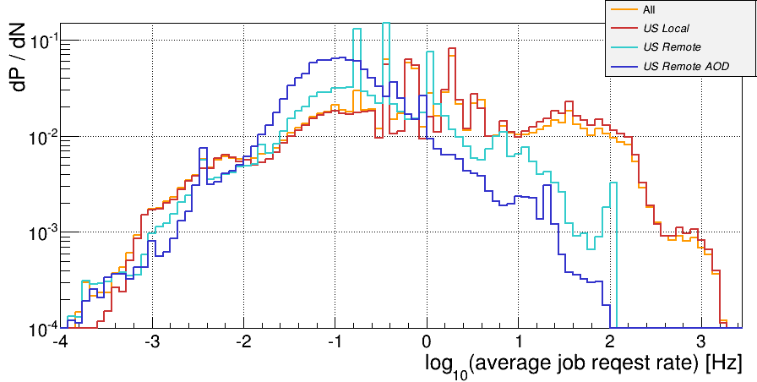
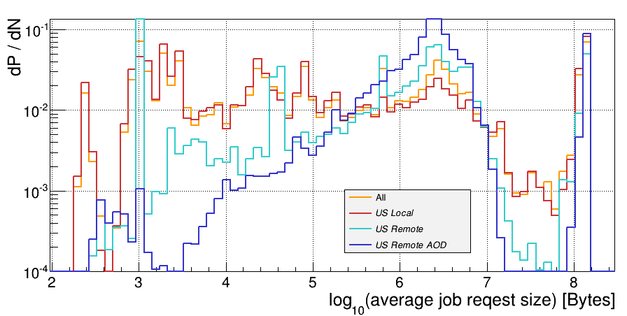
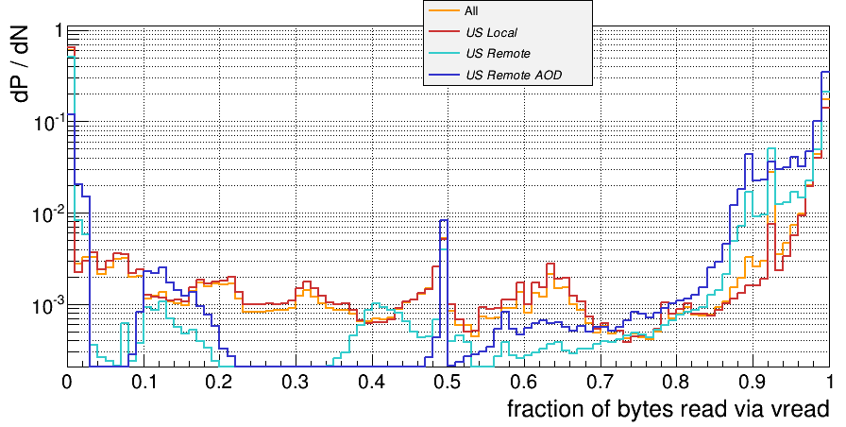
Comparison of job averages

Slide 14
AAA FAR data – what to really look at?
Leave alone non-US data
too early, and I don’t know what’s going on there
there isn’t that much of it anyway
Also local access is problematic:
50% unknown users, unknown job mixture
issues with job/site configuration
This leaves as with remote access in the US:
Filter out known monitoring / testing users & paths
This leaves about 8.2 M records!
Review general characteristics
Start focusing on AOD and AODSIM access – ~4.3 M

Slide 15
STEP II. – Focus on US remote data access
Filter out non interesting things from before
Compare AOD vs. non-AOD, look at access from user directories
Accumulate total file-open & transfer rates for the federation
Plot histograms: data rates, read/vec read fractions, duration, …
Plot 2D histograms, everything against everything and vs. time!

Slide 16
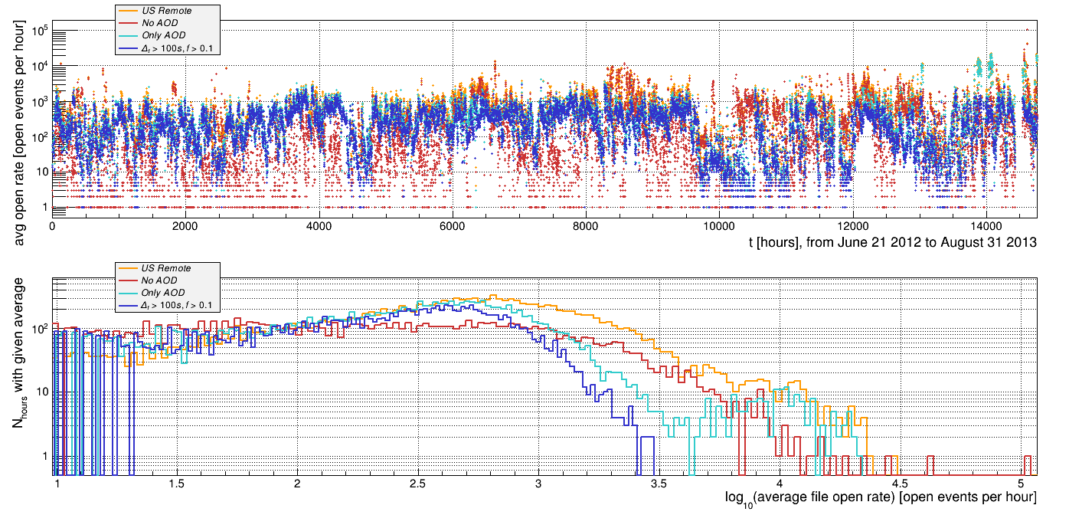
Total US remote file-open rates

Slide 17
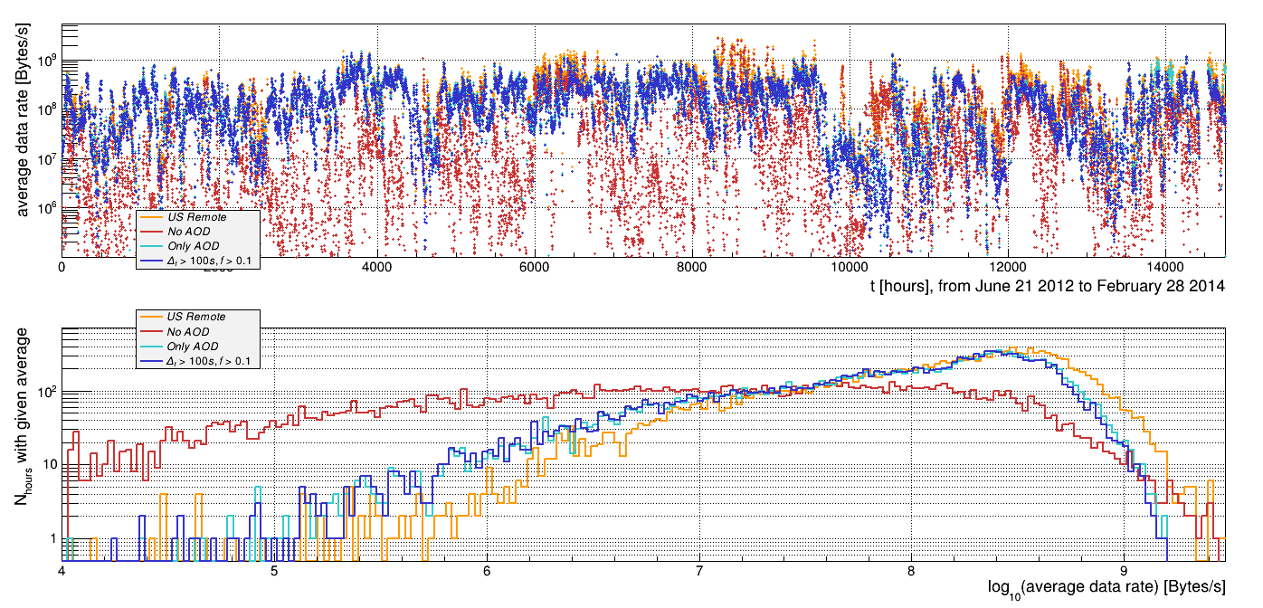
Total US remote read rates

Slide 18
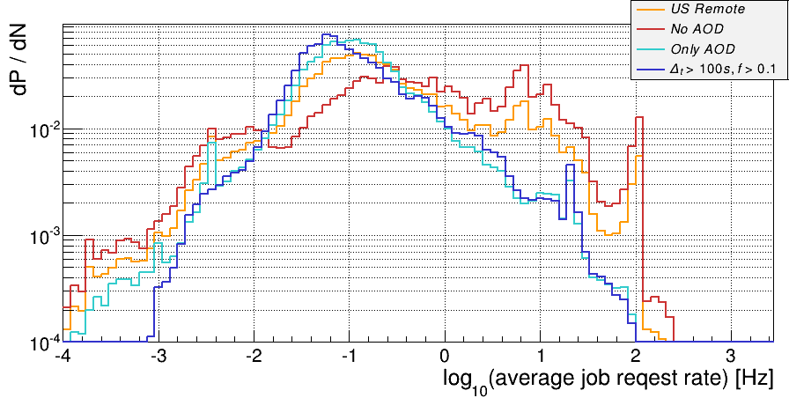
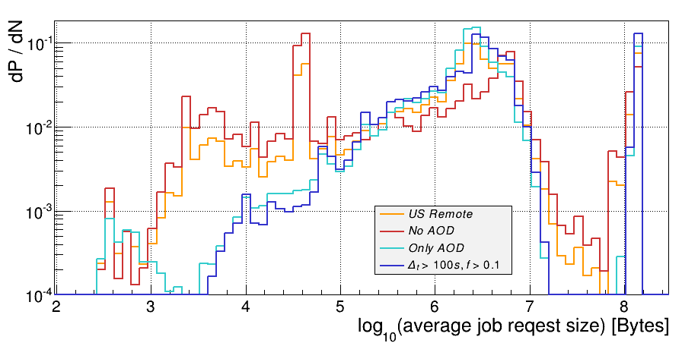
Job request rates and sizes
This goes over orders of magnitude, log-log!
AOD access better behaved, users do wonders
Notice the peak at 128 MB request size – these are xrdcp / lazy preloads

Slide 19
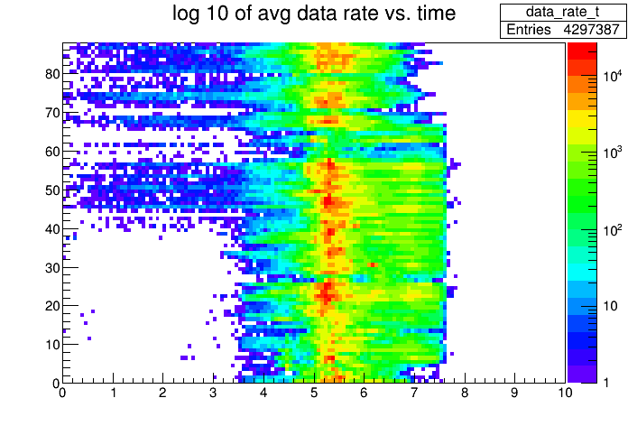
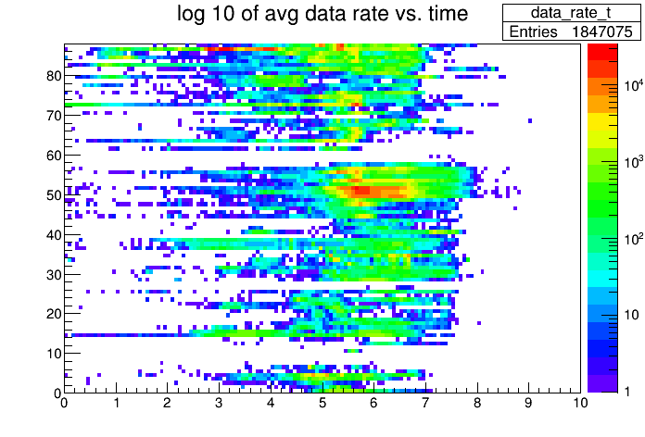
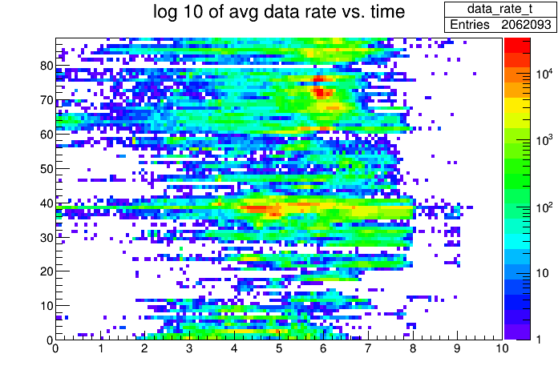
Job read rate vs. time in weeks
AOD the most consistent
User areas the most chaotic, in read rate and in time
AOD
non-AOD, user
non-AOD, non-user

Slide 20
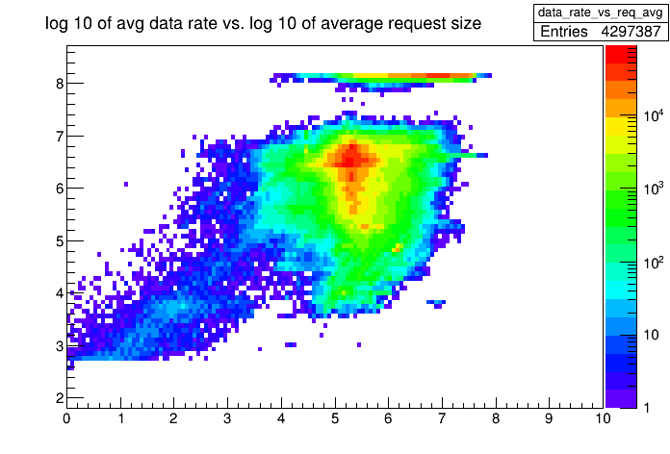
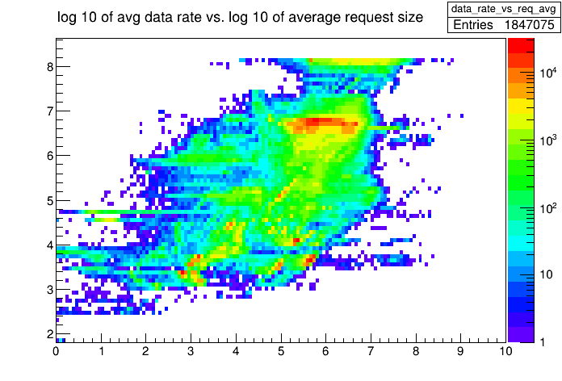
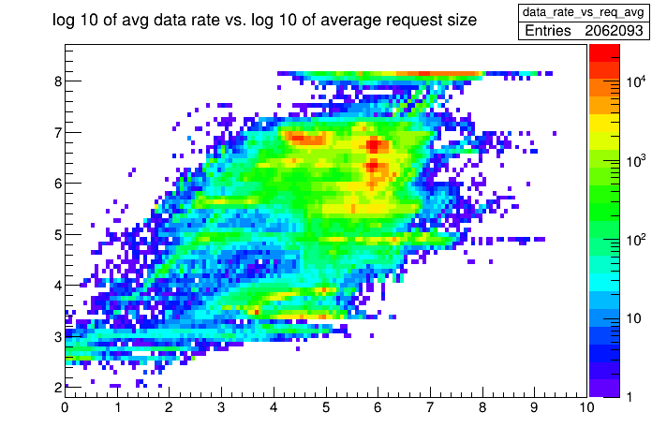
Job read rate vs. request size
Notice xrdcp / lazy-preload peaks
Again, AOD access consistent, +/- an order of magnitude ☺
AOD
non-AOD, user
non-AOD, non-user

Slide 21
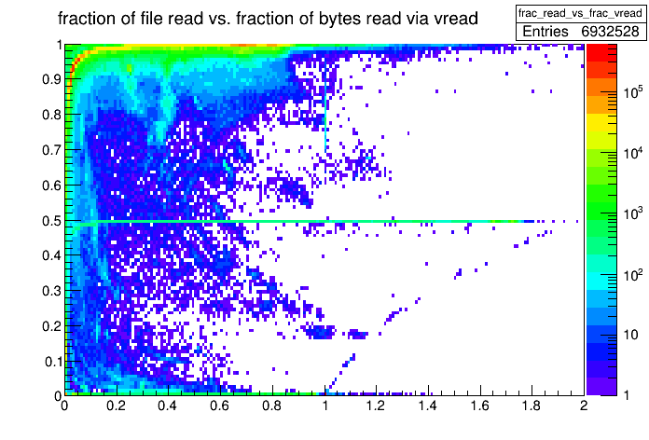
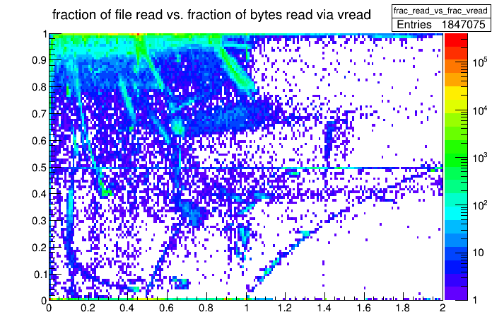
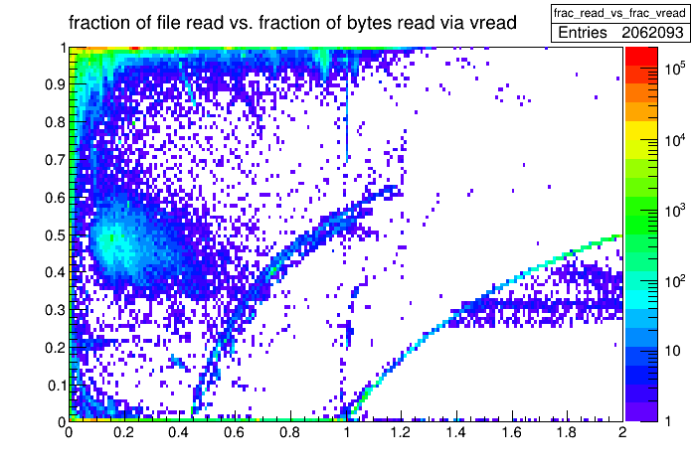
Job fraction read vs. fraction of vector reads
This is the plot where one would catch bad guys
CMS is doing good ☺
The ridge at 50% vector-read is a monitoring bug in the first 20% of data
AOD
non-AOD, user
non-AOD, non-user

Slide 22
STEP IV. – Analysis of IOV data: SEEKS and OFFSETS
The dataset
Request size & offset distributions
Vector reads

Slide 23
AAA IOV data overview I.
2013 Feb - 2014 Feb
3.4×10⁷s = 9,421 h = 56.1 weeks = 12.9 months
 | N (k)
All | 2,364
Without monitoring/tests | 785
US | 601
local AOD | 103
remote AOD | 303
idem without xrdcp | 260
idem with bad entries out | 193
matevz@desire xrd-far> ls --format single-column –sh
total 41G
3.9G xmxxx-2013-02.root
5.4G xmxxx-2013-03.root
4.6G xmxxx-2013-04.root
2.0G xmxxx-2013-05.root
4.6G xmxxx-2013-06.root
1.0G xmxxx-2013-07.root
0.8G xmxxx-2013-08.root
1.5G xmxxx-2013-09.root
3.4G xmxxx-2013-10.root
6.7G xmxxx-2013-11.root
2.2G xmxxx-2013-12.root
3.5G xmxxx-2014-01.root
1.7G xmxxx-2014-02.root
18,500 Bytes / record
(140-times FAR size)
Volume: 81% AODSIM, 9% AOD
→ together 800 TB

Slide 24
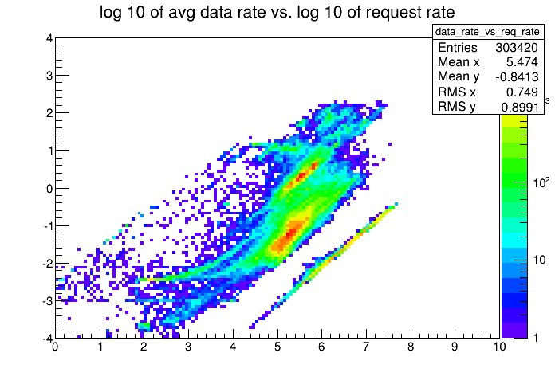
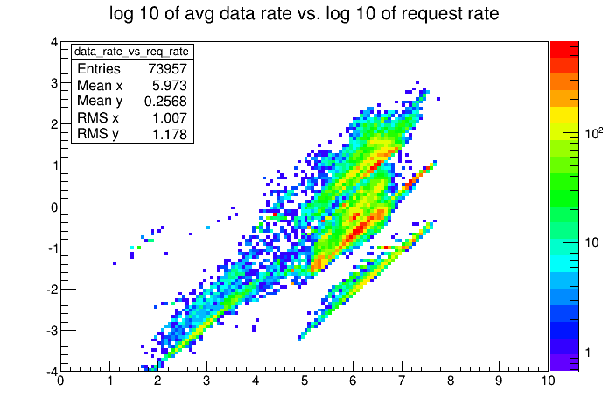
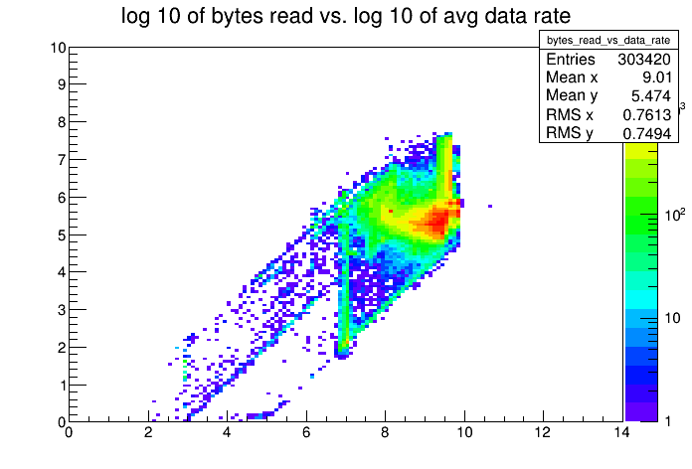
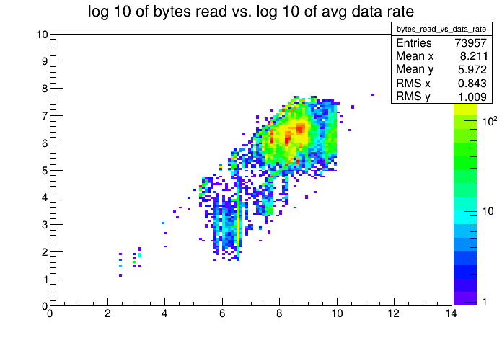
AAA IOV data overview II.
AOD remote
User directories

Slide 25
Read request size & offset distribution
Things get complicated here ☺
First, let’s look at full read requests
vector read is counted as one entity, we’ll look at offsets within vector reads soon
Histograms that will be shown:
per-job quantities: average, sum, (number, min, max)
expressed in bytes and in file-size fraction
cumulative distributions – each seek / read is an entry
separate positive / negative seeks
separate seeks from single/vector reads, preceded by single/vector reads

Slide 26
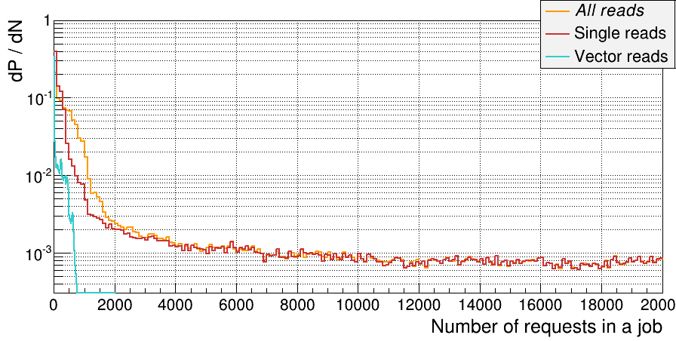
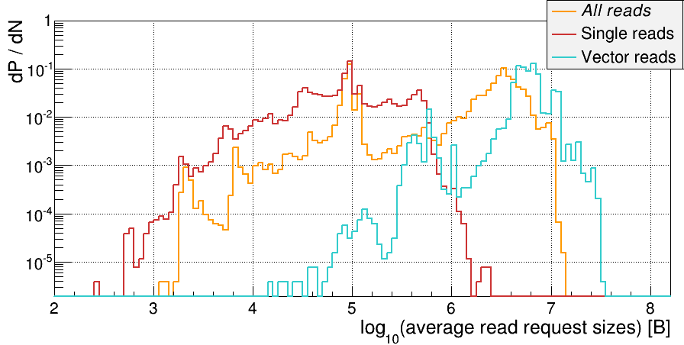
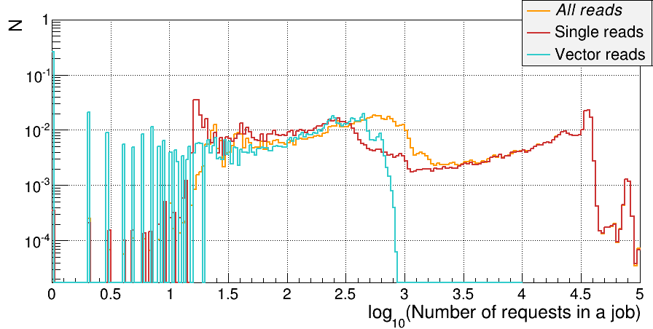
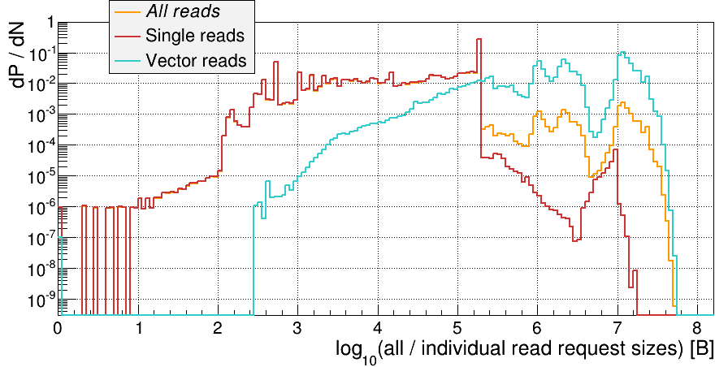
E.g., read requests:
One entry per job – 190 x 10³
One entry per read request – 1.7 x 10⁹

Slide 27
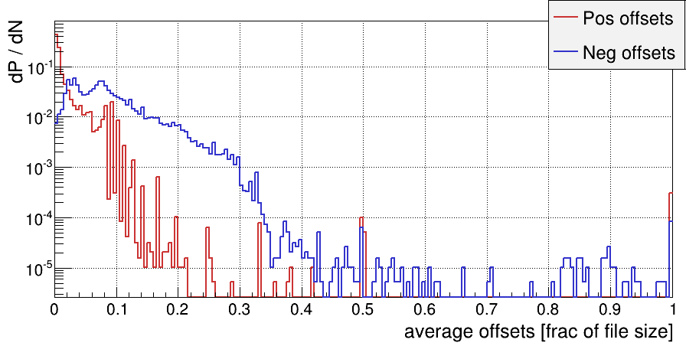
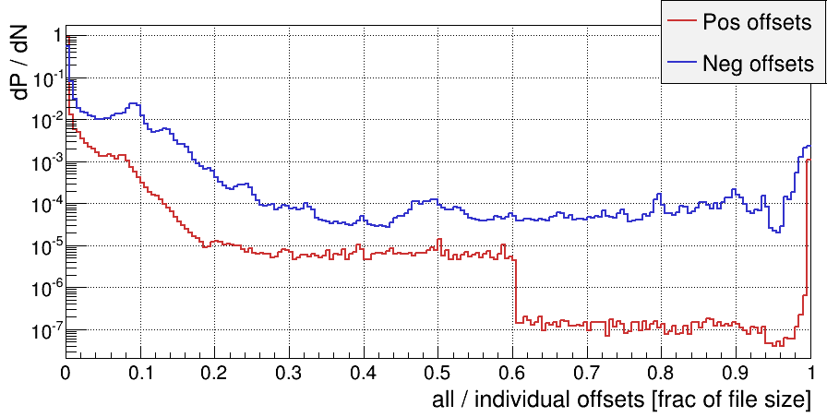
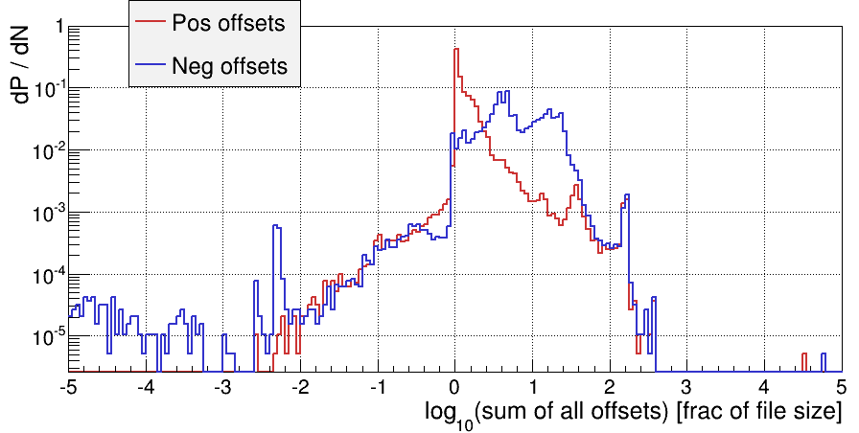
Positive and negative offsets
This is between reads:
a single read is an implicit seek forward, not counted
a vector read is an implicit seek forward to the end of the last sub-request – we’ll look at intra-offsets soon
Note the log x-axis on the last plot:
sum of seeks per job → we typically seek backwards many times the file size!

Slide 28
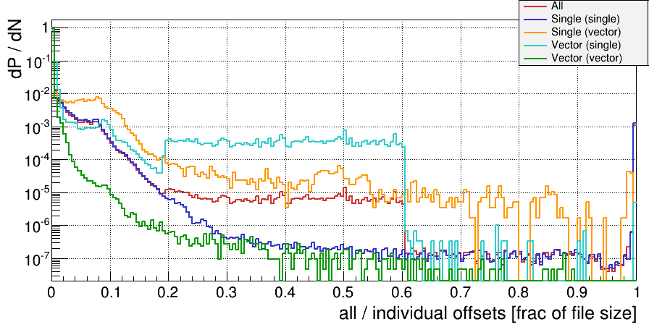
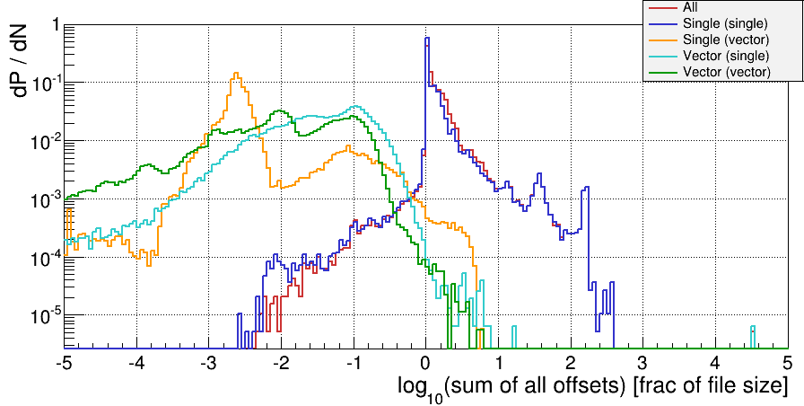
Positive offsets
Compare offsets for single versus vector reads.
Separate them also based on what the previous read was (single / vector).
Single reads jump forward more – especially when preceded by a single read.

Slide 29
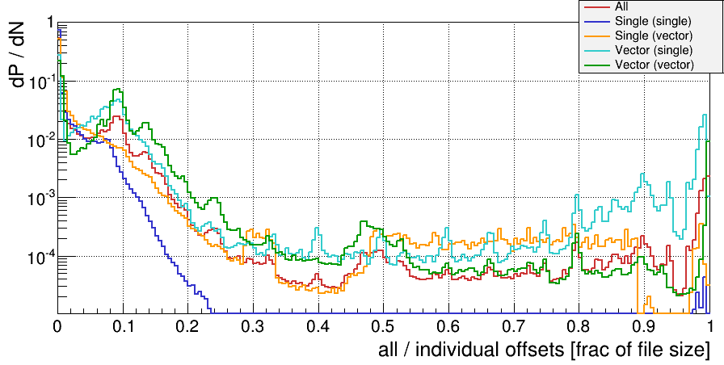
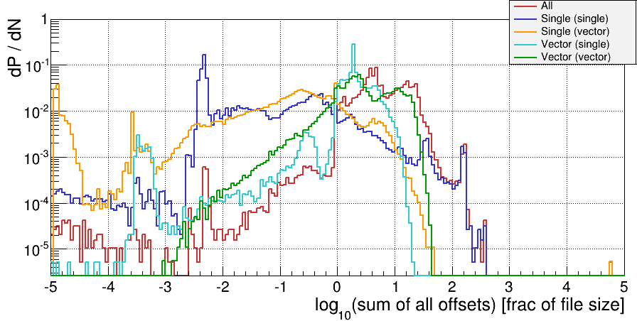
Negative offsets
Compare offsets for single versus vector reads.
Separate them also based on what the previous read was (single / vector).
Vector reads jump backwards more likely,
but in sum, there is also significant contribution from single reads, esp. for cases with “large backwards motion”

Slide 30
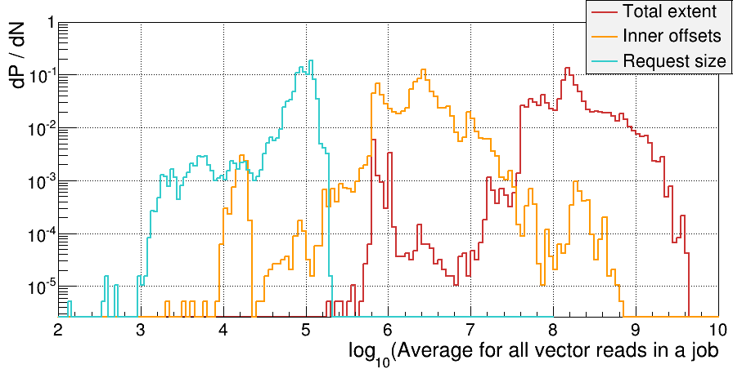
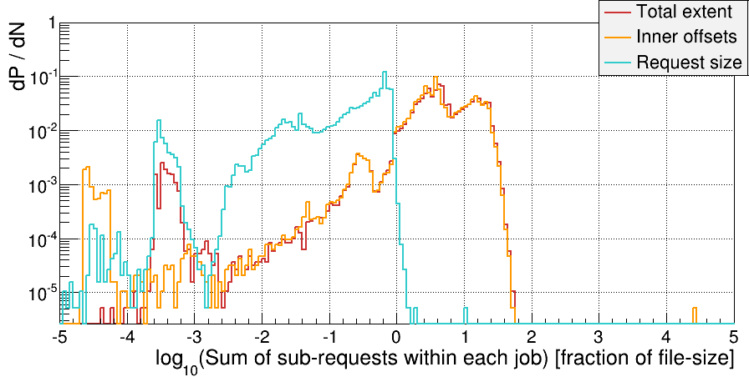
Offsets & extents within vector reads
Averages (in bytes):
requests: 10 kB
offsets: 1 – 10 MB
total extent: up to 1 GB
Sum of each:
requests: sum up to at most the file size
offsets and total extent practically the same:
They add up to from a couple to 20-times!
This covers the “missing” positive offsets.

Slide 31
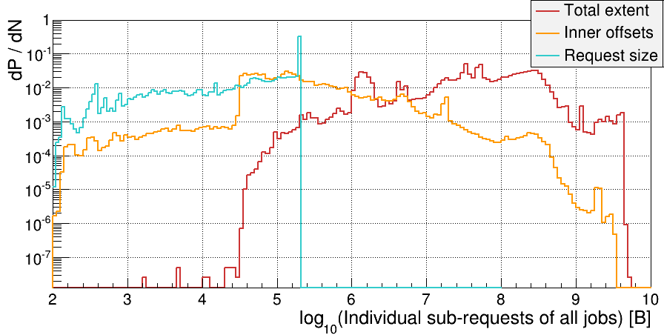
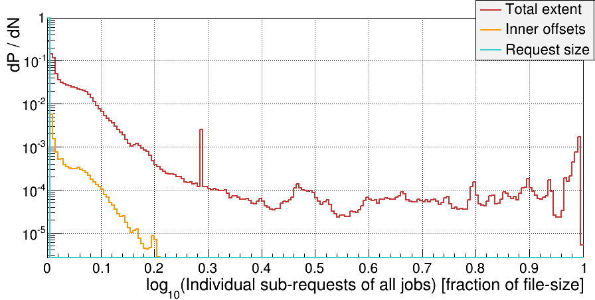
And individual vector sub-requests
In bytes:
Sharp cutoff at 20 kB
CMS buffer sizes
In fraction of file size:
Offsets don’t cross 20% of file size.

Slide 32
Time to slow down …
Is all this really relevant?
Is there a killer metrics for things that matter?
The last slide

Slide 33
Winding down …
There is a lot one can extract from XRootd monitoring alone
saying this with my XRootd hat on
the plots are
of particular interest to CMS
and of general interest to other VOs
BUT … things are about to change, for CMS, too
All this will be of limited value soon
What matters is that we can redo this easily

Slide 34
What’s the message?
This is a large selection of plots to look at
and one has to weed out a lot of noise
One could redo the analysis regularly … or make dedicated tests with relevant workloads.
But … we’re really after efficient remote access:
CPU efficiency (tied with experiment IO stack)
Computing model
Are we doing remote access for a single job?

Slide 35
A killer metrics?
Part of motivation was understanding how to best implement & configure a caching proxy:
proxy can do prefetching, and
can store data for later use.
If computing model envisions on-demand data placement, the remote-access-while-reading only happens once
A caching proxy simulation!

Slide 36
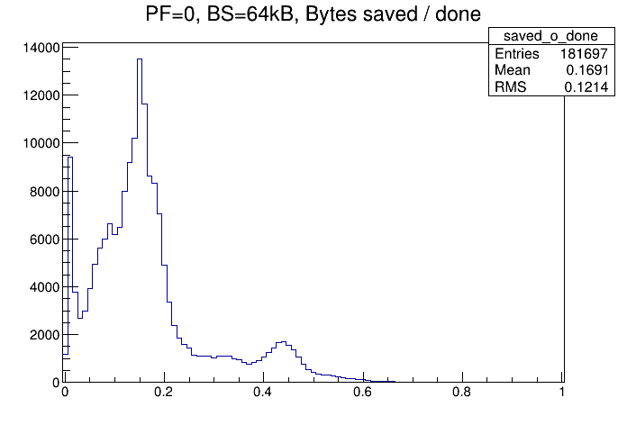
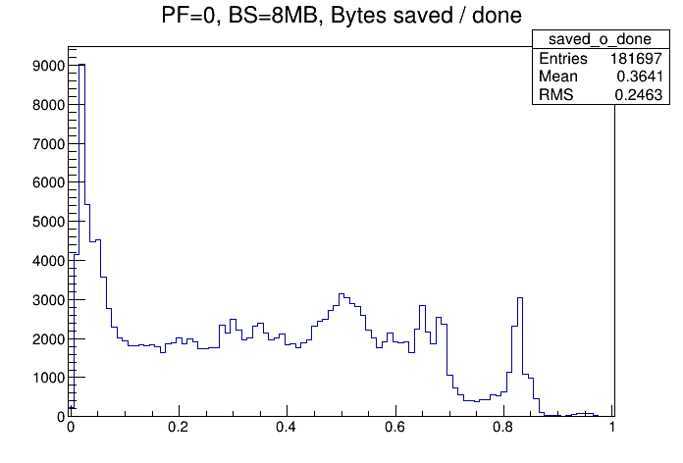
Caching proxy simulation preview
More about this in XRootd caching proxy talk
Can choose block size and prefetching rate
play the IOV data through
then observe the performance
100 Gbps networks are coming this summer!
Fraction of data served from cache

Slide 37
The last slide …
There are a lot of things that we do not want see in access reports.
Analysis is complicated because of the above and requires “closeness” to the federation.
Things change every week, +/-.
But … there are tools to study various remote access strategies
So we can put them to use when big changes hit.
Interesting (crucial?) for non-HEP VOs considering remote data access.

