Slide 1



LSST Data and Computing - Status and Plans
Dominique Boutigny
CNRS/IN2P3 and SLAC
OSG All Hands meeting
April 7-9, 2014

Slide 2
Acknowledgments
Slides, ideas and numbers borrowed to :
Tony Tyson (UC Davis)
Mario Juric (LSST)
Jacek Becla (SLAC)
Jim Bosch (Princeton)
Jeff Kantor (LSST)
Andy Connolly (U. Washington)

Slide 3
Large – Synoptic – Survey – Telescope
Synoptic : from the ancient Greek συνοπτικός (sunoptikos) “seeing the whole together or at a glance” – source : Wiktionary
LSST is an instrument designed to make high precision images of the whole accessible sky in 4-D (x, y, z, t) ➔ 10 year time-lapse movie of the sky
Time domain science
Novae – Supernovae – GRBs
Source characterization
Instantaneous discovery
Moving sources
Asteroids and comets
Proper motions of stars
Mapping the Milky Way
Tidal streams
Galactic structure
→ Complementary to GAIA
Dark energy and dark matter
Gravitational lensing (strong and weak)
Evolution of large scale galactic structures
→ Trace the nature of dark energy
3 keywords : Fast –Wide – Deep

Slide 4
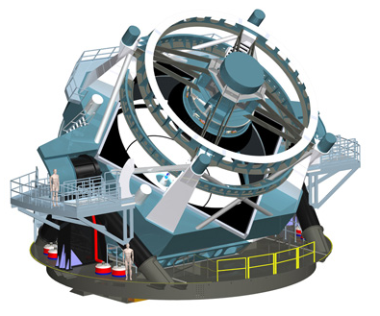
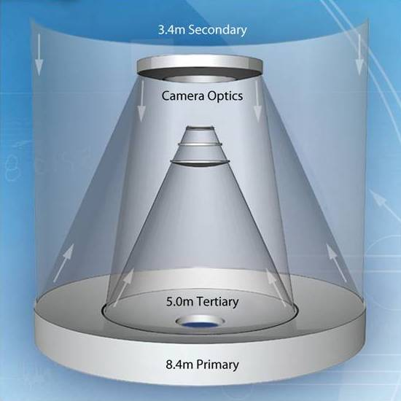
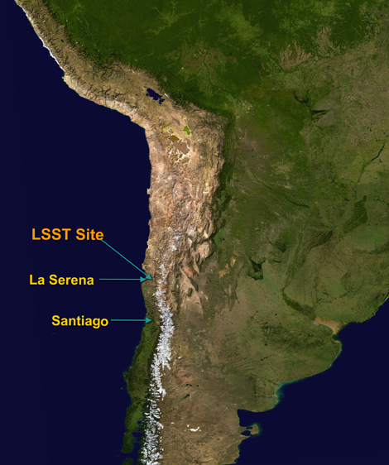
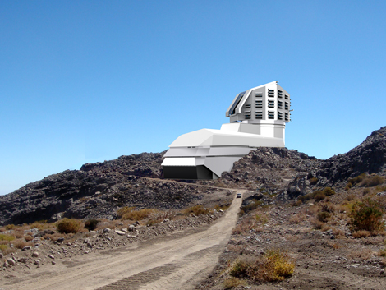
Telescope and Site
3-mirror optical formulae f/d = 1.23 ➔ extremely compact and luminous instrument
350 tons mobile structure (60 tons for the optics itself)
Cerro Pachòn
2700 m
<Seeing> = 0.67 arcsec

Slide 5
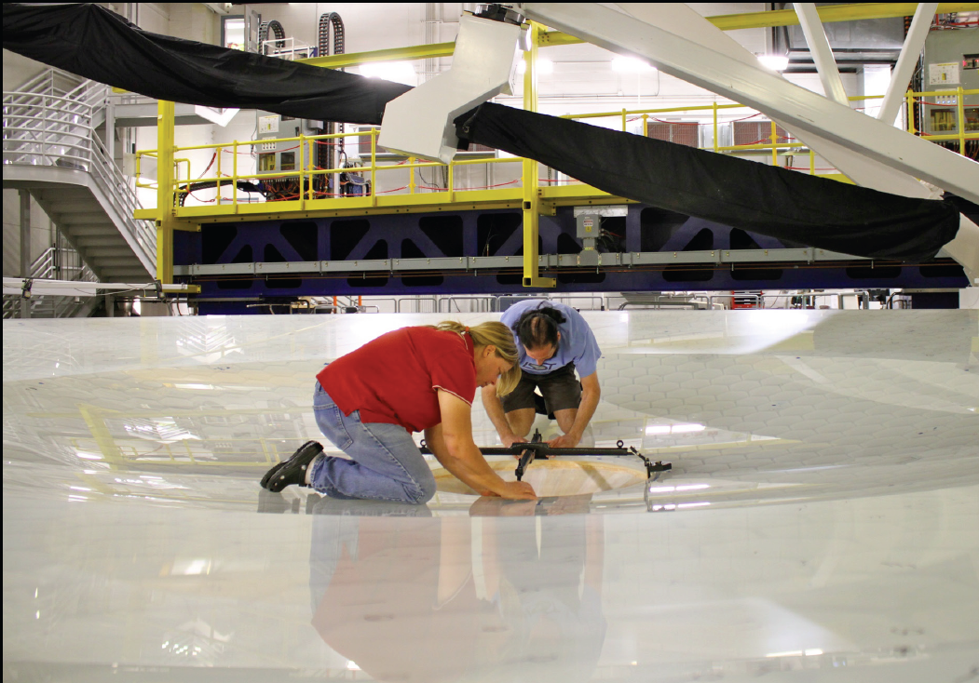

Slide 6
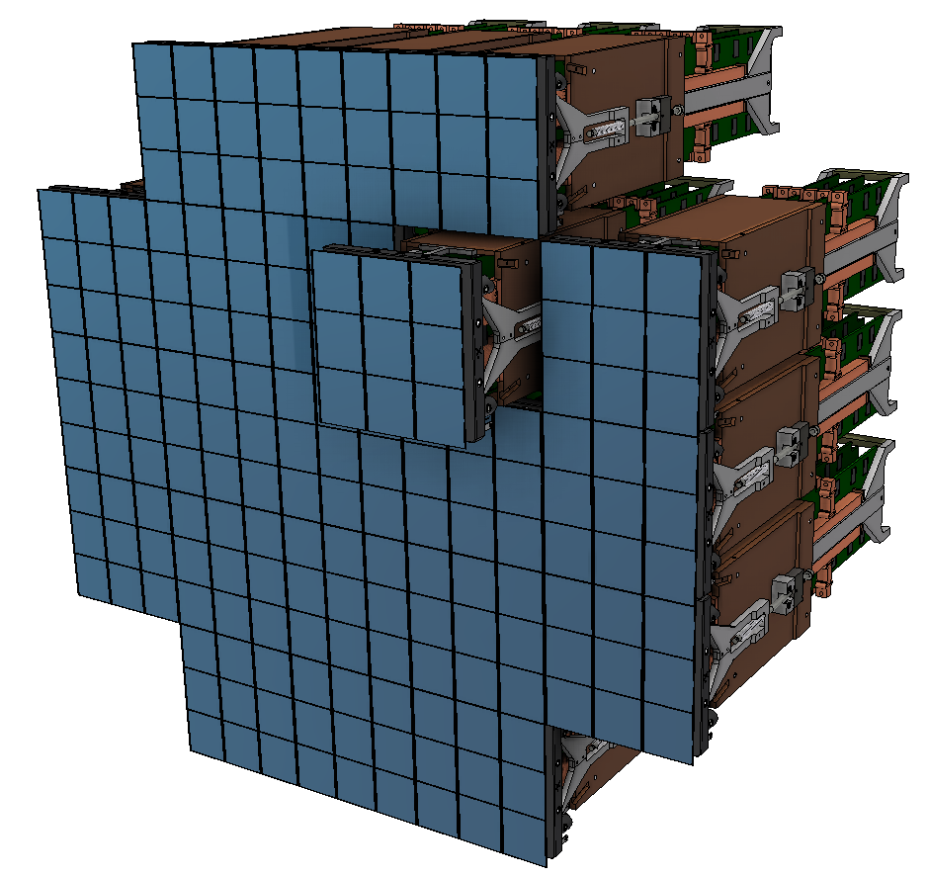
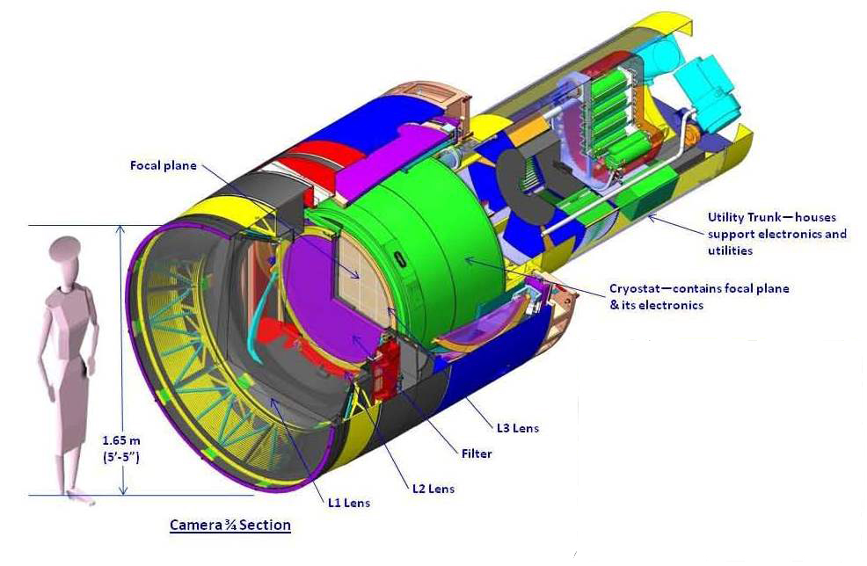
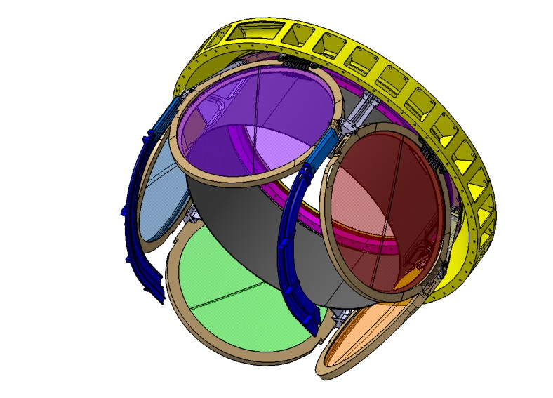
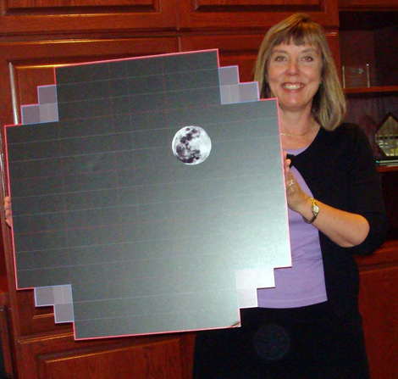
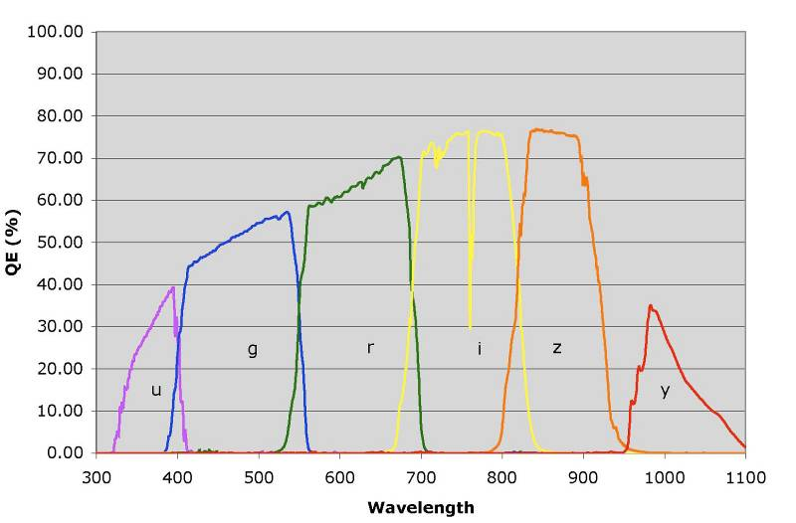
Camera and Filters
21 rafts
9 CCD / raft
64-centimeter diameter flat focal plane
3.2 billion pixels @ 0.2 arcsecond / pixel
± 5 microns total flatness deviation
2 second readout time
The comparison of the flux through a set of 6 filters will allow to get a good approximation of the redshift ➔ photo-z

Slide 7
LSST Surveys
1 visit = 2 successive exposures :
CCD Exposure : 15 s
CCD readout : 2 s
Shutter positioning : 1 + 1 s
Telescope slewing : 5 s (median)
Total / visit : 39 s (median) – 44 s (mean)
(CCD reading while slewing)
+ periodic filter exchange : 2 mn
× 3.2 Gpixels ➔ ~15 TB of raw data / night
Repeat this during 10 years starting in 2022 !
The whole visible sky is imaged every 3 days
Final image collection : 0.5 Exabytes
Deep Wide Survey : 18,000 deg²
Deep Drilling Survey : ~30 selected fields – 300 deg² : ~1 hour /night
Most of the sky will be covered over 800 times with 2 × 15 sec visits
Exposure of the same field are stacked together (co-addition) ➔ reach magnitude 27.5
Alerts on transient events will be available world-wide within 60 sec → ~10 millions / night

Slide 8
LSST From the Astronomer’s Perspective
A stream of ~10 million time-domain events per night, detected and transmitted to event distribution networks within 60 seconds of observation.
A catalog of orbits for ~6 million bodies in the Solar System.
A catalog of ~37 billion objects (20B galaxies, 17B stars), ~7 trillion observations (“sources”), and ~30 trillion measurements (“forced sources”), produced annually, accessible through online databases.
Deep co-added images.
Services and computing resources at the Data Access Centers to enable user-specified custom processing and analysis.
Software and APIs enabling development of analysis codes.
Level 1
Level 2
Level 3

Slide 9



LSST Operations: Sites and Data Flows
French IN2P3 Site
Data Release production
(subject to final agreement approval)
Split Data Release Processing : 50% @ NCSA / 50% @ CC-IN2P3
2 copies of the data
Archive Site
Archive Center
  Alert Production
  Data Release Production
  Calibration Products Production
  EPO Infrastructure
  Long-term Storage (copy 2)
Data Access Center
  Data Access and User Services
Dedicated Long Haul Networks
Two redundant 40 Gbit links from La Serena to Champaign, IL (existing fiber)
Summit and Base Sites
Telescope and Camera
Data Acquisition
Crosstalk Correction
Long-term storage (copy 1)
Chilean Data Access Center
HQ Site
Science Operations
Observatory Management
Education and Public Outreach
Notes:
There will be 15 TB of data transferred per night (within a 24 hour period)
LSST will result in a final database of 15 PB (DR11)
LSST will result in a final image collection of 0.5 Exabytes (DR11; raw and processed)

Slide 10
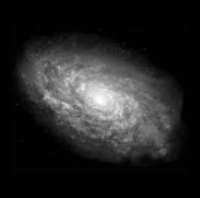
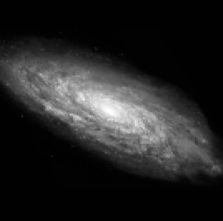
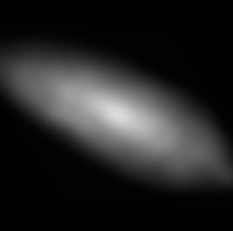
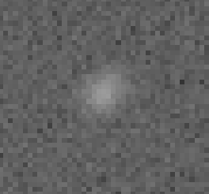
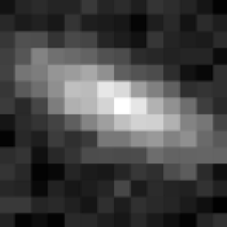
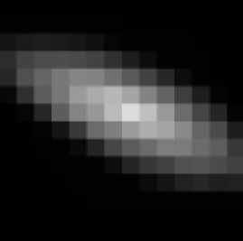
An example : Galaxy shape measurement for Weak Lensing
Effect of Weak Lensing
Atmosphere & telescope
This is what we want to measure (on a statistical basis)
Pixelisation
Noise
➔ Needs unprecedented control of the instrument, and of the data processing software !

Slide 11
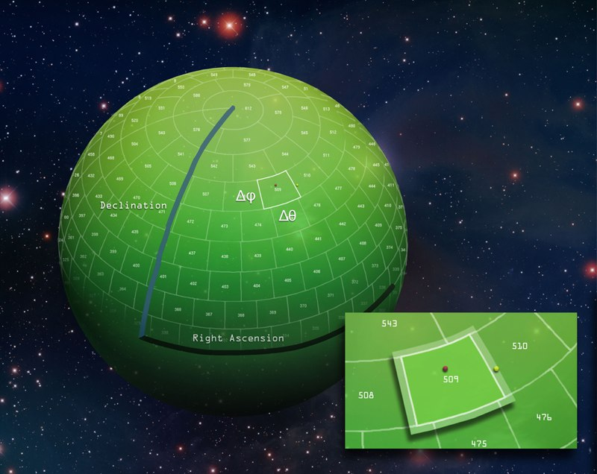
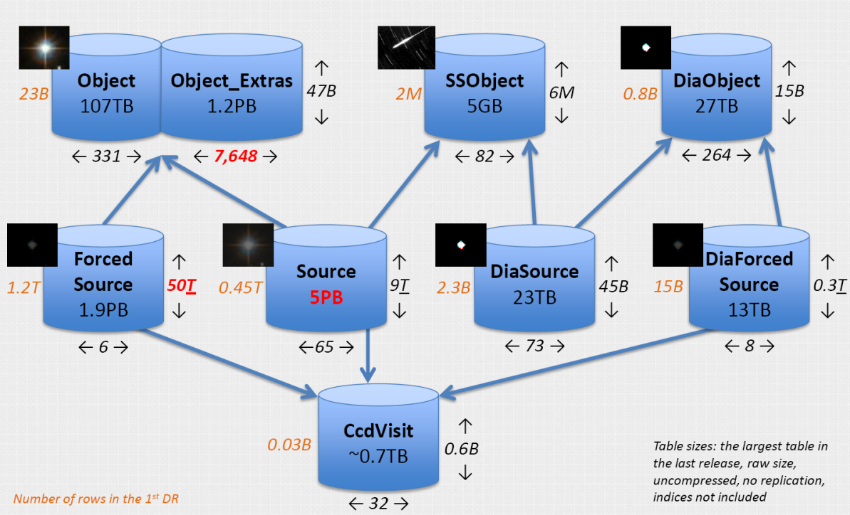
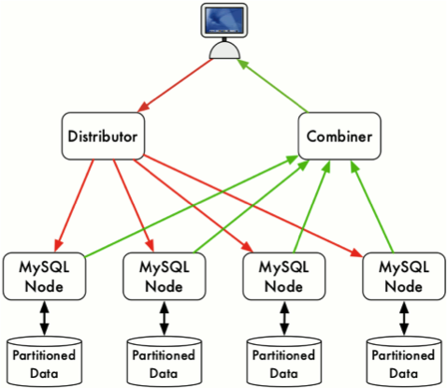
The database : a key component
The challenge is to design an SQL database system able to store trillions of objects while keeping a reasonable access time
Qserv : developed at SLAC + IPAC – Design optimized for astronomical queries
xrootd protocol
Massively parallel – distributed – fault tolerant relational database
Total size : ~83 PB (11 Data Release)

Slide 12
LSST Software Stack
The goal is to develop a full modular, efficient and versatile image analysis framework
  ~50 M$ funding for construction and commissioning of the LSST stack and associated middleware
  All the code is, and will stay open source
LSST software stack is largely written from scratch, in Python, unless computational demands require the use of C++
  C++:
    Computationally intensive code
    Made available to Python via SWIG
  Python:
    All high-level code
    Prefer Python to C++ unless performance demands otherwise
Modularity
  Virtually everything is a Python module.
  ~60 packages (git repositories, ~corresponding to python packages)
Designed to support several instruments (not only LSST) : SDSS – HSC – CFHT – DES

Slide 13
2013 Data Challenge and Qserv test
Large scale data challenge run in 2013 ➔ test the ability to run split Data Release Processing at NCSA + CC-IN2P3
  Run LSST stack on SDSS stripe 82 (50% / 50% + overlap region for validation)
  Raw data : ~4.5 Mfiles / ~5 TB per site
  Output 21 Mfiles / ~100 TB at CC-IN2P3 (similar at NCSA)
  ~1 MHS06.hours at CC-IN2P3
NCSA : XSEDE allocation mainly at TACC – Middleware based on HTCondor
CC-IN2P3 : 700 cores on the Grid Engine batch system + limited test of the DIRAC middleware
Exchange data between NCSA and CC-IN2P3 using iRODS
Output stored in a (large) MySQL database (not Qserv yet)
➔ Excellent results (even if everything is not fully understood) – LSST stack, while a prototype, is already approximately at the SDSS level.
Large scale Qserv testing on a 300 node cluster at CC-IN2P3 ➔ Very useful for Qserv developers – Scalability issues have been discovered

Slide 14
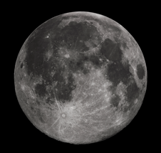
New Algorithms: Background-matched co-add of SDSS Stripe 82 in the vicinity of M2.
Background matching preserves diffuse structures.
Generated with LSST pipeline prototypes.
Figure:
5 sq. deg.
background-matched coadd composite
(g,r,i)
~55 epochs
Region: Aqr
Galactic lat = -35.0
Slide: Yusra AlSayyad
http://moe.astro.washington.edu/sdss/
Notes:
This was originally my first slide. I kind of liked it there.
Background was brightened with power-point to get it to show up on a projector.

Slide 15
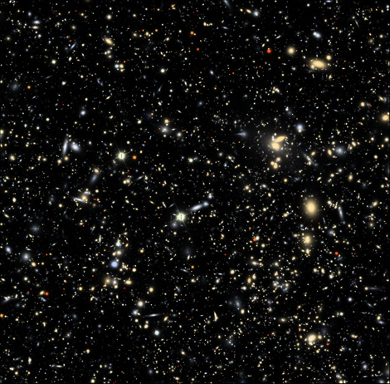
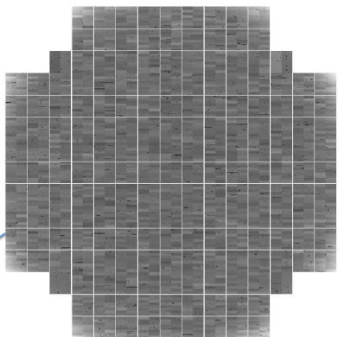
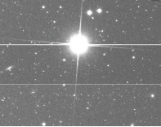
Simulation
PhoSim : image simulation at the photon level :
Telescope and camera including imperfections
Atmosphere
1 CCD → 1/189th of the focal plane
Connected to OpSim to simulate telescope operation
Sky background, Moon, engineering models (settle time, readout time, …), science requirements
➔ critical to elaborate an optimal survey strategy

Slide 16
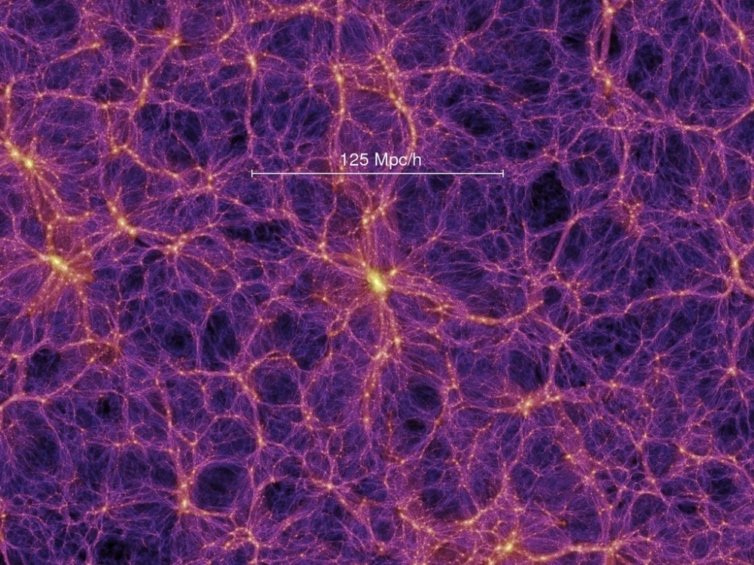
Simulation (contd.)
CatSim : to generate catalog of simulated astronomical sources
Inputs from cosmological simulations of the universe
Reproduce number, size, spatial distributions and redshifts of galaxies
Galaxy positions and redshifts from
Millennium Simulation
CatSim + OpSim + PhoSim : a full set of simulation tools to study and optimize LSST operation and performances and to prepare science pipelines

Slide 17

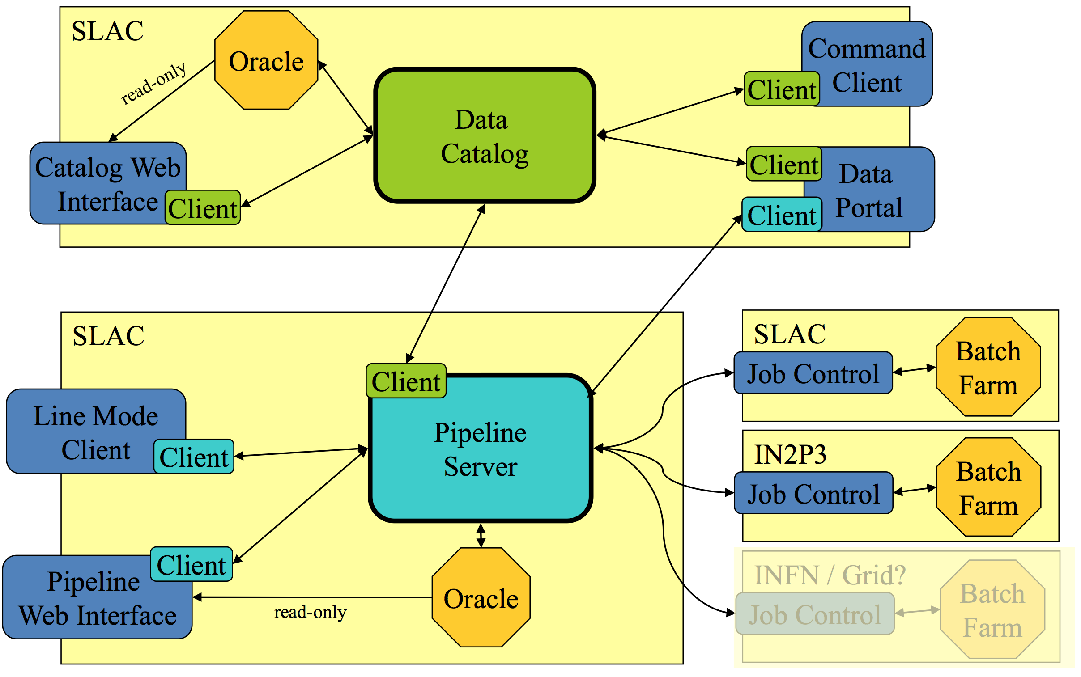
Science collaborations
LSST is an instrument – LSST collaboration's responsibility is to provide
  Catalogs of astrophysical sources
  LSST software stack
  Level 3 computing cycles at LSST Data Access Centers
LSST is not in charge of organizing the scientific exploitation of the data
➔ Dedicated collaborations
DESC is the Dark Energy Science Collaboration (November 2012)
Dark Energy science will require very sophisticated data treatment
  Will probably require to have access to some amount of data at the "pixel" level
  A significant amount of computing resources will be required
Initiative to propose "User Centers"
  Scientific support and expertise center
  Documentation – recipes – …
  Computing resources
  Simulation – Data Challenges – ...
PanDA as distributed job manager and gateway to grid, cloud, HPC resources
© Tony Johnson / Torre Wenaus

Slide 18
Summary
LSST is going to push astronomical data to an unprecedented scale
Project is approved and will operate in 2022 – 2031
  Construction will start this summer
LSST is building a new open source, multi-instrument, software stack
A highly distributed / fault tolerant SQL database system to store and give access to the catalogs is being developed ➔ Qserv
Yearly Data Release Processing will be split between NCSA and CC-IN2P3
A full simulation chains (Sky, optics, atmosphere, telescope operation) is being developed
We are just at the beginning of the process to define how science collaborations (like DESC) will access to the data

