Slide 1



Rob Gardner
Computation and Enrico Fermi Institutes
University of Chicago
Joint US ATLAS US CMS meeting at OSG All Hands at SLAC
April 7, 2014

Slide 2
ATLAS Connect: a prototype US ATLAS project
A set of computing services designed to augment existing tools used by US ATLAS, focusing on batch-like analysis processing
  Facilitate access to US ATLAS “beyond pledge” cycles and extend connectivity to non-grid resources
  Possible solution to add “Tier 3-like” capability for institutions with aging and undersized Tier 3 clusters
  Provide as service – minimize IT hassle at endpoints
Minimal development
  Use existing, well supported tools like HTCondor, Globus Online, Xrootd
  Leverage work in OSG Campus Grids area (e.g. OSG Connect, U-Bolt (UC3))

Slide 3
ATLAS Connect is one of three Tier3 strategies
A US ATLAS Tier3 implementation committee is tasked with exploring alternative Tier3 designs
Others:
  Connect Tier3 centers to Panda
  Implement a cloud-like Tier3 system using agile technology (cloud service menus, virtualization)
All three are being activity pursued and tested with likely analysis use cases for Run 2

Slide 4
Three Service Types
ATLAS Connect User
  A user login service with POSIX visible block storage
  Similar to OSG Connect
ATLAS Connect Cluster
  Job flocking service from a Tier 3
ATLAS Connect Panda
  Connect Panda to non-grid resources (cloud, campus clusters, and some HPC centers)

Slide 5



Campus Grids
Off-grid Tier3
connect.usatlas.org
ATLAS T1 (dev)
Tier2
FAXbox
portal
TACC Stampede (dev)
rccf.usatlas.org
(glidein factories)
Cloud (AWS)
login.usatlas.org

Slide 6



ATLAS Connect Services
Globus Platform
  Reliable file transfer to ‘scratch’ endpoints
  Identity management
  Groups, Projects
Login host
  Auto-provisioning, quickly validating users
Bosco-based Glidein Factories
  “Remote Cluster Connect Factories” (RCCF)
  One instance per resource target
Gratia accounting & Cycle Server monitoring
FAXbox storage service
  POSIX, http, xrootd, Globus access

Slide 7
Looks like a very large virtual Tier3
Users want to see quick, immediate “local” batch service
We want to give them the illusion of control through availability
Most Tier3 batch use is very spikey
Use beyond pledge and other opportunistic resources to elastically absorb periods of peak demand
Easily adjust virtual pool size according to US ATLAS priorities

Slide 8
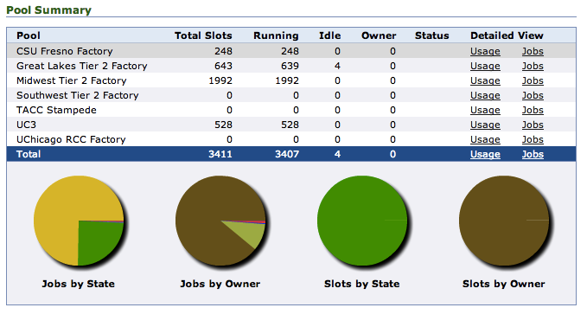
Current resource targets
Pool size varies depending on demand, matchmaking, priority at resource
(Off-grid Tier3)
(XSEDE)
(UC Campus grid)
(UC computing center)

Slide 9
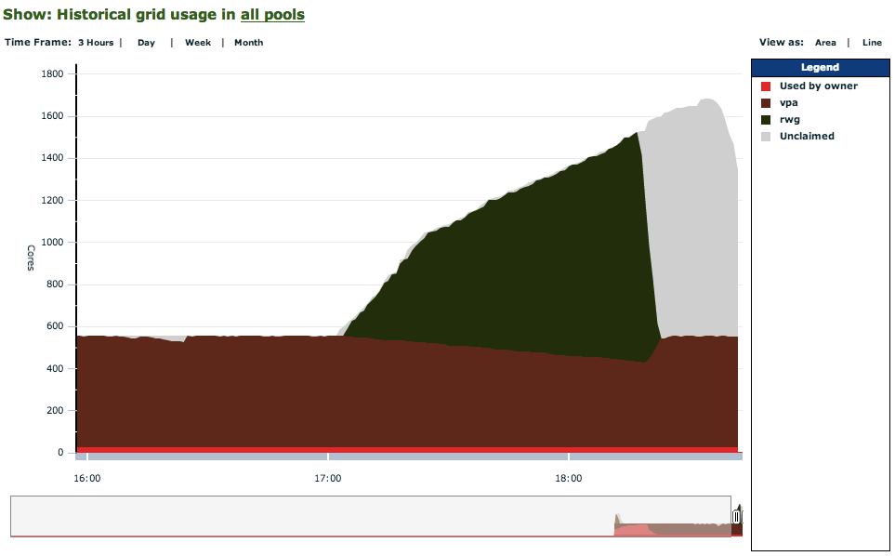
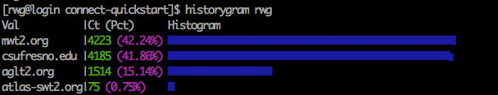
Connect is very quick relative to grid
Submission: cluster-like (seconds)
Factory latency manageable @Tier3
batch scale
Flock then
glide
Unclaimed
glideins
Throughput:
10000 5 min jobs
In 90 minutes
Condor
direct
Site distribution

Slide 10
Transient User Storage: FAXbox
Similar to OSG Stash
To assist with ATLAS Connect User and flocked jobs via ATLAS Connect Cluster
  Pre-stage data, write outputs for later use, etc.
Use standard Xrootd tools and protocol
    root://faxbox.usatlas.org/user/netID/file
    Therefore read from anywhere, even a prun job
    Will include a user quota system, and monitoring tools
POSIX, Globus Online and http access too
User managed, not ADC managed, no annoying blacklisting or emails

Slide 11
Globus reliable file transfer
ATLAS Connect is integrated with Globus
  Globus is the UC-developed service for reliable file transfer and data sharing (c.f. globus.org)
FAXbox storage has a Globus Connect gridftp server, and as such is a Globus “endpoint”
  connect#faxbox
Can easily use Globus to transfer back to Tier3 if you want to
Many U.S. campuses are deploying Globus data services – stash on campus

Slide 12
Tier3 to Tier2 flocking
This is ATLAS Connect Cluster
Tier3 HTCondor as the local scheduler
  Configure schedd to flock to the RCCF service
  The RCCF service can reach any of the targets in the ATLAS Connect system
    But for simplicity we configure it to submit to a large “nearby” Tier2 which has plenty of slots for T3 demand
    Easily reconfigure for periods of high demand

Slide 13

Tier1
connect.usatlas.org
Tier2s
FAXbox
Amazon cloud
RCC Factory
rccf.usatlas.org
Campus Grids
xrd globus
Local Tier3 Center
Local Tier3 Center
Local Tier3
Centers

Slide 14
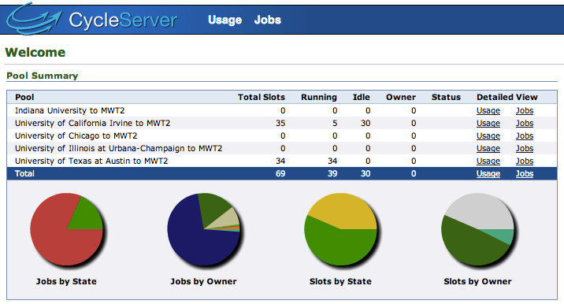
Tier3 to Tier2 flocking via ATLAS Connect
Five Tier3 clusters configured in this way so far
Works well, very low maintenance

Slide 15
Yes, DHTC is a mode shift for local cluster users
Users should not expect their home directories, NFS shares, or to even run jobs as their own user.
Instead, HTCondor transfer mechanisms, FAX for data access, CVMFS for software
Make use of ATLAS LOCALGROUPDISK’s
Smaller outputs (on the order of 1GB) can be handled by Condor’s internal mechanisms
Need to develop best practices and examples
  Collect at http://connect.usatlas.org/ handbook

Slide 16
Think Local, Compute Global
Another mode is not use the community login service, but submit from Tier3 or laptop
For this use the Bosco client
Will watch and provide input to any HTCondor myHTC projects

Slide 17
Integrating Off-Grid resources
ATLAS Connect can be used to connect to off-grid resources:
  Accessible from ATLAS Connect User, Cluster or even Panda
“Wrap” campus clusters and big targets such as from XSEDE
Minimize local IT support
  Ideally, a user account, ssh tunnel is needed
  A local squid helps but not required (use a nearby squid in US ATLAS)

Slide 18
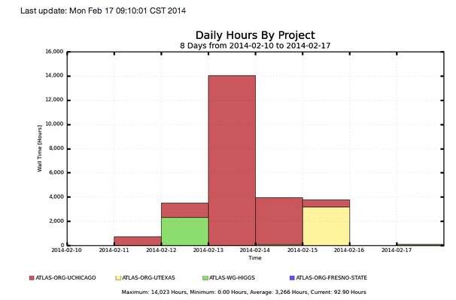
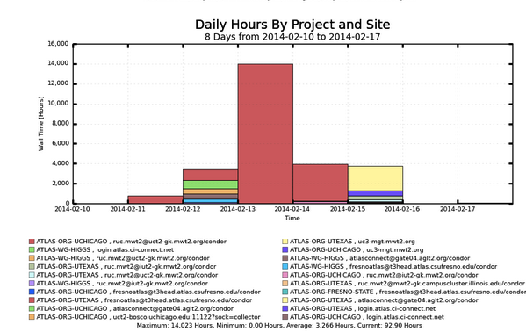
Early adopters beginning
by group
By group and site

Slide 19
ATLAS and XSEDE
Project to directly connect the ATLAS computing environment to TACC Stampede
Central component of ATLAS Connect
  Users (user login) ← from 44 US ATLAS institutions
  Clusters (Tier3 flocking with HTCondor)
  Central production from CERN (PanDA pilots)
Integrating with a variety of tools
Organized as XSEDE Science Gateway
  Project Name: ATLAS CONNECT (TG-PHY140018) startup allocation
  Principal Investigator: Peter Onyisi, University of Texas at Austin
  Gateway team: Raminder Jeet, Suresh Maru, Marlon Pierce, Nancy Wilkins-Diehr
  Stampede: Chris Hempel
  US ATLAS Computing management: M. Ernst, R. Gardner
  ATLAS Connect tech team: D. Lesny, L. Bryant, D. Champion

Slide 20
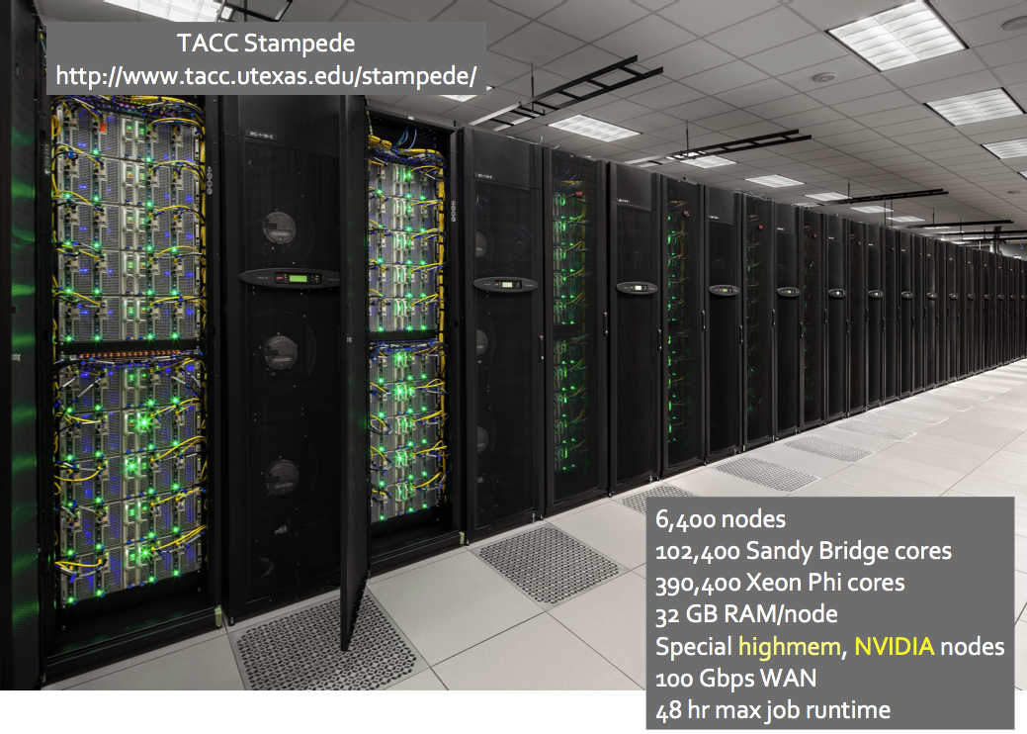
Stampede
Peter Onysis

Slide 21
Approach
Key is minimizing Stampede admin involvement while hiding complexity for users
  Simple SSH to Stampede SLURM submit node
  ATLAS software mounted using CVMFS and Parrot
  ATLAS squid cache configured nearby
  Wide area federated storage access
  Maintain similar look and feel as native ATLAS nodes
Leverages HTCondor, Glidein Factory, CCTools, OSG accounting and CI Connect technologies
  User data staging + access, Unix accounts, groups, ID management → all handled outside XSEDE

Slide 22
ATLAS + XSEDE Status
Using SHERPA HEP Monte Carlo event generator and ROOT analysis of ATLAS data as representative applications
Solution for scheduling multiple jobs in single Stampede job slot (16 cores)
Using same approach for campus clusters
  Useful for OSG Connect, campus grids, campus bridging

Slide 23
ATLAS + XSEDE Status: Panda CONNECT
CONNECT queue created and configured
APF deployed, working
APF flocking to RCCF (glidein factory) tested and works well as expected
Parrot wrappers to mount CVMFS repos
Compatibility libraries needed on top of SL6 are provided by custom images created with fakeroot/fakechroot
Race condition with Parrot under investigation by CCTools team at Notre Dame

Slide 24
Analysis example
Tier1
connect.usatlas.org
Tier2 USERDISK
LOCALGROUPDISK
Tier2s
SE
Faxbox
faxbox.usatlas.org
Optional user inputs
XSEDE cluster
RCC Factory
rccf.usatlas.org
+ autopyfactory
Off-grid
pilot
xrd http globus
pilot
Campus Grids
pilot
pilot
pilot
pilot
pilot
pilot
pilot
pilot
pilot
pilot
ANALY
CONNECT
Local Tier3 Center
prun
dq2

Slide 25
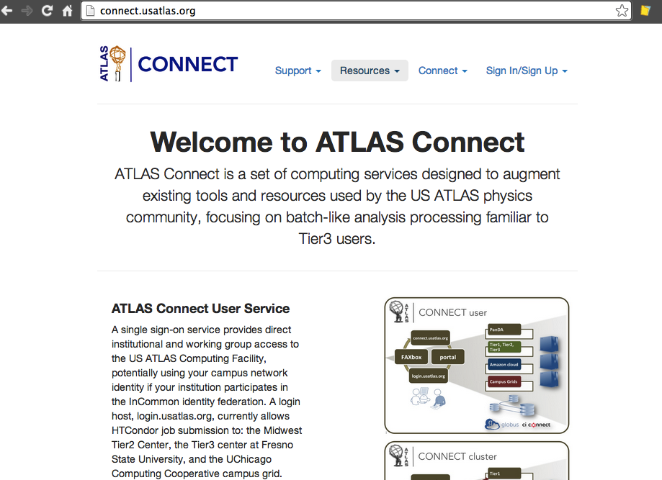
Login to the US ATLAS Computing Facility++
Go to website, sign up with your campus ID*
(*) Or Globus ID,
or Google ID

Slide 26
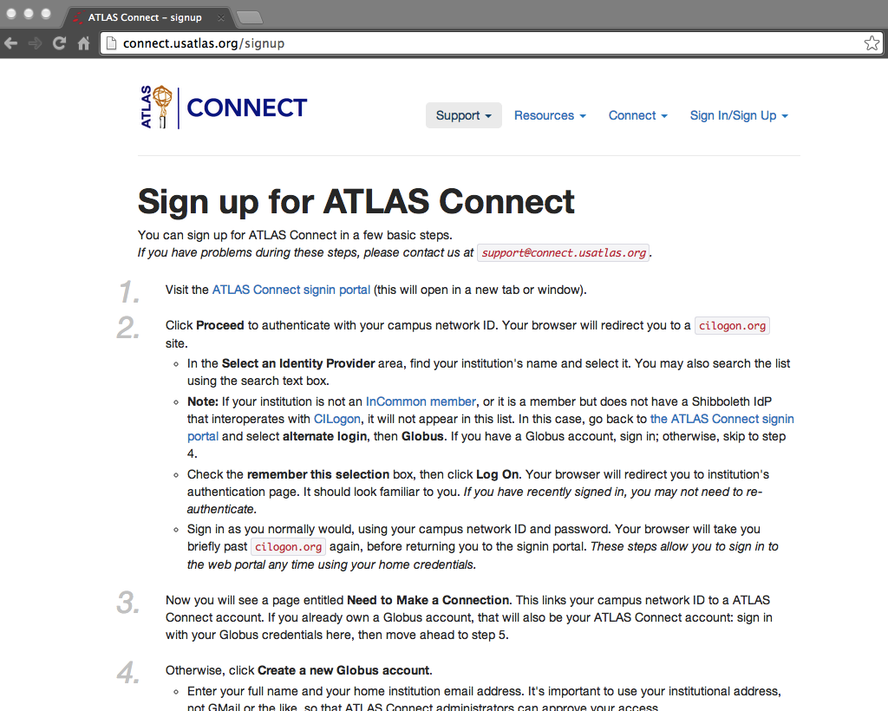
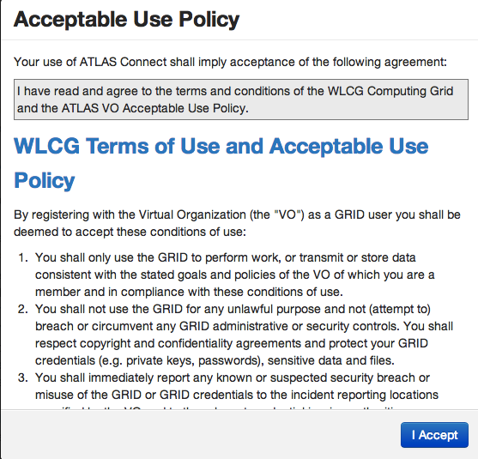

Slide 28
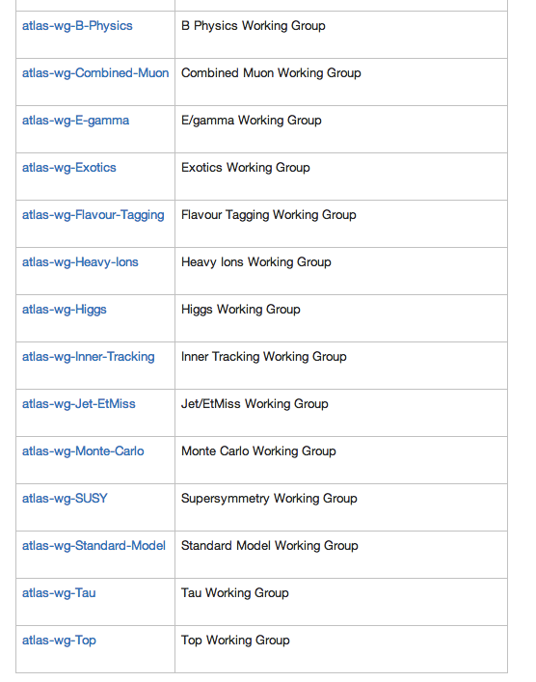
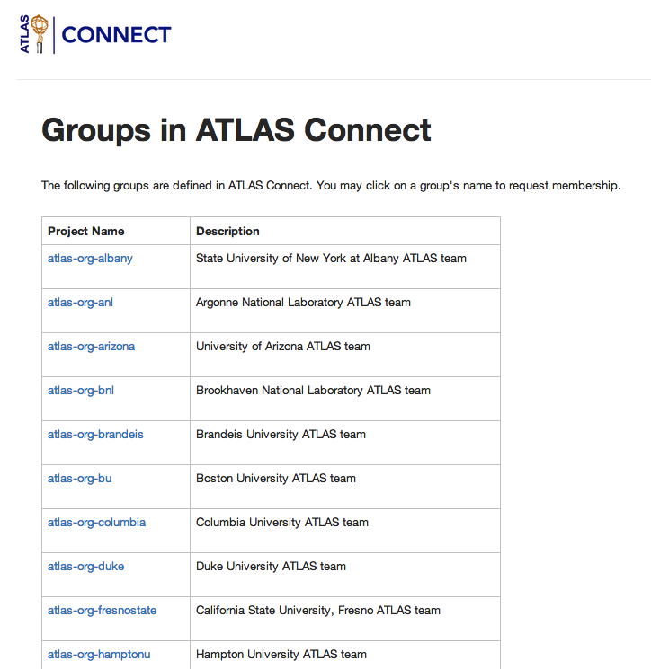
ATLAS physics working groups
(14)
US ATLAS Tier3 institutions (44)
Include in condor submit file to tag jobs
access control
accounting

Slide 29
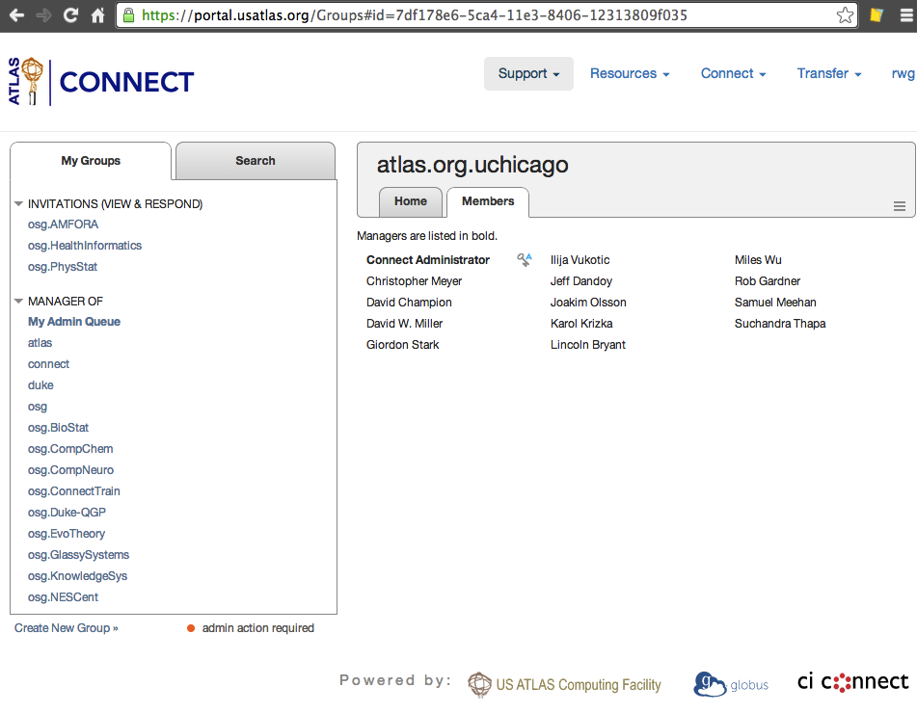
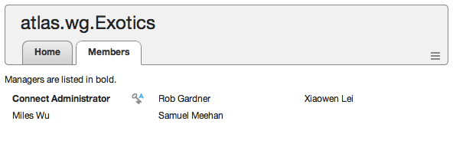
Institutional group membership.
Controls access to resources (use
in Condor submit file)
← Also have ATLAS physics working group tags.

Slide 30
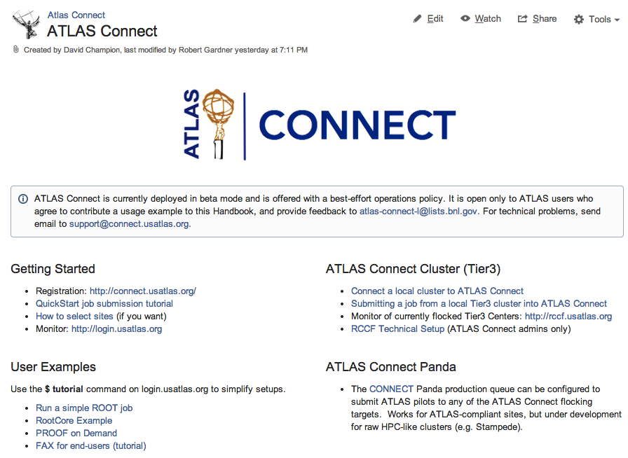

Slide 31
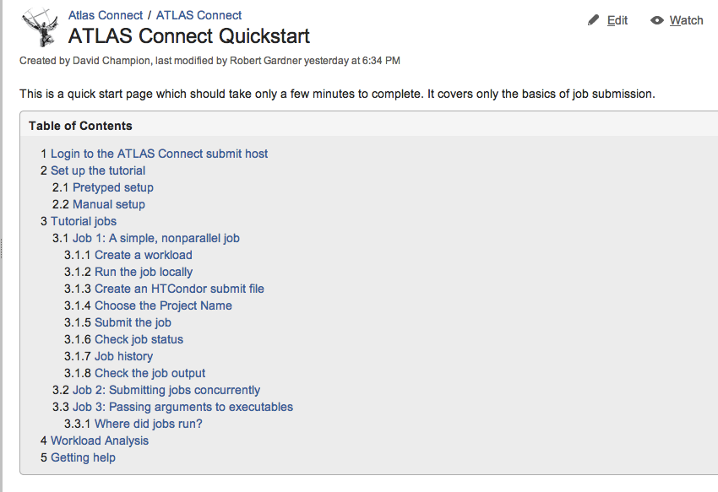

Slide 32
Acknowledgements
Dave Lesny – UIUC (MWT2)
Lincoln Bryant, David Champion – UChicago (MWT2)
Steve Teucke, Rachana Ananthakrishnan – (UChicago Globus)
Ilija Vukotic (UChicago ATLAS)
Suchandra Thapa (UChicago OSG)
Peter Onysis – UTexas
Jim Basney (CI-Logon) & InCommon Federation

Slide 33
Thank you!

