Slide 1
XRootD Monitoring Report
A.Beche
D.Giordano

Slide 2
Outlines
Talk 1: XRootD Monitoring Dashboard
Context
Dataflow and deployment model
Database: storage & aggregation
User interface & use cases
Open issues & future work
Summary
Talk 2: Beyond XRootD monitoring
HTTP/WebDAV integration
Integration in the WLCG Transfers Dashboard

Slide 3
XRootD federation monitoring
Activity started during summer 2012
4 sites for FAX, 11 for AAA
Monitoring data increased accordingly
 | July 2012 | March 2014
AAA | 606k | 43M
FAX | 15k | 22M

Slide 4
Why monitoring ?
Understand data flows to estimate data traffic
Provide information for efficient operations
Identify access patterns and propose data placement strategies

Slide 5
XRootD monitoring dataflow
real time
asynchronous
Federation
GLED Collector
stomp
Consumer
Raw
Stats
ActiveMQ
stomp
UDP
10 minutes
External
applications
WEB
API
Dashboard
UI

Slide 6
GLED Deployment model
FAX EU
CERN (1 site)
FAX US
SLAC (9Hz)
EOS
CERN (150Hz)
AMQ @ CERN
Shared cluster
5 nodes
AAA
UCSD (16Hz)
EOS
CERN (10Hz)

Slide 7
Consolidated dataflow
Two usage of these raw data:
Dashboard monitoring
XRootD popularity
Now share the same database:
Storage optimization
Consistency guaranteed

Slide 8
Database
AAA
~300 GB
~1B records
Daily insert
2 GB / 6M rows
FAX
~600 GB
~2B records
* Indexes excluded
Storage
Raw, statistics, metadata
Tables daily partitioned, no global indexes

Slide 9
Database
Raw data aggregation:
Done using PL/SQL procedures
Events are unordered
Stateless: Full re-computation of touched bins each time
Compute stats from raw data in 10 min bins
Aggregate 10 min stats in daily bins

Slide 10
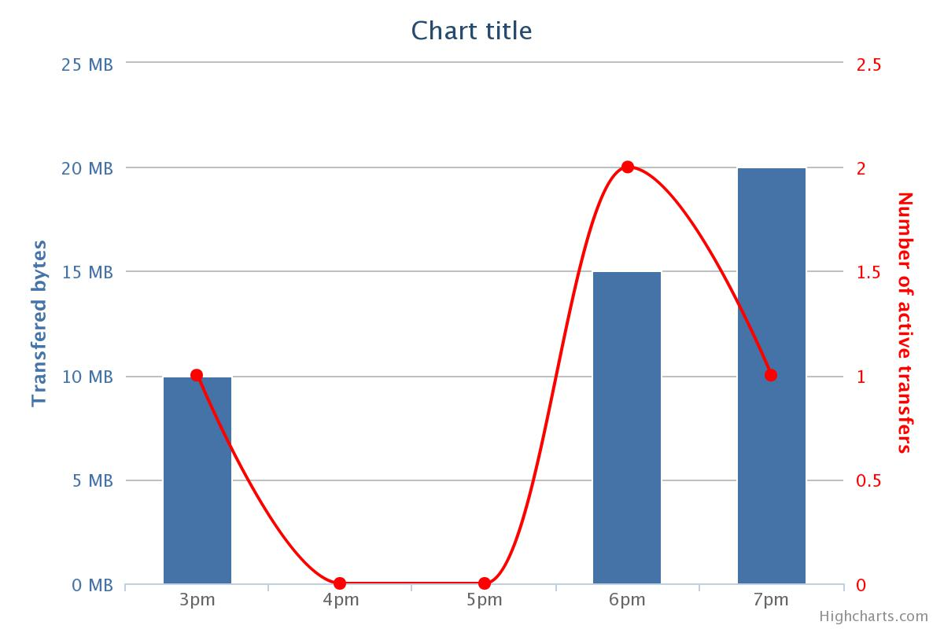
Aggregation methods
Easy method
Transfers
2pm
3pm
4pm
5pm
6pm
7pm
Transfers | 1 | 0 | 0 | 2 | 1
Bytes | 10 | 0 | 0 | 15 | 20

Slide 11
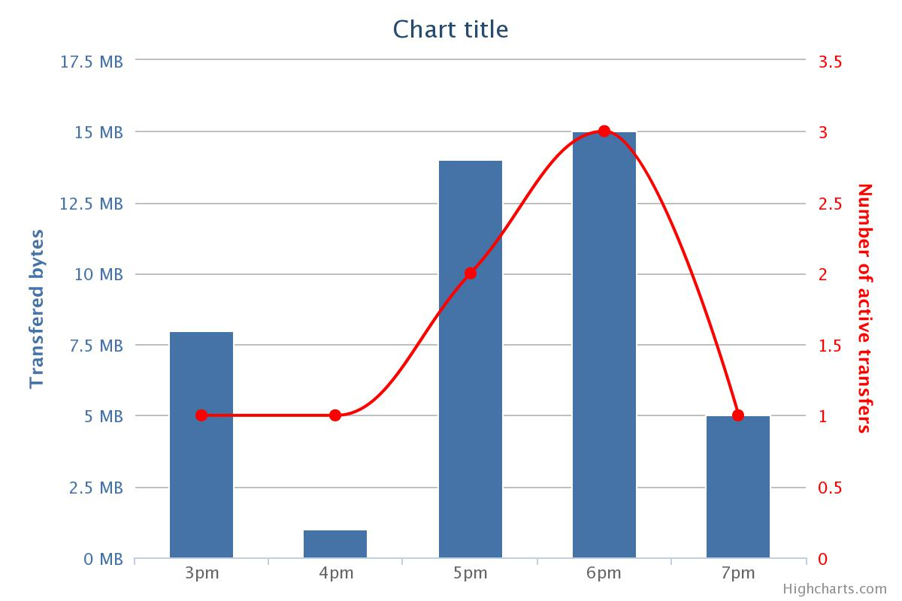
Aggregation methods
Easy method
Transfers
2pm
3pm
4pm
5pm
6pm
7pm
Transfers | 1 | 0 | 0 | 2 | 1
Bytes | 10 | 0 | 0 | 15 | 20
Adopted method
Transfers | 1 (1) | 1 (0) | 2 (0) | 3 (2) | 1 (1)
Bytes | 8 | 1 | 14 (9+6) | 15 (1+9+5) | 5

Slide 12
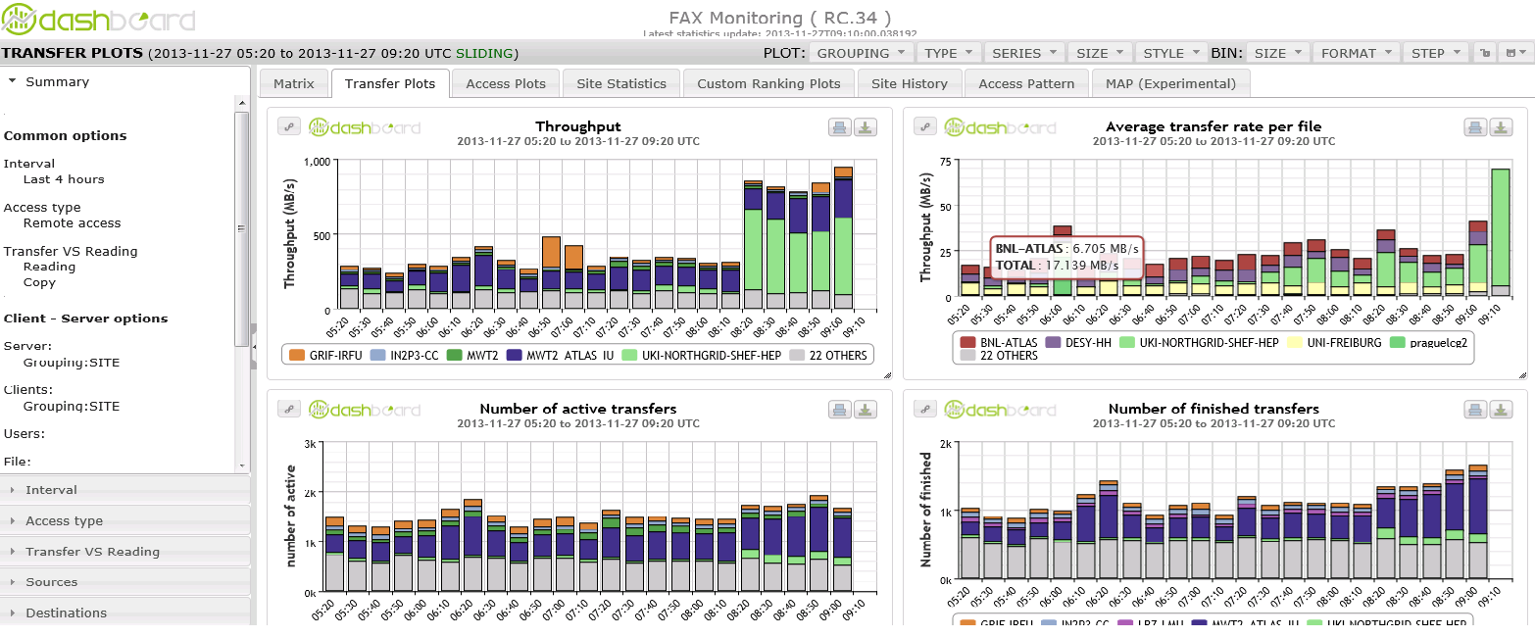
Visualization Interface

Slide 13
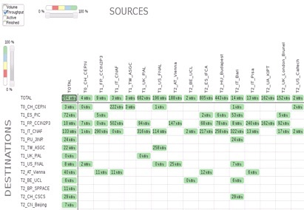
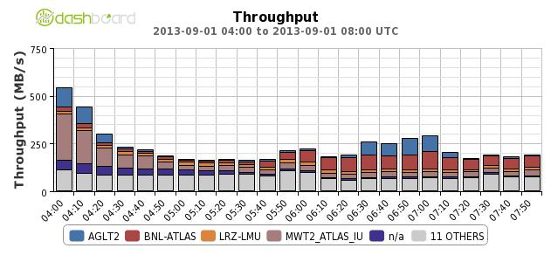
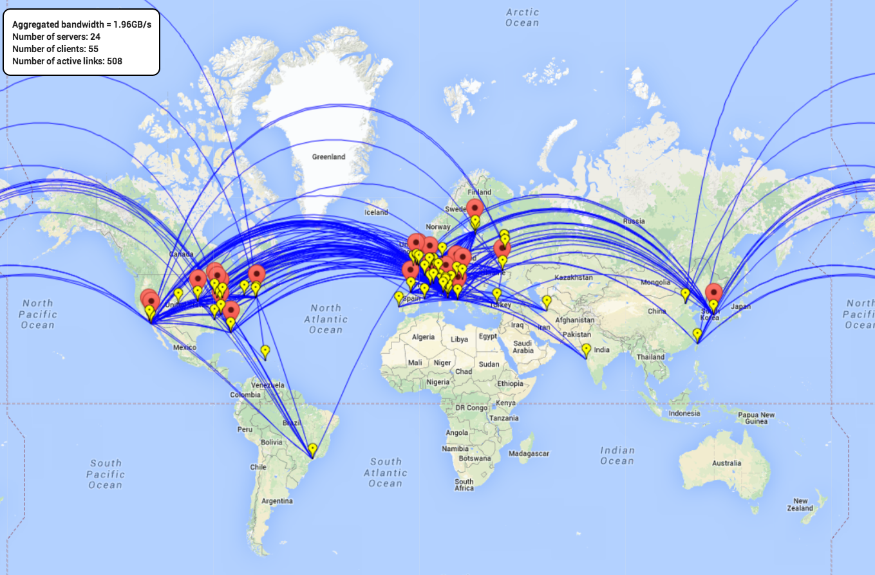
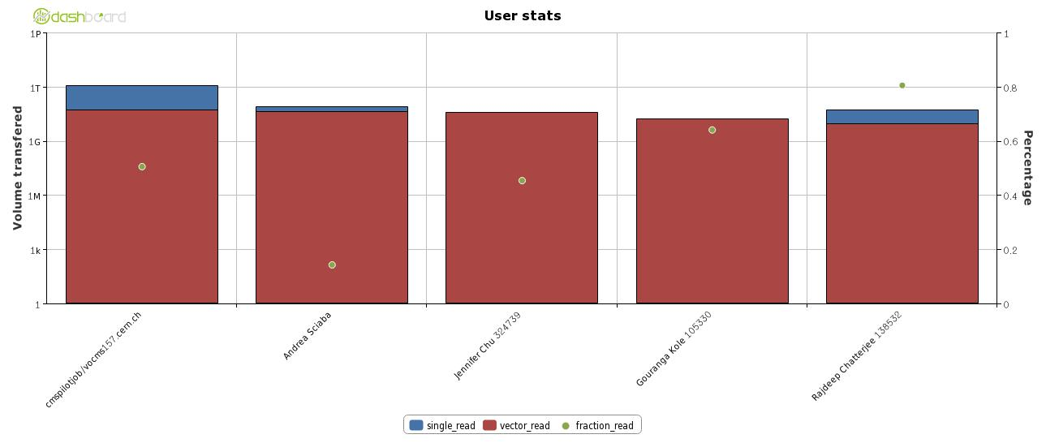
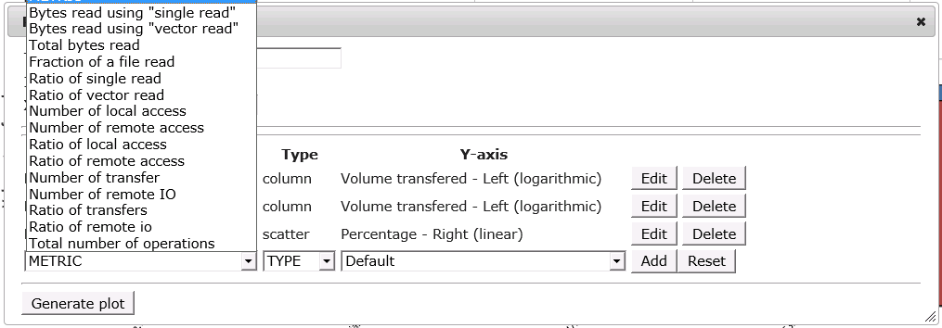
Pre-defined set of views

Slide 14
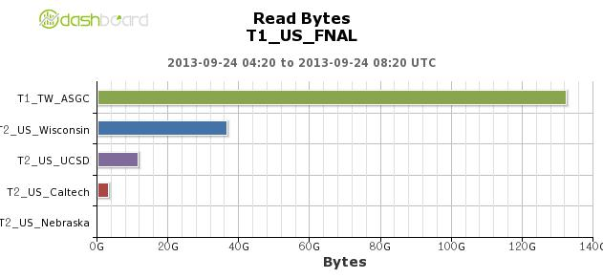
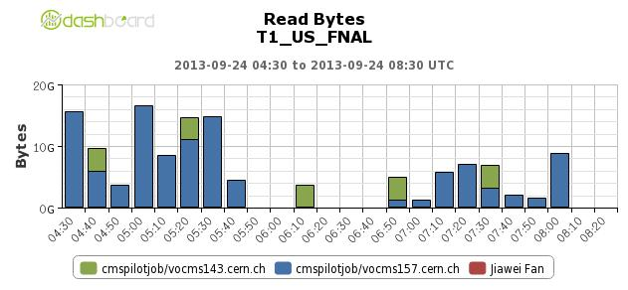
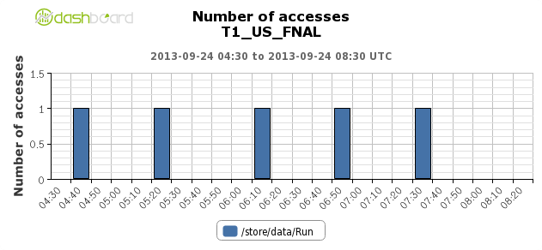
Use case example Understand site access patterns
Which sites are reading from FNAL
Zoom to a specific site to understand which users are reading
Understand which files are read by a user
1
2
2
3

Slide 15
Data popularity
XRootD monitoring provides information about file access patterns:
Including non official collections (ie: user files)
Contribute to simplify and make more efficient the usage of disk resources
Popularity data analytics built on this information:
Adopted already for CMS-EOS
will be extended to full AAA

Slide 16
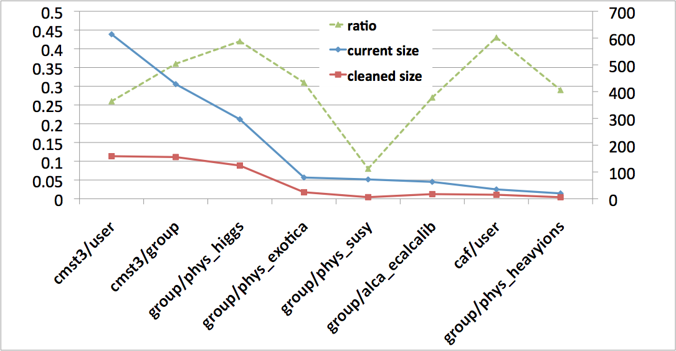
Archive recommendation for CMS-EOS
Help to manage the disk space of EOS including user space
No central bookkeeping system
Unused files: created > 4 months ago, no access in the last 3 months:
~500 TB of space occupied and not used <=> 30% of total for these areas
%
TB

Slide 17
Open issues
Missing servers:
Dcache sites
Server should provide their site name.
CMS: only 5 sites:
anon, BUDAPEST, Hephy-Vienna, T2_US_USCD, UKI-LT2-Brunel
Not coherent convention naming
ATLAS: GLED RPM to be deployed
GLED Collector improvements:
Reliability of the service:
Recover time, can be long due to time difference
GLED should be operated as a production service
Scalability:
to be fixed with automatic reconnection soon

Slide 18
Future work
Strong requirement from ATLAS to understand efficiency:
Need the concept of error / failure
How XRootD server could be instrumented to report it?
European GLED collector is up and running:
Only 1 pilot site is reporting to it (CNAF)
Should we keep it?
Data mining activity (not started yet):
Almost 2 years of raw data (1TB)

Slide 19
Data Mining
Extract further knowledge from the data…
Detect inefficiencies
Propose deletion strategies
Define data placement
… by
Understand access patterns and data usage
Correlate data traffic and data access performance
Possibility to automate some operations

Slide 20
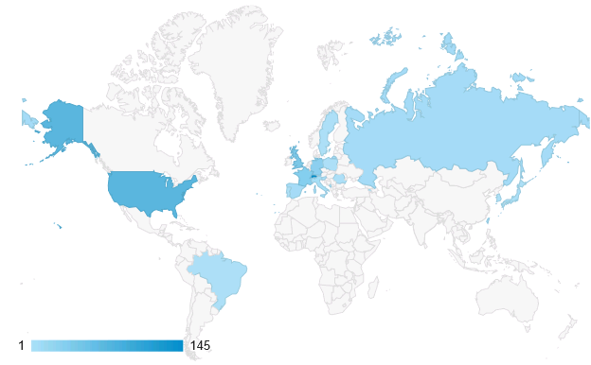
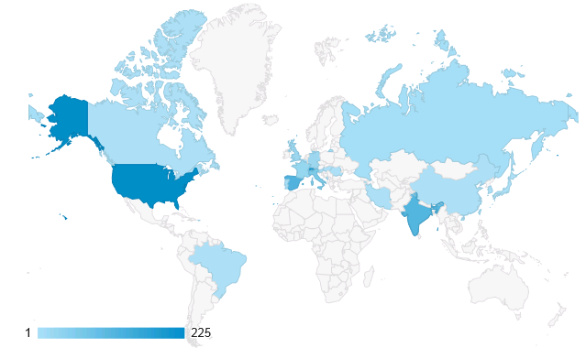
Application usage
FAX
AAA
20
30
10
15

Slide 21
Summary
Monitoring federations is a challenge
High rate of traffic & information
Challenge met by data aggregation, scalable technologies
Dashboard is not actively used
Less than 10 daily users (FAX), less than 15 (AAA)
Is there any missing functionalities?
Improvement work is ongoing
New requests are coming
XRootD monitoring is a one piece of the entire Data transfers puzzle
See next talk

Slide 22
Beyond XRootD monitoring
A.Beche
D.Giordano

Slide 23
Outlines
Talk 1: XRootD Monitoring Dashboard
Context
Dataflow and deployment model
Database: storage & aggregation
User interface & use cases
Open issues & future work
Summary
Talk 2: Beyond XRootD monitoring
HTTP/WebDAV integration
Integration in the WLCG Transfers Dashboard

Slide 24
HTTP Federation is coming
HTTP protocol will be used in the future
XRootD servers can be accessed
See Fabrizio’s presentation on xrdhttp
Two kind of accesses:
Pure HTTP access (through Apache)
HTTP gate to XRootD server
Can’t be monitor in the same way

Slide 25
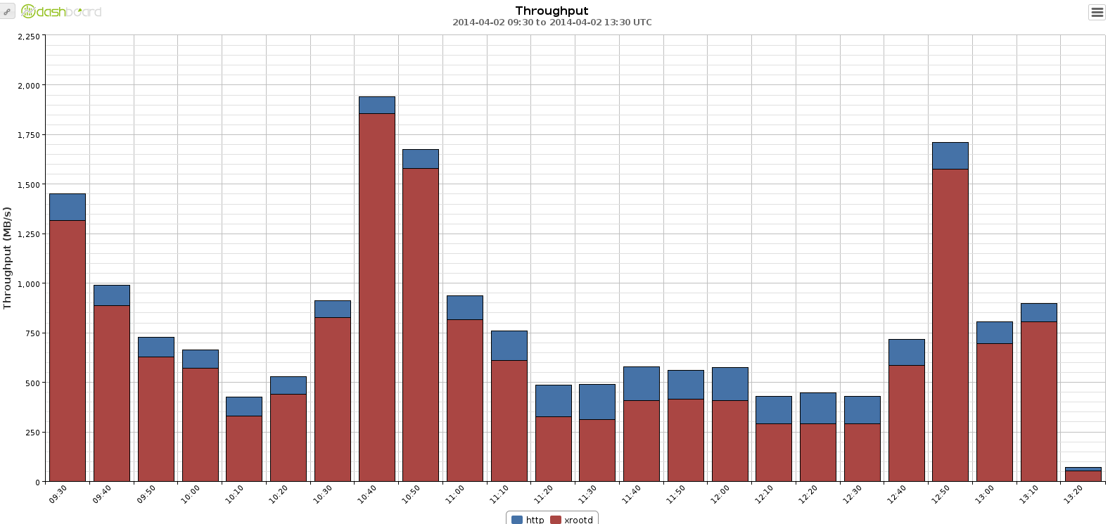
Monitoring XRootD access protocol
XRootD 4 will now reports the user protocol:
All the monitoring chain needs to be updated
Dashboard DB and UI are fully ready
HTTP
XRootD

Slide 26
HTTP/WebDAV federation monitoring
XRootD Federation
Site
Site
SE
JOB
XRootD
GLED
collector
ActiveMQ

Slide 27
HTTP/WebDAV federation monitoring
XRootD Federation
HTTP Federation
Site
Site
Site
SE
JOB
XRootD
GLED
collector
ActiveMQ

Slide 28
HTTP/WebDAV federation monitoring
XRootD Federation
HTTP Federation
Site
Site
Site
SE
Xrd HTTP
JOB
JOB
XRootD
GLED
collector
ActiveMQ

Slide 29
HTTP/WebDAV federation monitoring
XRootD Federation
HTTP Federation
Site
Site
Site
SE
Xrd HTTP
JOB
JOB
XRootD
Apache
JOB
GLED
collector
ActiveMQ

Slide 30
HTTP/WebDAV federation monitoring
XRootD Federation
HTTP Federation
Site
Site
Site
SE
Xrd HTTP
JOB
JOB
XRootD
Apache
JOB
GLED
collector
?
ActiveMQ

Slide 31
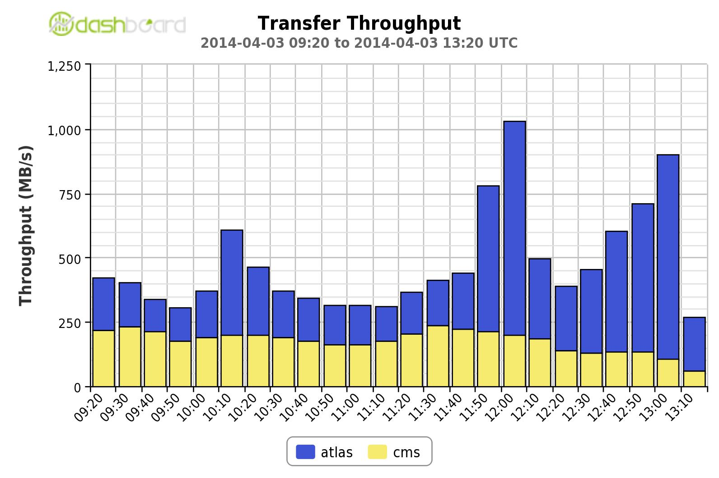
How to compare data from different applications?

Slide 32
data transfers & accesses monitoring tools
WEB
API / UI
WEB
API/UI
WEB
API/UI
WLCG
FAX
AAA
FTS
FAX
EOS
AAA
EOS

Slide 33
WLCG Transfers Dashboard federated approach
WLCG Transfers Dashboard
API / UI
WEB
API / UI
WEB
API/UI
WEB
API/UI
FTS
FAX
AAA
FAX
EOS
AAA
FTS
EOS

Slide 34
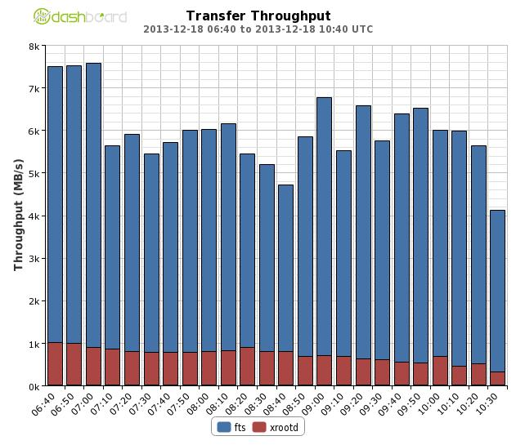
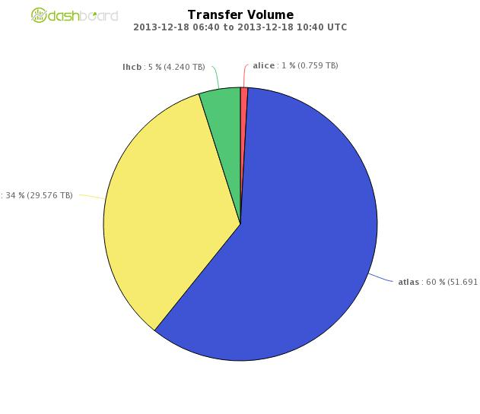
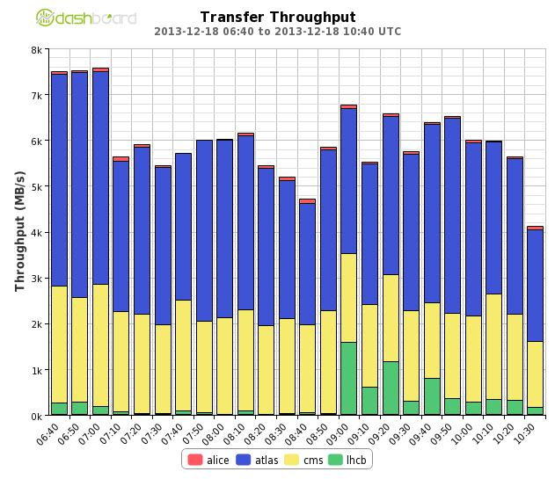
Some plots
FTS
XRootD
ALTAS
LHCb
CMS
ALICE

Slide 35
Summary
Lots of effort has been put in XRootD monitoring workflow and dashboard in the last 2 years
Reliable system achieved
Lots of use cases covered
HTTP Monitoring already started
Will require a lot of effort to reach XRootD monitoring level
New WLCG Transfers Dashboard architecture
Highly extensible system
Cross-VO or cross-technology analysis

Slide 36
Credits
Andreeva Julia
Cons Lionel
Giordano Domenico
Saiz Pablo
Tadel Matevz
Tuckett David
Vukotic Ilija
The AAA and FAX deployment team
….

Slide 37
Useful links
AAA Dashboard
http://dashb-cms-xrootd-transfers.cern.ch
FAX Dashboard:
http://dashb-atlas-xrootd-transfers.cern.ch
CHEP materials
https://indico.cern.ch/abstractDisplay.py?abstractId=101&confId=214784
https://indico.cern.ch/getFile.py/access?contribId=94&sessionId=6&resId=0&materialId=slides&confId=214784
https://indico.cern.ch/getFile.py/access?contribId=265&sessionId=6&resId=1&materialId=slides&confId=214784
Xbrowse framework:
https://twiki.cern.ch/twiki/bin/view/ArdaGrid/XbrowseFramework
Thanks for your attention

