Slide 1
Campus Grids, Bridges & Clouds
Parallel Session

Slide 2
Session Plan
Review survey and update with discussion here
Round table lightning questions
Goal is a lively, free-for-all, open set of discussions!

Slide 3
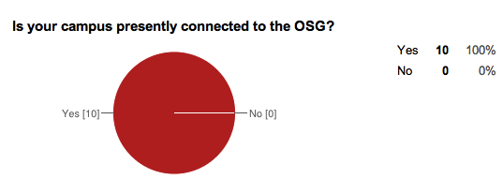
Survey!

Slide 4
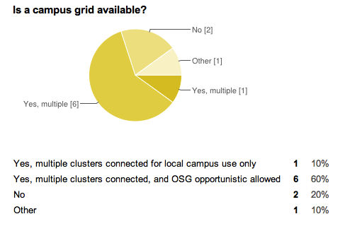
Survey!

Slide 5
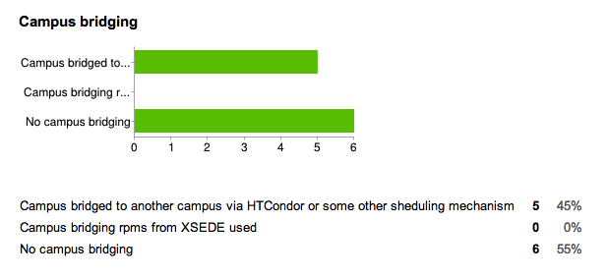
Survey!

Slide 6
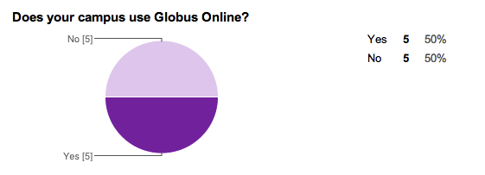
Survey!

Slide 7
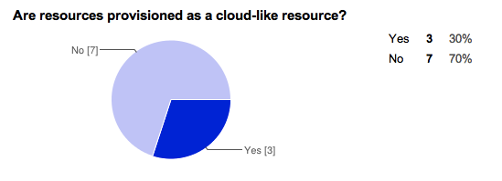
Survey!

Slide 8
Survey!

Slide 9
Lightning Response Questions
What are the key challenges to leveraging available resources on campus outside your immediate administrative control?

Slide 10
Lightning Response Questions
What strategies work best for engaging research communities outside of physics?

Slide 11
Lightning Response Questions
Virtualizing physical resources and providing cloud services is a common priority (survey). What are the approaches and challenges?

Slide 12
Lightning Response Questions
Condo Clusters in shared data center?

Slide 13
Lightning Response Questions
Social challenge of the private cluster

Slide 14
Your Questions
Q:

