Slide 1
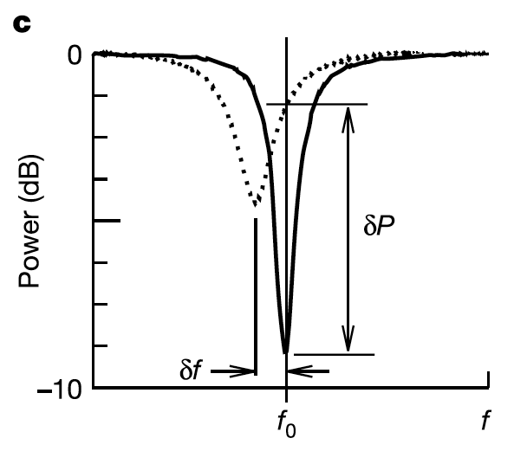
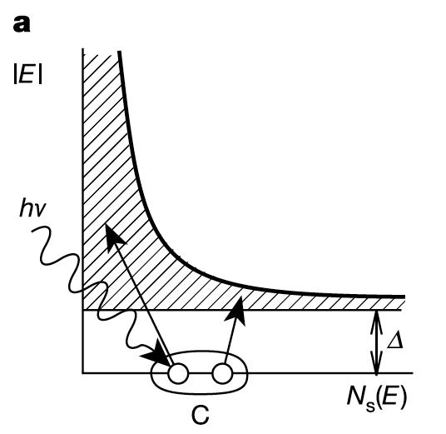
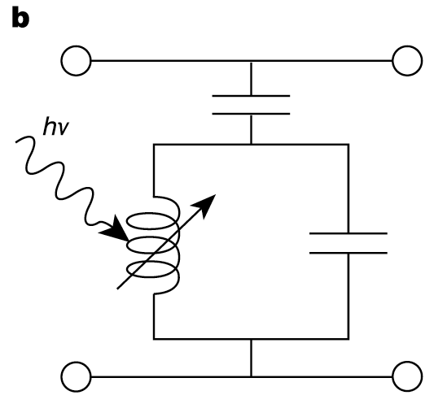
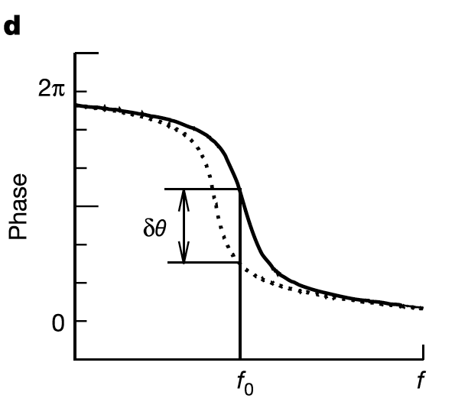
Workshop summary

Slide 2
What I think we achieved
Got a few good ideas of potential science opportunities with MKIDs (need more work to investigate them)
Got a view of what other groups are doing.
A list of things we have to answer in order to make a strong science case.

Slide 6
Seth Meeker

Slide 7
Seth Meeker

Slide 8
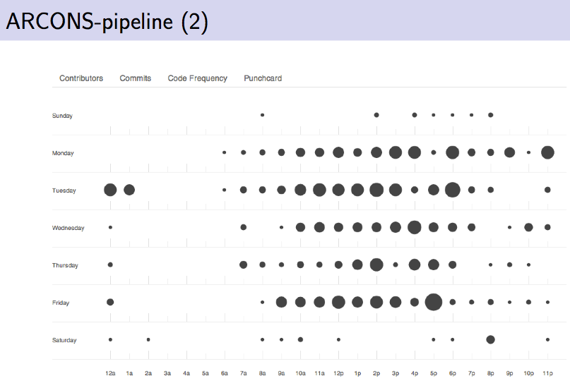
Data reduction is possible, but it is a new “astronomy”. Very cool, a lot of possibilities, and a lot of work…
Specially Monday night.

Slide 9
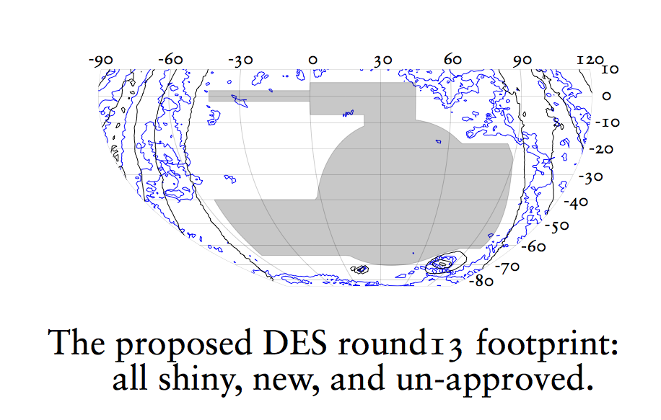
J. Annis
MKIDs in the south and DES

Slide 10
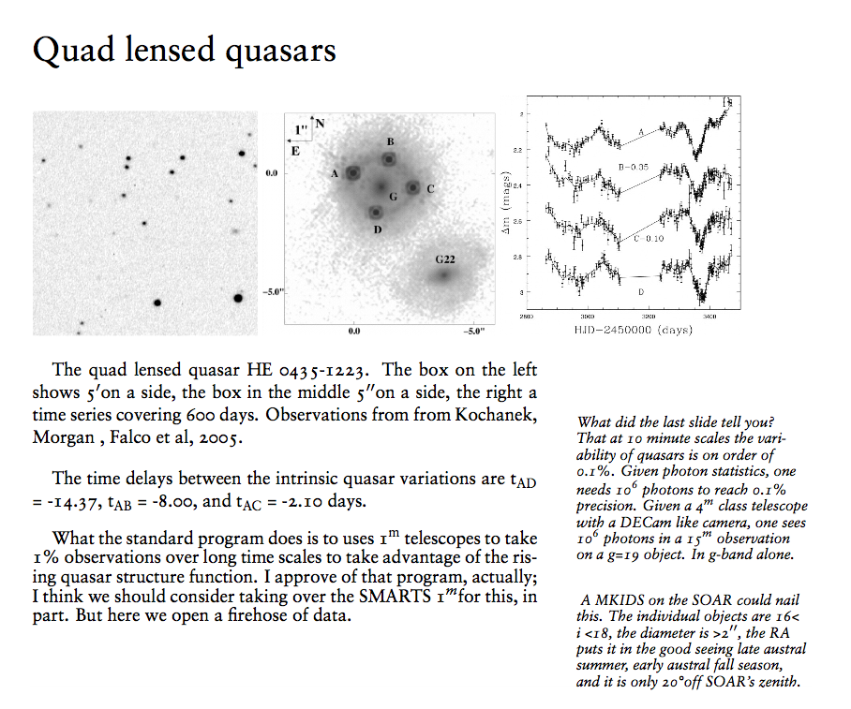
J. Annis
MKIDs in the south and DES
Something to really consider for an MKIDs instrument in the south in the coming years.

Slide 11
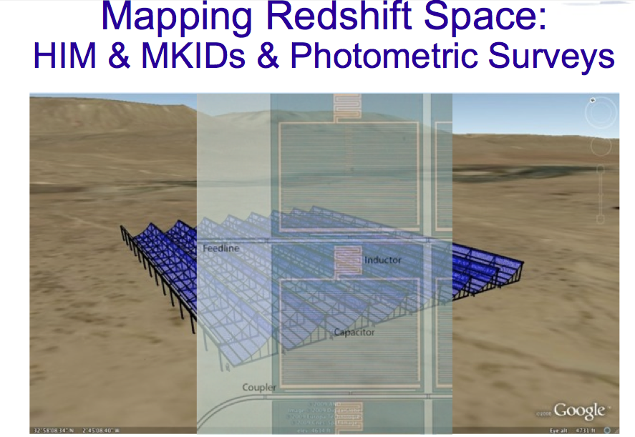
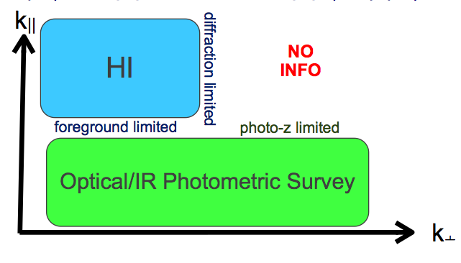
A. Stebbing
Combine Hydrogen Intensity Mapping (photo-z info) + MKID survey (angular info)

Slide 13
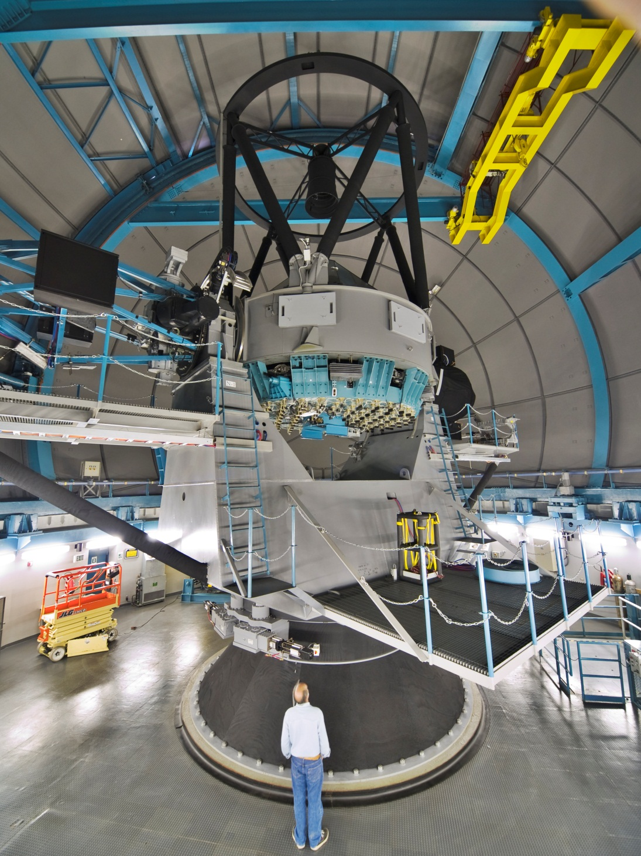
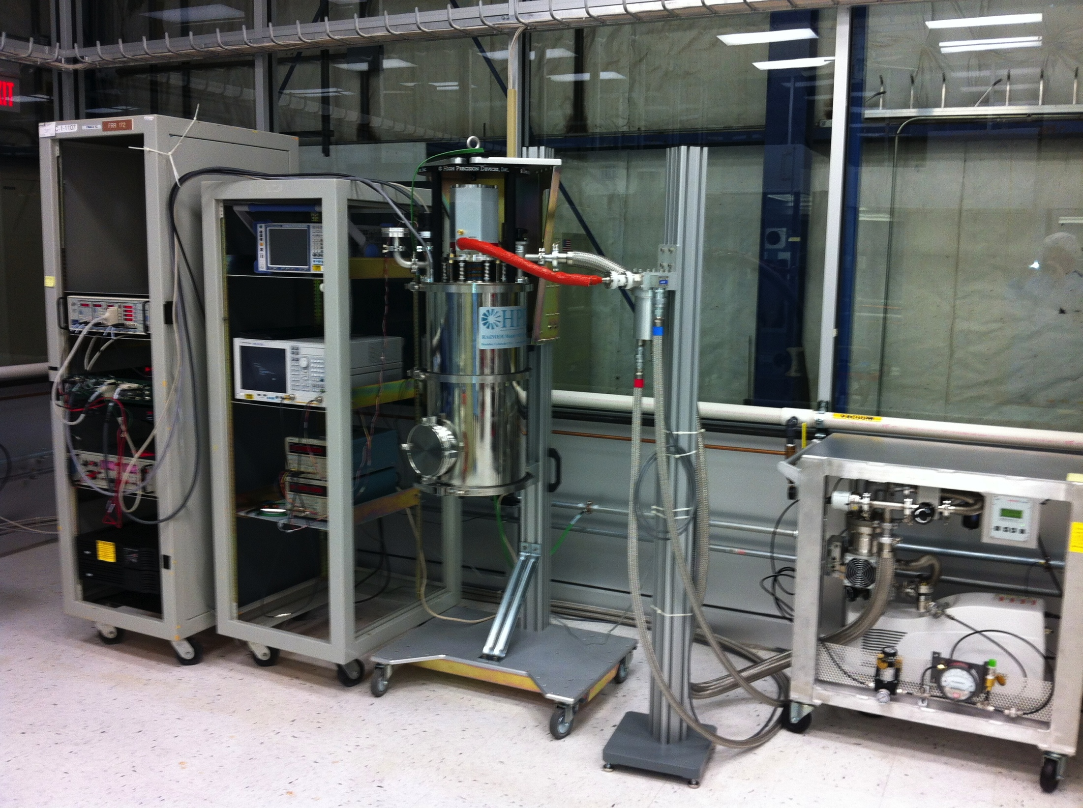
J. Estrada
FNAL effort

Slide 14
B. Nord.
Powerful and flexible simulation framework that we should use to make our science case.
Help will be needed…

Slide 15
Ben Mazin

Slide 16
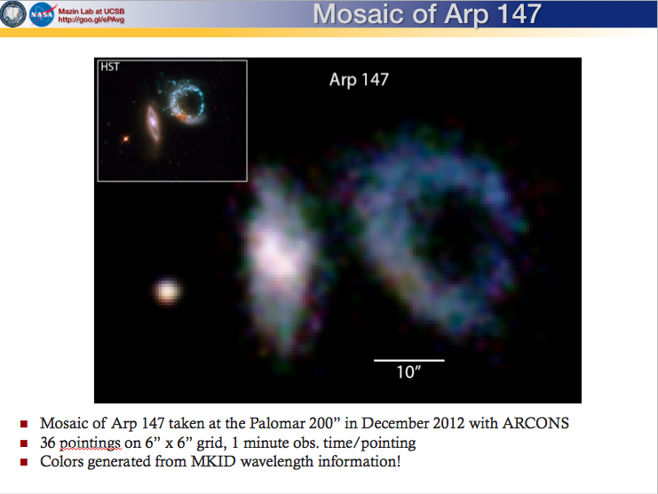
Ben Mazin

Slide 17
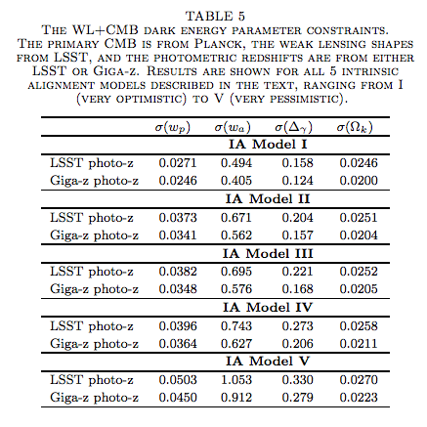
Ben Mazin

Slide 18
Ben Mazin

Slide 19
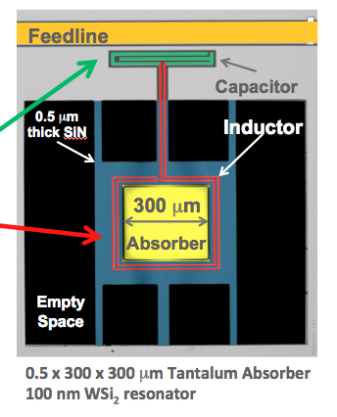
TKID for X-rays
Orlando Quaranta
KIDs for X-ray at ANL

Slide 20
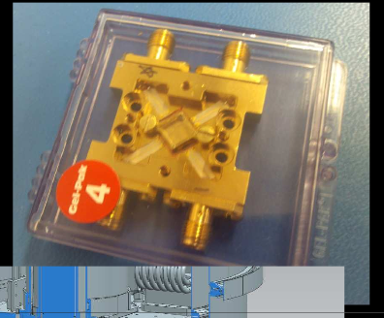
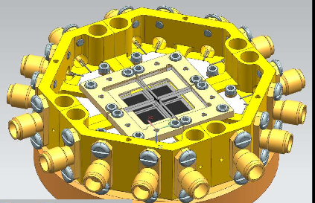
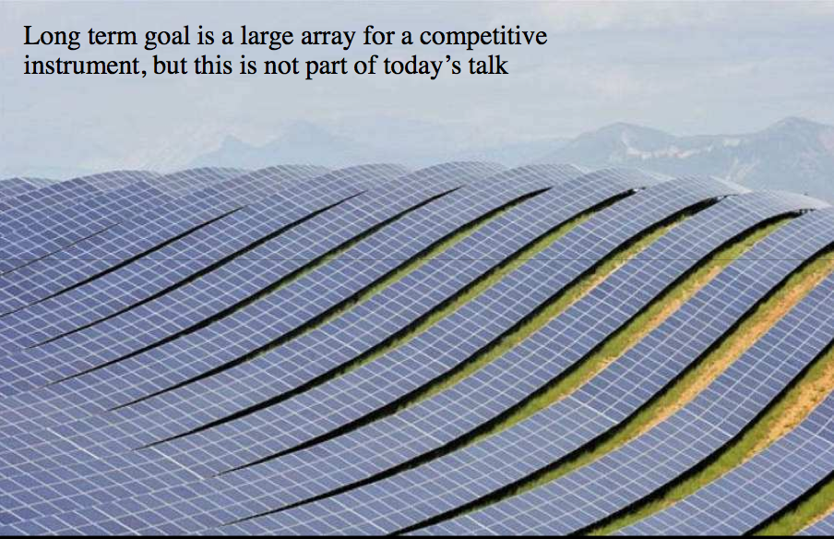
2013
2016
?????
2020?
Greg Derylo
Mechanical issues to move from a small array to a large instrument…
The way there is not easy.

Slide 21
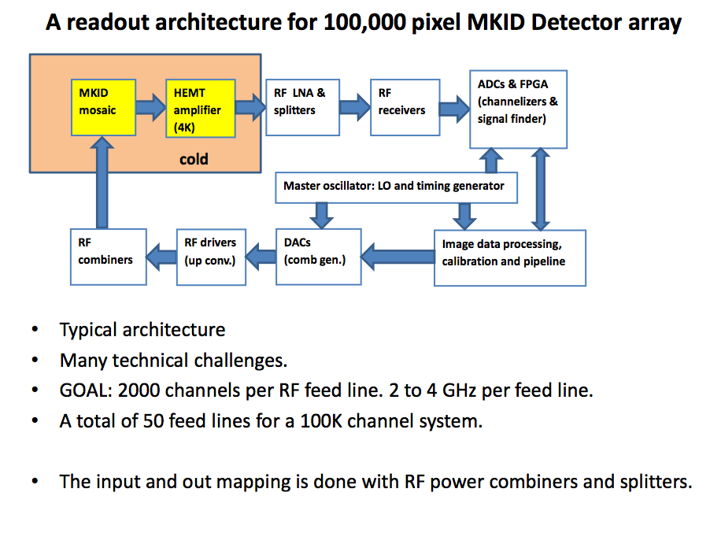
C. Cancelo
How do we readout a system with 100,000 channels?

Slide 22
C. Cancelo
Take advantage of this Synergy!

Slide 23
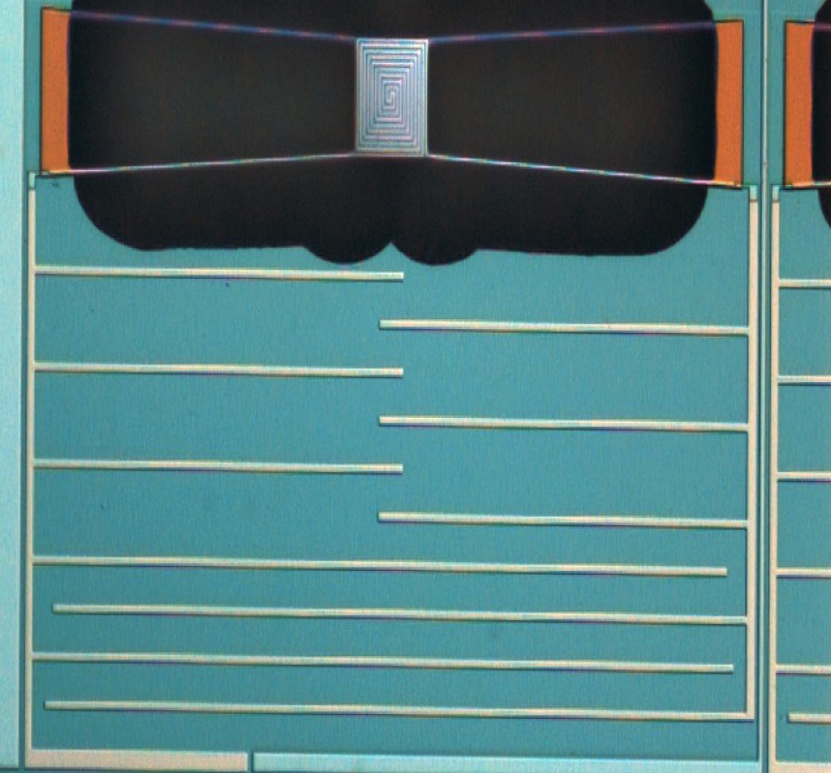
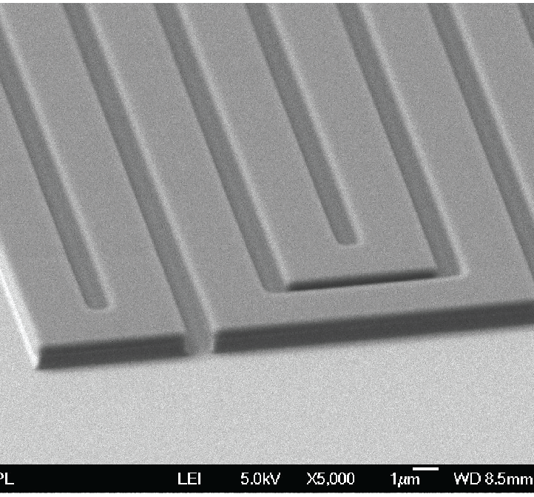
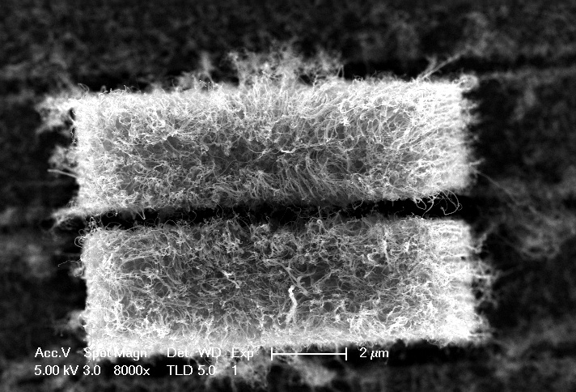
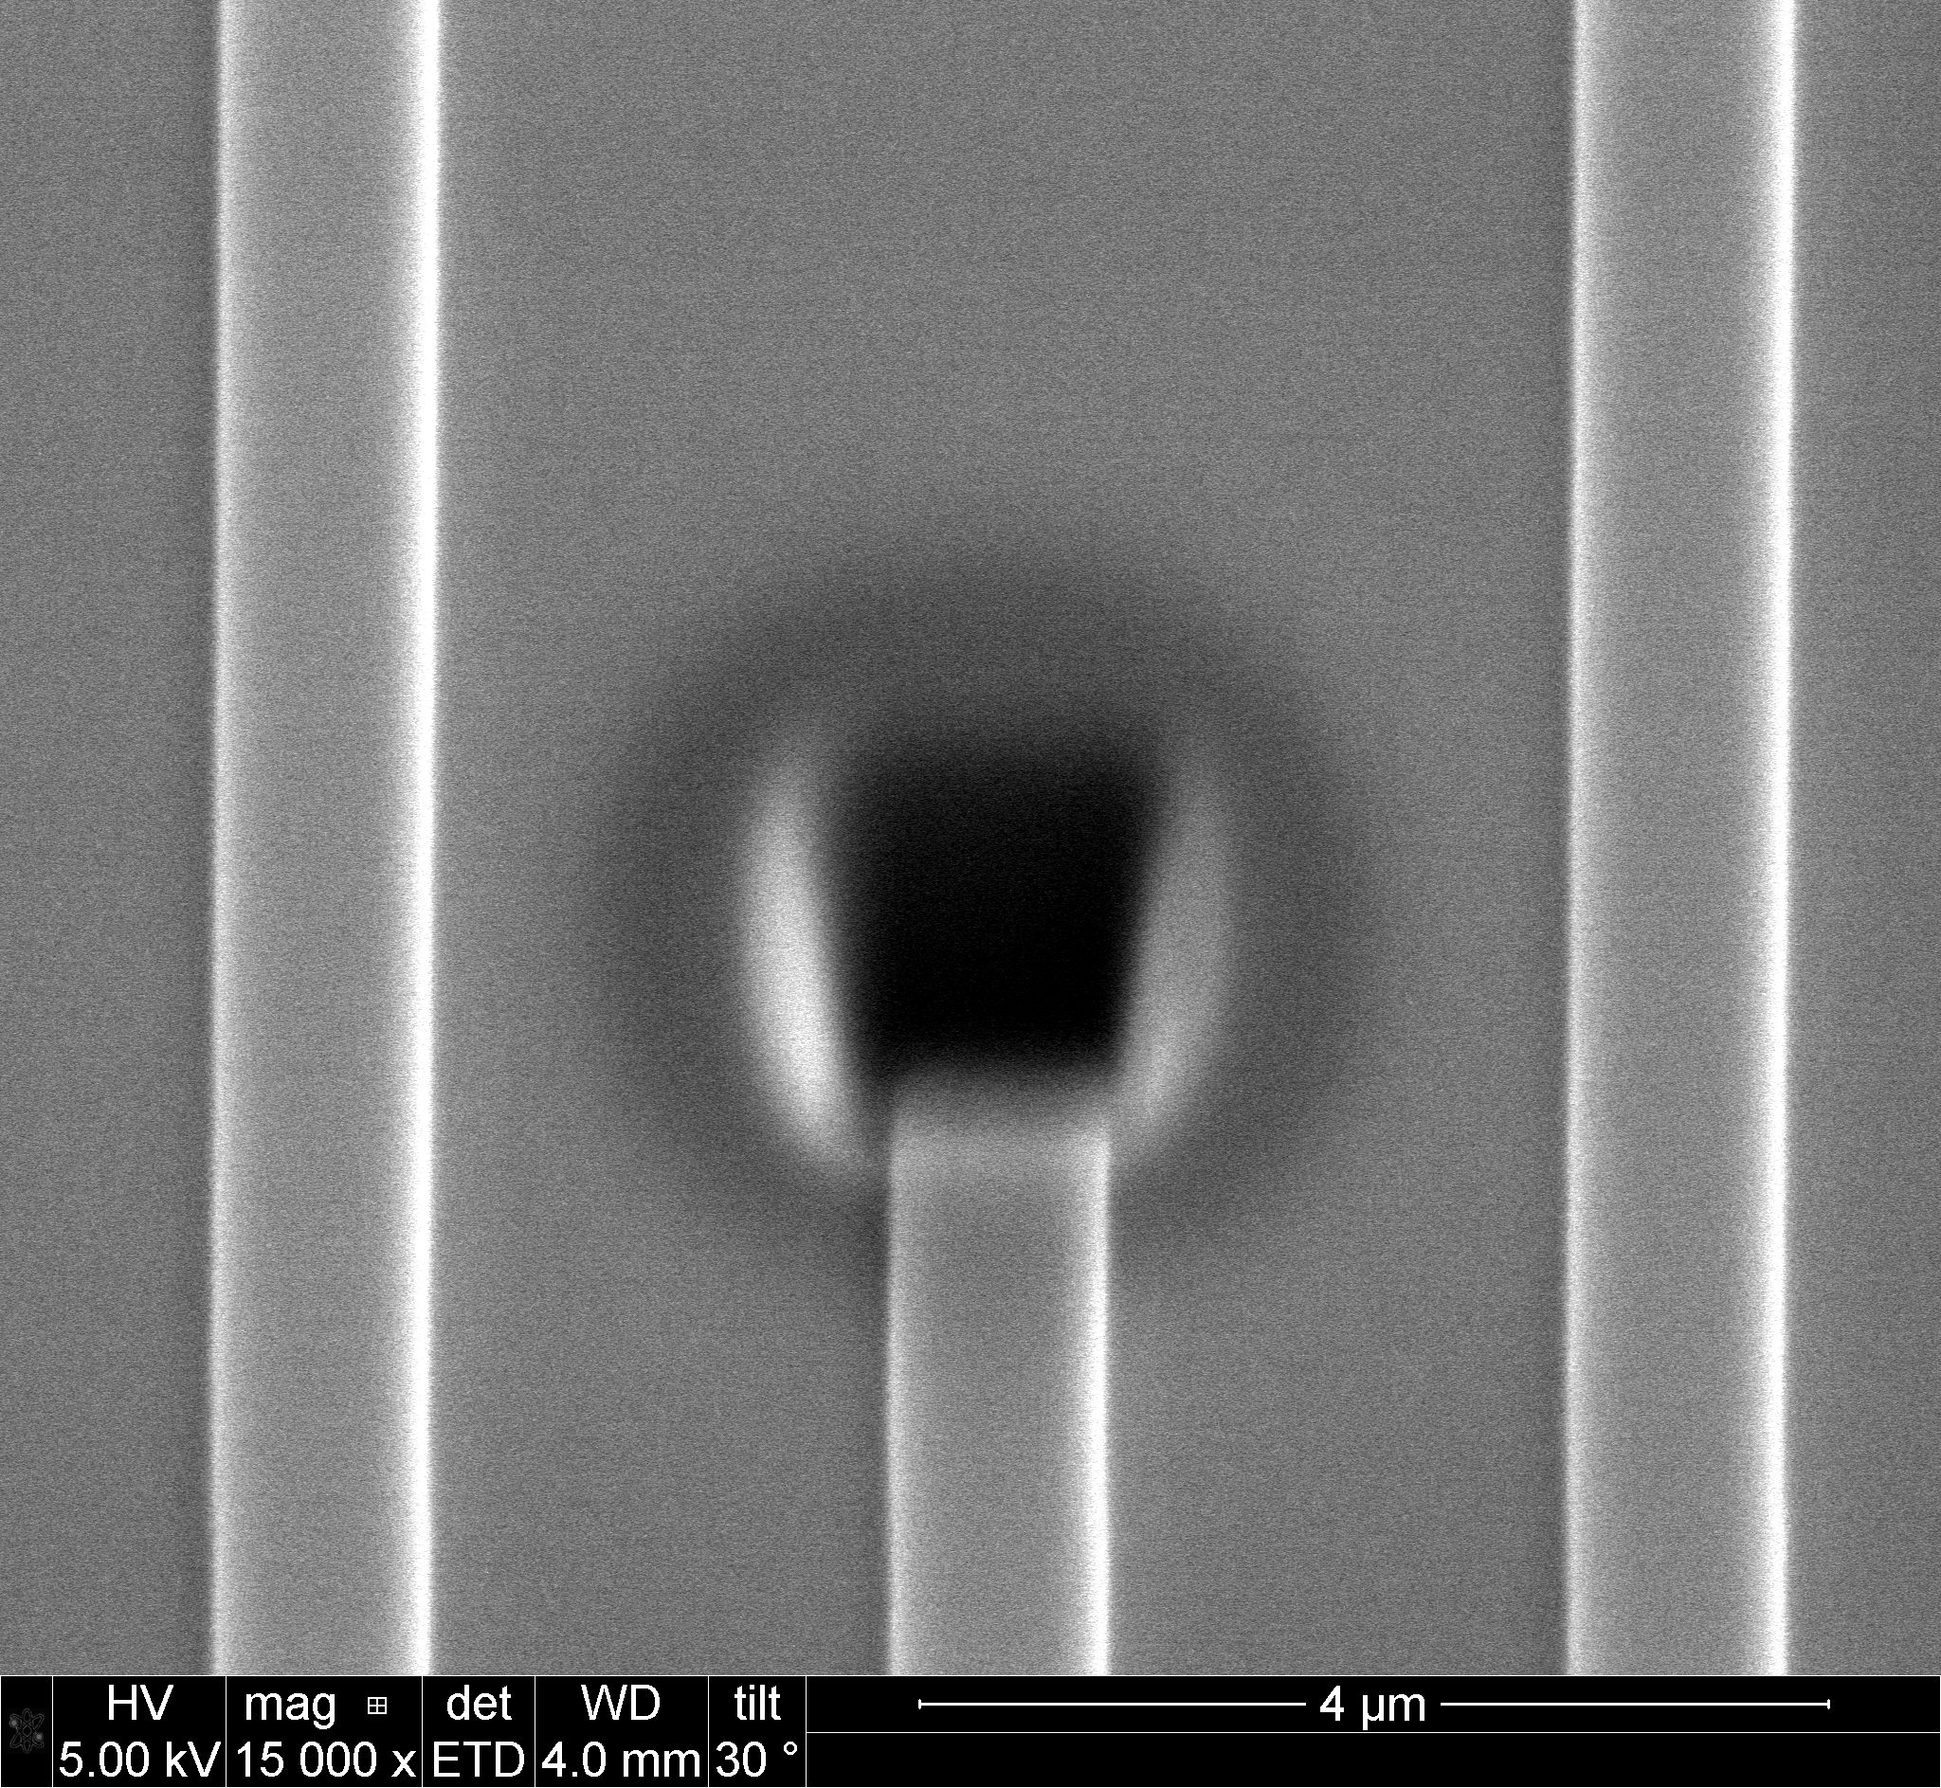
Paul Szypryt (UCSB)
Impressive R&D
Trenched (TLS noise)
Optical membrane (remove location
Dependece in response)
Multilayer TiN film
(uniformity)
Focused Ion beam milling (repairs)
Carbon nanotubes (QE)

Slide 24
SN with MKIDs (M.Soares-Santos)
Follow up of SNIa hosts from future surveys, seems impractical.
Spectra starved field.
and high IR sensitivity could be interesting for a high redshift sample.

Slide 25
MKIDs co-observing Fast Radio Bursts (A.Stebbins)
Dispersion velocity of photon seen in FRB (August 2001) for radio photons
Dispertion time ~msec could be interesting for a MKIDs observation.
Science 2013 paper “Population of cosmological FRBs” (Thornton)
msec time delays due to scattering
(6 known FRB)
Large energy density, Large field, temperature 300 Mplanck
Estimated rate 1/day/sq-deg.
NS-NS coalescence seems like a good candidate(?) seems to match the size and rate.
Co-observe:
wide field passive observations: Gravity waves, neutrinos
triggered observations:
MKIDS in a small telescope with high time resolution (high S/N), maybe a lot of energy not yet observed.

Slide 26
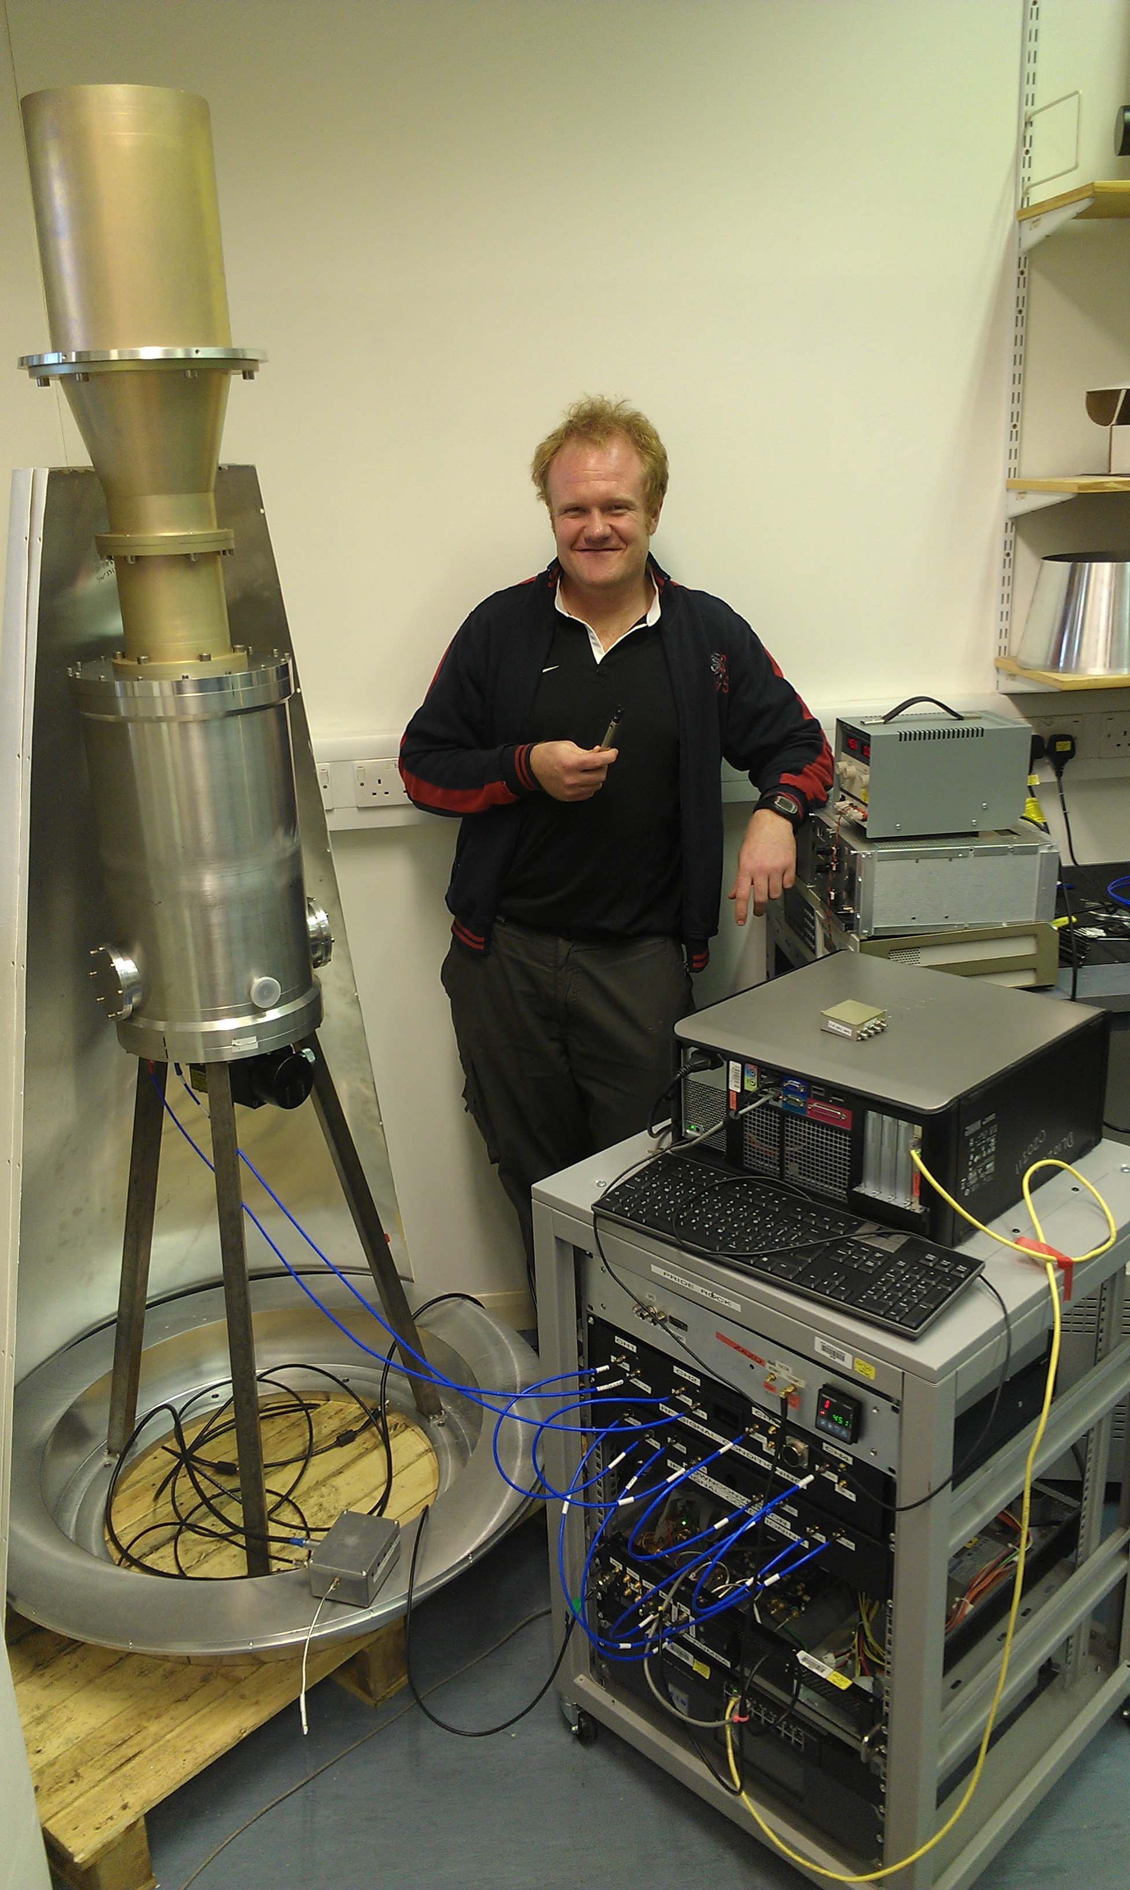
Doppler mapping with for short period systems. Impractical with CCDs. Readout noise kills you with CCDs.
Radio cosmology
group
Continuous ADR
Mullard SSL

Slide 27
X-shooter is the state of the art instrument.
KIDspec : super X-shotter
Use MKIDs to sort the orders from 0.3um to 2.5um

Slide 29
Scott Dodelson

Slide 30
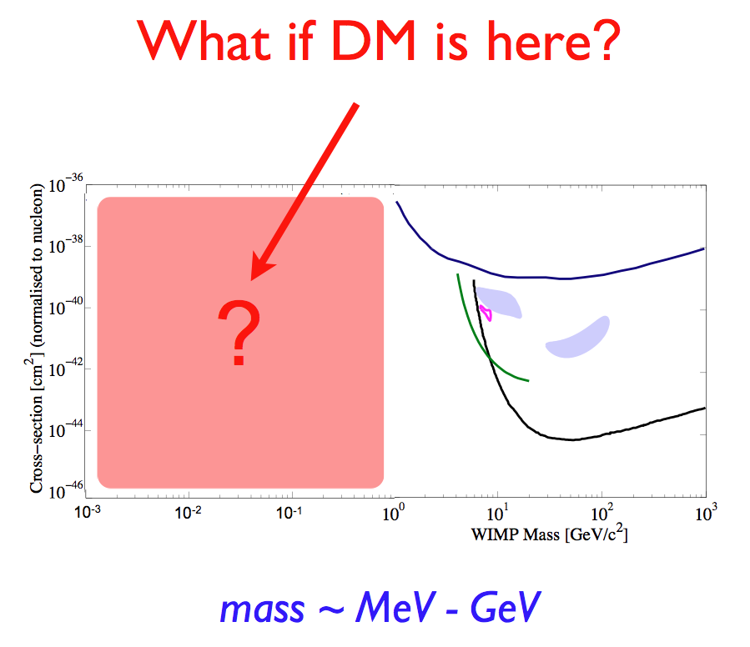
Nuclear recoil search does not work.

Slide 31
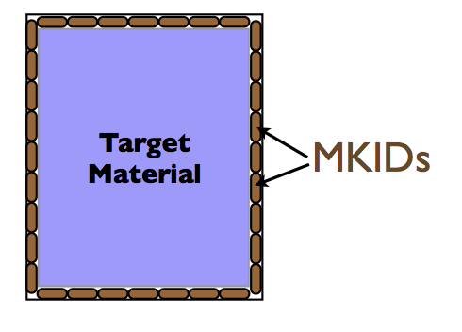
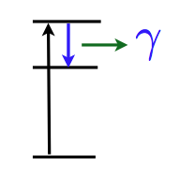

Slide 32
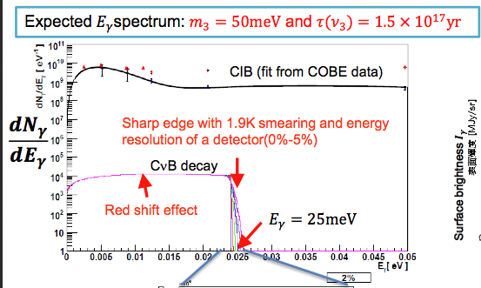

Slide 33
Almost photon shot noise limited, the only way to improve is increase the number of detectors.
Current technology is antenna cuopled TES

Slide 34
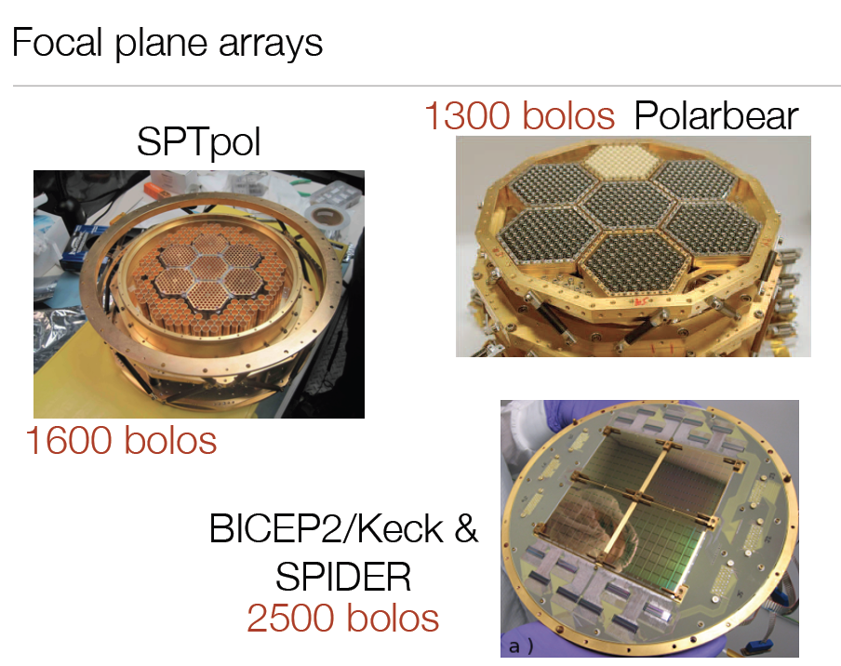
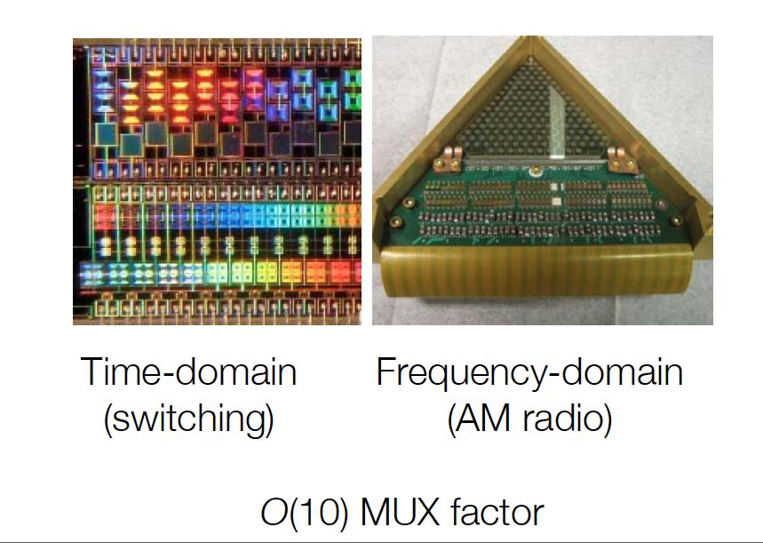

Slide 36
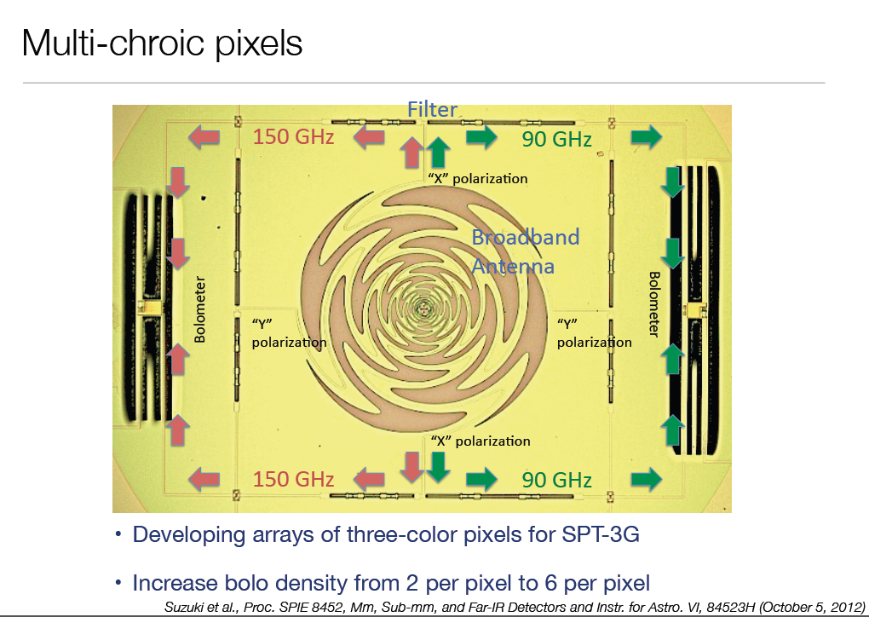
Higher density detector arrays

Slide 37
Getting close to photon noise limited.
Also need work on TLS noise
Could this be the technology for very large arrays (~500k)

