Slide 1
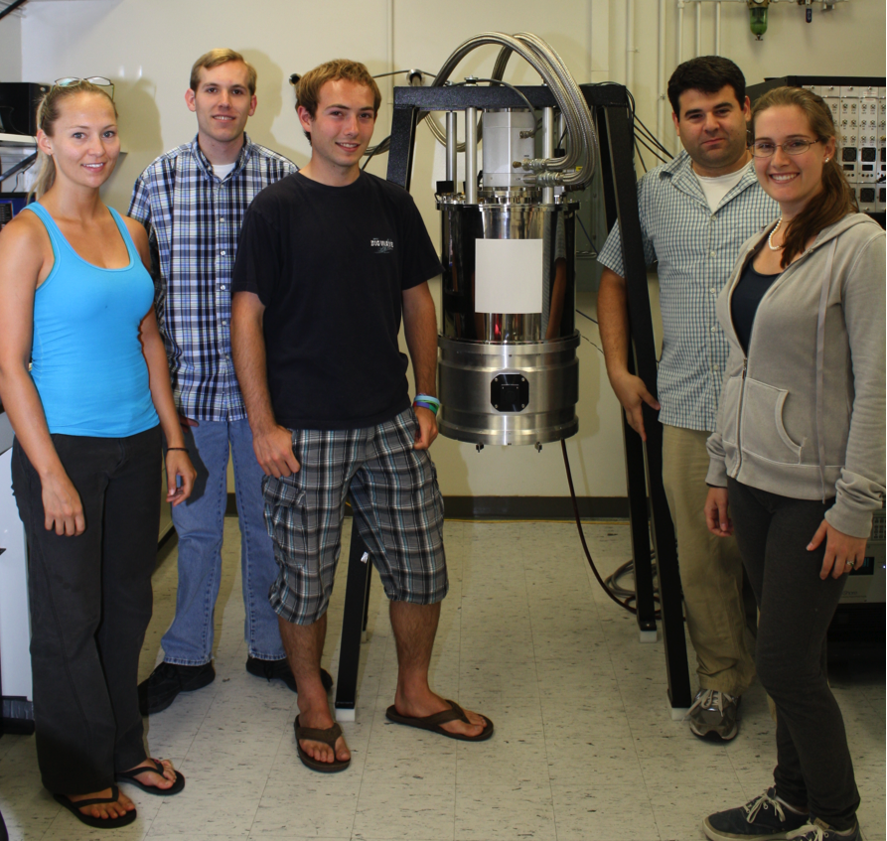
Optical Lumped Element MKIDs: Overview and Development Timeline
Seth Meeker
August 2012
Fermilab MKID Workshop
The Optical/UV MKID Team:
UCSB: Ben Mazin, Seth Meeker, Danica Marsden, Matt Strader, Gerhard Ulbricht, Paul Szypryt, Alex Walter, Julian van Eyken
Oxford: Kieran O’Brien
Fermilab: Chris Stoughton
JPL: Bruce Bumble, Rick LeDuc

Slide 2
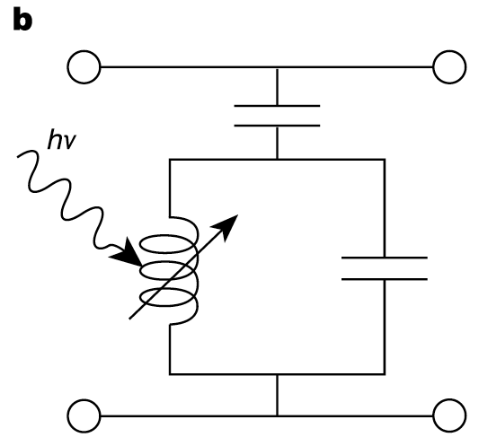
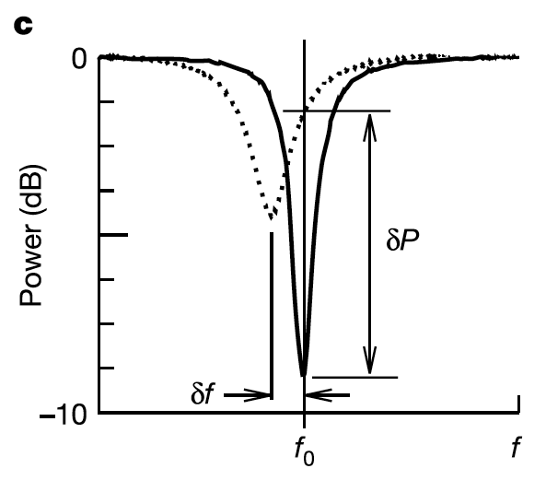
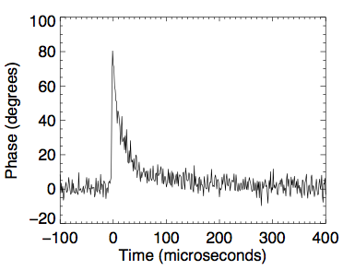
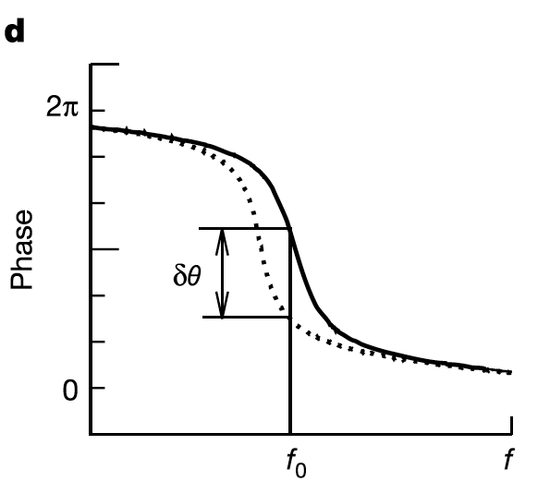
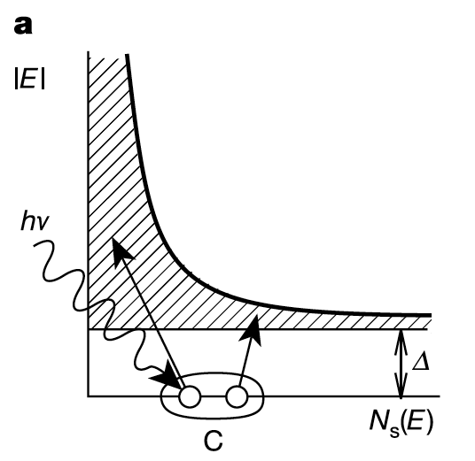
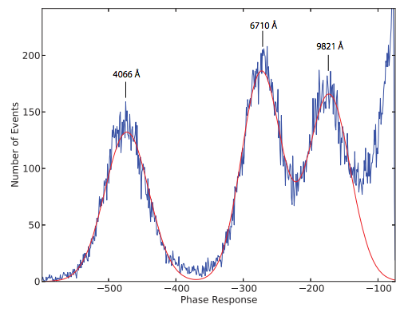
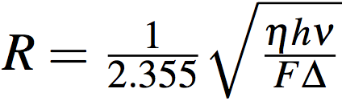
Microwave Kinetic Inductance Detectors
MKID Equivalent Circuit
Typical Single Photon Event
Inductor is a
Superconductor!
Energy Gap
Silicon – 1.10000 eV
Aluminum – 0.00018 eV
Energy resolution:
Cooper Pair

Slide 3
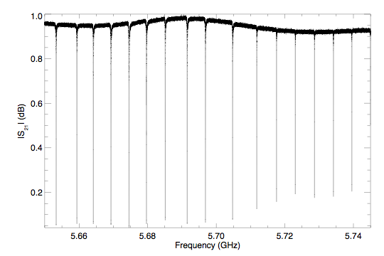
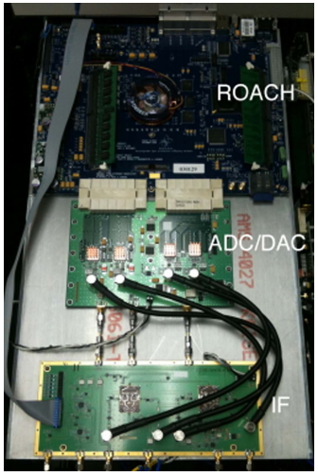
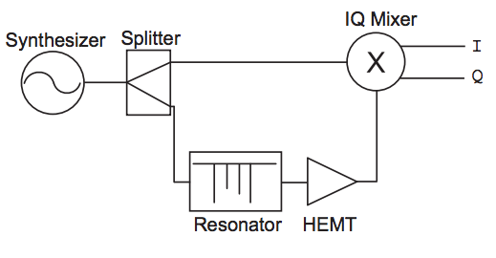
Frequency Multiplexing
A major advantage of MKIDs over similar LTD technology is the ability to scale to large arrays with frequency domain multiplexing
Example of a homodyne detection circuit

Slide 4
The MKID Advantage
Low temperature detectors (~100 mK)
Photon Counting
Energy Resolution with theoretical maximum R~150 at 100 mK
Time resolution ~10s of microseconds
Scalable to large arrays
Relatively simple design, few low temperature electronics required

Slide 5
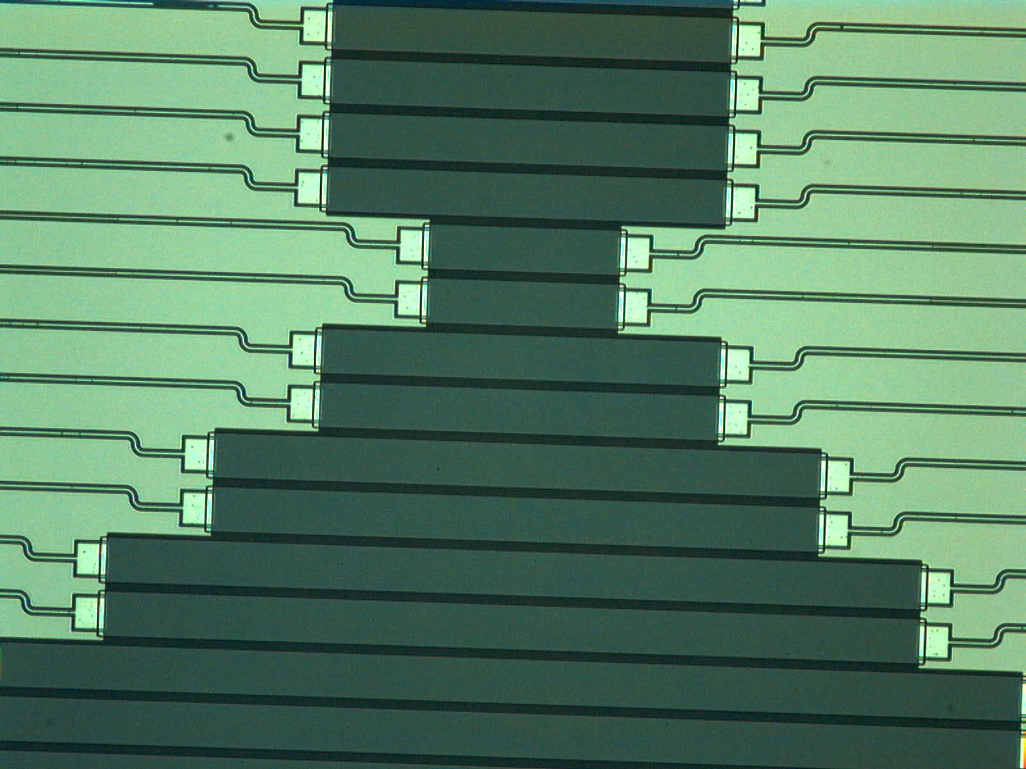
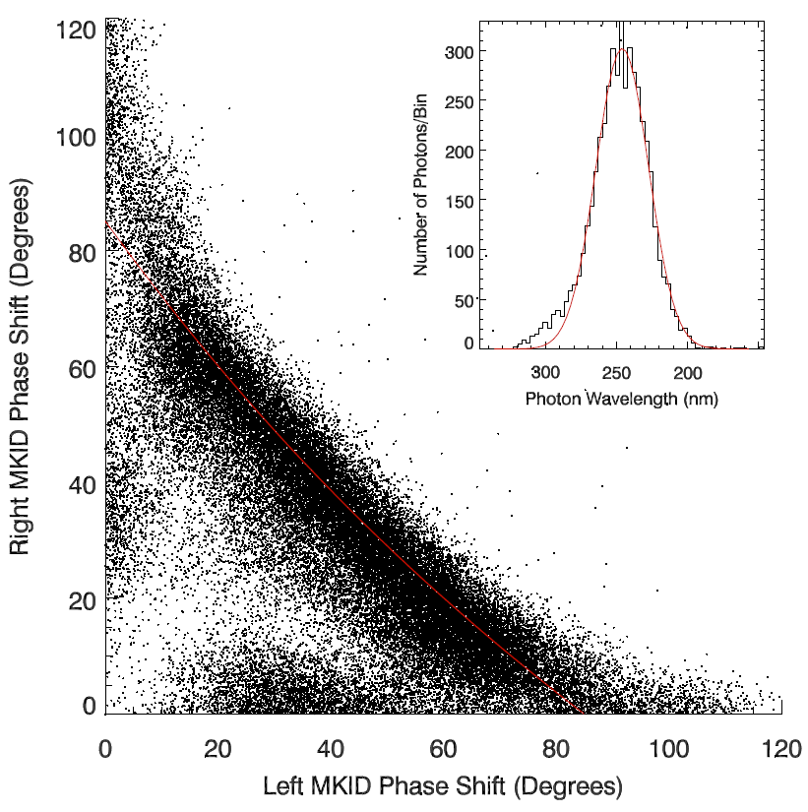
Strip Detectors
Original array concept used absorbing strips with an MKID on each end. The sum of the MKID responses gives total photon energy, and ratio of responses gives location of photon strike along strip.
Highest energy resolution achieved with this design: R~6 at 254 nm.

Slide 6
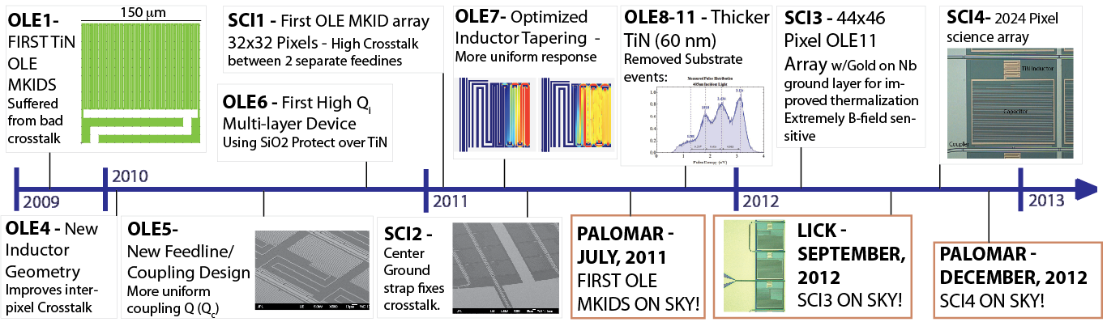
OLE Development Timeline

Slide 7
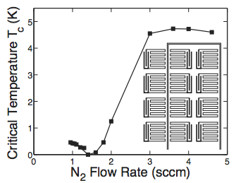
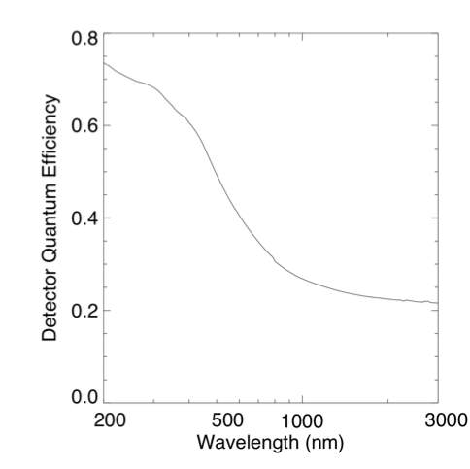
TiN basics
Leduc et al. 2010 discusses the requirements for ultrasensitive MKIDs and how they are met by TiN.
Hard material, corrosion resistant
Varying Nitrogen content allows for a tunable critical temperature
High quantum efficiency
Residual Resistivity Ratio ~1
High normal-state resistivity guarantees a high kinetic inductance fraction by Mattis-Bardeen -> great for sensitive detectors

Slide 8
OLE Development Timeline

Slide 9
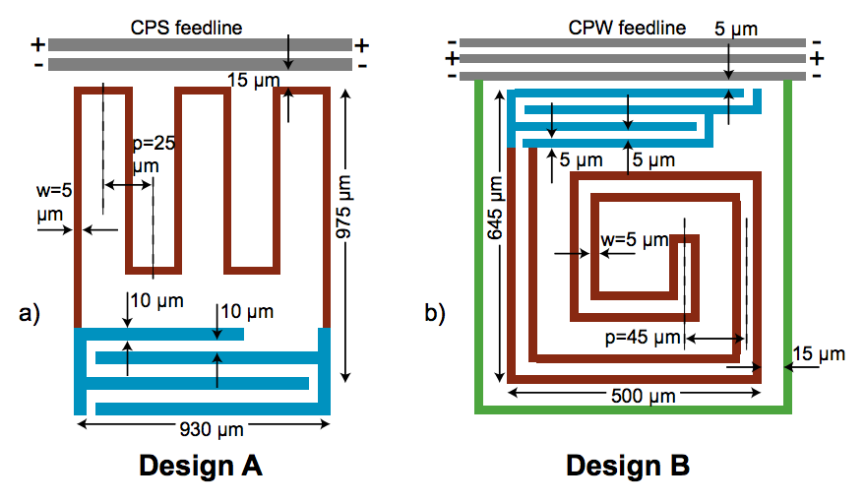
Crosstalk Reduction
From Noroozian et al. 2012
Double-wound inductor keeps opposite polarity conductors in close proximity to cancel fields more effectively and prevent coupling with other resonators. Grounded perimeter also improves isolation.

Slide 10
OLE Development Timeline

Slide 11
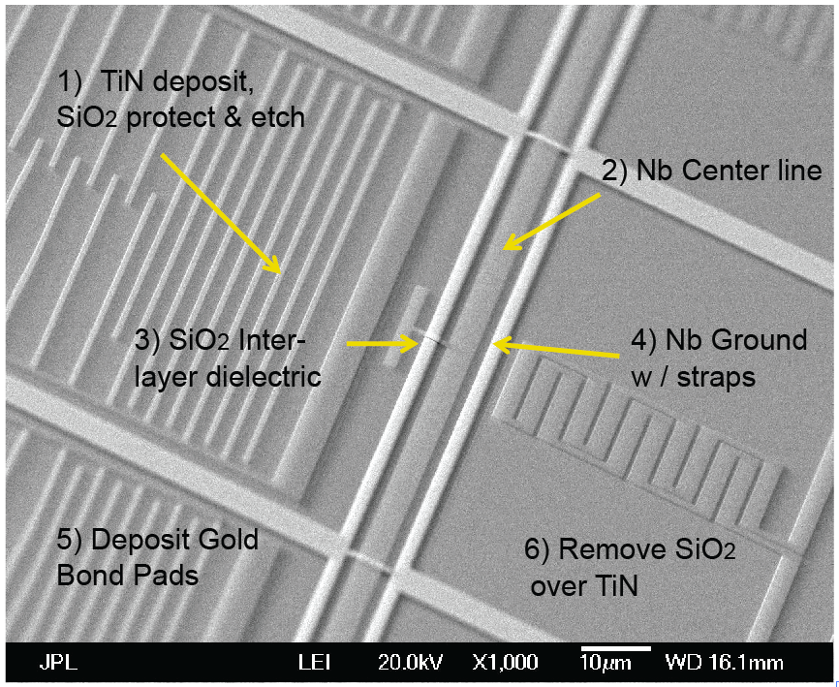
High Q Fabrication Procedure
Protecting TiN resonators with SiO2 layer is key step to maintaining high Q resonators during subsequent lift-off processes.

Slide 12
OLE Development Timeline

Slide 13
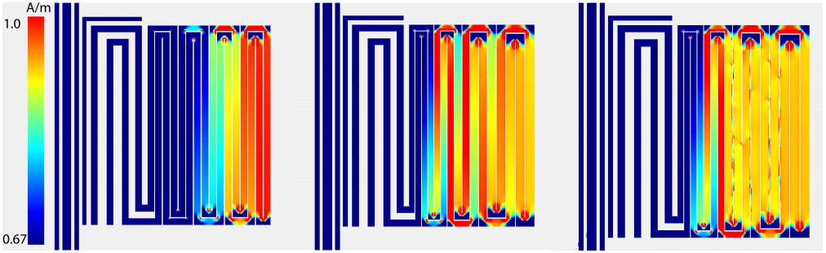
Inductor Tapering
Detector response dependent on local current density in inductor. Optimized tapering of the leg widths to make current density distribution as uniform as possible. At our lithographic precision, simulated uniformity of ~4% can be achieved.

Slide 14
OLE Development Timeline

Slide 15
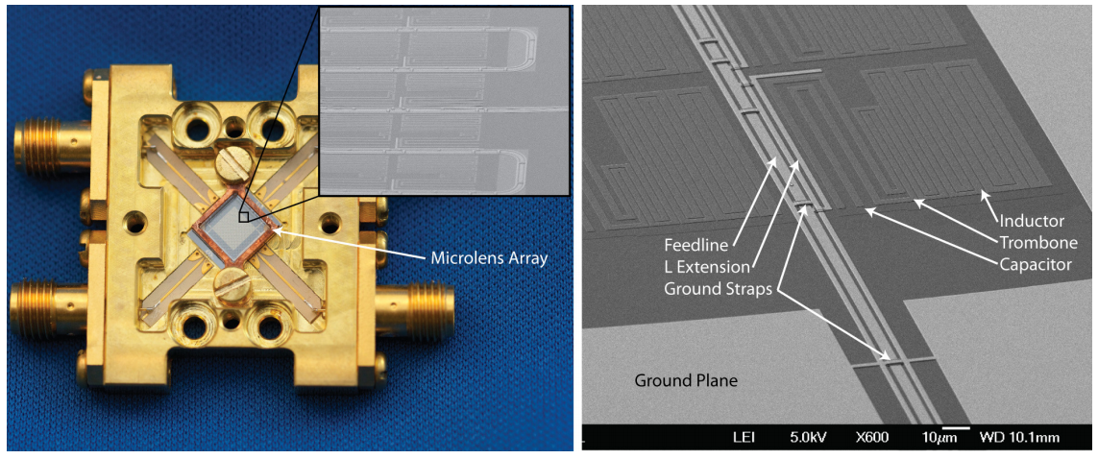
OLE7/SCI2
First optical MKID science array to go on the sky. Used OLE7 pixels shown above.

Slide 16
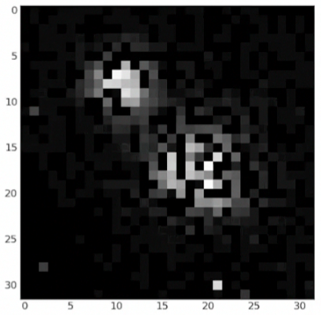
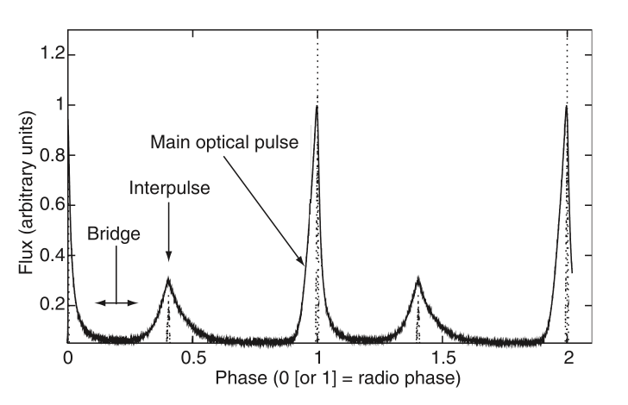
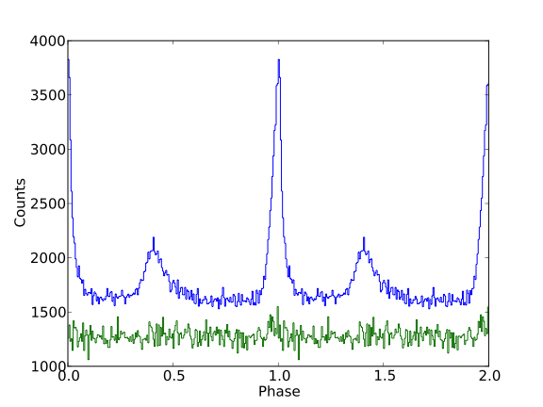
SCI2 Performance
Imaging capability confirmed.
Timing capability confirmed with observation of Crab Pulsar optical pulses

Slide 17
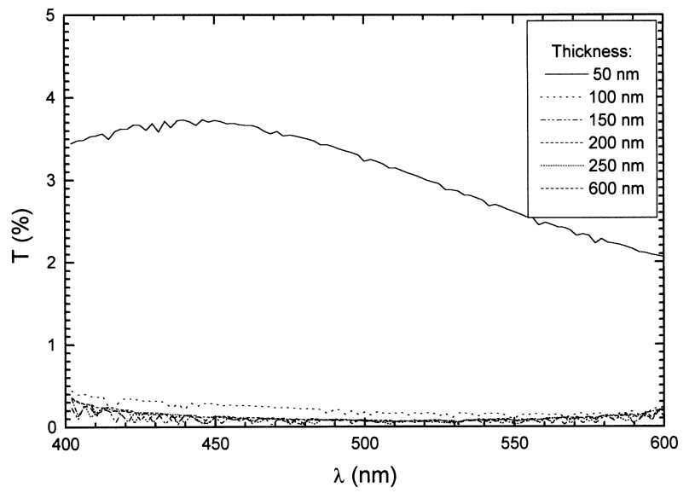
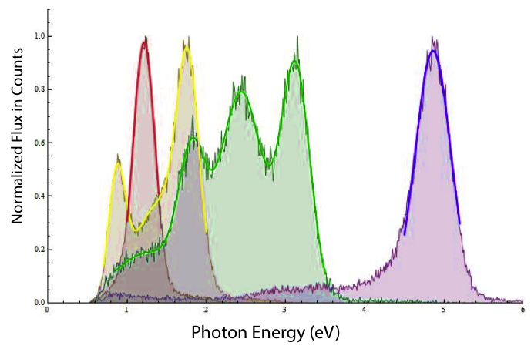
Substrate Events
From Roquiny et al. 1999
Optical photons that pass through the TiN film are absorbed very efficiently in the Si substrate, where they deposit their energy causing phonons to scatter back into the TiN. These events manifest as multi-peaked spectra, rather than the single gaussian peaks expected for monochromatic illumination.
To remove substrate events we move to a much thicker TiN film (from 20nm to 60 nm) where transmission through the TiN approaches 0%.

Slide 18
OLE Development Timeline

Slide 19
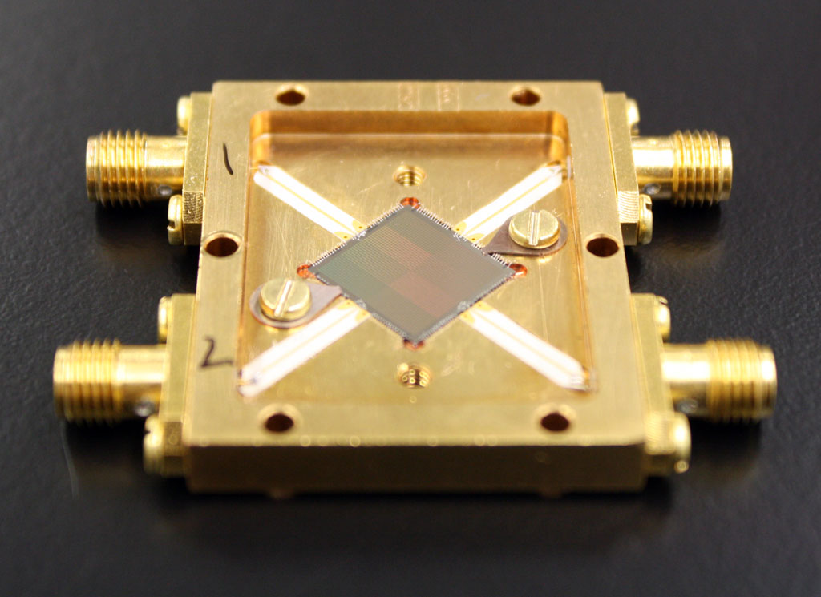
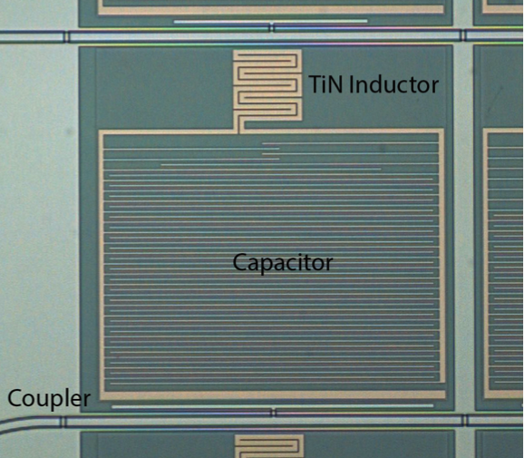
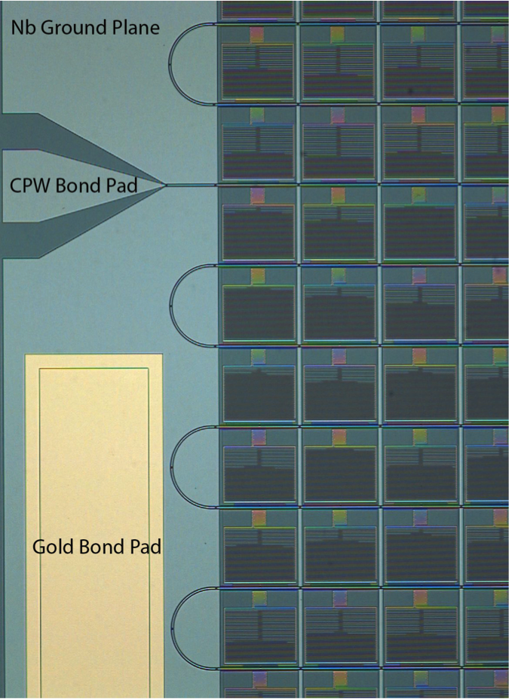
OLE11/SCI4
Changing from 20nm thick TiN to 60nm thick necessitates a redesign of the resonator to maintain the inductor volume, which controls the detector sensitivity.

Slide 20
OLE Development Timeline

Slide 21

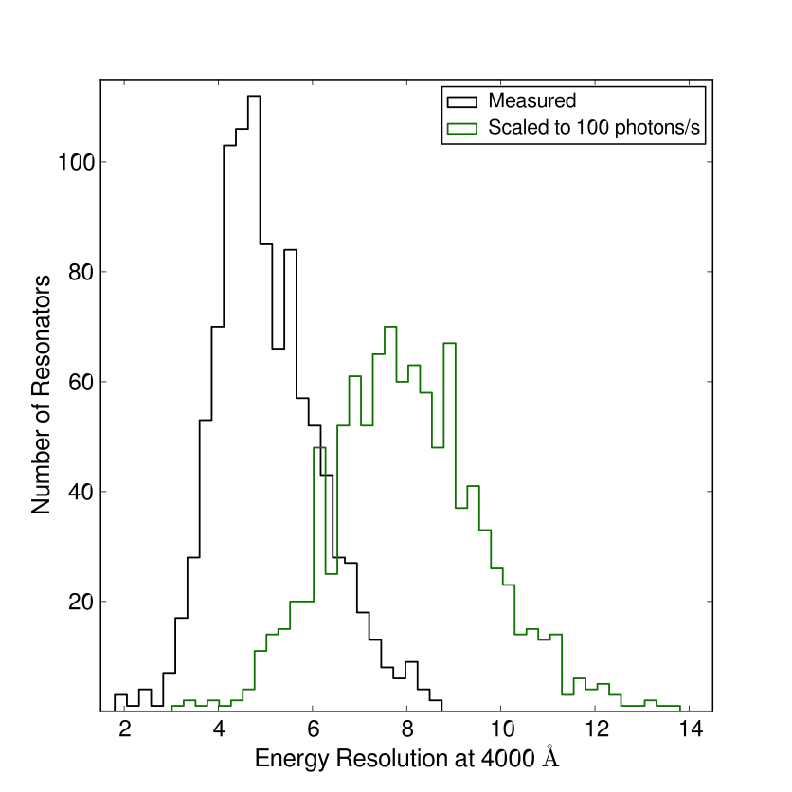
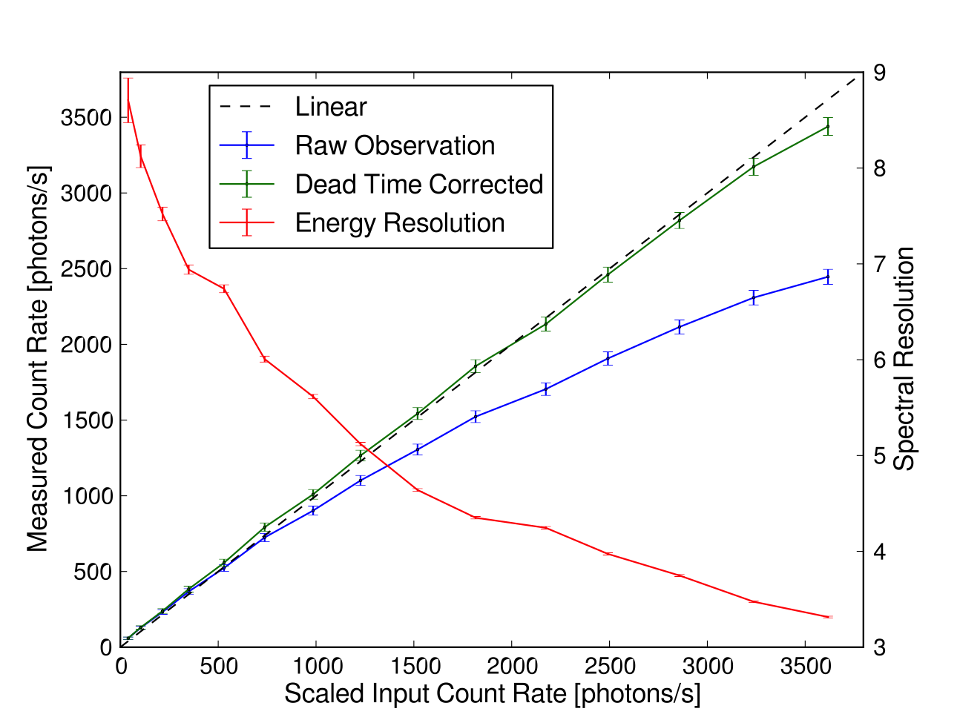
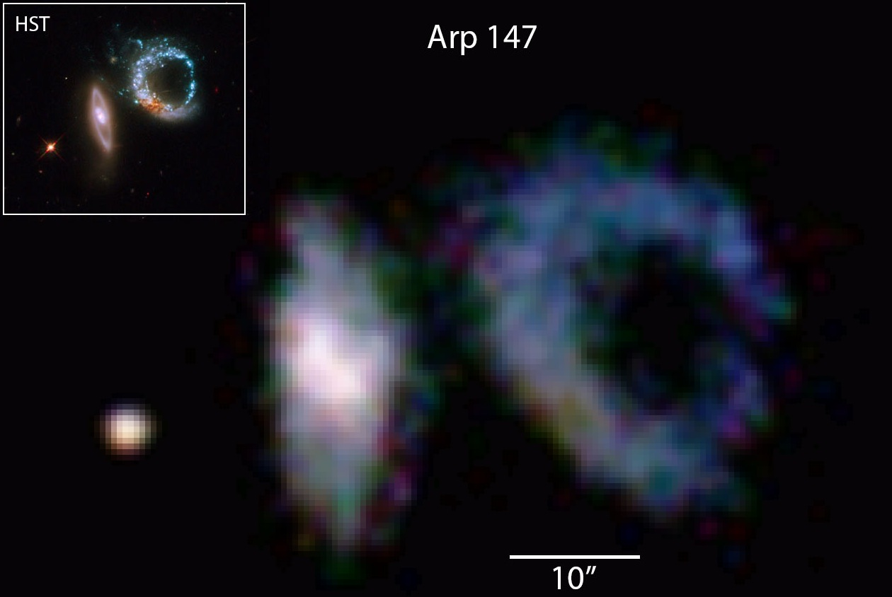
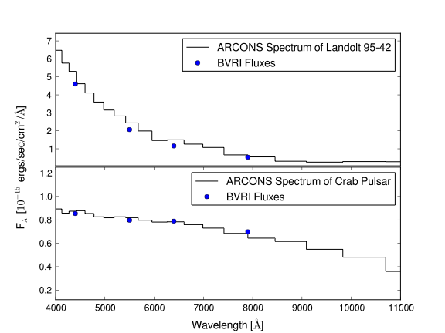
OLE11/SCI4 Performance

Slide 22
References
Original MKID paper
  Day et al. “A broadband superconducting detector suitable for use in large arrays.” Nature, vol. 425, pp.817-821, 2003.
Strip detectors, homodyne setup, all the basics
  Ben Mazin’s thesis
MKID readout
  McHugh et al. “A readout for large arrays of Microwave Kinetic Inductance Detectors.” Rev. Sci Inst, 83, 044702, 2012
TiN paper
  Leduc et al. “Titanium nitride films for ultrasensitive microresonator detectors.” App. Phys. Lett, 97, 102509, 2010
Crosstalk reduction
  Noroozian et al. “Crosstalk reduction for superconducting microwave resonator arrays.” IEEE Transactions on Microwave Theory and Techniques, 60, 5, pp.1235-1243, 2012
First OLE array paper
  Mazin et al. “A superconducting focal plane array for ultraviolet, optical, and near-infrared astrophysics.” Optics Express, 20, 2, 1503-1511, 2012
ARCONS instrument paper and OLE update
  Mazin et al. “ARCONS: a 2024 pixel optical through near-IR cryogenic imaging spectrophotometer.” Accepted to PASP, 2013.
Exhaustive superconducting resonator review
  Zmuidzinas, Jonas. “Superconducting microresonators: Physics and applications.” Annual Rev. of Cond. Matter Physics, Vol 3, 169-214, 2012
Find these on the Mazin Lab website: web.physics.ucsb.edu/~bmazin/

Slide 23
WARNING:
NOW ENTERING BONUS SLIDES

Slide 24
QE curve
QE (measured at LCOGT) is for TiN measured on a Sapphire substrate
Device remains sensitive up to 10’s microns
Sky background very high, so need to block IR photons

Slide 25
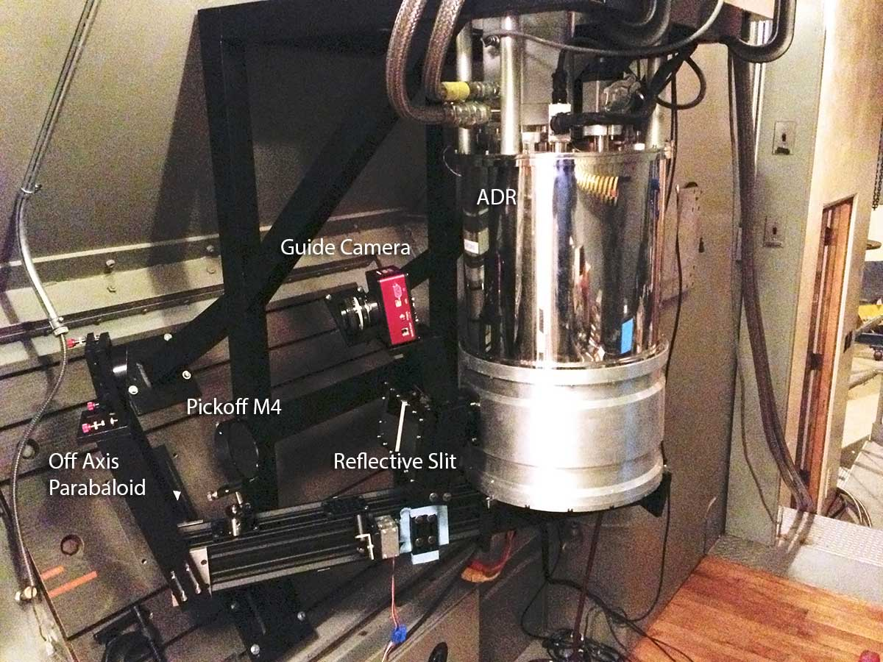
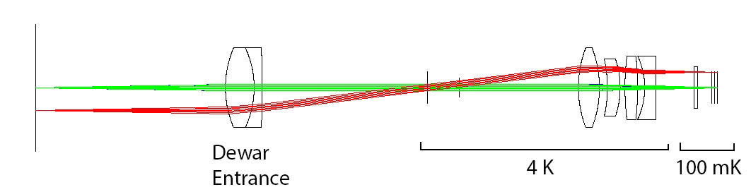
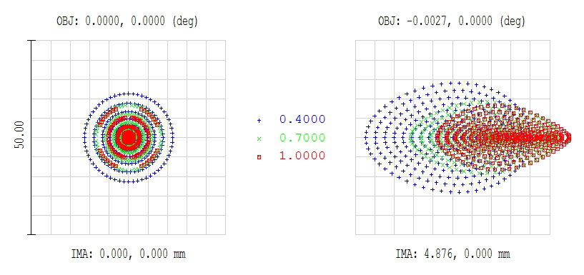
Proven at the Telescope with ARCONS
Array Camera for Optical to Near-IR Spectrophotometery (ARCONS)
First Light: July 28, 2011, Palomar 200” Coudé
Now 24 observing nights (Palomar+Lick)
Lens coupled 2024 (44x46) pixel array in cryogen-free ADR
0.5” pixels yields 22”x23” FOV
400 nm to 1100 nm simultaneous bandwidth with maximum count rate of ~2000 cts/pixel/sec
350-1350 nm soon
Energy resolution R~8 at 400 nm

Slide 26
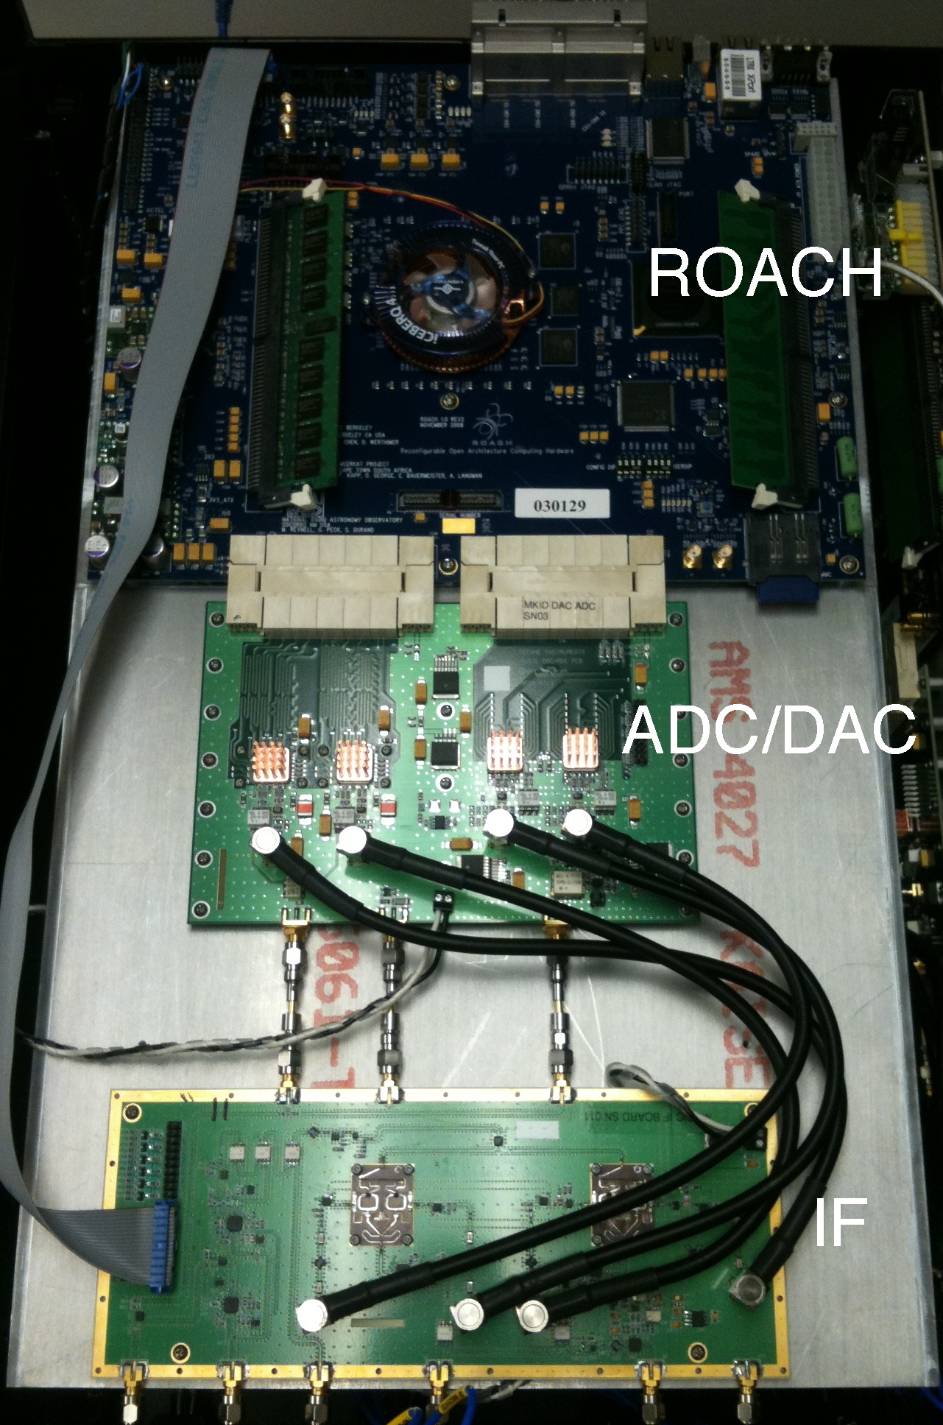
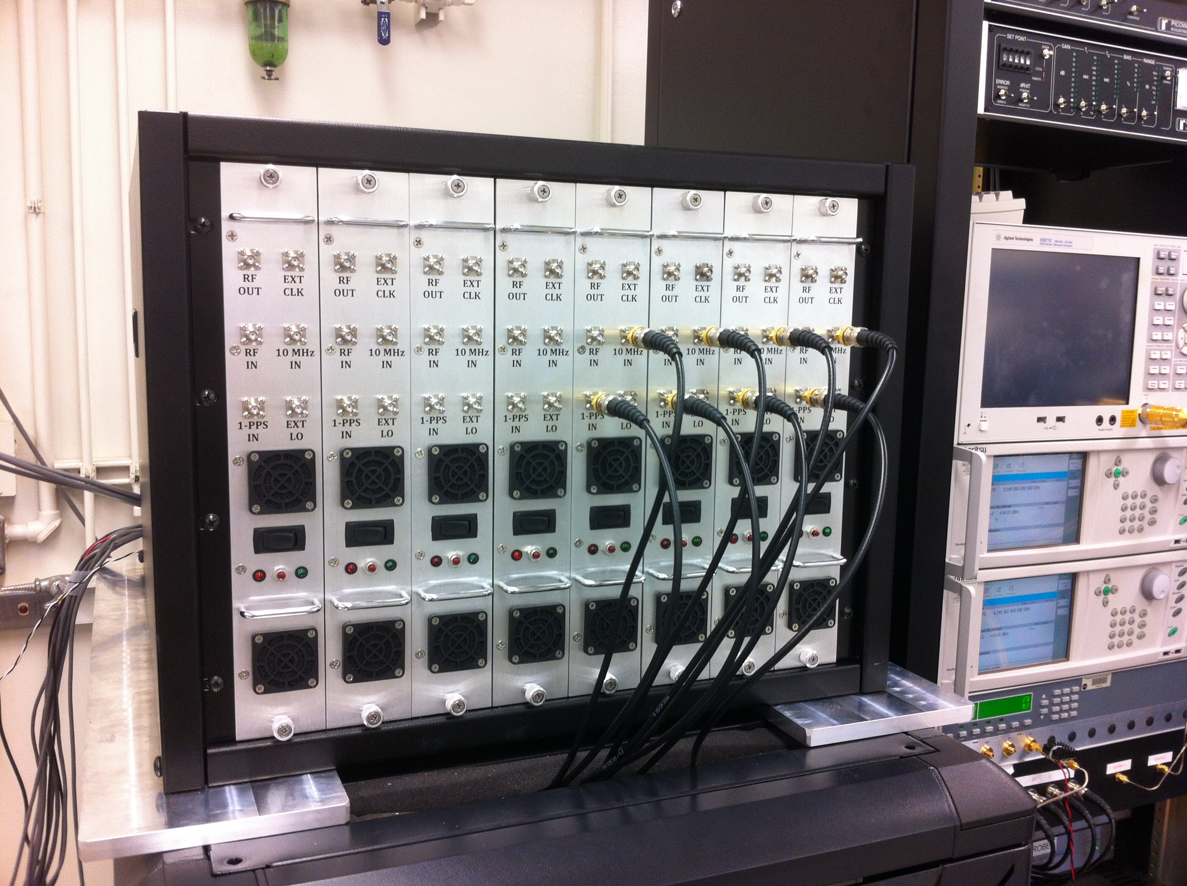
Current Readout System (Gen 1)
Dual 1 GSPS 16-bit DACs
Dual 550 MSPS 12-bit ADCs
ROACH with Virtex 5 SX95T
Complete readout for 256 resonators in 550 MHz of bandwidth
8 ROACH boards read out 2048 pix
~$25/pixel (Gen2 - $3/pixel)

Slide 27
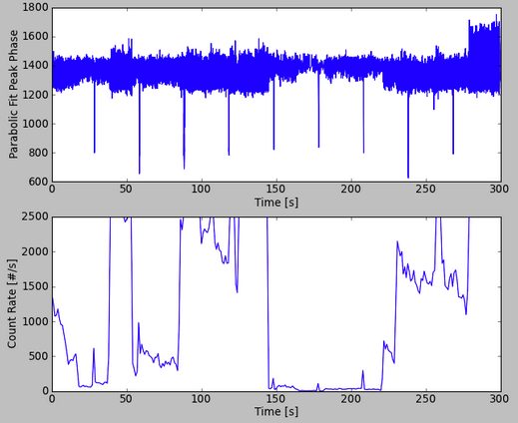
Baseline broadening->Hot pixels

