Slide 1
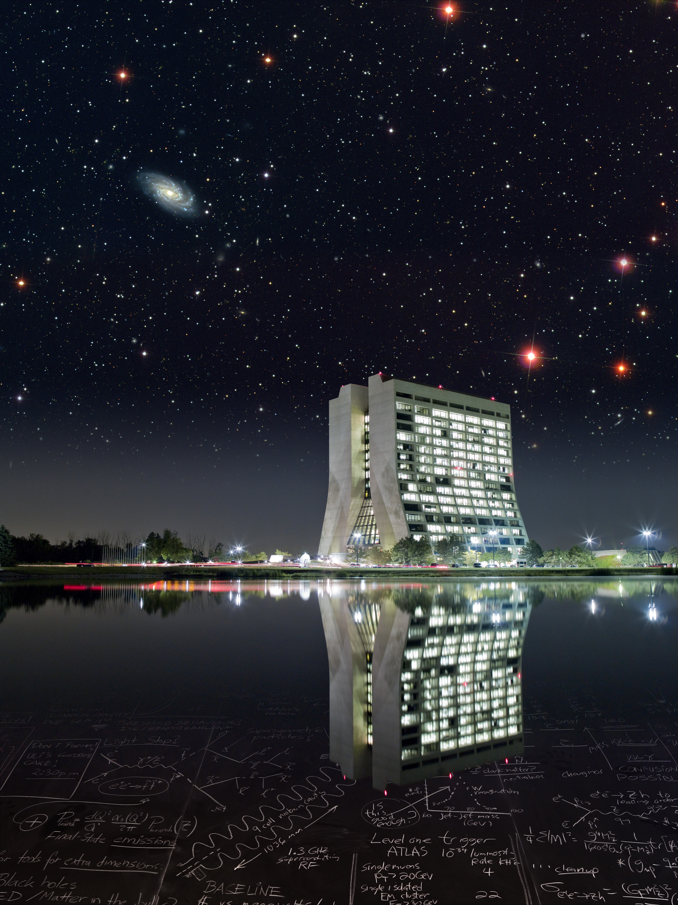
Welcome to Fermilab

Slide 2
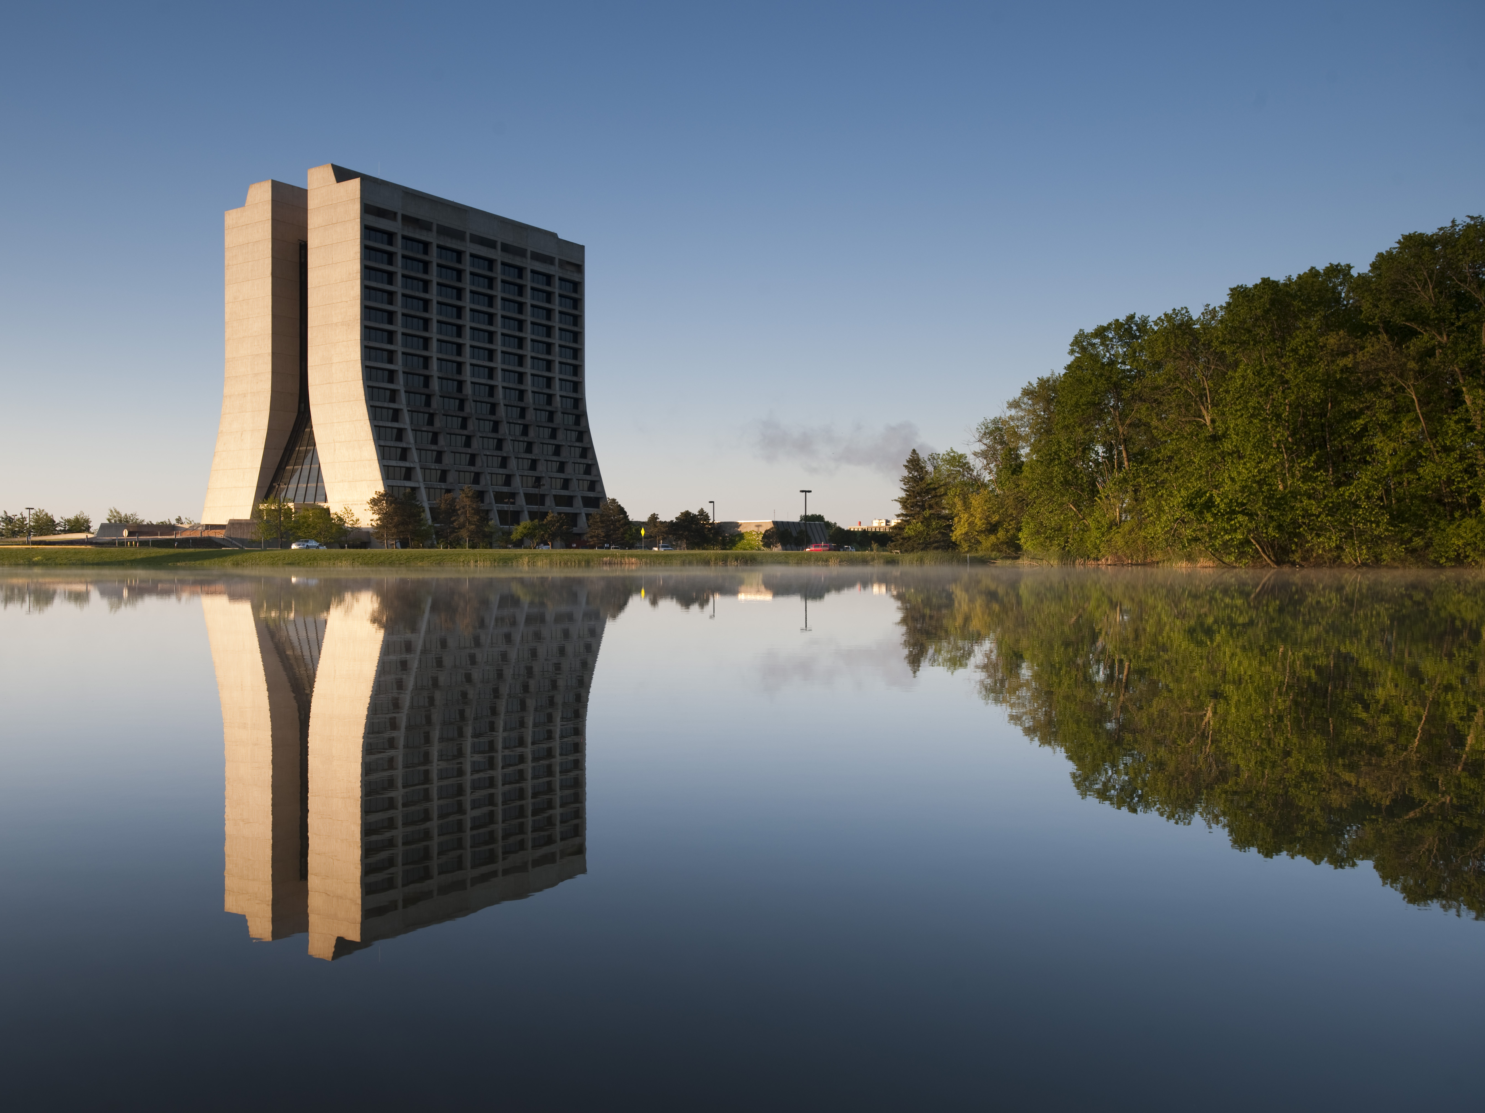
Motivation
(My non-expert questions on MKIDs and cosmology)
Gaston Gutierrez
Fermilab
Why dark energy? And the next two factors of five or ten?
A brief introduction to MKIDs (enough to set the stage)
Quick survey of the main players (DES, MS-DESI, EUCLID, LSST)
MKIDs as a low resolution spectrograph in the LSST era.
I will conclude with my list of questions.

Slide 3
MKIDs in general
There are plans to use MKIDs in many different areas, e.g. dark matter, CMB, x-rays detectors, visible astronomy, dark energy, etc.
CMB experiment for example need small array of MKIDs to do science and they are on their way to do just that in the next few years (see next two transparencies for GroundBIRD)
I will only address during this talk the questions related to how to do science with MKIDs in relation to dark energy. Given Femilab’s involvement in DES and now in MS-DESI it is only natural to try to continue on the Dark Energy path. Also as a DOE Lab we can do cosmology but not astronomy.

Slide 4
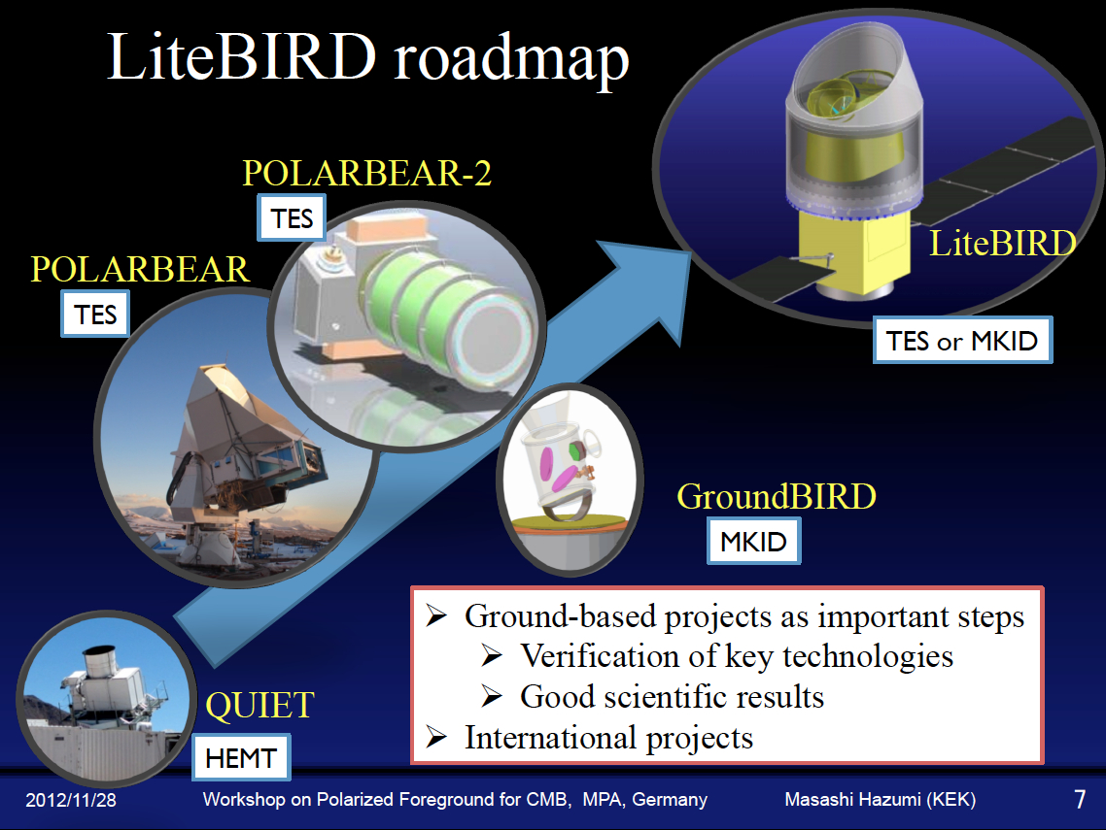

Slide 5
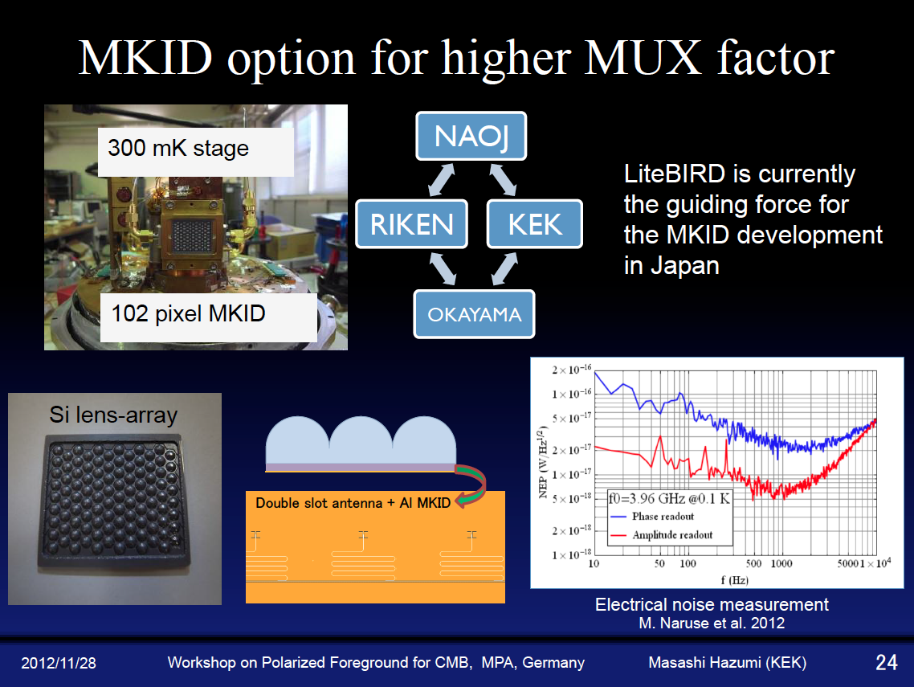

Slide 6
MKIDs for Dark Energy
The path in relation to the question of using MKIDs to study Dark Energy is as follows:
As we speak: ARCONS is providing a demonstration on the first real use of an arrays of about 2,000 MKIDs for astronomy.
The next 5 years: or next factor of 5-10 (10 -20 thousand resonators) will be the installation of a larger MKIDs arrays in the Soar telescope.
The 2020-2030 decade: I think that there is consensus that the next factor of 5-10, or 100 thousand resonators in the form of a low resolution spectrograph, will be the first instrument capable of doing Dark Energy science.
(Of course several orders of magnitude later we can have large imaging arrays)

Slide 7
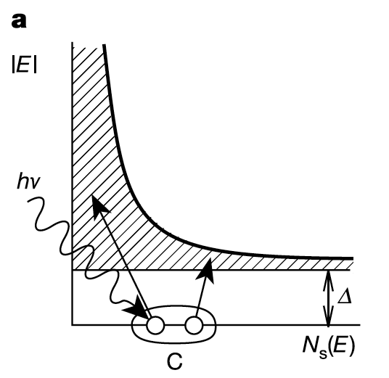
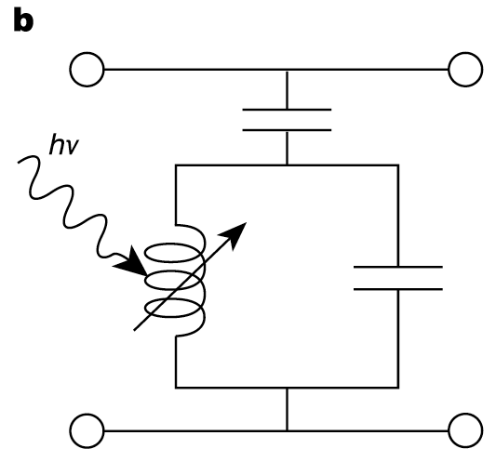
What are MKIDs ?
MKIDs = Microwave Kinetic inductance Detector (or a superconducting resonator)
A photon strikes the superconductor breaking a few thousand Cooper pairs.
The broken Cooper pairs change the inductance of the resonator.

Slide 8
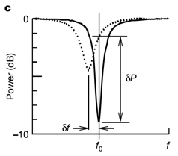
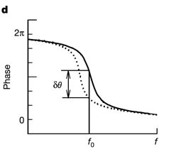
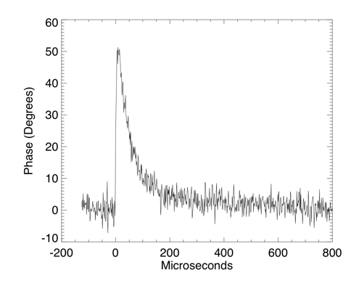
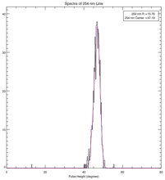
MKIDs (superconducting resonators)
The resonance frequency and phase change due to the change in inductance.
The phase change is measured providing a time and energy measurement for each photon.
The theoretical energy resolution is about R=λ/Δλ≈100
Up to about 2000 resonators could be coupled to the same feed line.

Slide 9
Theoretical resolution for MKIDs
The limiting resolution of the MKIDs is given by the fluctuations in the number of quasi-particles. In other words it will be proportional to the square root of the number of quasi-particles. That is
Where η=0.57 is the efficiency for producing quasi-particles, hν is the photon energy,
Δ=1.72 k_{B} T_{c} is the superconducting gap (T_{c} is the superconductor critical temperature), the factor 2.355 converts rms to FWHM and F≈0.2 is the Fano factor (*).
(*) For example for a binomial system where η is the probability of producing quasi-particles and (1-η) the probability of producing phonons the rms of this binomial distribution is given by σ²=N_{qp} (1-η). Then the Fano factor is 1-η=0.43. In the real case the interaction between phonons and quasi-particle reduces the Fano factor to about 0.2

Slide 10
A comparison of R for different experiments
MKIDS TiNx (Tc=0.8K)
MKIDS Al (Tc=1.175K)
PAU
MKIDS Ta (Tc=4.47K)
PRIMUS
DES
(T_{c} in Kelvin and λ in μm)

Slide 11
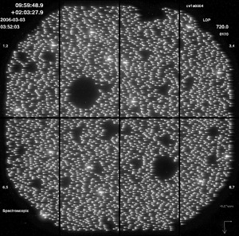
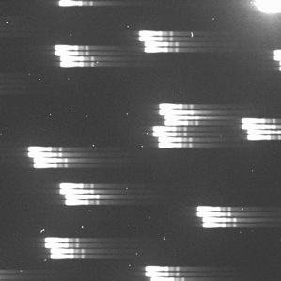
Transforming R into δz: the PRIMUS survey
arXiv:1011.4307v2 [astro-ph.CO] 11-Aug-2011
PRIMUS is a survey performed with the Magellan telescope. The survey uses a mask followed by a prisms to spread the light into the CCDs to obtain spectroscopic information.
A 24-minute IMACS prism exposure of a slitmask with ~3000 objects in the COSMOS field. Areas around bright stars are masked to avoid scattered light and photometric catalog errors.
A close up of a small portion of a single exposure. Each object has 4 traces; we drill 2 slits for each object and nod the telescope between them. The other 2 traces are sky. The footprint for one object on the detector is 6.4” x 28”.

Slide 12
Spectral resolution (or R) for PRIMUS

Slide 13
PRIMUS δz resolution

Slide 14
Transforming redshift to co-moving distance
The co-moving distance for a given redshift z is given by:
For a flat universe (Ω_{k} =0), a photo-z error δz=0.0035 (1+z) and a Hubble constant H₀=100 h (km/sec)/Mpc we have
Which is plotted in the right hand plot for h=0.75, Ω_{m} =0.25, and Ω_{Λ} =0.75

Slide 15
Giga-Z, a low resolution multi-object spectrograph
(See B. Mazin et al. in the SPIE Proceedings, July 2012)
A 1” mask (red circles) in each of the 10” pixels is superimposed over a Hubble UDF image.
Galaxies are projected on an array of 100,000 MKIDs+microlense array (~0.7 deg²). A mask selects a galaxy in each pixel. The readout consists of about 100 feed-lines.

Slide 16
Redshift Space Distortions (RSD)
The two point correlation function ξ looks like:
Simulations from:
Enrique Gaztañaga et al,
MNRAS 422, 2904 (2012)

Slide 17
RSD with BOSS
Reid et al, arXiv:1203.6641v1, Mar 2012

Slide 18
So, what needs to be measured to study DE?
Then for Dark Energy studies we want to measure the following objects over as large a volume as possible (many Gpc³):
Galaxy shapes, types, angular position and redshifts.
Supernovae (SNe Ia).
Angular position and spectrum of quasars. Mapping of hydrogen clouds.
Future projects that will do that on a large scale are:
DES: imager with 5 filters. In 5 years will cover 5000 square degrees to magnitude 24 and z up to ~1.5. Status: running.
MS-DESI: Spectrograph. Status: start in 2017?
EUCLID: Space imager and spectrograph. Status: launch date ~2019.
LSST: imager with 6 filters. Status: scheduled to start in 2021.

Slide 19
MS-DESI
4 m telescope
5000 fiber, 3 arm spectrograph, R~4000
Spectra for 1800 objects/deg² (~10% of available galaxies)
Magnitude limit ~22.5, z~3.5
Will cover 14,000 deg² in 3 years
20 M galaxies, 0.6 M QSO
~5 μm resolution
~12 mm actuator pitch

Slide 20
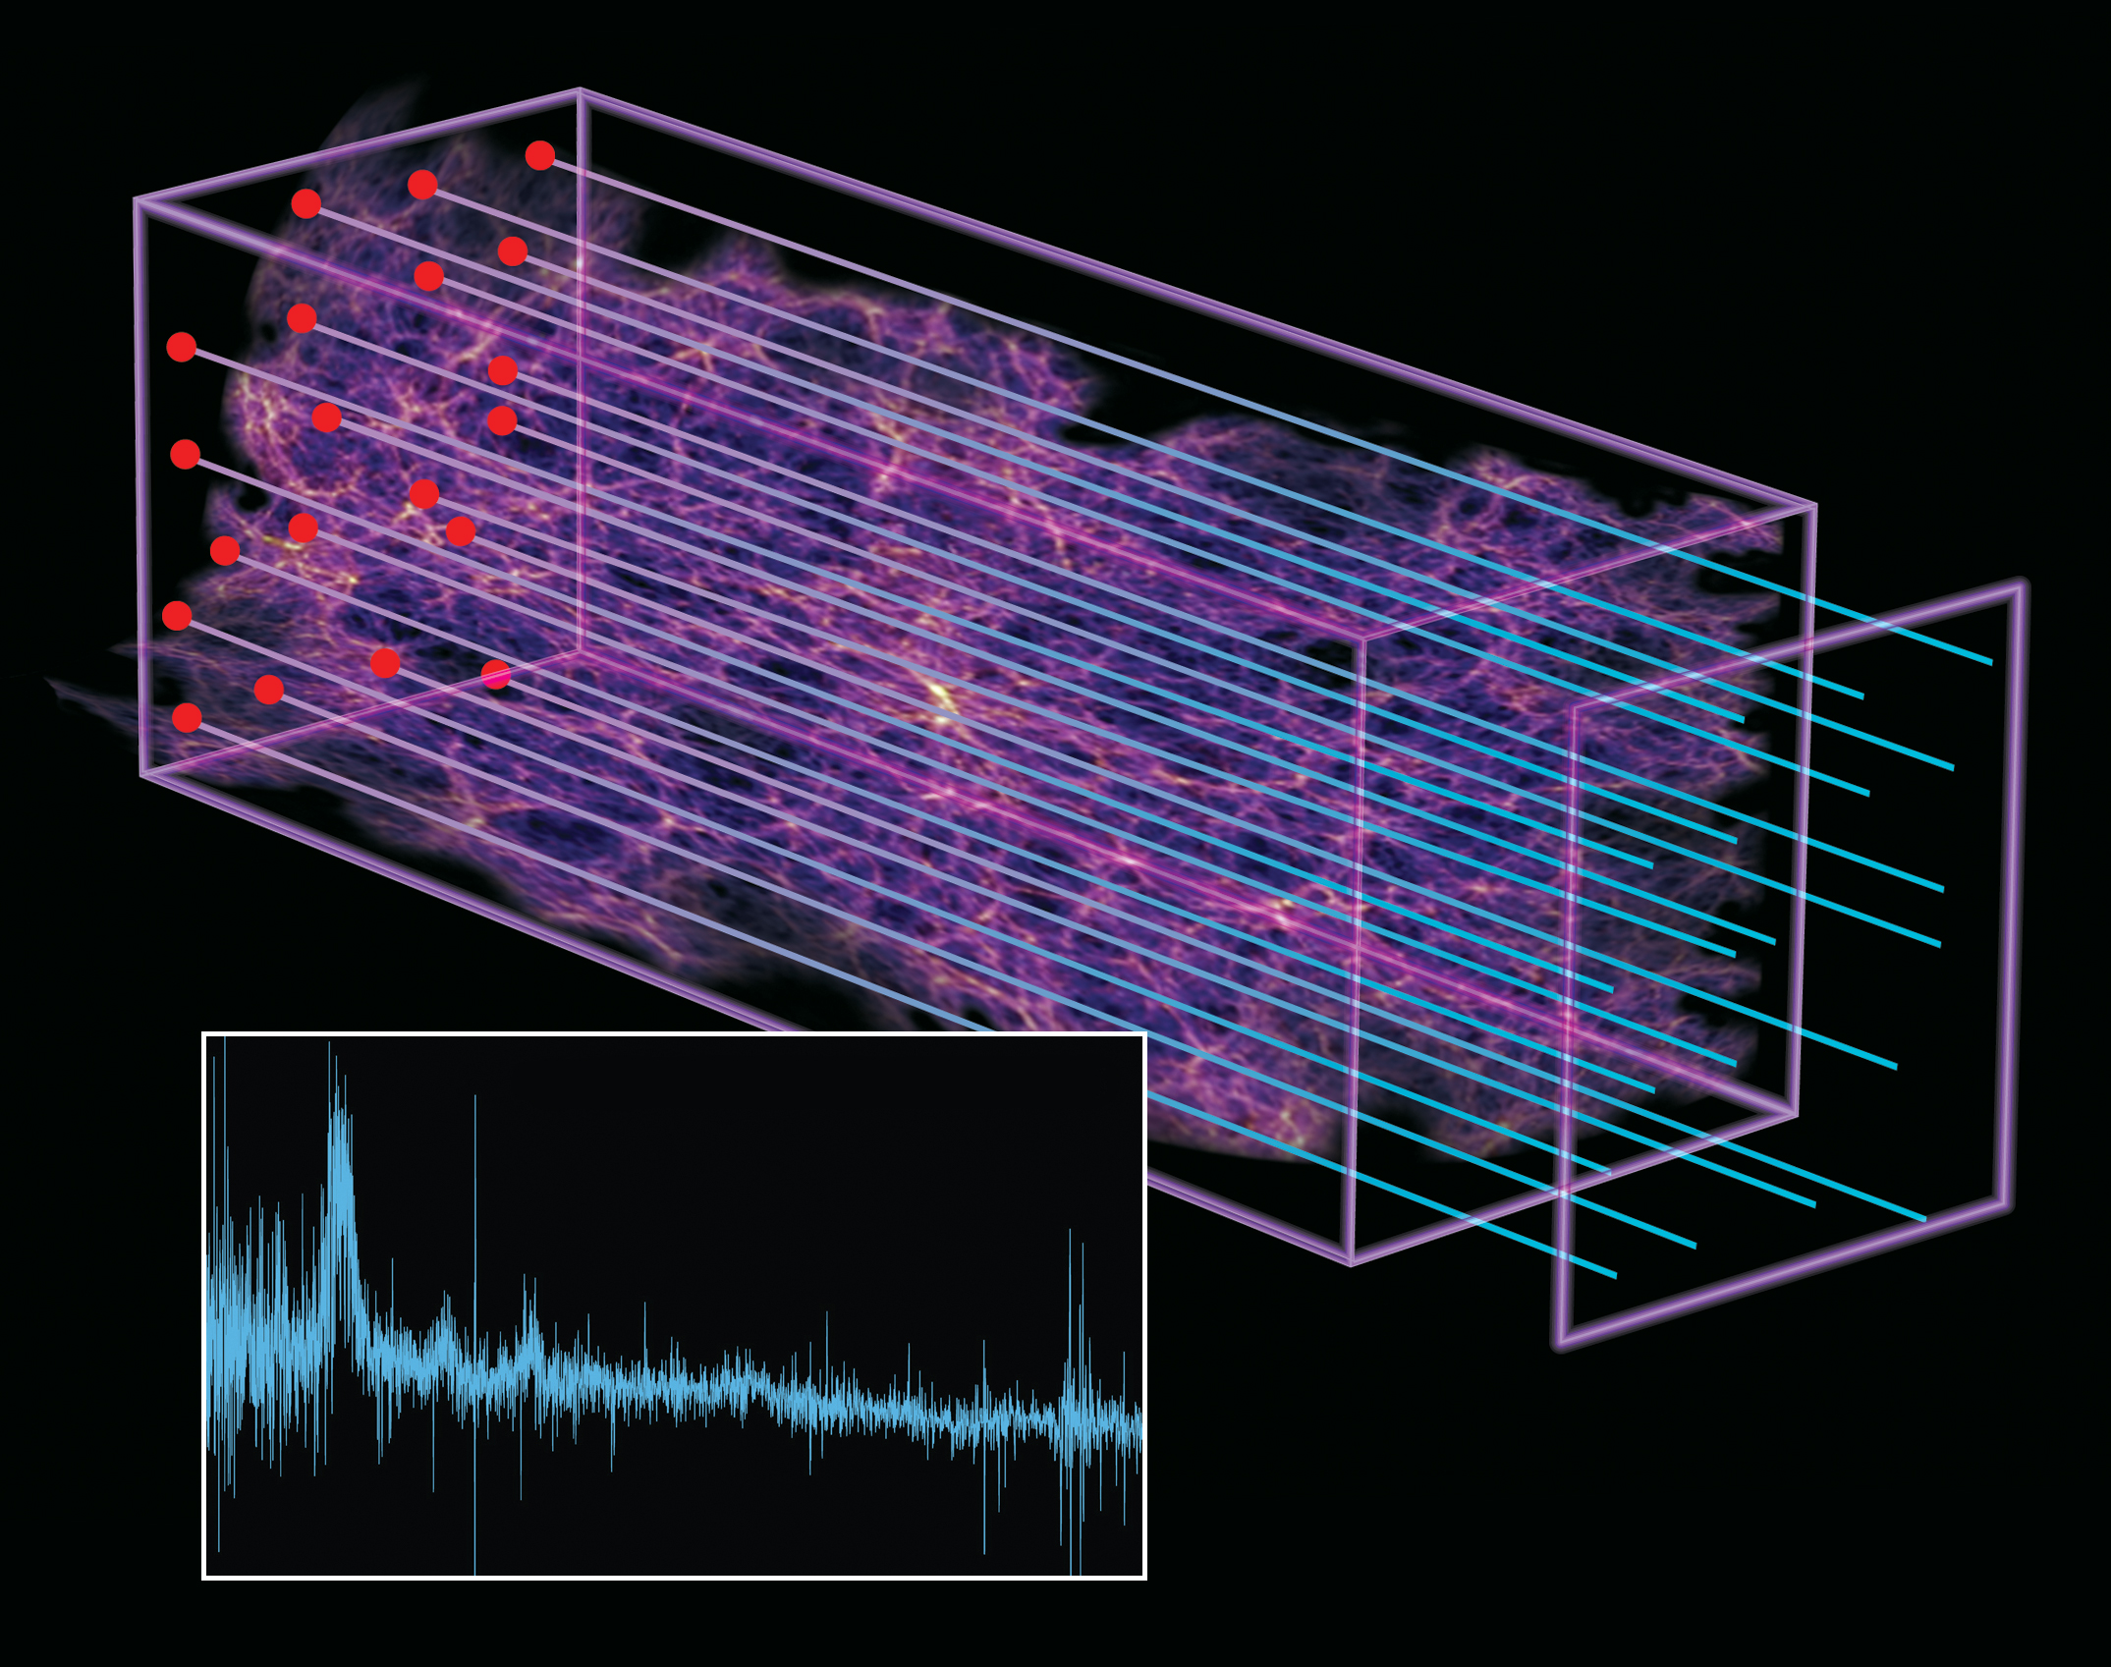
How far in redshift will MS-DESI go?
Beautiful new result: “BAO in the Lyα forest of BOSS quasars” arXiv:1211.261v1, Nov 2012.

Slide 21
MS-DESI

Slide 22
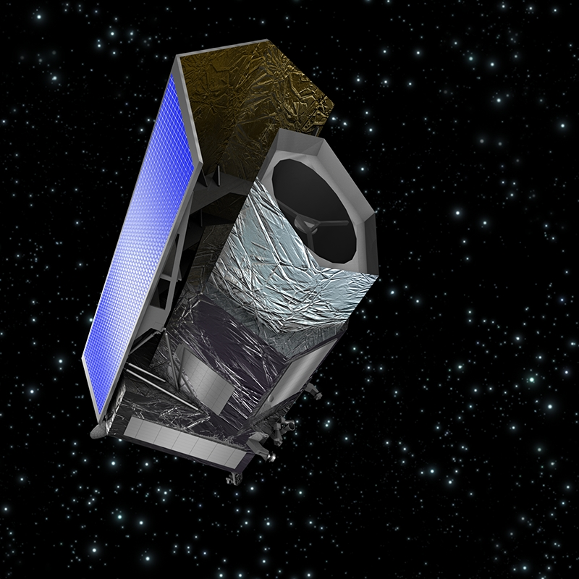
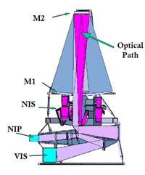
EUCLID
1.2 m telescope
Visible imager (VIS), NIR photometry, low resolution NIR spectroscopy R~250 to 0.7<z<2.1
Visible m~24.5, NIR m~24
Shapes for ~1.5 B galaxies
Low resolution spectra for ~50 M galaxies to 0.7<z<2.1
Will cover 15,000 deg² in 6 years
VIS
NISP

Slide 23
EUCLID

Slide 24
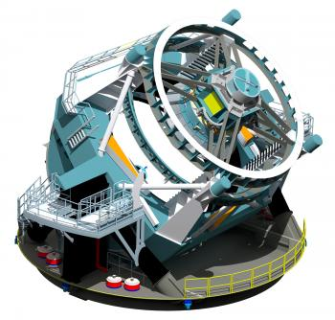
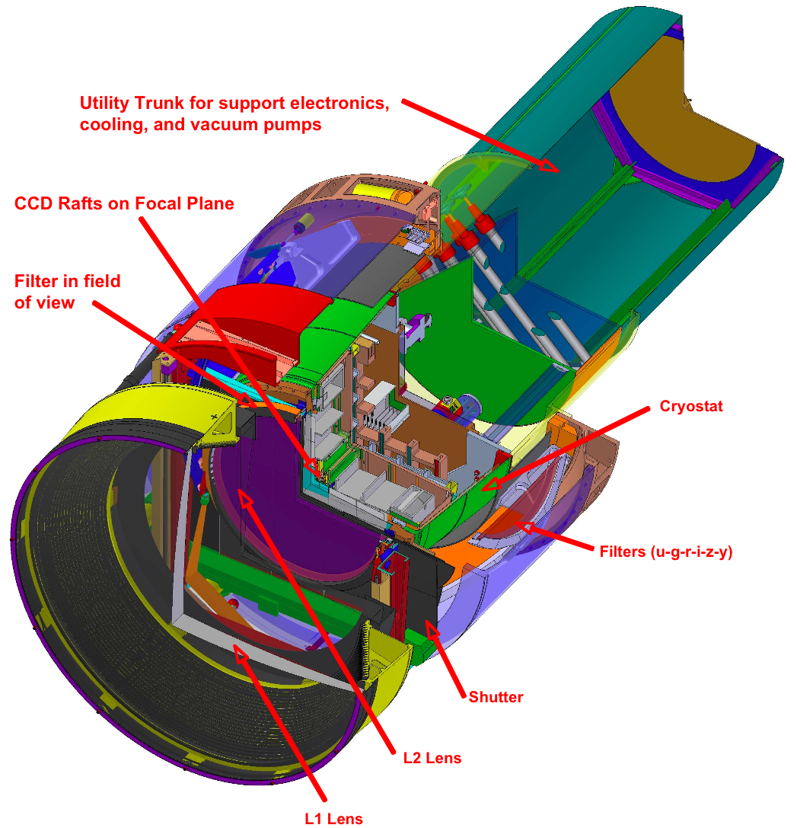
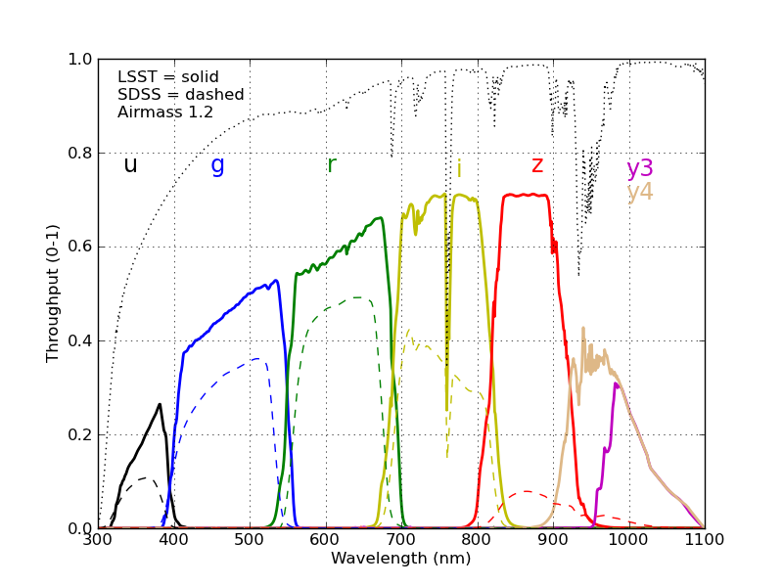
LSST
~8 m telescope
6 filter for visible photometry
Reach up to magnitude ~27.5
Will cover 20,000 deg² in 10 years.
Will measure ~20 B galaxies

Slide 25
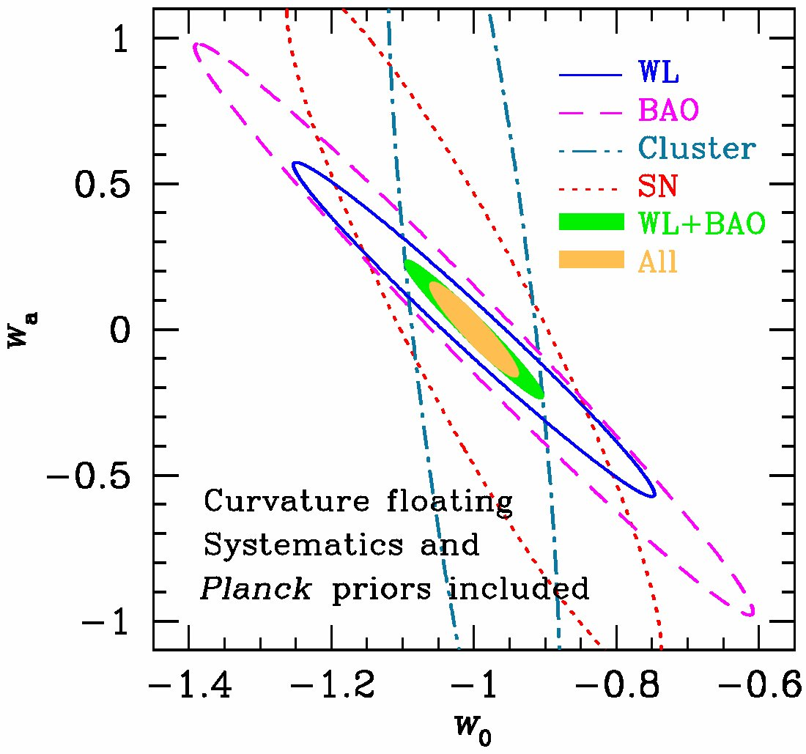
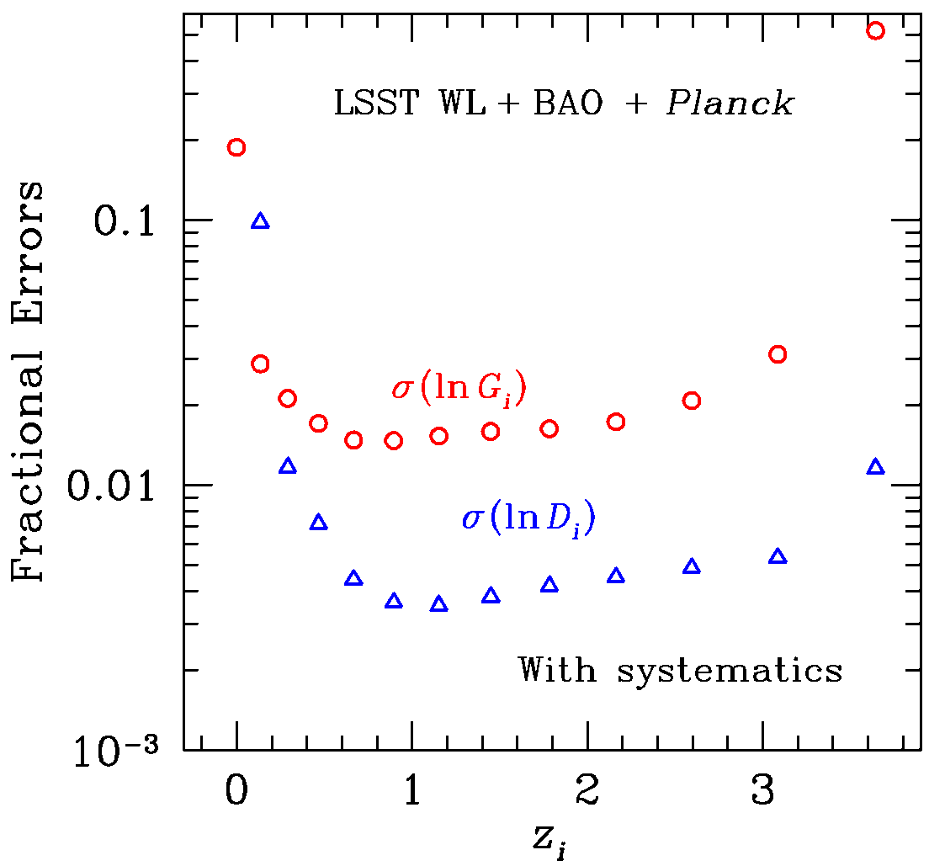
LSST
D_{i} = co-moving distance
G_{i} = growth rate

Slide 26
What do we do in the decade 2020-2030?
Situation after DES, MS-DESI, EUCLID, Panstars … :
About 15,000 deg² of the sky will have been imaged to magnitude of 24-24.5. This will give about 1.5 billion galaxies.
High resolution spectroscopy will exists for about 25 million galaxies and about 0.5-1. M QSO. Low resolution NIR spectroscopy will exists for about 50 M galaxies.
Situation during/after LSST:
Imaging will improve by an order of magnitude. About 20,000 deg² of the sky will be imaged to magnitude of about 27.5. This will give about 10 billion galaxies.
But no big improvement in spectroscopy that I know off.
So we may ask the question: can we get high or low spectroscopy for most of the LSST galaxies up to magnitude ~24.5 ?

Slide 27
Can we scale spectrographs like MS-DESI?
Scaling from magnitude 22.5 to 24.5 requires an increase in the number of photons by a factor of 40. This can not be done by increasing the exposure time. Going to an 8 m telescope will still leaves us short of a factor of 10. Reducing R may help but not by much, so this looks difficult.
Right now with 4000-5000 fibers MS-DESI measure 1500-1800 objects per deg² out of the 10,000 available.
At magnitude 24.5 one has about 100,000 galaxies/deg², doing spectroscopy on half of them will require 30 times the number of fibers and 2 mm pitch between fibers. To me that kind of scaling doesn’t look doable with current technology.
Can MKIDs provide a way out of this problem?

Slide 28
What could a low resolution MKIDs spectrograph (e.g. Giga-Z) do if it works as expected?
In a 4 (8) m telescope it could go up to magnitude 24.5 (25.7), covering 20,000 square degrees in 3 years (7 year run).
It could provide a redshift resolution equivalent to a distance resolution of ≈15 Mpc, good enough to be into the non-linear regime of GR.
It will cover most of the available galaxies/deg² up to magnitude 24.5. That is about 100,000 galaxies per square degree for a total of about 2 (4) billion galaxies.
What are the problems that need to be solved?
The list is ambitious but we believe doable:
  R has to get closer to the theoretical limit.
  The packaging need to be greatly improved.
  The RF electronics needs improvement.
  A flat RF cable suitable to work at 100 mK needs to be developed.
  It will help to improve the QE.

Slide 29
Some questions for the workshop?
Can the use of MKIDs transform LSST from a Stage IV to a Stage V Dark Energy experiment?
What would be the gain of doing RSD with LSST+MKIDs?
Can we do QSO? Supernovae?
Is there any gain on having low resolution spectroscopy over the same sky as opposed to different skies?
During the LSST era what would be the advantage of having a low resolution spectrograph in the south vs., for example, moving MS-DESI to the Blanco?
If bias can be measured with DES+SPT first and LSST+SPT later, would that help the MKIDs case?

Slide 30
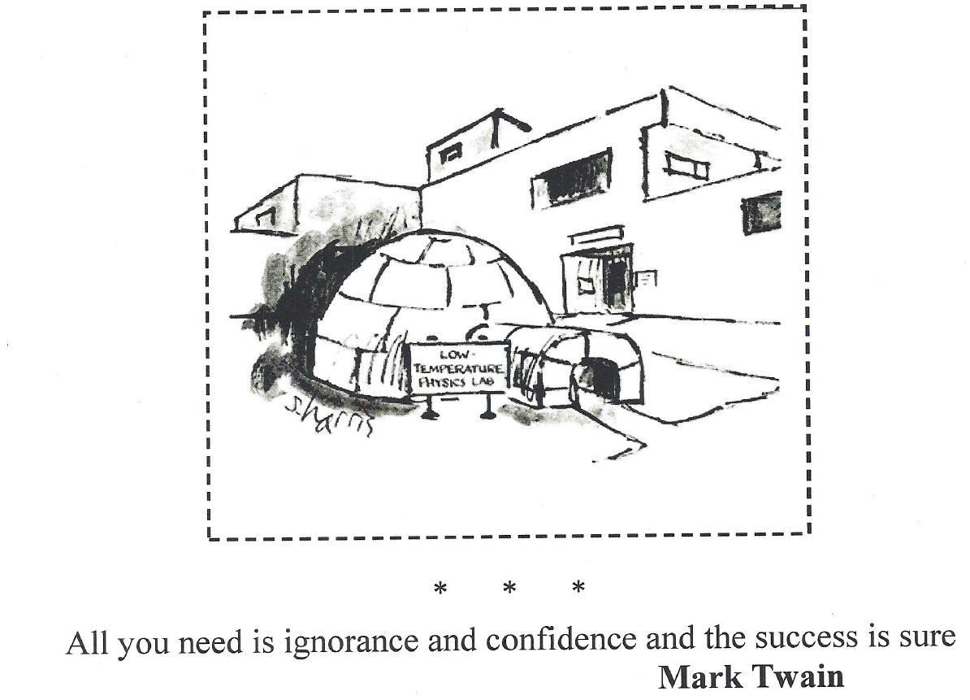

Slide 32
The End

