Slide 1
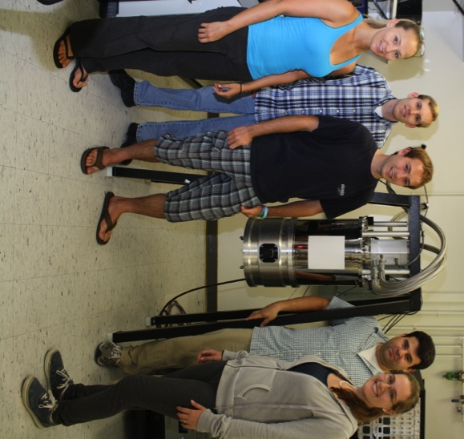
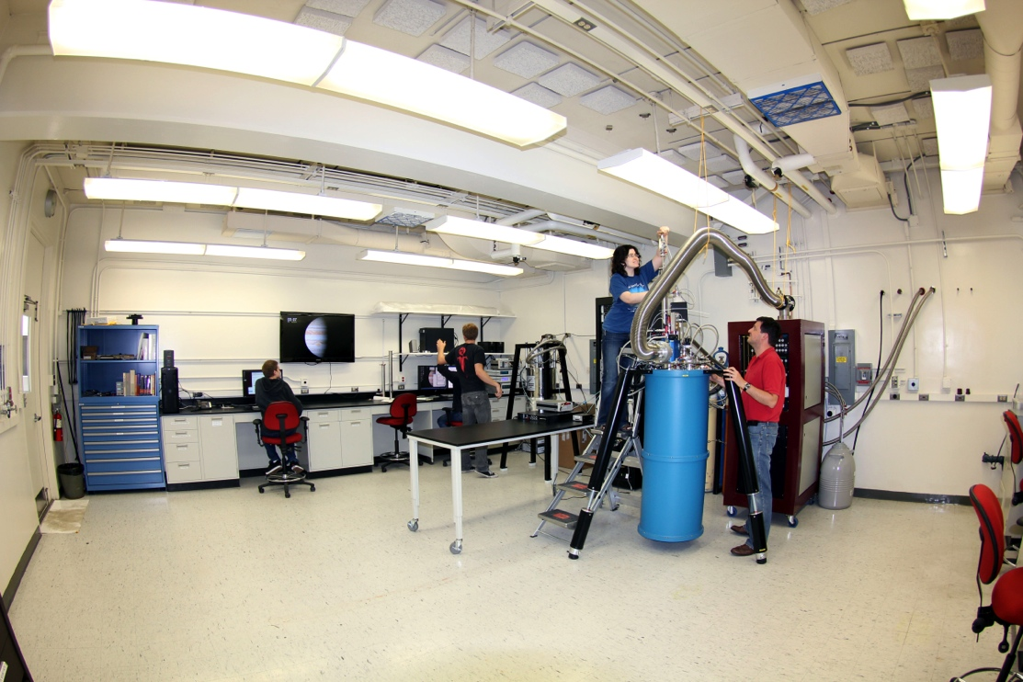




UVOIR Microwave Kinetic Inductance Detectors for Astrophysics
Ben Mazin, August 2013
The Optical/UV MKID Team:
UCSB: Danica Marsden, Ben Mazin, Seth Meeker, Matt Strader, Paul Szypryt, Gerhard Ulbricht, Julian van Eyken, Alex Walter
JPL: Bruce Bumble
Oxford: Kieran O’Brien
Fermilab: Chris Stoughton
Mazin Lab @ UCSB +

Slide 2
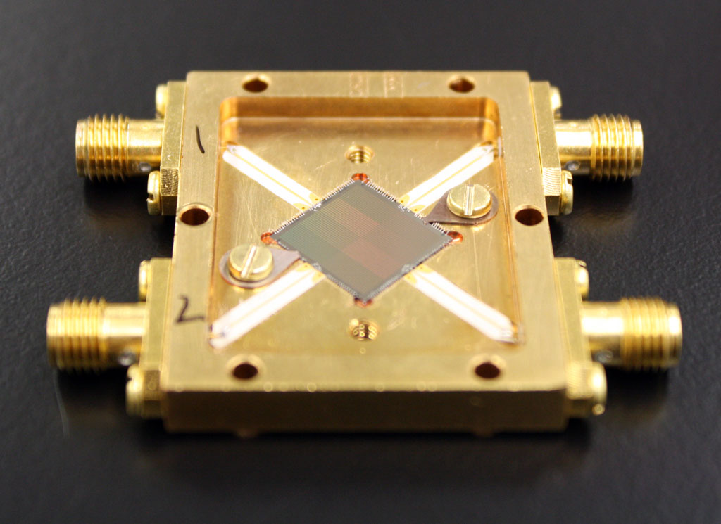
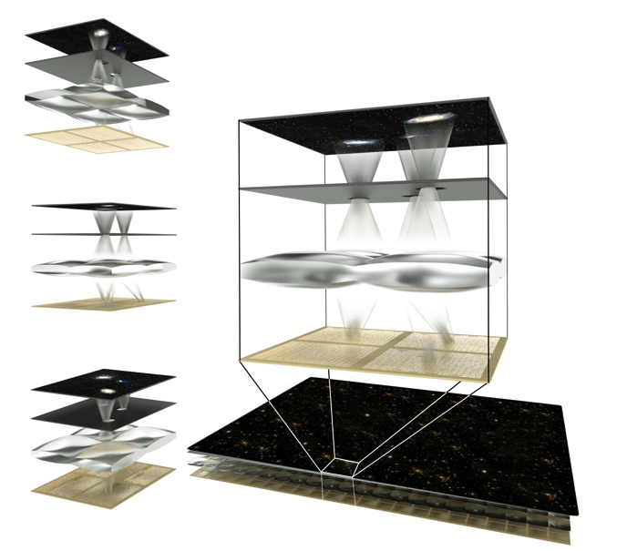
Take Aways
We’ve built an optical/near-IR detector array based on superconductors that, like an X-ray Microcalorimeter, can count individual photons and determine their energy without filters or gratings
We’re going to use these detectors to revolutionize astronomy by taking spectra of EVERYTHING
Day et. al, Nature, 2003
Mazin et. al, Proc. SPIE 2010
Mazin et. al, Optics Express 2012

Slide 3
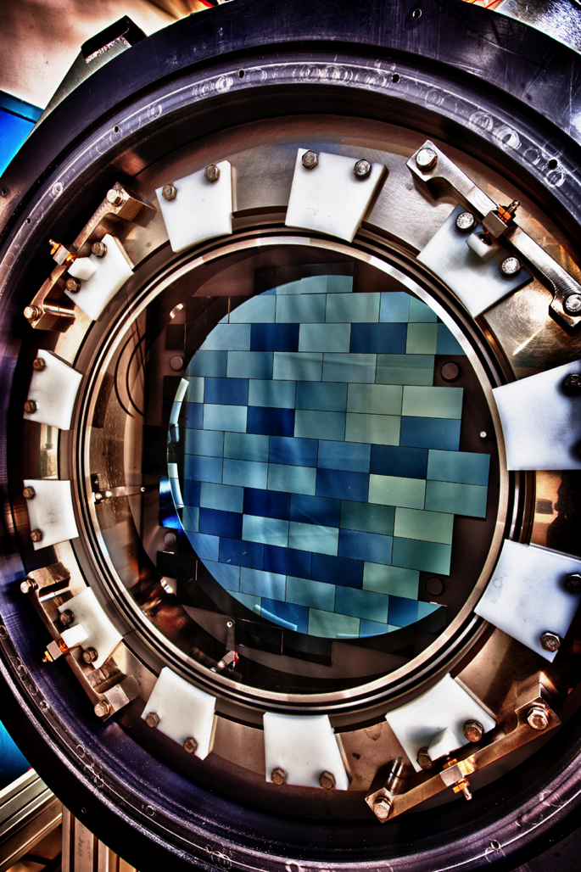
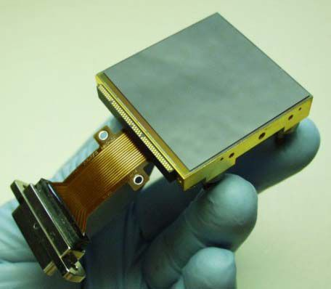
Semiconductor Detectors
Astronomers typically use CCDs and CMOS detectors in the optical/near-IR range to convert photons into electrical signals
Photoelectric effect means at most 1 electron per photon
DECam CCD Mosaic
Hawaii2rg HgCdTe Array

Slide 4
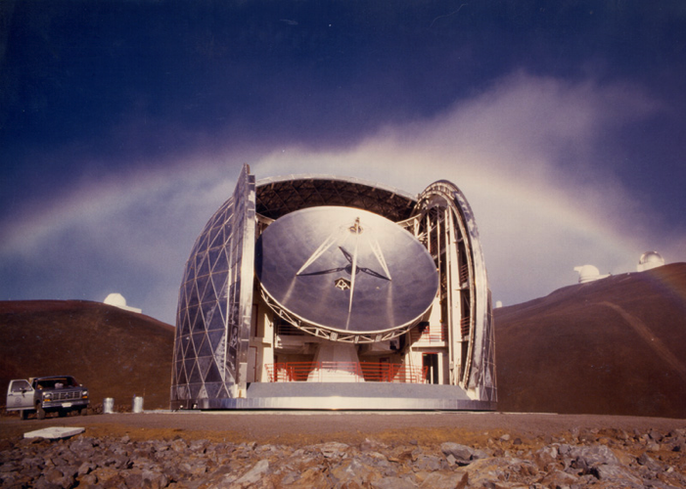
We can’t let the submm guys have all the fun!
The “submillimeter” approach to Astronomy:
  Build your own detectors
  Don’t be afraid of low temperatures
  Put them in an instrument
  Do science
Can this approach be productive in the UV/optical/near-IR where excellent commercially available detectors exist? Yes! Semiconductor detectors are powerful, but:
    Usually poor time resolution
    No intrinsic energy resolution
    Read Noise, Dark Current, Cosmic Rays
    Dispersion can lead to packing problems/inefficient use of array real estate

Slide 5
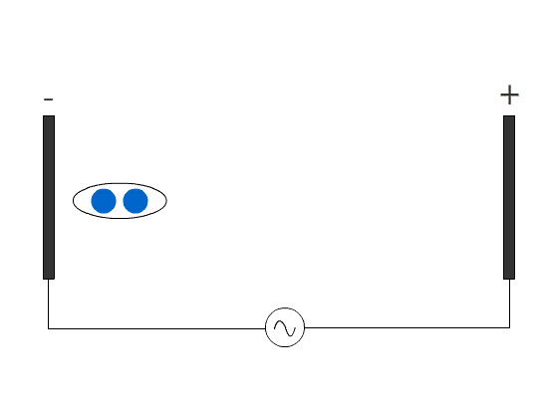
Kinetic Inductance Effect
Kinetic Inductance = extra inductance from stored kinetic energy in Cooper Pairs

Slide 6
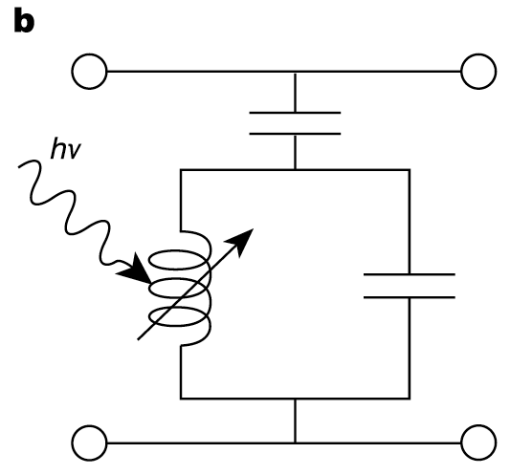
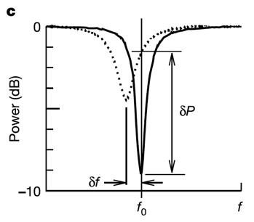
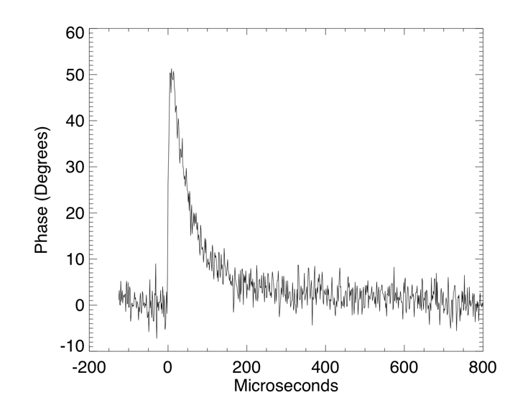
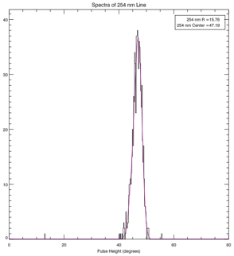
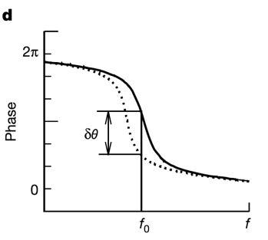
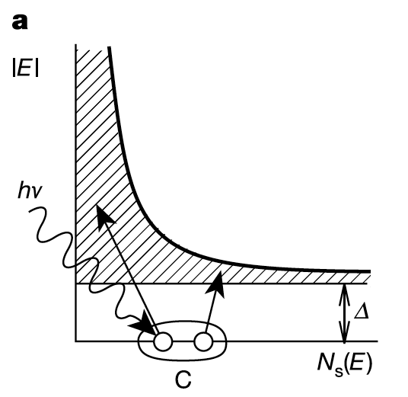

MKIDs
MKID Equivalent Circuit
Typical Single Photon Event
Inductor is a
Superconductor!
Energy Gap
Silicon – 1.10000 eV
Aluminum – 0.00018 eV
Energy resolution:
Cooper Pair

Slide 7
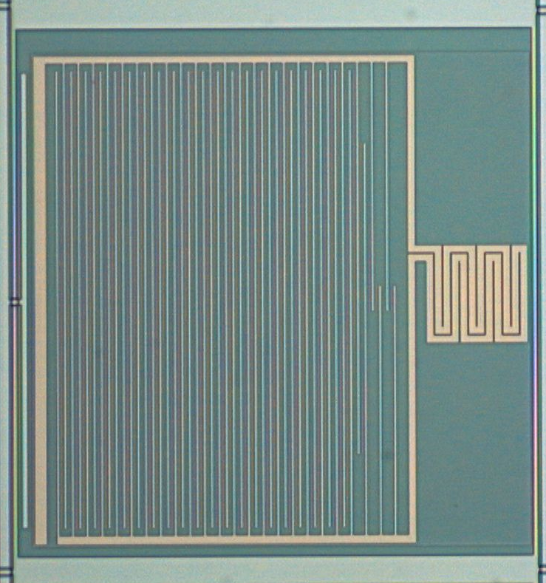
What is a Kinetic Inductance Detector ?

Slide 8
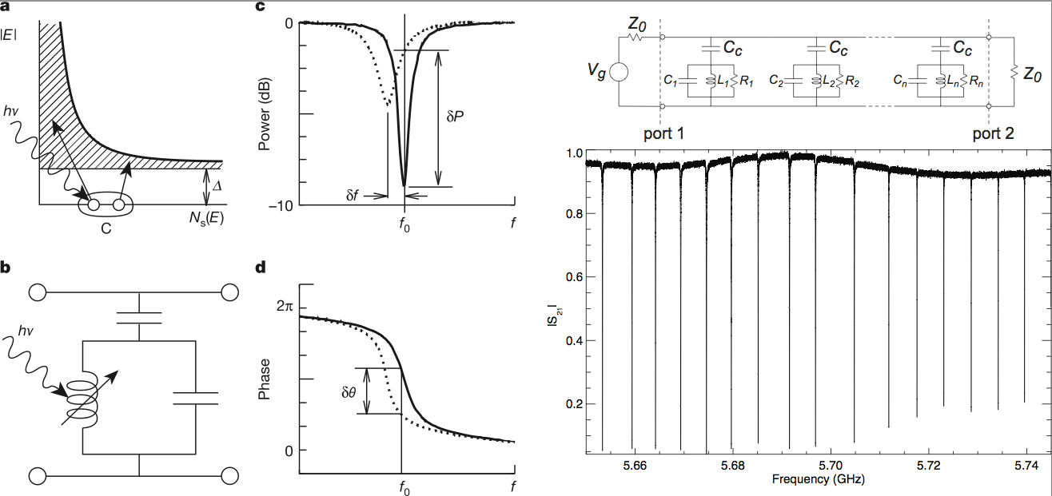
Frequency Domain Multiplexing
Each resonator (pixel) has a unique resonant frequency in the GHz range
A comb of sine waves is generated and sent through the device
Thousands of resonators can be read out on a single microwave transmission line (FDM)

Slide 9
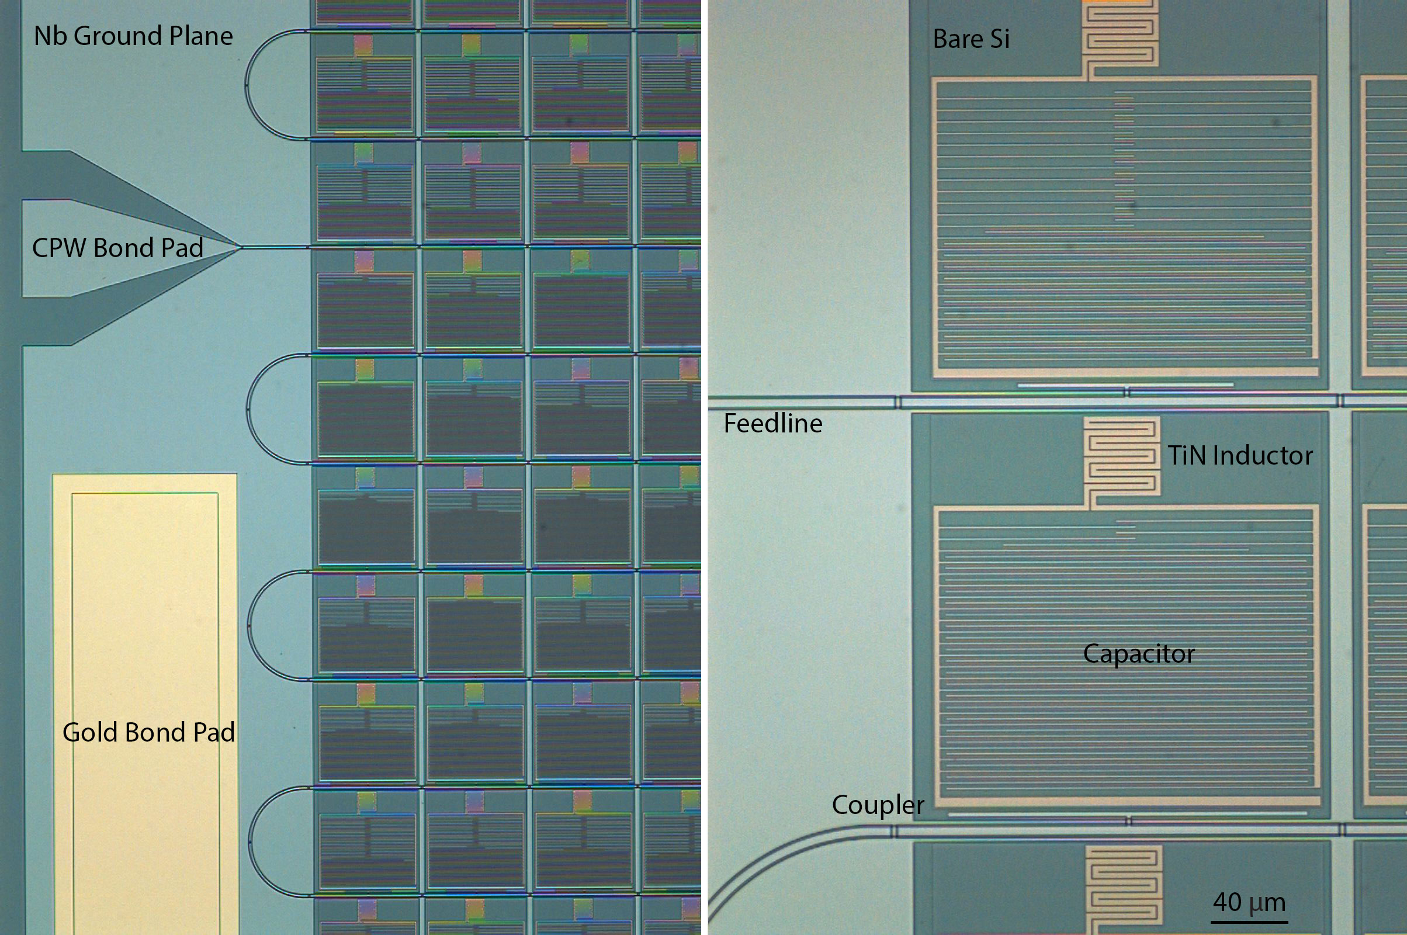
UVOIR MKIDs
Directly absorb photons in the TiN_{x} (800 mK) MKID inductor
Nb ground planes with SiO₂ crossovers
Microlens array boosts fill factor to 92%

Slide 10

UVOIR MKIDs
UVOIR MKIDs now on sky with ARCONS
2024 (44x46) pixel array
222 micron pixel pitch
2 feedlines
2 MHz resonator spacing
~92% resonator yield
~70% “good” pixel yield
  Frequency collisions dominate yield!
110 mK operating temp
Mazin et al. 2013, PASP submitted
(arXiv:1306.4674)

Slide 11
Digital MKID Readout
Software Defined Radio (SDR) Overview
  Leverages massive industry investment in ADCs/FPGAs
  Generate frequency comb and upconvert to frequency of interest
  Pass through MKID and amplify
  Downconvert and Digitize
  “Channelize” signals in a powerful FPGA
  Process pulses (optical/UV/X-ray) or just output time stream (submm)

Slide 12
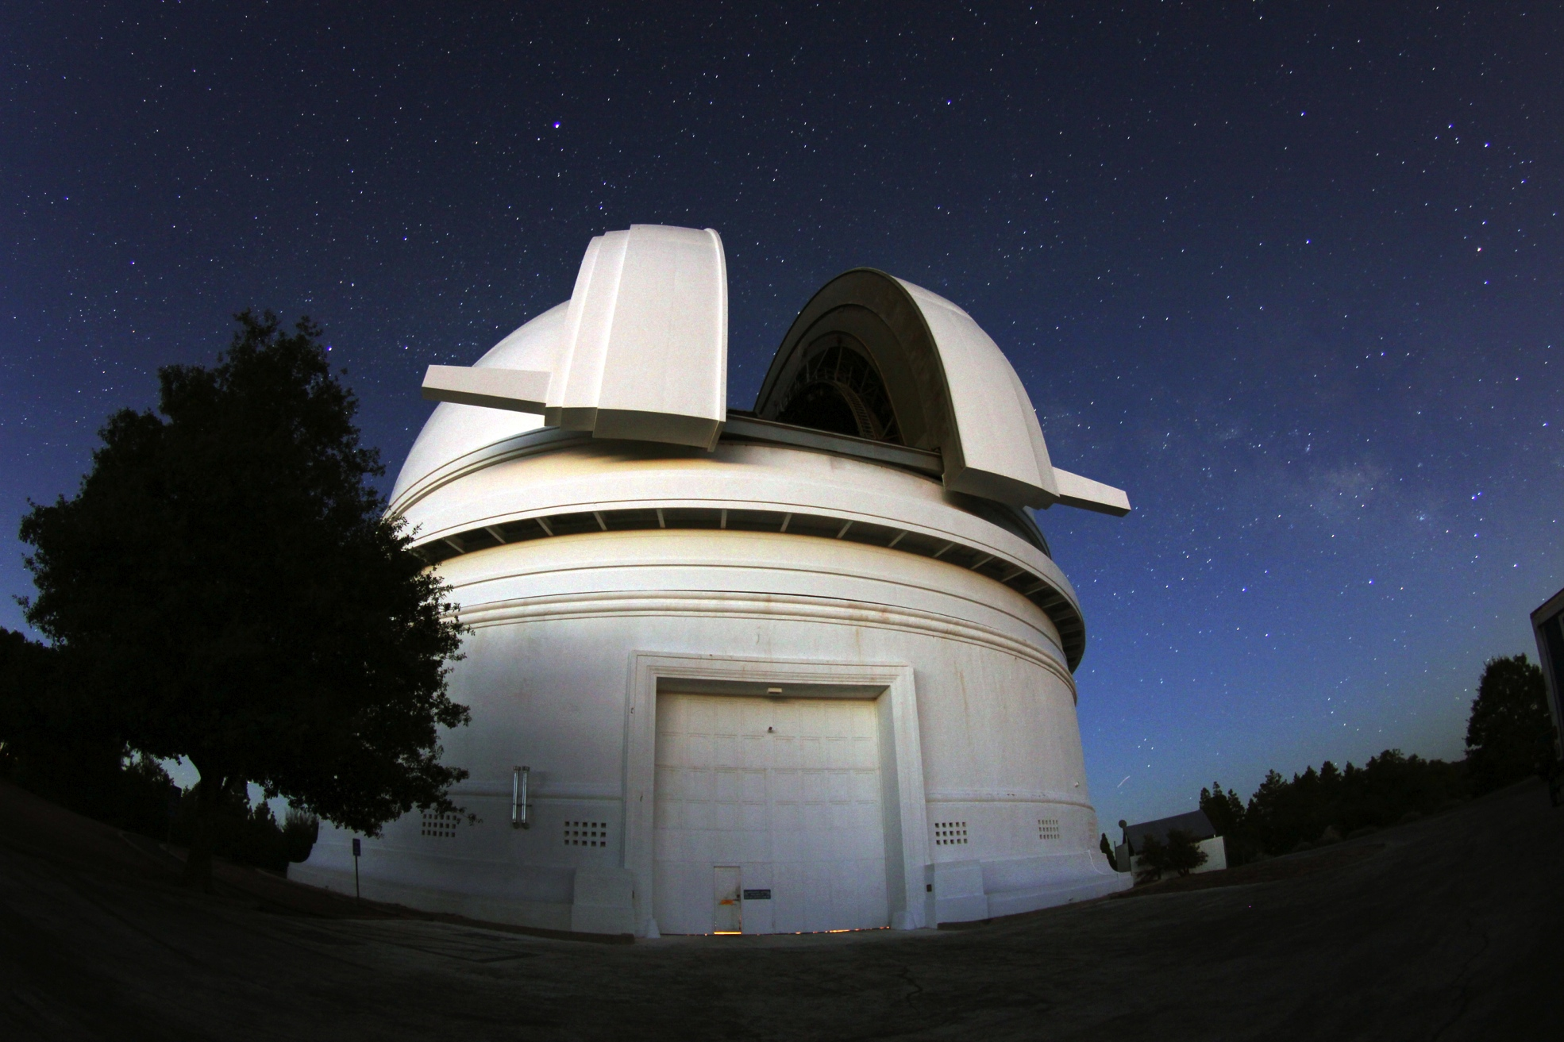
To Palomar!

Slide 13
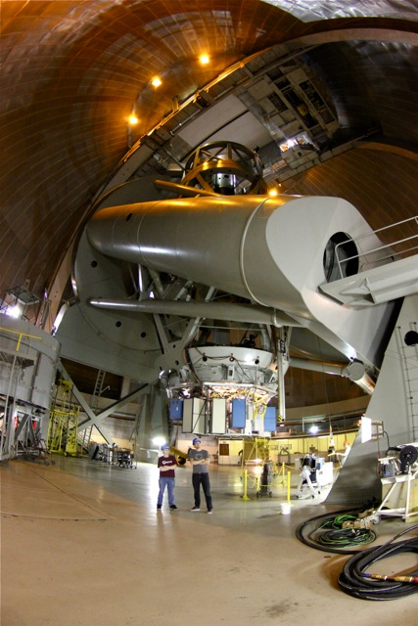
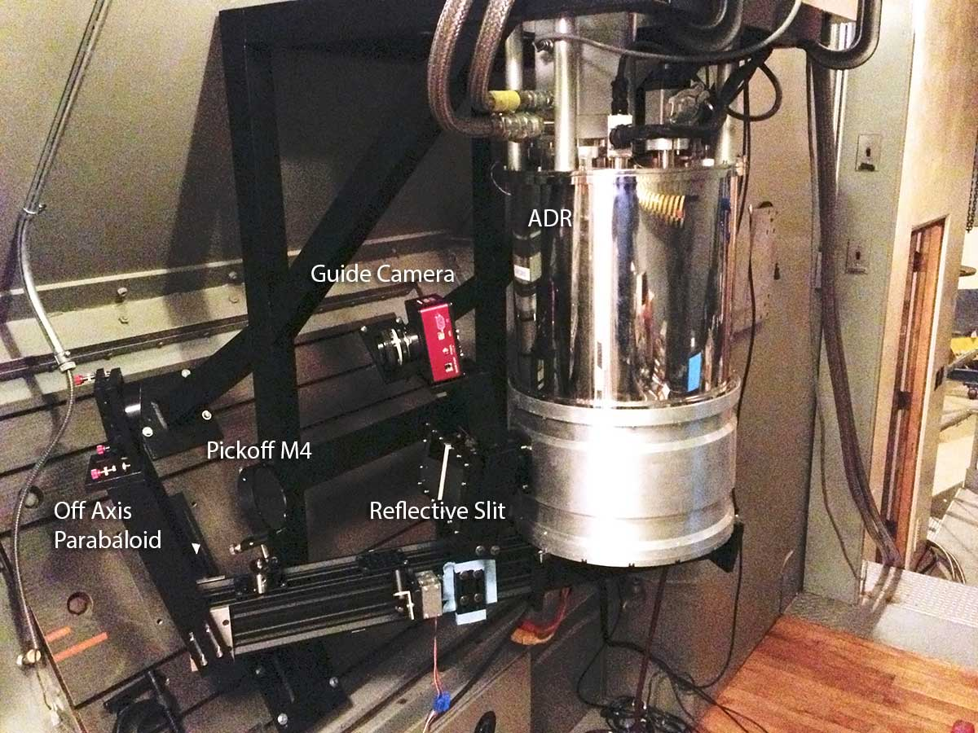
135 ft
ARCONS
16.67 ft
5.67 ft

Slide 14
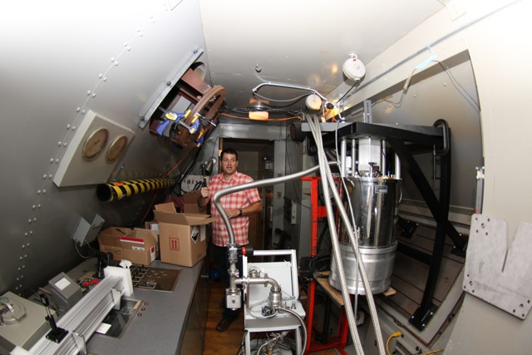
Kieran O’Brien,
shocked at how little light gets to Coudé…

Slide 15
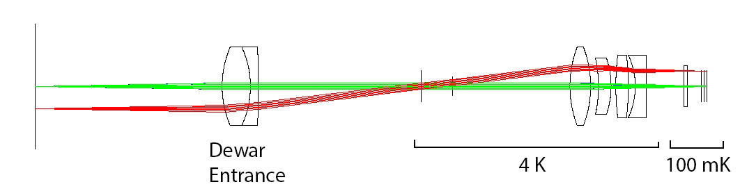
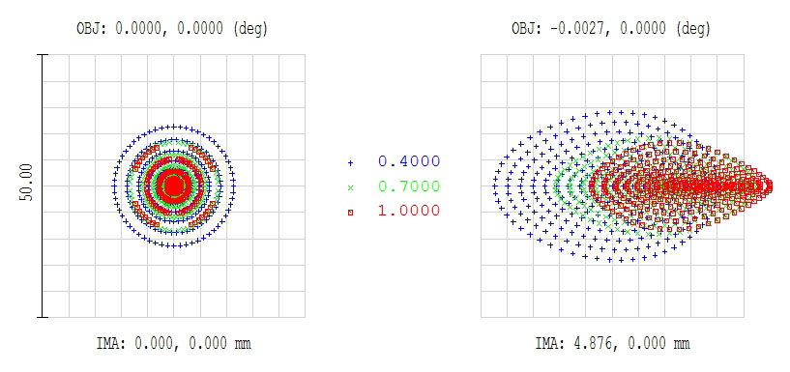
Proven at the Telescope with ARCONS
Array Camera for Optical to Near-IR Spectrophotometery (ARCONS)
First Light: July 28, 2011, Palomar 200” Coudé
Now 24 observing nights (Palomar+Lick)
Lens coupled 2024 (44x46) pixel array in cryogen-free ADR
0.5” pixels yields 22”x23” FOV
400 nm to 1100 nm simultaneous bandwidth with maximum count rate of ~2000 cts/pixel/sec
350-1350 nm soon
Energy resolution R~8 at 400 nm

Slide 16
ARCONS Performance
Wavelength calibration uses 3 lasers on swing arm
Firmware dead time introduces correctable non-linearity at high count rates
Firmware baseline subtraction degrades energy resolution at high count rates

Slide 17
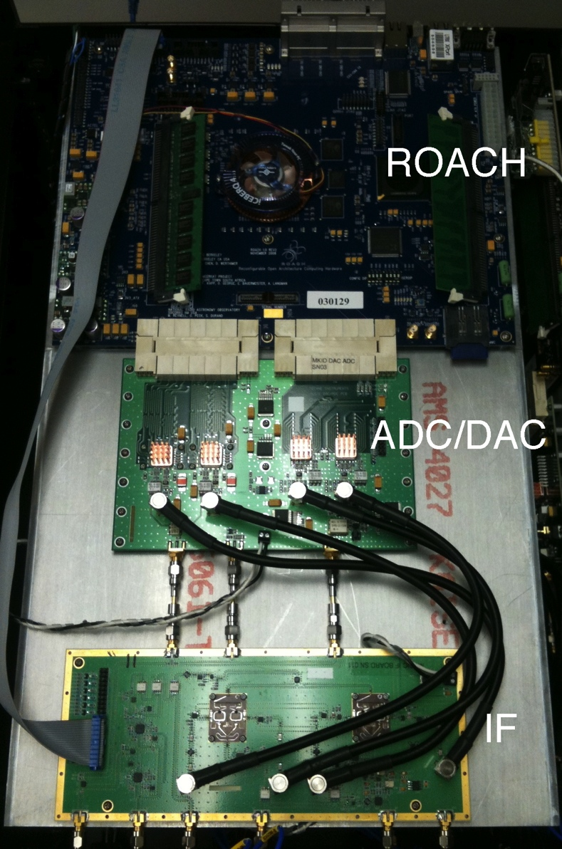
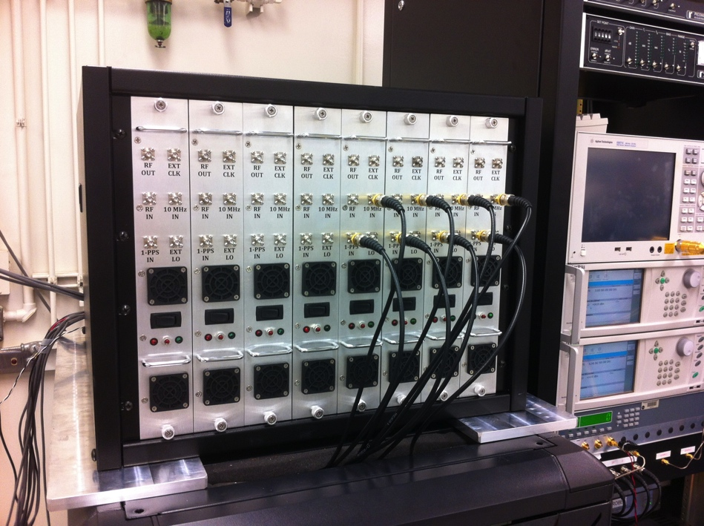
Current Readout System (Gen 1)
Dual 1 GSPS 16-bit DACs
Dual 550 MSPS 12-bit ADCs
ROACH with Virtex 5 SX95T
Complete readout for 256 resonators in 550 MHz of bandwidth
8 ROACH boards read out 2048 pix
~$25/pixel (Gen2 - $3/pixel)

Slide 18
Pipeline
Significant work is now going into our software pipeline
Python based, using HDF5 (Pytables) storage

Slide 19
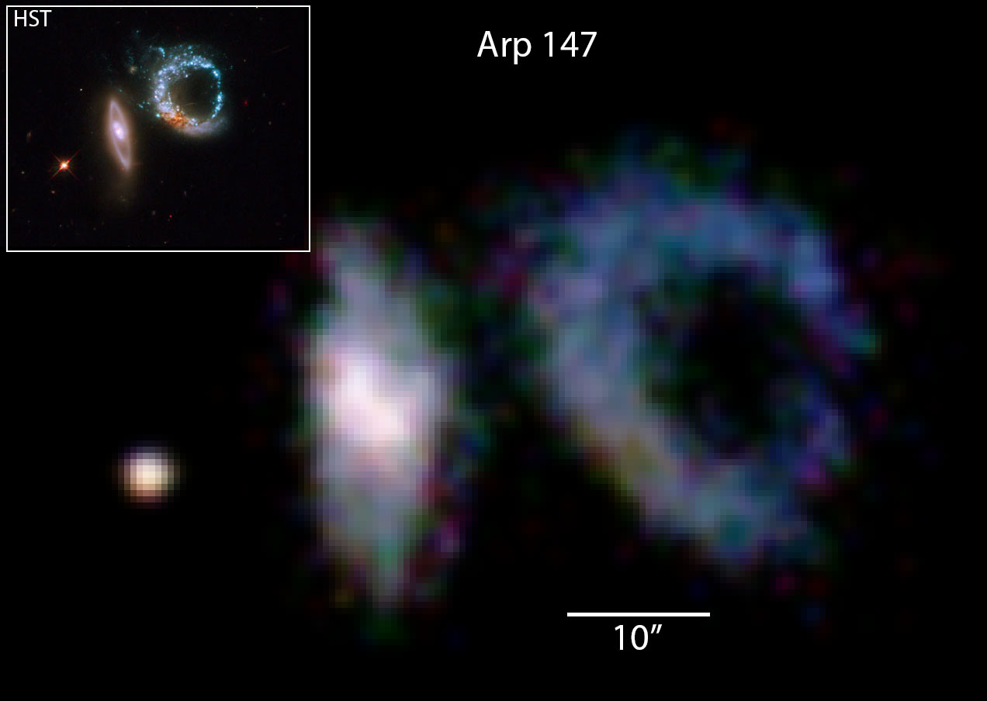
Mosaic of Arp 147
Mosaic of Arp 147 taken at the Palomar 200” in December 2012 with ARCONS
36 pointings on 6” x 6” grid, 1 minute obs. time/pointing
Colors generated from MKID wavelength information!

Slide 20

Crab Pulsar
Made on the mountain during our Palomar run!

Slide 21
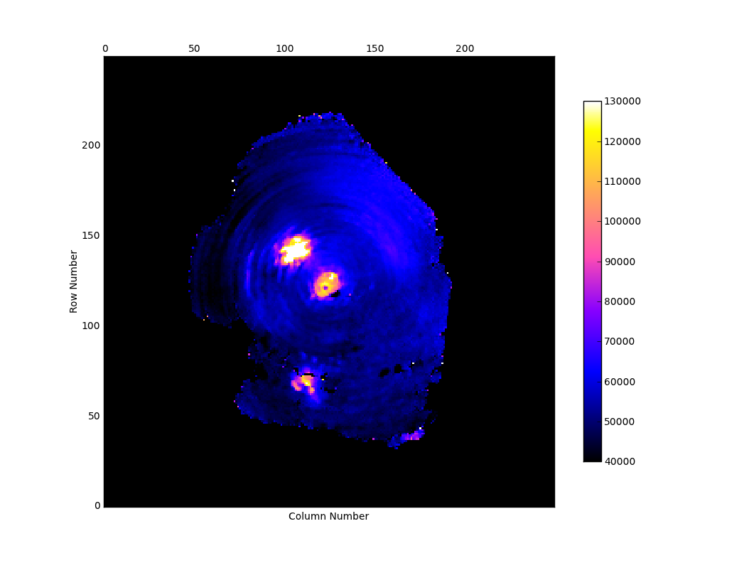
Crab Image Stack (from pipeline)
2 hours of Crab data processed through the full imaging pipeline
400-600 nm band.
Still have work to do!

Slide 22
Flux Calibrated Spectra
Spectra of standard stars match pre-existing photometry

Slide 23
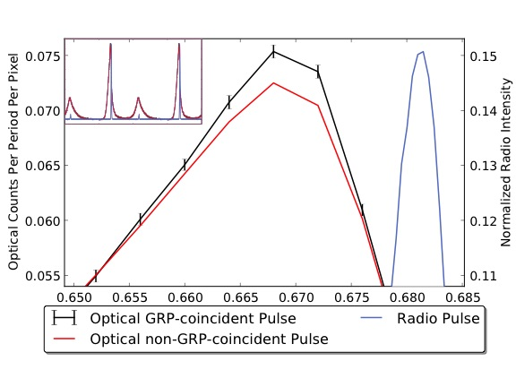
Crab and GBT Observations
Shearer et al. 2003 saw a 3% enhancement in optical flux coincident with Crab Giant Radio Pulses (GRPs)
We see it, too. (Analysis mainly by Matt Strader at UCSB)

Slide 24
Simultaneous ARCONS + GBT
We also see no appreciable spectral differences between GRP and non-GRP coincident pulses

Slide 25
Phase/Brightness Correlation!
Unexpectedly, we also see a correlation between GRP arrival phase and optical flux. This has never been seen before, and seriously challenges established models of pulsar emission.
Strader et al. 2013. Submitting this week to Science.

Slide 26
Eclipsing Am CVn SDSS J0926+36
Measured light curves of eclipsing Am CVn J0926+3624
m_{i} = 19.4

Slide 27
Short Period Binaries
No high frequency QPOs or significant spectral variability during eclipse

Slide 28
Ephemeris
Combining with data from Copperwheat 2011 allows 6 year baseline to determine ephemeris
Pdot = 3.0 ± 0.5 x 10⁻¹³ detected for the first time!

Slide 29
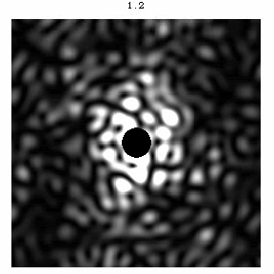
IFU for Planet Finding
Coronagraphs are limited by speckles from scattered and diffracted light
  Energy-resolving focal planes increase sensitivity by a factor of up to 10-100 (!)
  Time resolution, zero read noise are very helpful (Dark Speckle Technique)
  Lower mirror and coronagraph tolerances
  Removes requirement of a separate spectrograph
  Gives the spectra of all planets in the dark box
  DARKNESS recently funded by NSF!
Simulation from S. Remi and B. Oppenheimer at AMNH

Slide 30
DARKNESS Performance
DARK-speckle Near-IR Energy-resolved Superconducting Spectrophotometer

Slide 31
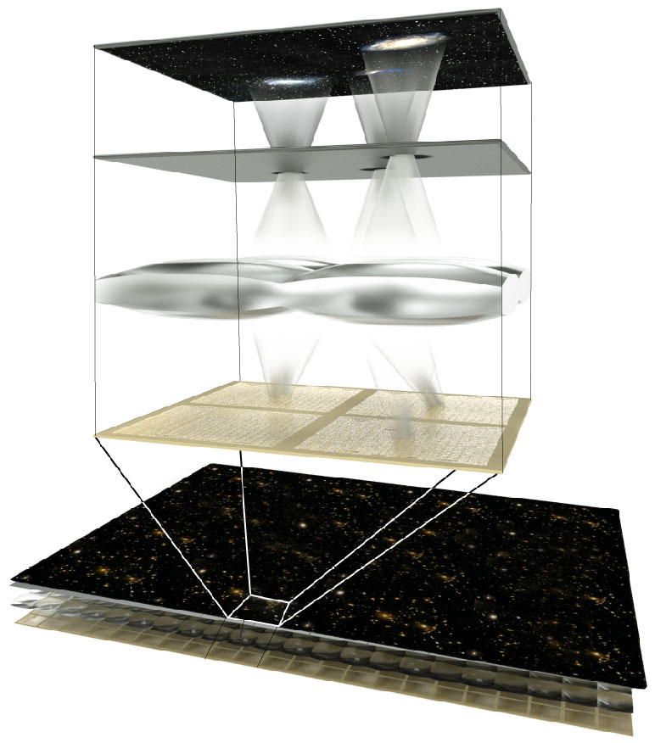
SuperMOS
SuperMOS: A Superconducting Multi-Object Spectrograph
Uses newly developed Microwave Kinetic Inductance Detectors (MKIDs)
A focal plane mask allows selection of sources
No dispersive optics – MKIDs provide the spectral resolution of R~50, 0.3-1.35 micron band
Scales to much larger number of simultaneous objects than fiber-fed solutions

Slide 32
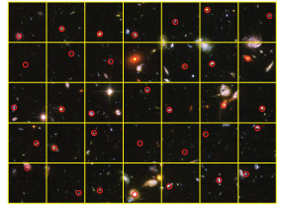
SuperMOS
Pre-existing imaging is used to select one galaxy per “macropixel”
A ~1” hole is drilled/burned in a metal mask (or shutter is opened, or DMM is actuated) at this location, allowing only light from a desired source through the mask
A reimaging system or microlens array takes the light from a hole anywhere in the macropixel and focuses it onto a single MKID
Uniquely maps 1 source to 1 MKID
Some fraction empty to sample sky for background subtraction

Slide 33
Giga-z Simulated Galaxy Spectra
Full Giga-z paper:
Marsden et al. 2013
ApJS, accepted
arXiv:1307.5066

Slide 34
Redshift Determination
Simulations show:
  σ_{z}/1+z ~ 0.01 for field galaxies
  σ_{z}/1+z ~ 0.005 for LRGs
LSST
Giga-z
3x better than LSST alone, with a much lower catastrophic failure rate

Slide 35
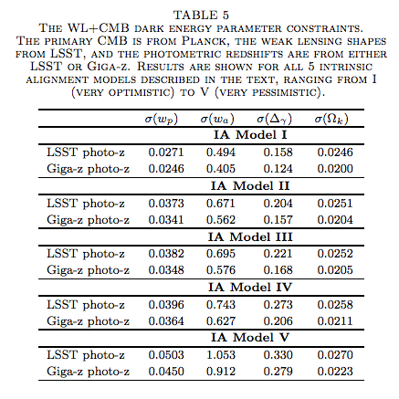
Weak Lensing with Giga-z
With weak lensing, adding Giga-z to LSST is equivalent to doing the 10-yr LSST survey again in the northern hemisphere.

Slide 36
Dark Energy with Giga-z
From EUCLID BAO simulations (Wang et al 2011). We should actually do better since we go to redshift zero, while EUCLID is limited to z > 0.35.

Slide 37
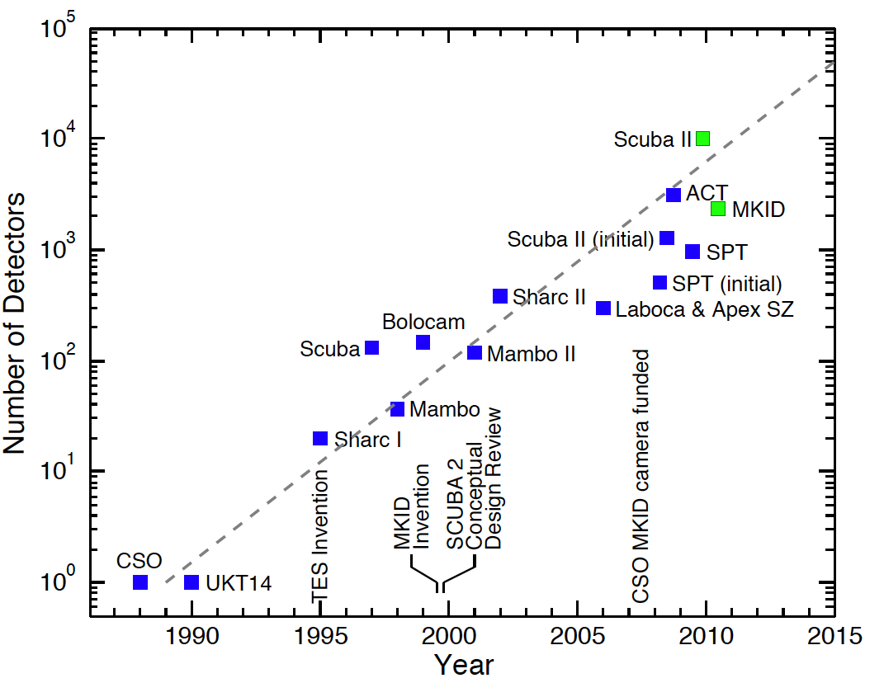
MKID Scaling
Plot from J. Zmuidzinas

Slide 38

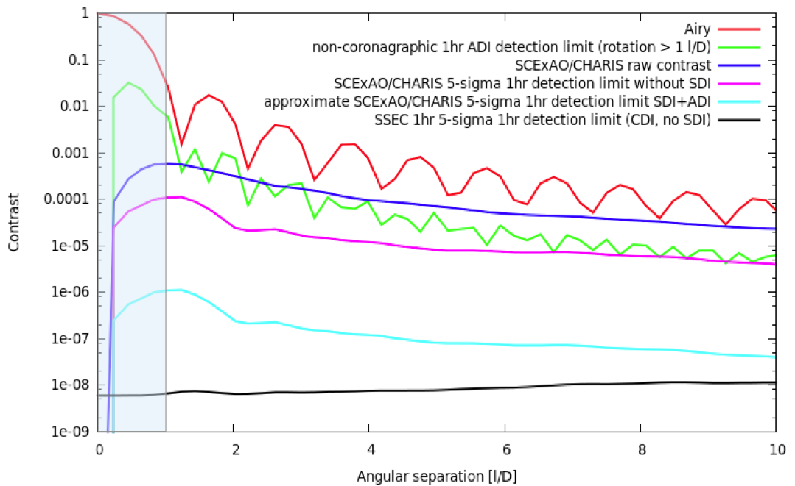
Future Plans
Continue MKID development, focusing on spectral resolution, yield and QE
Continue observations with ARCONS at Palomar 200”
Seek funding for 2nd generation, 30kpix-class MKID Instruments
  Keck: KRAKENS
  CFHT: Anuenue
Build and commission DARKNESS
Work with Fermilab and others on SuperMOS like Giga-z

