Slide 1
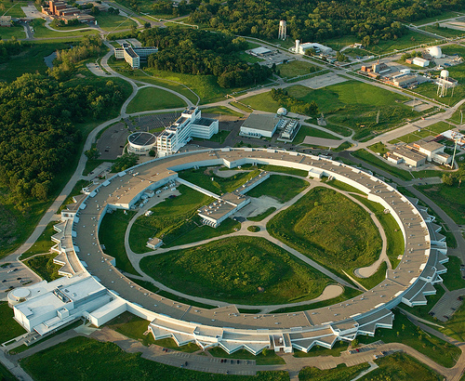
Thermal Kinetic Inductance Detectors for x-rays
Orlando Quaranta
Thomas Cecil
Lisa Gades
Antonino Miceli
Advanced Photon Source

Slide 2
Overview
Motivation
Introduction to MKIDs
The TKID Concept
TKID Development at Argonne

Slide 3
Cryogenic X-ray Detector R&D
Spectroscopy at synchrotrons is defined by two widely used detector types
  Solid State, e.g. Si drift diode
    Count rate > 1MHZ
    Limited resolution (~150 eV at 6 keV)
  Wavelength dispersive, e.g. bent crystal analyzer or grating
    Sub-eV resolution
    Limited solid angle and efficiency
Take advantage of local resources
  Center for Nanoscale Materials User Facility for device fabrication
  Transition Edge Sensors expertise from Uchicago/ANL Cosmology for SPT

Slide 4
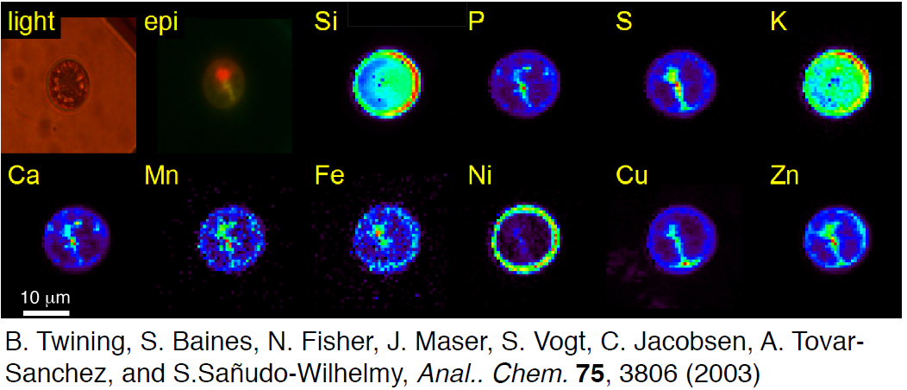
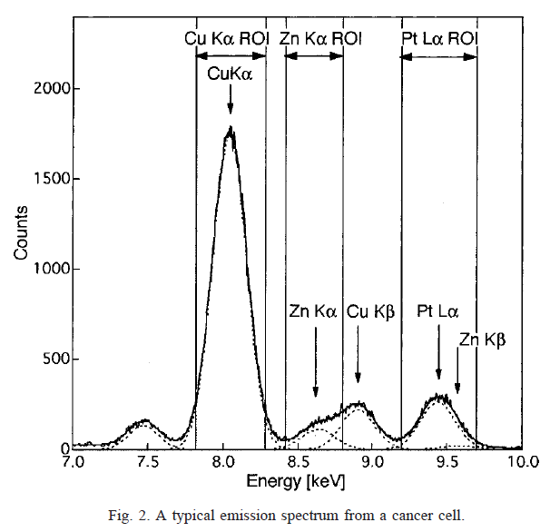
Example Application: X-ray microscopy of cells
Mapping elemental distributions
Resolve overlapping emission lines
Differentiate Pt Lα₁ from Zn Kβ signals (130 eV spacing).
Resolve Kα/Kβ overlaps
Need ~ 30 eV
P. Ilinski, et al., The Direct Mapping of the Uptake of Platinum Anticancer Agents in Individual
Human Ovarian Adenocarcinoma Cells Using a Hard X-ray Microprobe, CANCER RESEARCH 63, 1776–1779, April 15, 2003

Slide 5
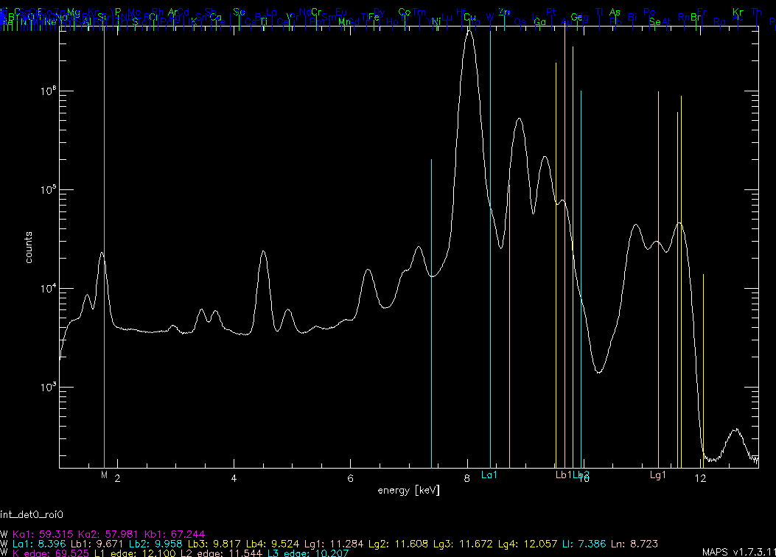
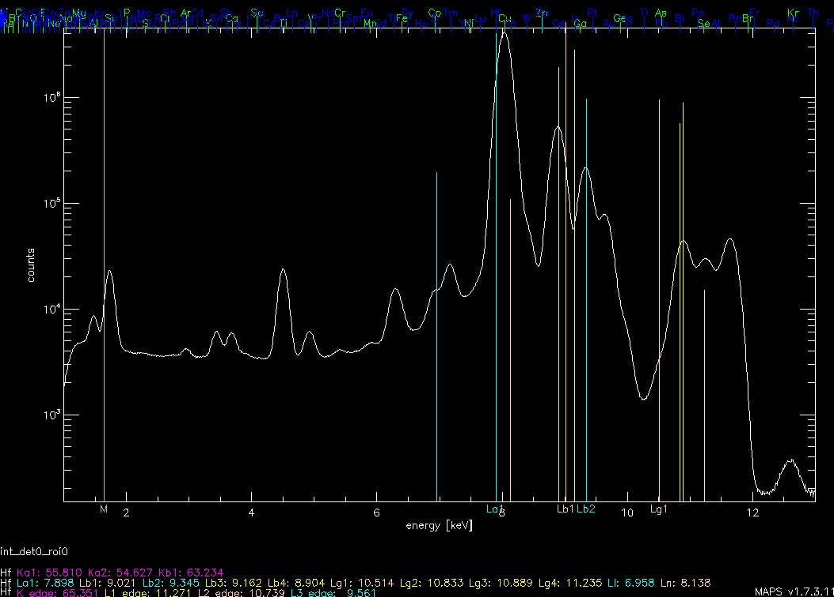
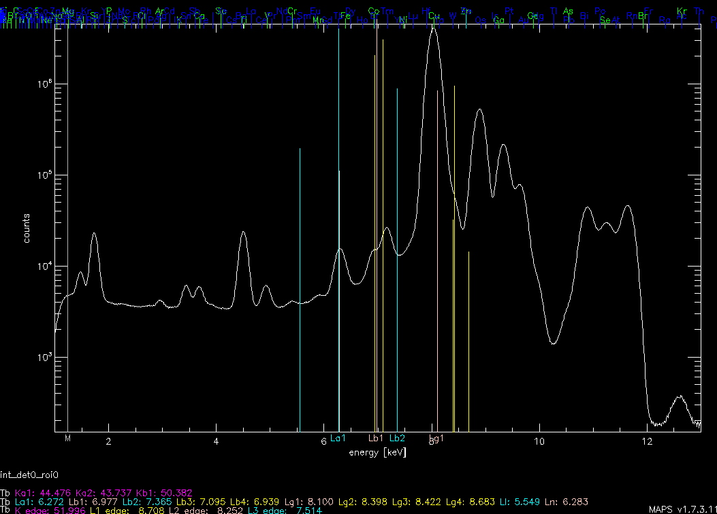
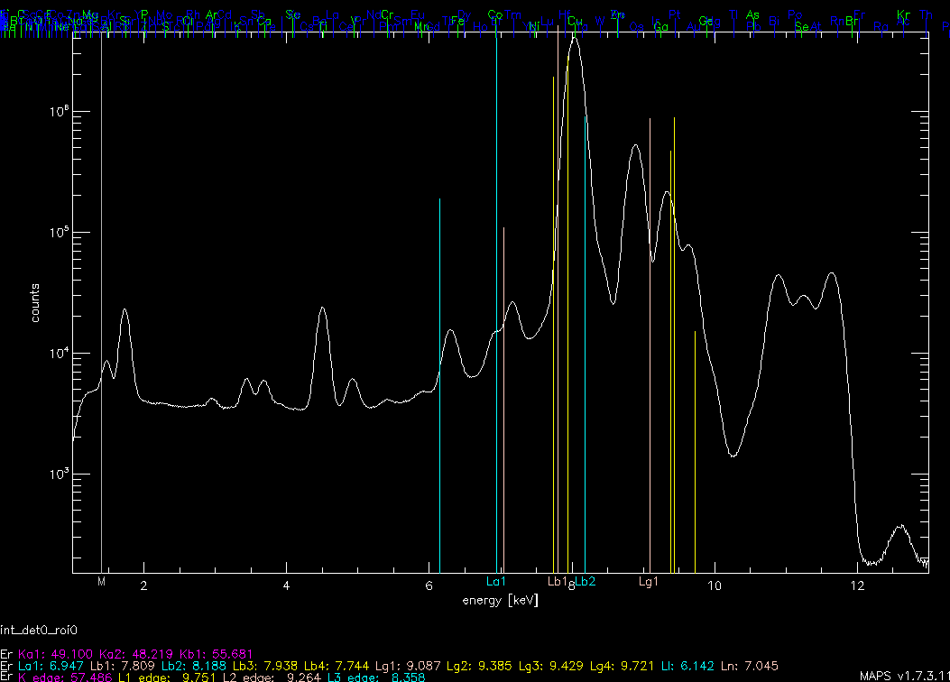
Example Application: X-ray microscopy of circuits
Mapping heavy elements (L-lines) in integrated circuits.
  For example Er, Hf, Ta, Tb, Tm, W
  Significant overlaps.
Terbium ?
Erbium ?
Tungsten?
Hafnium ?
Courtesy of BAE Systems & Stefan Vogt (APS)

Slide 6
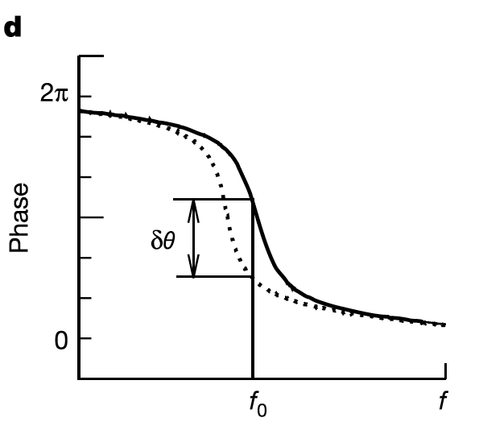
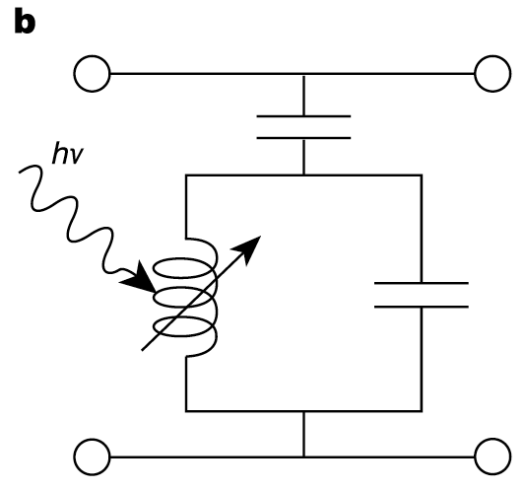
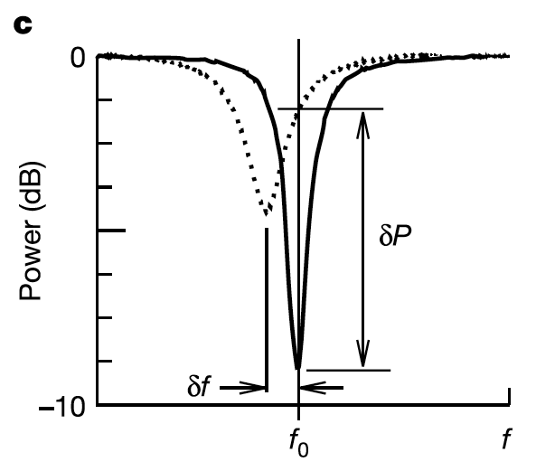
Microwave Kinetic Inductance Detectors
Excess quasiparticles or ΔT generated by x-ray causes an inductance increase (i.e., “kinetic inductance”)
  Measure inductance change in a LC resonating circuit
Observables….
ΔL_{s}
Multiplexing: Lithographically vary geometric inductance/resonant frequency…
ΔR_{s}

Slide 7
MKID Development at Argonne
The goal is energy resolution ~ 10eV with good count rate capabilities (> 100kcps)
Entire Process is done “In-house”
  Device Simulation
    RF simulations
    Thermal modeling
  Fabrication
    Custom deposition system
    Processing at Center for Nanoscale Materials User Facility
  Device Testing
    100 mK cryostat
    RF electronics
    “Roach” board

Slide 8
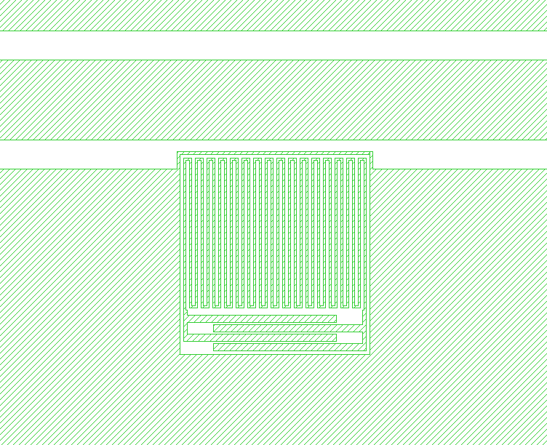
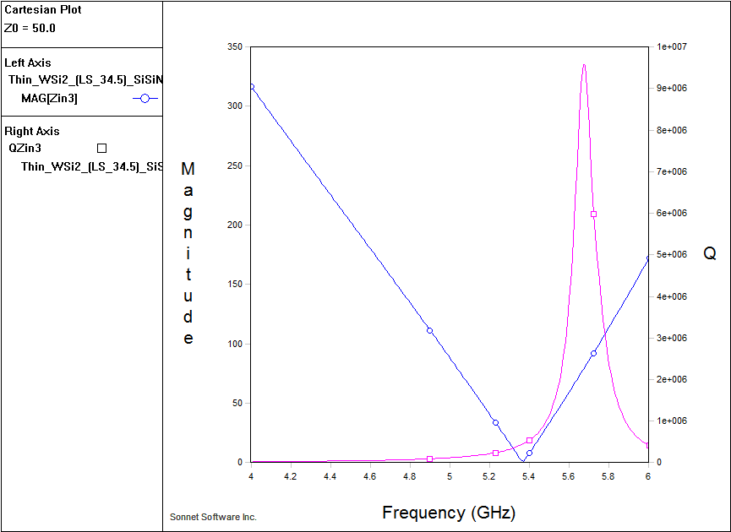
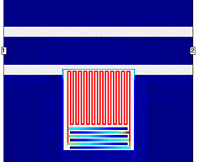
MKID Development at Argonne
RF simulations
MKIDs is a planar microwave resonator
  Use Sonnet software
  Incorporate surface inductance into model
  Solve for
    Resonance frequency
    Quality factor
    Current Density
Resonator Geometry
Resonance Frequency and Q
Current Density

Slide 9
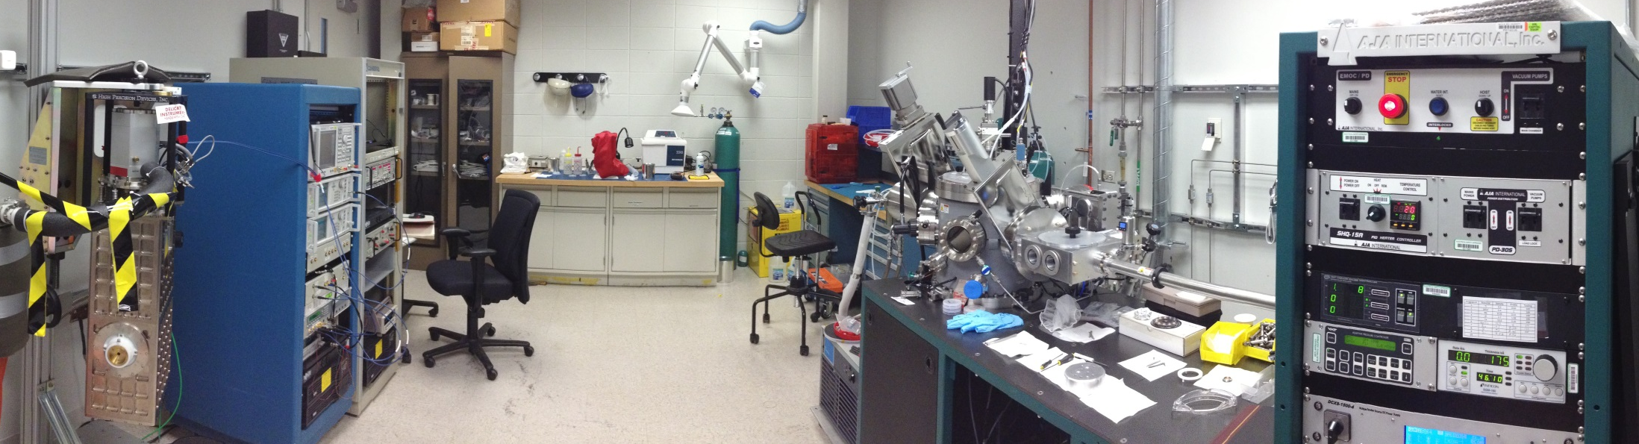
MKID Development at Argonne
  Device Fabrication
    Completely in-house with dedicated deposition chamber
  Cryogenics and Device Characterization
    Turnkey 100 mK cryostat (cryogen-free)
  Readout electronics
    Multi-pixel implementation in progress (Tim Madden)

Slide 10
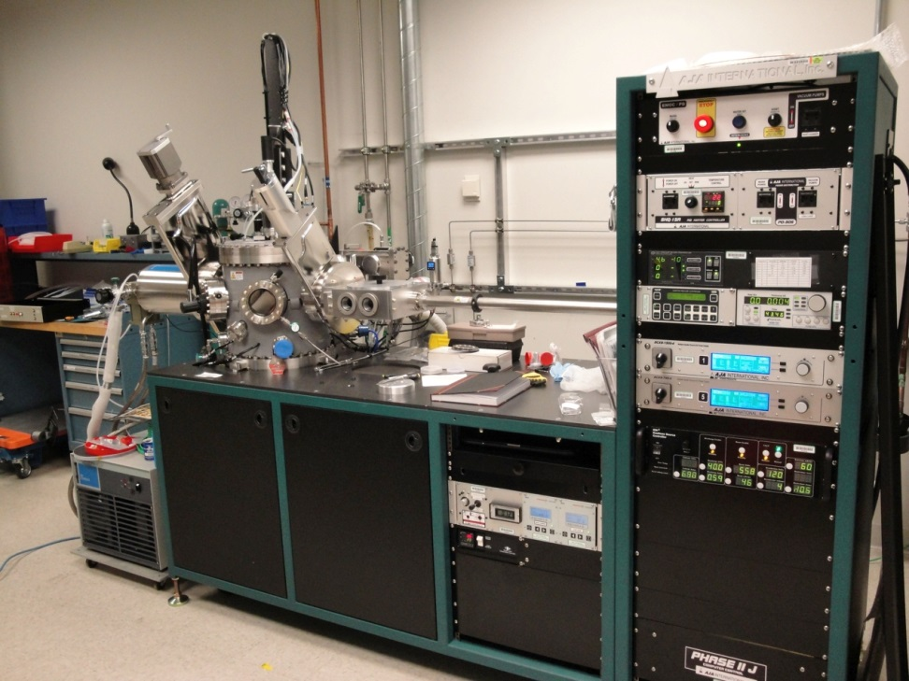
MKID Development at Argonne
Material Deposition
Current Materials
  WSix
  Ta
  Al
  Nb
  TiN (under development)
800C substrate heating
In-situ ion mill
Deep UHV sputtering system

Slide 11
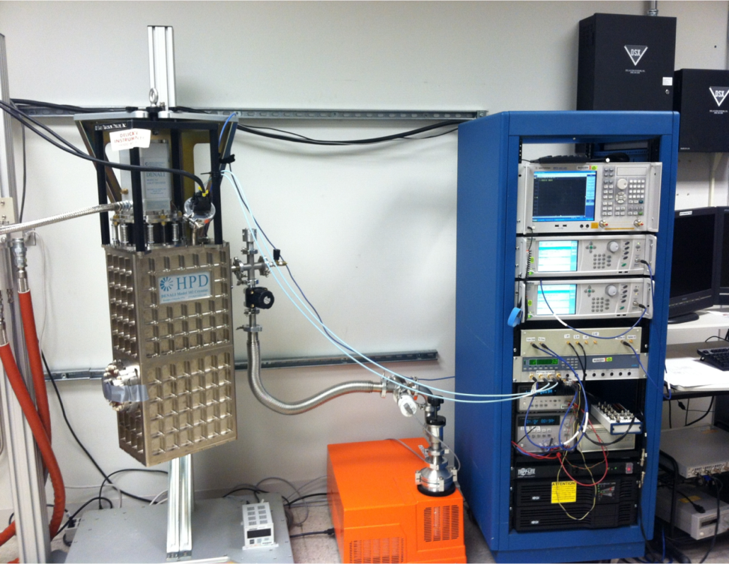
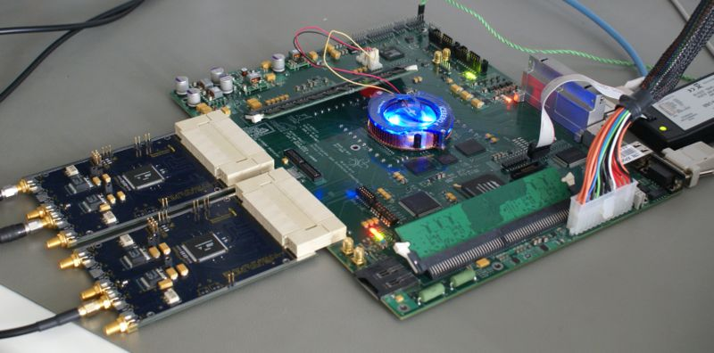
MKID Development at Argonne
Device Measurement
ADR Cryostat with IQ mixers
“Roach” Board – Multi pixel read-out
<100 mK in 24 hours
100 mK hold time of 1-2 days
Open source protocol developed for radio astronomy
Enables readout of up to ~ 256 resonators per board
Just starting to implement at Argonne
Photo of ROACH board with two ADC boards

Slide 12
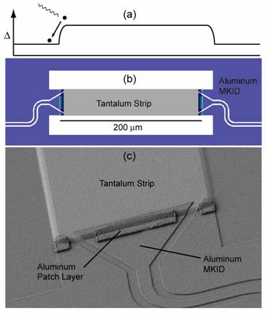
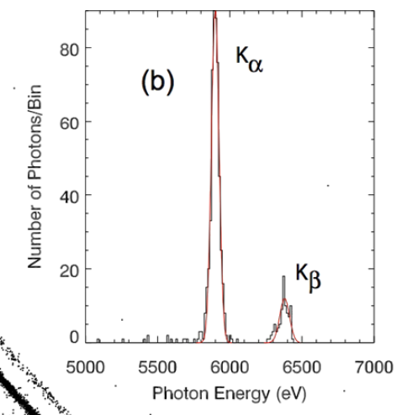
Introduction to MKIDs
So what’s the problem for X-ray’s
62eV
Mazin et al 2006
Energy resolution of ~60 eV @ 6 keV for Al resonator with Ta Absorber
Limitations in device design
  Diffusion length of quasi-particles in absorber limits device size, materials, and substrate
  Thickness of absorber may be limited due to processing incompatibilities

Slide 13
Thermal Kinetic Inductance Detector (TKID)
The concept
Ultimately a kinetic inductance detector is measuring the quasi-particle density in the superconductor
Gao (2008) established that excess quasi-particles generated by a photon were ‘equivalent’ to those created by a change in temperature
So, we can measure either quasi-particles from an absorbed photon, or a change in temperature

Slide 14
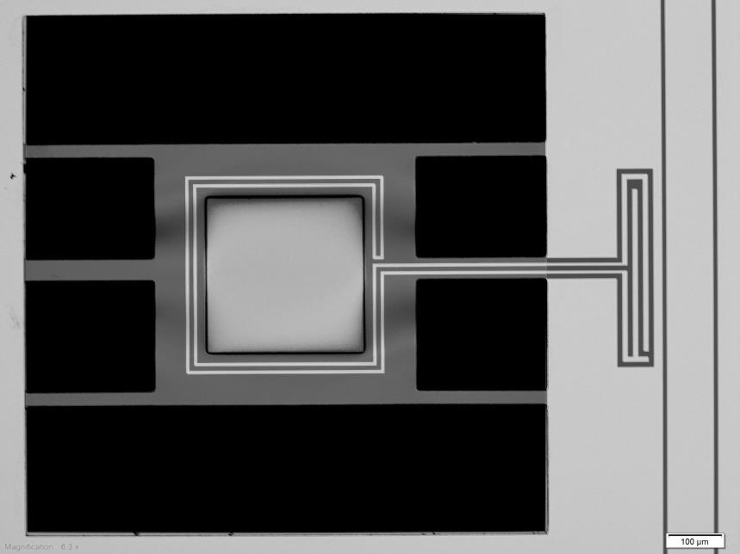
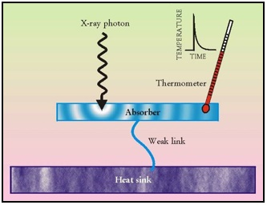
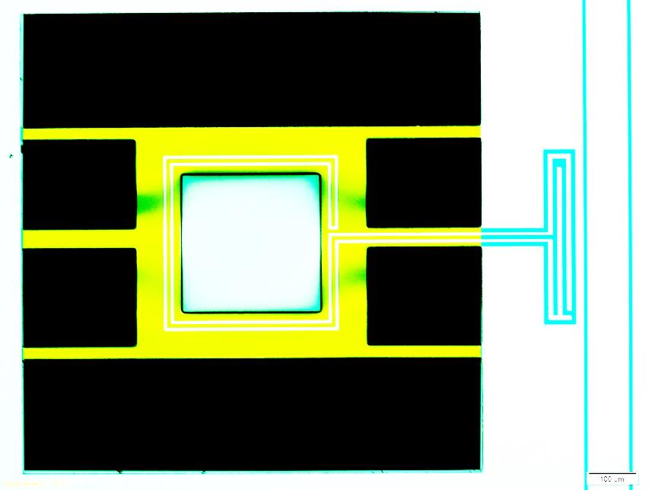
Thermal Kinetic Inductance Detector
Anatomy of a TKID
Feedline
Microcalorimeter
Superconducting
Resonator
Capacitor
0.5 μm thick SiN
Inductor
+
300 μm
Absorber
Empty
Space
The inductor of the resonator serves as the thermometer of the micro-calorimeter
0.5 x 300 x 300 μm Tantalum Absorber
100 nm WSi₂ resonator

Slide 15
Thermal Kinetic Inductance Detector
Potential Advantages
Absorbers size, shape and nature not limited by quasi-particle diffusion
  Can use mushroom absorbers for x-rays
  Different options for the material
Effective quasi-particle lifetime now set by thermal time constant and not by the resonator material properties
Not Fano limited
  Measuring temperature of absorber, not ‘counting’ non-equilibrium quasi-particles
Take advantage of the big knowledge base from other microcalorimeter technologies

Slide 16
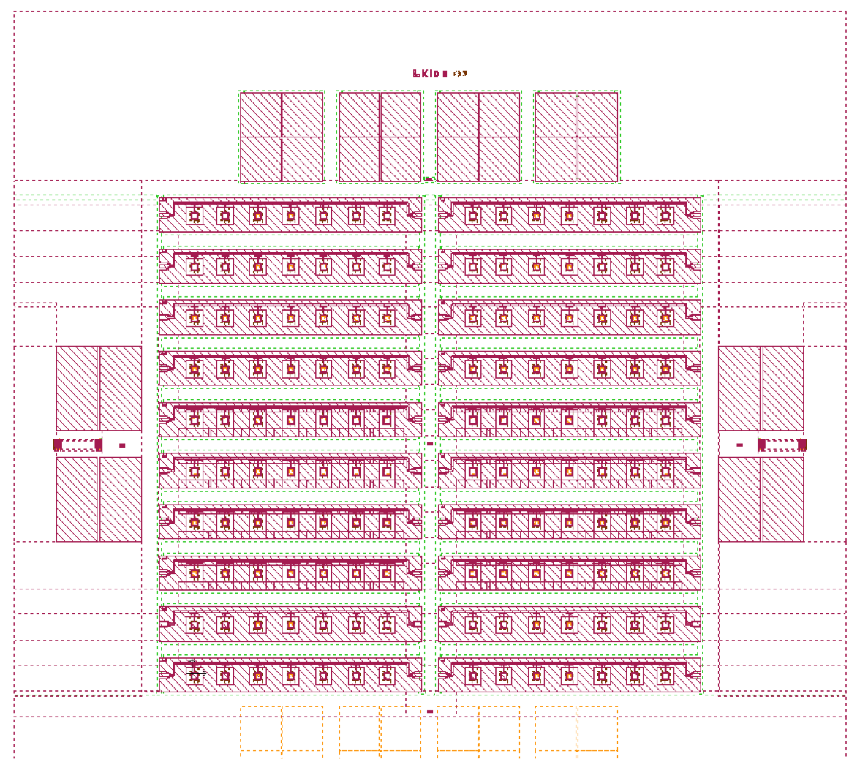
TKID Development at Argonne
Fabrication
Current TKID design
  Five layer design
    SiN Mesa
    Resonator
    Absorber
    SiN Membrane
    SiN Island

Slide 17
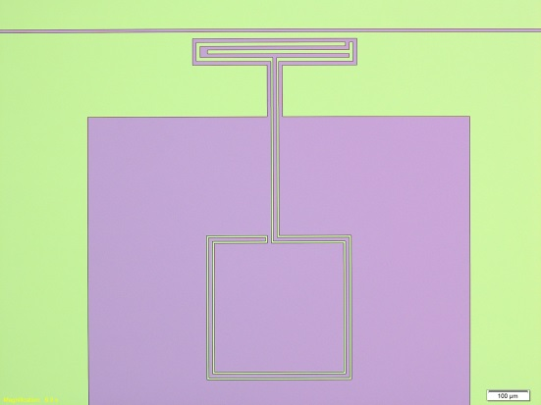
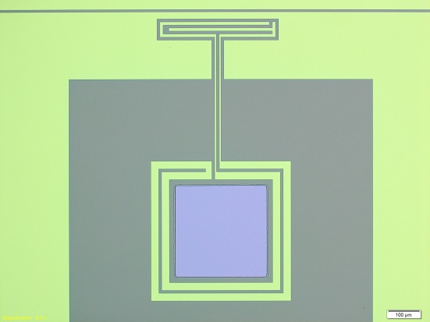
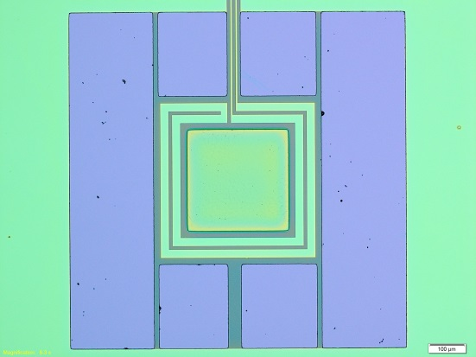
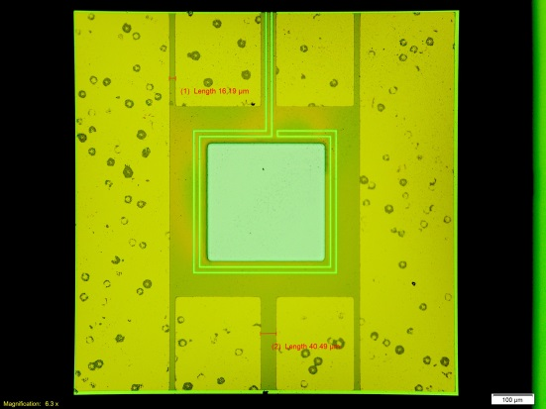
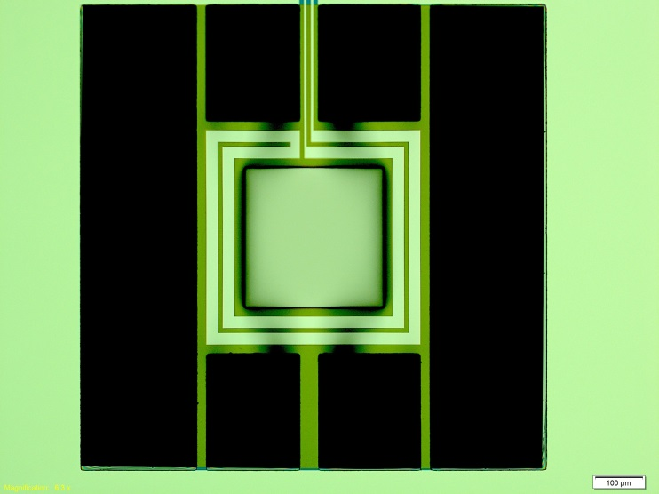
TKID Development at Argonne
Fabrication Process flow
0.5 μm SiN + 300 μm Silicon wafer
Resonator deposition (@ APS)
Resonator Lithography (MA-6, CNM)
Resonator Etch (Oxford RIE, CNM)
Resist strip (1165 remover, CNM)
Absorber Lithography (MA-6, CNM)
Absorber deposition (@ APS, CNM)
Absorber liftoff (1165 remover, CNM)
SiN bridge lithography(MA-6, CNM)
Backside SiN membrane lithography (MA-6, CNM)
Backside SiN etch (March etcher, CNM)
Bulk Si etch (KOH, CNM)
Backside protective Al depositions (@ APS)
SiN bridge etch (March etcher, CNM)
Al wet etch (CNM)
Resist strip (1165 remover, CNM)
Turn-around time 1-2 weeks

Slide 18
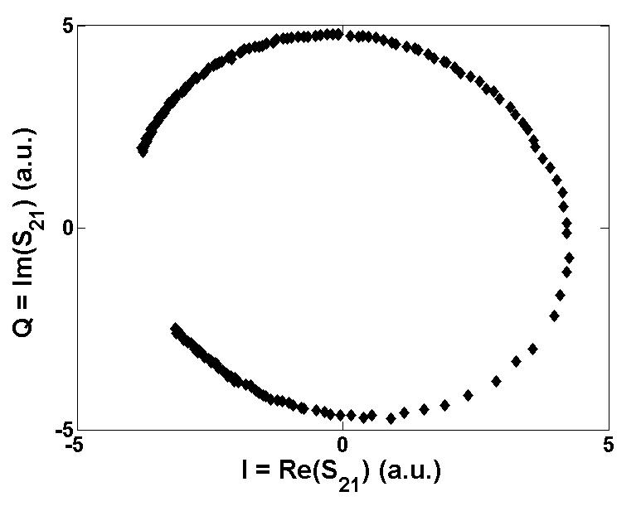
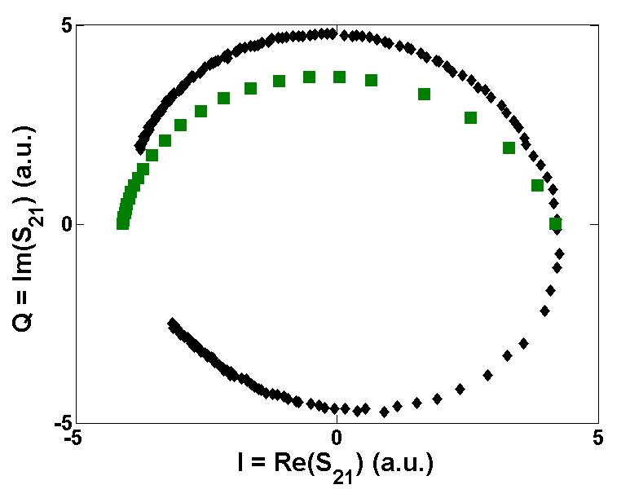
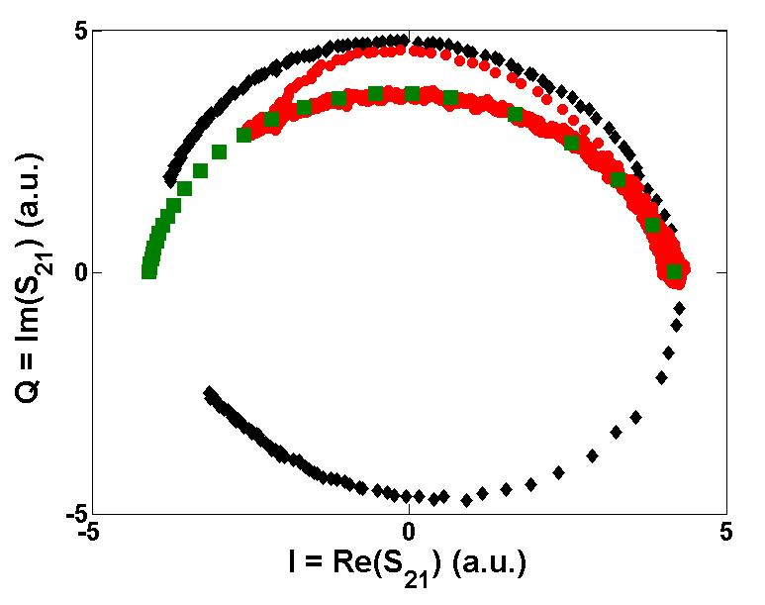
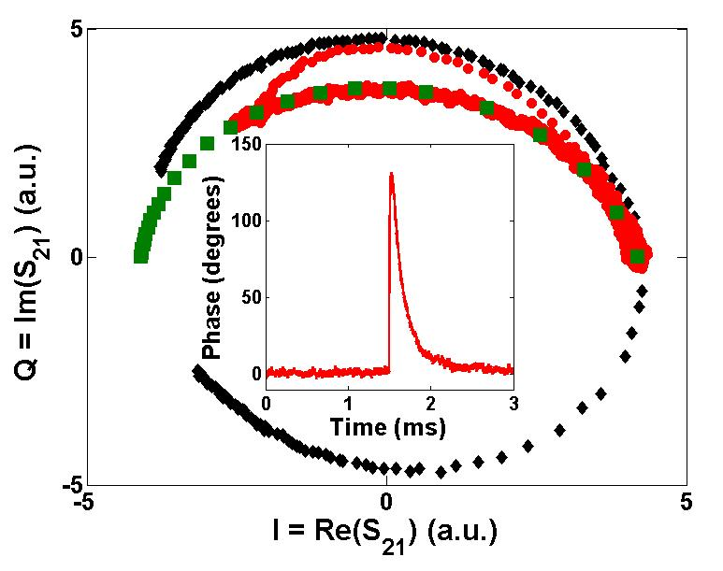
Thermal Kinetic Inductance Detector
Pulses
Thermal Pulse
Static frequency, temperature sweep
X
Resonance frequency
Static temperature, frequency sweep

Slide 19
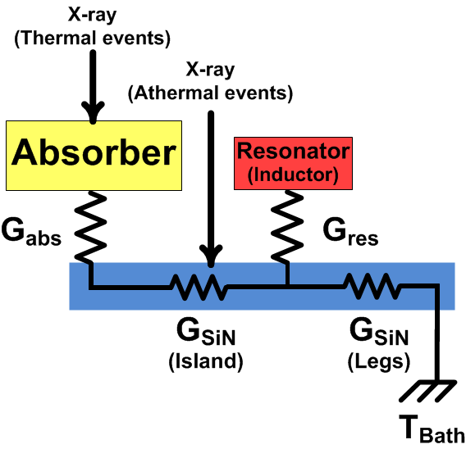
TKID Development at Argonne
Thermal and athermal Pulses
Comparison of Thermal pulse (x-ray hit in absorber) and athermal pulse (x-ray hit in substrate)
Without an x-ray aperture, x-ray can hit the entire wafer creating several types of pulses

Slide 20
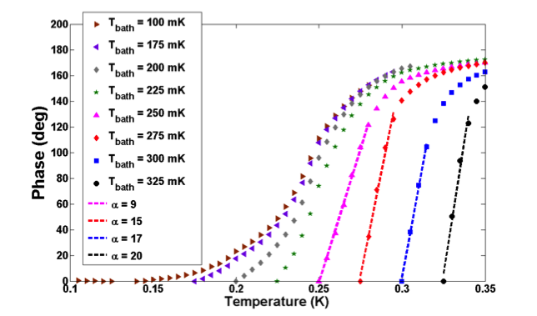
TKID Measurements
Sensitivity
Can calculate a sensitivity similar to other calorimeter
This can be written in terms of commonly measured units
Phase versus temperature curves at a range of bath temperatures for a 100 nm WSi2 resonator with Ta absorber
Response is linear over ~ 120°
Sensitivity is lower than a TES, but comparable to Thermistor

Slide 21
TKID Measurements
Pulse height and decay time
Au and Ta absorbers
100 nm WSi2 resonators
Au absorber much smaller pulses
Superconducting absorber
  Decay time increases with temperature – this is the opposite of what you expect for quasi-particle recombination
  2 decay times

Slide 22
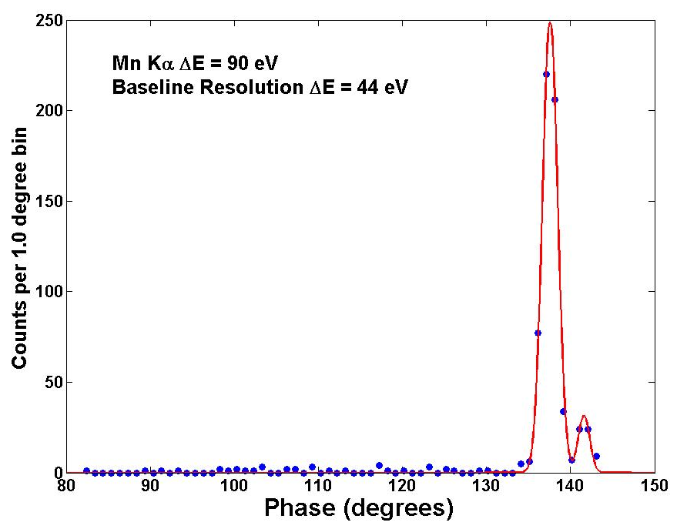
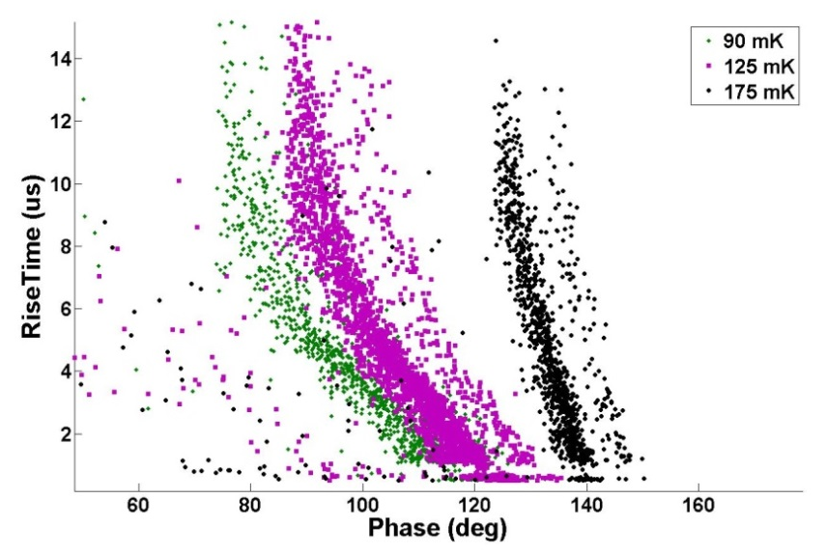
TKID Measurements
Pulse Histograms
Strong relationship between rise time and pulse height
Slope changes as a function of bath temperature
Data taken for device with Ta absorber and Fe-55 source
Fit using matched filter
Baseline: ~ 40 eV, Measured: ~100 eV

Slide 23
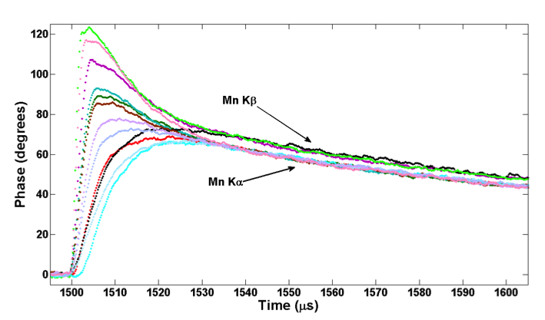
TKID Measurements
Variable rise time
We think this is due to poor thermalization in the absorber (position dependent pulse shape)
Pulses from single Ta device showing range of rise time and pulse heights
Separation between Mn Kα and Kβ lines after ~ 30μsec
Device with Au absober show much less position dependence
Data taken for device with Ta absorber and Fe-55 source
Fit using matched filter
Baseline: ~ 40 eV, Measured: ~100 eV

Slide 24
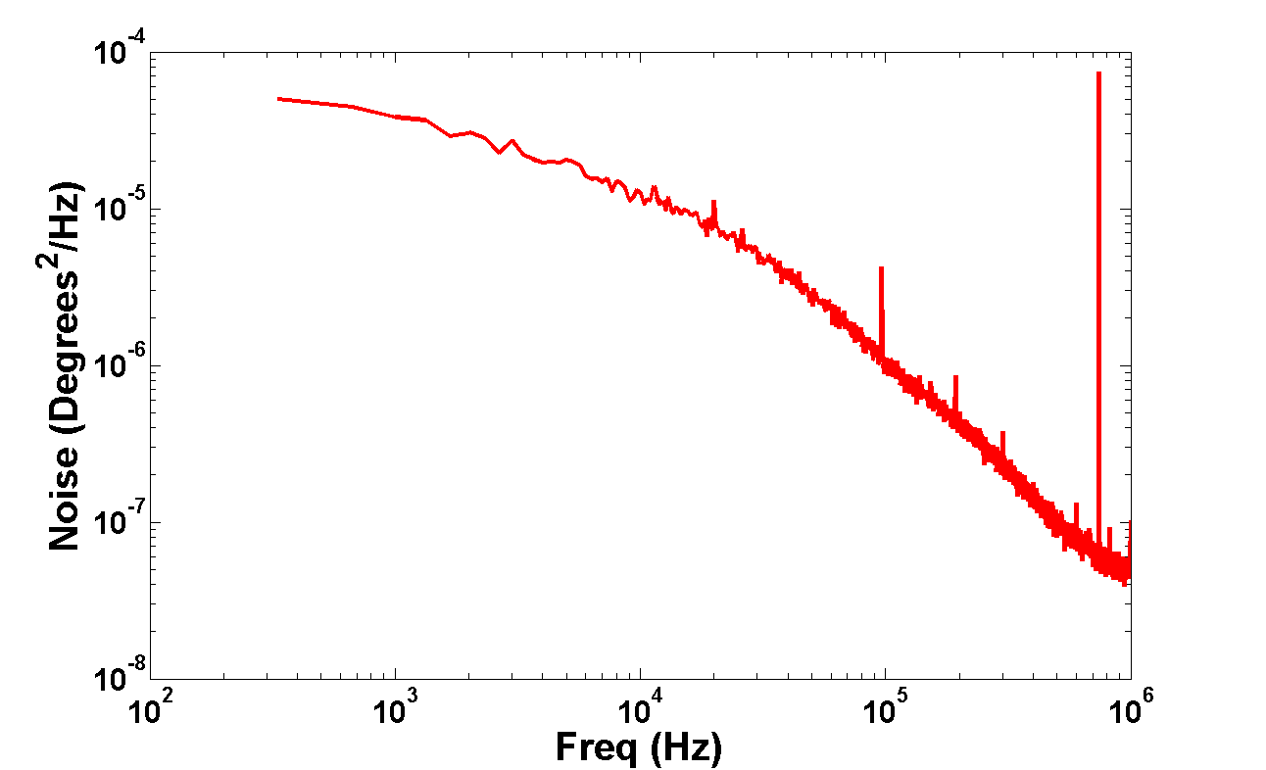
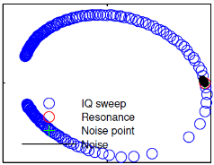
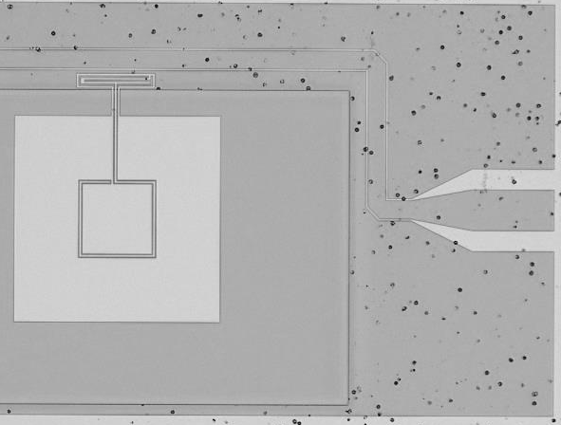
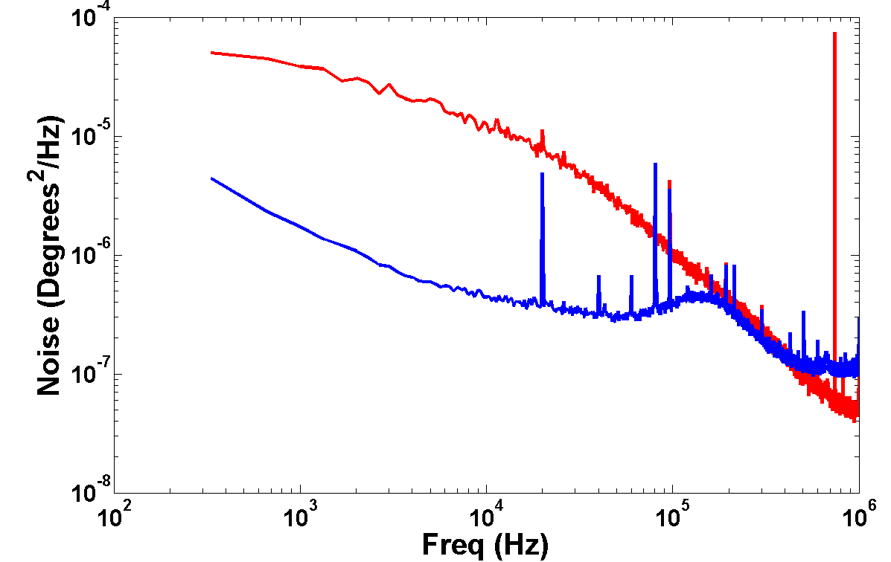
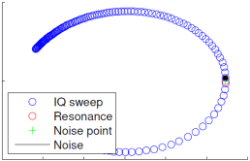
Reducing the noise
Capacitor on SiN
Current design is particularly noisy compared to the best KID resonators.
  Baseline resolution is 45 eV
  Strong 1/f noise component from the SiN under capacitor
First attempt to remove SiN
  Baseline resolution is 15 eV
    Even with defects in the mask!
  Assuming 150 μs decay time
There are a number of ways to further reduce the noise:
  Larger capacitor design
  Partially removing substrate under the capacitor
  SOI membranes
SiN
Capacitor on SiN
Capacitor on Si

Slide 25
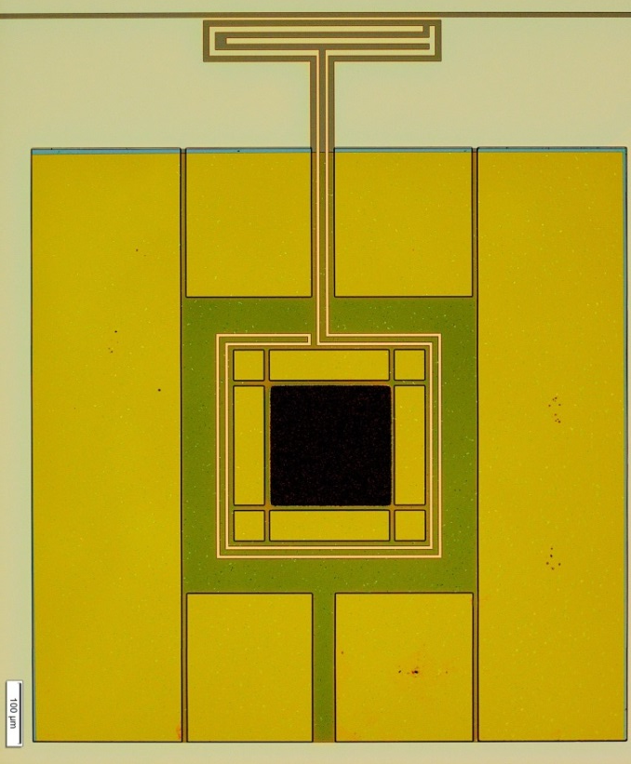
Future Work
Reduce noise (previous slide)
Absorbers with better thermalization
  Au underlayers, Sn, Bi, HgCdTe
  Decouple absorber from resonators (“double island”)
Effects of the absorber of the resonator properties
  Au absorbers reduce the Qi
  The presence of a superconducting underlayer seems to help
  Possible different designs with less coupling between the absorber and the resonator
Better Modeling
  Improve thermal simulations to better guide device design
  Analytical model of Thermal KIDs
    See recent work by Lindeman et.al. in J Appl. Phys.

Slide 26
Summary
MKIDs are a versatile detector for applications from sub-mm to gamma ray enabling large number of pixels
TKID is a new variation that uses the inductor as a sensitive thermometer
Prototype TKID x-ray detector has baseline FWHM resolution of 44 eV @ 6 keV (measures ~100 eV)
On going work to improve energy resolution, position dependence and understand the fundamental limits of these devices

