Slide 1
Status of R&D at UCSB
Paul Szypryt
Mazin Lab
August 26, 2013

Slide 2
Status as of Palomar 2012

Slide 3
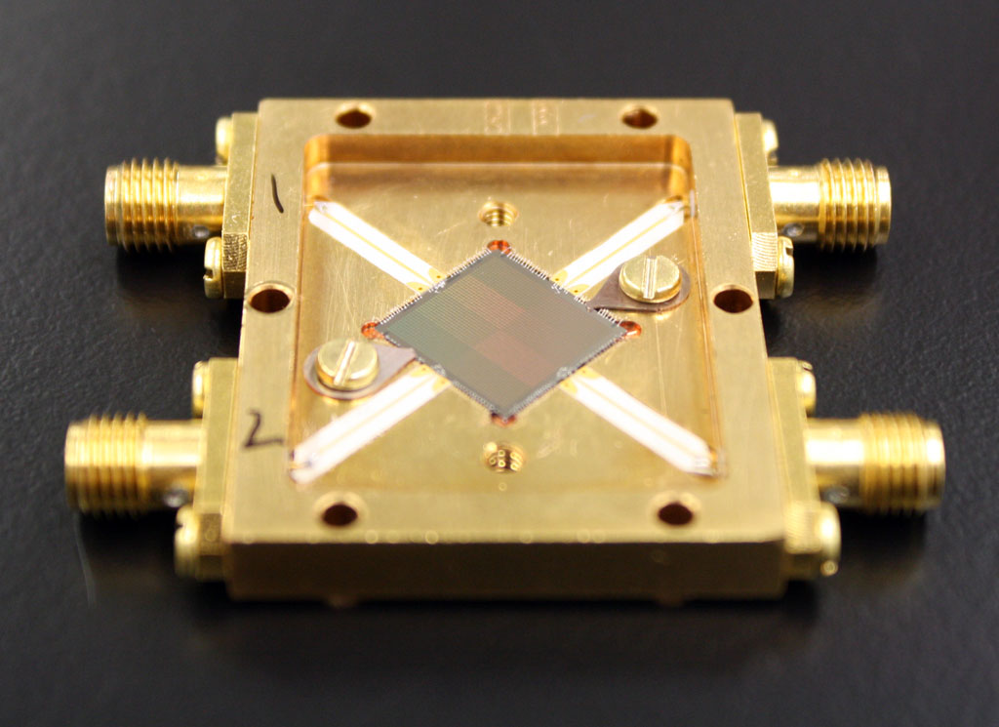
SCI-4
TiN inductors and capacitors, Nb feedlines
Energy resolution of around 10%
2024 (44x46) pixel array
222 micron pixel pitch
$≥90\%$resonator yield after fabrication
$≈$ 70% good pixel yield

Slide 4
ARCONS
Operated at 110 mK
8 ROACH boards for readout
350–1100 nm bandwidth, after filters
20x20 arcsecond field of view

Slide 5
Science Results
Crab Pulsar
SDSS J0926+3624
3% enhancement in optical flux coincident with Crab Giant Radio Pulses (GRPs)
Period change of $3×{10}^{−13}±0.5×{10}^{−13}$

Slide 6
Current Work

Slide 7
X-ray MKIDs
KID inductor on SiN Membrane, capacitor on bulk Si
Thermal Kinetic Inductance Detectors (TKIDs)
X-ray hits absorber on island, heats island, breaks quasiparticles changes surface impedance

Slide 8
X-ray MKIDs
Pulse lifetime of up to 1.6 ms
Saturated, but noise and pulse shape imply <10 eV at 6 keV

Slide 9
Optical Membrane Devices
Inductor suspended on SiN membrane, no absorber
Eliminates location dependent response of photon events
Phonon noise limited, due to heat transfer between island and heat bath, $∆E= ξ\sqrt{k_{B}T^{2}C}$
Theoretical energy resolution of 100 at 300 nm and 100 mK.

Slide 10
Optical Membrane Devices
Membrane legs successful, even with 1x125 μm dimensions
Some defects, but fairly high yield
Tapered membrane edge and extra step plug to alleviate step coverage problems

Slide 11
Trenched Devices
Trenching in Si near capacitor legs
TiN capacitor remains on hills
Reduce TLS noise

Slide 12
Trenched Devices

Slide 13
Carbon Nanotube Absorbers
Currently growing CNTs on MKIDs to act as photon absorbers – potential for near 100% QE over a huge band!
Ni catalyst added to inductor
Plasma enhanced chemical vapor deposition using C2H2 and NH3 gas
Can be used with TKIDs, where inductor is separate from absorber

Slide 14
Carbon Nanotube Absorbers
Vertically aligned CNT forests are the only material that currently emulates a blackbody across the range of MKID sensitivity (~0.2-10μm).
Can be placed near MKID inductors without increasing TLS noise
Can currently grow CNTs on MKIDs, still need to refine photon detection process

Slide 15
Focused Ion Beam Milling
Resonant frequency dependent on capacitance and inductance
Very sensitive to inductor shape, less sensitive to capacitor shape
Can remove capacitor material to reduce capacitance, and therefore increase resonant frequency

Slide 16
Focused Ion Beam Milling

Slide 17
Focused Ion Beam Milling

Slide 18
Focused Ion Beam Milling

Slide 19
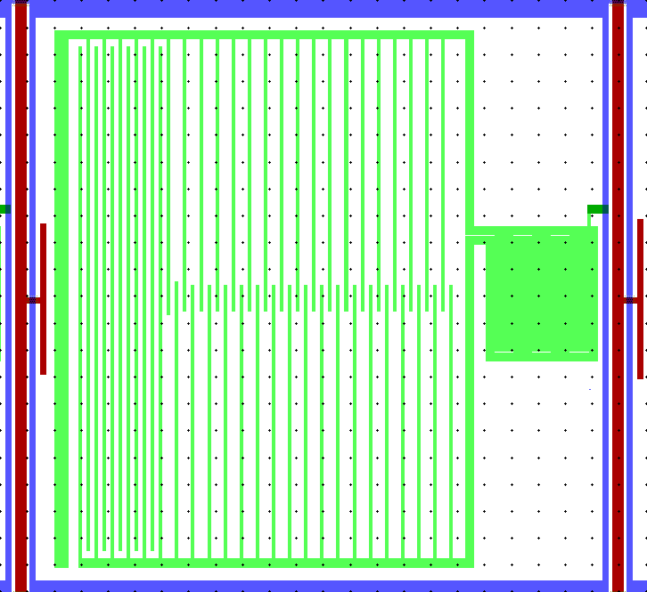
SCI-5 Array
Connection to ground at center of inductor, where fields should be smallest. May help with issues caused by floating pixels.
Refined process to take advantage of NIST multilayer TiN, which is destroyed by HF etch in our current process.

Slide 20
SCI-5 Array
JPL TiN film
NIST Multilayer TiN film

Slide 21
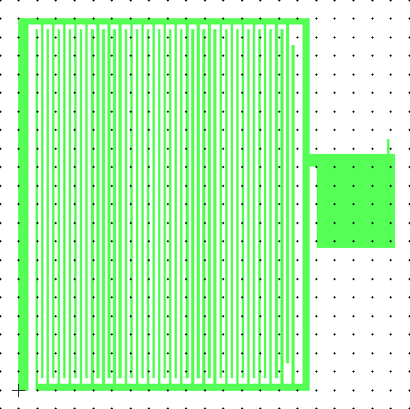
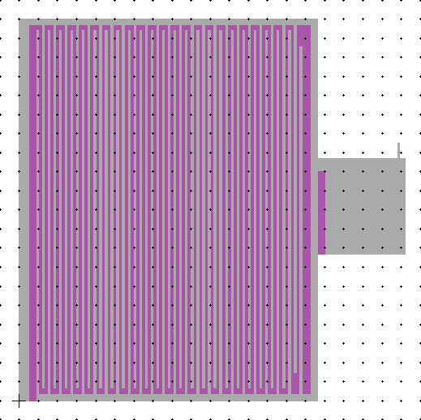
SCI-5 Array
Deposit TiN Outline
Nb Feedline/Ground Plane
Dielectric for Crossovers
Nb Feedline Center strip
Gold Bond Pads
Pattern TiN

Slide 22
Future Projects

Slide 23
Palomar 2013
Improve quantum efficiency
Microlens alignment stage
Improving filtering
Realuminizing Coudé flat
Improve energy resolution
Low-noise HEMT amplifiers
ROACH-2
Eliminate hot pixels
Virtual ground strap

Slide 24
ROACH-2
More FPGA resources
Faster clock rates
Better digital filters
Increase pixels per ROACH board
https://casper.berkeley.edu/

Slide 25
Other Projects
DARKNESS
DARK-speckle Near-IR Energy-resolved Superconducting Spectrophotometer
KRAKENS
Keck Radiometer Array using KID Energy Sensors
180x180 pixels, 54x54” field of view, R = 20, Cassegrain focus
Mega-z

Slide 26
Summary
Palomar 2012 successful, but much room to improve
Recent efforts:
X-ray MKIDs
Trenched Devices
Carbon Nanotube Absorbers
Focused Ion Beam Milling
SCI-5 Array Design
Aiming to improve QE, energy resolution, and yield, and to eliminate hot pixels, for next run

