Slide 1


Finding New Physics using heavy flavor decays
S. Stone

Slide 2

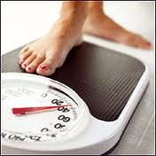
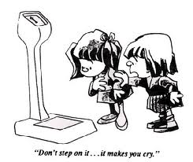
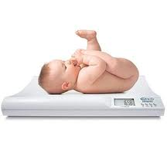
What is Heavy Flavor Physics ?
Define Heavy Flavor Physics
  Flavor Physics: Study of interactions that differ among flavors: (quark flavors are u, d, c, s, b, t)
  Heavy: Not SM neutrino’s or u or d quarks, maybe s quarks, concentrate here on b quarks (some c), t too heavy
u, d, ν’s
s, μ
c & b, τ; ν_{Μ}’s ?
  t
too light
maybe
just right
too heavy

Slide 3
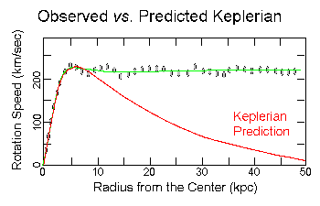
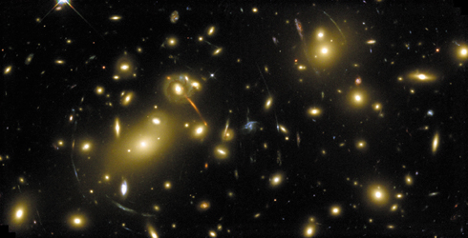
Physics Beyond the Standard Model
  Baryogenesis: From current measurements can only generate (n_{B}-n_{B})/n_{γ} =~10⁻²⁰ but ~6x10⁻¹⁰ is needed. Thus New Physics must exist to generate needed CP Violation
Dark Matter
Hierarchy Problem: We don’t understand how we get from the Planck scale of Energy ~10¹⁹ GeV to the Electroweak Scale ~100 GeV without “fine tuning” quantum corrections
Gravitational
lensing

Slide 4
Masses
12 orders of magnitude differences not explained; t quark as heavy as Tungsten

Slide 5
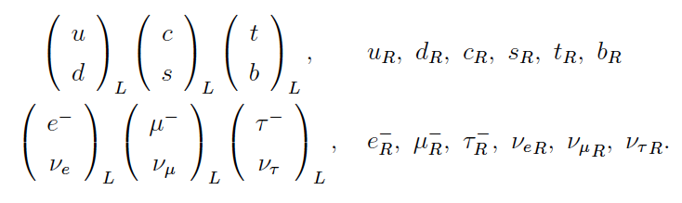

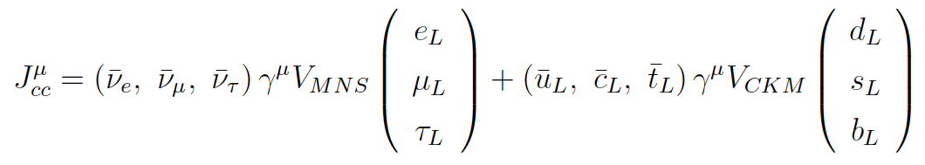
Formalism
Standard model fermions
SM gauge bosons: γ, W±, Z⁰ & H⁰.
Lagrangian for charged current interactions is
where

Slide 6
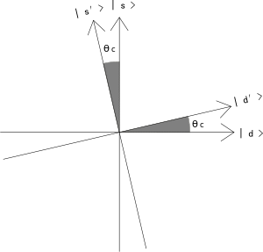
Quark Mixing
Consider the charm quark. It forms a 2nd generation doublet with the strange quark (c,s). Yet it also decays into the d quark which is in the first generation with the u quark (u,d).
We say this happens because the s & d quarks are “mixed” i.e. their wave functions really are described by a rotation matrix
where the s´ couples to c
θ_{C}=13º

Slide 7
Quark Mixing & CKM Matrix
All 3 generations of -1/3 quarks
(d, s, b) are mixed
Described by CKM matrix (also ν are mixed)
Unitary 3x3 matrix can be described by 4 parameters λ=0.225, A=0.8, constraints on ρ & η
These are fundamental constants of nature in the Standard Model
Shown to order λ⁴

Slide 8
CKM vs. PMNS
Area ~V²
Why these values? Are the two related? Are they related to masses?

Slide 9
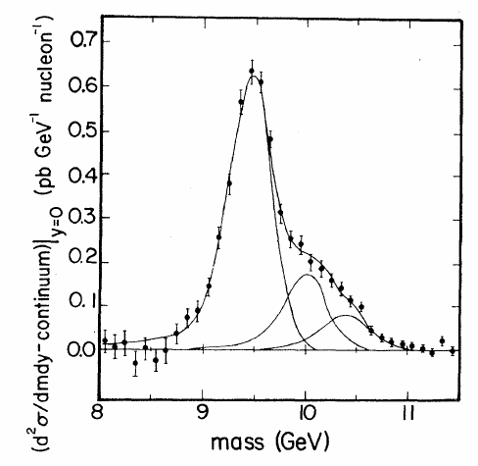
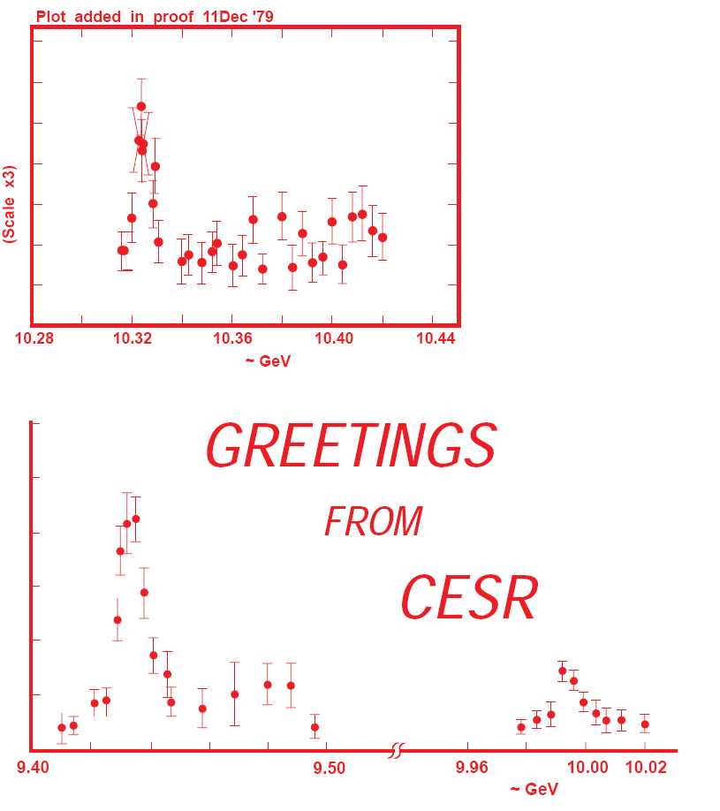
A bit of history
Herb et. al, PRL 39, 252 (1977)
Υ, formed of bb quarks,
found at Fermilab in the μ⁺μ⁻ chanel
Followed by Doris Υ, Υ′; CLEO & CUSB that distinctly observed all 3 states, & published on the 1979 Xmas card

Slide 10
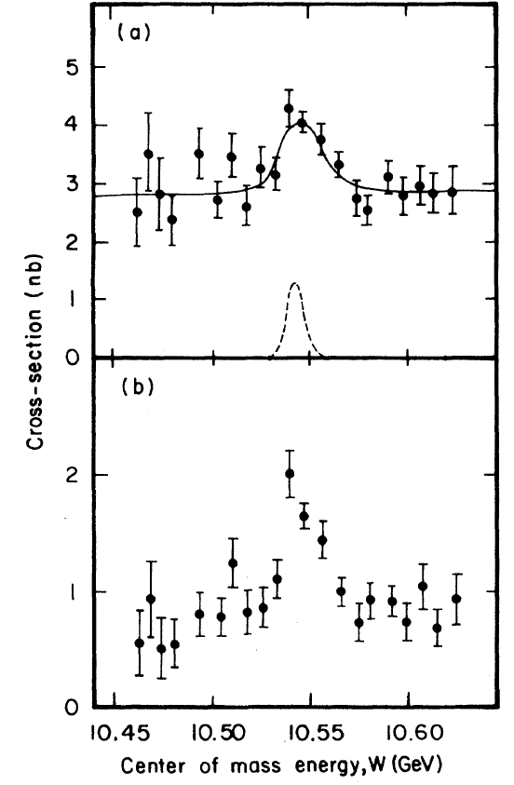
Discovery of Y(4S)
The Υ states were narrow, their observed widths were consistent with
the experimental mass
resolution, so below the
threshold to decay into BB
Another resonance was
found that was ~20 MeV wide,
& subsequently shown to decay
into either B⁺B⁻ or B⁰B⁰
“More spherical events”

Slide 11
B Experiments
S. Stone
e⁺e⁻ at Y(4S) ARGUS, CLEO, BaBar, & Belle
e⁺e⁻ at Z⁰, LEP & SLC
CDF & D0, 1.8 TeV pp
LHCb, CMS & ATLAS, 7-8 TeV pp

Slide 12
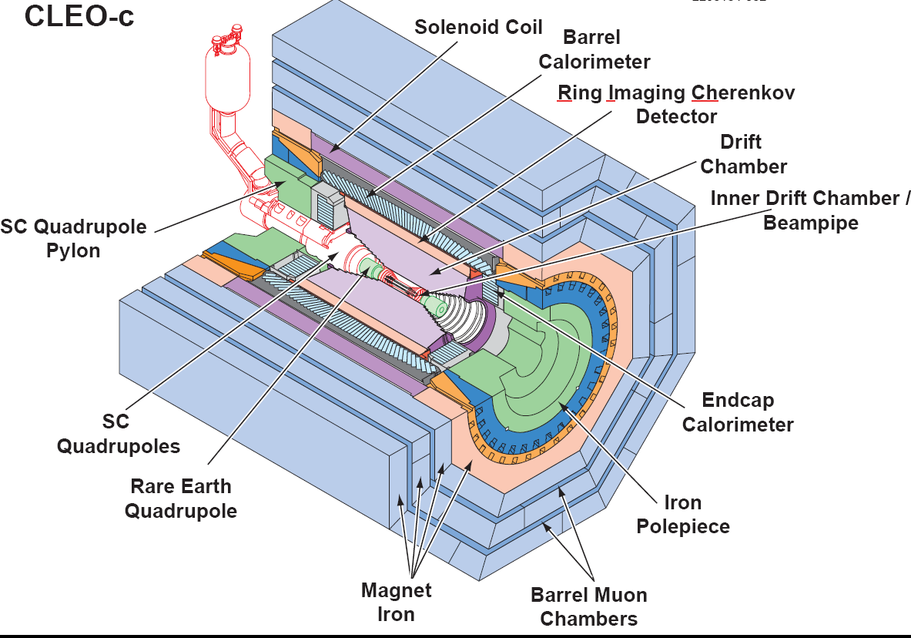
e⁺e⁻ at Y(4S)
All detectors have cylindrical geometries with common elements
Key: PID, CsI ecal
Vertex detector usually Si strips, to measure B & B
vertex separations, possible since beams in Belle & Babar have different energies; causes boost along beam direction. Typical resolutions on τ_{B} ~900 fs.

Slide 13
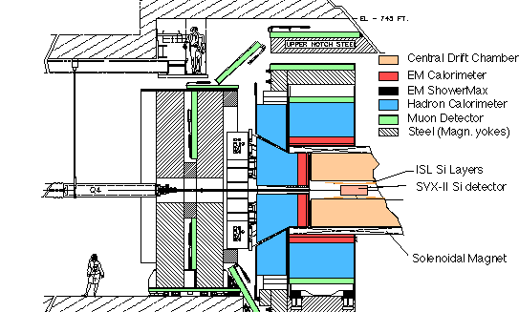
Central detectors at pp
⁽-⁾
CDF

Slide 14
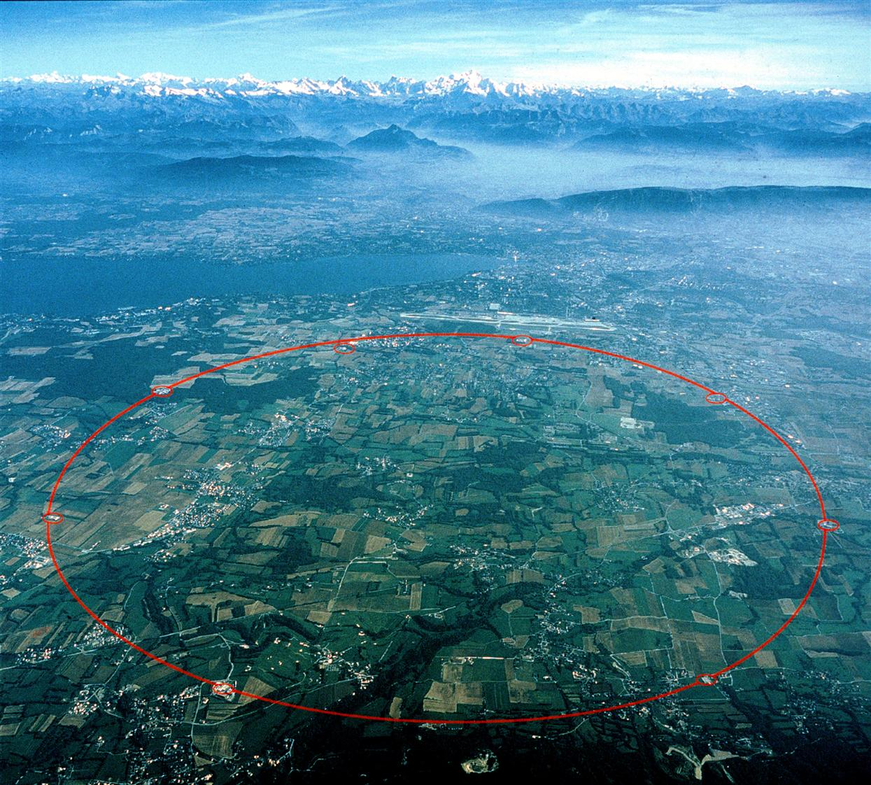
The LHC
4 TeV x 4 TeV pp collisions (future ~7 x ~7)

Slide 15

The LHC
27 km in circumference

Slide 16
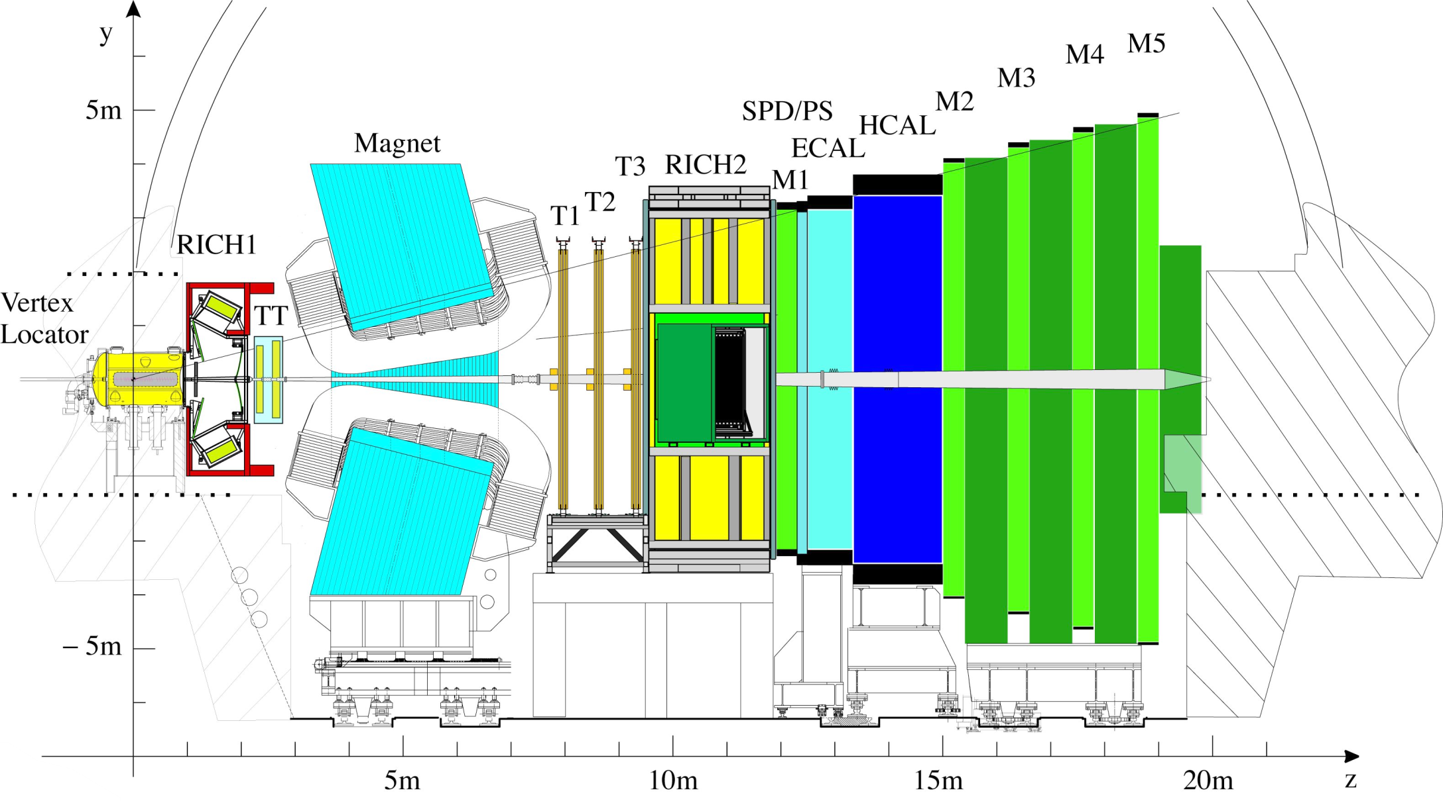
The LHCb Detector

Slide 17
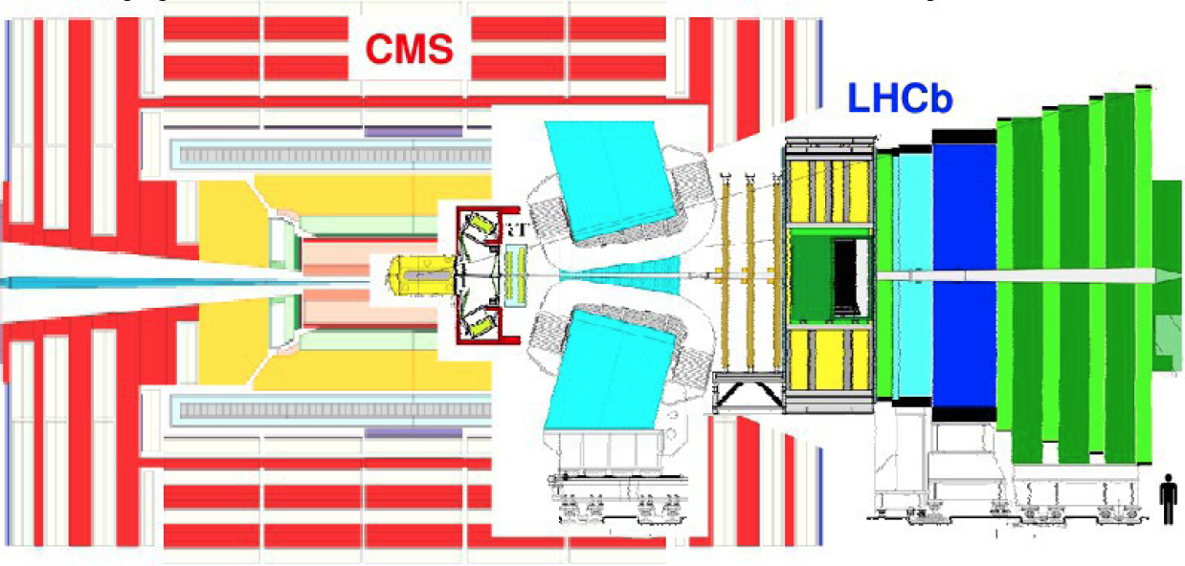
Detector Geometry
Complementary to ATLAS & CMS
Much less expensive

Slide 18
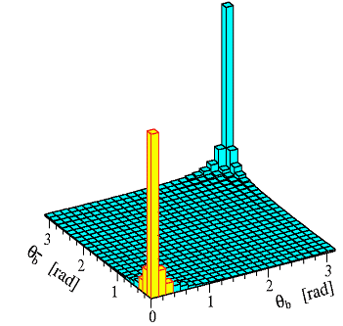
The Forward Direction at the LHC
The primary pp collision produces a pair of bb quarks. They then form hadrons. In the forward region at LHC the bb production σ is large
The hadrons containing the b & b quarks are both likely to be in the acceptance. Essential for knowing if a neutral B meson started out as a B⁰ or B⁰, determined by “flavor tagging”
At L=2x10³²/cm²-s, we get ~10¹² B hadrons in 10⁷ sec
Production
∠ Of B vs B
θ B (rad)
θ B (rad)
Pythia production cross section (7 TeV)
p_{T}
130 μb
300 μb
η=−ln(tanθ/2)
18

Slide 19
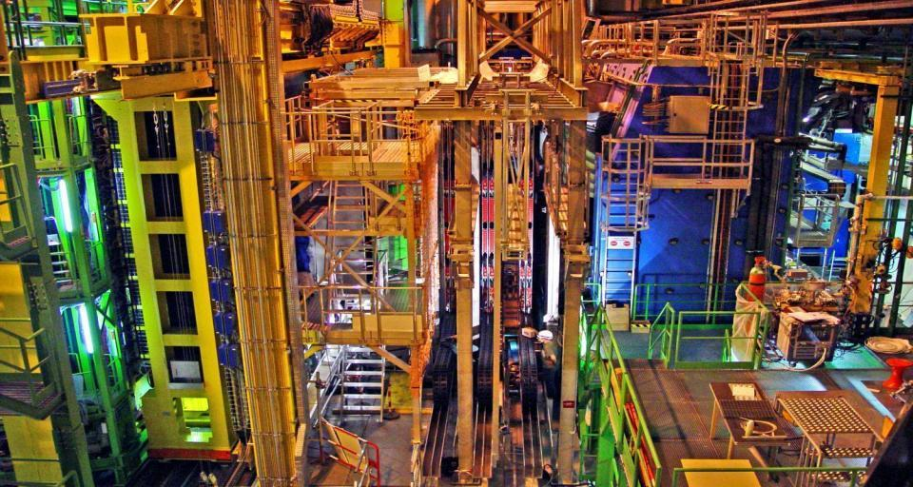

Detector Workings
LHCb detector ~ fully installed and commissioned → walk through the detector using the example of a B_{s}→D_{s}K decay

Slide 20
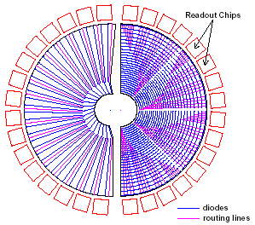
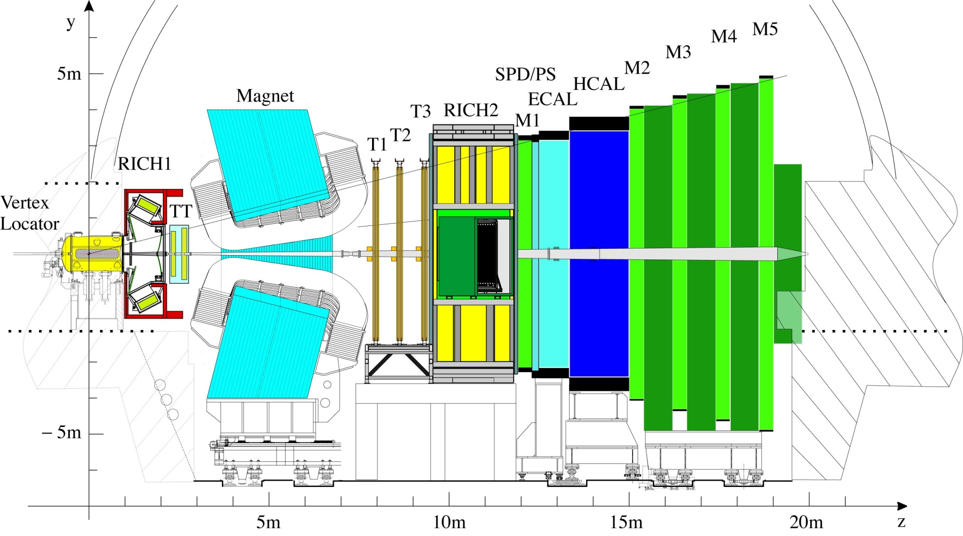
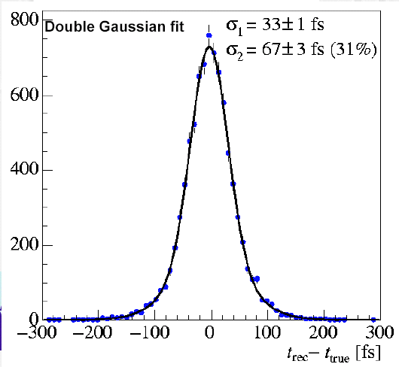
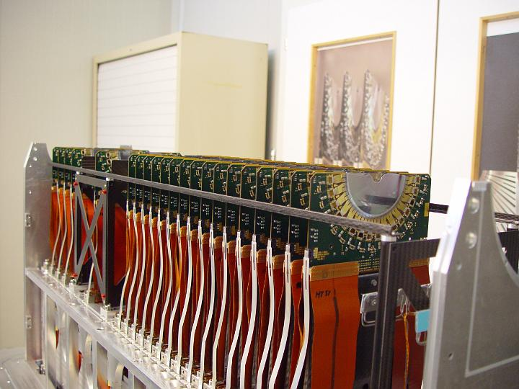
B-Vertex Measurement
Example: B_{s} → D_{s} K
φ
sensors
144 μm
σ(τ) ~40 fs
R
sensors
47 μm
K⁺
B_{s}
K⁺
D_{s}
K⁻
Primary vertex
π⁻
d~1cm
440 μm
Decay time resolution = 40 fs
Vertex Locator (Velo)
Silicon strip detector with
~ 5 μm hit resolution
→ 30 μm IP resolution
Vertexing:
trigger on impact parameter
measurement of decay distance
& decay time=d/v=md/p

Slide 21
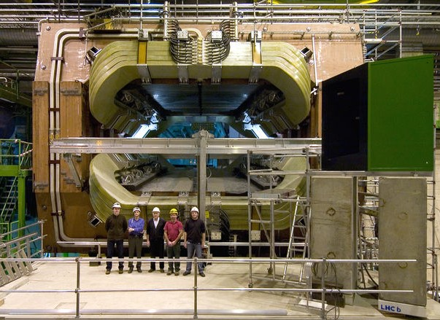

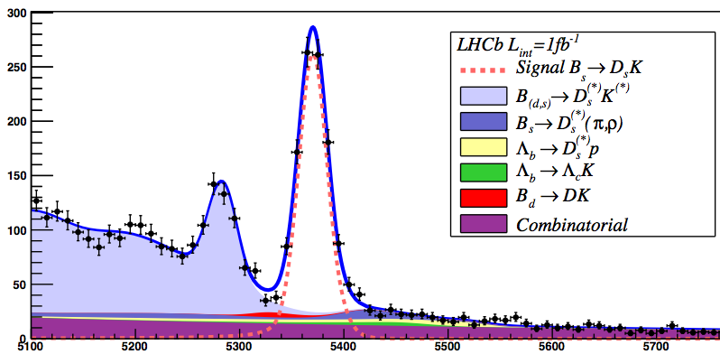
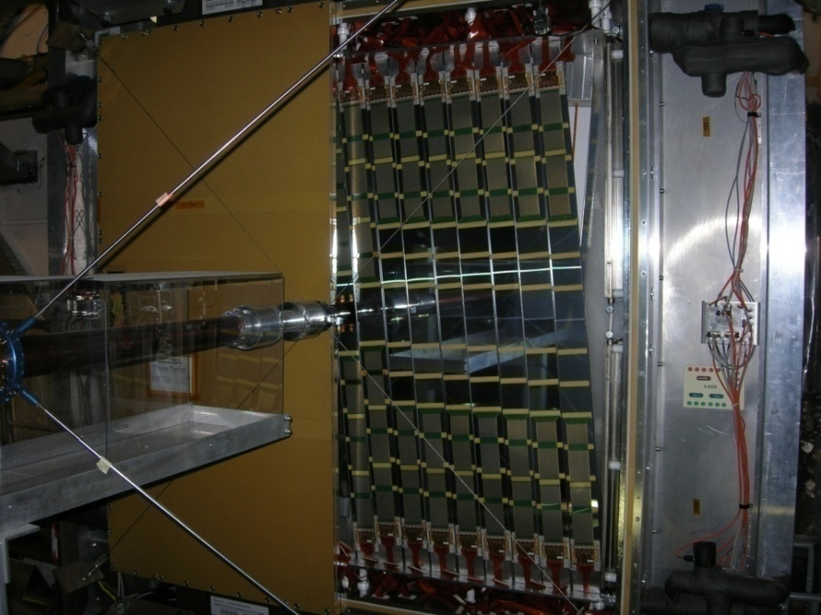
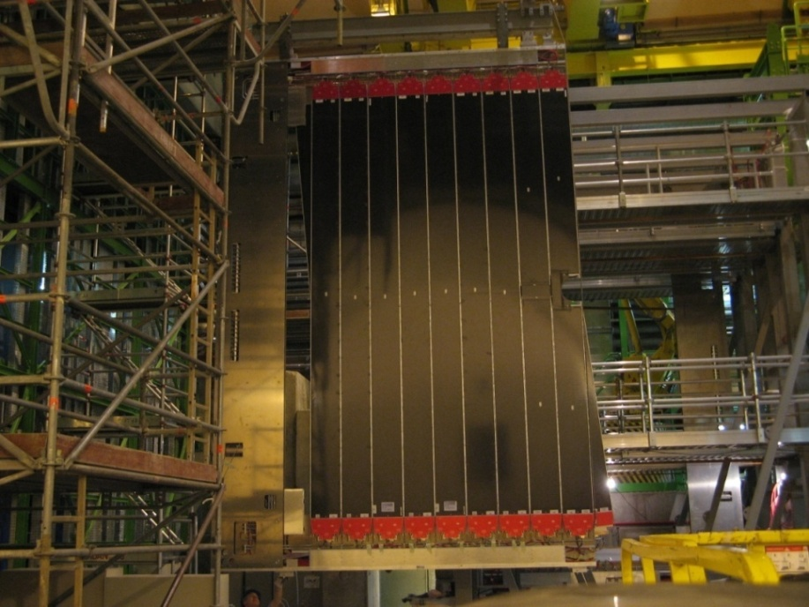
Momentum and Mass measurement
Momentum meas. + direction (VELO): Mass resolution for background suppression
Mass resolution
σ ~15 MeV
o - +
B_{s}→ D_{s} K
π⁺, K⁺
B_{s}
Bº
K⁺
D_{s}
K⁻
π⁻
Primary vertex
b^{tag}

5100 5300 5500 5700
m(D_{s}K) (MeV)

Slide 22
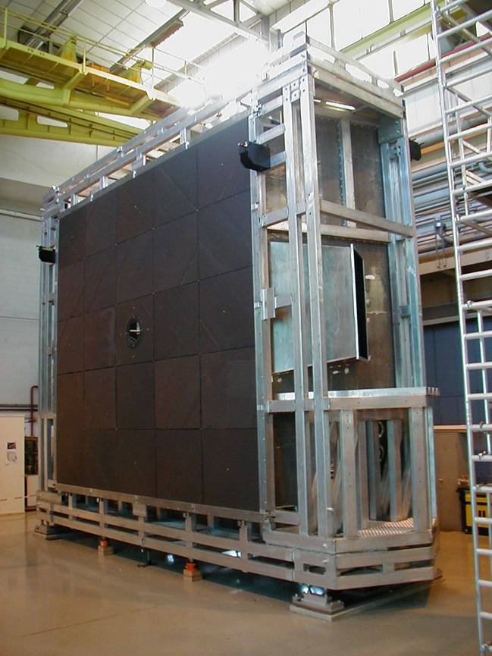
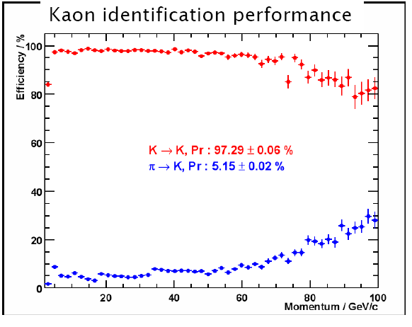
Hadron Identification
RICH: K/π identification using Cherenkov light emission angle
Bs → Ds K
SS flavour tagging
π⁺,K⁺
B_{s}
K⁺
K→K : 96.77 ± 0.06%
π→K : 3.94 ± 0.02%
D_{s}
K⁻
π⁻
Primary vertex
b^{tag}

RICH1: 5 cm aerogel n=1.03
  4 m³ C₄F₁₀ n=1.0014
RICH2: 100 m3 CF₄ n=1.0005

Slide 23
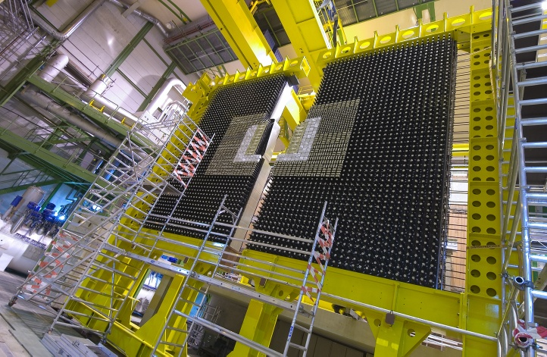
Calorimetry and L0 trigger
e
h
ECAL (inner modules): σ(E)/E ~ 8.2% /√E + 0.9%
Calorimeter system :
Identify electrons, hadrons, π⁰ ,γ
Level 0 trigger: high E_{T} electron and hadron
K⁺
B_{s}
K⁺
D_{s}
K⁻
Primary vertex
b^{tag}
π⁻

Slide 24
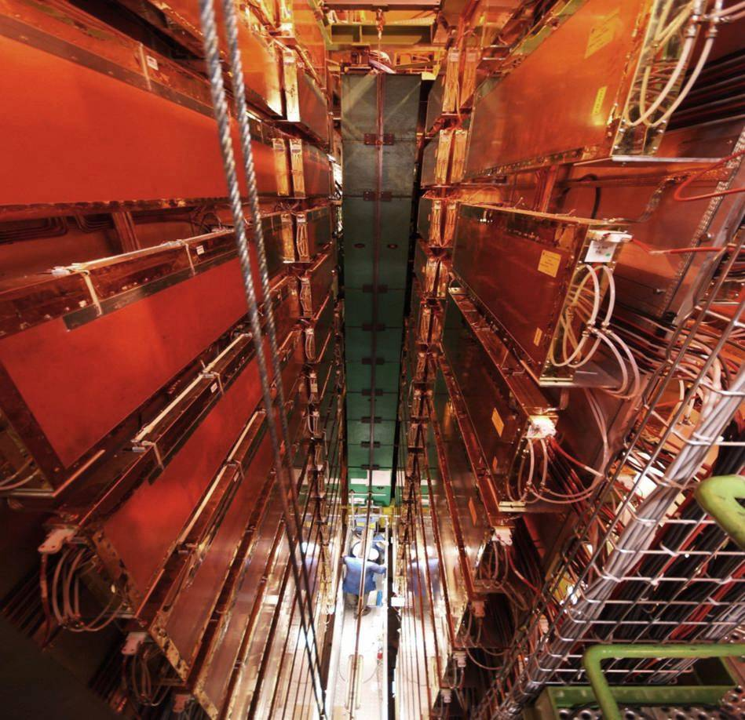
Muon identification and L0 trigger
μ
Muon system:
Level 0 trigger: High P_{t} muons
OS flavour tagging
K⁺
B_{s}
K⁺
D_{s}
K⁻
Primary vertex
b^{tag}
π⁻

Slide 25
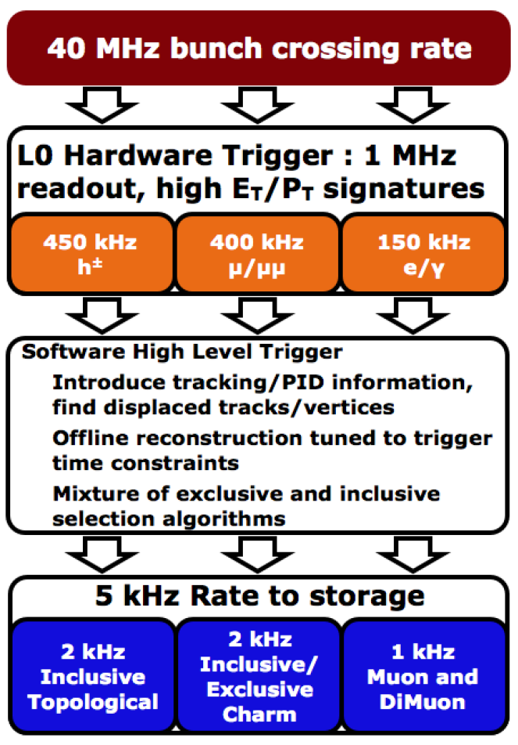
Triggering
Trigger is crucial as σ_{bb} is less than 1% of total inelastic cross section and B decays of
interest typically have B ranching ratios of <10⁻⁵
Hardware level (L0)
  Search for high-p_{T} μ, e, γ and hadron candidates
Software level (High Level Trigger, HLT)
  Farm with O(29000) multi-core processors)
  Very flexible algorithms, writes ~5 kHz to storage
This is the bottleneck

Slide 26
Detector Performance
Detector works better than expected
Run at 4x10⁻³² cm⁻²/s instead of 2x10³², with fewer bunches in the machine which is more difficult ~<1.5> interactions/crossing
Detector efficiency >95% for all systems
Problems: Vertex resolution slightly worse, flavor tagging somewhat poorer
Luminosity is leveled – small changes of L with time; beams are brought closer together when currents decrease

Slide 27
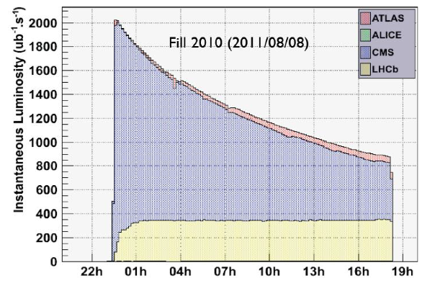
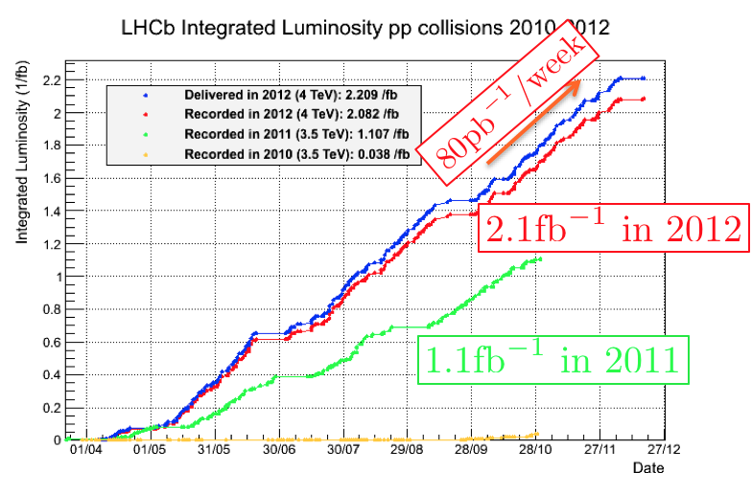
Luminosity Leveling
Luminosity is maintained
as at a constant value of
~4x10³²/cm∙s by displacing
beams transversely
Integral L is 1/fb in 2011,
collected 2/fb more in
2012

Slide 28
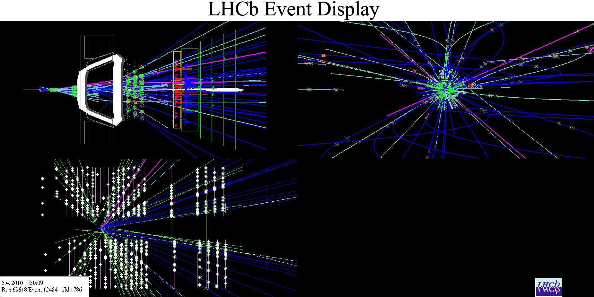
B⁻→J/ψ K⁻

Slide 29
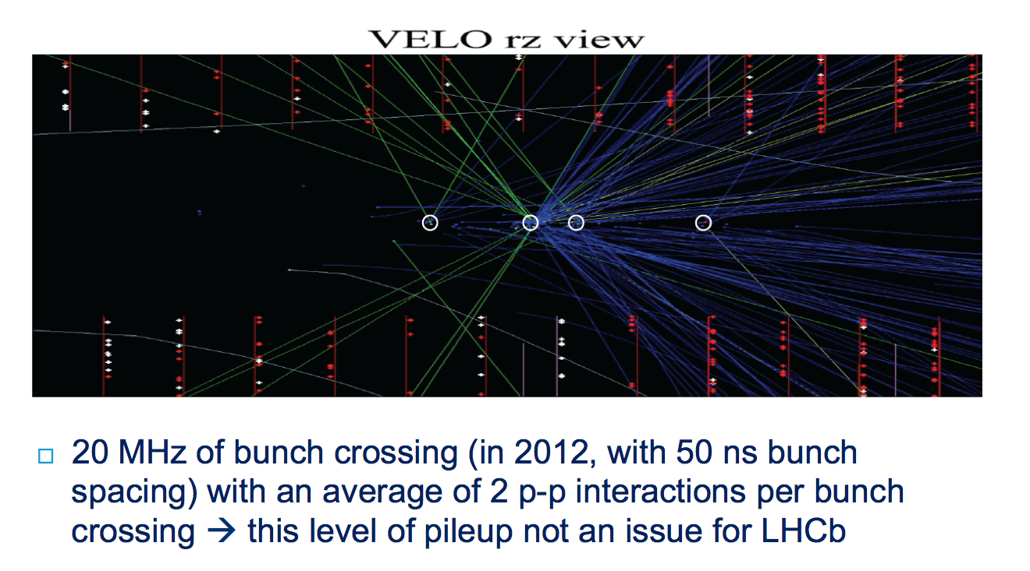
Running Conditions
1.5 pp

Slide 30
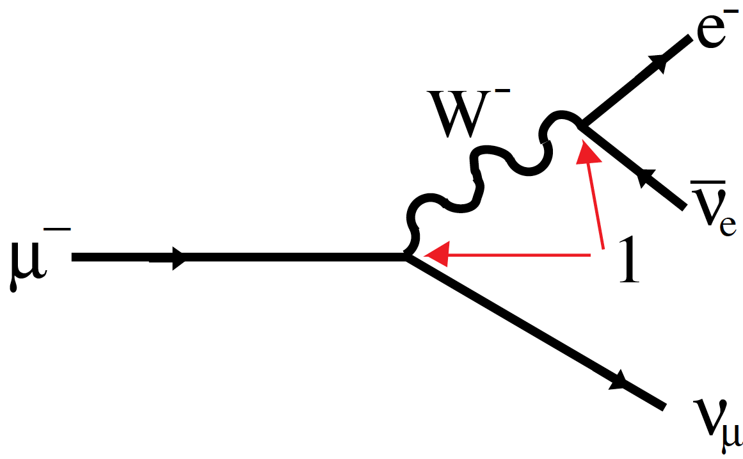

Weak decay constant
Consider the b decay of
The decay width is given by
Since Γ_{μ}⋅τ_{μ}=ħ, measuring the muon lifetime determines G_{F}.

Slide 31
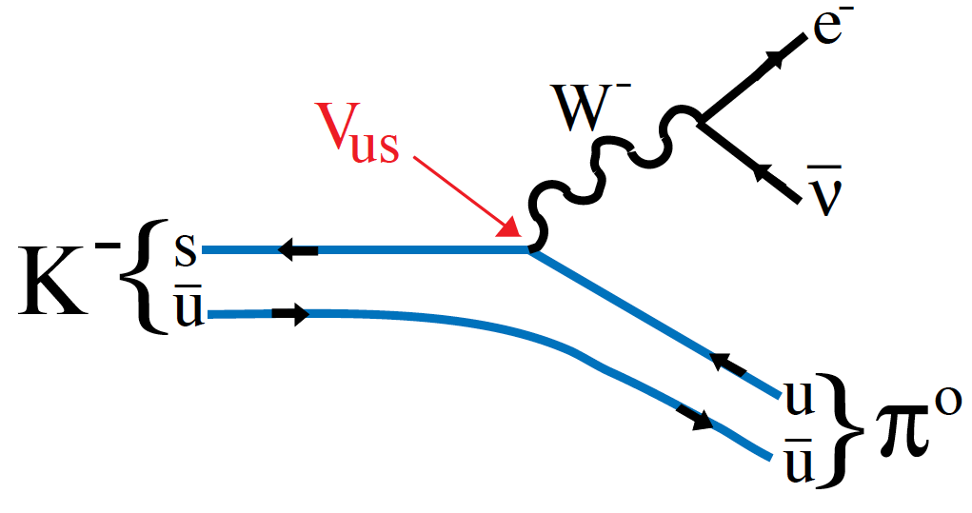
|V_{us}|
|V_{ud}| =0.97418±0.00026
is measured using
nuclear β decays
For |V_{us}| use semileptonic kaon
decays. The decay width is given by
  C_{K} is a Clebsch-Gordan coefficent =1/2
  S_{EW} is the short-distance EW correction =1.0232
  Δ’s are SU(2) breaking & long-distance E&M corrects
  I_{K,l}(λ) is the phase space integral

Slide 32
|V_{us}| II
f₊(0): Here we have quark transition, yet the quarks have to form a single hadron, the π⁰
The probability of this happening is parameterized in terms of the 4-momentum transfer squared, q²=(p-p′)². From the fact that the K→π weak transition must be Vector
For massless leptons the f₋(q²) term vanishes
The shape of f(q²) can be measured, so only f₊(0) remains to be calculated.

Slide 33
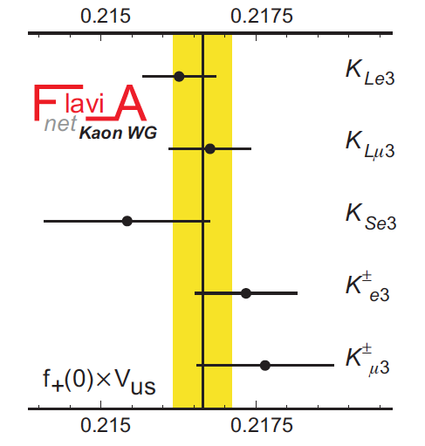
|V_{us}| III
Measurements of f₊(0)|V_{us}|
f₊(0)=0.964(5)
λ=|V_{us}|=0.2246±0.0012
Experiment measures
K lifetime, shape of form-
factor & value of the form-
factor at q²=0

Slide 34
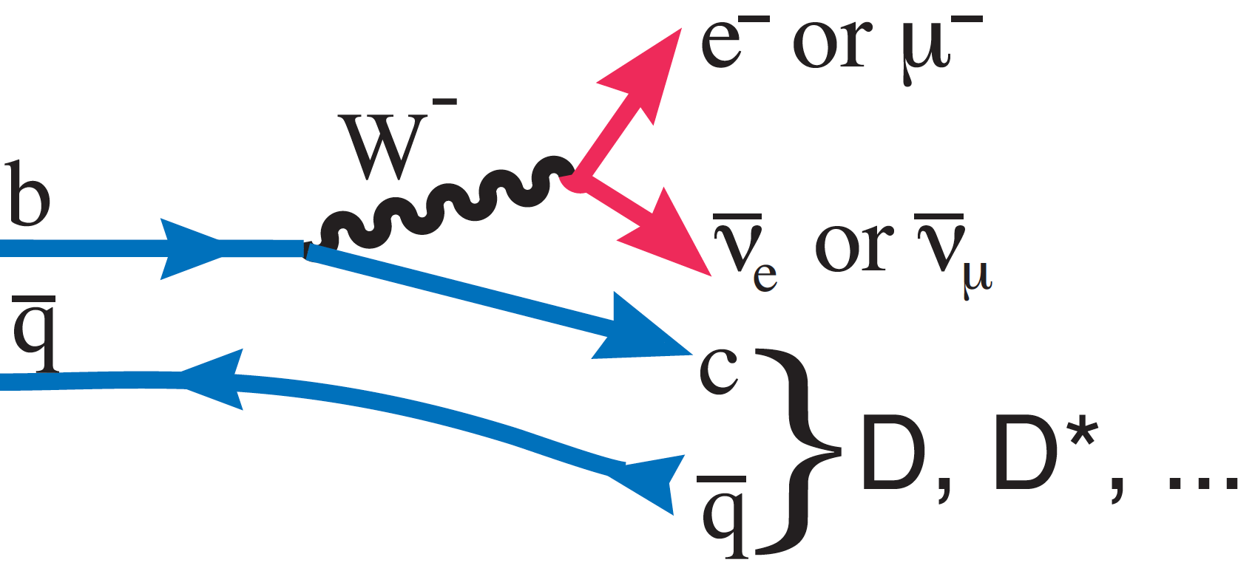
|V_{cb}|
Basic decay diagram:
Two methods used to determine |V_{cb}| from data: Exclusive, only a D or D* produced, & Inclusive, take all b→c decays
If B→D one form-factor, for B→D*, have 3
V_{cb}

Slide 35
Exclusive |V_{cb}|
Based on HQET invented by N. Isgur & M. Wise
  Idea is that there are spin & flavor symmetries between two ∞ heavy quarks; the b & c quarks are not quite that heavy, but corrections can be calculated in a controlled way. In HQET only 1 ff for B→D*, where there are 3 independent spin states
  Consider the invariant 4-velocity transfer, ω. When ω=1, the b transforms into a c with the same velocity, so the form-factor is unity modulo some small corrections
  Note

Slide 36
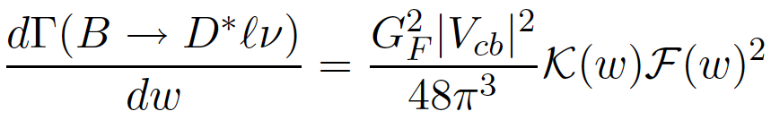
Exclusive |V_{cb}| II
F(ω) is the form-factor
K(ω) is the phase space factor, which goes to zero as ω→, so data must be extrapolated. There are theoretical models for the shape of F(ω). All that’s necessary is the lifetime, the value of the branching fraction at F(1), which determines (F(1)|V_{cb}|)², & the theoretically determined corrections to F(1) from 1

Slide 37
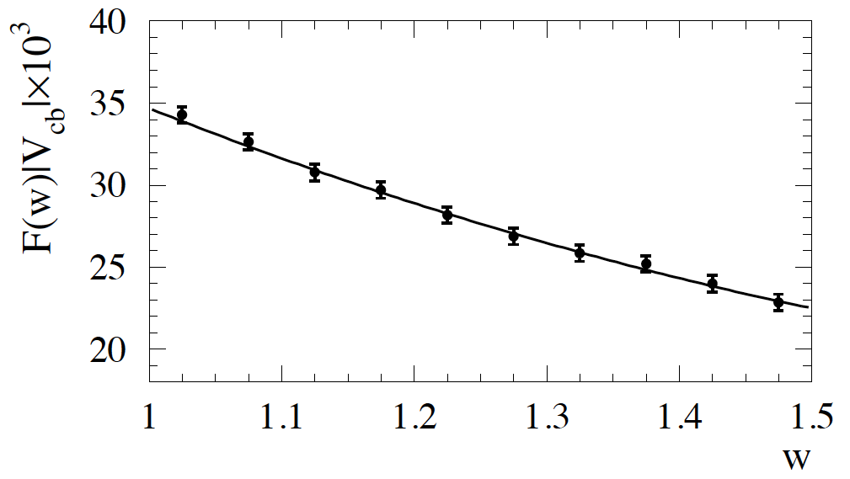
Exclusive |V_{cb}| III
Predictions of
F(1)
  Lattice (FNAL/MILC):
  0.906±0.004±0.012
  QCD sum rules
  0.86±0.02
|V_{cb}|x10³=39.04±0.49_{exp}±0.53_{QCD}±0.19_{QED} (Lattice)
=41.6±0.6_{exp}±1.9_{thy} (Sum rules)
BaBar arXiv:0705.4008

Slide 38
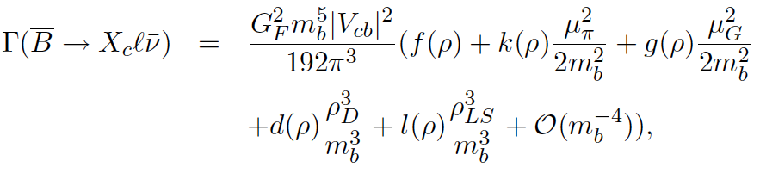

Inclusive |V_{cb}|
Here assume that the ensemble of exclusive b→c decays, B→Dlν, D*lν, D**lν,… can be approximated by a continuum, called “duality”. The model is called the Heavy Quark Expansion (HQE).
The decay rate is related to |V_{cb}| as
We will not go into the details here see arXiv:0902.3743

Slide 39
Inclusive |V_{cb}| II
Latest result: |V_{cb}|x10³ = 41.94±0.43_{fit}±0.59_{thy}
= 41.94±0.73
Exclusive (Lattice) = 39.04±0.75
Difference has χ²=3.8 for 1 dof, prob=5%
Could there be a problem here?
Λ_{b}/B⁰ lifetime ratio: HQE predicts that the lifetime ratio is almost equal, with Λ_{b} being shorter by a few %.

Slide 40
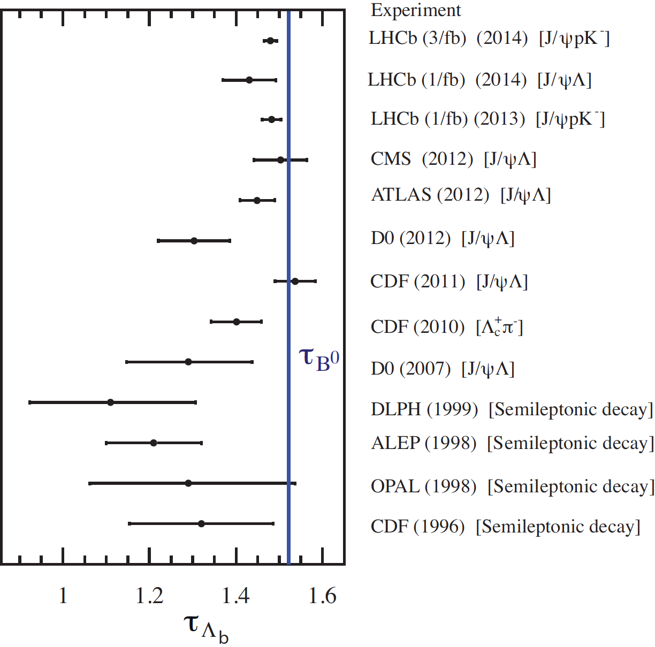
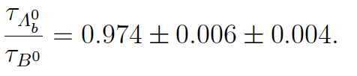
Λ_{b}/B⁰ lifetime ratio
Λ_{b} lifetime measurements were much lower
LHCb now finds
Consistent with HQE original prediction. Credit Uraltsev

Slide 41
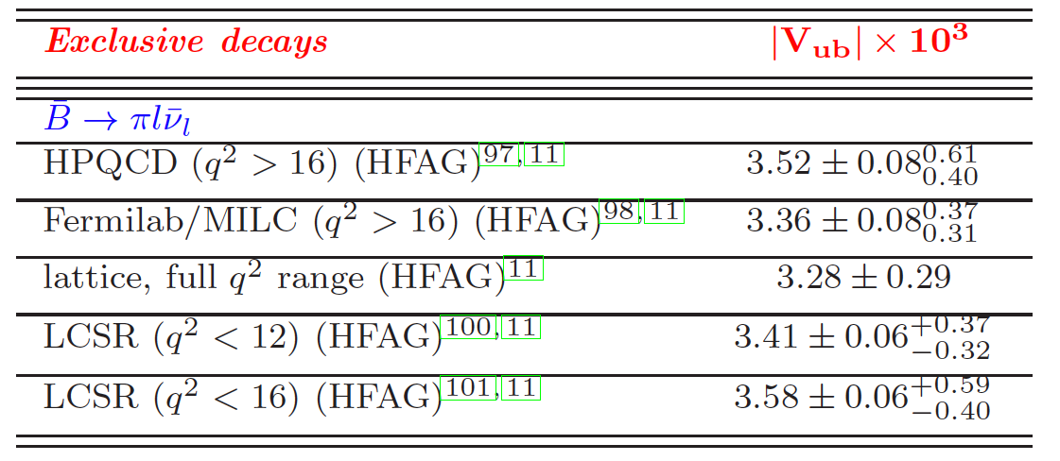
Exclusive |V_{ub}|
No theory like HQET
Must rely on Lattice & model calculations
See Ricciardi arXiv:1403.7750

Slide 42
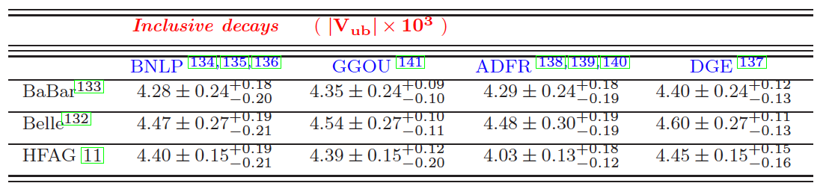
Exclusive |V_{ub}|
Use HQE. Here many final states possible
So take e.g. exclusive (3.28±0.29)x10⁻³
& inclusive (4.20 ±0.25)x10⁻³
These are inconsistent!
No resolution in sight
See Ricciardi arXiv:1403.7750
Models:

Slide 43
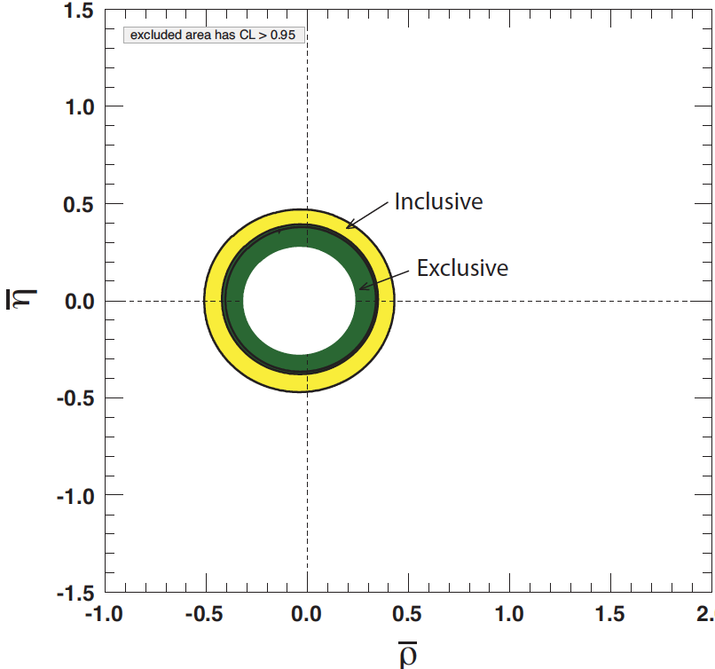
|V_{ub}|
Summary
Note
ρ=ρ(1-λ²/2)
η=η(1-λ²/2)
Bands are
±2σ

Slide 44
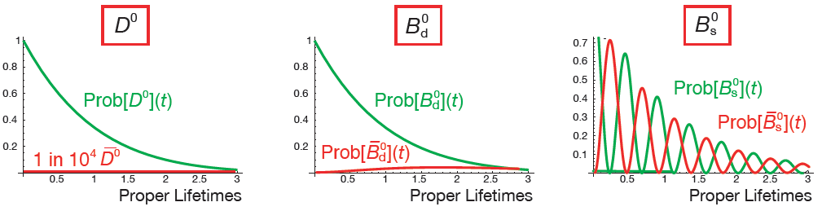
Neutral Meson Mixing
Neutral heavy mesons can transform
into their anti-particles via 2nd
order weak interactions
Short distance transition rate
depends on
  mass of intermediate q_{i}, the heavier the larger, favors mesons containing s & b, since t is allowed
  CKM elements V_{ij}.
New particles possible in the loop
almost zero?
from Van Kooten

Slide 45

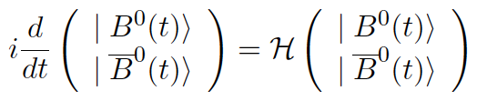
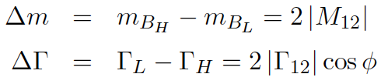

Mixing formalism
Hamiltonian
Schrodinger equation
Diagonalizing

Slide 46




B Mixing data
First measured by CDF
First seen by ARGUS

Slide 47

Dº-Dº Mixing
D*⁺→π⁺Dº provides an initial flavor tag
“Wrong-sign” (WS) Dº can appear via mixing or a rare decay that gives the same final state called doubly-Cabbibo suppressed decay (DCS), where DCS follow ~exp(-t/τ_{D}o). Mixing, however, depends on t in a more complicated way
Define R_{D}=DCS/(Cabibbo favored). Mixing is parameterized as x´ & y´, functions of Δm & ΔΓ.
Measure Wrong-sign/Right-sign, R(t)= (WS/RS)

Slide 48



Charm mixing result
D*⁺→π⁺Dº,
Dº→K⁻π⁺ (RS)
Dº→K⁺π⁻ (WS)
RS
WS
No mixing
excluded at 9.1σ,
systematic errors
are included
y´=(7.2±2.4)%
x´²=(-0.09±0.13)%
.

Slide 49


B mixing CKM constraints
For B⁰ mixing
B_{B} is a theoretical parameter, f_{B}, the meson decay constant is also estimated theoretically though in principle measuring B⁻→τν would determine |V_{ub}|²f_{B}². F is a known function & η_{QCD}~0.8
Similar Eq. for B_{s} mixing. Errors cancel in

Slide 50


B mixing & CKM constraints
We have
So the ratio gives
a circle in the (ρ,η)
plane centered
at (1,0).
(Modulo small higher
order corrections)

Slide 51
Sakharov conditions
Big bang gave matter & anti-matter
For the Universe to exist:
  Baryon # violation
  Departure from thermal equilibrium
  C & CP violation, where C is charge conjugation, e.g, C|p>=±|p>, & P is parity P|ψ(r)>=±|ψ(−r)>
  1. is satisfied as SM gives B violation at high T
  2. is satisfied from the EW phase transition
  3. C & CP are violated by weak interactions
BUT amount of CPV is too small by 10⁹, so new sources need to be found

Slide 52

CP formalism
Basic idea: two interfering amplitudes that ultimately involve the CKM parameter η.
Favorable if A & B are about the same size
Resulting rate difference depends on both a strong & weak phase difference

Slide 53


CP formalism
Consider specifically |B⁰＞, but this can be for any P⁰: K⁰, B⁰, B⁰_{s}, or D⁰.
CP|B⁰＞=|B⁰＞. So these are not CP eigenstates, but
& are with CP|B₁⁰＞=|B₁⁰＞ & CP|B₂⁰＞=−|B₂⁰＞
To allow for CPV define
where CP is violated if |p/q|≠1

Slide 54





CPV via interference of mixing & decay
Here we are interested in a final state that can be reached by either a |P⁰＞ or a |P⁰＞
Then we can utilize
mixing to provide another
Interfering amplitude
f can be a CP eigenstate, but it doesn’t have to be
Define . If
we have “direct” CPV, but all that is needed is for which can happen even if

Slide 55



CPV for f_{CP}
The asymmetry is given by
For |λ|=1, we have

Slide 56

CP mixing phase
Depends on CKM elements in mixing or box diagram
For B⁰ For B_{s}
arg(p/q)=β arg(p/q)~0

Slide 57




CPV for B⁰
Need p/q and A/A. Choosing a suitable CP eigenstate forces A/A=1. p/q comes from mixing
B⁰:
From unitarity
This is SM
(ρ,η)
η
ρ

Slide 58


B⁰→{cc} K⁰
For charmonium final states (Belle)

Slide 59

Measurements of sin2β
Requires knowledge of B flavor at birth – use info from the other B in the event
sin2β values
Belle 0.667±0.023±0.012
BaBar:
0.691±0.028±0.012
World Average:
0.682 ± 0.019
B⁰
B⁰
B⁰
B⁰
J/ψ K_{s}
J/ψ K_{L}
Belle
Belle
β= or

Slide 60
CPV in B_{s}→J/ψ X
For f =J/ψ φ or J/ψ f₀
Small CPV expected, good place for NP to appear. Non zero due
to CKM effects of order
λ⁴ in V_{ts}
J/ψφ not a CP eigenstate. Why? But can be used

Slide 61
CPV Time Evolution for B_{S}
Consider
Define
Only 1 A_{f} & ΔΓ=0
Then , & λ_{f} is a function of V_{ij} in SM
For Bº, ΔΓ≈0, but there can be multiple A_{f}
If in addition ΔΓ≠0, eg. B_{s}
See Nierste
arXiv:0904.1869 [hep-ph]

Slide 62



Transversity
}
for S-wave under φ predicted
by Stone & Zhang PRD 79,
074024 (2009)

Slide 63

Transversity II
only term for f=f_{cp}

Slide 64


φ_{s} from B_{s}→J/ψπ⁺π⁻
Reconstructed
π⁺π⁻ mass spectrum
In region between
arrows, measured
to be >97.7%
CP-odd @95% cl
(1/fb)
(uncertainty for 3/fb~0.070 rad)
f (980)
peak, now use
entire mass
range
0
background

Slide 65


φ_{s} results from J/ψφ
LHCb values
Γ=0.6580±0.0054
±0.0066 (ps⁻¹)
ΔΓ=0.116 ±0.018
±0.006 (ps⁻¹)
φ_{s}=0.001±0.101
±0.027 (rad)
Combining LHCb results:

