Slide 1
BICEP2 and the Early Universe
B-modes the 1st 3 weeks
The new energy frontier
Albert Stebbins
Academic Lecture Series
Fermilab 2014-04-08

Slide 3
What Does All This Mean?
Not Swirly
Swirly

Slide 4
Joint Experimental-Theoretical Physics Seminar
Detection of B-mode Polarization on Degree Angular Scales with the BICEP2
Experiment at the South Pole
Abby Vieregg
U. of Chicago
Friday April 11 4PM

Slide 5
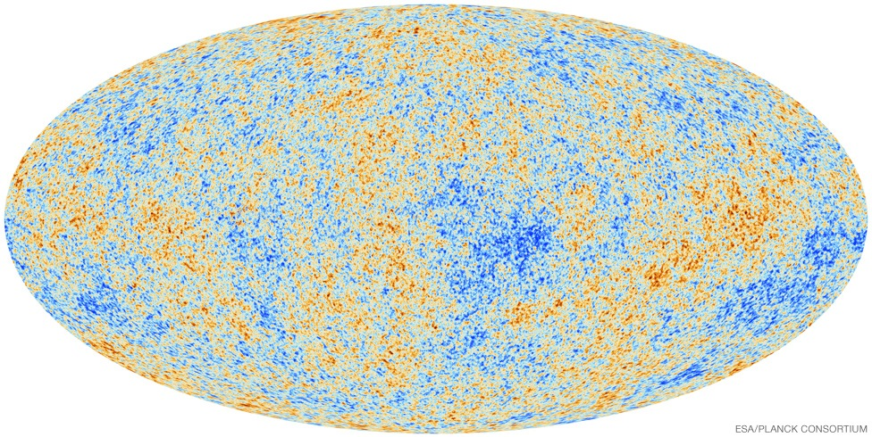
Cosmic Microwave Background
Temperature
COBE
WMAP
Planck

Slide 6
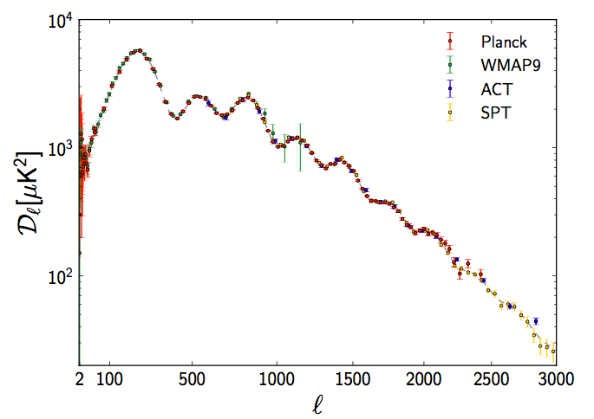
Angular Spectrum: Temperature

Slide 7
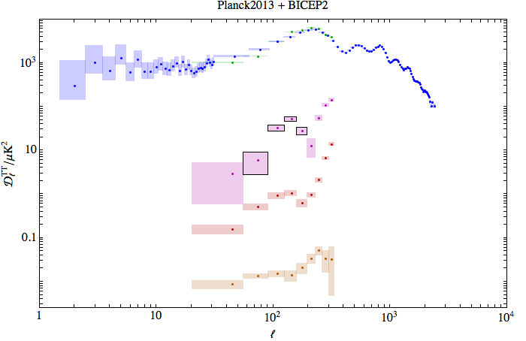
Spectra: After BICEP2

Slide 8
How to Describe the CMBR? Microscopic Description
Ea[x,t] ∝ ∫ dν e^{i2πνt} ∫ d²ĉ e^{i2π ν ĉ∙x} Ẽa[ĉ,ν]
in a small frequency bin:
⟨ ⟩∝( )
Light are a collection of electromagnetic waves.
Ẽx Ẽx* | Ẽx Ẽz*
Ẽz Ẽx* | Ẽz Ẽz*
I+Q | U+i V
U-iV | I-Q
I intensity
Q,U linear polarization
V circular polarization
The interesting information is usually only in the time averaged 2nd moments of the E fields.
Expectation:
CMBR slightly linearly polarized
I²»Q²+U² » V² Rees (1968)

Slide 9
Graphical Representation of Linear Polarization 2d Symmetric Traceless Tensors
Q > 0
Q < 0
U > 0
U < 0

Slide 10
Linear Polarization Patterns
Q patterns
U patterns

Slide 11
Linear Polarization Patterns
k
0º-90º pattern
90^{O}
scalar pattern Stebbins 1996
gradient pattern Kaminokowski, Kosowsky, Stebbins 1997
E-mode Seljak, Zaldarriaga 1997
0^{O}
90^{O}
k
Stebbins 1996 pseudo-scalar pattern
Kaminokowski, Kosowsky, Stebbins 1997 curl pattern
Seljak, Zaldarriaga 1997 B-mode
+45^{O}
-45^{O}
+45^{O}
±45º pattern

Slide 12
How to Describe the CMBR? Intensity and Units
or GW’s
In astronomy I[ĉ, ν, x,t] usually has units: ergs/cm2/sec/steradian/Hz
recall Poynting energy flux S=ExB/(8π)=|E|²/(8π) (Gaussian CGS units)
radio astronomy: often convenient to define a Rayleigh Jeans Brightness temperature
kTRJ = ½(c/ν)²I
this gives the thermodynamic brightness temperature if hν≪kT,
theoretically it is most convenient to use the quantum mechanical occupation number
n^{T}[ν] = ½(c/ν)²I/(hν) = kTRJ/(hν)
for a blackbody n = nBB[ν,T] = 1/(e^{(hν)/(kT)}-1)
N.B.one can multiply E,B,V by ½(c/ν)2/(hν) to put them in dimensionless occupation number units: nT, nE, nB, nV

Slide 13
WHERE DOES THE POLARIZATION COME FROM?
Thomson scattering of temperature anisotropies.

Slide 14
Thomson Scattering

Slide 15
Thomson Scattering

Slide 16
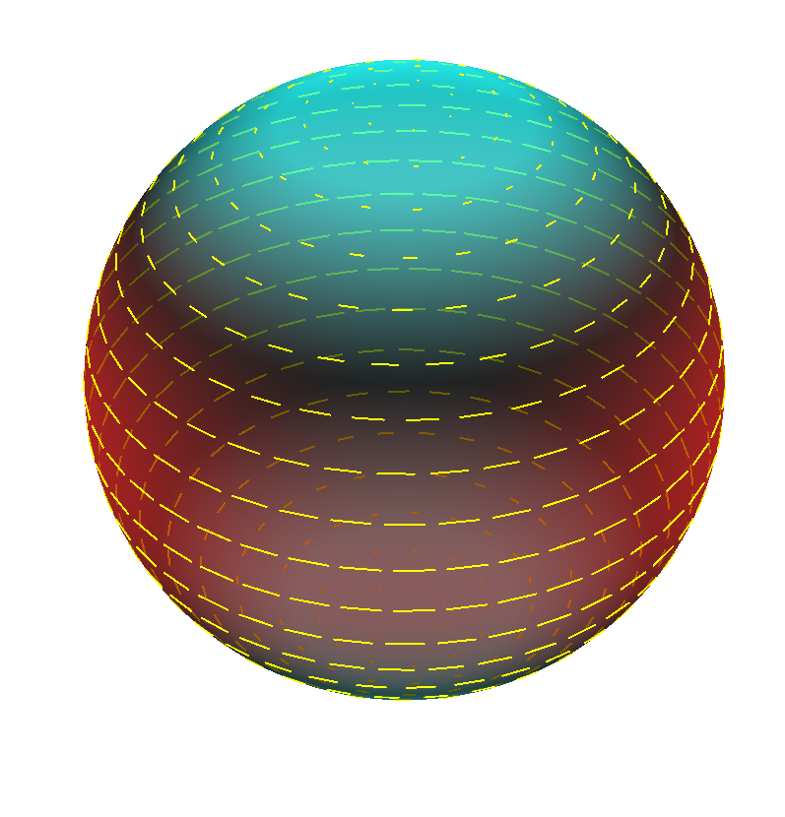
Thomson Scattering and Polarization

Slide 17
WHERE DO THE B-MODES COME FROM?
Thomson scattering of temperature anisotropies w/ non-zero helicity.
or lensing

Slide 18
How to Describe the CMBR? Macroscopic Description
On cosmological length and times-scales (millions to billions of light-years):
I[ĉ, ν, x,t], Q[ĉ, ν, x,t], U[ĉ, ν, x,t], V [ĉ, ν, x,t]
as we shall see V=0 is a good approximation.
Spatial Fourier transform, e.g.
I[ĉ,ν,x,t] =∑k e^{i k∙x} Ĩ[ĉ,ν,k,t]
Angular decomposition: spherical harmonics
Ĩ[ĉ,ν,k,t] =∑ℓ∑m Y(ℓ,ℎ) [ĉ] Ĩ(ℓ, ℎ)[ν,k,t]
For each k, align “North Pole” of Y(l, ℎ) to k direction then ℎ gives helicity
as we shall see I(l, ℎ)=0 for |ℎ|>2 is a good approximation.
A simple Y(l,ℎ) decomposition of Q,U is not the best!

Slide 19
How to Describe the CMBR? Summary
Mode decomposed each Stokes parameter w/ “quantum numbers”
k spatial dependence
ℎ helicity: =0 scalar, =1 vector, =2 tensor, …
ℓ angular wavenumber

Slide 20
Polarization Pattern from Helicity 0 Brightness Pattern
Always E-modes

Slide 21
Polarization Pattern from Helicity 1 Brightness Pattern
Mixture of E&B modes

Slide 22
Polarization Pattern from Helicity 2 Brightness Pattern
Mixture of E&B modes

Slide 23
WHERE DO THE TEMPERATURE ANISOTROPIES COME FROM?
Motion of baryons associated with metric perturbations

Slide 24
General Relativity
Metric geometry
10 free functions reduced by 4 to 6 by coordinate freedom
Can decompose according to helicity (2scalar+2vector+2tensor)
Dynamics: Einstein’s Eq’s: Gμν=8πG Tμν

Slide 25
Scalar, Vector, Tensor Motions
h=0,
h=±1,
h=±2

Slide 26
Tensor Motions
h=±2

Slide 27
WHEN/WHERE DID THIS SCATTERING HAPPEN?
Require sufficient but not too much scattering:
recombination z=1000
reionization z=10

Slide 28
CMBR Visibility Function
z
e^{-τ}dτ/dz
Details matter for polarization
Physics simple: ~Saha equilibrium
That we know all all the details is verified by the good fit of the angular temperature spectrum!

Slide 29
WHERE DO THE MOTIONS/METRIC PERTURBATIONS COME FROM?
They must come from early in the history of the universe: inflation.

Slide 30
Polarizations are correlated on scales larger than the naive horizon at recombination

Slide 32
Inflationary Paradigm
Solution to causality problem: make horizon bigger: Guth, Starobinsky, Linde, …
At some early time in past p/ρ<-⅓
p≅-ρ is a natural value for scalar fields
ρ=½(∂ϕ/∂t)²+½(▽ϕ)²+V[ϕ]
p=½(∂ϕ/∂t)²+½(▽ϕ)²-V[ϕ]
uniform ϕ: ∂²ϕ/∂t²+3H ∂ϕ/∂t+V’[ϕ] =0
slow roll: ε=(V’[ϕ]/V[ϕ])²/(16πG)≪1 η=V’’[ϕ]/V[ϕ]/(8πG)≪1
slow roll: ∂ϕ/∂t≅-⅓H⁻¹V’[ϕ] H²≅8πGV[ϕ]/3
flat potential: p/ρ≅-1+⅔ε

Slide 33
Inhomogeneities
Quantum fields fluctuate in (highly) curved space-time
deSitter space: TH=H/2π
fluctuations in scalar modes: inflation: δϕ
fluctuation in tensor modes: δgμν
(δΦ)[k]² ≅ (8πG)² V[ϕ] / (16ε) ∝ k^{ns-1}
(hGW)[k]² ≅ (8πG)² V[ϕ] ∝ k^{nt}
ns≅1-6ε+2η≅0.96±0.02 nt≅-2ε r≅16ε

Slide 34
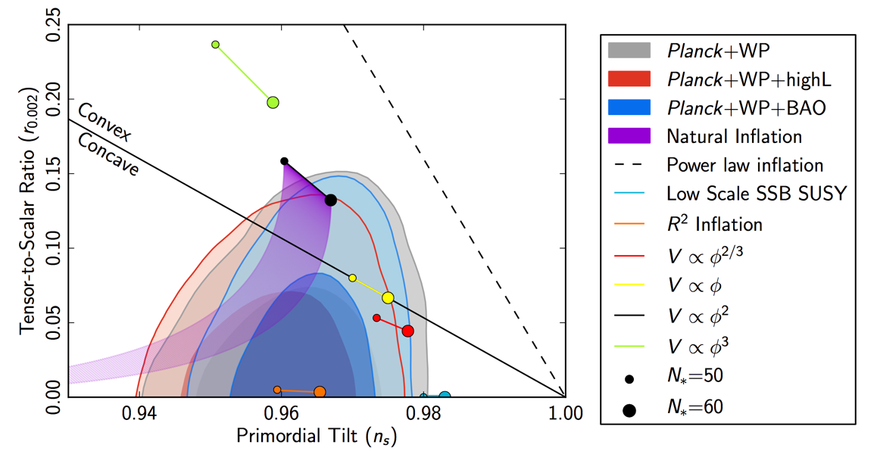
Constraints on Inflation
PLANCK 2013 + BICEP2 + varying ns

Slide 35
WHERE DOES THIS MEAN FOR PHYSICS?
Many things

Slide 36
Physics Take Aways
Most direct measurement of dynamical gravitational modes (tensor gravity waves) to date.
Basis phenomenology of simplest inflation models seems to work ε ～ η r ～ 16 ε～ 4 (1-ns)
Energy scale of inflation firmly close to the GUT scale V[𝜙] ～ (5 10¹⁶ GeV)⁴
Gravity (waves) appear to have quantum fluctuation.
Large field excursions, Δ𝜙 ≳ Mpl, seem inevitable.
Normal field theory seem to work close to Planck scale
No sign of large gravitational corrections.

Slide 37
How Do We Confirm And Further Test This Result?

Slide 38
The Plan (Dodelson 2014)
Direct Confirmation
Improve errors or r. and ns
Measure nt
CMB: Planck 2014, SPIDER, SPT+++, Stage 4 CMB
Look for wiggles
Look for gravity wave on much smaller scales.

Slide 39
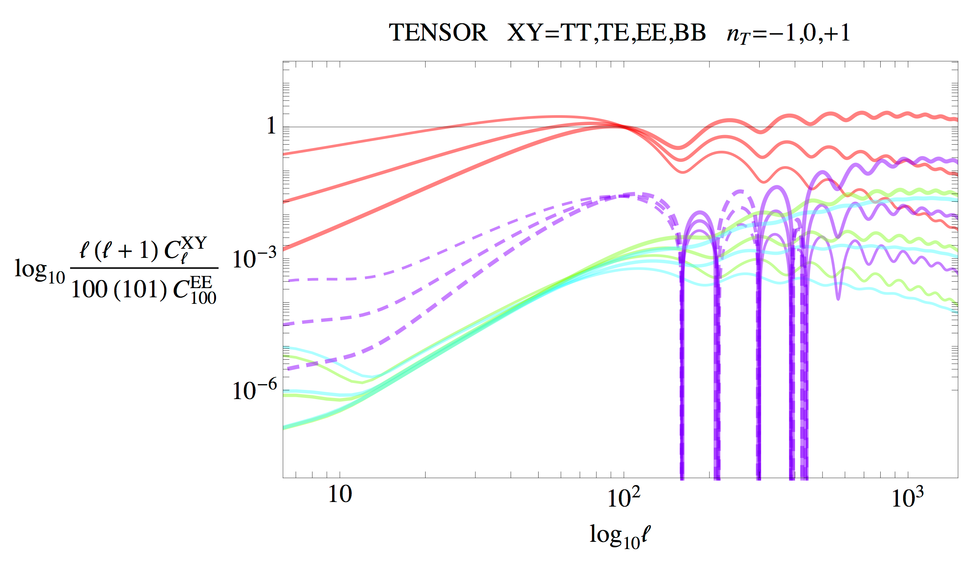
Wiggles
TT
TE
EE
BB
Proves tensor wave nature and primordiality
N.B. This is hidden in the scalar CMB

Slide 40
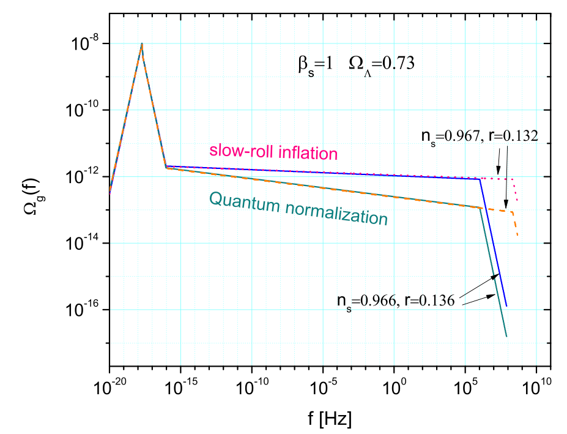
Interferometric Detection of Primordial Gravitational Radiation

Slide 41
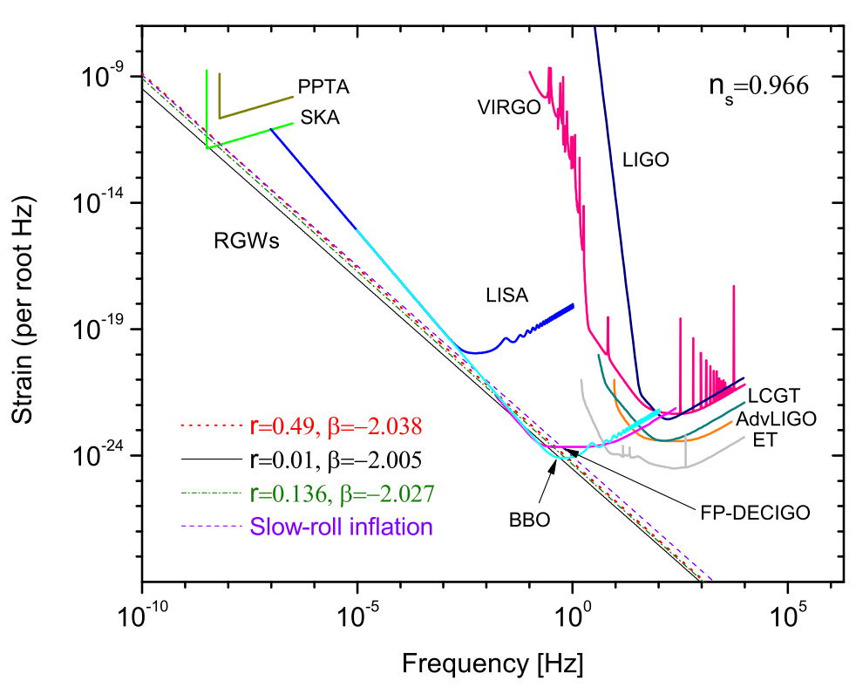
Interferometric Detection of Primordial Gravitational Waves:
Spectral Index: nT
nT=2β+4
nT=2β+4

Slide 42
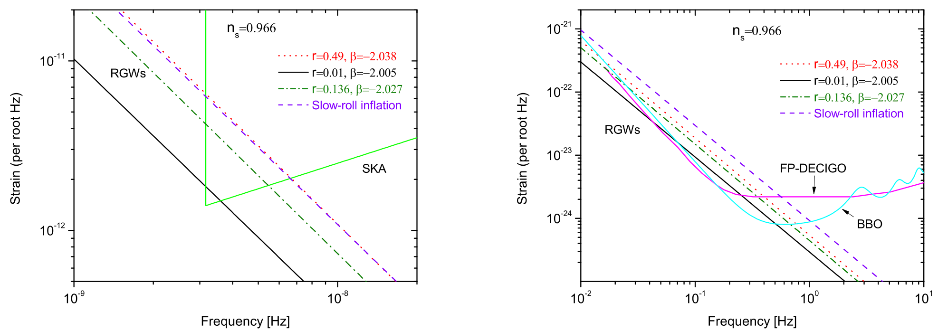
Interferometric Detection of Primordial Gravitational Radiation

