Slide 1

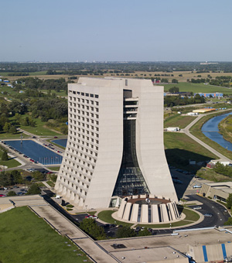
Ewkinos at the LHC*
In the light of the Higgs boson.
Nearly degeneracy a real challenge.
Tao Han, Univ. of Pittsburgh
SUSY @ the Near Energy Frontier, FNAL
Nov. 11, 2013
* TH, Sanjay Padhi, Shufang Su: arXiv:1309.5966

Slide 2
With respect to Gaugino/Higgsino masses M1, M2 and μ:
Categorize the theory into 6 distinctive cases
Comprehensive scan in M1, M2 and μ and study the decays characteristics, signal classification
Exploring LHC reach for the electroweak sector
charginos, Neutralinos with the help of the Higgs boson
TH, Sanjay Padhi, and Shufang Su, arXiv:1309.5966

Slide 3
Gauginos and Higgsinos
Neutral ones: Bino, Wino, Hu⁰, Hd⁰
charged ones: Winos, Hu⁺, Hd⁻
Parameters: M1, M2, μ, tanβ
~
~
~
~
Order of M1, M2 and μ :
-
Bino LSP
M1 < M2, μ
Wino LSP
M2 < M1, μ
Higgsino LSP
μ < M1, M2
Bino
Wino
Higgsino
e.g.:
sugra, CMSSM,
gaugino mass unification,...
canonical case
e.g.: AMSB,...
e.g.:“Higgsino-world”,...
Chen et. al., hep-ph/9512230
Moroi et. al., hep-ph/9904250
Gherghetta et. al., hep-ph/9904378
Bear et. al., hep-ph/0007073
Moroi et. al., ArXiv: 0802.3725
Baer, Barger and Huang,
ArXiv: 1107.5581, …
“Natural SUSY”?

Slide 4
Overall, Six cases
New Terminology:
LSP(s): usual LSP+degenerate states
NLSP(s): 2nd set low-lying (degenerate) states
-
Case AI: Bino LSP-Wino NLSP M1 < M2 < μ
Case AII: Bino LSP-Higgsino NLSP M1 < μ < M2
Case BI: Wino LSP-Bino NLSP M2 < M1 < μ
Case BII: Wino LSP-Higgsino NLSP M2 < μ < M1
Case CI: Higgsino LSP-Bino NLSP μ < M1 < M2
Case CII: Higgsino LSP-Wino NLSP μ < M2 < M1

Slide 5
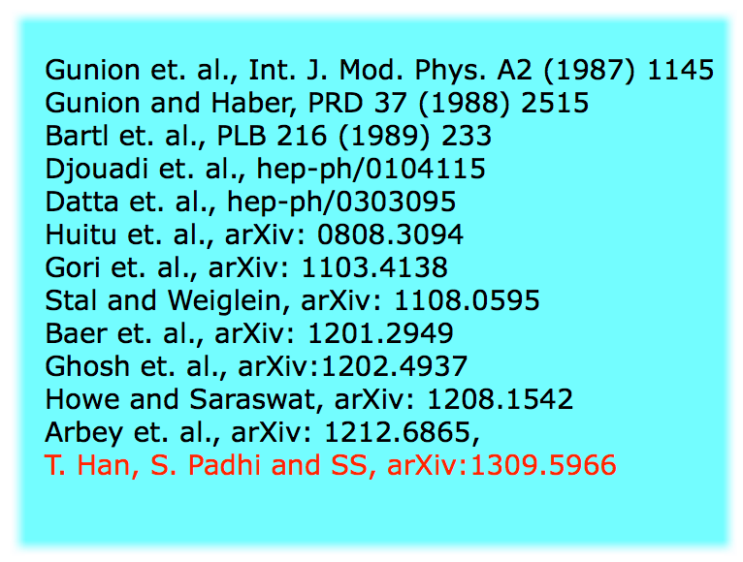
Decay of heavy neutralino and chargino
-
χ1±
χ2⁰
χ1⁰ h
χ1⁰ Z
χ1⁰ W±
A rich mixture of
(W/Z/h)(W/Z/h)+MET final states!
χ1⁰
χ2⁰
χ3⁰
χ2±
χ2⁰
χ1± W
χ1⁰ h
χ1⁰ Z
χ1± W
χ1± Z
χ1± h
χ1⁰ h
χ1⁰ Z
χ1⁰
χ1±
χ1⁰ W
χ1⁰
χ1±

Slide 6
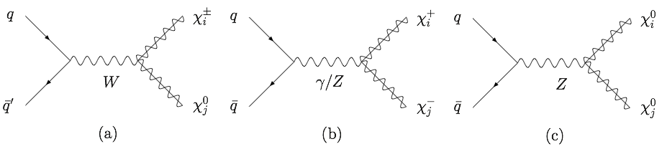

Leading Production
Dominant production:
Wino pair production:
χ⁺χ⁻, χ±χ⁰
Higgsino pair production:
χ⁺χ⁻, χ±χ⁰, χ⁰_{i}χ⁰_{j}
-
Br(WZ) < 100%, sometime highly suppressed
Wh complementary to WZ channel: new discovery potential
Zh could also be important
hh usually is small
(Sub-leading Production:
Χ_{i} Χ_{j} + jets, and VBF at the end.)

Slide 7
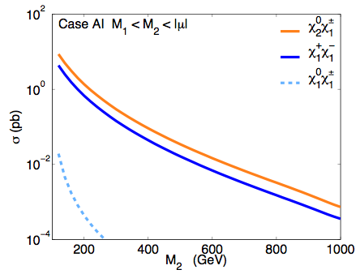
Case AI: Bino LSP - Wino NLSP
-
χ1±
χ2⁰
Case AI: M1 < M2 < μ
χ1⁰ h
χ1⁰ Z
χ1⁰ W±
χ1⁰
LHC 14
χ1± χ2⁰
χ1⁺ χ1⁻

Slide 8
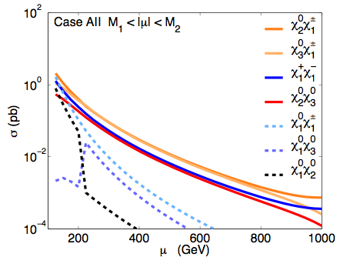
Case AII: Bino LSP - Higgsino NLSP
-
χ3⁰
χ2⁰
χ1±
Case AII: M1 < μ < M2
χ1⁰ h
χ1⁰ Z
χ1⁰ W±
χ1⁰
LHC 14

Slide 9
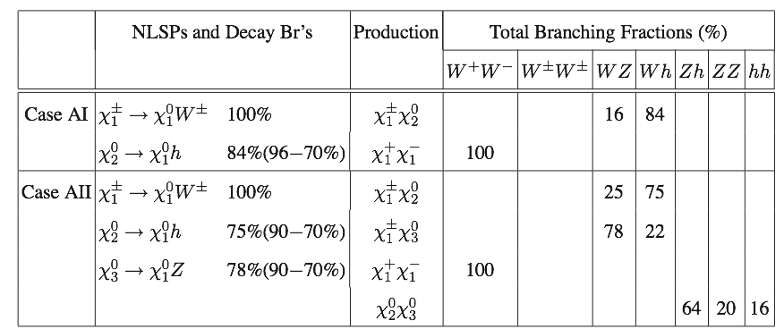
Case A signals:
-
new discovery potential
current WZ+MET limit weakened
Wh comparable to WZ channel

Slide 10
W h:
-
Z h:

Slide 11
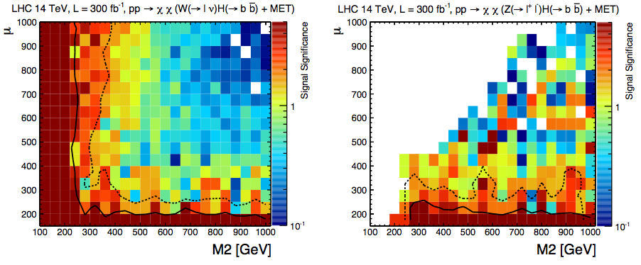
Neutralino/Chargino search: Wh/Zh Channels
-
WH
ZH
Unique signal !
Wh complementary to WZ channels !
TH, Sanjay Padhi, Shufang Su: arXiv:1309.5966

Slide 12
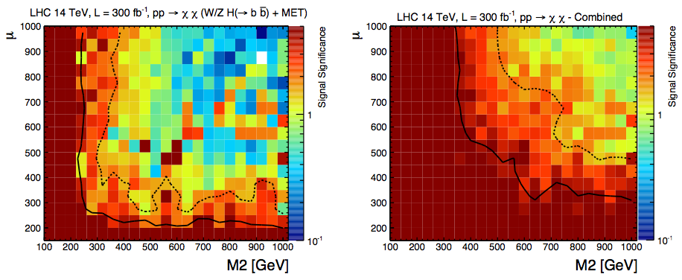
Neutralino/Chargino search: Combined
-
WH+ZH
All Combined

Slide 13
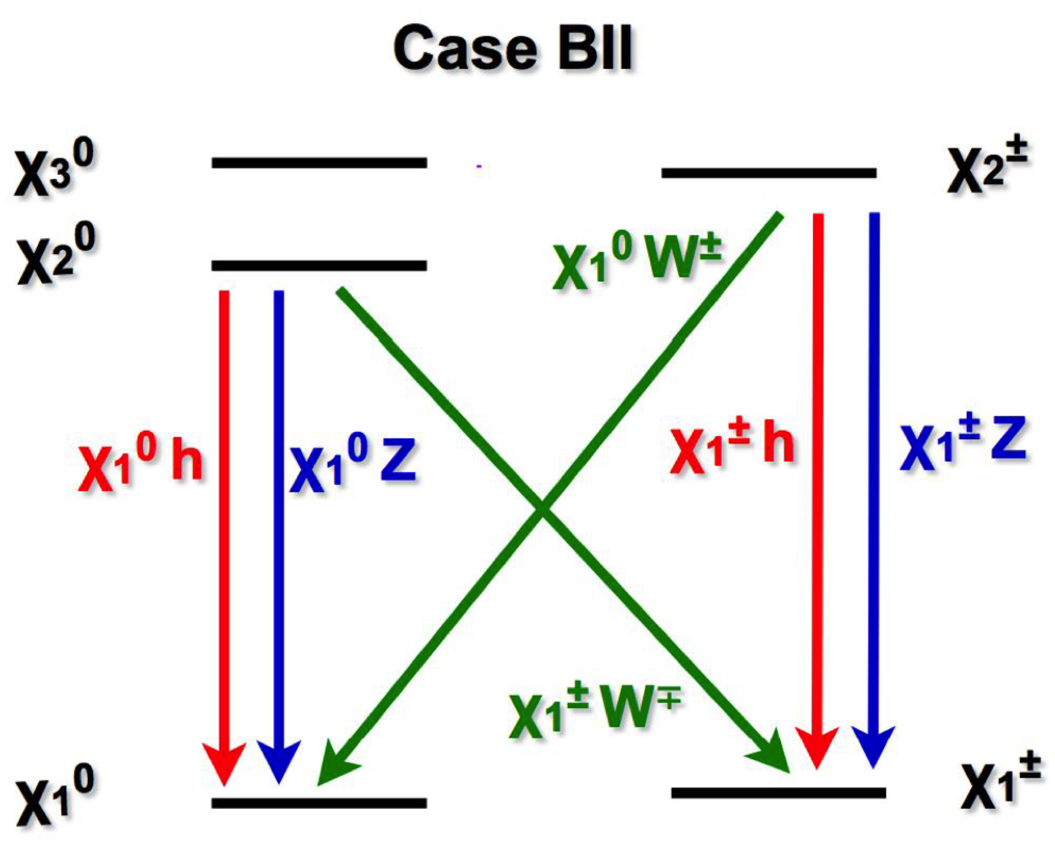
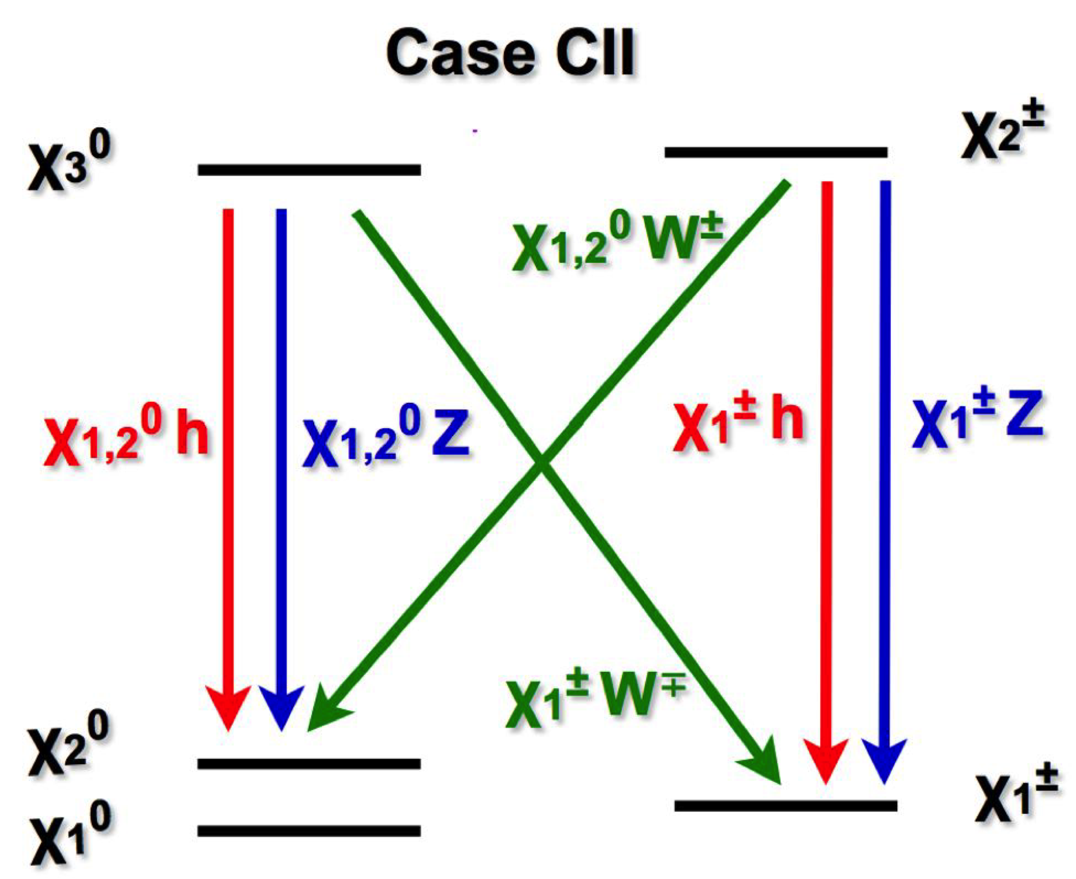
Case BII , Case CII
M2 < μ < M1
μ < M2 < M1
-
Similar reach to Case A.

Slide 14
Case BI Case CI
M2 < M1 < μ
μ < M1< M2
-
Very difficult:
NLSP production small; LSP nearly degenerate.

Slide 15
Compressed Spectrum/Nearly Degenerate LSP’s
If the missing particle (LSP) mass is close to that of the parent, then the missing KINETIC energy is small.
-
* ISR Mono jet + E_{T}^{miss} + soft l’s
1, 2, 3 soft leptons observed?
pT(l) > 10 GeV, pT(j) > 30 GeV:
(S. Gori’s talk)
Current mono jet+E_{T}^{miss}
may put weak bounds
Work by ATLAS/CMS?
* Giudice, TH, L.-T. Wang, K. Wang: arXiv:1004.4902
+ S. Gori, S. Jung, L.-T. Wang, arXiv:1004.4902

Slide 16
Compressed Spectrum/Nearly Degenerate LSP’s
* VBF: 2 jets + E_{T}^{miss} + soft l’s
-
* Giudice, TH, L.-T. Wang, K. Wang: arXiv:1004.4902
14 TeV
* B. Dutta, T. Kamon et al., arXiv:1210.0964; arXiv:1304.7779; arXiv:1308.0355.

Slide 17
Concluding Remarks
Channel | Signal (LHC) | Signal (ILC)
W⁺W⁻ | OS2L + MET | hadronic (4j), semileptonic, leptonic final states +MT
W±W± | SS2L + MET
WZ | 3L + MET
Wh | 1L + bb + MET
Zh | OS2l +bb + MET
LSP pair | Mono-jet, VBF | ISR photon + soft
-
Wh and Zh channels comparable/complementary: M ~ 500-700 GeV
Compressed/nearly degenerate spectrum: Very difficult (for 200 GeV or so) !
May need cleaner environment like the ILC.

Slide 18

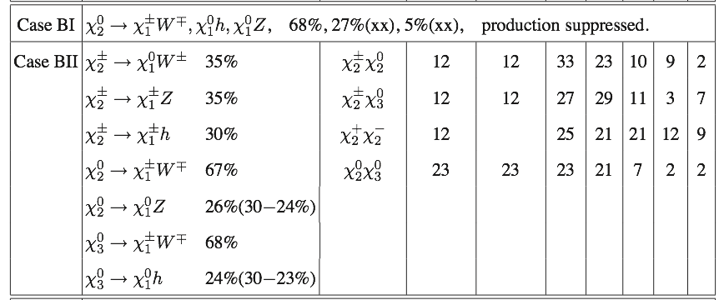
Case B Signals
-
ILC, ISR analyses for Wino LSP pair
Wh comparable to WZ channel

Slide 19
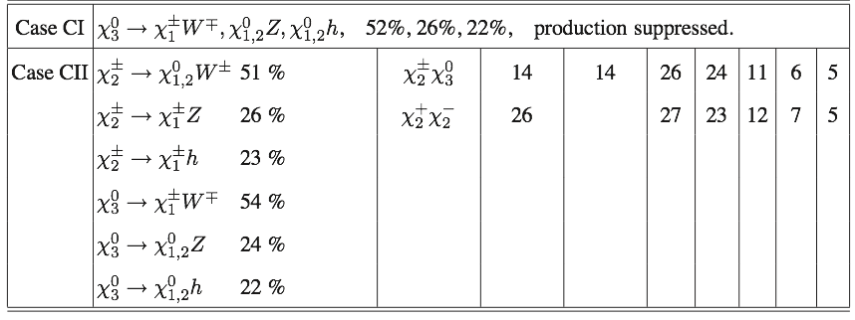
Case C Signals
-
ILC, Χ1,2⁰Χ3⁰ pair or ISR analyses for Higgsino LSP pair
Wh comparable to WZ channel

Slide 20
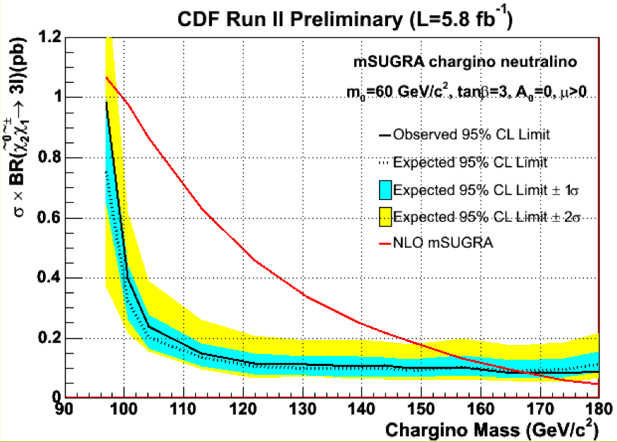
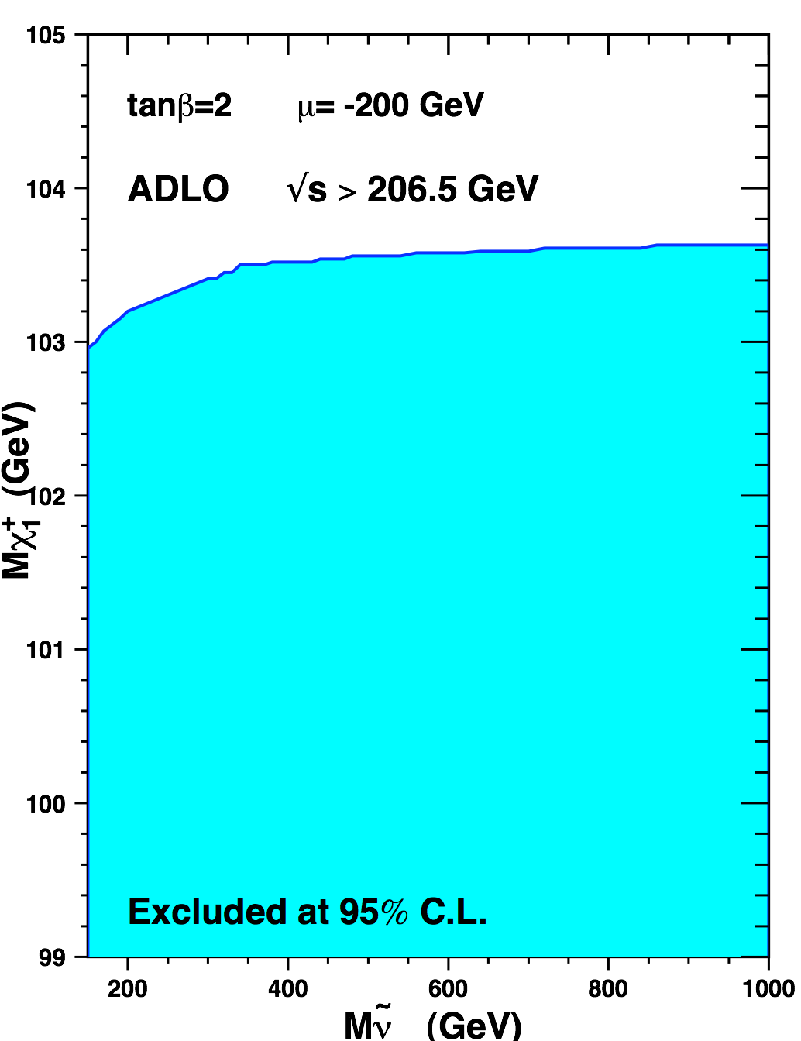
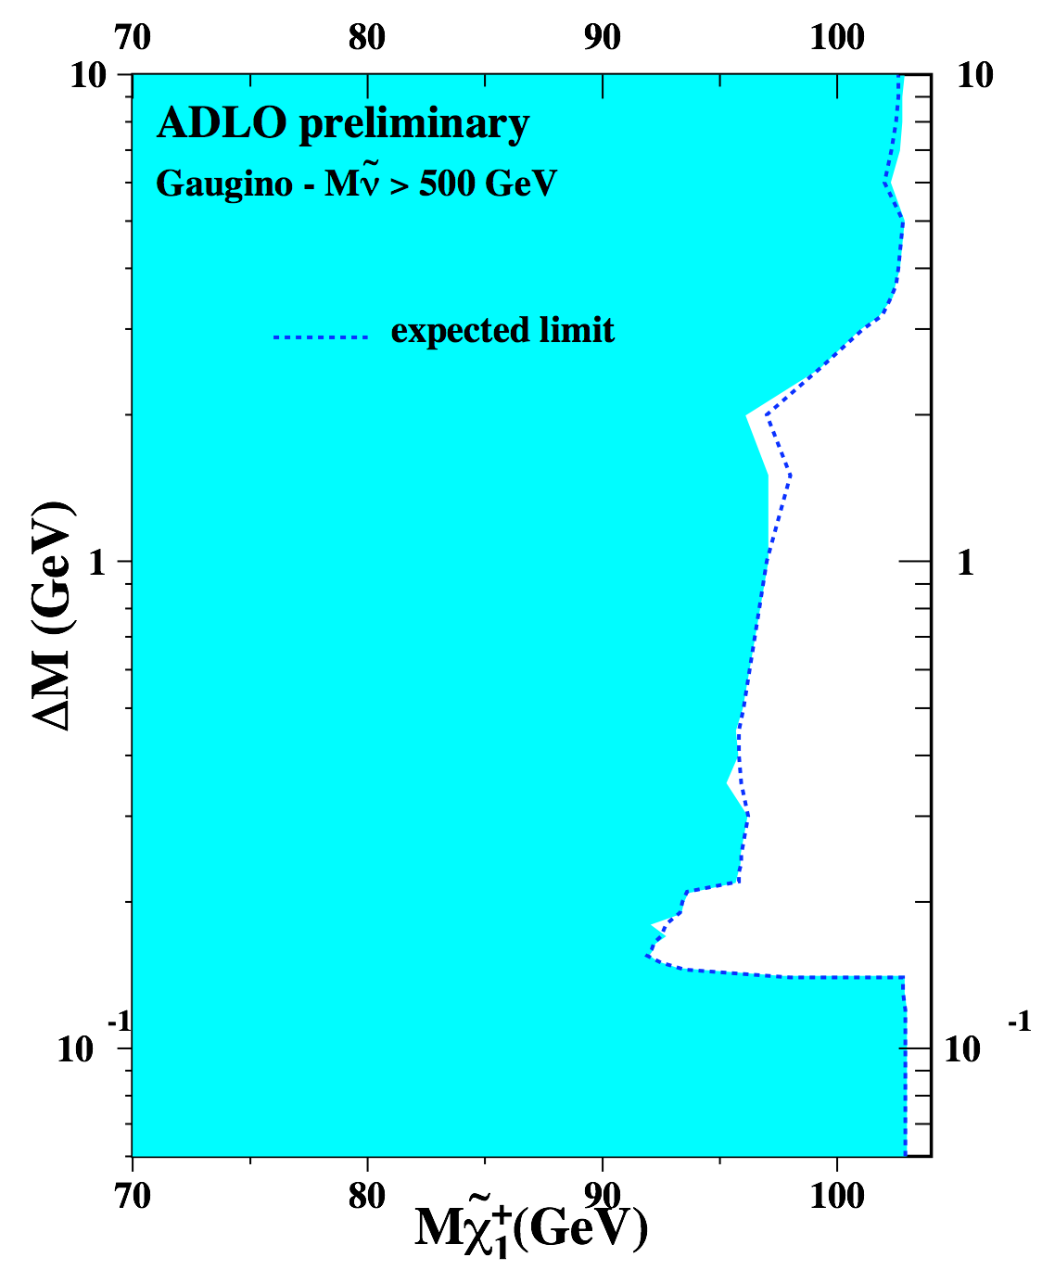
Current limits: neutralino/chargino
canonical case
-
trilepton+MET from χ1± χ2⁰
degenerate case
Have at least one of these assumptions:
gaugino mass unification:
M1= (5/3) tan²θW M2 = 1/2 M2
sfermion mass unification
decouple sfermions
mSUGRA
particular benchmark point
...
mχ1± > 167 GeV
(mSUGRA tanβ=3, A0=0)
CDF Note 10636
D0: arXiv:0901.0646
mχ1± > 103.5 GeV
for msnue > 300 GeV
mχ1± > 91.9 /92.4
    GeV
mχ1⁰ > 47/50 GeV
(CMSSM, mSUGRA)
No mass limit in general
LEPSUSYWG/01-03.1
LEPSUSYWG/02-04.1

Slide 21
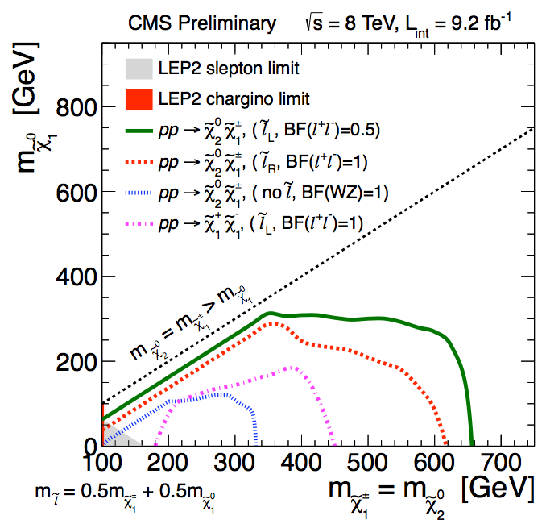
CMS limits
-
CMS PAS SUS-12-022
dilepton/trilepton + MET
lepton rich final states to
enhance reach: only works for Wino NLSP with light slepton_L.
Limits weaker for
slepton_L heavy
χ2⁰,χ1± being Higgsinos
small mχ1± - mχ10
100% WZ Br -- Usually not realized!

