Slide 1
WBS 476.02.04.02/476.02.04.03
Accelerator Controls & Instrumentation
Brian Drendel
Fermilab
Muon g-2 Director’s CD-1 Review
July 23-25

Slide 2
Outline
WBS L3 Scope of this system
WBS L3 Organization
Requirements
Design
Risks
ESH&Q
Cost Summary
Schedule Summary
Focus CD-1 to CD-2
Summary

Slide 3
Accelerator Controls & Instrumentation Scope
Establish Controls and Communication links to the MC-1 building and associated enclosures.
Update existing Muon Rings enclosure interlocks system for g-2 operations.
Establish safety system for Extraction enclosure, M5 line enclosure and MC-1 detector hall.
Establish instrumentation to measure beam intensity, position, losses and particle composition for low intensity secondary beam.

Slide 4
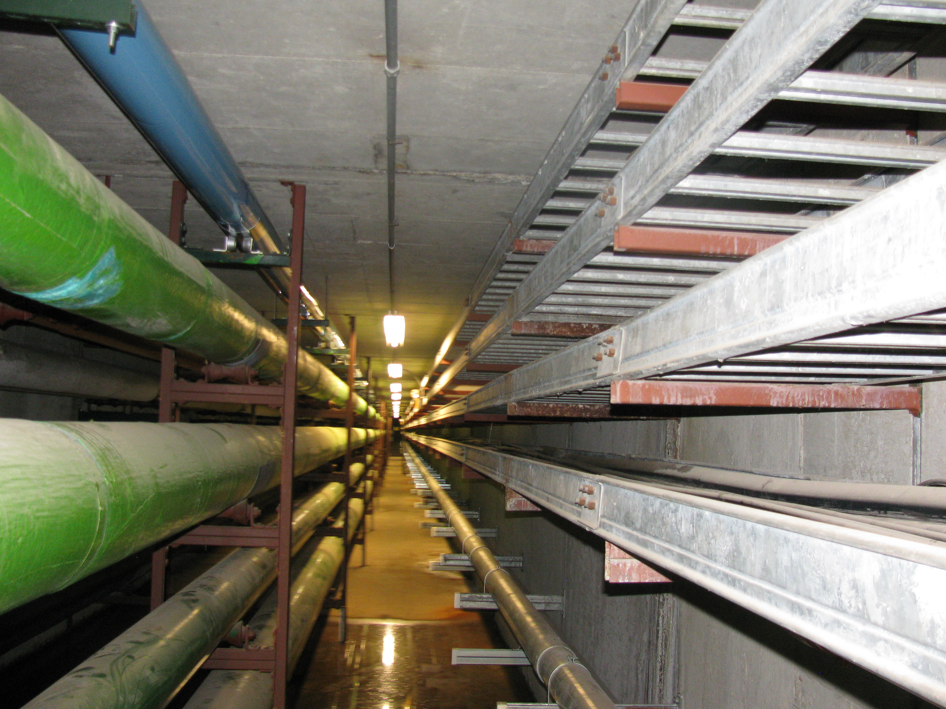
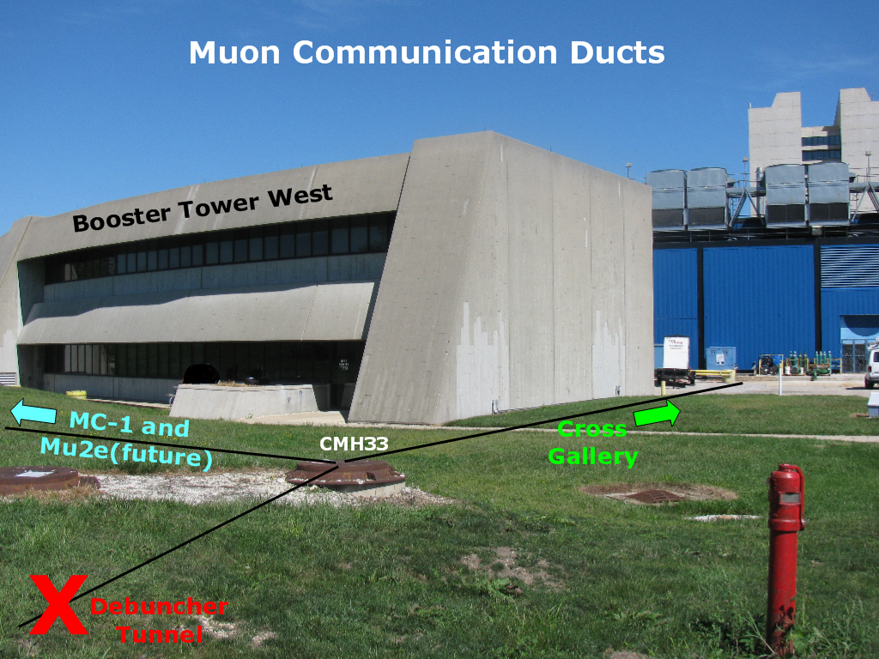
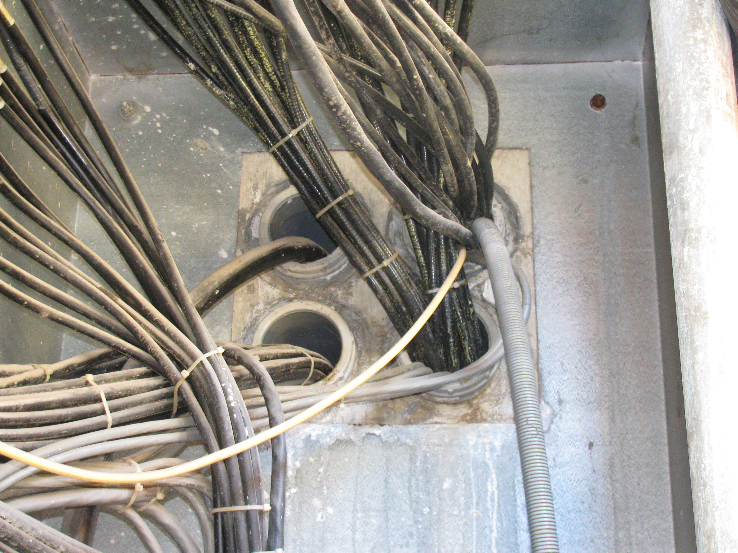
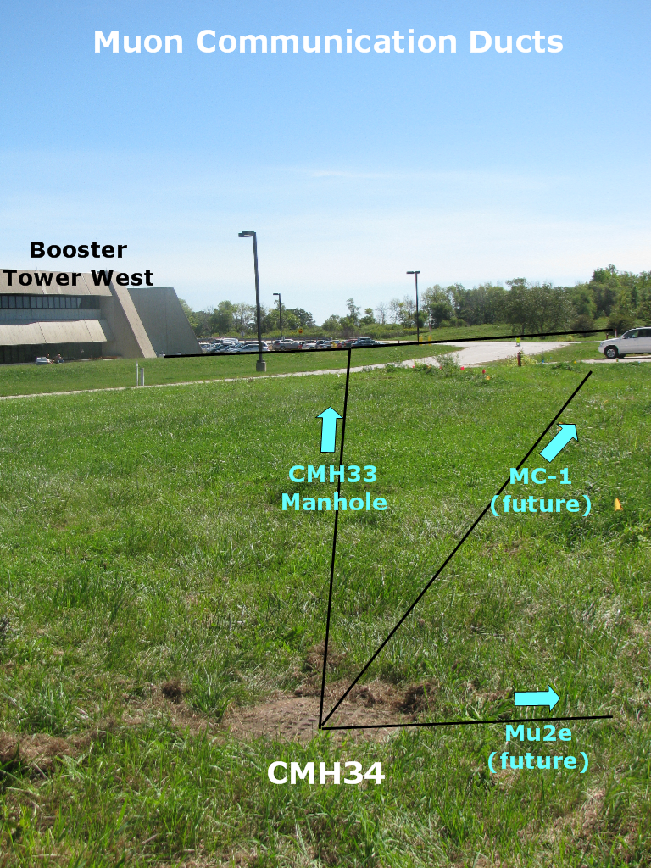
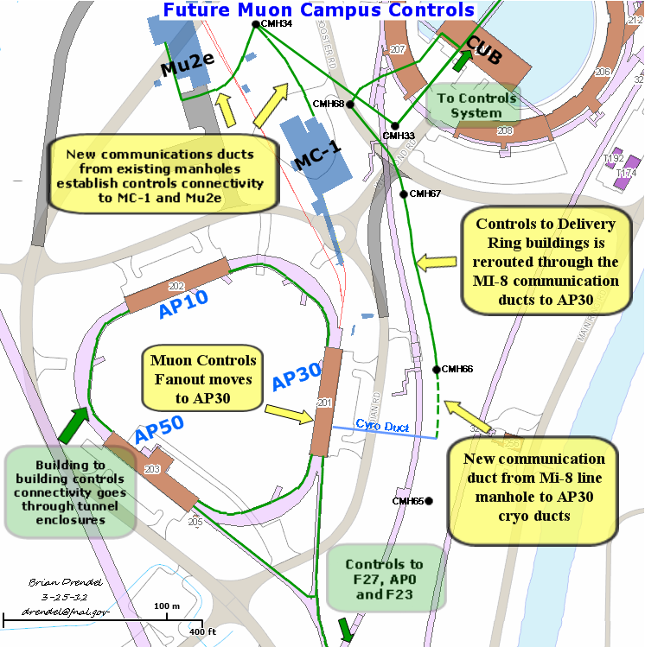
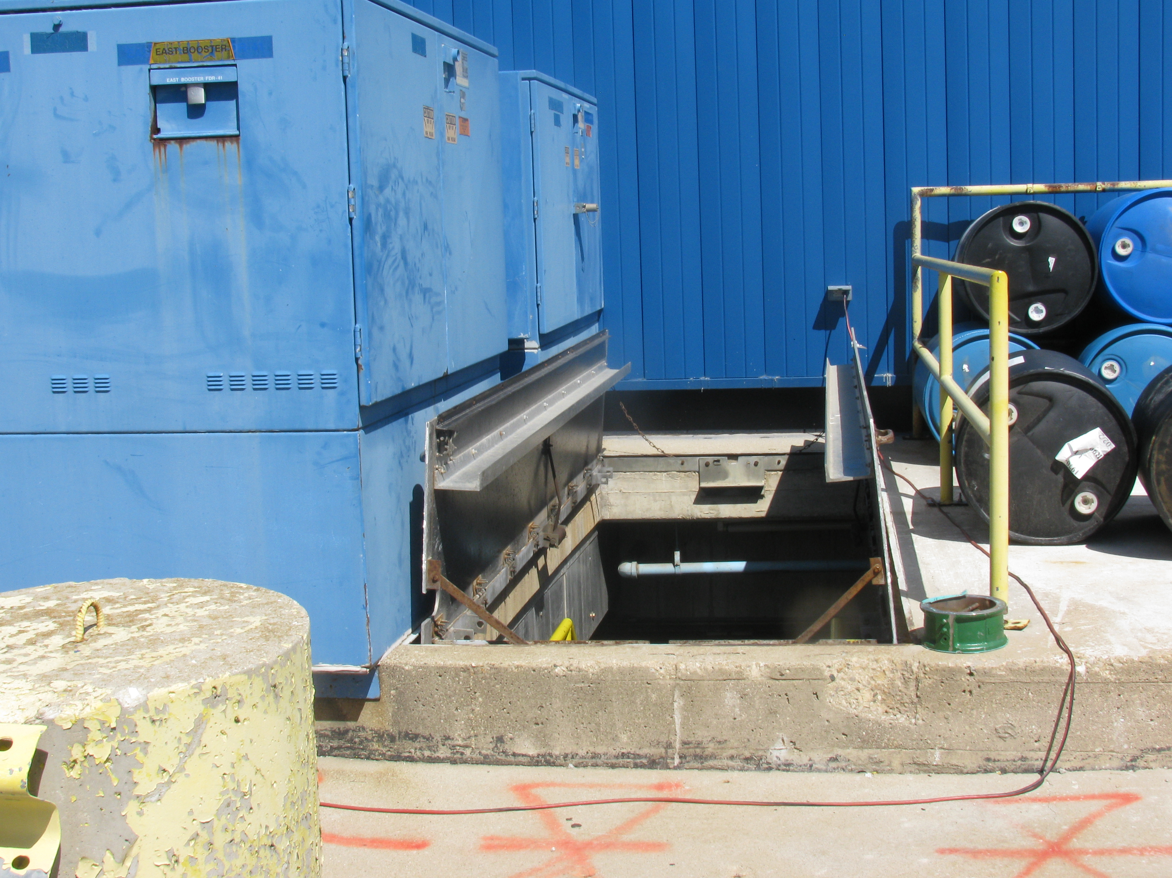
Accelerator Controls Scope
Utility Tunnel
New controls and communication connectivity will be established from the cross gallery to the MC-1 service building.
CUB to CMH34
CUB

Slide 5
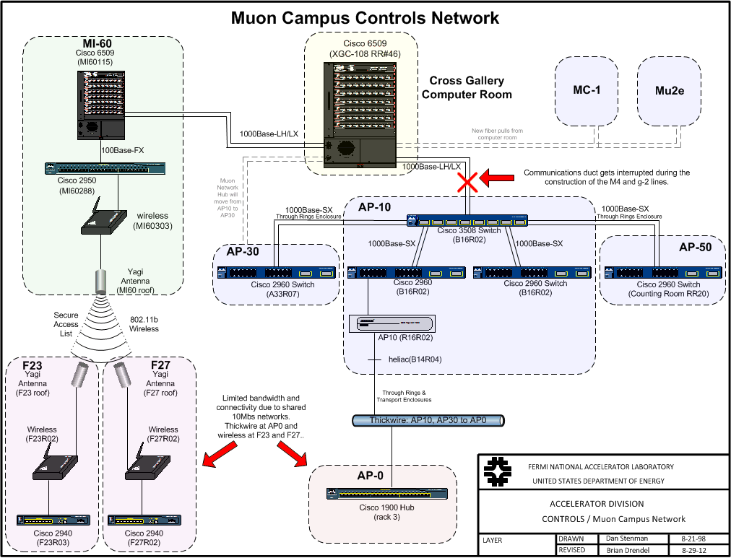
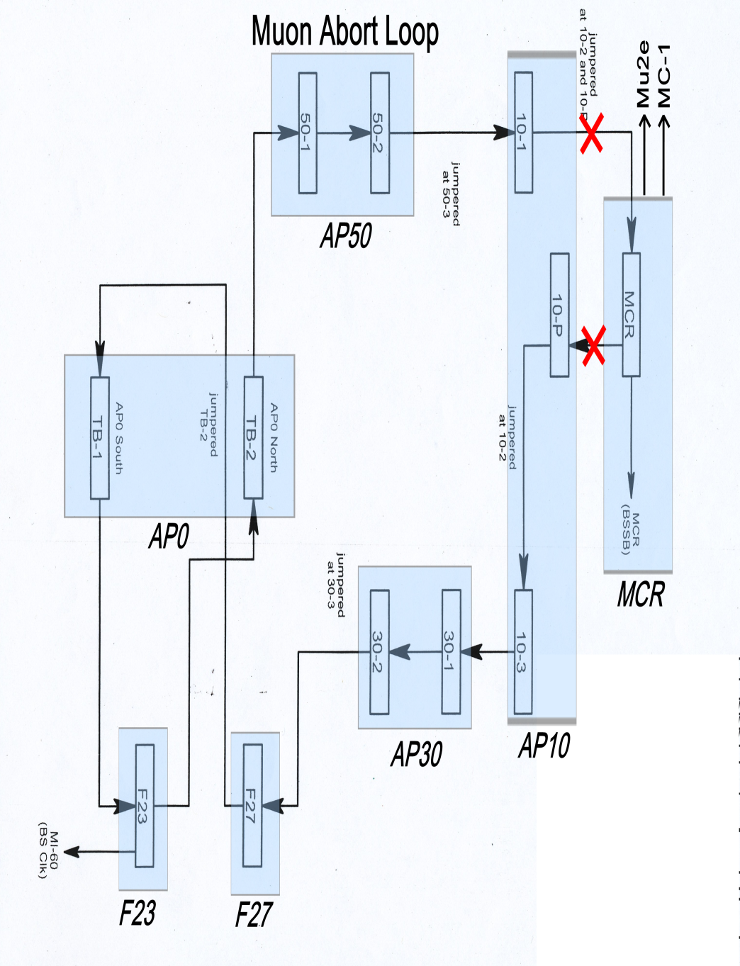

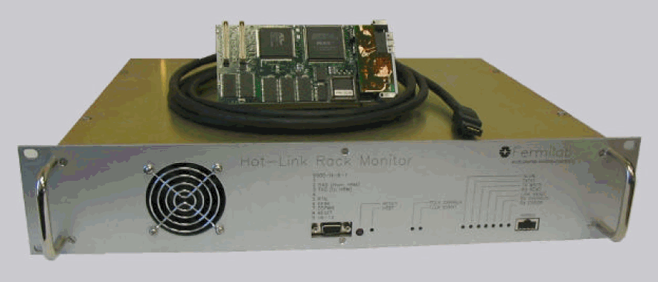
Accelerator Controls Scope
Controls Ethernet
Hot-Link Rack Monitors
Timing Link
Beam Synch Link
Beam Abort Link
Site Emergency Warning System
Fire and Utility System
RADMUX
Phone

Slide 6
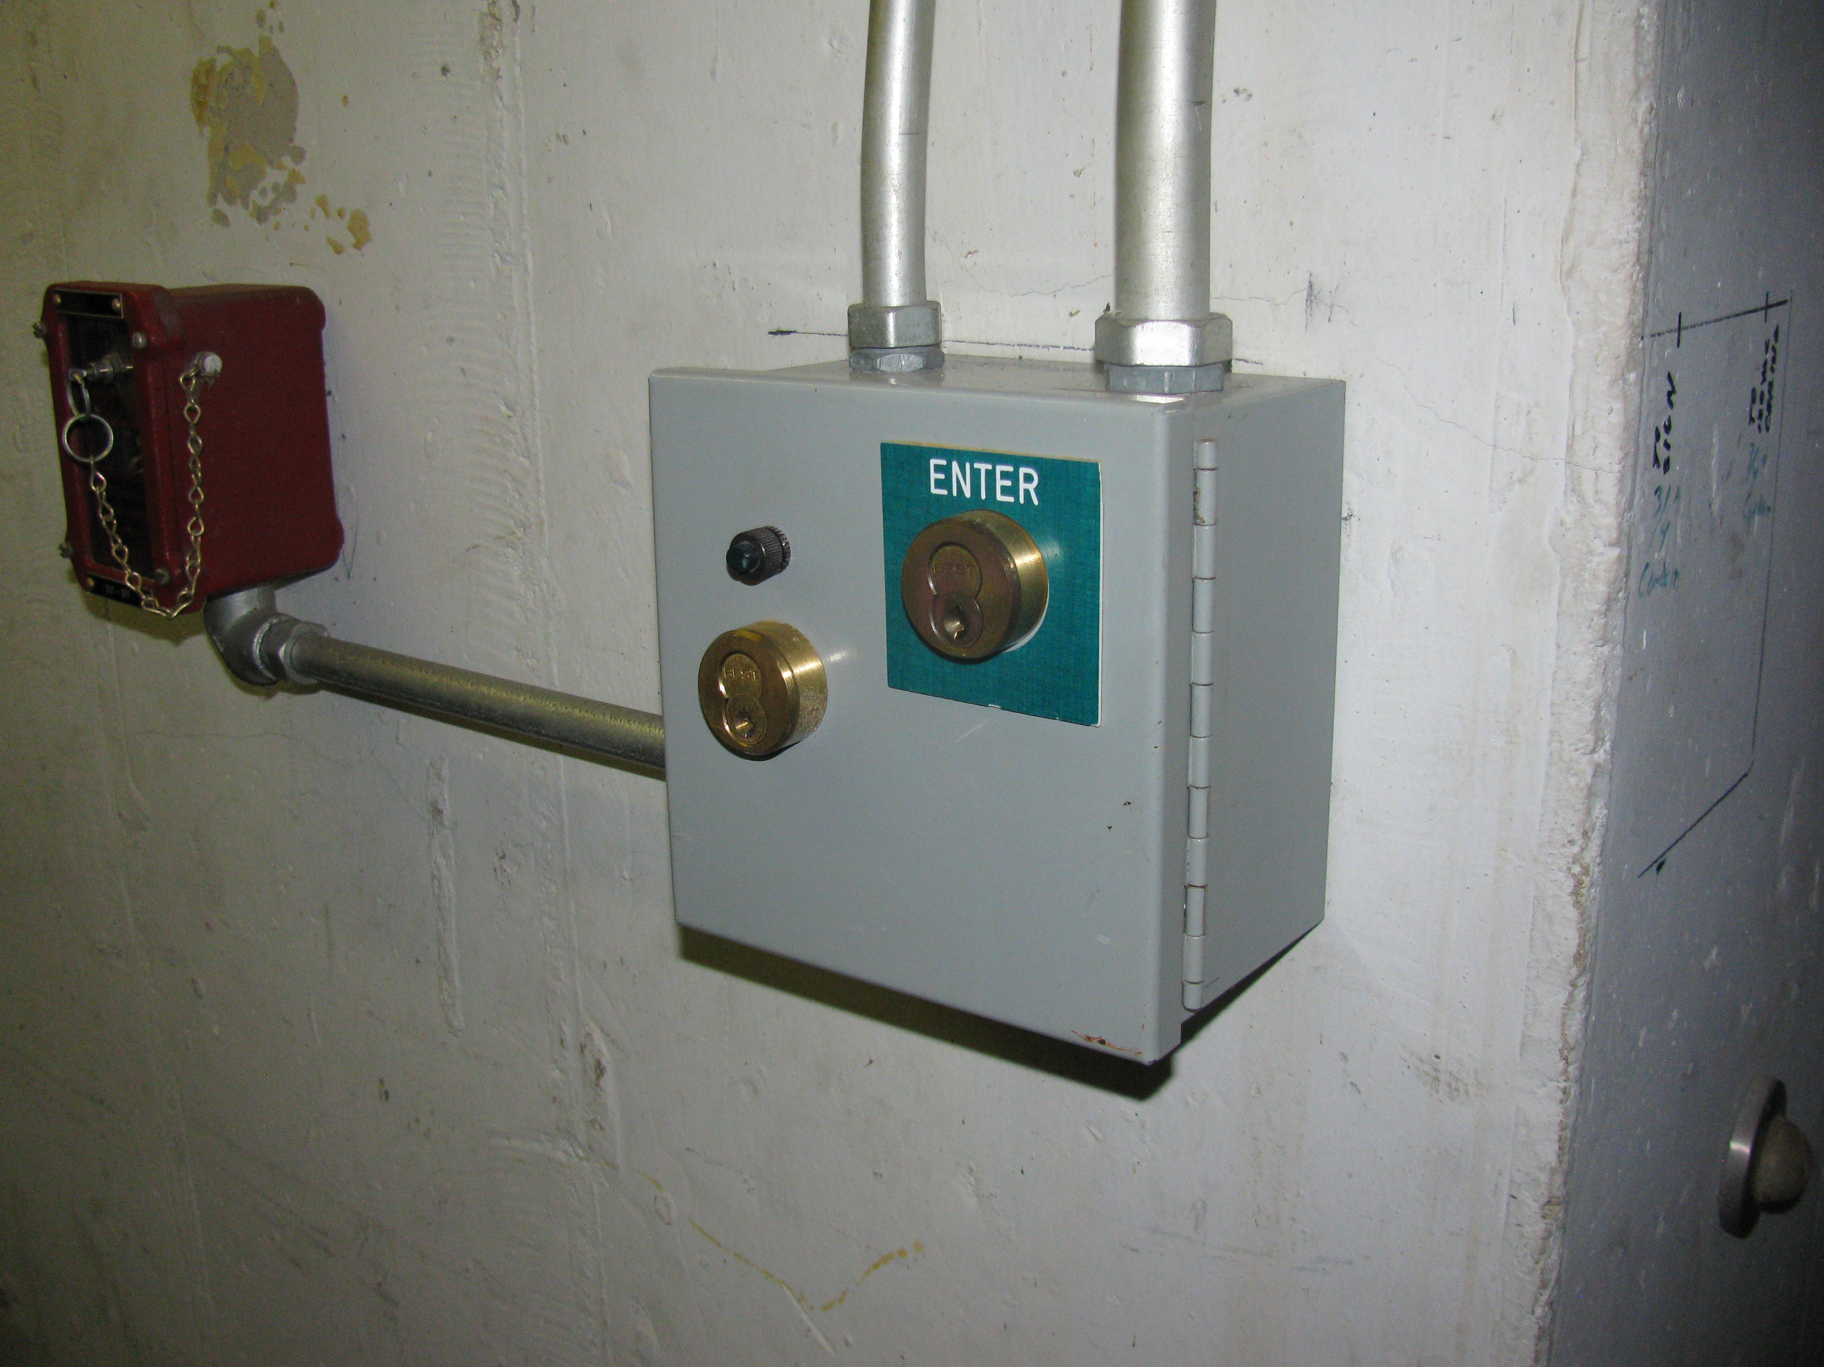
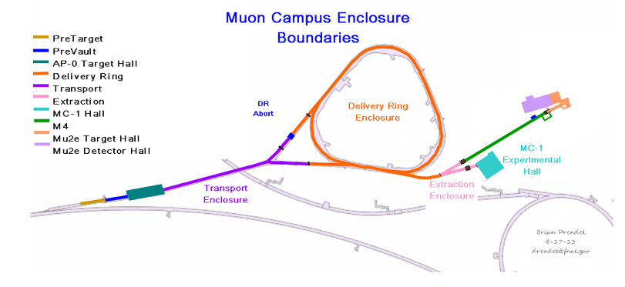
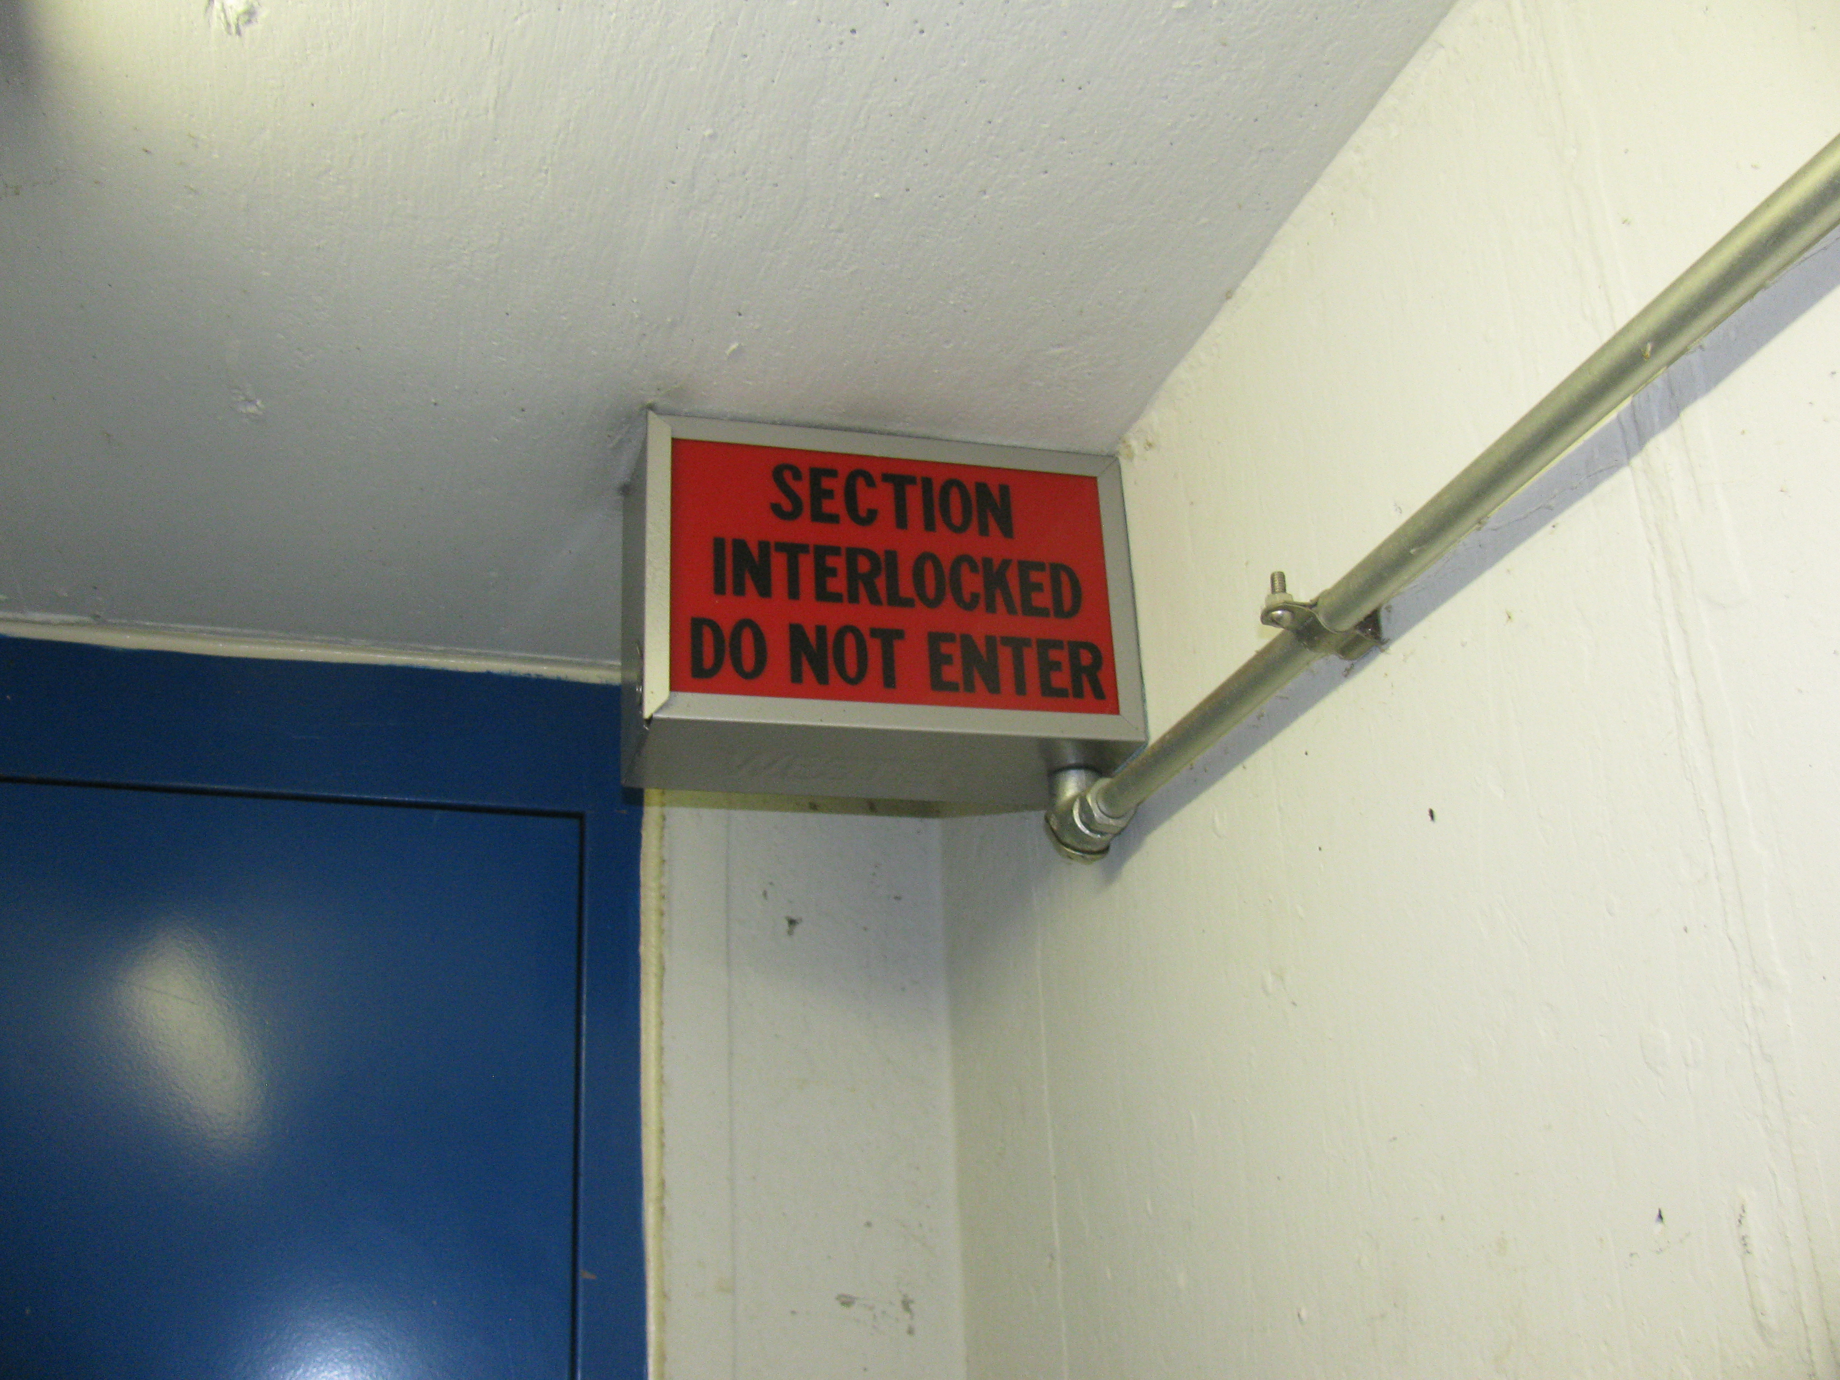
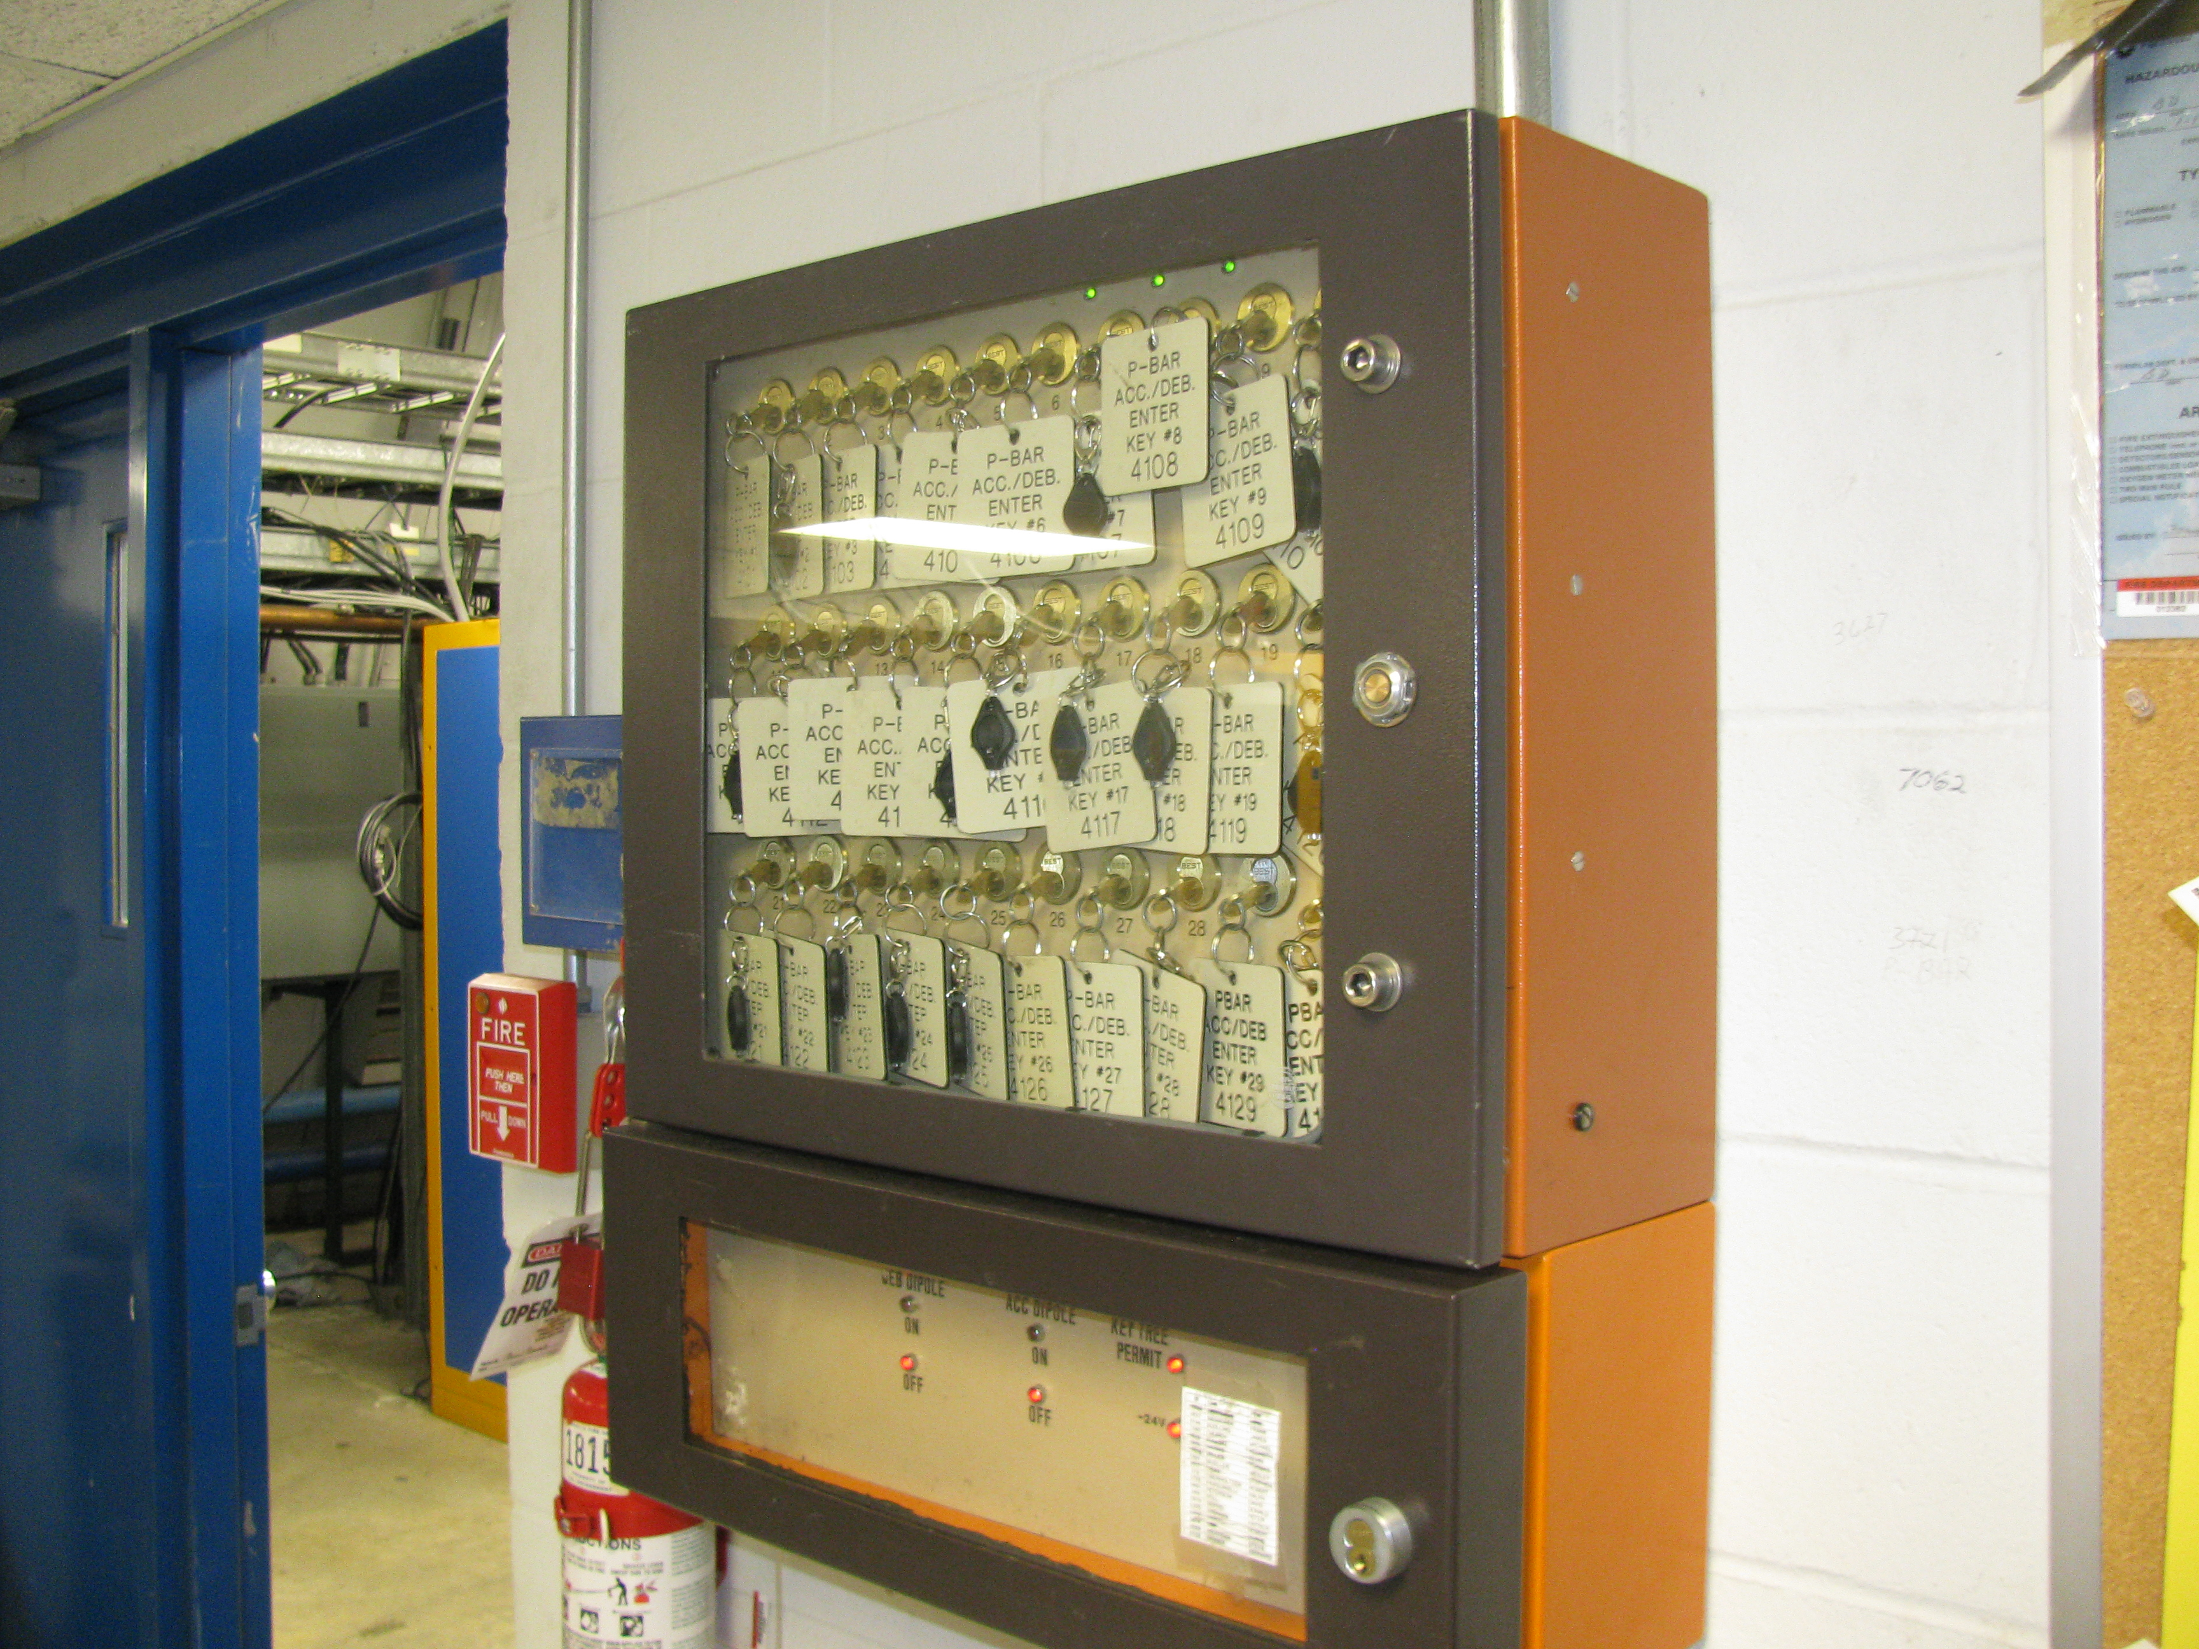
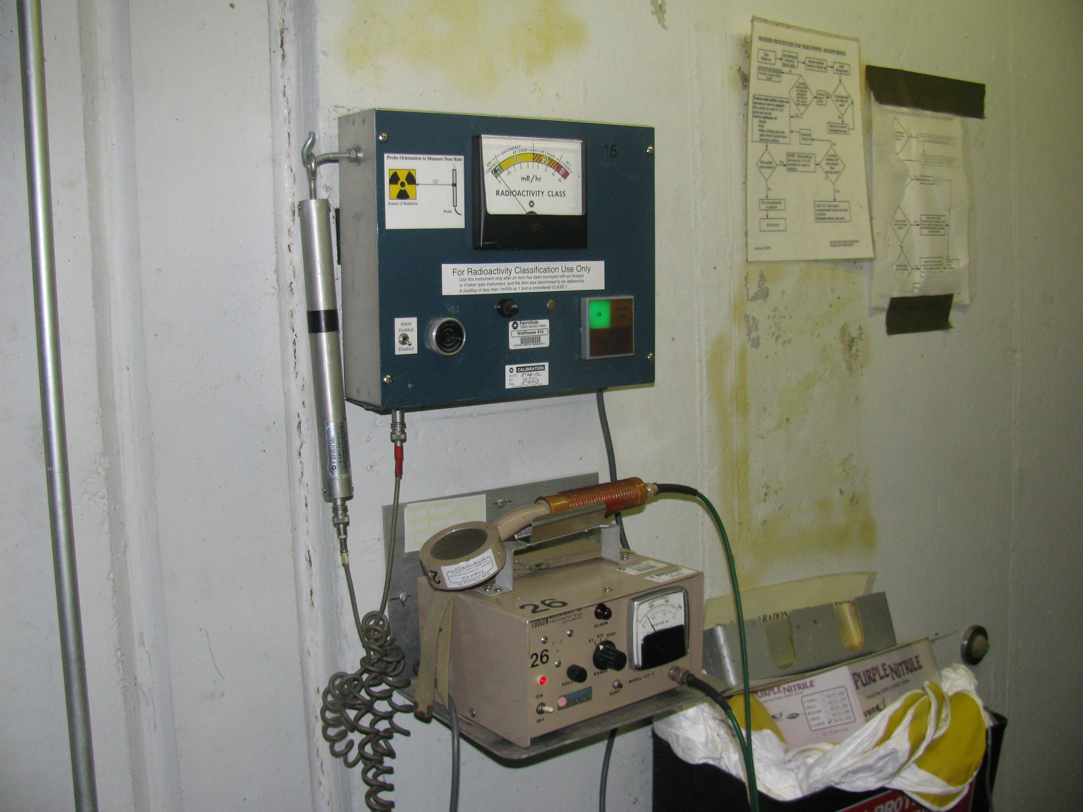
Accelerator Interlocks Scope
Pbar-style interlocks
  Delivery Ring enclosure extended.
  New Extraction enclosure.
Rack Mounted Safety System (RMSS)
  MC-1 Experimental Hall
Oxygen Deficiency Hazard (ODH) system for MC-1.

Slide 7
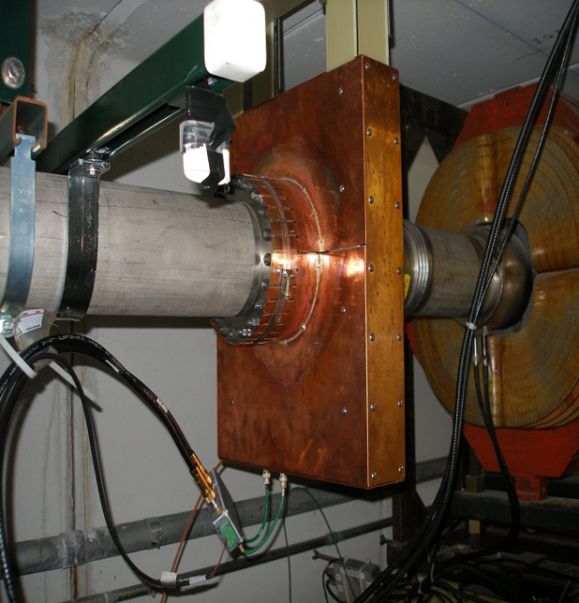
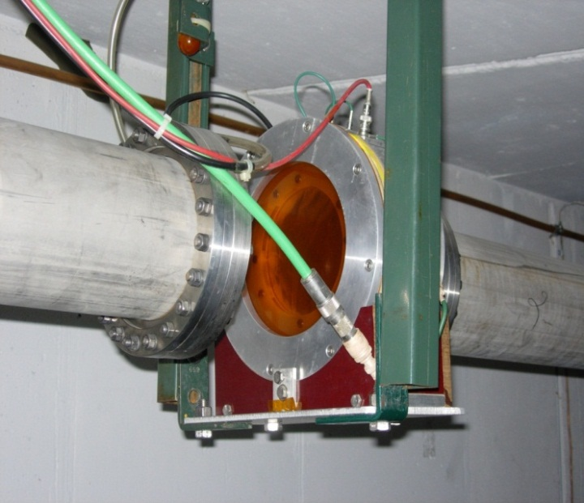
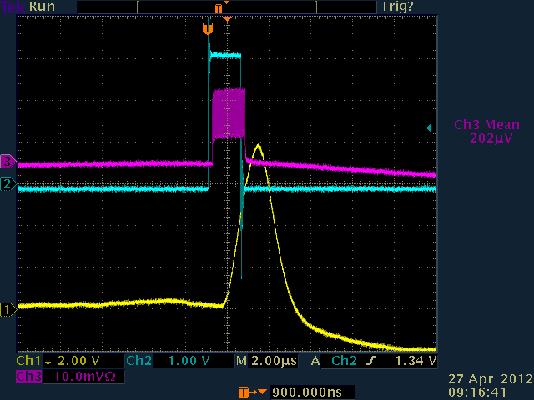
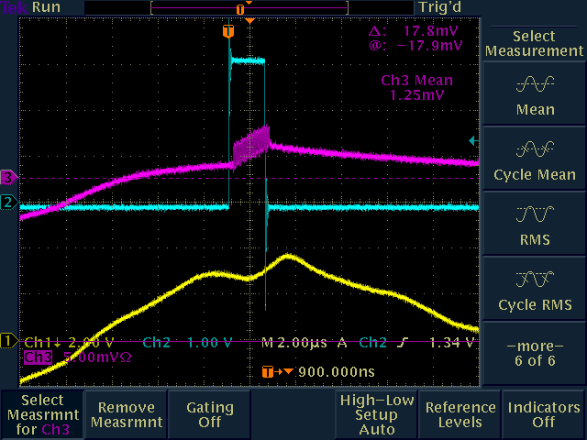
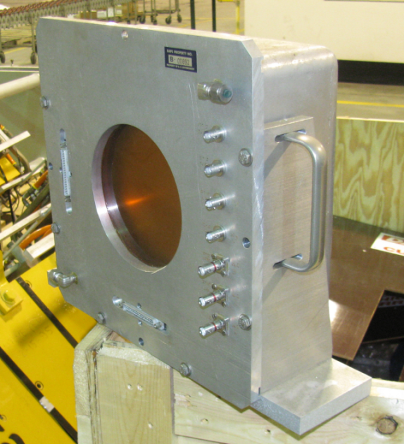
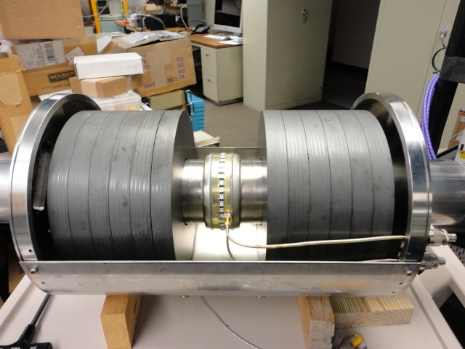
Accelerator Instrumentation Scope
Beam Intensity
  Toroid
  Ion chamber
  BNL Ion Chamber/SWIC combo
  Wall Current Monitor
Ion Chamber
Toroid
Toroid
BNL SWIC/
Ion Chamber
WCM
2e9
2e8

Slide 8
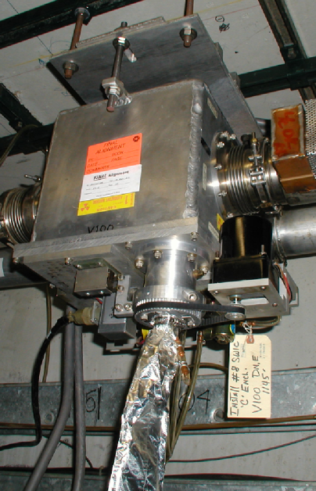
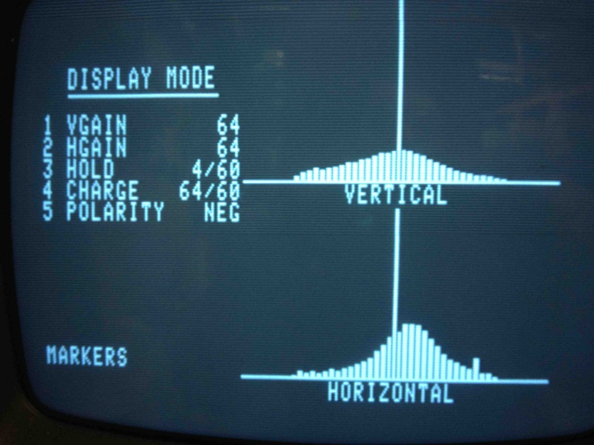
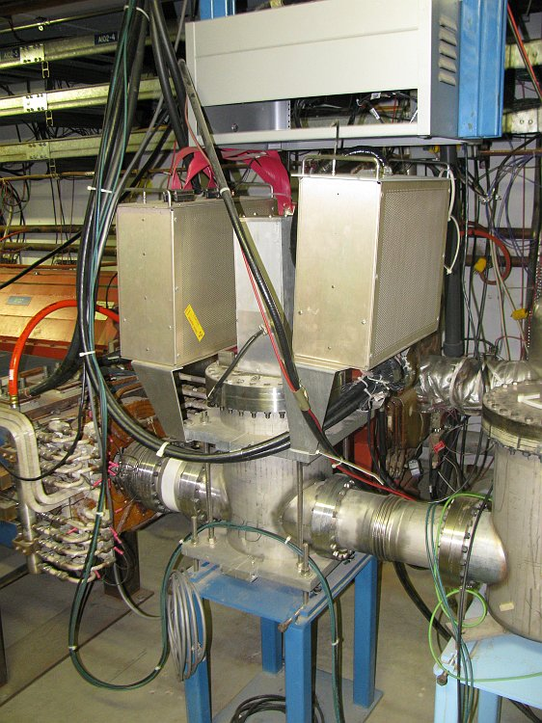
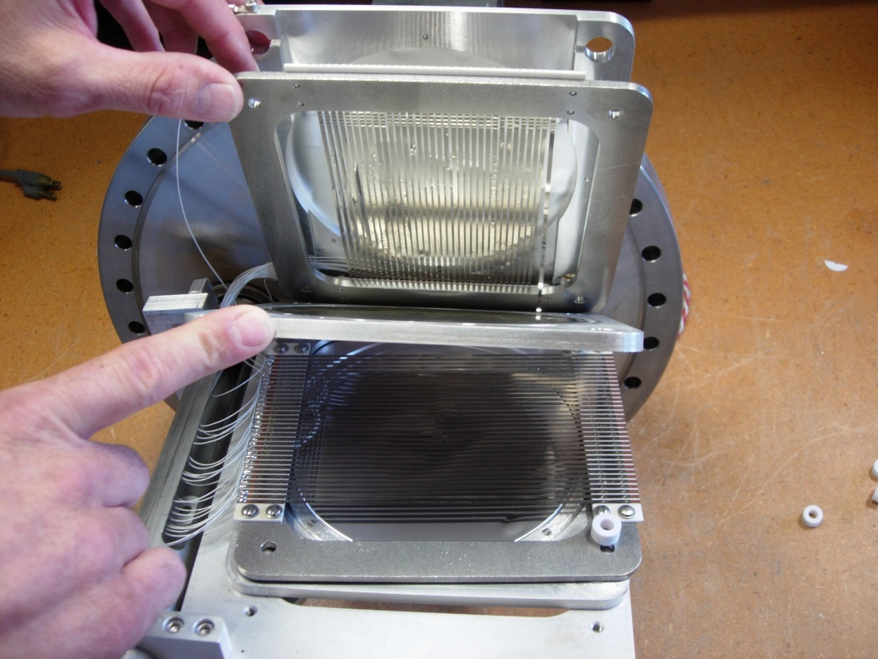
Accelerator Instrumentation Scope
Beam Profile/Position
  Secondary Emission Monitors (SEMs) with high gain preamps.
  Segmented Wire Ion Chambers (SWICs)
  BNL SWICs
FNAL SWIC
BNL SWIC
Beam Profile
SEM
SEM Foils

Slide 9
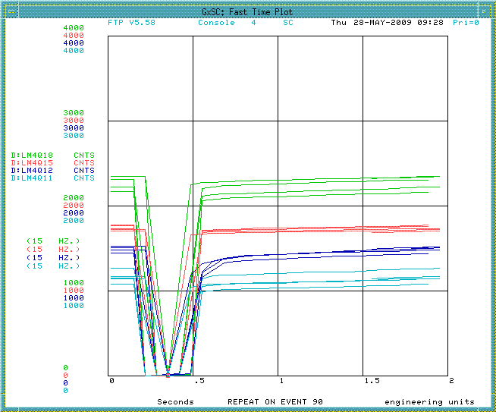
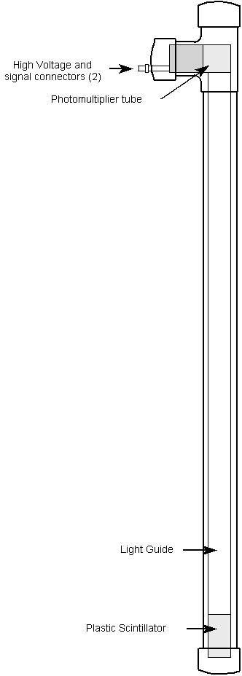
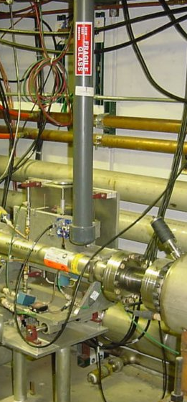
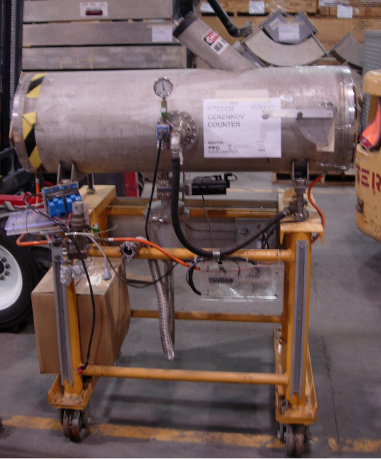
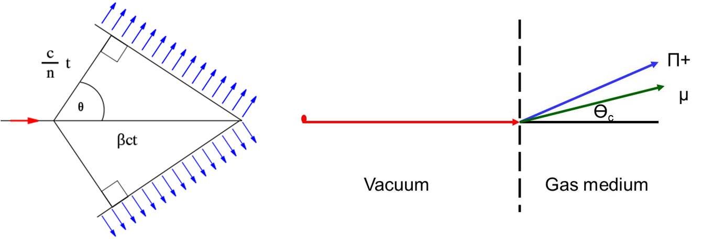
Accelerator Instrumentation Scope
Other measurements
  Beam Loss Monitors
  Cerenkov Counter
Beam Losses
PMT style BLM
Cerenkov Counter
Cerenkov Radiation

Slide 10
Accelerator Controls & Instrumentation Organization
Brian Drendel, L3 Manager
WBS 2.4 Controls and Instrumentation
2.4.1 Conceptual Design
2.4.2 Controls
2.4.3 Instrumentation
2.4.2.1 MC-1 building
2.4.3.1 Toroids
2.4.2.2 Safety system
2.4.3.2 Wire profile
2.4.3.3 g-2 line SWICs
2.4.3.4 Beam loss
2.4.3.5 Wall current
2.4.3.6 Ion chambers
2.4.3.7 M4 line SWICs
2.4.3.8 Cherenkov

Slide 11
Controls Requirements
Required System | MI60,F0,F1,F2 | F23,AP0, F27 | AP10,AP30, AP50 | MC-1
Ethernet | Single-mode Fiber 100-1000Mbps | Wireless/Thicknet 10Mbps* | Single-mode Fiber 100-1000Mbps | Single-mode Fiber 100-1000Mbps
CAMAC/HRM | CAMAC | CAMAC | CAMAC | HRM
Serial Timing Links | Multi-mode Fiber | Multi-mode Fiber | Multi-mode Fiber | Multi-mode Fiber
Beam Synch | Multi-mode Fiber (RRBS & MIBS) | Multi-mode Fiber (RRBS) | Multi-mode Fiber (RRBS) | Multi-mode Fiber (RRBS)
Permit Loop | Multi-mode Fiber (Muon) | Multi-mode Fiber (Muon) | Multi-mode Fiber (Muon) | Multi-mode Fiber (Muon)
FIRUS | Single-mode Fiber | Single-mode Fiber | Single-mode Fiber | Single-mode Fiber
Safety System | 4/6/20 Conductor | 4/6/20 Conductor | 4/6/20 Conductor | 4/6/20 Conductor
SEWs | Single-mode Fiber | Single-mode Fiber | Single-mode Fiber | Paging System
Radmux | 18 AWG 16x30 | 18 AWG 16x30 | 18 AWG 16x30 | 18 AWG 16x30
Phones | 100/400 Conductor | 100/400 Conductor | 100/400 Conductor | 100/400 Conductor

Slide 12
Safety System Requirements
 | F-Sector PreTarget Prevault | Transport Delivery Ring | Extraction | M4 Enclosure | MC-1 Detector
Interlocked Enclosure | Yes | Yes | Yes | Yes | Yes
Coasting Beam | No | Yes | No | No | No
CDC | Yes | Yes | Yes | Yes | Yes
Interlocked Detectors/TLMs | Yes | Yes | Yes | Yes | Yes
ODH | No | No | No | No | Yes
Mini-loops | No | Yes | No | No | No
The safety system components will each be implemented within the guidelines required by the Fermilab Environment, Safety and Health Manual (FESHM) which can be found online at http://esh.fnal.gov/xms/FESHM.

Slide 13
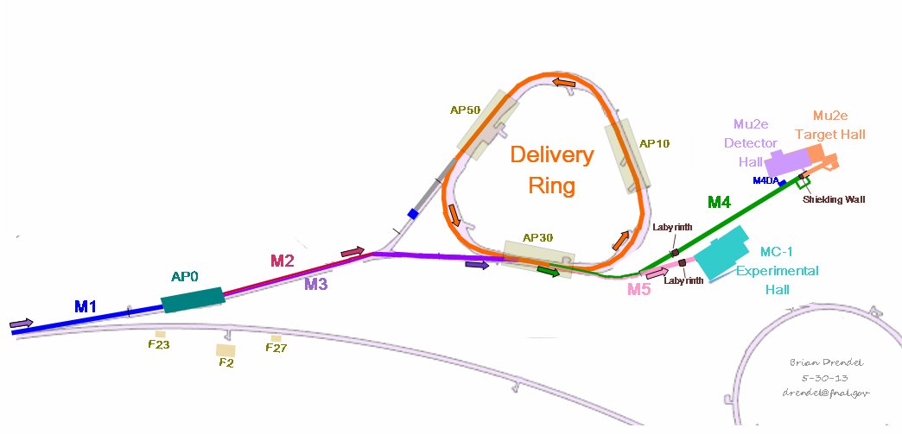
Instrumentation Requirements
  Much of the existing Instrumentation from the Antiproton Source will be reused for g-2 operations. Beam requirements can be broken down into the following categories.
    Mixed Secondary Beam (1E7 to 2E8)
      Intensity: Ion Chambers, Wall Current Monitors
      Position: SEMs
      Losses: BLMs
    Proton-only (2E7)
      Intensity: Ion Chambers
      Position: SEMs
      Losses: BLMs
    Muon-only (2E5)
      Intensity: Ion Chambers
      Position/Profile: SWICs
      Particle Composition: Cerenkov Detector

Slide 14
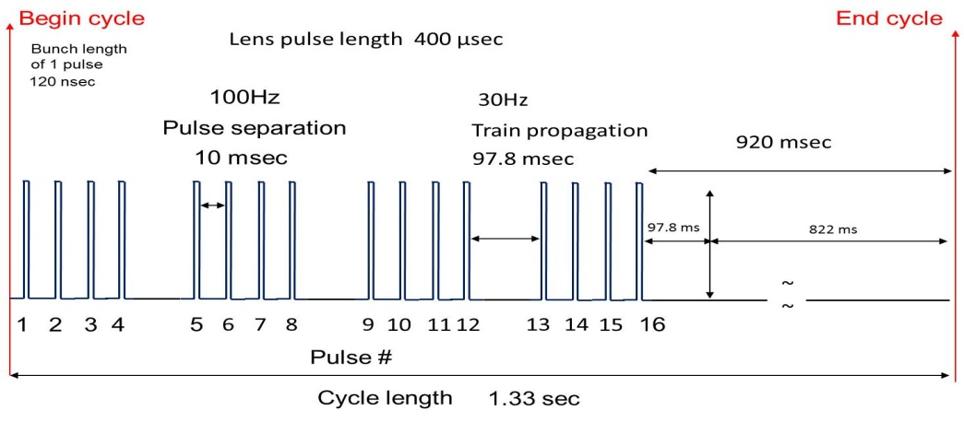
Instrumentation Requirements
Average Rate = 12Hz, Burst rate = 100Hz
Either four groups of four or two groups of eight in a 1.33 second neutrino cycle.

Slide 15
Instrumentation Requirements
 | Mixed Secondary Beam |  | Proton-Only | Muon-only
 | Beam Lines | Delivery Ring
Beam Lines | M2 (AP2) ->M3 (AP3) | Delivery Ring | Abort Line | M4 -> M5
Particles | μ+,π+,t+, p, e+ | μ+,π+, p | Protons | Muons
Energy (GeV/c) | 3.094 | 3.094 | 3.094 | 3.094
# of Particles | 1E7 to 2E8 | 1E7 | 1E7 | 1E5
Transverse Acceptance (π-mm-mrad) (unnormalized) | 40 | 40 | 40 | 40
Bunch Length (nsec) (95%) | 120 | 120 | 120 | 120
Beam Line (m) | 285 | 505 | 50 | 100
Beam | 12Hz, 100Hz bursts | Circulates a few turns (1.69 μsec/turn) | 12Hz, 100Hz bursts | 12Hz, 100Hz bursts

Slide 16
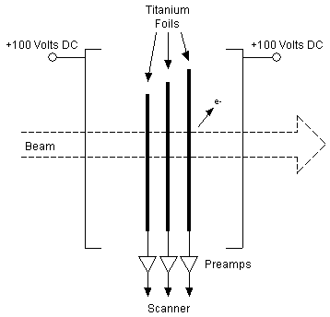
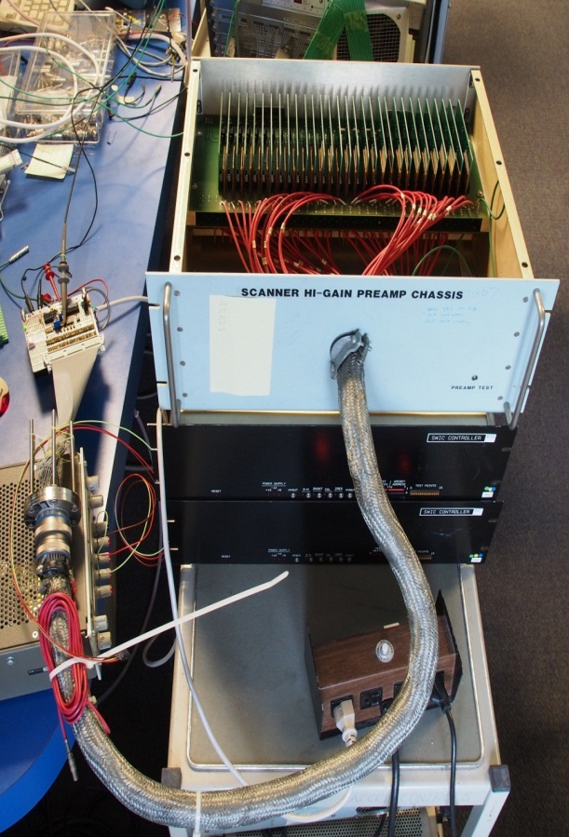
Instrumentation Design: SEM Preamp
The preamp amplifies the beam signal from each wire foil in the SEM.
  Use existing Preamp chassis.
  Replace amplifier boards with new op-amp design.
  Prototype is in progress.
SEM Foils
SEM
Preamp Design
Preamp Test
SEM
Notes:
The 60 amplifier boards are replaced with a new, op-amp based design.
The signal from the SEM, a very small current, is turned into a voltage by running it through a resistor, R1. The capacitance of the coaxial cable connecting the preamp to the SEM will slow down and stretch the incoming pulse. The op-amp amplifies the voltage pulse, and its output trickles out a resistor R4 to a current integrator in the scanner.
The DC blocking capacitor eliminates the need for a trim pot to remove DC bias.
The circuit is easily reconfigurable for higher or lower gains. Higher gains will be more sensitive to the signal, but are also more susceptible to noise. Experimentation will tell us where the happy medium lies.
A challenge will be integration timing. In experiments, best results were obtained with very short integration windows (< 100 msec). Placing the integration window around the incoming pulse may be tricky, but should be feasible.

Slide 17
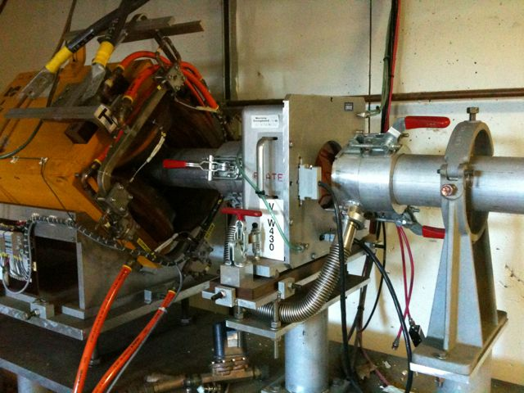
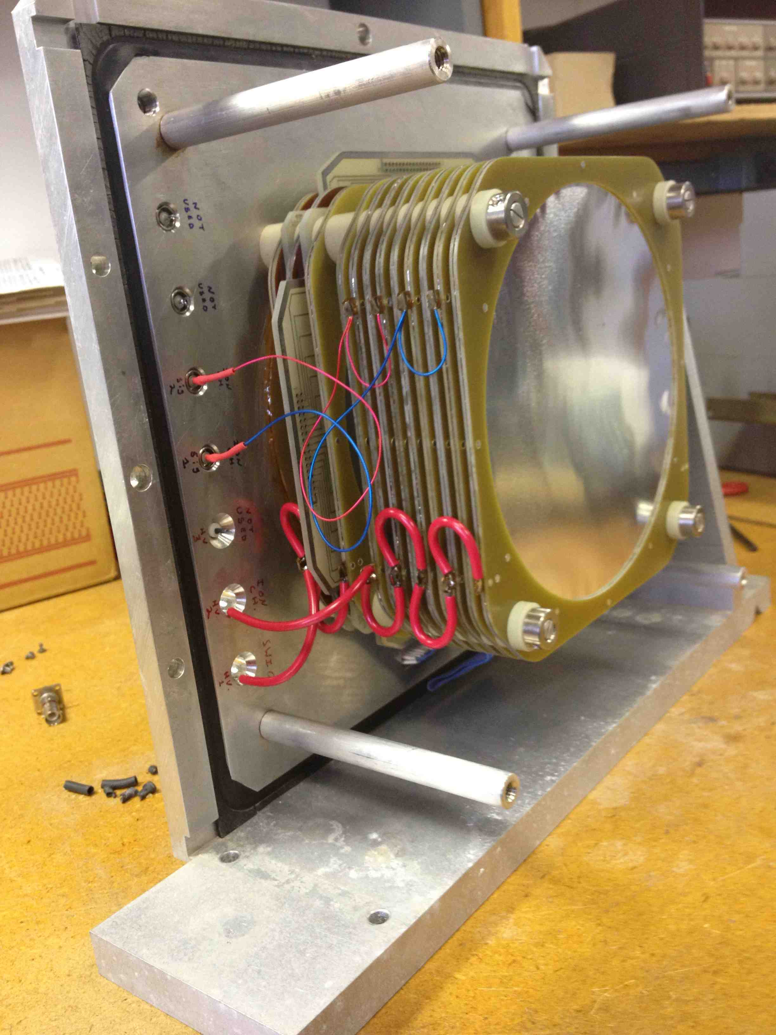
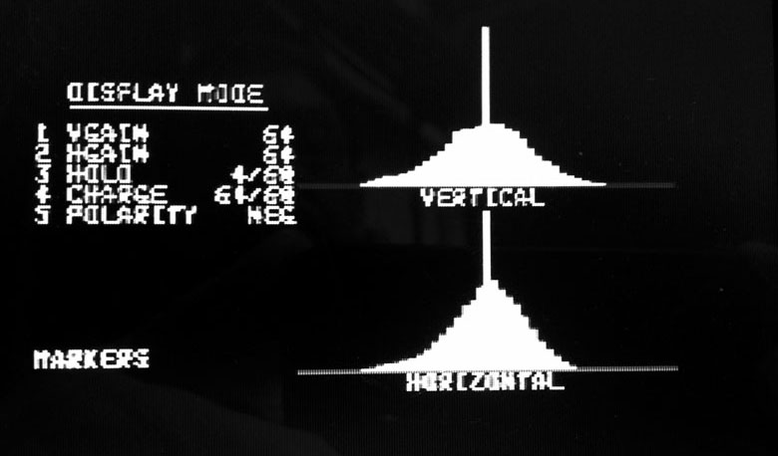
BNL SWIC
The BNL detectors can display profile and intensity (ion chamber) of low intensity beams.
Ion Chamber:
  The ion chamber section has 2 sets of signal foils sandwiched between bias foils.
  Using ArCO2, the expected signal for a 10e7 beam is 477.5 pC and only 4.77 pC at 10e5 beam. The present current digitizer bottoms out around 25 pC so an upgrade of the current digitizer is necessary.
SWIC:
  8 BNL SWICs were shipped to Fermilab.
  High Voltage connectors replaced to current standards.
  Wire planes tested.
    Two spare wire planes are being shipped from BNL.
  The beam profile section (toward the Al plate) is made up by sandwiching 2 signal wire planes (X,Y profiles) between 3 HV foils.
  Preliminary tests using a 0.6 mCi, Sr90 radiation source, gave the profile shown. The voltage was set to -1600 Volts and, given the parameters on the display, a 10e5 particle beam should be readily displayed.
  Will test during beam studies period.

Slide 18
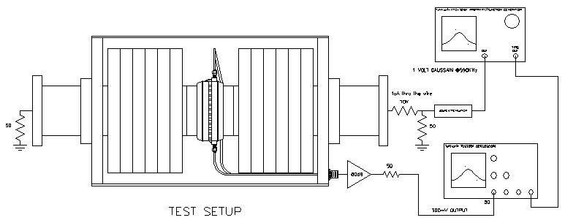
Instrumentation Design: WCM
Mu2e WCM designed to measure slow spill in quanta of 2E7.
Similar to M2 and M3 line intensities, so maybe we can use a WCM as a less evasive option that IC for measuring beam intensities.
Peter Prieto
Notes:
Mu2e WCM may be able to be used for g-2 operations too.
-Designed method of measuring beam intensity without causing losses
-Capable of resolving ~3e7 protons per bunch during slow spill
-To be used as a signal source for feedback regulation of the RF knockout system in mu2e
-Optimize passband of WCM between 400 KHz and 3 MHz
Test Setup
-Gaussian bunches τ=1.69 usec
-Current on WCM wire = 1 uAmp
-Amplifier Gain = 80 dB
-Scope termination = 50 Ohm
Problems:
-Signal modulation due to power supply ripple amplified by the 80 dB amplifier gain
-Measured ripple 400 mV caused by 60Hz from PS and then amplified 80 dB
-Solve problem by averaging signal
Beam with a bunch structure causes current to flow on the inside of a metallic beam pipe, such as the stainless steel beam pipes used in the Antiproton Source. By breaking the metal beam pipe with an insulating ceramic gap and placing a resistor across the gap, one can measure the voltage drop across the resistor that is proportional to the beam current.
The frequency response of the pickup rolls off on the low end because of beam pipe conditions external to the pickup, so the pickup is housed in a shielding box loaded with ferrite material to provide a known value of inductance. The geometry of the ceramic gap and the resistors are chosen to form a properly terminated transmission line. The low frequency response of the wall monitor is determined by the time constant set by the ferrite (16 mH) and the gap resistance (0.5Ω), it is about 5 kHz. The characteristics of the ferrite inductors also set the high frequency response of the pickup. Two types of ferrites and a coating of microwave absorbing paint inside the shielding box are used to provide an even frequency response to 6 GHz.
As beam passes irregularities like bellows in the beam pipe, it induces microwave fields at frequencies determined by the dimensions of the beam pipe structures. That energy travels down the inside of the pipe and can be detected by the wall monitor. To avoid those noise problems, ferrite chokes are installed on both ends of the wall detector.
Signals are taken off the gap at four points around the circumference and summed to minimize sensitivity of the output signal to variations in beam position within the pipe. The overall sensitivity of the monitor, accounting for gap resistance, summing of the four signals, 50Ω terminating resistor, etc. is approximately 0.15Ω.

Slide 19
Cerenkov Detector
Cerenkov Detector shipped from BNL.
Re-commission during beam studies.
Modify or build new stand(s)
Connect to our control system.
Notes:
BNL muon g-2 E821experiment used a Cerenkov detector to measure the beam composition entering the muon ring. The number of muons and pions were compared to Monte Carlo simulation and were found to be consistent with predictions [1] using this detector. However, only the compositions including п+, e+, and µ+ could be counted. Protons could not be counted using the setup for E821. The detector was filled with isobutene gas at pressures ranging from 0 to 1.2 atm in order to break the threshold for Cerenkov light. In 2012, the Cerenkov detector that was used in E821 was shipped to FNAL for similar use in the g-2 FNAL. Now that the detector has arrived, there is an opportunity to use the detector for the proposed 2013 beam tests. However, there is not much known about the detector and how to operate it or prepare it for installation. This document is an attempt to lay how the detector works and a plan to use it.
The basic principle of the Cerenkov detector is that Cherenkov radiation results when a charged particle travels through a dielectric (electrically polarizable) medium with a speed greater than that at which light would otherwise propagate in the same medium[3]. As a charged particle travels, it disrupts the local electromagnetic field (EM) in its medium. Electrons in the atoms of the medium will be displaced, and the atoms become polarized by the passing EM field of a charged particle. Photons are emitted as an insulator's electrons restore themselves to equilibrium after the disruption has passed. (In a conductor, the EM disruption can be restored without emitting a photon.) In normal circumstances, these photons destructively interfere with each other and no radiation is detected. However, when a disruption which travels faster than light is propagating through the medium, the photons constructively interfere and intensify the observed radiation. Figure 3 shows the particles trajectory and the angle of Cerenkov light emitted.
The following equation provides a way to calculate the angle of Cerenkov light from a given particles speed as it interacts with a gas with refractive index n.
$$cos⁡Ɵ_{c}=1/nβ$$
Where:
Ɵ_{c} = Cerenkov light angle
n = index of refraction of medium
β = v/c velocity of particle / speed of light
With the condition: β > 1/n
Also, the index of refraction of the gas can be calculated using the following [2]
$$n= \sqrt{1\frac{+2Kρ}{1−Kρ}}$$
Where K = 0.362 cm³/g for isobutene and 0.5848 cm³/g for C₄F₈O. ρ is the density of gas. Therefore, the gas density threshold for a particle to produce Cerenkov light is [2]
$$_{threshold}=\frac{1}{K} \frac{1−β^{2}}{1+2β^{2}}$$
Table 2 shows some common index of refractions of various gases that could be used in the Cerenkov detector. E821 used isobutene. However, isobutane is flammable and possess extra considerations for use in the tunnel. A comparable gas has been recommended by E. Ramberg which has been used in the Meson Test which is C₄F₈O.
Table 2: Index of refraction for different gases used in Cerenkov detector.
Gas
Index of refraction
He
1.000034694
Isobutane
1.00215
Ar
1.0002762
Ni
1.000331757
C₄F₈O
1.001389 +-.000024 @1atm 22° C [1]

Slide 20
Risks
476.02.04.02.01 (Accelerator Controls)
  Risk: HRM not compatible with all controls hardware.
  Mitigation: Implement CAMAC at MC-1
476.02.04.02.01 (Accelerator Controls)
  Risk: Inability to complete cable pull along designated path due to an unplanned obstacle or insufficient room.
  Mitigation: Design alternate cable path.

Slide 21
Risks
476.02.04.03.02 (SEMs)
  Risk: New high gain preamps are not able to measure the low intensity secondary beam in the M2 line, M3 line and Delivery Ring, or hardware condition of SEMs and lack of available spare parts result in insufficient SEM coverage in the beam lines.
  Mitigation: Build new SWICs
476.02.04.03.03 (BNL SWICs)
  Risk: BNL SWIC hardware is not in sufficient condition to refurbish for g-2 operations, interfacing to FNAL controls is not possible, or too many breaks in the vacuum system don't allow us to use the BNL SWICs.
  Mitigation: Build new FNAL SWICs.
476.02.04.03.05 (WCMs)
  Risk: Beam studies show that WCM cannot measure 2E7 beam or WCM is not cost efficient.
  Mitigation: Implement Ion Chambers instead.

Slide 22
Risks
476.02.04.03.07 (M4 Line SWICs)
  Risk: Not enough spare vacuum cans are available.
  Mitigation: Build new SWIC vacuum cans
476.02.04.03.01(Toroids), 476.02.04.03.02 (SEMs), 476.02.04.03.03 (M5 SWICs), 476.02.04.03.04 (BLMs), 476.02.04.03.05 (WCM), 476.02.04.03.06 (Ion Chambers), 476.02.04.03.08 (Cerenkov Counter).
  Risk: AP2 line beam studies commissioning is not able to be completed due to a number of reasons including lack of sufficient funding or engineering support.
  Mitigation: Complete instrumentation commissioning in the M2 line, M3 line, Delivery Ring, M4 line and M5 line after construction is complete.

Slide 23
ESH&Q
Controls system, Safety System and Instrumentation will all be implemented within the guidelines documented in the Fermilab Environment, Safety and Health Manual (FESHM) which can be found online at http://esh.fnal.gov/xms/FESHM.

Slide 24
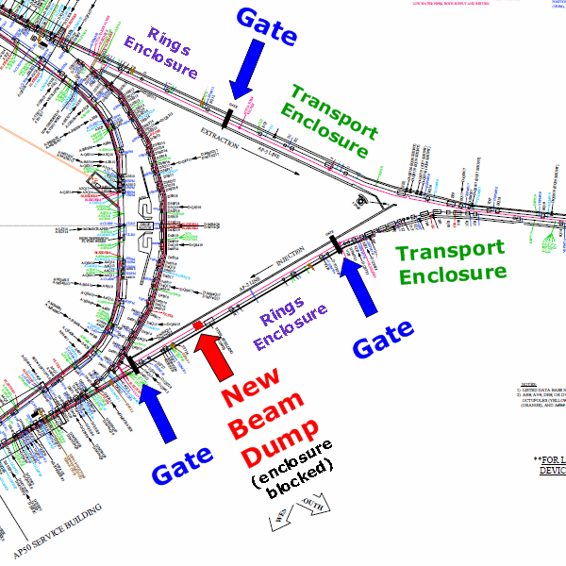
ESH&Q
Tunnel interlocks modification to meet ESH&Q requirements:
  Tunnel egress between the Delivery Ring and Transport enclosures on the AP2 side will be blocked as a result of a new beam abort dump.
  A new gate installed
  Two a mini-loop will be added on each side.

Slide 25
Cost Distribution
Base Cost = AY $K (No Contingency)

Slide 26
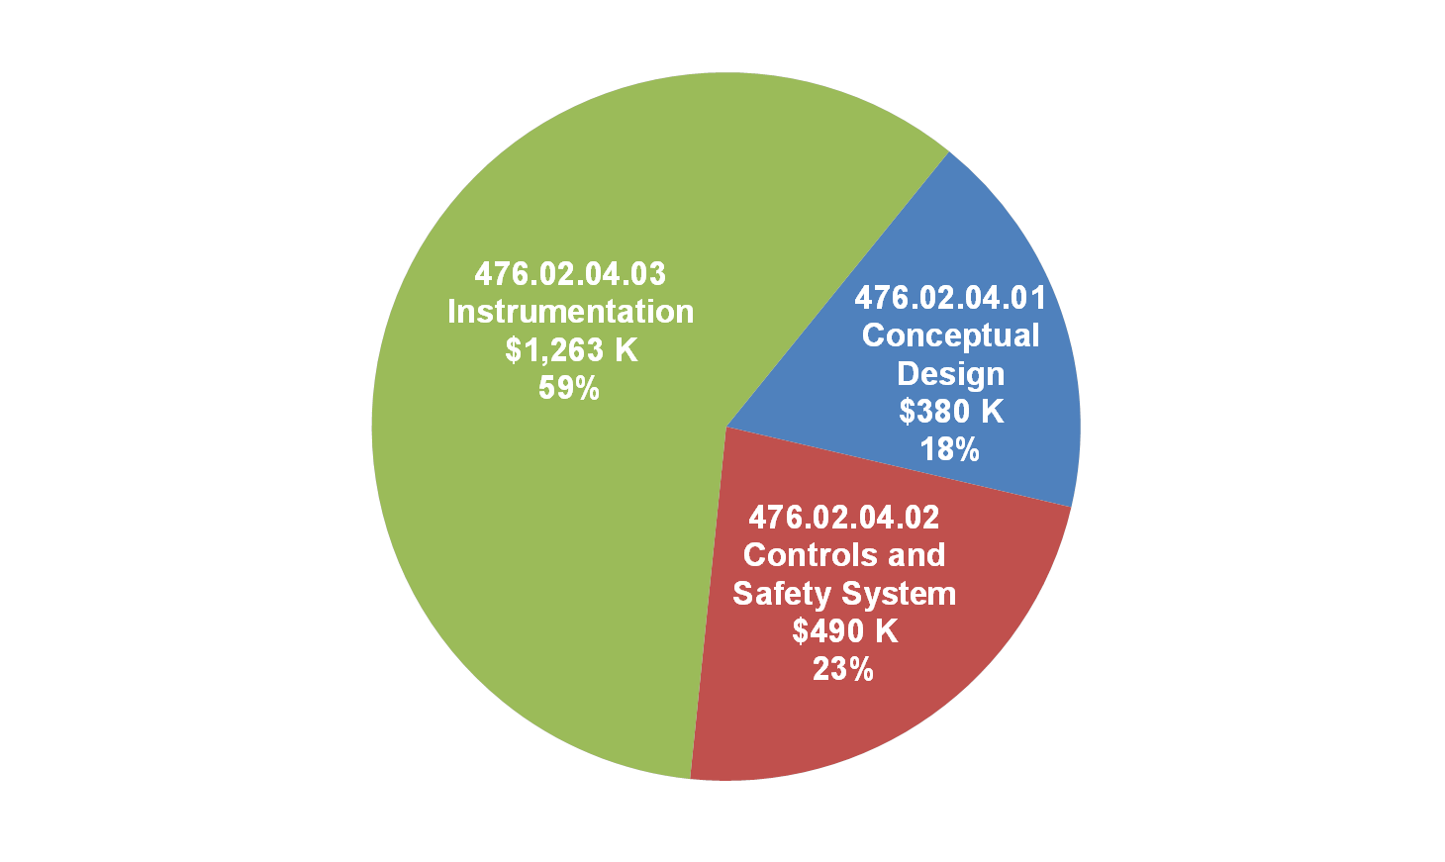
Cost Distribution
Cost Driver: Labor
Cost Driver: Labor
Cost Driver: Contract Electricians and M&S
Base Cost = AY $K
(No Contingency)

Slide 27
Resource Type
Base Cost = AY $K
(No Contingency)

Slide 28
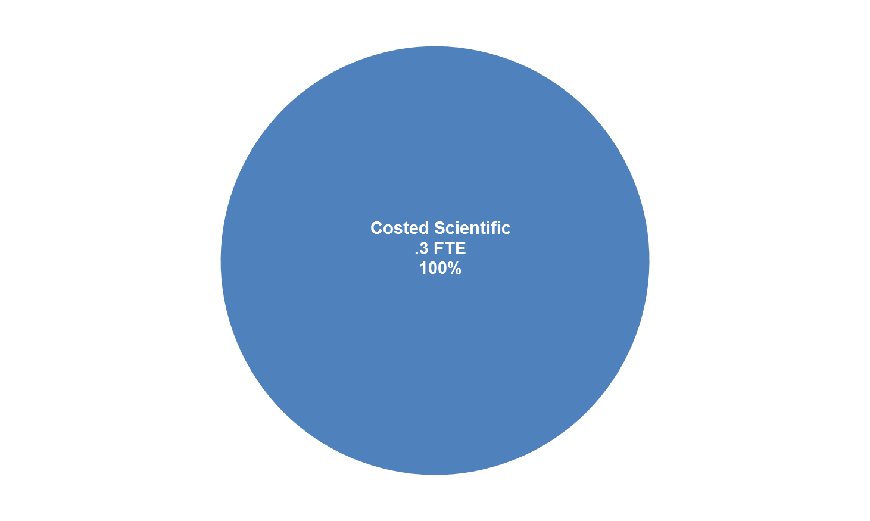
Scientists breakdown

Slide 29
Quality of Estimate
Estimates are all engineering estimates applying project contingency rules to each activity and mostly fall in the 30% to 40% range.
Higher contingency (40% to 50%) was applied to selected Instrumentation activities based on
  Design plan is not as mature
  Scope of repair/refurbishment of existing equipment uncertain
  Beam tests required to ascertain performance at g-2 intensities

Slide 30
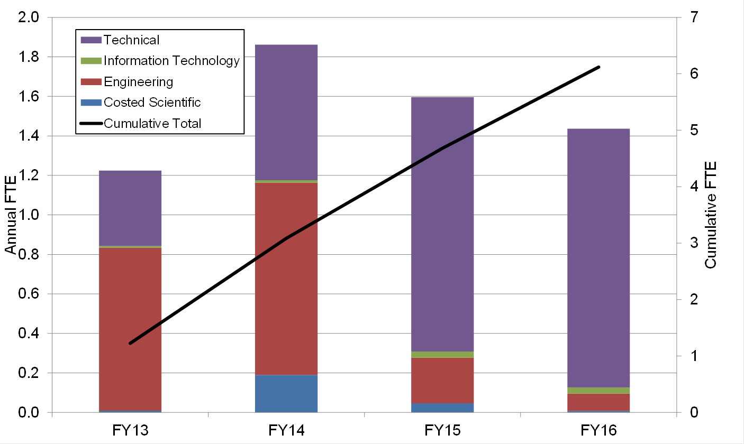
Labor Resources by Year

Slide 31
Labor Resources by Type

Slide 32
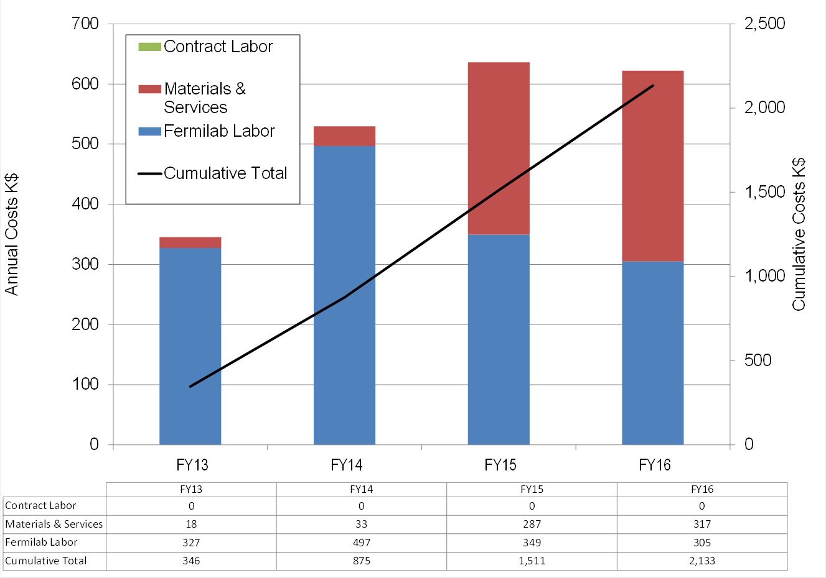
Cost Profile by FY.

Slide 33
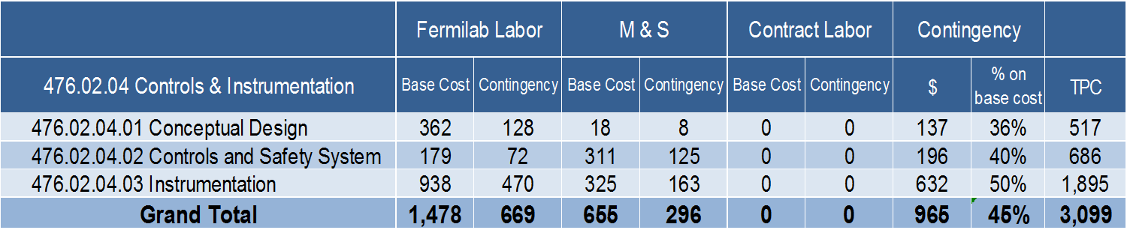
TPC Summary
Base Cost & Contingency in AY K$

Slide 34
Major Milestones

Slide 35
Major Milestones

Slide 36
Major Milestones

Slide 37
Major Milestones

Slide 38
Summary
Establish controls communications, a safety system and beam instrumentation for the MC-1 service building and extraction line enclosure.
Beam studies required during 2013 beam studies period will be needed to make appropriate design decisions on Accelerator Instrumentation.
The conceptual design changes since March 2012 are exploration of the Mu2e WCM, new design of the SEM preamps, Cerenkov detector, BNL SWIC’s for the M5 line.
The cost is $3,099K
Between CD-1 and CD-2 we will focus on the continued design of the low intensity instrumentation.

Slide 39
Supplemental Instrumentation Slides

Slide 40
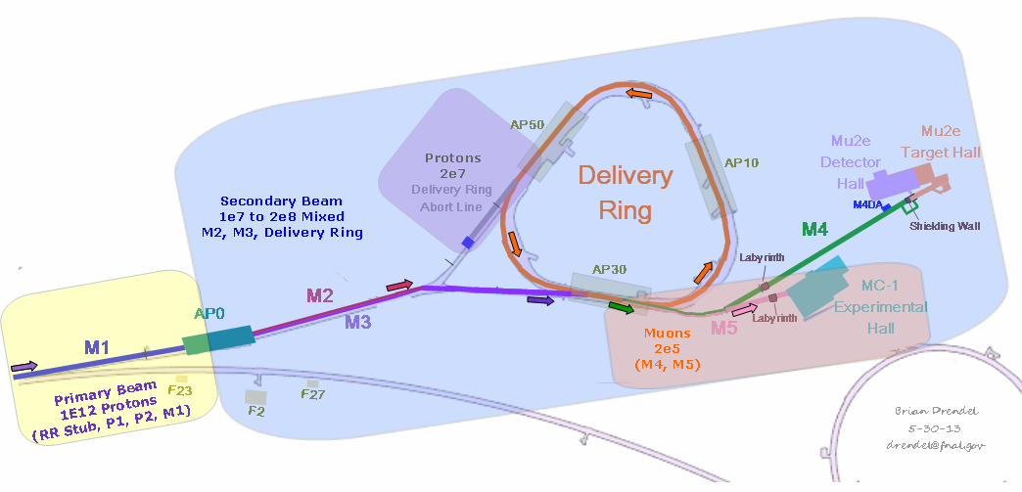
Requirements
  Much of the existing Instrumentation from the Antiproton Source will be reused for g-2 operations. Beam requirements can be broken down into the following categories.
    Primary Proton Beam:
      Intensity: Toroids
      Position: BPMs, Multiwires, SEMs
      Losses: BLMs
    Mixed Secondary Beam
      Intensity: Ion Chambers, Wall Current Monitors
      Position: SEMs
      Losses: BLMs
    Proton-only
      Intensity: Ion Chambers
      Position: SEMs
      Losses: BLMs
    Muon-only
      Intensity: Ion Chambers
      Position/Profile: SWICs
      Particle Composition: Cerenkov Detector
Notes:
Toroids:
-5 toroids in the primary beam lines: P1 (2), P2, AP1 (2)
-4 toroids in the secondary beam lines: AP2 (3), D/A
BPMs:
-P1 (30), P2(18), AP1 (18) and AP3 (58) fully equipped with Echotek BPMs
-Delivery Ring (120): Electronics will need to be replaced.
-P1 Stub (2 new BPMs)
Multiwires/SEMs:
P1 (6), P2 (4), AP1 (5), AP3 (7), AP2 (8), D/A (4), DR (2), Acc (1)
P1 Stub (2 new Nova style Multiwires)
IC:
AP2 (1)

Slide 41
Instrumentation Requirements
 | Primary Beam | Mixed Secondary Beam |  | Proton-Only | Muon-only
 |  | Beam Lines | Delivery Ring
Beam Lines | P1->P2->M1 (AP1) | M2 (AP2) ->M3 (AP3) | Delivery Ring | Abort Line | M4 -> M5
Particles | Protons | μ+,π+,t+, p, e+ | μ+,π+, p | Protons | Muons
Energy (GeV/c) | 8.89 | 3.094 | 3.094 | 3.094 | 3.094
# of Particles | 1E12 | 1E7 to 2E8 | 1E7 | 1E7 | 1E5
Transverse Admittance (π-mm-mrad) (unnormalized) | 18 (95% normalized emittance) | 40 | 40 | 40 | 40
Bunch Length (nsec) (95%) | 120 | 120 | 120 | 120 | 120
Beam Line (m) | 581 | 285 | 505 | 50 | 100
Beam | 12Hz, 100Hz bursts | 12Hz, 100Hz bursts | Circulates a few turns (1.69 μsec/turn) | 12Hz, 100Hz bursts | 12Hz, 100Hz bursts

Slide 42
Conceptual Design
Intensity Measurements
  Toroids
  Ion Chambers (ICs)
  Wall Current Monitors (WCMs)
Position/Profile Measurements
  Beam Position Monitors (BPMs)
  Secondary Emission Monitors (SEMs)
  Segmented Wire Ion Chambers (SWICs)
Losses/Particle Composition
  Beam Loss Monitors (BLMs)
  Cerenkov Detector
B. Drendel Muon g-2 Independent Design Review June 5-7, 2013

Slide 43
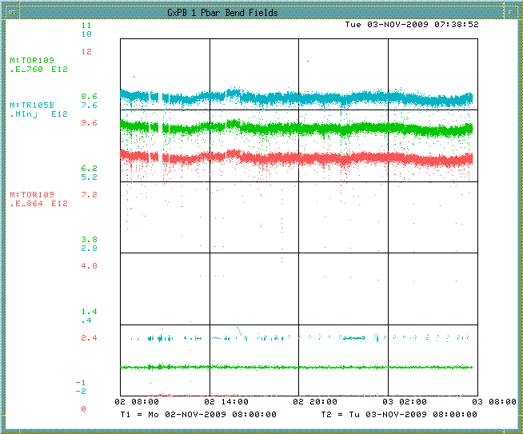
Toroids
Toroids exist in the transport lines to monitor beam intensity.
Primary Protons:
  Toroids in the P1, P2 and M1 lines will still be used to measure high intensity primary beam and will need minimal maintenance.
  Existing NIM electronics will be used as a cost savings measure. Upgrading to a more recent VME standard would add cost.
  Calibration and general maintenance will be done.
Secondary Beam:
  Previously used toroids to measure low intensity secondary pbar beam of approximately 10¹⁰ but required high gain and careful filtering.
  Poor high frequency response makes it more difficult to see the single 2.515MHz bunch.
  The preamp shielding was sufficient for antiproton source operations, but we may need to add additional shielding.
  Beam studies were conducted to examine the feasibility of using toroids with the g-2 low intensity secondary beam.
Notes:
Two toroids in P1, one in P2, two in the M1 line, three in the old AP2 line and one in the D/A line.
Toroids configured for high intensity running can measure 10^12 or 10^13.
Use existing Toroids and insulators in the P1, P2 and M1 beam lines. Some work needed on some of the stands, signal cables and calibration cables. A couple of Toroids may need to be added or moved. VME crate, controllers and timing cards re-purposed from other accelerator locations.
Toroids for low intensity pbars in the AP2 line measured 10^10 to 10^11, but won’t be able to be used in the M3 line. A pulse of 10¹⁰ particles in 1.6 microseconds is equivalent to 1 mA of current flowing through the toroid. This produces an output signal of only 1 mV, requiring high gain and careful filtering. In the AP2 line we connected to scopes.
Pearson single turn large aperture toroids are located in the transport lines to monitor beam intensity. They are beam transformers that produce a signal that is proportional to the intensity (1 V for every 1 A of current). The toroids make use of integrators that sample over a gated period that is defined by a Main Injector Beam Synch (MIBS) timer.
-

Slide 44
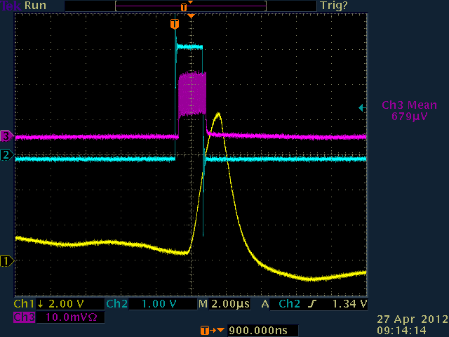
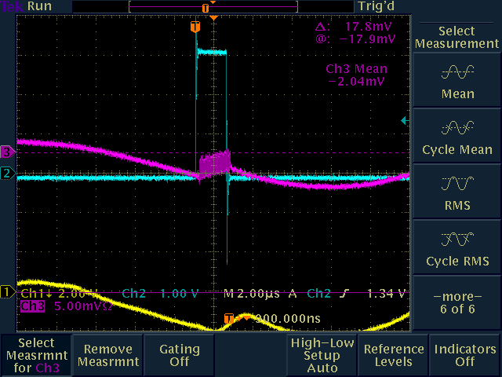
Tor704 Test Signal Response
2E9
Test Pulse
2E8
Test Pulse
Notes:
-Put high gain preamps
-Advantage of toroid is you can plug in a test signal in the upstairs electronics to calibrate the output signal.

Slide 45
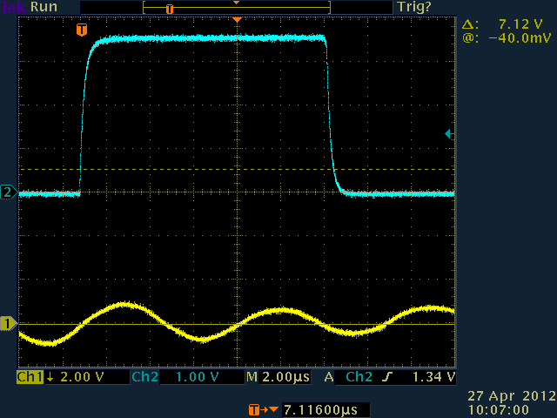
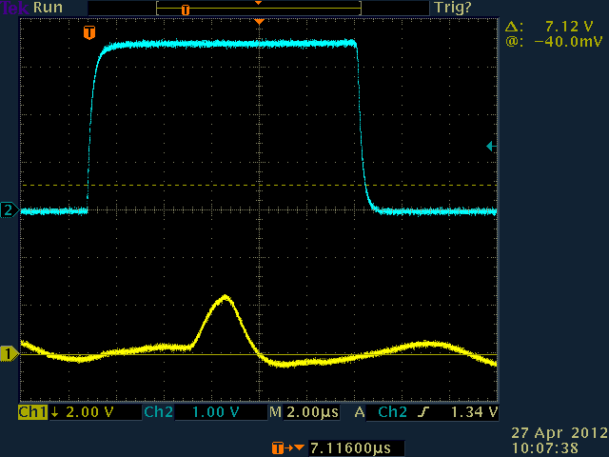
Tor704 Beam Response
No Beam
Beam
Similar conditions to g-2 we see a small beam signal.
  1E12 protons on target (8.9 GeV/c) with 3.1 GeV/c secondaries
  Tried to setup software to get the scope peak and calculate intensity.
    Had trouble with intensities this low.
  Picking out the peak by eye, we get about 5e8, or about two times what the model says.

Slide 46
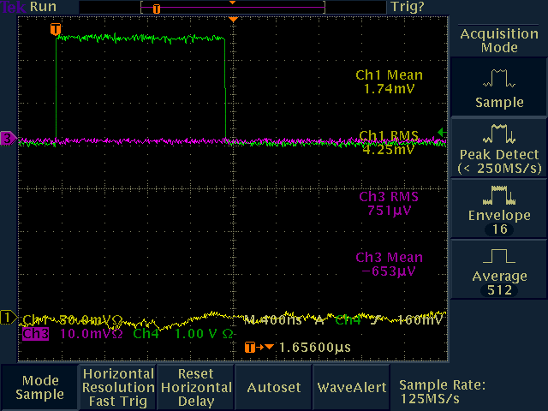


Tor724 Test Signal Response
No Signal
2.4E9
Test Pulse
2E8
Test Pulse
Notes:
-Model shows beam at Tor724 should be a factor of 8 reduction. We see no signal at 724.
-Toroid will get less signal with the short 2.515MHz bunch.
-We will not be able to use Toroids for low intensity operations.

Slide 47

Ion Chamber
Contains a signal foil between two high voltage foils and the chamber is filled with gas (Helium, ArC02, etc…). Particles pass through the chamber and ionize the gas giving a signal proportional to beam intensity.
Can measure smaller beam currents than toroids and or SEMs, and bunch structure and particle charge do not impact response.
Good for measuring beam in the 10⁵ to 10¹¹ range.
Can be calibrated to ~5%.
Ion chambers require a vacuum break.
Two options are non- retractable (inexpensive) and ones installed in a vacuum can that are retractable (expensive).
Have a pool of spares available plus SWIC/Ion Chamber combination units from BNL.
For g-2 operations, we will install one at the end of the M2, one at the end of M3, one in the Delivery Ring and one in the M5 line.
  Any ion chambers in the Delivery Ring or M4 line would need to be retractable to be compatible with Mu2e operations.
Notes:
-IC728 is the only location in Pbar/Muon that has an ion chamber.
-One that has a leak and a second one.
-If we can’t locate spares we may have to build some.
-Work includes calibrating the existing toroid and building additional ones.
- M2 (1), M3 (1), DR(?), M4, g-2
Requires a vacuum break, ArCo2, degrades beam quality.
Good for measuring beam intensities from 10^5 to 10^11
Used to use one in the AP2 line at the 728 location. Further back also at 704 and 806
-The ion chamber has a high voltage electrode at -300V and a signal
electrode contained in a chamber filled with helium gas. Secondary particles
traveling down the AP-2 line pass through the chamber and ionize the helium
resulting in a current path to the signal electrode. The result is a signal
proportional to the beam intensity.
-A small amount of helium passes out of the ion chamber through a
bubbler, however the loss rate is very small.
An ion chamber is able to measure smaller beam currents than a toroid
so it is an appropriate choice for low intensity secondaries.
- The ion chambers have a tendency to leak gas into the beampipe

Slide 48

BNL IC + SWIC Detectors
The BNL detectors can display profile and intensity (ion chamber) of low intensity beams.
The ion chamber section has 2 sets of signal foils sandwiched between bias foils.
Using ArCO2, the expected signal for a 10e7 beam is 477.5 pC and only 4.77 pC at 10e5 beam. The present current digitizer bottoms out around 25 pC so an upgrade of the current digitizer is necessary.
Notes:
I made a calculation to determine the signal available for the current digitizer for two intensity ranges using the BNL ion chamber section of the detector.
(Gs) Gas length (for both sections tied together) is 2" or 5.08 cm
(Pp) Pair production of ArCO2 per charged particle is 94/cm of gas
(Np) number of charged particles
(e) electron charge
So, in the plateau region the expected charge Q is given by: Gs x Pp x Np x e, or for a 10e7 beam Q= 5.08x 94x10e7x 1.6e-19 = 477.5 pCoulomb for a 10e7 beam and 4.77 pCoulomb for a 10e5 beam. Even though we have not calibrated the detector yet I expect the plateau to go from 200 V to about 1000V with a small increase of signal toward the higher value. Your current digitizer will definitely "see" the larger amount but what about the lower?
Our present current digitizer will not see anywhere near this low of a signal level. It bottoms out at about 25 nanocoulombs. I am working on a new current digitizer that should go down to around 1 nanocoulomb but that's about the best that we can do.

Slide 49

IC728 Beam Response
8.9GeV/c primaries, 3.1 GeV/c positive secondaries.
Beam intensity plot stepping down from 2E12 on target to ~1E11.
Ion chamber tracks beam on target.
Ion chamber intensities (not calibrated) measured from 8E7 down to ~5E6.

Slide 50
Wall Current Monitor
Mu2e WCM designed to measure slow spill in quanta of 2E7.
Similar to M2 and M3 line intensities, so maybe we can use a WCM as a less evasive option that IC for measuring beam intensities.
Peter Prieto
Notes:
Mu2e WCM may be able to be used for g-2 operations too.
-Designed method of measuring beam intensity without causing losses
-Capable of resolving ~3e7 protons per bunch during slow spill
-To be used as a signal source for feedback regulation of the RF knockout system in mu2e
-Optimize passband of WCM between 400 KHz and 3 MHz
Test Setup
-Gaussian bunches τ=1.69 usec
-Current on WCM wire = 1 uAmp
-Amplifier Gain = 80 dB
-Scope termination = 50 Ohm
Problems:
-Signal modulation due to power supply ripple amplified by the 80 dB amplifier gain
-Measured ripple 400 mV caused by 60Hz from PS and then amplified 80 dB
-Solve problem by averaging signal
Beam with a bunch structure causes current to flow on the inside of a metallic beam pipe, such as the stainless steel beam pipes used in the Antiproton Source. By breaking the metal beam pipe with an insulating ceramic gap and placing a resistor across the gap, one can measure the voltage drop across the resistor that is proportional to the beam current.
The frequency response of the pickup rolls off on the low end because of beam pipe conditions external to the pickup, so the pickup is housed in a shielding box loaded with ferrite material to provide a known value of inductance. The geometry of the ceramic gap and the resistors are chosen to form a properly terminated transmission line. The low frequency response of the wall monitor is determined by the time constant set by the ferrite (16 mH) and the gap resistance (0.5Ω), it is about 5 kHz. The characteristics of the ferrite inductors also set the high frequency response of the pickup. Two types of ferrites and a coating of microwave absorbing paint inside the shielding box are used to provide an even frequency response to 6 GHz.
As beam passes irregularities like bellows in the beam pipe, it induces microwave fields at frequencies determined by the dimensions of the beam pipe structures. That energy travels down the inside of the pipe and can be detected by the wall monitor. To avoid those noise problems, ferrite chokes are installed on both ends of the wall detector.
Signals are taken off the gap at four points around the circumference and summed to minimize sensitivity of the output signal to variations in beam position within the pipe. The overall sensitivity of the monitor, accounting for gap resistance, summing of the four signals, 50Ω terminating resistor, etc. is approximately 0.15Ω.

Slide 51
Beam Position Monitors
BPMs were used in Pbar Operations to measure beam position with sub-millimeter resolution for autotune steering program.
  Three different styles of BPMs.
  Preamps used for downstream AP2 (10¹⁰ particles)
  Two cascaded preamps for a total gain of 50dB used for ~ 2 x 10⁸ D/A line beam.
P1, P2, M1 and M3 BPMs are designed to see four 2.5MHz bunches.
  Minor electronics changes required.
M2 and Debuncher BPMs can only see 53MHz and will be upgraded to Echotech standard with 2.5MHz electronics.
  Repurpose Tevatron BPM crates
  Repurpose Recycler BPM electronics
Where can we use BPMs?
BPMs can be used for primary beam autotune.
BPMs will likely not be used for low intensity secondary beam.
Notes:
Delivery Ring BPM Plan:
-Removing old BPM electronics hardware from the Delivery Ring (Debuncher).
-Modify Recycler analog transition boards to handle expected signal intensity produced by a 1e12 ppb (2.5 MHz) in the Delivery Ring.
-Design a plate which transitions N-type connectors to DB-9 connectors allowing BPM signals to connect to 2.5 MHz transition board DB -9 input connectors.
-Design and test 2.5 MHz filters in the digital down-converter boards installed in the Debuncher.
-Install VME64X crates in Delivery Ring service building.
-Purchase MVME5500 processor boards to be used as crate controllers or if any available from TeV BPM system use those.
-Make # of Top Plates for the relay racks where the VME64X crates will be installed.
-Modify transition boards to handle signal intensity in the 2.5 MHz channel which is already implemented in the existing transition boards.
-Develop front-end software in the BPM system that can be used with Debuncher control system.
-Develop code to process signals from the digital down converter boards and produce a beam position signal.
Beam Line BPM Plan
-P1, P2, M1 (AP1) and M3 (AP3) lines have an Echotek-based BPM system , no software is required for these lines. It is based on detecting 2.5MHz single bunch on a single pass by digitizing at 80 MHz.
-Hardware changes to the 2.5 MHz channel to handle the input signal level consist on adding an external attenuator at the top plate for each BPM pickup.
-The Debuncher Abort line has 8 BPM’s. It will require two 2.5 MHz recycler transition boards and two 8 channel echotek boards. It will need 1 VME64X -9 channel slot crate, one MVME5500 processor and one timing board.
Pbar has three different styles of BPMs.
Provide sub-millimeter resolution of the horizontal and vertical positions.
Debuncher BPM’s are cylindrical with an 18 cm diameter. BPM's can also be found in the AP1, 2 and 3 beamlines. The AP-1 line has 7.6 cm diameter combined horizontal and vertical BPM’s at every quadrupole location while the AP-2 and AP-3 lines are single-plane and 13 cm in diameter, generally alternating planes at quadrupole locations.
The 120 Debuncher BPMs are divided into six “houses” of 20 BPMs each (10 horizontal and 10 vertical) – can only see 53MHz beam.
The P1, P2, AP1 and AP3 lines all share the Echotek style BPM electronics that were built as part of the “Rapid Transfers” Run II Upgrade. Electronics racks reside in MI60-S (P1 Line), F1 (P2 Line), F23 (AP1 and AP3 Lines), F27 (AP3 Line) and AP30 (AP3 Line). These BPMs are designed to detect seven to 84 consecutive 53MHz proton bunches in reverse proton or stacking mode, and four 2.5MHz pbar bunches in Accumulator to Recycler antiproton transfer mode. There are two crates used to process the BPM data: the analog crate and the VME crate. Figure 7.7 gives an overview of the Echotek BPM layout.
-Signals from the BPM A and B plates in the tunnel are sent up to the service buildings via RG8/RG213 cables and are connected to the back of the analog filter cards in the analog crate. The analog cards filter, attenuate and amplify the analog BPM signals as needed. Each analog card can handle two BPMs (four BPM plate signals) which are processed and output through the front panel cables to Echotek cards in the BPM VME crate. The analog crate also contains a test/control module that handles setup of the filter modules including test pulses. The entire crate is powered with an external +5V power supply that is found near the bottom of the rack.
- Secondary particles in the AP-2 line have the same 53MHz bunch structure as the targeted proton beam, so BPM’s can be used to detect beam position. There are 34 BPMs in the AP-2 beam line and seven BPMs in the D to A line that share common design features. When stacking, the number of antiprotons and other negative secondaries (mostly pions and electrons) in the AP-2 line is relatively small, on the order of 1 x 10¹¹ at the beginning of the line and 1 x 10¹⁰ at the end of the line. The beam intensity in the D to A line is even smaller, with ~10⁸ or less reaching the Debuncher. In addition, the AP-2 BPMs on the Debuncher end of the line see significant electrical noise from the Debuncher Injection kicker. For these reasons, the AP-2 and D to A Line BPMs could not be used for measuring pbars in past years. In 2005, new BPM electronics were designed for use in the AP-2 line. After the electronics were installed and deemed a success, they were then propagated to the D to A line BPMs. AP-2 BPMs can be used to look at both bunched stacking secondaries and bunched reverse proton beam while D to A line BPMs are only used under special conditions. During stacking, the D to A BPMs are only used with the Pledge Pin application (currently P155) for tuning on closure into the Accumulator. The D to A line BPMs can also be used to look at bunched reverse protons.
As beam decreases in intensity while traversing the AP2 and the D to A lines, increasing amounts of amplification is needed before the signals can be processed. The upstream AP2 BPM (701-715) plate signals are sent straight up to the F27 service building where they are amplified by 20dB RF amps. The downstream AP2 BPM (716-734) plates have low noise Hittite amps with 25dB gain located in the tunnel. The D/A line BPMs must read even lower intensities, so two cascaded Hittite amps with a total gain of about 50dB are attached to the pickup plates in the tunnel.
P1, P2, AP1 and AP3 lines hardware and Echotek electronics are already in place and are already are capable of seeing 2.5MHz beam.
Debuncher BPM tunnel hardware can be reused. Electronics would need to be removed and replaced with the Echotek system to see the 2.5MHz beam.
Echotek electronics would be repurposed from the Tevatron and Recycler.
Beam only circulates in the Debuncher three times, we need to determine if we can see this beam with the proposed BPM system. Debuncher abort line would use the AP2 line BPM tunnel hardware and update the electronics to the Echotek system.
We will not likely be able to use them in AP3, Debuncher, Abort or Extraction Line

Slide 52


AP2 BPMs
8.9GeV/c primaries, 3.1 GeV/c positive secondaries.
Beam intensity plot stepping down from 2E12 on target to ~1E11.
Only first couple of BPMs in the AP2 line have intensity data with 1E12 POT.

Slide 53

Secondary Emission Monitor
Measure the beam profile using 30 horizontal and 30 vertical titanium strips.
Beam particles have elastic collisions with the strips, dislodging them, creating current. 2.5% to 5% efficient.
Destructive measurement like the SWIC, but operate at beam pipe vacuum and have no gas.
We have an ample supply of SEMs already installed in the AP2 and AP3 lines that could provide coverage for the M2 and M3 lines with minimal expense.
New preamps and clearing foils may need to be implemented to work with the lower g-2 intensities.
  D/A line SEMs have special high gain preamps that make them 260 times more sensitive. There are only five of these preamps.
SEMs “may” be able to be used for low intensity secondaries in the M2, M3 and Delivery ring.
SEMs will not work for M4 and g-2 lines for g-2 operations.
SEMs can be used for occasional diagnostics in the beam lines for Mu2e operations.
Notes:
SEM grids are used to measure the beam profile in the horizontal and vertical planes. SEMs consist of rows of 30 vertical and 30 horizontal titanium strips that can be placed in the path of the beam. Beam particles have elastic collisions with electrons in the strips and dislodge them (see figure 7.8). This causes a current to flow in the strips, which is amplified by preamplifiers.
Wire spacing is either 1.5mm or 3mm and most are 3mm.
- SEMs: P1 (6), P2 (4), AP1 (5), AP3 (7), AP2 (8), D/A (4), DR (2), Acc (1)
For every forty protons or antiprotons passing through the SEM, one electron is dislodged yielding a detector efficiency of 2.5%. A
- clearing voltage of +100 VDC can be applied to foils placed before and after the strips to improve the work function of the titanium and double the efficiency to 5%. Since a small amount of the beam collides with the titanium strips, SEM grids are not completely passive devices. Most SEM grids are located in the transport lines, although a few are located near injection and extraction points in the rings to be used during initial tune-up. If one of the ring SEM grids is left in, beam will be rapidly lost.
The SEM grids operate at beam pipe vacuum pressure and thus have no gas gain like the Segmented Wire Ionization Chambers (SWICs) found in Switchyard. Preamp boxes are used to amplify the signals generated by the SEM. Preamp boxes contain a pair of motherboards with 30 preamp boards plugged into each (one horizontal and one vertical set). Some versions of the preamp box have charge splitters that, when selected, attenuate the signal to the preamps 15 times when the charge split input is +5V. D to A line SEMs use preamps with two available gain configurations. Switching the gains requires a tunnel access. D to A line SEM gains are up to 260 times more sensitive than those of the other SEMs due to the low beam intensities found during stacking.
P1, P2, AP1 and AP3 :
Existing SEM/Multiwire tunnel hardware will be used.
Some refurbishing will be required on some of the cans.
Electronics will be upgraded to an instrumentation standard.
Debuncher There is currently one SEM in the Debuncher Ring.
Debuncher Abort One or two existing AP2 SEMs can be used for the Debuncher abort line
Extraction Line Need to develop a plan for SEMs in the extraction line.
BNL SWICS and/or ion chambers
Instrumentation experts will determine if we can use the SWICs and Ion Chambers used by the BLN g-2 decay line.

Slide 54






Beam Studies – AP2 SEMs
AP2 Line SEMs for 3.1GeV/c secondaries from 1E12 protons on target.
Noise
  Raw data is noisy
  Manual background subtraction
  Hardware background subtraction?
Preamps
  Six “high gain” preamps
  Only two worked in 8/3.1
  Designing a new high gain preamp
Clearing Foils
  Clearing foils can increase signal to noise for low intensity signals.
  Was not used for Pbar Operations.
Manual Noise Subtraction
Clearing Foil
Noisy Signals
Low gain preamp
Gain of 250
~ 25 units + spare
High gain preamp
Gain of 1000
Only 6 units
Notes:
AP2 Line SEMs RAW data for 3.1GeV/c secondaries from 1E12 protons on target.
Only 2 of 6 hi gain preamps worked for 8/3.1
715 and 733 provide profiles.
Not enough spare cards to build
additional units for AP2 & g-2 line
Need preamp redesign with possible increased dynamic range for g-2 and M4 (mu2e) line
Need to develop a set of specs for design.
AP2 Line SEMs with manual (file) noise subtraction for 3.1GeV/c secondaries from 1E12 protons on target.
Need triggered background subtraction (BGS). The new scanner will provide this feature.
New scanner time difference from background and beam frame -> ~ 3msec.
Would like to get profiles for all 16 g-2 pulses with BGS. Looks achievable.
We understand that there can be an increase in signal to noise by using clearing fields (CF) (for low intensity signals).
Currently, CF not used or supported. 100V power supplies are removed. AP1,AP2,Ap3 had sufficient intensities without them.
Hooked up the CF to 1 SEM during beam studies and applied 100v but did not see any differences.
Need expert technical help to assess.

Slide 55
SEM Preamps
Use existing Preamp chassis.
Replace amplifier boards with new op-amp design.
Prototype is in progress.
Basic Circuit Design
Test Setup
Notes:
The 60 amplifier boards are replaced with a new, op-amp based design.
The signal from the SEM, a very small current, is turned into a voltage by running it through a resistor, R1. The capacitance of the coaxial cable connecting the preamp to the SEM will slow down and stretch the incoming pulse. The op-amp amplifies the voltage pulse, and its output trickles out a resistor R4 to a current integrator in the scanner.
The DC blocking capacitor eliminates the need for a trim pot to remove DC bias.
The circuit is easily reconfigurable for higher or lower gains. Higher gains will be more sensitive to the signal, but are also more susceptible to noise. Experimentation will tell us where the happy medium lies.
A challenge will be integration timing. In experiments, best results were obtained with very short integration windows (< 100 msec). Placing the integration window around the incoming pulse may be tricky, but should be feasible.

Slide 56


Segmented Wire Ion Chamber
Displays transverse beam profiles using 48 horizontal and 48 vertical wires
Measures beam intensities from 10⁵ to 10¹³, so they can be used to measure the low intensity secondaries.
Commonly used at Fermilab in Switchyard and other areas with low beam intensity.
Destructive beam measurement. 7E9 lost in one pass from 5E12.
Two styles: SY and Bayonet
ArC0₂ gas flows through vacuum can.
3-4 mil titanium vacuum window.
Vacuum boxes don’t normally hold good vacuum. 10⁻⁶ torr at best.
SWICs could be used in the M4 and M5 lines for g-2 operations.
May need to be used in the M2 line, M3 line and Delivery Rings if SEMS don’t work..
Notes:
48 Horizonal and 48 vertical wires near ground. Center diagonal at HV
ArC02 gas flows through vacuum can
3 to 4 mil titanium vacuum window separates vacuum can from beam line
Gas ionizes – positive ions move toward signal wires.
Destructive measurement of beam.
Each SWIC loses 7E9 per 5E12
Two styles – SY (square box – wires rotate vertically) and Bayonet can (wires move up/down)
Vacuum cans have 4” beam flange, but can accommodate up to 6”
Wire spacing 0.5 to 3mm
Measure beam intensities from 10^5 to 10^13.
Instrumentation doing an inventory from spares. There appears to not be enough spares to cover everything, so additional ones would have to be made.
Vacuum boxes don’t normally hold good vacuum. 10^-6 tor at best.

Slide 57
BNL SWICs
8 BNL SWICs were shipped to Fermilab.
High Voltage connectors replaced to current standards.
Wire planes tested.
  Two spare wire planes are being shipped from BNL.
The beam profile section (toward the Al plate) is made up by sandwiching 2 signal wire planes (X,Y profiles) between 3 HV foils.
Preliminary tests using a 0.6 mCi, Sr90 radiation source, gave the profile shown below. The voltage was set to -1600 Volts and, given the parameters on the display, a 10e5 particle beam should be readily displayed.
Will test during beam studies period.

Slide 58




Beam Loss Monitor
PMT
Tevatron ion chamber loss monitors (lower left) will be used in the P1, P2 and M1 lines.
More sensitive plastic scintillator design (top left and right) already exist in the Debuncher and will be reused for g-2 operations.
Spare PMT style BLMs from the Accumulator could be used to provide additional coverage in M2, M3, M4 and M5 lines.
NIM
Ion Chamber
CAMAC
HV
Notes:
- There are two types of Beam Loss Monitors (BLMs) in the Antiproton Source, ion chamber and plastic scintillator with a photomultiplier tube (PMT). The ion chamber BLMs can be found in the P1, P2, AP-1 and part of the AP-3 beamlines and are used to monitor losses during stacking and pbar transfers. The plastic scintillator BLMs are distributed throughout the Accumulator and Debuncher rings and can be used for studies or for locating loss points.
- The ion chamber monitors are the same as those used in the Tevatron. The BLM detector is a sealed glass ion chamber with a volume of 110 cubic centimeters that is filled to 1 atmosphere with Argon. A high voltage power supply is daisy- chained to a string of BLMs and provides about a 1,500 Volt bias to the chamber. The output goes upstairs on an RG58 signal cable to a beam loss integrator and then to a Multiplexed Analog to Digital Converter (MADC). The MADC is read by the control system in the usual way.
- The plastic scintillator design BLM is sensitive to a small number of particles, something the ion chamber loss monitors aren’t. The loss monitors are made up of a 4"x2"x1/2" piece of plastic scintillator glued to a 36" long Lucite light guide (see Figure 7.3). At the end of the light guide, a small Lucite coupling attaches it to an RCA 4552 PMT. The PMT's were recycled from old “paint can” loss monitors and are relatively rugged. The intent of the light guide is to keep the scintillator near the magnets but to extend the phototubes up and away from the region of beam loss. This assembly is mounted in a housing made up of PVC pipe and has feed-throughs for the high voltage and signal cables.
- P1, P2, AP1 Repurpose BLM chassis from Tevatron and assemble integrator cards. Refurbish some of the existing ion chambers. Repurpose additional ion chambers from the Tevatron. Debuncher: For Mu2e operations, the current BLM system will be replaced by Tevatron style BLMs, but this may not be appropriate for the smaller g-2 beam intensities.
- The existing Debuncher BLM system was designed for low intensity secondaries and may be more suitable for g-2 operations. Debuncher Abort Line: Need to develop a plan for BLMs in the Debuncher abort line
Extraction Line Need to develop a plan for BLMs in the extraction line.

Slide 59
Cerenkov Detector
Cerenkov Detector shipped from BNL.
Re-commission during beam studies.
Modify or build new stand(s)
Connect to our control system.
Notes:
BNL muon g-2 E821experiment used a Cerenkov detector to measure the beam composition entering the muon ring. The number of muons and pions were compared to Monte Carlo simulation and were found to be consistent with predictions [1] using this detector. However, only the compositions including п+, e+, and µ+ could be counted. Protons could not be counted using the setup for E821. The detector was filled with isobutene gas at pressures ranging from 0 to 1.2 atm in order to break the threshold for Cerenkov light. In 2012, the Cerenkov detector that was used in E821 was shipped to FNAL for similar use in the g-2 FNAL. Now that the detector has arrived, there is an opportunity to use the detector for the proposed 2013 beam tests. However, there is not much known about the detector and how to operate it or prepare it for installation. This document is an attempt to lay how the detector works and a plan to use it.
The basic principle of the Cerenkov detector is that Cherenkov radiation results when a charged particle travels through a dielectric (electrically polarizable) medium with a speed greater than that at which light would otherwise propagate in the same medium[3]. As a charged particle travels, it disrupts the local electromagnetic field (EM) in its medium. Electrons in the atoms of the medium will be displaced, and the atoms become polarized by the passing EM field of a charged particle. Photons are emitted as an insulator's electrons restore themselves to equilibrium after the disruption has passed. (In a conductor, the EM disruption can be restored without emitting a photon.) In normal circumstances, these photons destructively interfere with each other and no radiation is detected. However, when a disruption which travels faster than light is propagating through the medium, the photons constructively interfere and intensify the observed radiation. Figure 3 shows the particles trajectory and the angle of Cerenkov light emitted.
The following equation provides a way to calculate the angle of Cerenkov light from a given particles speed as it interacts with a gas with refractive index n.
$$cos⁡Ɵ_{c}=1/nβ$$
Where:
Ɵ_{c} = Cerenkov light angle
n = index of refraction of medium
β = v/c velocity of particle / speed of light
With the condition: β > 1/n
Also, the index of refraction of the gas can be calculated using the following [2]
$$n= \sqrt{1\frac{+2Kρ}{1−Kρ}}$$
Where K = 0.362 cm³/g for isobutene and 0.5848 cm³/g for C₄F₈O. ρ is the density of gas. Therefore, the gas density threshold for a particle to produce Cerenkov light is [2]
$$_{threshold}=\frac{1}{K} \frac{1−β^{2}}{1+2β^{2}}$$
Table 2 shows some common index of refractions of various gases that could be used in the Cerenkov detector. E821 used isobutene. However, isobutane is flammable and possess extra considerations for use in the tunnel. A comparable gas has been recommended by E. Ramberg which has been used in the Meson Test which is C₄F₈O.
Table 2: Index of refraction for different gases used in Cerenkov detector.
Gas
Index of refraction
He
1.000034694
Isobutane
1.00215
Ar
1.0002762
Ni
1.000331757
C₄F₈O
1.001389 +-.000024 @1atm 22° C [1]

Slide 60
Alternatives
ICs vs WCMs (M2 line, M3 line, Delivery Ring)
  Secondary beam intensity measurements could be performed via either standard ion chambers or the new WCMs.
  Ion Chambers are a standard commodity, are less expensive and well supported.
  WCMs as less disruptive since no vacuum windows are required and elements are in the path of the beam.
SEMs vs SWICs (M2 line, M3 line, Delivery Ring)
  Repurposing SEMs and adding high gain electronics should save money over bulding new SWICs.
  SEMs have less of an impact on vacuum and beam.
  SWICs are more reliable at lower beam intensities.
B. Drendel Muon g-2 Independent Design Review June 5-7, 2013

Slide 61
Path to Final Design
Beam Studies (focus is in on low intensity secondary beam)
  SEMs
    High gain preamps
  BNL SWICs/ICs
  Cerenkov Counter
  Toroids
  BPMs
  BLMs
Finalize Designs
  SEM Preamps
  SWIC/IC Electronics
  Cerenkov Counter Electronics
B. Drendel Muon g-2 Independent Design Review June 5-7, 2013

Slide 62

Beam Studies: SEMs
D. Still
Mode
(GeV)
Notes:
There are two primary issues with these SEMs. The first issue is that that electronics and hardware is old and in many cases in need of maintenance and repair. Signal cables and grounds need to be cleaned up, and we need to test the conditions of the internal hardware on the SEM itself. We were only able to obtain profiles on a limited number of SEMs, so some effort will need to be put into determining the problems with the non-functional SEMs. The second issue is the SEMs will need to measure beam approximately two orders of magnitude lower in intensity than the former Antiproton stacking operations. As a result, preamps for these SEMs will need to be replaced with high gain units. The April 2012 beam studies showed that we only had two working high gain preamps. Using those two preamps we were able to obtain beam profiles, though additional work will be required to make those beam profiles as clean as the profile shown above in Figure 2. Additional preamps will need to be designed and built to increase the number of working SEMs.

Slide 63



Beam Studies: Cerenkov Counter
Install the Cerenkov Detector in the end of the AP2 beam line for beam studies.
Extend an existing vacuum break at 728 means we can use existing vacuum windows.
Later it will be moved to the M5 line for g-2 operations.
D. Still
Notes:
Cerenkov response (proportional to the yield of the light in arbitrary units) versus gas pressure. Muon and pion thresholds to produce Cerenkov light are shown. The linear fits determine the number of the particles which produce Cerenkov light. From this we can get fractions of particles. Protons are not in the range of the detector, but we will have an ion chamber which gives total number of particles.

Slide 64

Beam Studies: Toroids
New Ion Chamber
Isntall
A new ion chamber will need to be installed in the upstream AP2 line for beam studies.
This requires us to break vacuum and install two new vacuum windows.
The additional Toroid at the 704 location will allow us to test the physics model for beam transmission down the line at g-2 energies.
D. Still
Notes:
An ion chamber should be installed at 705. A good preforming ion chamber should be obtained from Dan Shooe. The IC705 should be installed similarly to IC728 with means to remove it quickly. Signal and high voltage cables will need to pulled as well as a gas tube from AP0 to 705. Upstairs an Ar gas bottle will need to be plumbed into the installed gas line with appropriate pressure regulation and flow. Readout electronics will also need to be proved by Dan and installed in an empty rack near the TOR704 hardware.

Slide 65





SEM System
B. Drendel Muon g-2 Independent Design Review June 5-7, 2013

Slide 66

Beam Studies – AP2 SEMs
AP2 Line SEMs RAW data for 3.1GeV/c secondaries from 1E12 protons on target.
Only 2 of 6 hi gain preamps worked for 8/3.1
715 and 733 provide profiles.
Not enough spare cards to build
additional units for AP2 & g-2 line
Need preamp redesign with possible increased dynamic range for g-2 and M4 (mu2e) line
Need to develop a set of specs for design.
Low gain preamp
Gain of 250
~ 25 units + spare
High gain preamp
Gain of 1000
Only 6 units

Slide 67


Beam Studies – Reducing Noise
AP2 Line SEMs with manual (file) noise subtraction for 3.1GeV/c secondaries from 1E12 protons on target.
Need triggered background subtraction (BGS). The new scanner will provide this feature.
New scanner time difference from background and beam frame -> ~ 3msec.
Would like to get profiles for all 16 g-2 pulses with BGS. Looks achievable.

Slide 68
Clearing Fields
We understand that there can be an increase in signal to noise by using clearing fields (CF) (for low intensity signals).
Currently, CF not used or supported. 100V power supplies are removed. AP1,AP2,Ap3 had sufficient intensities without them.
Hooked up the CF to 1 SEM during beam studies and applied 100v but did not see any differences.
Need expert technical help to assess.

Slide 69

Tor704 Beam Response
J. Morgan
2.13E12 8.9GeV/c primaries, 3.1 GeV/c POSITIVE secondaries.
Approximately double the POT to be used for g-2.
Average intensity 1.86E9 with signal subtracted from noise.
Simulation results predict 4.7E8

Slide 70

IC728 Beam Response
J. Morgan
2.1E12 8.9GeV/c primaries, 3.1 GeV/c positive secondaries.
Approximately double the POT that will be used for g-2.
Ion chamber measures ~6.6E7.
Cary’s simulation results predict 6.7E7.

Slide 71


IC728
Original ion chamber.
Removed, but still in the tunnel
Believed to have a gas leak
Second ion chamber was installed.
No gas leak, but relative calibration is questionable.

Slide 72
Beam Study Modes
120 GeV/c Protons
1E11
-8.89GeV/c
1E10
Stacking
Pbars
1)
8E12
target
AP1
704
AP2
733
120 GeV/c Protons
-3.1GeV/c
2)
target
AP1
704
AP2
733
8.9 GeV/c Protons
-3.1GeV/c
3)
target
AP1
704
AP2
733
120 GeV/c Protons
+3.1GeV/c
4)
target
AP1
704
AP2
733
8.9 GeV/c Protons
2E8
+3.1GeV/c
2E7
Similar
to
g-2
5)
1E12
target
AP1
704
AP2
733

Slide 73

Beam Studies – Target SEM
AP0 Target SEM with 1E12 of 8.89GeV/c protons on target and spot sized optimized.
Similar to Muon g-2 conditions except this profile is measured from a bunch train of 81 bunches 53MHz beam.
Muon g-2 beam will be a single 2.5MHz 120nsec bunch.

Slide 74

Beam Studies – SEM Intensity
SEMs for measuring beam intensity?
Needs to be calibrated – as long as profile has good fit.
SEM 733V
Intensity
(Poor fit at end)
SEM 715H
Intensity

Slide 75
Beam Loss Monitor
Tevatron ion chamber loss monitors (lower left) will be used in the P1, P2 and M1 lines.
More sensitive plastic scintillator design (top left and right) already exist in the Debuncher and will be reused for g-2 operations.
Spare PMT style BLMs from the Accumulator could be used to provide additional coverage in M2, M3, M4 and M5 lines.
Notes:
- There are two types of Beam Loss Monitors (BLMs) in the Antiproton Source, ion chamber and plastic scintillator with a photomultiplier tube (PMT). The ion chamber BLMs can be found in the P1, P2, AP-1 and part of the AP-3 beamlines and are used to monitor losses during stacking and pbar transfers. The plastic scintillator BLMs are distributed throughout the Accumulator and Debuncher rings and can be used for studies or for locating loss points.
- The ion chamber monitors are the same as those used in the Tevatron. The BLM detector is a sealed glass ion chamber with a volume of 110 cubic centimeters that is filled to 1 atmosphere with Argon. A high voltage power supply is daisy- chained to a string of BLMs and provides about a 1,500 Volt bias to the chamber. The output goes upstairs on an RG58 signal cable to a beam loss integrator and then to a Multiplexed Analog to Digital Converter (MADC). The MADC is read by the control system in the usual way.
- The plastic scintillator design BLM is sensitive to a small number of particles, something the ion chamber loss monitors aren’t. The loss monitors are made up of a 4"x2"x1/2" piece of plastic scintillator glued to a 36" long Lucite light guide (see Figure 7.3). At the end of the light guide, a small Lucite coupling attaches it to an RCA 4552 PMT. The PMT's were recycled from old “paint can” loss monitors and are relatively rugged. The intent of the light guide is to keep the scintillator near the magnets but to extend the phototubes up and away from the region of beam loss. This assembly is mounted in a housing made up of PVC pipe and has feed-throughs for the high voltage and signal cables.
- P1, P2, AP1 Repurpose BLM chassis from Tevatron and assemble integrator cards. Refurbish some of the existing ion chambers. Repurpose additional ion chambers from the Tevatron. Debuncher: For Mu2e operations, the current BLM system will be replaced by Tevatron style BLMs, but this may not be appropriate for the smaller g-2 beam intensities.
- The existing Debuncher BLM system was designed for low intensity secondaries and may be more suitable for g-2 operations. Debuncher Abort Line: Need to develop a plan for BLMs in the Debuncher abort line
Extraction Line Need to develop a plan for BLMs in the extraction line.

Slide 76
BLMs
Sealed plastic container
NIM
Scintillator
Lightguide
PMT
CAMAC
S
D
A
HV
CAMAC
NIM
HV
Close to 1 MIP sensitivity
Very fast ~ 20nsec

Slide 77

Wall Current Monitor
Wall current monitor could be used to measure the beam intensity.
During Pbar Operations we used a wall current monitor in AP1 for both high intensity 53MHz protons and low intensity 2.5MHz Pbars.
AD/Instrumentation is designing a prototype WCM for to measure Mu2e spill (slices of 2e7 every 56msec).
For g-2 operations, we might be able to add a WCM to the Delivery Ring and/or the beam lines to measure low intensity circulating beam intensity.
Pros: Passive device
Cons: More expensive ($30K) to build than a non-retracting ion chamber ($5K).
Not included in the studies since AP1 high intensity primary beam.
8E12 53MHZ Proton Beam
82 bunches
7E10 2.5MHZ Pbar Beam

Slide 78
Instrumentation Beam Studies
Primary Proton Beam (P1, P2, M1):
  Beam intensity and energy that will be used during g-2 operations can easily be recreated during beam studies.
  RF structure of studies beam is different than g-2 operations.
  We are hoping this to be fairly straight forward to use existing instrumentation with some minor upgrades.
Mixed g-2 Secondary Beam (M2,M3 and Delivery Ring):
  Beam intensity and energy that will be used during g-2 operations can easily be recreated during beam studies.
  RF structure of studies beam is different than g-2 operations.
  Beam intensities in the M2 and M3 lines will have three orders of magnitude less than the equivalent lines used in pbar operations, but comparable to D/A line intensities.
  Modifications to instrumentation (adding preamps, etc…) will be required, and in some cases challenging.
  Some additional instrumentation may be required.
Muon Secondary Beam (M4 and g-2 Line):
  Muon beam will be three orders of magnitude smaller than the D/A line.
  Measuring the low intensity muon secondaries will be challenging.

Slide 79
Controls Support Slides

Slide 80
Communications Manholes
Establishing controls to MC-1 is covered on the g-2 project.

Slide 81



Communications Manholes
Reconnecting the existing Muon Campus service building controls is covered on the Delivery Ring AIP.

Slide 82
Ethernet Connectivity
Separate bundles of 96 count single mode and 36 count multimode fiber optic cable to AP30, MC-1 and Mu2e handle Ethernet, Controls Links, Timing Links, Abort Link and FIRUS.
Safety system will require copper cable pulls to the three buildings. Costing is yet to bet determined.
SEWS runs over CATV. Looking for other options.
Phone system will remain standard phone lines instead of VOIP
AP0, F23 and F27 are not upgraded. This is a risk registry item.
Notes:
Many modern devices have some form of Ethernet user interface. In addition, many devices and remote front ends use Ethernet to interface the control system instead of using the traditional CAMAC. The results are an increasing demand on the Controls Ethernet. Figure 3 is a map of the Muon Controls network. All of the current Muon Ring service buildings have Gigabit fiber optic connections from the cross-gallery computer room to Cisco network switches centrally located in each service building. These will provide ample network bandwidth and connections after the reconfiguration for g-2 and Mu2e. A central Ethernet switch that fans out to the other Muon Department buildings is currently located in AP10, but will need to be moved to AP30 as will be discussed later in this document.
Ethernet connects between the Muon rings service buildings via multimode fiber optic cable paths that traverse the Rings enclosure on the Accumulator side. The multimode fiber currently in place will remain functional during g-2 operations. However, in the higher radiation environments expected during Mu2e operations, these fiber optic cable pulls will need to be upgraded to single-mode fiber at a minimum, or the more costly rad hardened fiber if radiation rates are too high.
Most beam line service buildings have gigabit fiber connected to centrally located network switches that provide ample network bandwidth and connections. AP0, F23, and F27 are the only three buildings that do not have this functionality. AP0 runs off a 10Mbps hub that connects to 10Base5 “Thicknet” that runs through the Transport and Rings enclosures back to AP10, while F23 and F27 run off 802.11b wireless from MI60. Both are 10 Mbps shared networks with limited bandwidth and connectivity. It is anticipated that the network in these three buildings may be sufficient for g-2 operations; however, network upgrade options are being considered as will be discussed below.

Slide 83




Limited Legacy Networks
MI-60 Wireless
AP0 Thicknet
AP0 Ethernet Hub
Wireless network at F23/F27 and Thicknet at AP0
  Limited bandwidth
  Limited connections
  More difficult troubleshooting
Least costly upgrade is fiber run through tunnel enclosures.
F23 Wireless
Notes:
Shared 10Mbps networks at F23, F27 and AP0 limit bandwidth and connectivity.
Most beam line service buildings have gigabit fiber connected to centrally located network switches that provide ample network bandwidth and connections. AP0, F23, and F27 are the only three buildings that do not have this functionality. AP0 runs off a 10Mbps hub that connects to 10Base5 “Thicknet” that runs through the Transport and Rings enclosures back to AP10, while F23 and F27 run off 802.11b wireless from MI60. Both are 10 Mbps shared networks with limited bandwidth and connectivity. It is anticipated that the network in these three buildings may be sufficient for g-2 operations; however, network upgrade options are being considered as will be discussed below.

Slide 84

CAMAC and Timing Serial Links
Base Plan
  Existing buildings will remain on CAMAC.
  MC-1 and Mu2e will upgrade to HRMs.
TCLK, RRBS, FIRUS and other links will use existing infrastructure.
X
Notes:
Accelerator device timing that does not require synchronization to the RF buckets will remain on the existing 10MHz Tevatron Clock (TCLK) system. The existing TCLK infrastructure will remain in existing service buildings and new TCLK link feeds will be run via multimode fiber optic cable from the Mac Room to the new MC-1 and Mu2e service buildings.
F0, F1, F2 need both 2.5MHz RRBS and 53MHz MIBS. Replace TVBS feed at MI-60CR with RRBS.
Muon buildings willneed 2.5MHz RRBS. MIBS feed at F0 will be replaced with RRBS. F0 -> F23 -> AP0 -> (AP0 -> F27) -> AP50 -> AP30

Slide 85
Beam Synch Clock
Used to provide critical beam related timing for kickers, beam abort, instrumentation.
Synchronize beam in a given machine to its LLRF system
  Main Injector: 53Mhz
    Used for 8 GeV and 120GeV Muon Studies in 2013
    Used for SY120 operations
  Recycler: 2.5MHz
    Used for Muon Campus operations after reconfiguratoin.
BS Event | System | Reflected TCLK Event | TCLK Reference | Delay Name | Description | Beam Permit/Aborts which must be permitting to encode event
$AA | MIBS |  | MI LLRF |  | RF/7; zero azimuth marker, occurs on every revolution
$75 | MIBS | $39 | $30 | I:MIBLX | 120 GeV extraction from MI to SWYD | P1*P2*SWYD
$79 | MIBS | $81 | $80 | I:MIPBTX | 120 GeV extraction from MI to Muon | P1*P2*MUON
$7E | MIBS | $99 | $93 | I:MIAX | 8 GeV transfer from MI to Muon | P1*P2*MUON
$AA | RRBS |  | RR LLRF |  | RF/7; zero azimuth marker, occurs on every revolution
$A6 | RRBS | $F6 | $E9 | R:RRMNX | 8 GeV transfer from RR to Muon | P1*P2*MUON
SY Operations
2013
Studies
g-2 Operations
Notes:
Used to provide critical beam related timing
-Injection/extractionKickers, Beam Abort, TEL, etc.
Synchronized to the beam in a given machine via its LLRFsystem
Base frequency is rf/7 (approximately 7.5 MHz)
- rf source is LLRF
Carry a turn marker ($AA)
-triggered by LLRF
Most events are associated with beam transfers
-often qualified against downstream permit status
Events are encoded immediately after $AA marker on clock
Presently only 16 possible events per system (hardware limitation)
Hardware located at MI-60
- cannot be modified while machine running
Information can be found on Timing & Links Group web page
- http://www-bd.fnal.gov/controls/hardware_vogel/index.html

Slide 86
Beam Synch
F-Sector:
  F0, F1 and F2 service buildings will need both 53MHz clock for SY120 operation as well as 2.5MHz clock for muon campus operations.
  The fiber links that feed F0, F1 and F2 already support multiple beam sync clocks (MIBS, TVBS and APTVBS).
  Summer 2013 beam studies
    No changes
  g-2 operations
    The TVBS feed at MI-60 CR will be replaced with a RRBS feed.
    The MIBS fiber link will be unchanged.
Muon Campus
  Recycler 2.5MHz clock will need to replace the current Main Injector 53MHz clock in the Muon Buildings covering downstream of the P2 line.
  The current beam synch path is copper, going through tunnels, and goes F0 ->F23->AP0-> (AP0 -> F27) AP50 -> AP30.
  Summer 2013 beam studies
    No changes
  g-2 operations
    The MIBS feed at F0 will be replaced with RRBS.
    If both RRBS and MIBS are needed, then additional costs will be incurred.
Experimental Building
  Beam synch connectivity to the MC-1 and Mu2e service buildings will connect from the cross gallery to the buildings through the multi-mode fiber optic cable pulls.
Notes:
Accelerator device timing for devices that require synchronization to the RF buckets will continue to be handled through the Beam Synch Clocks; however, a few changes will be required to maintain functionality. The F0, F1 and F2 service buildings will need both 53MHz Main Injector beam synch (MIBS) for SY120 operations and 2.5MHz Recycler beam synch (RRBS) for g-2 and Mu2e operations. These buildings already support multiple beam synch clocks, so the addition of RRBS will require minimal effort. An obsolete 53MHz Tevatron beam synch (TVBS) feed in the MI60 control room will be replaced with a 2.5MHz RRBS feed to provide the necessary functionality. The remaining Muon Department service buildings currently use 53MHz MIBS, but will require 2.5MHz RRBS for g-2 and Mu2e operations. This functionality can be obtained by replacing the MIBS feed at F0 with RRBS and using the existing infrastructure. Further upgrades and cable pulls will only be required if it is later determined that both MIBS and RRBS are required in these service buildings. New beam synch feeds to the g-2 and Mu2e service building will be run via multimode fiber optic cable from the Mac Room.

Slide 87
Abort Loop
M1/M3/Delivery Ring Permit
  Will use existing Pbar beam permit infrastructure.
  If we lose permit conditions, permit drops immediately and we send beam to Delivery Ring abort.
  This permit will provide the single input back to the BSSB. This means a single beam switch and single beam permit, with no BSSB hardware replacement costs.
  The Camac 201 module will need to be moved from the MCR to the location of the Accumulator abort kicker (AP50).
  Camac 479 card will also be located at AP50 to monitor clock events and fall of the abort permit.
Notes:
The Delivery Ring permit loop provides a means of inhibiting incoming beam when there is a problem with the beam delivery system. The Pbar beam permit infrastructure will be used in the existing buildings. The CAMAC 201 and 479 cards, which provide the 50MHz abort loop signal and monitor timing, will need to be moved from the MAC Room to AP50 to accommodate the addition of the abort kicker at AP50. Existing CAMAC 200 modules in each CAMAC crate can accommodate up to eight abort inputs each. If additional abort inputs are required, spare CAMAC 200 modules will be repurposed from the Tevatron and will only require an EPROM or PAL change to bring into operation. The permit loop will be extended to the MC-1 and Mu2e service buildings via multimode fiber optic cable from the Mac Room. Abort inputs for these buildings will plug into a Hot-Link Rack Monitor abort card as will be mentioned below.
Permit scenarios still need to be developed to determine necessary operational scenarios. We will need the capability of running beam to the Delivery Ring dump when Mu2e and g-2 are down, and running to either experiment while the other is down.
A new beam abort will be constructed what is now the downstream AP2 line. During g-2 operations, the abort will be used to kick the proton beam on every beam cycle; however, low beam power levels of the secondary beam will not require that beam permit electronics be associated with the abort dump. In contrast, the high intensity primary beam used during Mu2e operations will require the beam permit to be connected to the abort. When beam permit conditions change, beam will need to be immediately sent to the abort. We will use the existing cabling infrastructure from the Pbar beam permit system. Before Mu2e operations begin, the Camac 201 and 479 cards that currently exist in the cross gallery will need to be moved to the location of the abort kicker in AP50.
Beam permit connectivity to the MC-1 and Mu2e service buildings will connect from the cross gallery to the buildings through the multi-mode fiber optic cable pulls.

Slide 88

CAMAC
Existing Muon Campus buildings will remain on the function CAMAC controls system.
New buildings will not get CAMAC.
Notes:
Computer Automated Measurement and Control (CAMAC) crates exist in each service building and communicate with the control system through a VME style front-end computer over a 10MHz serial link as shown in Figure 1. Both digital and analog status and control of many accelerator devices occur through the CAMAC front ends. There should be no need to install additional CAMAC crates, as there is excess capacity in most of the existing crates. An inventory of existing CAMAC crates in the Muon Department service buildings shows that about 25% of the slots are unoccupied and could be used for additional CAMAC cards. In addition, further slots have become available that were used to interfaces devices that became obsolete with the retirement of Collider Run II operations. It is anticipated that there will be ample CAMAC crate coverage for g-2 operation in the existing Muon Department service buildings, and very few crates will need to be added or moved.

Slide 89
Hot-Link Rack Monitors
What is HRM?
  Flexible data acquisition and control system composed of a remote unit (RU) and a PCI Mezzanine Card (PCI).
  Each HRM provides sixty four 16 bit analog input channels, 8 analog output channels, 8 TCLK timer channels and 8 bytes of digital I/O.
  Each RU can accept up to three I/O Modules (IOM).
  New modules are being designed to slowly replace all of the functionality of CAMAC.
What is the plan?
  No HRMs in existing buildings.
  Implement HRMs in new buildings.
Notes:
HRM
-Flexible data acquisition and control system composed of a remote unit (RU) and a PCI Mezzanine Card (PCI).
-Remote Data Acquistion chassis
-Companion PMC, resides in host VME crate
-4-wire, 320 Mbps bidirectional serial link. Cable can be 20m
-Data collected at the remote chassis streams directly into PCI memory at the host with no host processor intervention.
HRM Advantages
-Platform independent
-Operating system independent
-Copact
-Easy expansion
-Potential to do preprocessing
New controls installations will use Hot-Link Rack Monitors (HRM’s) in place of CAMAC. A HRM runs on a VME platform that communicates with the control system over Ethernet as shown in Figure 2. Unlike CAMAC, no external serial link is required, minimizing the need for cable pulls between buildings. Each HRM installation provides 64 analog inputs channels, 8 analog output channels, 8 TCLK timer channels and 8 bytes of digital I/O. This incorporates the features of multiple CAMAC cards into a single-compact chassis. Like CAMAC, when additional functionality or controls channels are needed, additional units can be added. As an example, a HRM version of the CAMAC 200 module will be constructed to provide inputs into the Delivery Ring permit system. One or two HRMs will be installed in both MC-1 and Mu2e buildings and should provide ample controls coverage for both accelerator and experimental devices.
HRM’s are expected to eventually replace legacy CAMAC systems in the existing buildings. This migration will start by replacing existing 12 bit MADCs and CAMAC 190 cards for analog readings with 16 bit HRM channels. This option was considered for g-2 operation, but was determined to not be cost effective due to lack of available funding, limited legacy Ethernet connectivity in three of the Muon service buildings and the determination that the existing CAMAC would likely provide adequate performance for g-2 operations.
So is it “A HRM” or “An HRM”?
Grammer rules state that when a word beginning with H is used we use “a” if the h word has the consonant sound of h and use “an” if the h is silent. So it would be definitely “a Hot Rack Monitor” and I think “A HRM”

Slide 90
FIRUS
FIRUS connectivity will be accomplished through the single mode fiber optic cable pulls to AP30, MC-1 and Mu2e.

Slide 91
Site Emergency Warning System
For the Muon Service Buildings, the SEWS currently run on the CATV system.
CATV not needed for other systems.
SEWS will be run over single mode fiber optic cable to AP30 and then through the Muon Rings enclosure to AP10, where a connection will be made to the existing system
  The original plan was to wait to pull the single mode fiber between AP10 and AP30 until Mu2e operations, since the existing multi-mode fiber can operate in the lower radiation environment of g-2 operations. However, the SEWS will need to be established prior to g-2 operations, so the single mode fiber pull between AP10 and AP30 must be done in advance.
No cabling infrastructure will be needed for the SEWS in the Mu2e and MC-1 service buildings. A paging system will be internal to each building and will be tied to a radio receiver (called a TAR) which receives the SEWS radio broadcast system. The messages will be broadcast over the paging system.
Notes:
The SEWS currently runs to the Muon Rings buildings over the CATV system. When the communications duct is cut, the CATV system will not be reestablished to the Muon Rings buildings. Instead, the SEWS will be run over single mode fiber optic cable to AP30 and then through the Muon Rings enclosure to AP10, where a connection will be made to the existing system. The original plan was to wait to pull the single mode fiber between AP10 and AP30 until Mu2e operations, since the existing multi-mode fiber can operate in the lower radiation environment of g-2 operations. However, the SEWS will need to be established prior to g-2 operations, so the single mode fiber pull between AP10 and AP30 must be done in advance.
No cabling infrastructure will be needed for the SEWS in the Mu2e and MC-1 service buildings. A paging system will be internal to each building and will be tied to a radio receiver (called a TAR) which receives the SEWS radio broadcast system. The messages will be broadcast over the paging system.

Slide 92
Radmux
Radmux is a system used to transfer radiation area monitoring instrument data from MUX stations installed around the lab to a central station called Aardvark that is located at the south end of the transfer gallery.
  A new 18 AWG 16x30 cable bundle will be pulled from the cross gallery to AP30, along the same path as the network fiber, to restore Radmux connectivity to the Muon Campus buildings.
  . To establish Radmux to the experimental buildings, a new 3,600’ 18 AWG 16x30 cable bundle will be run from Aardvark to MC-1 and an additional 1,400’ cable bundle will be run from MC-1 to M2e.
Notes:
Radmux is a system used to transfer radiation area monitoring instrument data from MUX stations installed around the lab to a central station called Aardvark that is located at the south end of the transfer gallery. The system is generally referred to as MUX or Radmux, and it is owned by the ESH&Q section for keeping records of radiation exposure around the lab. The signal is run over ¾” diameter semi-rigid cables with multiple conductors inside the installation.
A new 18 AWG 16x30 cable bundle will be pulled from the cross gallery to AP30, along the same path as the network fiber, to restore Radmux connectivity to the Muon Campus buildings. To establish Radmux to the experimental buildings, a new 3,600’ 18 AWG 16x30 cable bundle will be run from Aardvark to MC-1 and an additional 1,400’ cable bundle will be run from MC-1 to M2e.

Slide 93

Phone
Phase 1: Phone connections to the existing Muon Rings service buildings will be reestablished by splicing into the 400 pair cable in the MI-8 communications duct at manhole CMH66 near AP30. A new section of 100 pair cable will be run from the splice, through a new above grade communications conduit to a section of no longer used cryo duct to AP30.
Phase 2: When the communications duct to AP10 is cut, we will leave the phone line between CUB and manhole CMH33 outside of Booster Tower West in place. We will splice into that cable a new 100 pair cable to run to manhole CMH34 near the Mu2e service building location. From there, there will be two splices providing phone lines that run to MC-1 and Mu2e service buildings through new communication ducts.

Slide 94

Safety System
Seven 20 conductor #18 AWG cables run from cross gallery to AP10.
A combination of four conductor, six conductor and 20 conductor cables will be pulled to provide al necessary safety system signal communications.
Notes:
Safety System Interlocks:
Safety system interlocks will need copper cable pulled to AP30, MC-1 and Mu2e. The existing Safety System signal trunk lines, which consist of seven 20 conductor #18 AWG cables that run from the safety system vault room XGC-005, through CUB to AP-10, will be interrupted due to the Muon Campus installation. These trunk lines will need to be spliced at CUB and replaced with new cables from CUB to the AP-30 Building. These cables will be pulled at the same time the Control System fiber to minimize contract electrician costs. Below we will outline how we will establish the Safety System signals for the Transport and Delivery Rings, as well as the new MC-1 and Mu2e areas. Figure 6 gives a pictorial representation of each of the required cable pulls. It should be noted that the costs outlined here deal only with the Safety System trunk line cables for the above mentioned areas and does not include the necessary Safety System assemblies, cable and hardware needed for the individual enclosure interlocks.
Muon Rings Interlocks:
The safety system will need to be reestablished to the existing Muon Campus areas when the seven 20 conductor cables are interrupted. We will remove the existing safety system splice junction box below the CUB outside stairwell, and pull the seven 20 conductor cables back to inside the double doors that separate the CUB outside stairwell from the utility tunnel, where the cables will be terminated in a new junction box. The seven 20 conductor cables running from the removed junction box to the communication manhole CMH33 heading to AP-10 will be pulled out and scraped.
At the new utility tunnel junction box we will have five 20 conductor cables pulled to the AP-30 Service Building via the MI-8 line communications ducts to AP-30 Cryo Room. In the AP-30 Cryo Room we will install a junction box to terminate these cables and use as a brake out point. We will also have a six pair twisted shielded cable pulled into AP-30 for the safety system audio system. This six pair cable along with a new 20 conductor cable will be pulled from the safety system vault room XGC-005 to the utility tunnel junction box and terminated there. From this utility tunnel junction box a six pair twisted shielded and 20 conductor cable will be pulled into the new junction box at AP-30
From the new junction box in the AP-30 Cryo Room two 20 conductor and one 4 pair twisted shielded cable will be pulled to the AP-0 safety system junction box. These cables will be pulled through the Muon Rings and Transport tunnel enclosures.
Pulled within the AP-30 service building will be two 20 conductor and one 4 pair twisted shielded cables between the new AP-30 junction box and the existing AP-30 junction box. This will complete reestablishment of the safety system cables for what is listed as “Transport and Delivery Ring” with the upgrade to the safety system audio system.
Making the transition to the new system will be made as efficiently as possible, but will take some time due to the required cable terminations and rerouting of the safety system signals.
Two 20 conductor cables will be pulled from the new AP-30 junction box and a new safety system end rack which will be installed to accommodate a critical device controller installation for g-2 and mu2e operations.
MC-1 and Mu2e Interlocks:
For g-2 installation, one 4 pair twisted shielded cable will be pulled from the Safety system vault room XGC-005 to the new utility tunnel junction box. One 20 conductor and one 4 pair twisted shielded cable will be pulled from the new utility tunnel junction box to the MC-1 building. Two 20 conductor and one 4 pair twisted shielded cables will be pulled from the MC-1 building to the new safety system end rack located at AP-30. The cables pulled between MC-1 and AP-30 are planned to be pulled through the enclosure tunnel.
For Mu2e installation one 4 pair twisted shielded cable will be pulled from the Safety system vault room XGC-005 to the new utility tunnel junction box. One 20 conductor and one 4 pair twisted shielded cable will be pulled from the new utility tunnel junction box to the Mu2e building. Two 20 conductors will be pulled from the mu2e building to the new safety system end rack located at AP-30. One 4 pair twisted shielded cable will be pulled from the MC-1 building to the Mu2e building. The cables pulled between MC-1, Mu2e and AP-30 will be pulled through the enclosure tunnel.

Slide 95
Pbar-style Interlocks
Notes:
The existing safety system enclosure interlock hardware installed in the Pre-Target, Pre-Vault, Vault, Transport and Delivery Rings will remain in place.
The three Pbar area Critical Device Controllers (CDCs) will be repurposed for g-2 operations, but may need to be relocated to cover the new safety system critical devices that will be used during g-2 operations. Interlocked radiation detectors may be moved and the system may be modified to include Total Loss Monitors (TLMs). The key trees from Pre-Vault, Pre-Target, and Transport will remain in the Main Control Room (MCR), while the remote AP10 keytree will likely be moved from AP10 to the MCR.

Slide 96
Abort Mini-loops
Tunnel egress between the Delivery Ring and Transport enclosures on the AP2 side will be blocked as a result of a new beam abort dump.
A new gate installed
Two a mini-loop will be added on each side.
Notes:
The tunnel egress between the Delivery Ring and Transport enclosures on the AP2 side will be blocked as a result of a new beam abort dump. A safety system mini loop will be created on each side of the abort dump to satisfy ES&H requirements.

Slide 97
New Enclosures
Pbar-style interlocks
  Delivery Ring enclosure extended.
  New Extraction enclosure.
Rack Mounted Safety System (RMSS)
  MC-1 Experimental Hall
Oxygen Deficiency Hazard (ODH) system for MC-1.
Notes:
The Delivery Ring enclosure is extended to the new extraction line enclosure under AP30. New interlocked gates will be installed at the boundary between the Delivery Ring enclosure and the extraction enclosure, between the extraction enclosure and the M4 enclosure that goes to Mu2e, and between the extraction enclosure and MC-1. Reset boxes for these gates will be repurposed from the Tevatron. Enclosure interlocks for the MC-1 experimental hall will use the Rack Mounted Safety System (RMSS) chassis mounted in a rack dedicated for safety system equipment. The RMSS chassis uses a reset box similar to the Main Injector.
Cryogenics will be used in the MC-1 experimental hall, so and Oxygen Deficiency Hazard (ODH) system will be implemented using a safety rated PLC system.

Slide 98
Alternatives
Splice 18 Heliax Controls signals that go to AP10.
Preserve existing controls communication path.

Slide 99
Path to Final Design
Make connection between MI8 line manhole CMH66 to the Cryo Duct work going to AP30.
Clear out the Cryo Duct.
New communication path to AP30 setup in parallel, prior to extraction line construction, minimizes controls downtime.

Slide 100
Risks
476.02.04.02.01 (Controls)
  Risk: CAMAC modules become obsolete and no longer work with controls front end and software infrastructure.
  Mitigation: Implement HRMs
476.02.04.02.01 (Controls)
  Risk: The MI8 communications ducts from CUB to the manhole near AP30 are either too full or obstructed for additional cable pulls.
  Mitigation: Build new communications ducts from CUB top AP30.

