Slide 1
Muon cooling with space-charge
6D Vacuum meeting
September 10, 2013
David Grote

Slide 2
Outline
Overview of Warp
Comparison to ICOOL
Simulations with space-charge
Conclusions

Slide 3
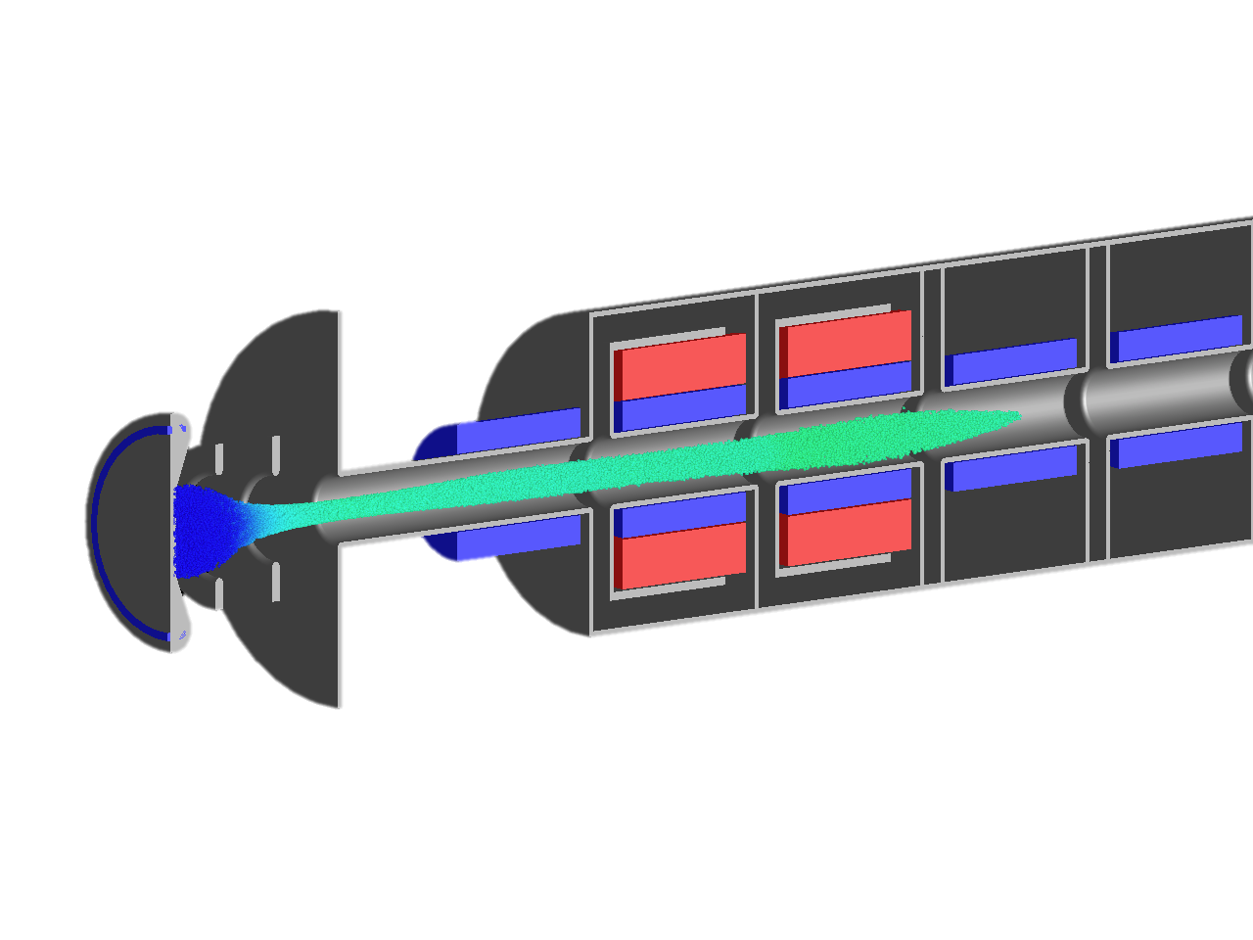
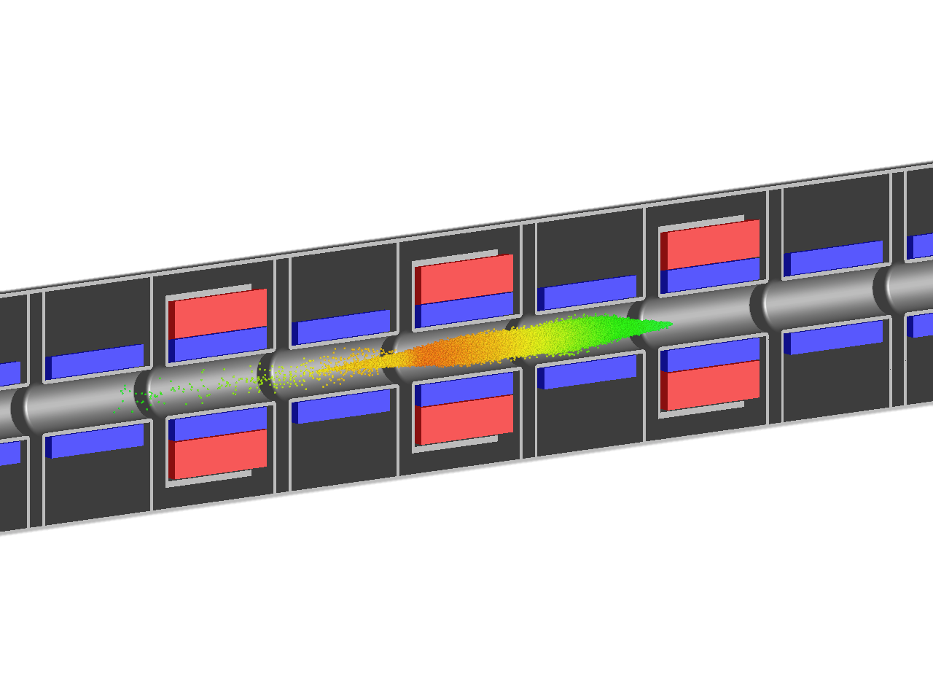
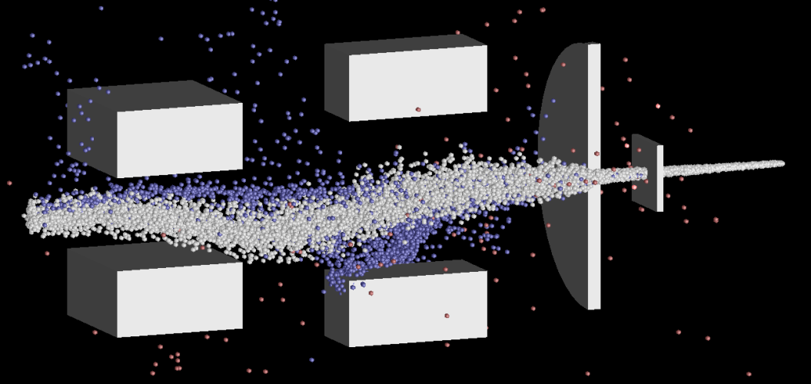
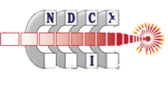
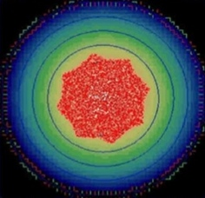
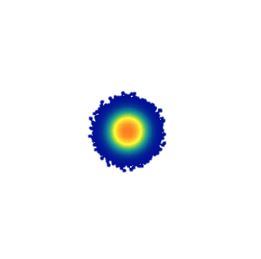
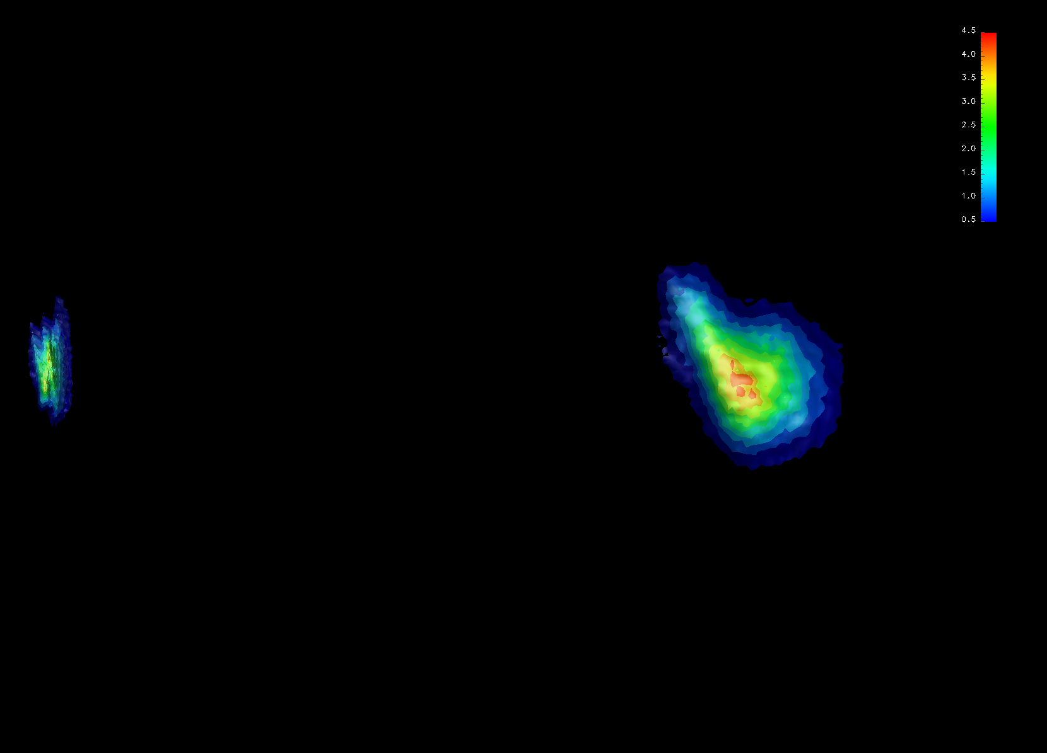
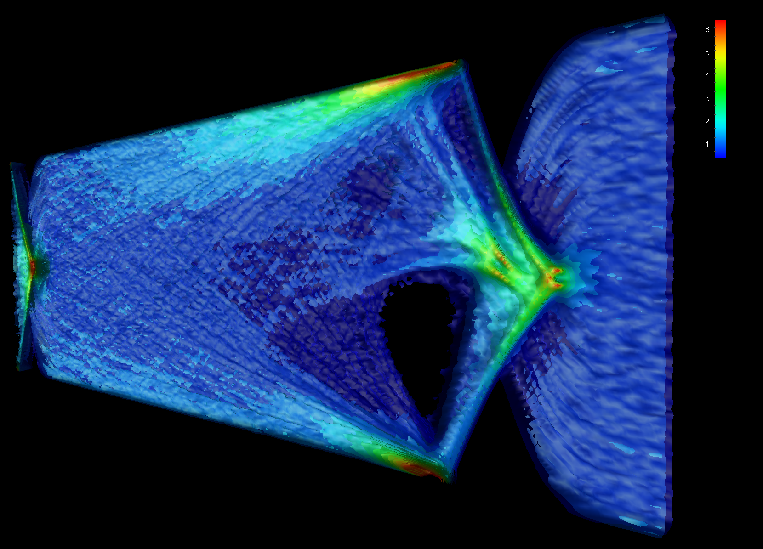
Warp is a framework for particle accelerator modeling
HIF/HEDP accelerators
Multi-charge state beams
Laser plasma acceleration
LEBT – Project X
Particle traps
Electron cloud studies
2-D slab of electrons
p+ bunches
s
Courtesy H. Sugimoto
Alpha anti-H trap
Paul trap
e- clouds
3-D beam
SPS - CERN

Slide 4
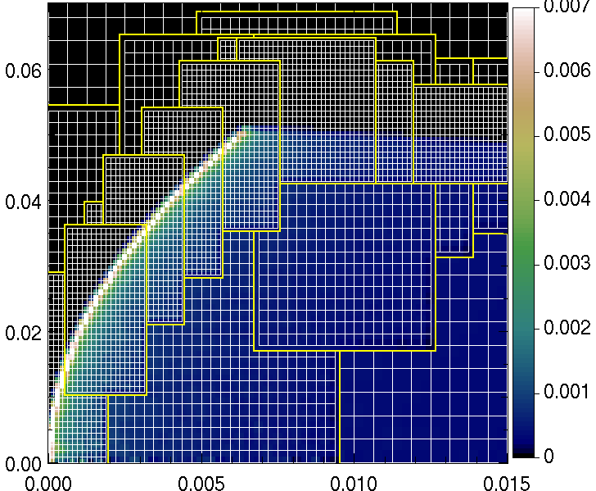
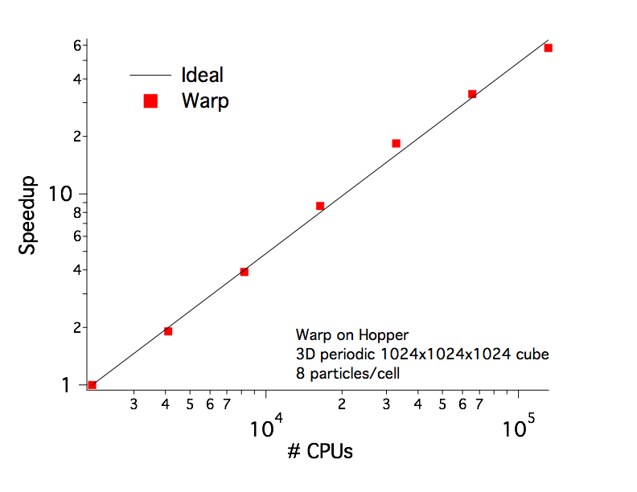
Warp: a parallel framework combining features of plasma (Particle-In-Cell) and accelerator codes
Geometry: 3D (x,y,z), 2-1/2D (x,y), (x,z) or axisym. (r,z)
Python and Fortran: “steerable,” input decks are programs
Field solvers: Electrostatic - FFT, multigrid; implicit; AMR Electromagnetic - Yee, Cole-Kark.; PML; AMR
Boundaries: “cut-cell” --- no restriction to “Legos”
Applied fields: magnets, electrodes, acceleration, user-set
Bends: “warped” coordinates; no “reference orbit”
Particle movers: Energy- or momentum-conserving; Boris, large time step “drift-Lorentz”, novel relativistic Leapfrog
Surface/volume physics: secondary e⁻ & photo-e⁻ emission, gas emission/tracking/ionization, time-dependent space-charge-limited emission
Parallel: MPI (1, 2 and 3D domain decomposition)
R (m)
Z (m)
Warp 3D EM/PIC on Hopper

Slide 5
Warp has proven useful to multiple applications
HIFS-VNL (LBNL,LLNL,PPPL): ion beams and plasmas
VENUS ion source (LBNL): beam transport
LOASIS (LBNL): LWFA in a boosted frame
FEL/CSR (LBNL): free e⁻ lasers, coherent synch. radiation
Anti H- trap (LBNL/U. Berkeley): model of anti H⁻ trap
U. Maryland: UMER sources and beam transport; teaching
Ferroelectric plasma source (Technion, U. MD): source
Fast ignition (LLNL): physics of filamentation
E-cloud for HEP (LHC, SPS, ILC, Cesr-TA, FNAL-MI): Warp-POSINST
Laser Isotope Separation (LLNL): now defunct
PLIA (CU Hong Kong): pulsed line ion accelerator
Laser driven ion source (TU Darmstadt): source
Magnetic Fusion (LLNL): oblique sheath at tokamak divertor

Slide 6
Warp reads and parses the ICOOL for001.dat input file
This avoids human errors in the translation.
Warp directly reads in the same forXXX.dat data files and ecalc9f.inp.
Warp handles all fields and manipulations, except the muon-material interaction.
For the interaction, Warp calls delta_ray and dedx from ICOOL.
All ICOOL input not supported, but only that needed for the current simulations.

Slide 7
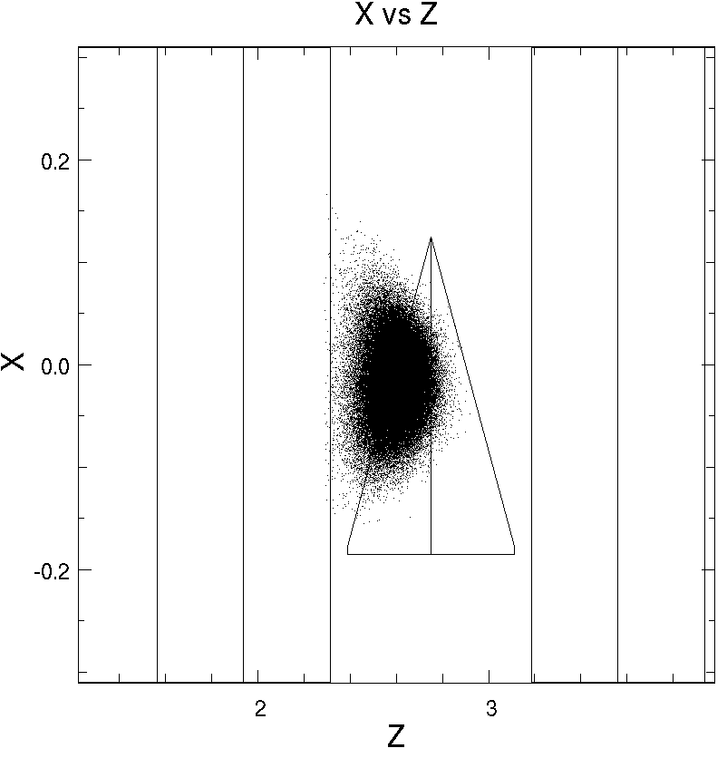
The cooling lattice in Warp
All pieces supported
RF cavities
Time dependent fields
Be windows, as absorbers and field boundary conditions
Cooling block
Wedge shaped
With windows
Solenoids
Beam, via macroparticles
Warp uses time as the independent variable
It relies on “residence corrections” for 2nd order integration across boundaries.

Slide 8
Simulations using RecFOFO lattice
Lattice from Diktys, dated July 16, 2013
16 stages
8 at 325 MHz
8 at 650 MHz
LH wedge absorbers
Tilted solenoids

Slide 9
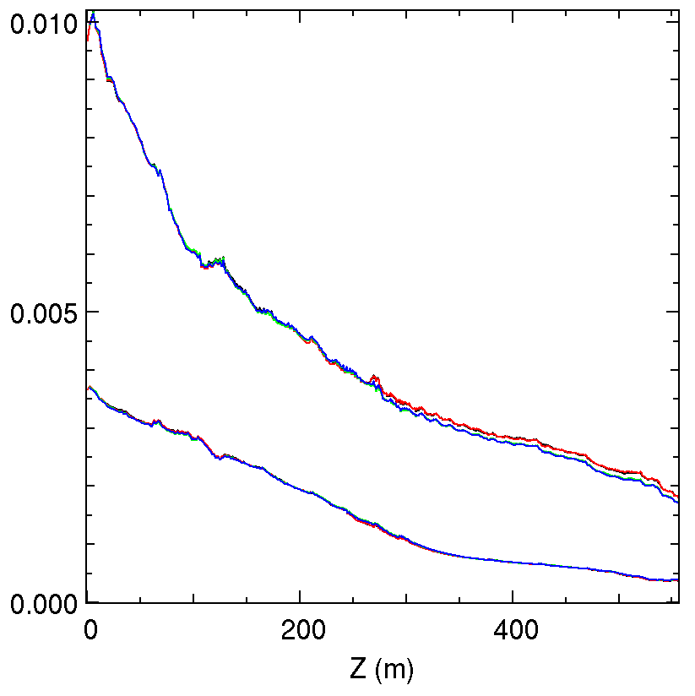
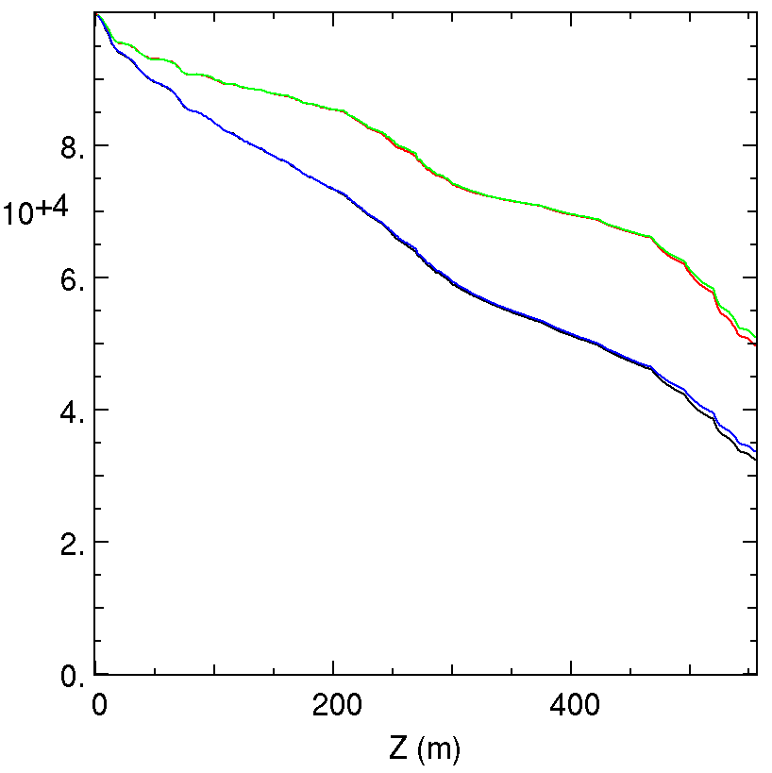
Comparison to ICOOL – no space-charge
Expect small differences
Different integrations – z versus t
Different diagnostics – Warp interpolates particles to diagnostic planes
No decay
ICOOL decay
ICOOL no decay
Warp decay
Warp no decay
ε_{long}
N₀
ε_{perp}
Decay

Slide 10
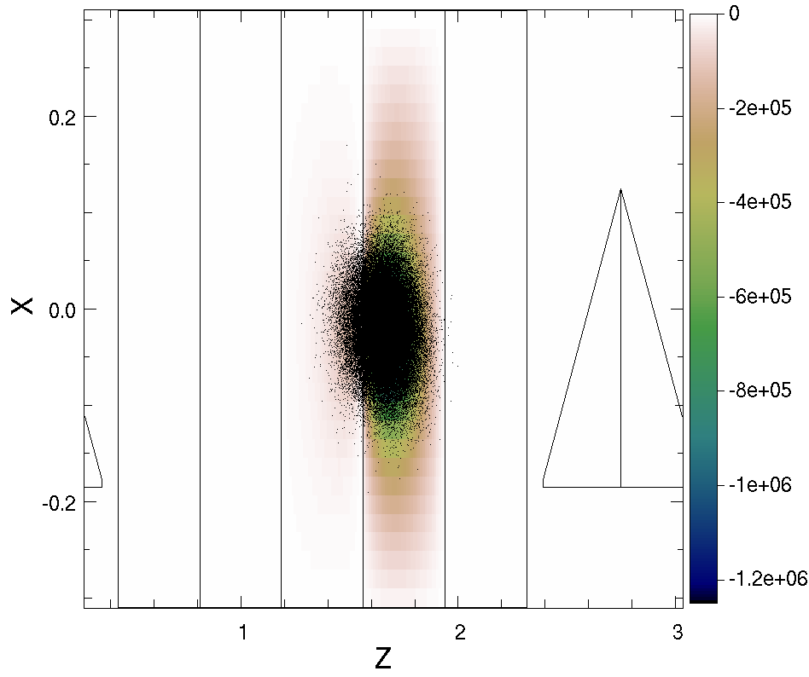
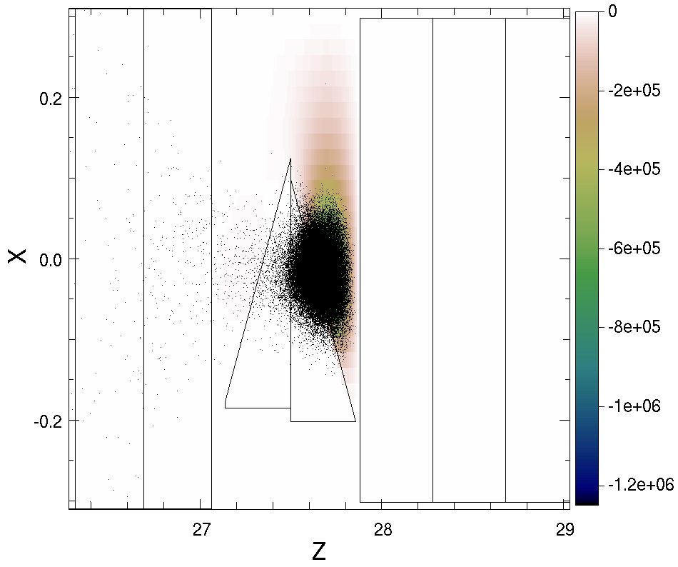
Simulations with space charge
Using electrostatics
Simulations start with 1.25x10¹³ muons
Volts
Volts

Slide 11
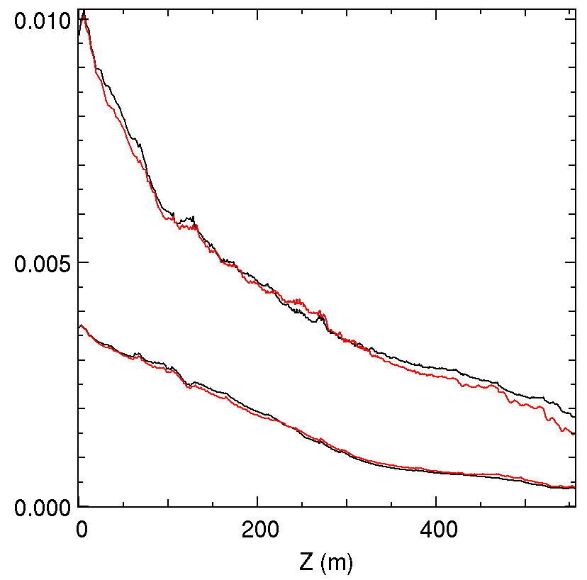
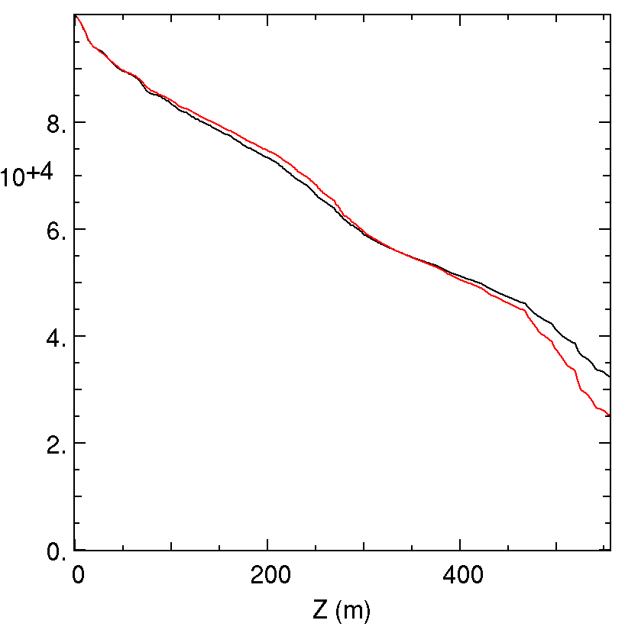
Muon cooling with space-charge
Little effect on emittance
Increase in loss – out the bunch ends.
ICOOL (no space-charge)
Warp (space-charge)
ε_{long}
N₀
ε_{perp}

Slide 12
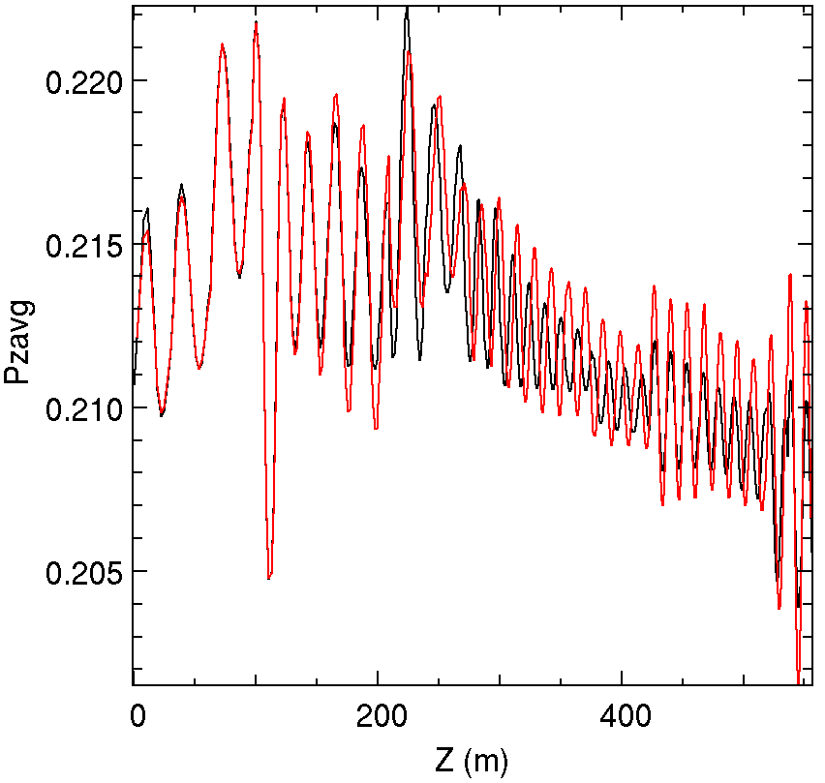
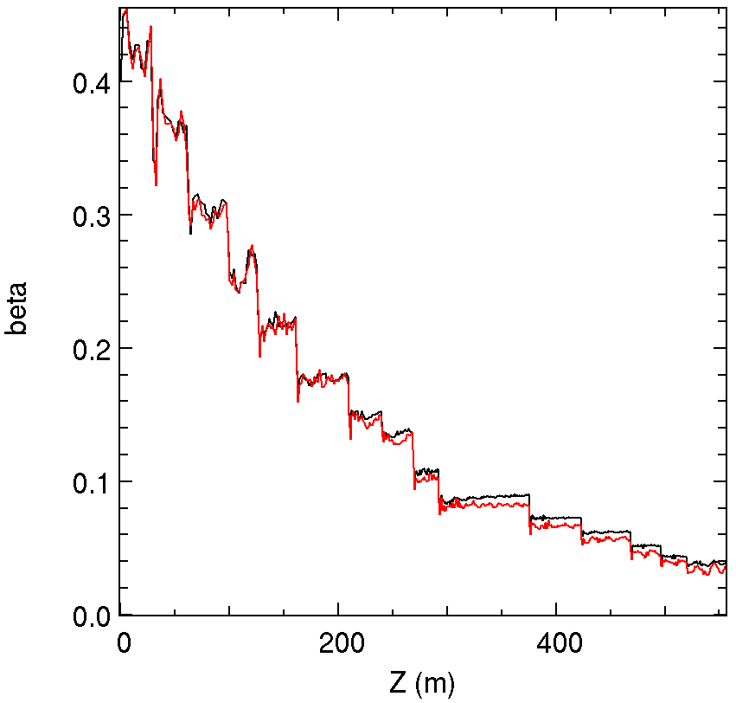
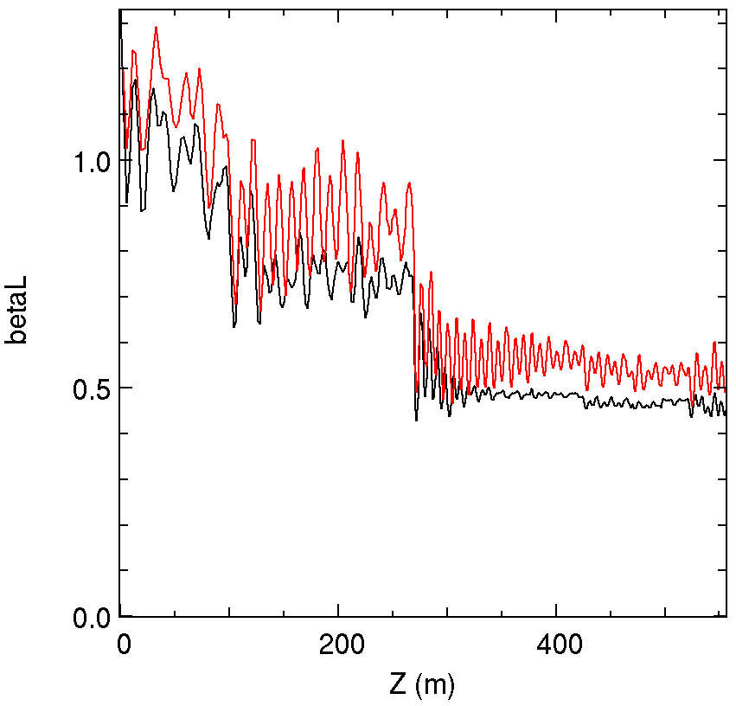
More diagnostics with space charge
ICOOL (no space-charge)
Warp (space-charge)

Slide 13
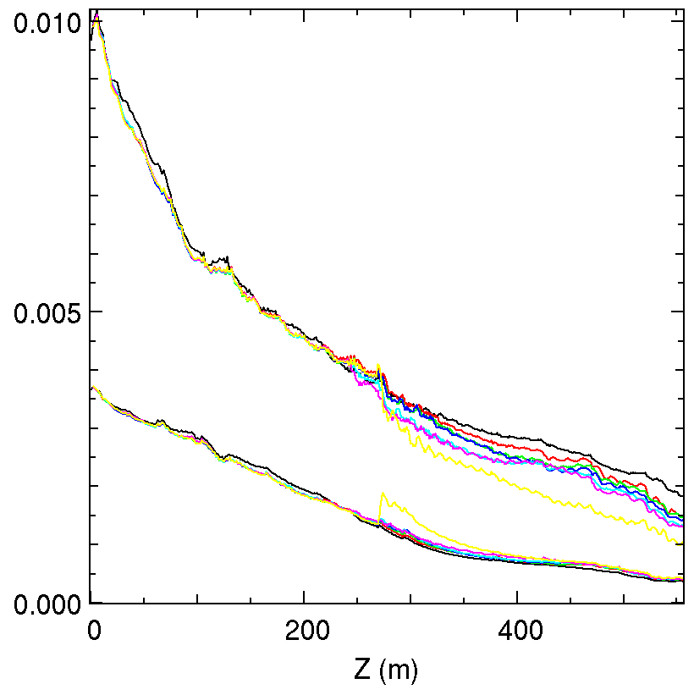
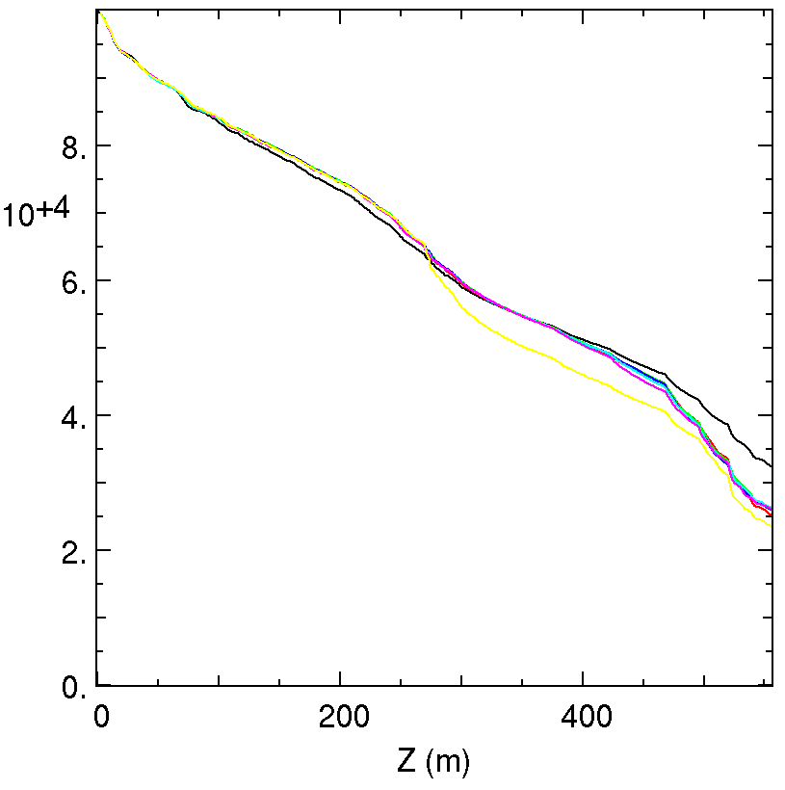
Effect of increased RF gradient – an easy knob to turn
Previous simulations showed (RZ) reduced particle loss.
Here, however, little effect is seen on N₀.
ICOOL
Warp:
+0 kV
+1.5 kV
+3.0 kV
+6.0 kV
+7.5 kV
+20. kV
ε_{long}
N₀
ε_{perp}

Slide 14
Conclusions
Warp is setup to simulate muon cooling.
Good agreement found with ICOOL (without space-charge).
For the RecFOFO design, the effect of space-charge is small – but increasing particle loss.
Hopefully, Warp can continue to be useful for the MAP project – unfortunately it looks like there may be no funds available in FY14.

