Slide 1
Muon Department Meeting
September12, 2013

Slide 2
Agenda
Announcements
New Electronic Logbook
Bend bus LOTO for controlled access
M4 Shield wall calculations
M5 Shield wall concept

Slide 3
Announcements
g-2 Review next week
Perfromance Review – sign up for a time slot

Slide 5
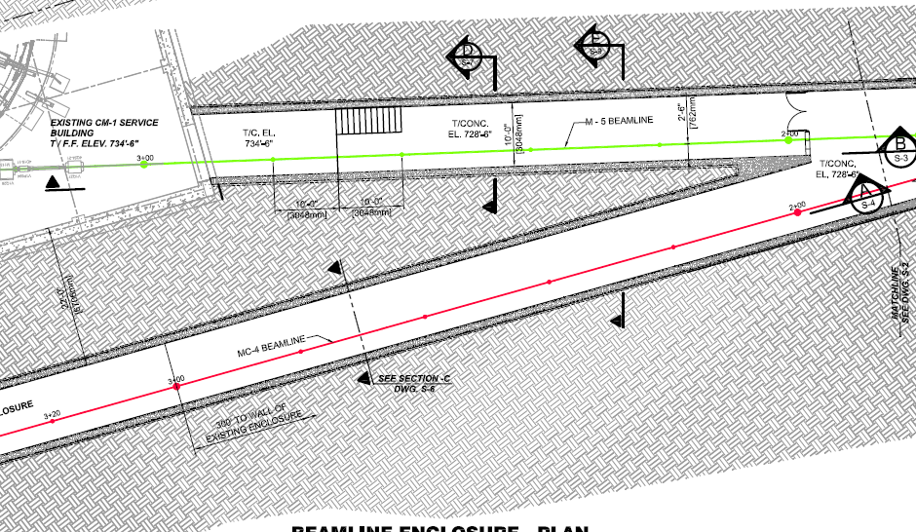
Jim Morgan’s M4 shield wall concept
Block
Wall
~50’
Q018
~37’
Q019
Q022
Q021
Q020
Q026
Q025
Q024
Q023

