Slide 1
M4 shield wall MARS simulation
September 12, 2013

Slide 2
Design considerations
Lattice
Collimation system sets US limit of bend magnet position
Image point sets US limit of shield wall
Instrumentation and down bend set limit of DS end of shield wall
My perspective (not a bad thing!)
A little like looking through a keyhole
impossible to see the big picture
Design is very constrained by distances defined in the sketch
Model is exactly as defined by the sketch

Slide 3
One of two sketches provided by Jim Morgan

Slide 4
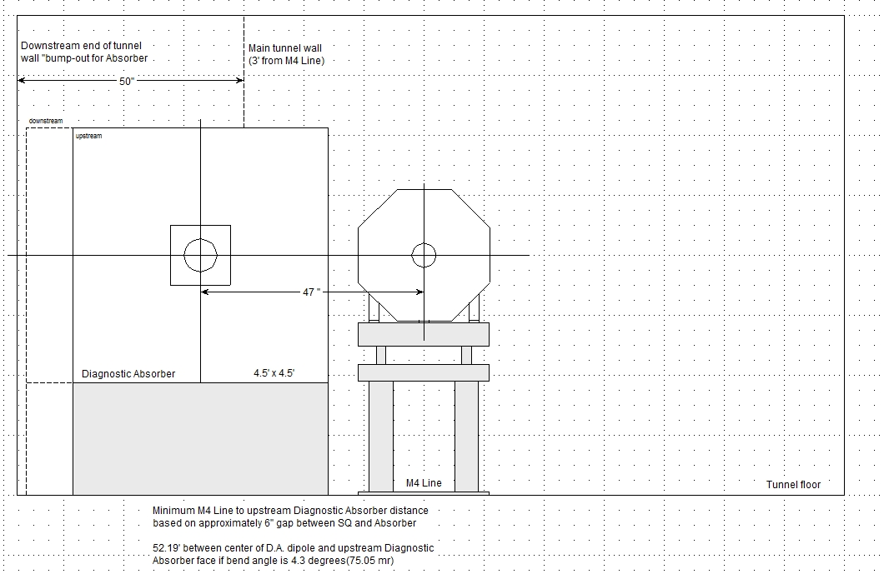
4.3 degree bend has end of dump
shining down the tunnel
This won’t do for 170 watt beam
Negotiated with Jim to get dump
totally within the bump
Requires a 5 ° bend
Sketch provided by Jim Morgan

Slide 5
Design considerations
Several bend angles discussed:
4.3 °
4.5837 °
5 °
5 ° is modeled in this work
To avoid end of dump within the M4 tunnel
Same dimensions as those on slide 2 are used in the model
Shield wall has to be sufficient for normal condition – 170 watts to diagnostic absorber
TLM would limit the accident condition to 138 watts
Is this an adequate limit for the accident condition?
Does TLM preclude normal operation due to beam lost in the abort?

Slide 6
Other considerations
Avoid penetrations through shield wall
Make bypass around shield wall wide as possible to accommodate cable trays
How many do we really need?
5 feet wide was modeled in this work
LCW through wall should be OK
TLM positioned at the ceiling centerline of tunnel

Slide 7
Model assumptions summary
12 foot thick shield wall
5 foot wide bypass labrinth
5 ° bend
MDC rotated 1.125° to optimize aperture
4”beam tube outside of magnet apertures
Beam dump from mu2e-doc-3308-v1
170 watts normal beam power with clean transmission
7 SQA magnets in the model, but no B field
MDC field for clean transmission to dump -1.69 Tesla

Slide 8
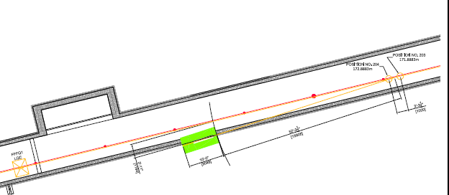
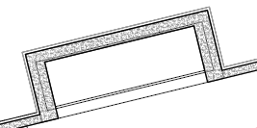
Jim’s model rotated 180°

Slide 9
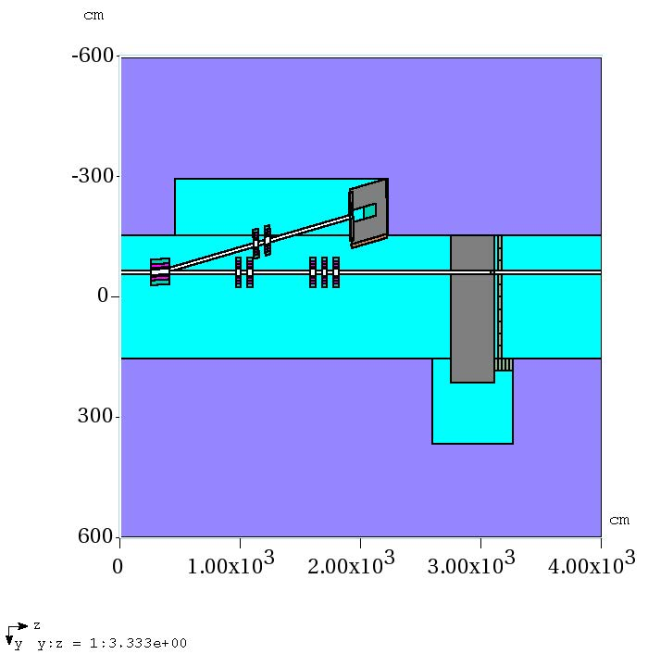
Model plan view

Slide 10
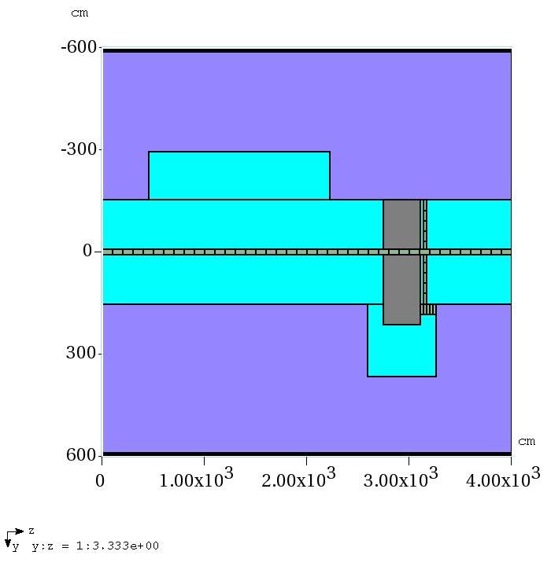
TLM located at ceiling

Slide 11
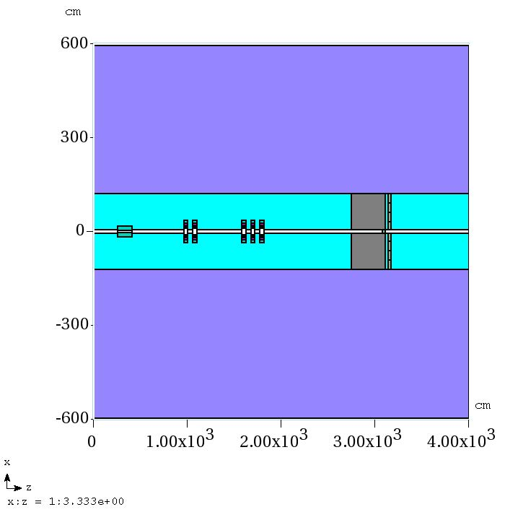
Main line elevation view

Slide 12
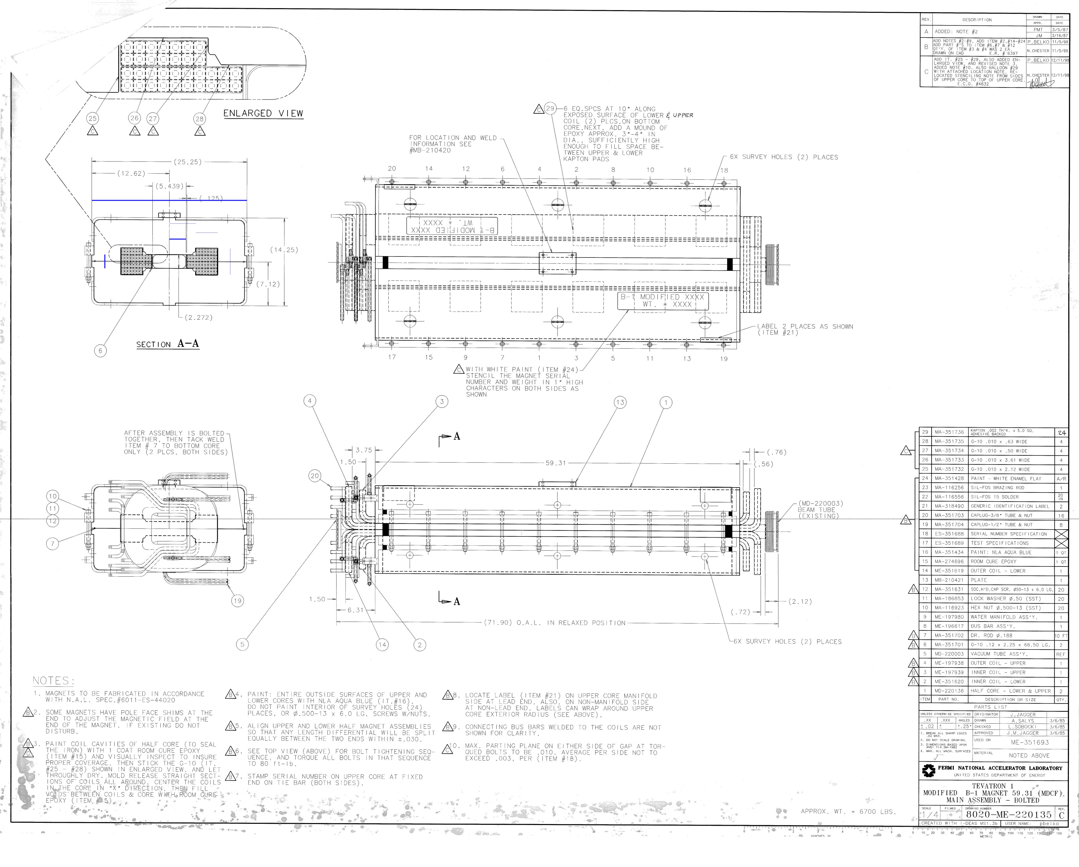
Tech division drawing of MDC

Slide 13
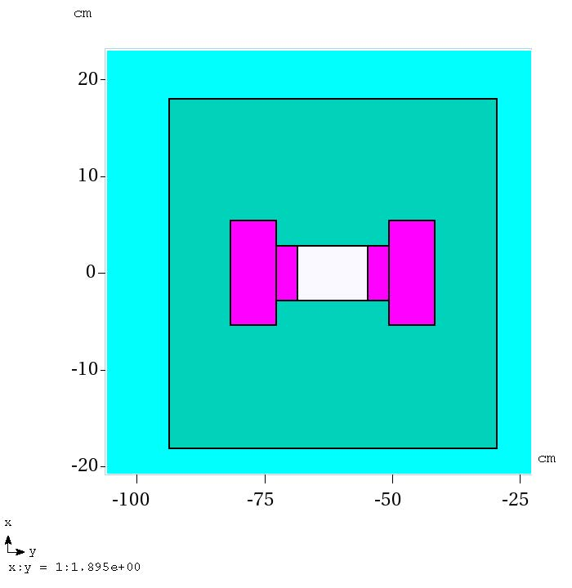
MARS model of MDC

Slide 14
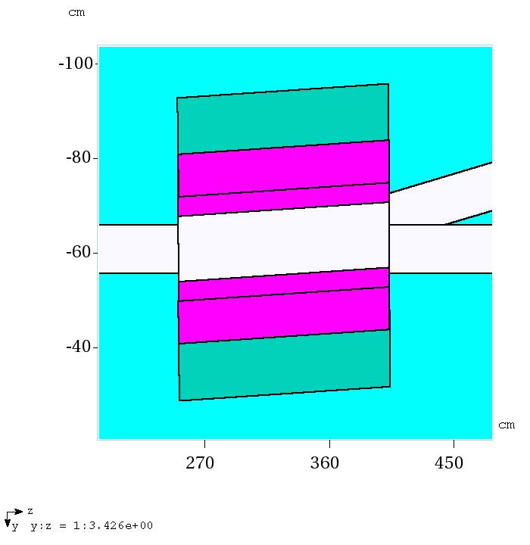
MDC plan view
Magnet rotated 1.125° by eye
to optimize aperture

Slide 15
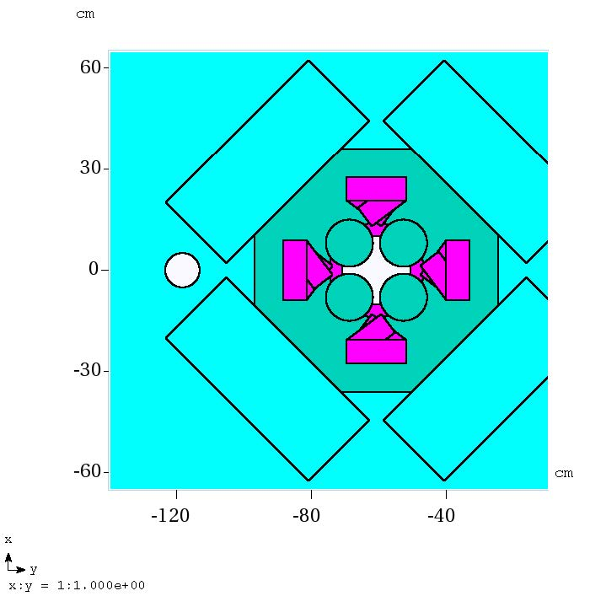
SQA elevation view

Slide 16
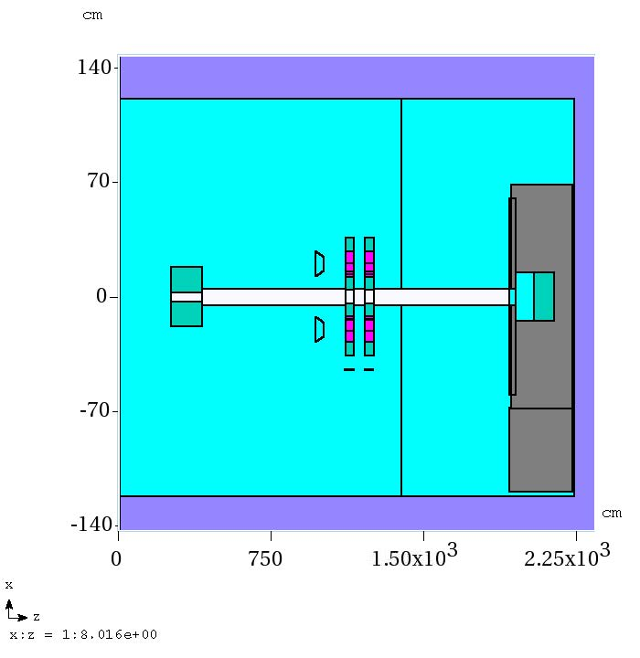
Dump line elevation view

Slide 17
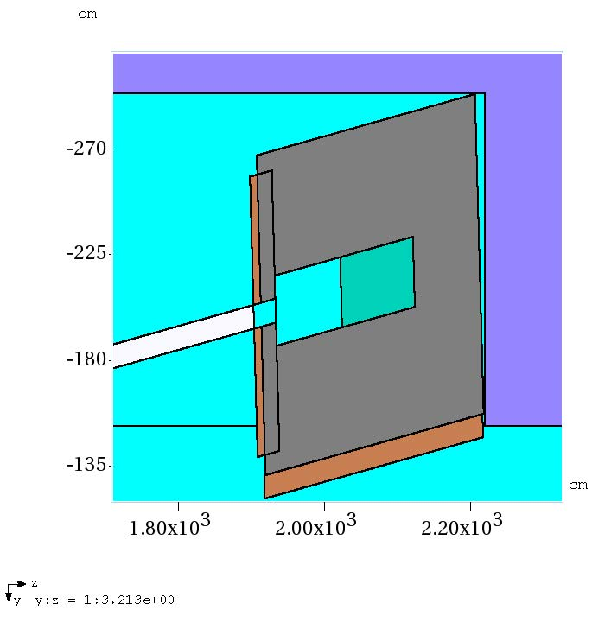
Dump plan view

Slide 18
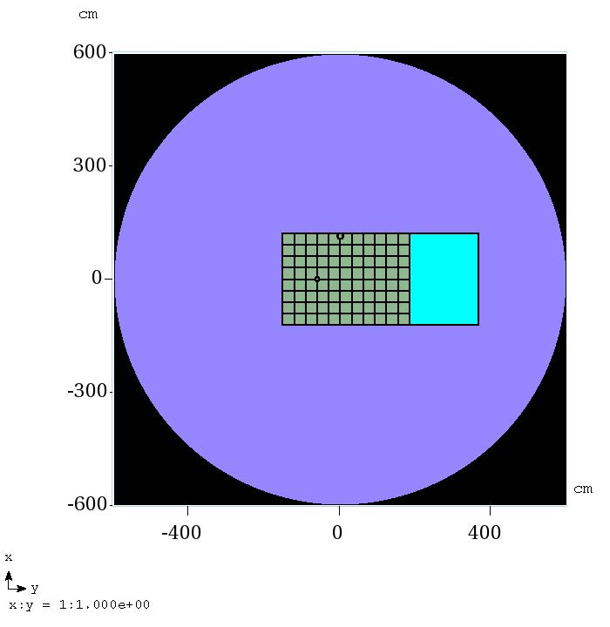
Tissue detector DS of shield wall
4” beam pipe
TLM

Slide 19
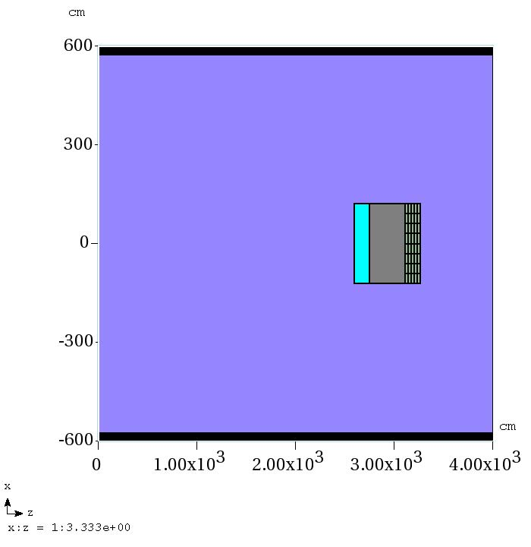
Elevation view of labyrinth detector wall

Slide 20
4 issues evaluated to date
The TLM response to nominal 170 watt beam steered cleanly to the dump (simple run)
Efficacy of labyrinth (2 stage MARS run)
Efficacy of shield wall (2 stage MARS run)
TLM response to 138 watt beam loss on MDC magnet (simple run)

Slide 21
Problem #1 – TLM response normal operation; 170 watts to dump
Just get TLM response
TLM divided into 40 one meter lengths
Total response of 40 detector lengths
Also look at hadron flux pattern

Slide 22
Problem #1 – TLM response

Slide 23
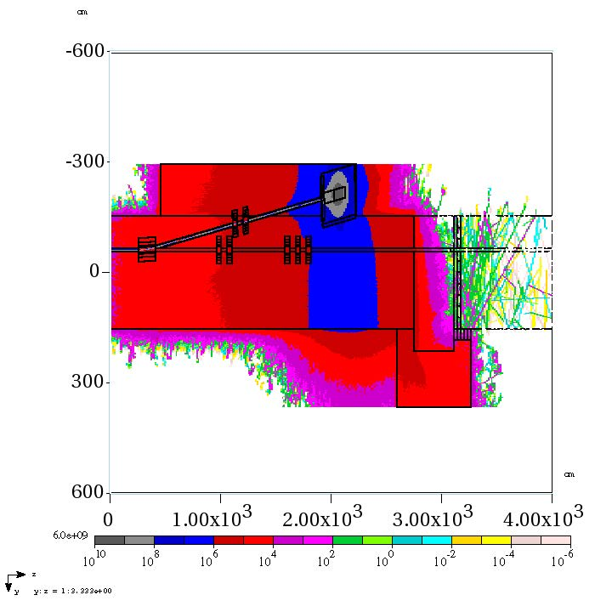
Problem #1
Moving the dump too close to the shield wall
would put the plume right into the labyrinth

Slide 24
Problem #2 – Efficacy of labyrinth
Requires 2 MARS runs
Run 1
set up a surface to collect particles
Use 1E-12 MeV low energy cutoff for neutrons
Run 2
File of particles begin at surface and are transported/interact through the labyrinth
Tissue equivalent detector at end of labyrinth used to measure effective dose rate
Results normalized to 170 watts and reported in mrem/hr

Slide 25
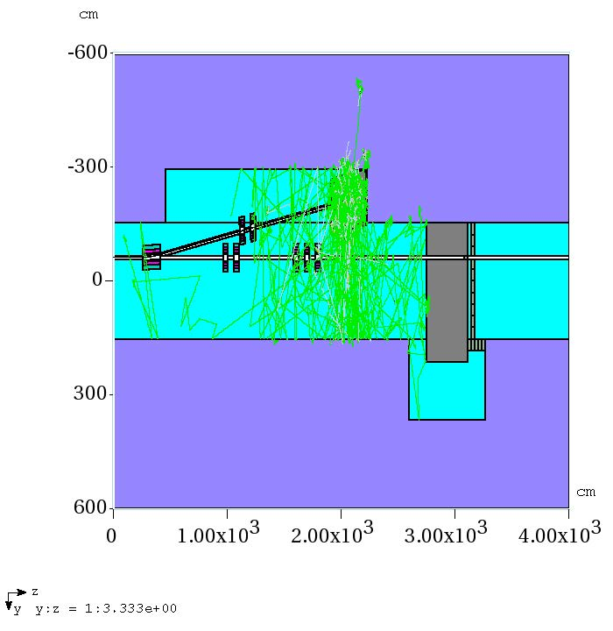
Problem #2 – particle file
produced in run 1
Particles collected
at this surface

Slide 26
Particle tracks for Run 2

Slide 27
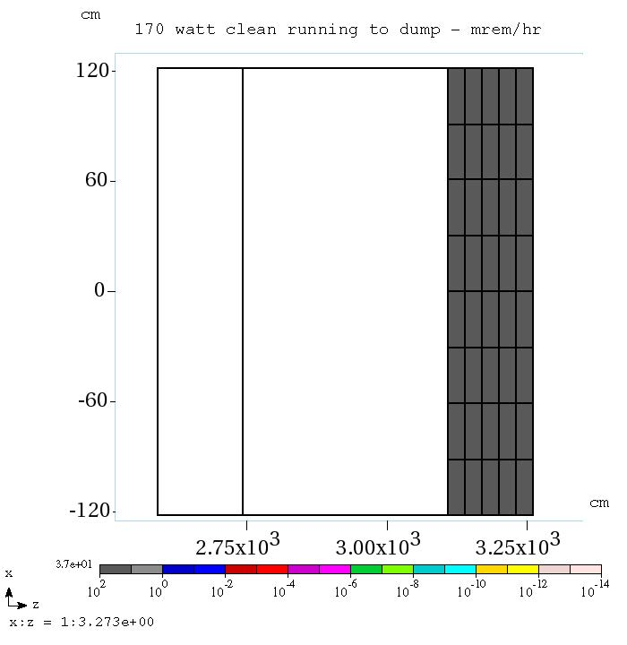
Total (DET) – 37 mrem/hr Neutron (DEN) – 30 mrem/hr Gamma (DEG) – 1.2 mrem/hr Muon (DEM) – 0.2 mrem/hr
These rates are too high to
permit access DS of shield wall
Problem #2

Slide 28
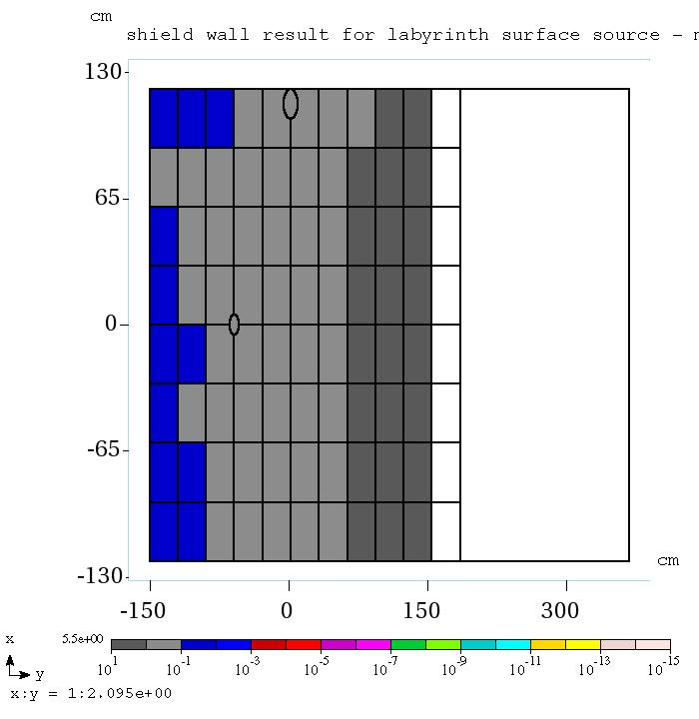

Slide 29
Problem #3 – efficacy of shield wall
Requires 2 MARS runs
Run 1
set up a surface to collect particles
Turn off 1E-12 MeV low energy cutoff for neutrons
(Low energy neutrons won’t make it through the shield)
Run 2
File of particles begin at shield wall surface and are transported/interact through the shield wall
Tissue equivalent detector DS of shield wall used to measure effective dose rate
Results normalized to 170 watts and reported in mrem/hr

Slide 30
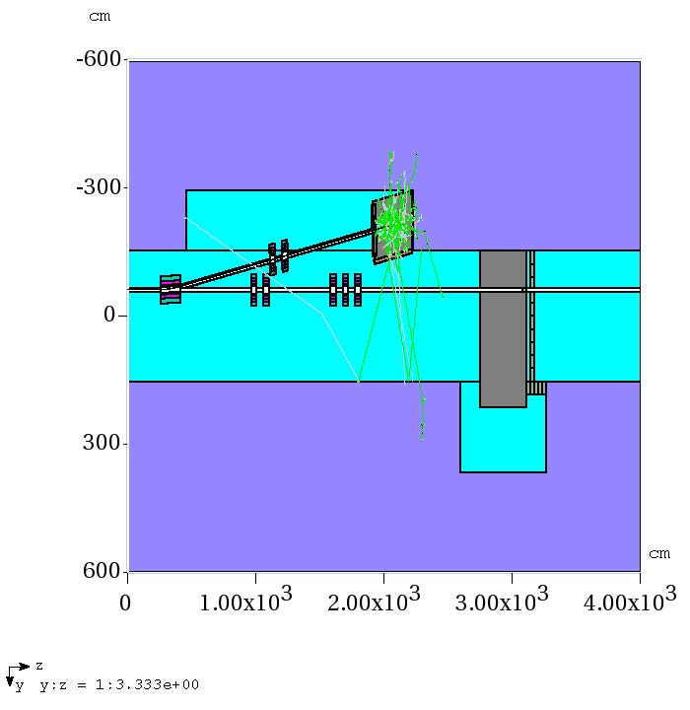
Problem #3
Particles collected
at this surface

Slide 31
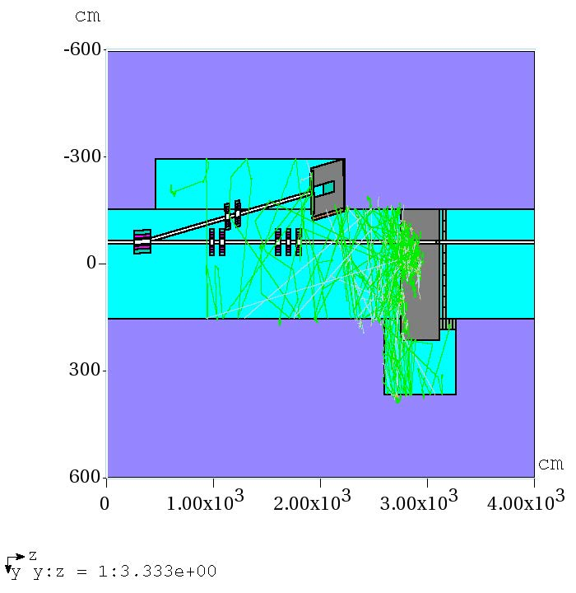
Particle tracks for Run 3

Slide 32
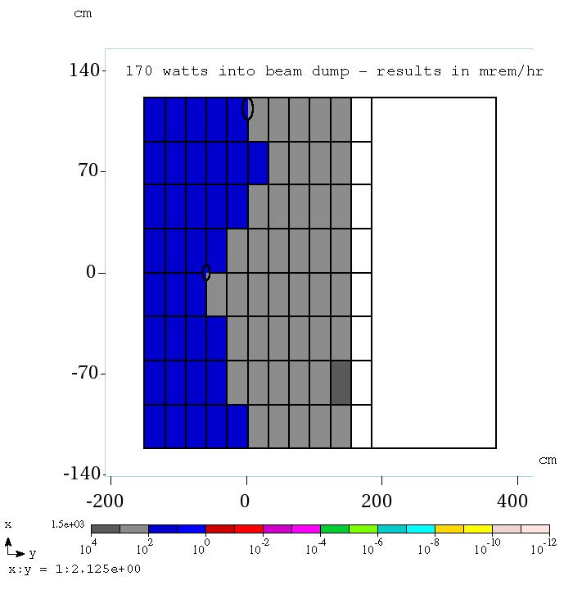
Few hundred mrem/hr
Too high to permit access DS
of shield wall

Slide 33
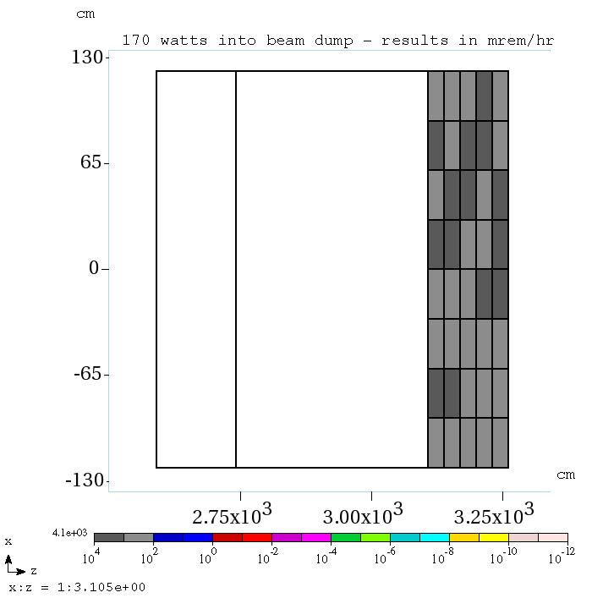
Peak rate at labyrinth exit

Slide 34
Problem #4 – TLM response to 138 watt beam loss
Move beam 5 cm left in model
Keep MCD magnetic field
Get TLM response to 138 watt beam loss – max permitted loss for the region
Compare result with problem #1
Determine if TLM allows normal operation to diagnostic absorber

Slide 35
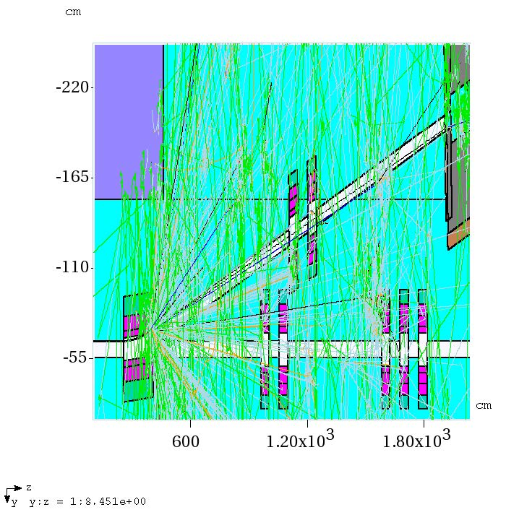
Problem #4 particle tracks

Slide 36
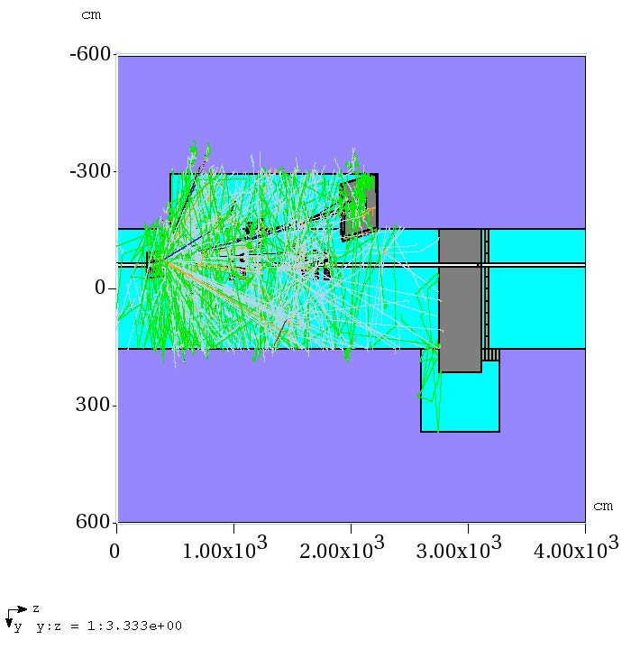
Problem #4 particle tracks

Slide 37
TLM response for Normal
operation is 3% of trip level - OK

Slide 38
Conclusions
TLM trip level permits 170 watt beam operation to diagnostic dump
Labyrinth is insufficient for 170 watt operation
Shield wall may be insufficient for 170 watt operation
Leakage through labyrinth confuses the shield wall efficacy question

Slide 39
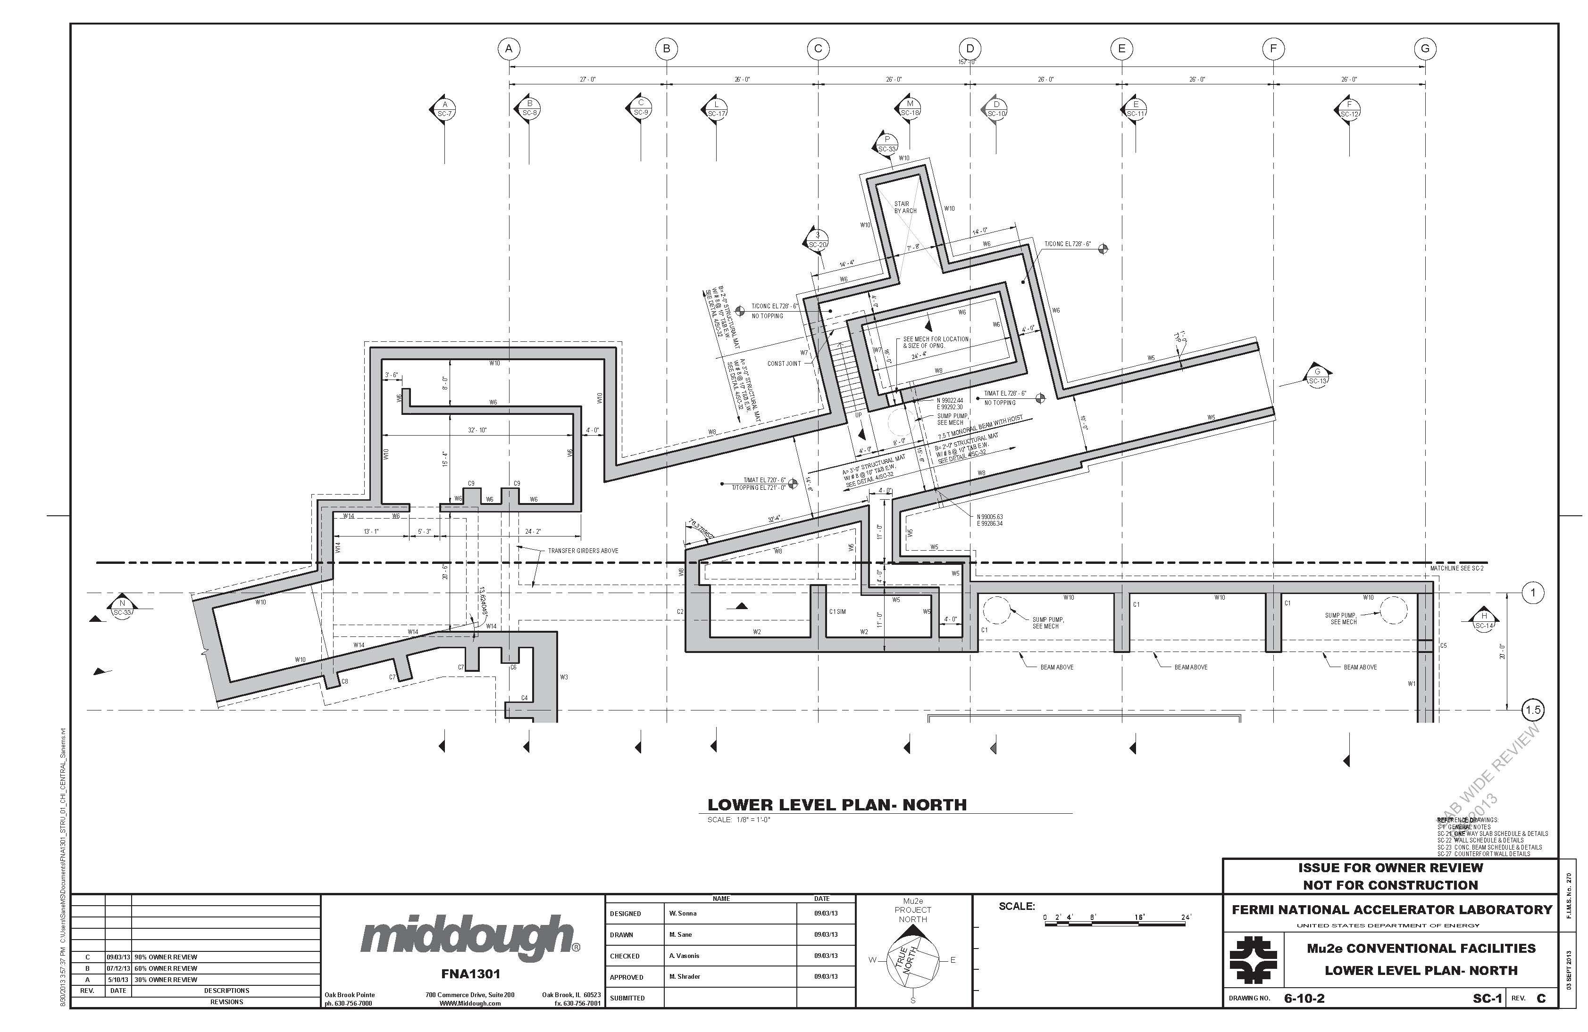

Slide 40
