Slide 1
Software-Defined Networking
Workshop: Motivations and preliminary findings
Inder Monga
Chief Technologist and Area Lead, ESnet
ESCC Meeting
February 26th, 2014

Slide 2
SDN in a nutshell…
…but operational networking is more
than the nutshell
Tools
Customer Apps
Software
processes
Vendor App 1
Vendor App n
troubleshooting
SDN Controller
people
Fault diagnosis
Switch
Router
Optical Transport

Slide 3

The ‘SDN operational gap’
Identify gaps and propose approaches
+ GENI
+ CCNIE
+ ASCR
+ DARPA
+ Academia
+ Vendors
+__________________?
Notes:
What is the missing gap? What will make these networks secure, and manageable? What is the ping equivalent of SDN? Or in this programmatic world, is that a different tool – ndb?

Slide 4

Workshop to focus on the gaps
Notes:
In the end, the push for this workshop came from the OSTP – the workshop goals and objectives that are captured in the document in front of you. I started my career programming routers in Wellfleet communications – I am sure very few people have heard of that company. But in the last 23 years from gopher to social media, pine to html-based email, billion dollar facebook and twitter IPOs, a lot of value has been created by the internet. We are at a unique stage, with new technology, that has in the past few years proven the potential to be helpful and disruptive.
This program review is to identify the gap to take SDN-based networks to the next level, to enable an engine of innovation, that when we look back, will have created equal or more value to the community at large. This is an important responsibility in your hands….How do we do that from the workshop today?

Slide 5
Three Goals
Bridge the ‘operational’ gap
    architecture, tools and policies
Deploy and operate securely multi-layer, multi-domain SDN networks
    Interwork with the current set of Internet technologies
Identify research, development and technologies needed to support new, innovative users and applications
Notes:
If I summarize the goals in different words – we need to bridge the ‘operational’ gap that we see facing SDN networks today. I see network engineers cringing at some of the techniques considered acceptable. The market has moved, from reactive flows to proactive flows, at least the majority. But there are still a lot of management gaps that make these networks operable. Some of that requires new tools, skills – architecture and planning changes, and what about policies – cannot have the same firewall policies as before.
In order to move the state of technology forward, it is important to supplement the research and innovative thinking with running networks (and running code). These networks do not have to be isolation as are many of the testbeds today – but need to be connected to the general purpose internet, and be carrying the same browser packets that the regular networks carry. I see some of you shaking your heads, well if you think that is fantasy, then pointing out a gap, and laying that challenge in front of the so many smart people in front of me today is the right thing to do. It is not possible today, hence the need for a concerted effort to bridge that gap and address security.
And in addition to that, the focus is on the users and applications – since a network that serves no users or applications, is similar to the tree that fell in the forest when no one was listening.

Slide 6
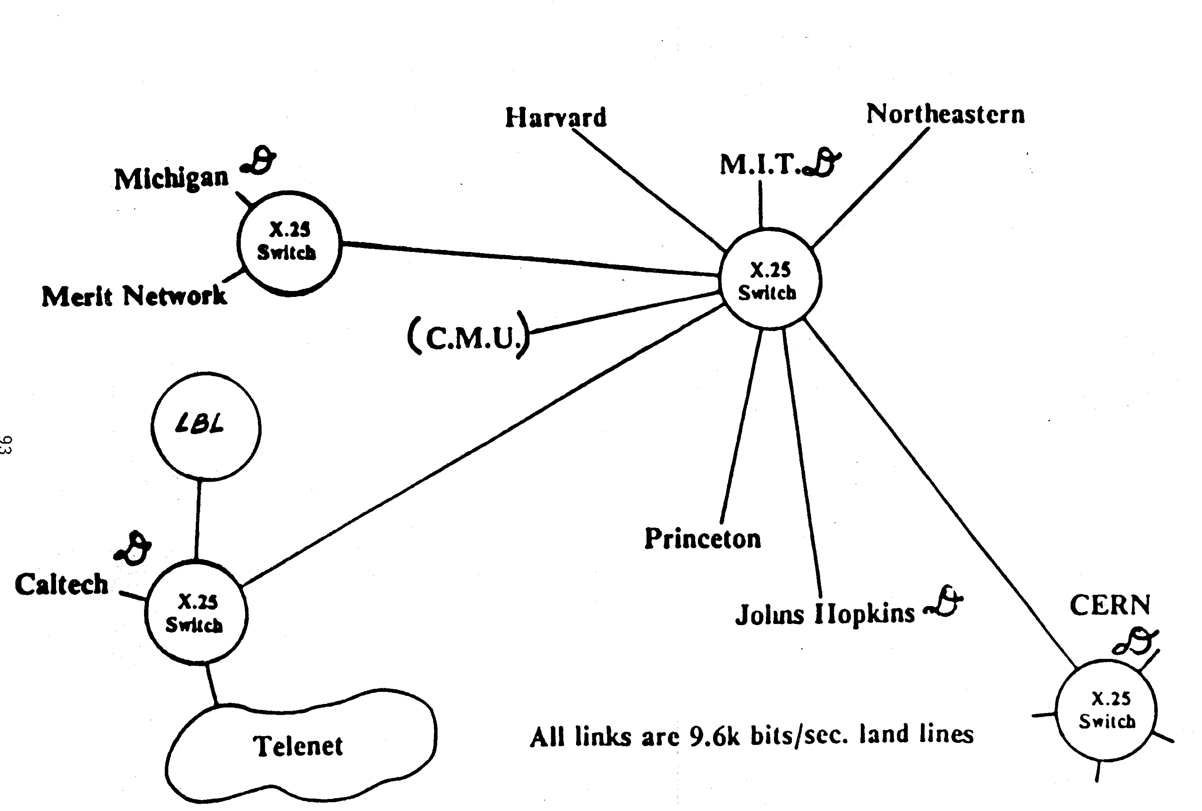
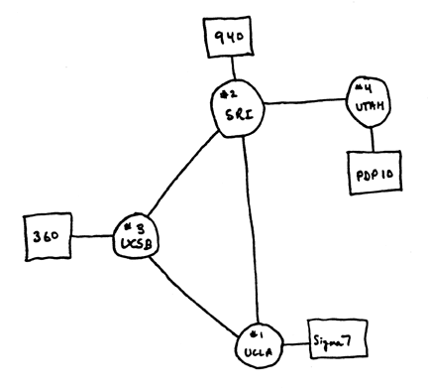
It is about running networks
(not just about network research)
Develop, deploy and (inter)operate
a prototype multi-domain SDN network
ARPAnet, 1969
HEPnet, 1986
http://www.computerhistory.org/internet_history/full_size_images/1969_4-node_map.gif
Future of intersite networking, LBL, 1986

Slide 7
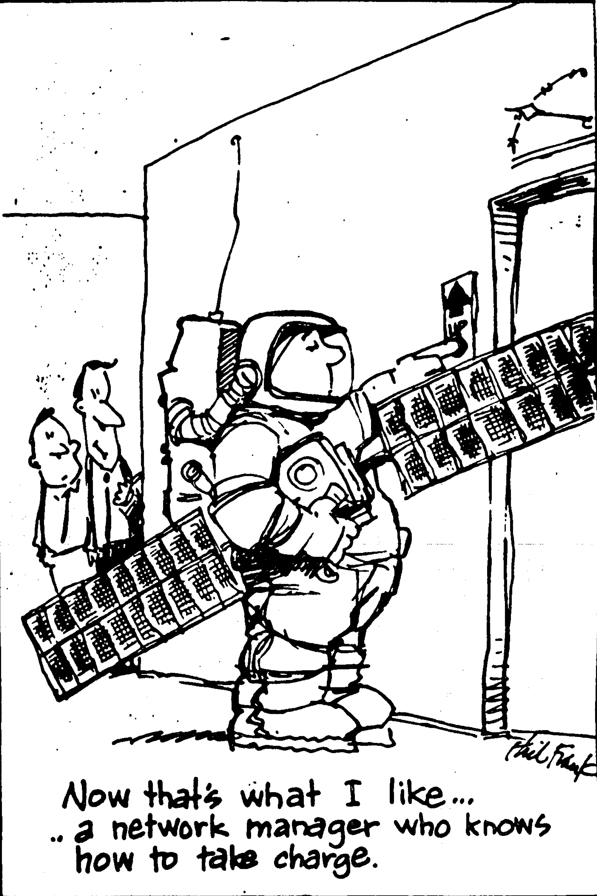
What does that help achieve?
Build an ecosystem of security-savvy, operational SDN experts with government and academic networks leading the way
Rapid prototypes with open-source tools, engage the open-source community
Share experiences, build knowledge
Engage operational knowledge with academia, open-source enthusiasts and industry at a larger scale

Slide 8



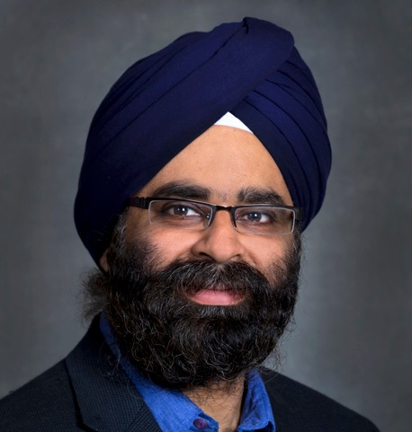





Workshop Organizers
Sponsors
Grant Miller
Vince Dattoria
Bryan Lyles
Workshop PI
Organizing Committee
Inder Monga
Chip Elliott
Ron Hutchins
Roy Campbell
Eric Boyd
Bill Snow
Steering Committee
Vince Dattoria (DOE), Bryan Lyles (NSF), Robert Bonneau (AFRL), Matthew Goodman (DARPA), Kevin Thompson (NSF), Bob Walter (DARPA)
NSF PIs
Joe Evans and Sean Peisert
Notes:
Before we start the workshop, I would like to thank the people who championed this workshop and made it happen, through their sponsorship. Grant Miller from NITRD, Vince Dattoria, program manager ESnet from DOE, and Bryan Lyles, program manager NSF. In addition, I had a lot of logistical support from Keri Cagle from OARU, and Angela Carter from NITRD – without them you wouldn’t be enjoying a seamless registration experience.
A lot of effort was put in by the organizing committee, Chip Ellitt, Ron Hutchins, Roy campbell, eric boyd and Bill Snow. In addition, we had a ‘problem-removal committee’ the steering group from LSN and NSF Pis who are going to work to disburse the payments for travel to academics. Please see me if you are unaware of that and/or want funding.

Slide 9
Workshop Structure
Keynotes - https://www.orau.gov/sdnpr2013/
Breakout groups
  Brainstorming
  Three broad areas
    Users and Applications (UAM)
    Technology and Operational Deployment (TOD)
    Security
Readouts and Discussion
Workshop Report (in progress)
Notes:
Keynotes – will provide you a sampling of the various perspectives, Breakout groups – here is your opportunity to speak up and share ideas, point missing gaps, Readouts and discussion amongst the larger team, and then a workshop report to ensure that we do not contain your insights and knowledge just within the four walls of this room. Before we start on them, let me share with you my perspective and then hopefully you will be able to listen to the keynotes with those lenses.

Slide 10
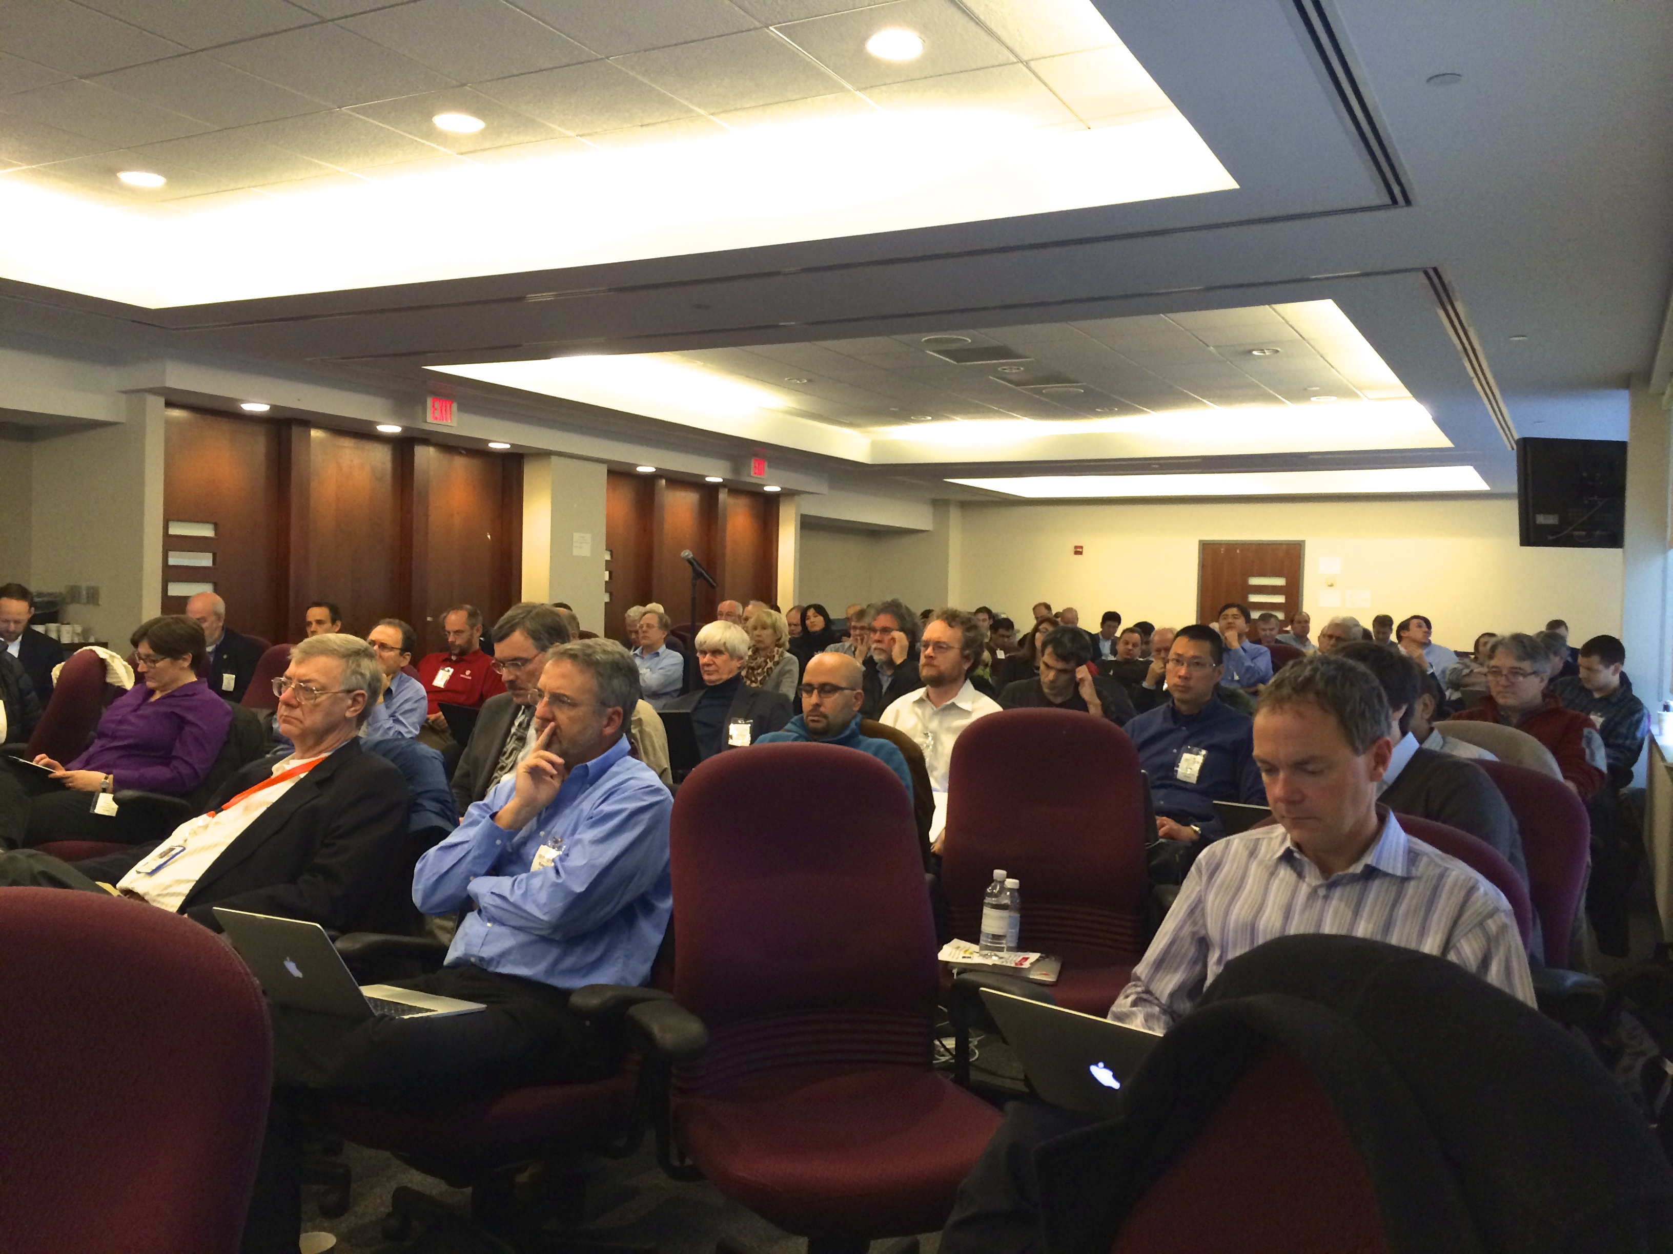
Workshop Attendance
Dec 17-18, 2013

Slide 11
Observations and gaps (only a subset)
Time is right for prototyping operational, multi-domain SDNs
  Connect up testbeds and operational networks
  Build the SBone, the ARPAnet, ….with new technologies
Multi-domain SDN deployment is key

Slide 12
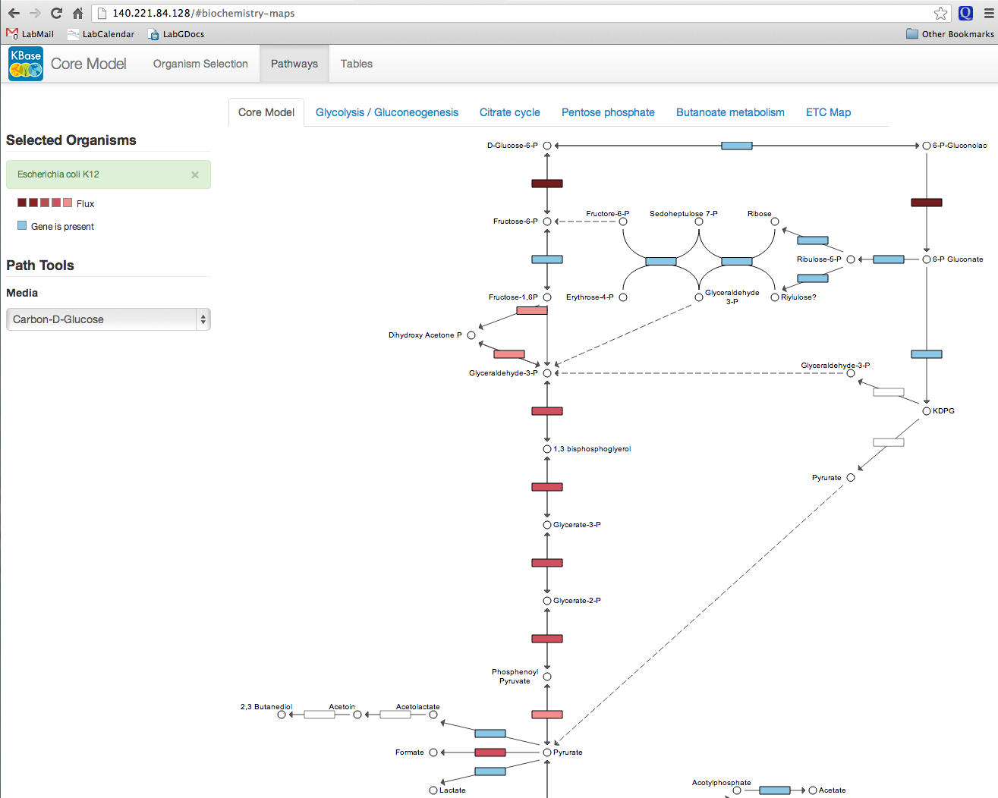

Observations and gaps contd.
Software-Defined Networking should transition to Software-Defined ‘Instrument’ (SDI)
  Include compute, storage along with network
  Break the networking black box

Slide 13
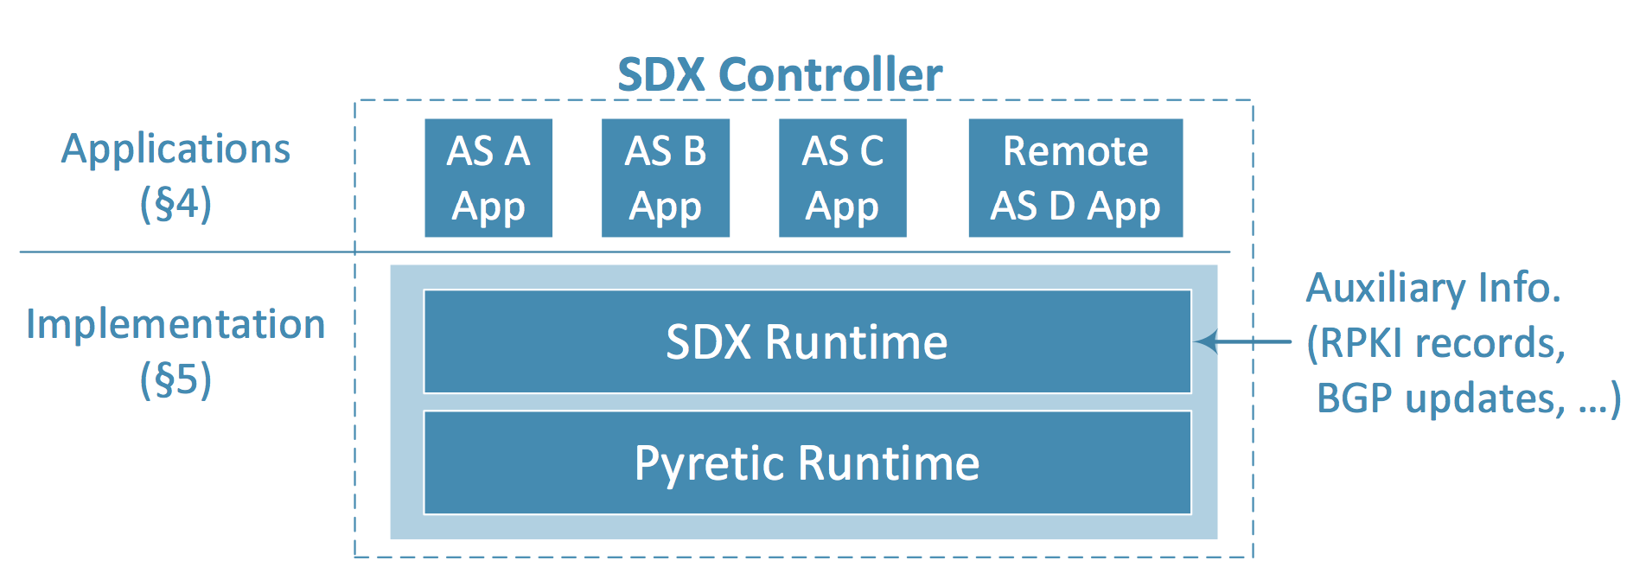
Observations and gaps contd.
Build multiple, community supported Software-Defined eXchanges (SDX)
Tackling exchanging IP data is table-stakes for a larger deployment
Collaboration with Josh Bailey, Google
Nick Feamster, Georgial Tech

Slide 14

Observations and gaps contd.
Open the SDN app-store
  Leveraging applications within a community will benefit all
  Support both ‘open’ and ‘closed’ source
Will require a set of standard APIs

Slide 15
Observations and gaps contd.
Community focus needed to bridge network management and service manageability gap
  no common debugging statistics?
  What are the ‘ping’ and ‘traceroute’ equivalents for SDN?
    Simple tools to debug connectivity, and when it does not work.
  Need a northbound API for debugging, not just for applications
    Query network state
    Interoperable across vendors and controllers

Slide 16
Observations and gaps contd.
Community best practices for building SDN networks
  Architecture for the control plane, sizing the control plane etc.
Network Bootstrapping
Education (Unlearning and learning)

Slide 17
Observations and gaps contd.
Profiles for various applications, so vendors/software developers can build to these profiles (supports the app-store idea)
  Don’t know how to make that happen, but a strong desire to have since SDN means so many things
Managing underlays and overlays – network virtualization
  Techniques not well understood, research topic

Slide 18
Security
Still a nascent topic, lots of definitions and discussions
Uses of SDN for Security
  Secure updates for applications
  Flexible intrusion detection
  Flexible Reaction/Provisioning
Making SDN secure
  Trust Model
  Correlation of complex network issues
  Policies (AAA, resource management, admission control etc.)
  Consistency model (valid vs invalid network state)

Slide 20
My inspiration and recommendation:
Draw upon principles of ‘Maker Movement’ when thinking about SDN
– this could be ‘our’ DIY project!
If it can be imagined, it can be made.
The first step in making a thing, even a non-physical thing, is visualizing it.
A most effective step in refining/developing a thing is collaborating with others on it.
Begin with the end in mind.
Making things always combines form with function.
The art of making should be appreciated and celebrated.
Credit to wikipedia for principles

Slide 21
10+ Layers of an Operational Network
People
(network engineers, sysadmins, operators)
Layer 10
Management, Tools, Measurement
Layer 8-9
Network
(control and data plane)
Layer 0-7
Notes:
Networks are hard to manage, and harder to evolve

Slide 22
What adopting SDN means to Operational Skillsets?
People
(network engineers, sysadmins, operators)
People
(network engineers**, sysadmins, operators**)
+
(software engineers/devops)
Layer 10
Management, Tools, Measurement
Network Operating System (control)
+
New tools, service plane and management
Layer 8-9
Network
(control and data plane)
Network
(API + data plane)
Layer 0-7
** need to develop new skills
Notes:
Makes networking look like the rest of the industry

