Slide 1
ECS
Michael Pfannenstiel, Patty Giuntoli, Sheila Cisko, Dan Peterson
ESCC Meeting
ECS Services Update
February 2014

Slide 2
Discussion Topics
ECS: to be discontinued on September 30, 2014
ReadyTalk Audio and Web Collaboration
ECS Video Bridging
Q1 Metrics
Transition Planning
Lab impact analysis
POCs for collaboration services
Pilots
Timeline

Slide 3
Q1- Average Monthly ECS Services Use ECS Video and ReadyTalk
Customer affiliation assignment determined via analysis of ECS-Video registration database

Slide 4
All ECS Services Q1 Average for SC Labs + ESnet
Monthly Average, combined services is 12,976 hours

Slide 5
All ECS Services December 2013 for Affiliated Organizations

Slide 6
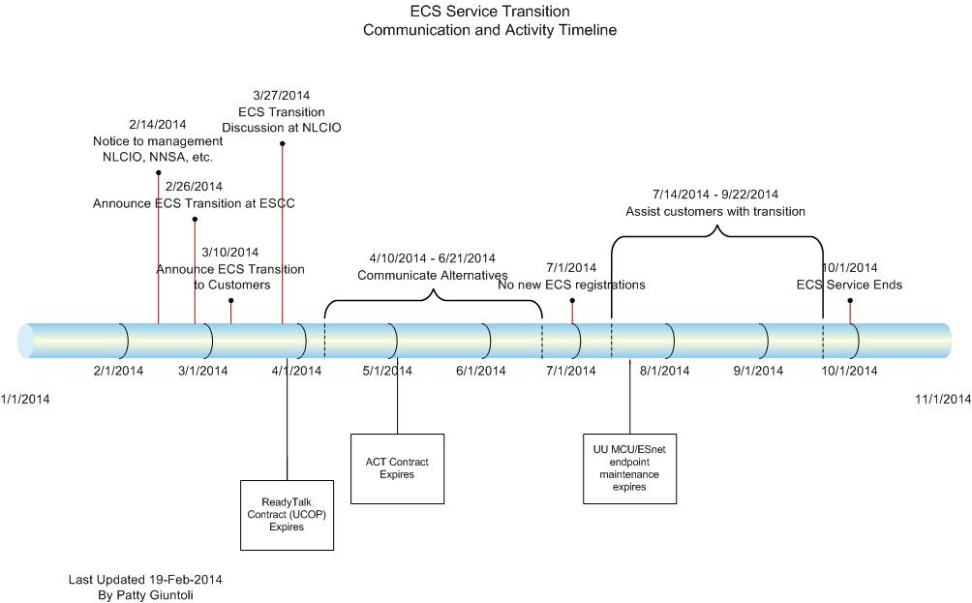
ECS Service Strategy Timeline

Slide 7
Fermi
ReadyTalk (Audio and Web Conferencing)
518 Registered Users
Of that, ~180 are active in any month
3814 average user hours each month Q1FY14
Max meeting attendees: Q1 – 144
90% of all calls have between 1-10 endpoints
~35% use Web Sharing with audio conferences
Averaging $9,500 per month in fees in Q1 13/14
Projected annual cost $110,000 Fiscal Year 14/15
Other service possibilities: Fuze via I2 Net+, Zoom, SeeVogh, Webex

Slide 8
Fermi – ECS Video
ECS Video (Video Bridging)
395 total registered endpoints
74 active registered endpoints
Fermi has 48 SD and HD room or shared workspace systems. Nearly half are HD.
Between 30-40 H323 End Points Connecting per Month
10-20 Desktop Endpoints (Jabber\Movi) Connecting per Month
880 average monthly H323 Codec Connected Hours
500 average monthly Desktop Connected Hours
Average 19 Hours each month per endpoint
Potential Cloud Service Replacement Options
BlueJeans, Open Exchange (Vidyo), PexIp, Acano

Slide 9
Lab Collaboration POCs
Lab/Org Group | POC | Lab/Org Group | POC
Ames | Doug Stepehens | DOE-OCIO | David Biser
Argonne | Dana Stasiak | Ofc of Science | Kevin Campbell
Brookhaven | Mary LaClair | INL | Gary Smylie
Fermi | Sheila Cisko | DOE-NNSA | Travis Howerton
J Lab | Andy Kowalski | KCP | Michael Bloomer
LANL | Allan Marcus | NETL | Dave Paton
LBNL | Charlie Verboom | NNSS | Robert Morrow
LLNL | Gianni Contardo | SNL | David Dirks
ORNL | Steve Raley | SRNL | John Longo
PNNL | Michael Bassett | SRNS | Randal Sims
SLAC | Guillaume Cessleux | Y-12 | John Buck

Slide 10
Next Steps
Internet2 NET+ Services
Standalone ReadyTalk contract for each Lab
Integrate with Lab Unified Communications initiatives
Consistency in service selection = ease of use across organizations, however, there may not be a one size fits all solution
ECS will work with identified POCs for requirements and service analysis
ECS continues to evaluate and test cloud services

