Slide 1
IPv6 Status Update & Discussion
Phil DeMar
Winter 2014 ESCC meeting
February 25, 2014

Slide 2
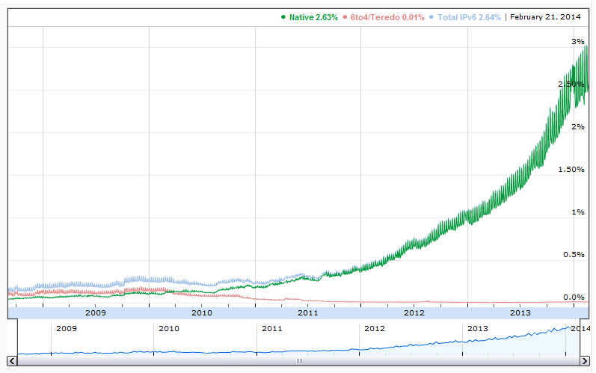
IPv6 – A Few High-Level Points
IPv6 use continues to grow:
Still pretty small
But is growth exponential?
Rumors of a new OMB IPv6 mandate:
Would focus on devices & mobility
Target milestone deadline = 2016

Slide 3
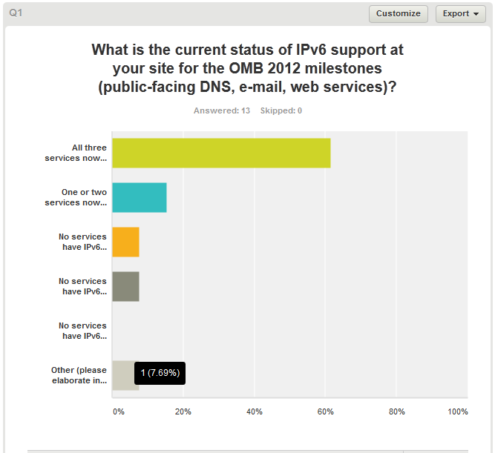
8
2
1
1
1
Lab IPv6 status at: https://my.es.net/sites/ipv6

Slide 4
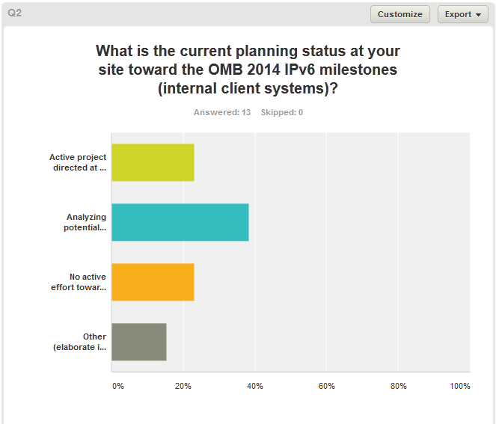
3
5
3
2
Comment: Compliance with the 2014 mandate would require a complete overhaul of our existing, best-practice cyber security implementation.

Slide 5
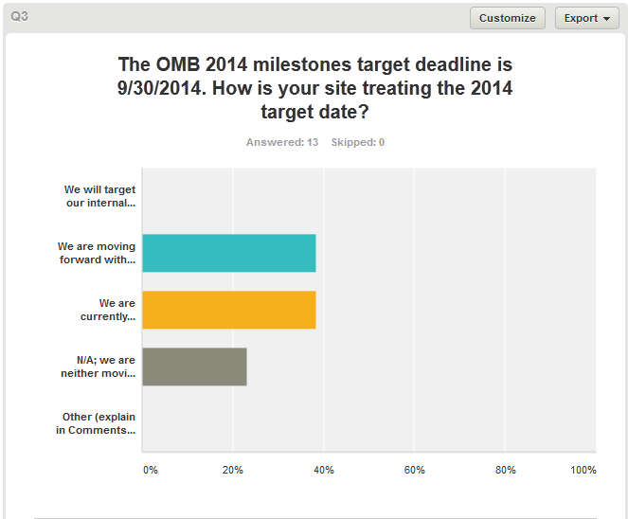
0
5
5
3

Slide 6
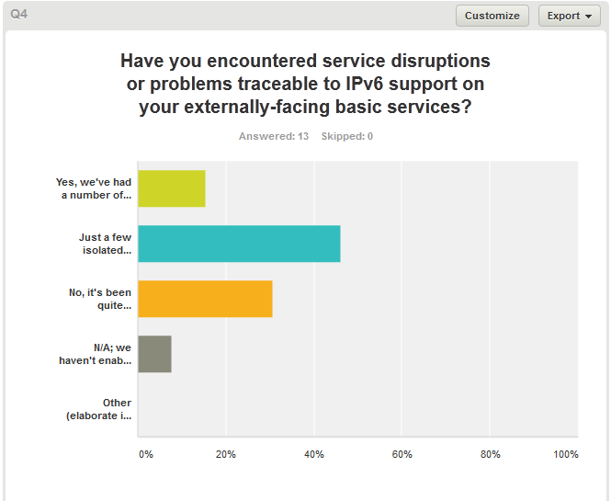
2
6
4
1

Slide 7
Comments on: Have You Encountered IPv6 Service Disruptions?
The biggest issue: We had one vendor (email filtering) who changed their mind about supporting us over IPv6 and dropped the service without notifying us first.
Impact only for IPv6 services not for IPv4
Few email issues related to sendmail problems; absence of IP address based blacklists; and reverse PTR requirements.
We are in the process of implementing a new firewall and expect to have IPv6 functioning on externally facing services by the end of the fiscal year. With the previous firewall, we experienced insurmountable IPv6 implementation issues.
All IPv6 comments pertain to our small Science DMZ. No IPv6 is on our production network.
Largely transparent. The interesting aspect is the few IPv6-related issues have been challenging to identify as IPv6-related. Just recognizing that IPv6 is involved is the key element in dealing with the problem.

Slide 8
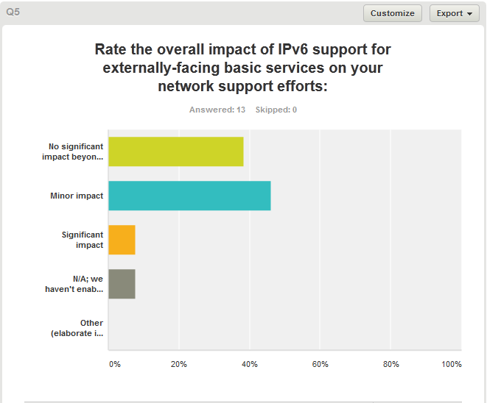
5
6
1
1

Slide 9
Comments on: Do You Have Any IPv6 Lessons-Learned
Incidents or Events to Share?
Our experience is that vendor support for email filtering products is spotty. We've had several problems in this area, with cloud services and appliances.
None
We were limiting Google mail and Cisco because the was no reputation based on the IPv6 partner connection. We are still working with senderbase.org on understanding this and had to whitelist these organization so that we would not queue email.
no
Yes, several incidents worth mentioning: - Performance issues when IPv6 traffic scaled up to science data movement - Bizarre IPv6 routing - Problems accessing an external IPv6 web site
Turning on IPv6 support in the edge firewall (Checkpoint) froze the system, even though specs claimed support. FW to be swapped out in February, 2014.

Slide 10
Comments on: High-Level Summary of your Site’s IPv6 Efforts - I
We plan to maintain out externally facing presence as a production service. We will expand this to include more web servers and other services, both externally- and internally-facing. We are replacing equipment where IPv6 support is substandard as part of the normal hardware life cycle.
Cyber security is doing some work to upgrade their monitoring systems to support IPv6. Not much else is happening at the site.
Moving IPv6 internal to client has not reached high enough on the project funding list. We are interested in pursuing more and working with our Cyber Security group as the develop and procure tools for to include IPv6 parity. No immediate realized drivers for doing such and therefore funding has appeared to continue.
IPv6 deployed close to border - DMZs, server lan, working on visitor wireless.
IPv6 not being made available to general users because of lack of integration in tools, such as IPAM, netflow.
The Laboratory is in the process of upgrading IPAM and DHCP for v6 functionality.

Slide 11
Comments on: High-Level Summary of your Site’s IPv6 Efforts - II
Intention is to support v6 in our Science DMZ.
We have deployed IPv6 on our Science DMZ. We have had some delays because some applications are not IPv6. Applications are non-commercial 3rd party.
Overall, a modest effort to continue to develop IPv6 capabilities within our campus network, largely out of opportunity cost. We are also now evaluating IPv6 with our science application in anticipation of possible use within LHC GRID computing.
Integrated into our DNS management system, available to server subnets by customer request. Fully available on the wireless networks used by 90% of users. Security infrastructure support partially implemented. Pilot of wired desktop support starting. Full router support (including multicast) 90% completed.
We do not provide public facing services from our internal network, just from systems on the DMZ, so we do not anticipate any IPv6 changes internally. Also, Cybersecurity is concerned that IPv6 support cannot be handled by their internal systems (IPS, internal firewall, SPLUNK, etc.)

Slide 12
Comments on: IPv6 Areas You Would Like to See Discussed
The general discussion of anything that is new/different with regard to IPv6 deployment at the sites is always useful. Warnings about potential pitfalls/cautionary tales are valuable.
Scanning IPv6 network and how other may achieve this without taking years. We also looked at enabling IPv6 for remote access but still waiting on vendor support and upgrade schedule before this will work. What dynamic address assignment protocol are others planning SLAAC or DHCPv6.
security issues
The obvious contention between the requirements of the OMB 2014 mandate and cyber security best practice.
How are sites handling addressing configuration options (A, M, & O bits)

Slide 13
Lessons-Learned Incidents or Events

Slide 14
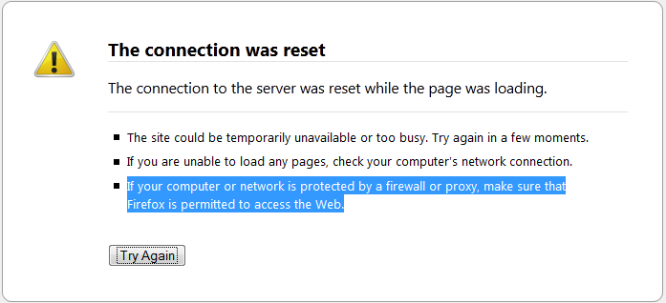
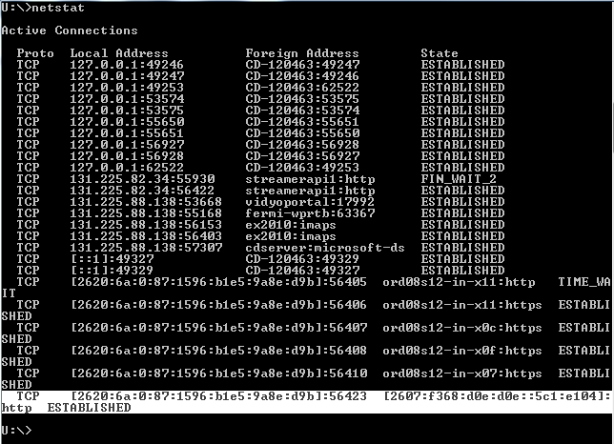
FNAL IPv6 Lesson-Learned #1 – Sometimes it’s the App…
Sequence:
science.energy.gov
Timeout failure
100% reproduceable
But others can reach it…
Disengaging from the IPv6-enabled network works?
Check out netstat when
attached to IPv6 network
Conclusion: science.doe.gov web server app hanging on
IPv6 connections

Slide 15
FNAL IPv6 Lesson-Learned #2 – IPv6 Paths May Not Be Logical…
Sequence:
FNAL HEPiX IPv6 testing shows FNAL <-> StarLight transfers have poorest performance?
Traceroute-6 shows path is “less than optimal”
FNAL
CERN
SL

Slide 16
FNAL IPv6 Lesson-Learned #3 – Traffic Loads May Reveal Hidden Problems…
Sequence:
FNAL joins HEPiX IPv6 test bed
IPv6 traffic levels jump
from (o) Mb/s to
(o) 100Mb/s
Border router CPU
jumps from 5% to
~50%
Investigation reveals
‘reverse path cache’
command caused problem

