Slide 1
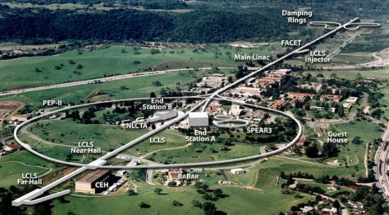
Energy Sciences Coordinating Committee: Welcome
ESCC Spring meeting, SLAC Feb 2014
James Williams, SLAC CIO
Notes:
40+ attendees from Labs (typically 2 per Lab) , ESnet (typically 5-10), and invited vendor technical folks (Bro – Security, Cisco & Aruba – wireless, Amazon – cloud) to provide input on the major topics for the meeting

Slide 2
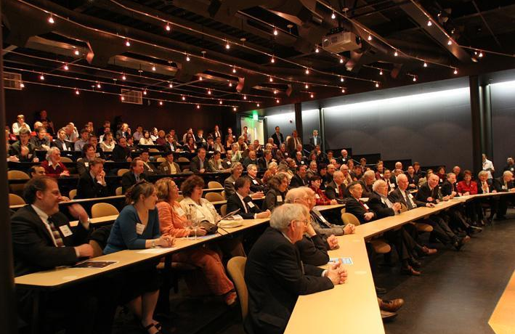
Where you sit today ………….
NobelistBurt Richter
Fred Kavli
Nobelist Steven Chu
Rep Anna Eshoo
Rep Mike Honda
Kavli Building Inauguration, March 17, 2006
Notes:
Also present are: SLAC Lab director (Persis Drell), director SSRL (Keith Hodgson), Arty Bienenstock (APS president, director SSRL, Special assistant to the president Obama for Science Research Policy), Marty Perl (Nobelist), Roger Blandford, Dick Taylor (Nobelist)…

Slide 3
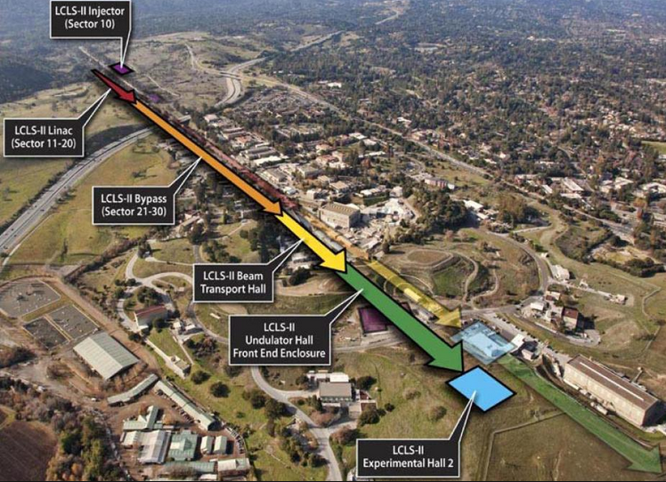
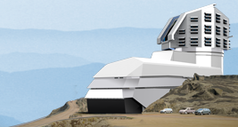
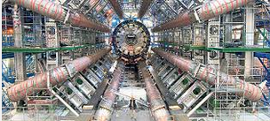
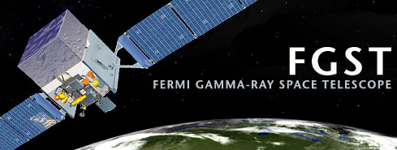
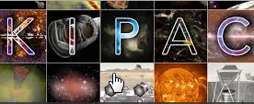
SLAC National Accelerator Laboratory
Our mission:
Grow into a premier photon science laboratory
Maintain our position as the premier accelerator laboratory
Plasma wakefield acceleration
ILC studies
Bunch compression
Pursue strategic programs in particle physics, particle astrophysics and cosmology
LCLS
LSST
ATLAS
Tier 2
Notes:
Plasma wakefield acceleration has a 10TW laser

Slide 4
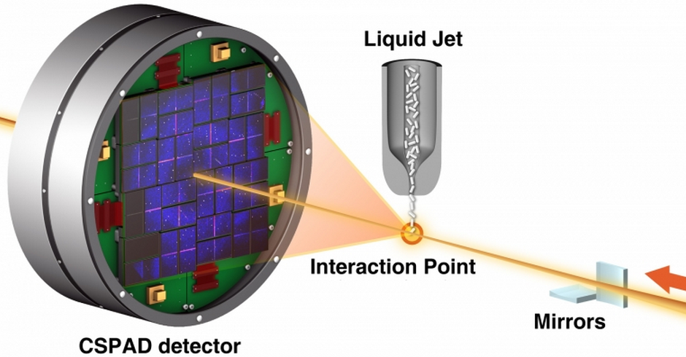
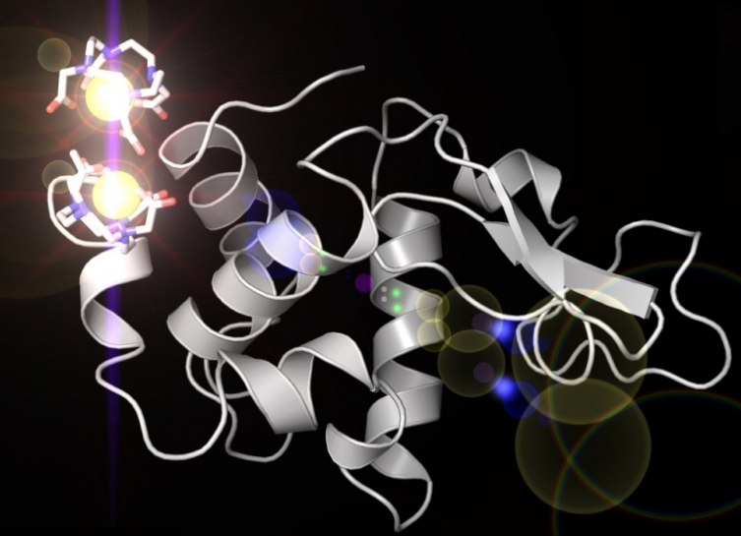
LCLS-II
With LCLS there are already huge data, networking and computing needs:
10 Peta Bytes already archived
Can capture 10GBytes/sec
One expmt today produces 10M X-Ray images in 48 hours or 200TBytes
Big data challenges
Building on the success of the world’s most powerful X-ray laser—the Linac Coherent Light Source (LCLS)—SLAC together with other DoE labs is planning an upgrade (LCLS-II) that will keep the United States at the forefront of X-ray science.
This may increase data rates significantly
Notes:
Funded by the Department of Energy Office of Science, LCLS has been a spectacular success, consistently exceeding goals and expectations. Its highly focused beam arrives in strobe-like pulses just a few millionths of a billionth of a second long. This allows researchers to take crisp pictures of atomic motion and changes in chemical bonds, shedding light on the fundamental processes of chemistry, technology and life itself. See https://portal.slac.stanford.edu/sites/lcls_public/lcls_ii/Pages/default.aspx
For data needs see https://www6.slac.stanford.edu/news/2013-06-13-X-ray-Laser-Explores-Big-Data-Frontier.aspx
The images showsa basic X-ray crystallography setup at the LCLS X-ray laser. X-ray pulses (orange) strike nanocrystals that are streamed from a liquid jet, producing diffraction patterns that are collected by a detector. Thousands of these patterns can be averaged and analyzed to reconstruct molecular models., seen to the right

Slide 5
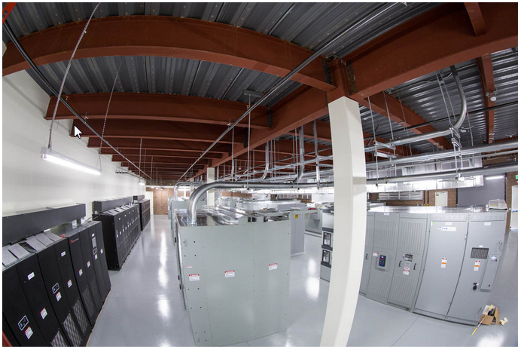
Science Computation
Exploring 100Gbps access for science this FY
SRCF/Stanford Research Computing Facility
Completed Aug 30, 2013
21,500 sqft,
150 racks,
Up to 3MW power,
UPS, efficient power

Slide 6
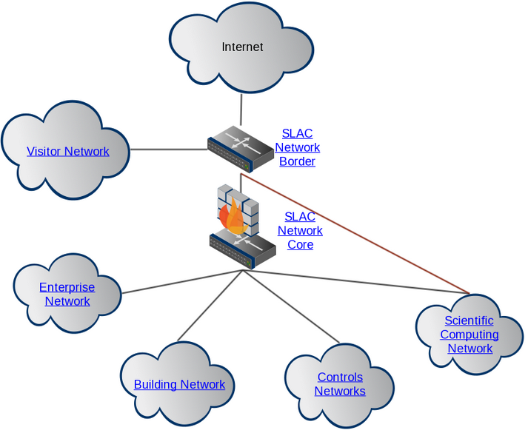
Keeping Science transport Unencumbered: DMZ for science

Slide 7
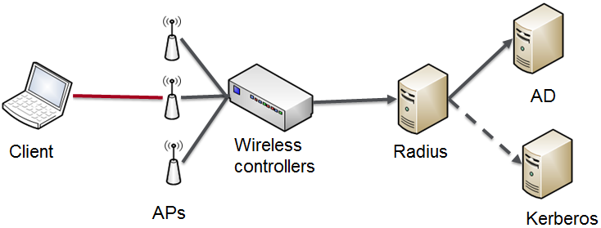
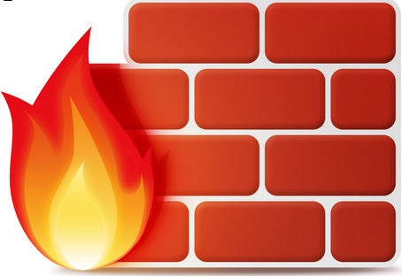
Fundamentals of Cyber Security Improvement
Based on best service management practices.
Secure Mobility, initially Secure Wireless (today only Guest/visitor)
Provide authentication and encryption, same priviledges as wired office
MDM, BYOD
Perimeter Content inspection Firewalls
Security Forensics (BRO)
Prevent and respond to attacks
Collaborate with LBNL
Service-now to replace several existing tools:
Start on incident management then request fulfilment, service catalog followed by asset management, configuration and change management
IP Address Management (NetDb/Stanford)
Faster resolution of incidents, lower overhead of network management, increased accuracy
Notes:
Replace RT, Configuration and Change Management driven by security requirements
Current IPAM (CANDO) not IPv6 capable, has many manual processes, 30 years old, IP address not MAC based

Slide 8
Independent Review Board
Established as an advisory and assurance body for the Computing Division
CIO at PNNL,
CIO at JPL,
CFO at LBNL.
CISO at LBNL
Associate VP for admin sys at Stanford
Information Security Officer at Stanford
CISO at Stanford

Slide 9
We are pleased to have you here…….
WELCOME TO SLAC!

