Slide 1
FNAL Site Report
Phil DeMar
Winter 2014 ESCC meeting
SLAC
February 25, 2014

Slide 2
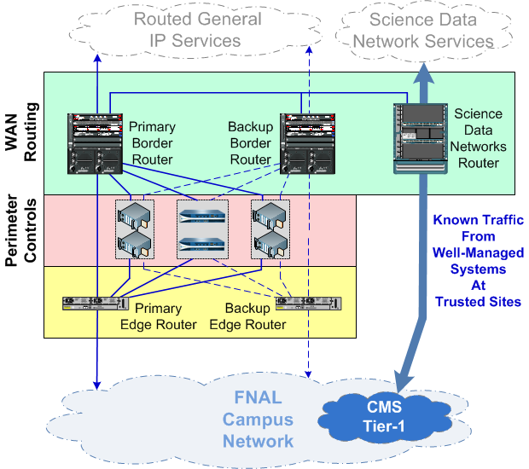
Perimeter Upgrades in Progress
Current implementation:
Primary & backup border routers for general IP traffic
Separate router for high impact science data traffic
Isolated via policy-based routing
100GE WAN link here…
Limitations & Issues:
Primary & backup routers nearing end-of-life
100GE-capable platforms are “expensive”
Inefficient use of 100GE WAN link(s)
100GE
6509s
CRS
(loan)

Slide 3
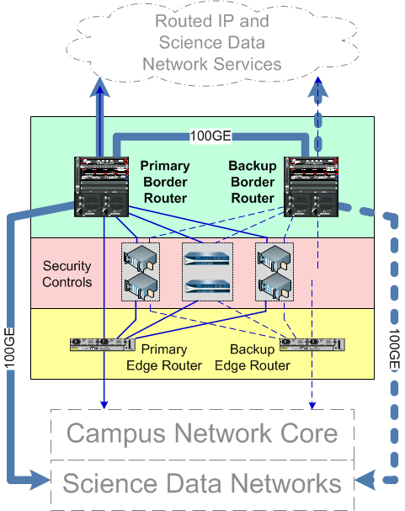
Migrating to New Perimeter Architecture
Will consolidate into two 100GE-capable border routers:
Anticipating 2x100GE WAN config.
Science data traffic will still be separated:
Expect to deploy VRF technologies
Initially continuing with PBR
But possibly OpenFlow in the future?
Router procurement under way:
Expect to have new routers in place this summer
100GE interface(s) may have to wait until next year

Slide 4
FNAL WLAN Upgrades (I)
Our long term WLAN strategy = eliminate copper in offices
Current WLAN deployment:
450 APs supporting ~2200 users (peak…)
(Virtually…) All user/office areas have WLAN coverage
Last year, completed higher-density pilot to upgrade central computing bldg
Expanding last year’s WLAN pilot to cover rest of site
802.11n-based, but with 802.11ac (v1) modules
Expect to have 500 new APs deployed by end-of-year
Legacy 802.11g-only APs (Cisco 1231s) excessed
Older 802.11n APs (Cisco 1142s) recycled out to peripheral areas

Slide 5
FNAL WLAN Upgrades (II)
WLAN controllers:
Three main controllers distributed in two data centers
Each controller capable of supporting 500APs
Migration to new APs means using demo controller for legacy APs
Controller software doesn’t support 3602i’s & 1231s concurrently
Some coverage issues encountered in migration
One-to-one replacement of older units causing some coverage loss
3602i’s apparently need higher density configuration

Slide 6
FNAL Internal (Client) IPv6 Support
General approach:
Computing Div. (staff) LAN as eat-your-own-dog-food environment:
Working on hardening IPv6 there to production quality
Stateful autoconfig (A/M/O flags = 0/1/1)
Volunteer WLAN for general users (& their devices):
“Stateless” autoconfig (A/M/O flags = 1/0/1)
Not in service yet (2-3 months off…)
DHCPv6 service working on InfoBlox appliance:
Test InfoBlox right now; need to migrate to production servers
Issues we’re grapping with right now:
Confusing scenarios with SLAAC:
Captive DNS-based registration process
Working with network blocking security tools
Lack of clarity on device client DHCPv6 support

Slide 7
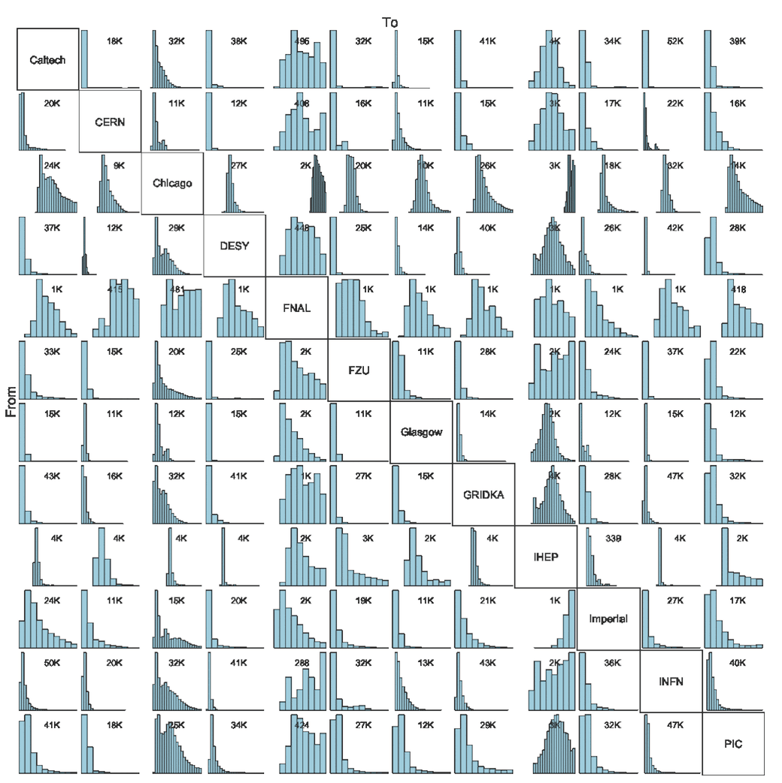
Science Applications IPv6 Testing/Evaluation
Participating in IPv6 HEPiX working group effort:
Under direction of Worldwide LHC Computing Grid (WLCG)
Driven by CERN data center address
needs due to virtualization
~250k public addresses
by 2015
HEPiX IPv6 test bed:
Currently 12 sites, distributed
globally
Testing methodology:
Persistent thruput testing
Dual stack configurations
LHC applications
GridFTP; <others>

Slide 8
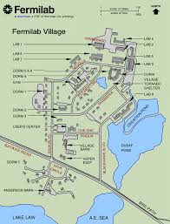
GPON Evaluations
GPON = Gigabit-capable Passive Optical Network
Target space = “Village” residences
Currently supported via Cisco LRE:
Uses 40 yr old phone lines
Max b/w = 5Mb/s
Deployment goal:
GPON service into each residence unit
GPON ports provide shared ~2Gb/s downstream & 1Gb/s upstream
Between 8 & 16 units per port
Worst case = ~150Mb/s upstream & 75Mb/s downstream per unit
Fermilab Village
~64 residence units
Internet via phone lines

Slide 9
GPON Evaluations (cont)
Selected vendor - Zhone
Base unit (MXK198) costs $8-10k
Provides 16 GPON ports
Premise units cost ~$250/each
GPON requires single mode fiber
Investigating micro-trenching (~1ft deep) to get fiber into units
Costliest part of the project – estimating $2-3/ft
Current status – Lab test bed
Next steps – limited user trial with existing fiber
Other potential users:
Sensors
Environmental monitoring
Security guard shacks

