Slide 1
ORNL Site Report
ESCC
Feb 25, 2014
Susan Hicks

Slide 2
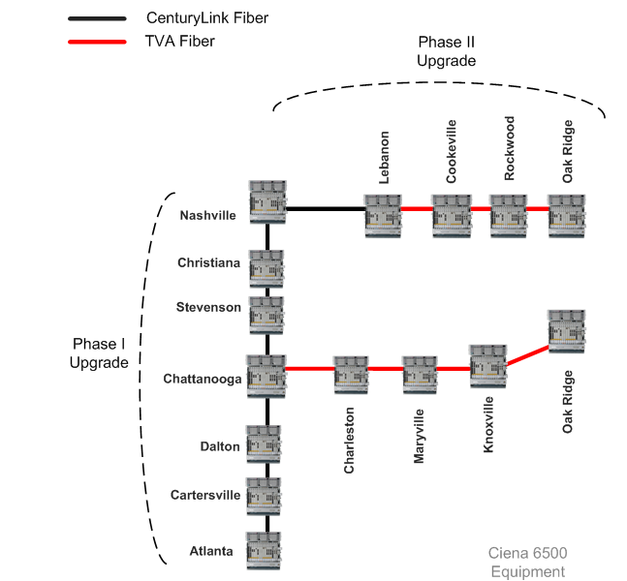
Optical Upgrades

Slide 3
IPv6
Deployed on border and several DMZ segments
Services (WWW, DNS, Email)
www.fueleconomy.gov
Visitor wireless, IPv6 working with wireless controller
Integrating with management/monitoring systems
(Bro, Sourcefire, Stealthwatch, Netreg, etc.)

Slide 4
Mobility
Ubiquitous wireless deployment
Citrix XenMobile for both government-owned equipment and personally-owned devices
Lync unified communications/collaboration
Evaluating ways ORNL staff are already using consumer cloud storage tools, particularly Dropbox, piloting Dropbox for Business to provide enhanced functionality and reduce risks to ORNL.
Mobile enabled applications in development
Reevaluating BYOD

Slide 5
Cloud
Amazon Virtual Private Cloud
Proof of concept prototype
Evaluating requirements for support and integration
Compute & Data Environment for Science (CADES)
ORNL vision for the future for computing and data services

Slide 6
Data Science and Compute Strategy at ORNL
Consolidate resources and develop a flexible and elastic infrastructure to satisfy needs of existing and future computing and data projects
Establish a Compute & Data Environment for Science (CADES)
Provide cutting edge data resources for R&D and for prepare for the future
Compute and Data Environment for Science targets full range of needs
Single PI Projects
Centers
User Facilities
Multi-Institutional
Projects
ORNL Compute and Data Environment for Science
Compute and Data Science Liaisons
Compute and Data Platforms
Tools, Software
Data
Analysis
Systems
File
Systems
Structured
Storage
Databases
Mid-Range
Compute
Data
Mining
Algorithms
Visualization
& Visual
Analytics
Data
Discovery &
Dissemination
Data Fusion
Algorithms
Semi-Structured
Storage
Ubiquitous
Storage
(Cloud)
Archival
Storage
Cloud
Compute
Scalable
Indexing
Semantic
Analysis
Algorithms
Natural
Language
Processing
Intelligent
User
Interfaces
Supply Common Computing and Data Needs

Slide 7
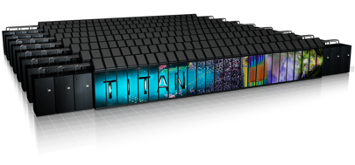
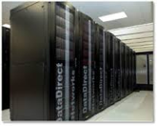
CADES Cloud Initial Infrastructure
Scalable I/O Backplane
A Data Intensive computing environment serving multiple projects and use cases
A rich software stack enabling highly integrated, collaborative, data-centric research
Supporting multiple data security levels from open research enclaves to secure enclaves for PHI and proprietary data
Open protocols and self-service portal for admins/users
ESNet & Internet2
OpenStack IaaS & Parallel Compute/Data Environment
100 Gbps
Shared home
450 Terabytes - NFS
Scalable Storage
5 Petabytes – Lustre, Cinder, Swift, RADOS
Utility Compute
Databases
Web Servers
Workflow Engines
Other Persistent Services
Integration With Extreme scale
27 Petaflops – Titan
200 Petabytes – HPSS
30 Petabytes - Lustre
High Performance
Data Mining, Fusion & Analytics
Modeling & Simulation

Slide 8
SDN
Evaluating potential use cases of SDN in CADES to facilitate dynamic reconfiguration
WFO project to evaluate SDN technology
Evaluating open source and vendor controllers (Nagi Rao)
Local and wide area (simulated) path control based on performance feedback
Discussion with Ciena on SDN support

Slide 9
Questions
?

