Slide 1
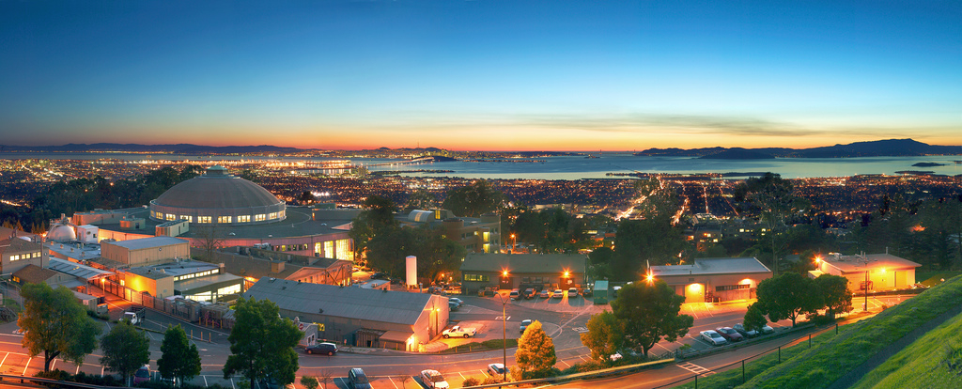
Greg’s Update
ESCC @ SLAC
February 25, 2014
Gregory Bell, Ph.D.
Director, Scientific Networking Division
Director, Energy Sciences Network
Lawrence Berkeley National Laboratory

Slide 2
Three Cheers for:
Phil, for extraordinary service to ESCC
Surya, for rising to the occasion
Susan, for rising to the occasion
SLAC, for hospitality
Plus three more cheers for Phil.

Slide 3
Topics
highlights of past six months
announcements, initiatives, projects

Slide 4
Topics
highlights of past six months
announcements, initiatives, projects

Slide 5
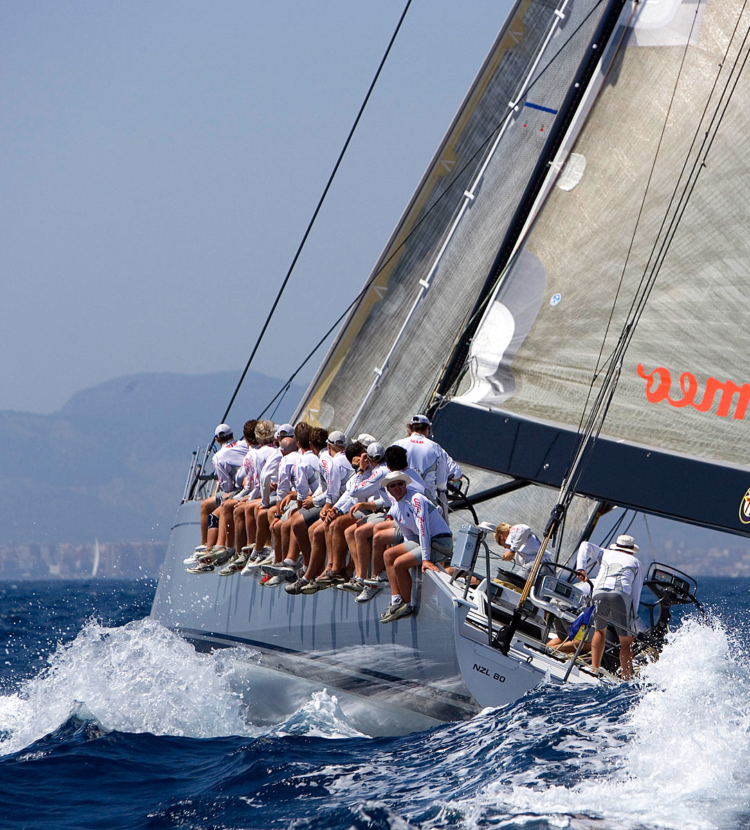
Overall trend: Smoother Sailing Continues
ANI project now officially complete!
Many sites connected at 100G.
Most job vacancies now filled.
Two newest teams (Tools and Science Engagement) fully staffed and firing on all cylinders.
Optimizing internal processes (budget, procurement, cyber) and “interfaces.”
First ESnet Software Retreat: refining strategy, converging on common tools, exchanging ideas.
Research and innovation continue.
Standard for NSI 2.0 published, to be implemented in OSCARS.
OpenFlow testbed; much work & thinking on SDN.
Since last ESCC: staff had one‘best paper’ award and one nomination (plus many papers citing ESnet testbed).
2012
2013,
2014

Slide 6
Overall trend: Smoother Sailing Continues
A great year for perfSONAR!
1100 deployments
new collaboration among major operators (ESnet, Internet2, IU, DANTE) for coordinated development
converged code base (no more PS vs MDM)
Science Engagement workshops and webinars proving very popular
OIN consistently selling out
Three keynotes since last ESCC
including Inder’s at CHEP
http://fasterdata.es.net has been updated
Removing operational ‘barnacles’ to lower costs, improve mission focus
out of IMAP / spam filtering business
2012
2013,
2014

Slide 7
Reminder about New (and Newish) Staff
Peter Murphy, Software / Visualization Engineer for Tools Team
started in August
Antony Courtney, Software / Visualization Engineer for Tools Team (part time)
starting soon
Nick Buraglio, Network Engineer
started in October
David Mitchell, Network Engineer
started in September
Brooklin Gore, Group Lead for Infrastructure
Started in June
Jason Zurawski, Science Engagement Engineer
Started in May
Mary Hester, Science Engagement
Started in March
Susan Lucas, Division Deputy for Business Operations
one year on the job

Slide 8
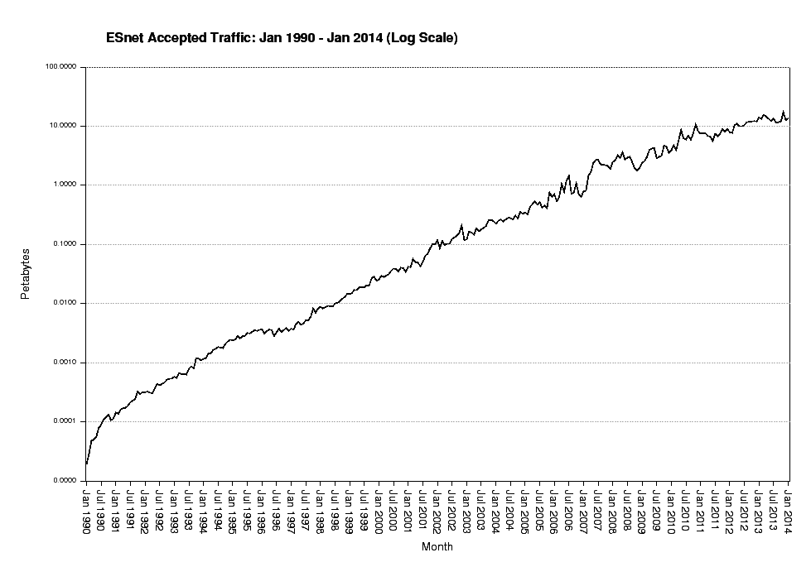

Slide 9
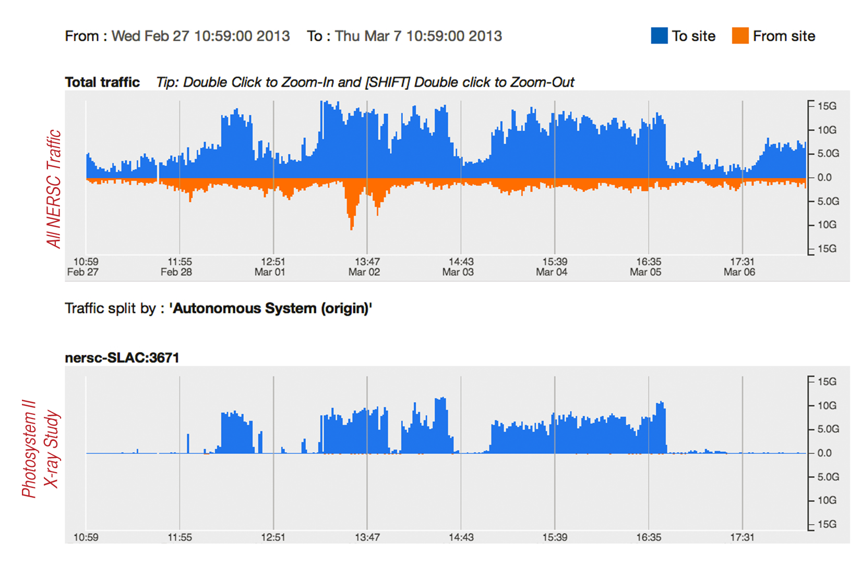
One Beamline Data Flow Tripled Network Use for DOE Supercomputing Center

Slide 10
Cautionary Tale: Non-US Light Source Currently Cannot Store or Export Data Produced by Certain Beamlines
Data-intensive experiment at non-US FEL
correlated X-ray scattering
expected data volume: 100TB, destined for SLAC and Stanford
generated during 60 hours of beam time
Data storage allocation at light source: 10TB
must get data off data acquisition system during the experiment
two supported methods: slow VPN, USB disk
As a result, scientists must build 100TB disk array, ship it internationally or carry the data home (not feasible).
ESnet is working to minimize the risk of similar outcomes in DOE, through focused engagement aimed at improving data mobility.

Slide 11
Reminder: NNSA Relationship has Evolved [repeat of slide from previous ESCC]
We have moved to new direct-funded model for FY13.
Reduces our distraction, increases efficiency
we had 20 separate agreements, now just one
sites didn’t always pay in the past, but we think NNSA OCIO will pay
this aligns NNSA model with model for SC
Allows ESnet to focus on technical / service interfaces
Site Coordinator relationship stays the same
NNSA OCIO developing governance process for coordinating and evaluating capability enhancement requests that have budget implications.
wrong in two ways!

Slide 12
Cartoon Version of ESnet Strategy
Discovery is unconstrained by geography.
2. Provide information and tools for optimal network use.
vision:
goals:
3. Pioneer architectures, protocols, applications.
1. Improve networking practices globally.
[Programmability: integration of facilities in real time; network circuits for deterministic performance, virtual topologies, enclaves.]

Slide 13
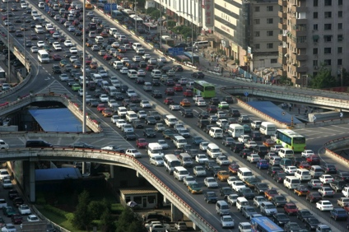
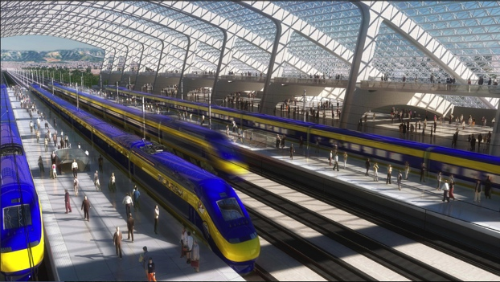
1. Improving Networking Practice Globally
ESnet’s “Science DMZ” architecture now recognized as global best practice.
NSF investing $60M in grants to promote adoption by US universities (among other aims).
Australian, Canadian universities following suit.

Slide 14
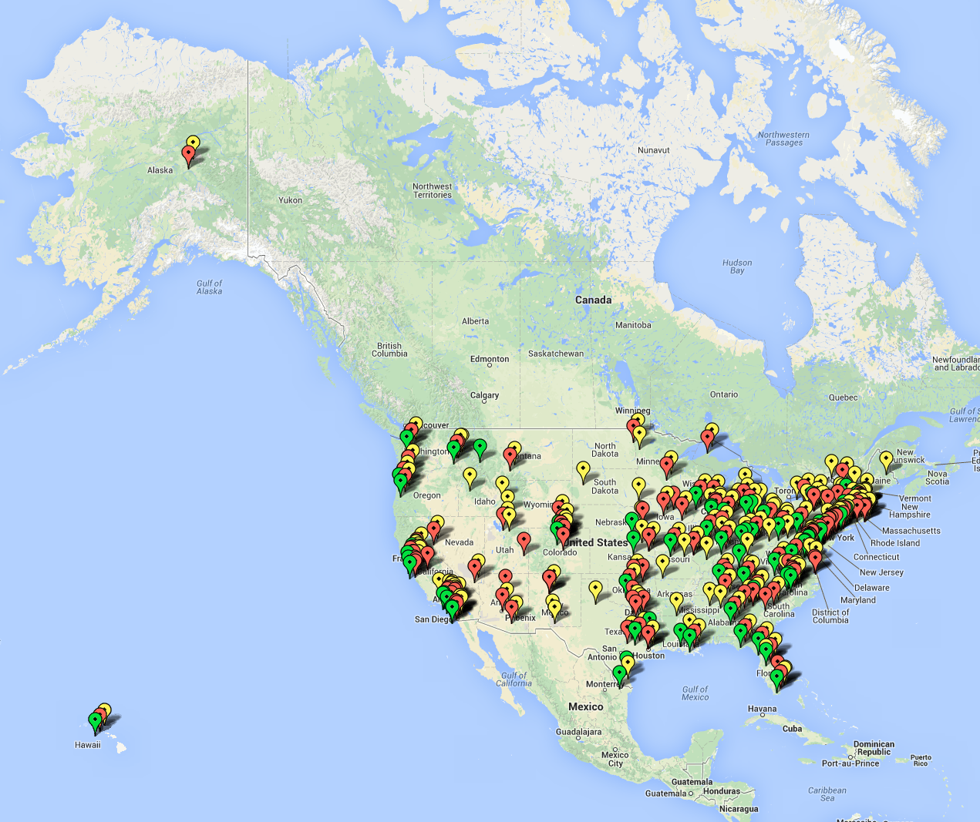
Universities funded by DOE & NSF
BER
BES
NSF CC-NIE awardees
Notes:
never been better.

Slide 15
2. Provide Information and Tools, so that Collaborations Can Make Optimal use of Network
New projects targeting 100 beamline users, climate community.
ESnet’s historical focus

Slide 16
100G Testbed: 2013 Summary
9 New Testbed Projects
http://www.es.net/RandD/100g-testbed/current-testbed-research/.
13 Testbed-based publications:
http://www.es.net/RandD/100g-testbed/publications/.
Best paper award winner:
Characterizing the Impact of End-System Affinities On the End-to-End Performance of High-Speed Flows, Nathan Hanford, Vishal Ahuja, Dipak Ghosal, et al. 3rd International Workshop on Network-aware Data Management (NDM13), in conjunction with SC'13.
very interesting results on impact of core selection on network throughput on Sandy-Bridge motherboards

Slide 17
Federated Testbed
Several sites are now doing experiments using the “Federated Testbed” model described at last ESCC.
OSCARS circuits over production network to connect to testbed
Current circuit endpoints:
FNAL to Testbed
NERSC to Testbed
BNL to Testbed
Caltech to CERN
NASA Goddard to Testbed
Navel Research Lab to Testbed
University of Chicago to Testbed

Slide 18
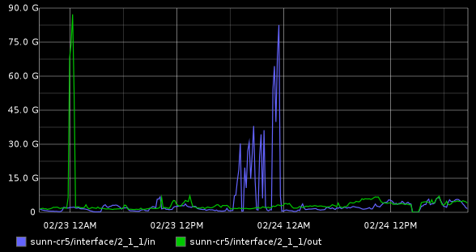
Sample Federated Testbed experiment: NERSC DTN Testing
Question: How many DTN nodes, connected to GPFS, are needed to fill NERSCs 100G pipe?
Experiment:
5 nodes at NERSC, 2x10G to WAN, Infiniband to GPFS
read from GPFS, send to memory of ESnet testbed hosts
results: 90G memory to memory, 80G disk (GPSF) to memory

Slide 19
perfSONAR Deployments now at 1100 hosts
Notes:
Metcalf’s law: power of network scales w/ square of nodes.
Eric Boyd’s corollary: value of performance measurement framework scales w/ number of nodes.

Slide 20
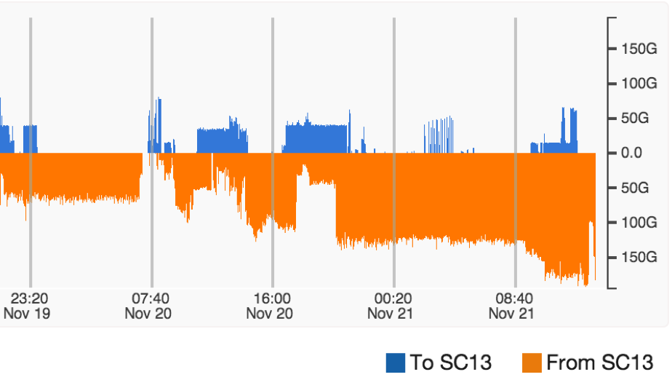
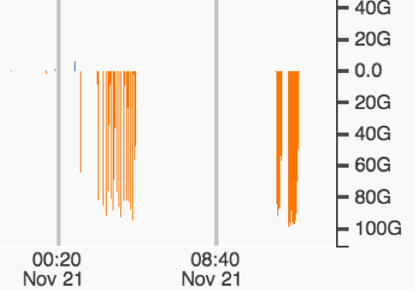
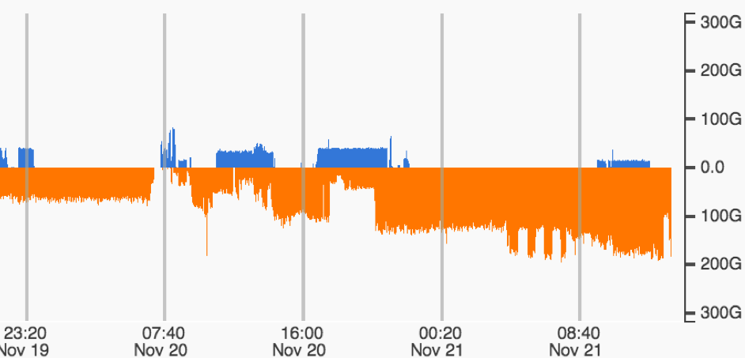
SC13 Demos Supported by ESnet
Ciena 400G Super-Channel
from Denver POP to convention center
NASA Goddard:
91Gbps from Goddard to SC13 disk-to-disk using a single pair of hosts
Caltech Demo
Goal: fill 7x100G links
Endpoints: CERN, KIT, BNL, FNAL, NERSC, U Mich, Caltech
ESnet traffic shown in this plot:

Slide 21
SC13 Traffic Animation: https://my.es.net/demos/sc13

Slide 22
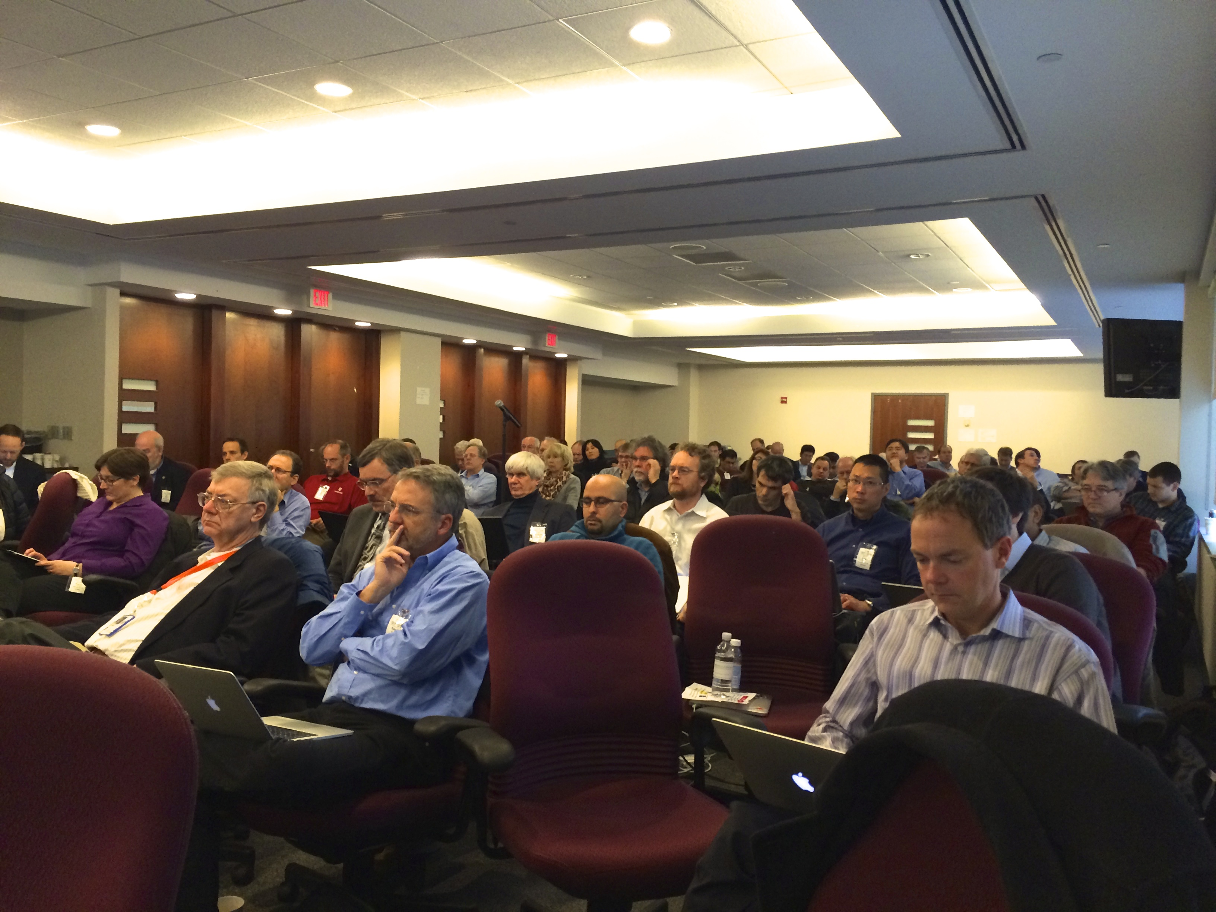
SDN Workshop Goals, Dec 16-17, 2013
Build a community of security-savvy, operational SDN experts
Inspire government and academic networks to lead the way
Promote rapid prototypes with open-source tools, engaging the open-source community
Share experiences, build knowledge
Create an ecosystem of operators, academics, open-source enthusiasts, industry partners (coalition of willing / able)

Slide 23
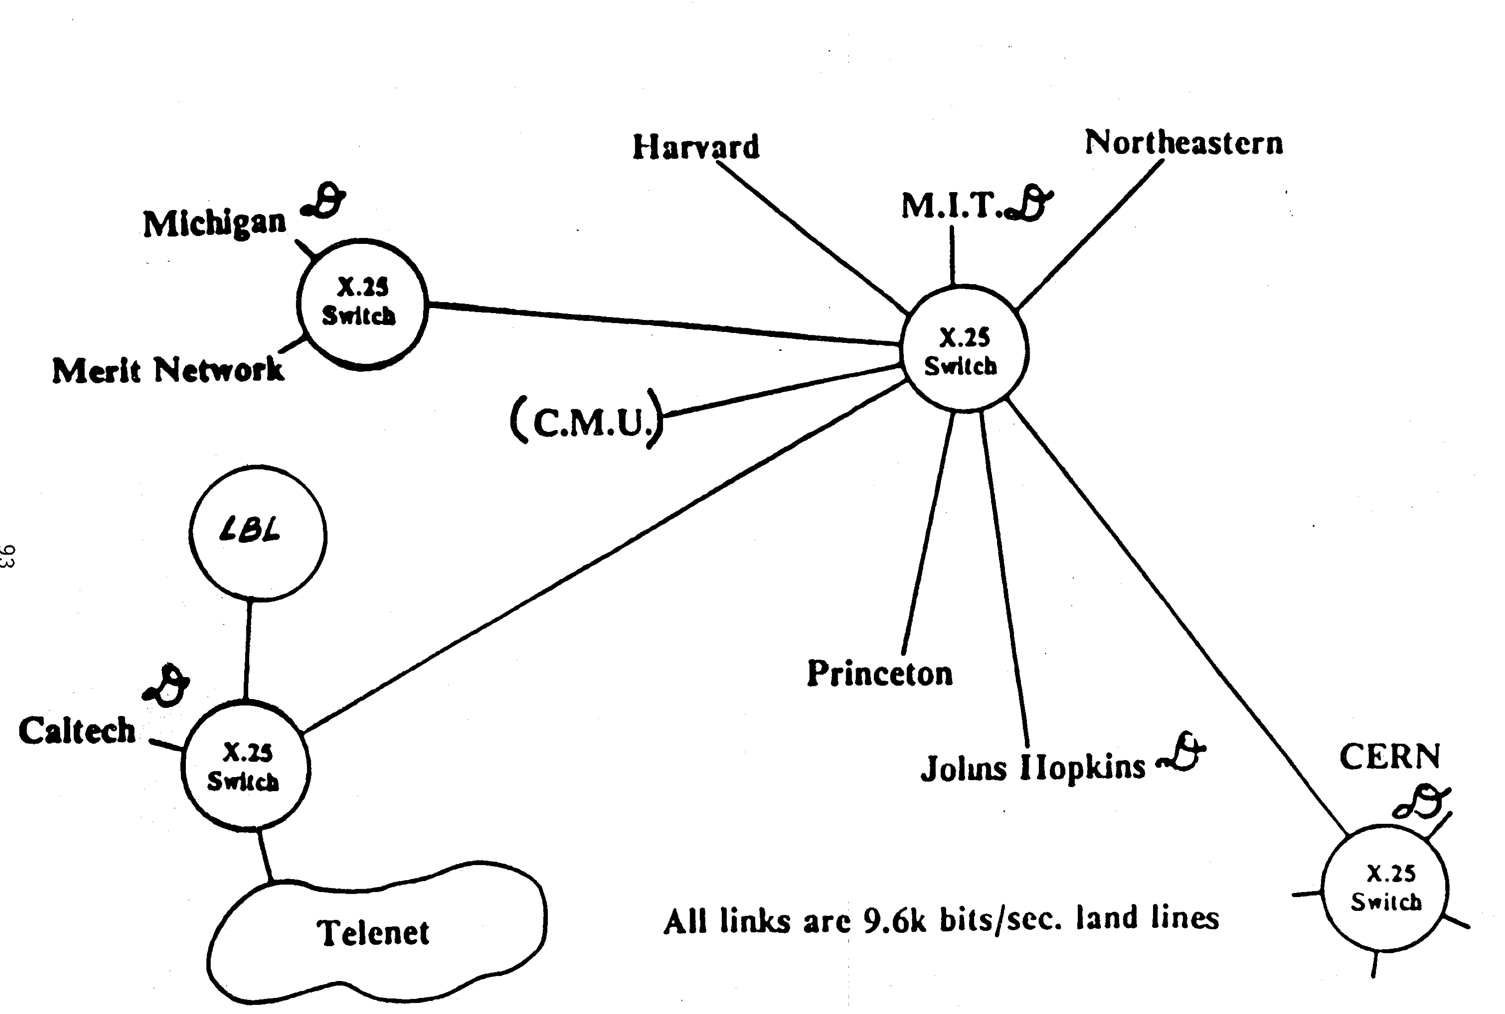
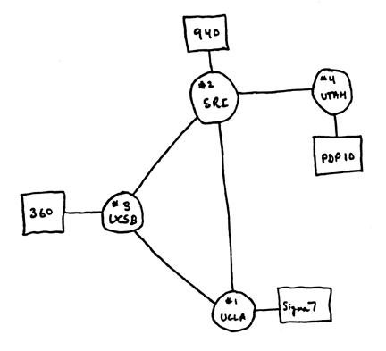
It is about running networks (in addition to network research)
Develop, deploy and (inter)operate
a prototype multi-domain SDN network
ARPAnet, 1969
HEPnet, 1986
http://www.computerhistory.org/internet_history/full_size_images/1969_4-node_map.gif
Future of intersite networking, LBL, 1986

Slide 24
Coming Soon – SDN Workshop Slide

Slide 25
KEY
Externally facing services
Internally hosted
Externally facing services
Externally hosted
ESNet Infrastructure Services
Updated 2/10/2014
24x7
Production
Positive changes aligned to mission
VIRTUALIZED
8x5
Production
PerfSonar
www.es.net
my.es.net
OpenDevNet & Testbeds
Conferencing Services
Development
OUTSOURCED
EXPANDED
ADOPTED
Collection Services:
Arbor, FlowDB, etc.
Linux Distro Mirrors
Email Services
ServiceNow
Google
Apps, Mail, Calendar
Under Evaluation
Internally facing services
Internally hosted
Internally facing services
Externally hosted
UPGRADED
Looking at Other Alternatives
FOSWiki
Secure Terminal Services
DNA
Servers
www1.es.net Staff Portal
Proof Point SPAM Guard
SalesForce.com
CRM
DNS GUI via
(NameSurfer)
IAM, SSO Services
IM via Jabber
SW Repos via Subversion
UPGRADED
Security services:
Access GW, 2F GW,
PGP, Syslog, BRO IDS
Config Mgmt via pxe-boot, CFEngine
Monitoring via Nagios, OpsView
Server Backups
NERSC
Tape Backup
HP Blade System
VMs, Bare Metal
Compellent System
NAS, SAN
LBL
HVAC, Power & Space Mgmt
UPGRADED
UPGRADED AND EXPANDED

Slide 26
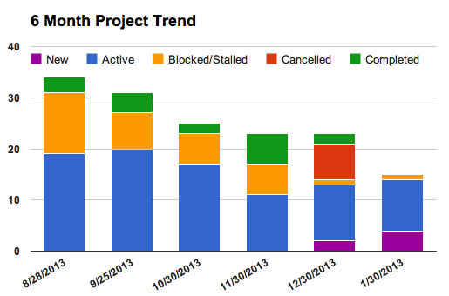
Infrastructure Project Portfolio Management
Introduced portfolio management concept with monthly global review, resourcing, project ranking
Improved staff work load and progress transparency
Completing a few projects a month
Portfolio reflects desired work
Eliminating blocked/stalled projects
Resources gate new project work
Matching active projects to available resources

Slide 27
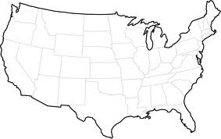
Dual Coast Data Centers
fasterdata.es.net
(copy of) fasterdata.es.net
VMware
VMware
HP Blade Center
HP Blade Center
Compellent Storage
Compellent Storage
LBL
Block level replication
over 10G WAN link
BNL
Ensure we have current copies of critical services on both coasts
LBL is default live site
Fail to BNL service for DR, maintenance, or as needed
Pilot with web services March ‘14
BNL
LBL
Service
Migration

Slide 28
Topics
highlights of past six months
announcements, initiatives, and projects

Slide 29
Announcements
ECS service to sunset at end of FY2014.
Transatlantic Extension: we hope to have final news by mid-March.
TIC for OUO?
please talk to us if this becomes an issue at your site
OSCARS may be helpful
We would like to understand your site’s SDN interests / ambitions.

Slide 30
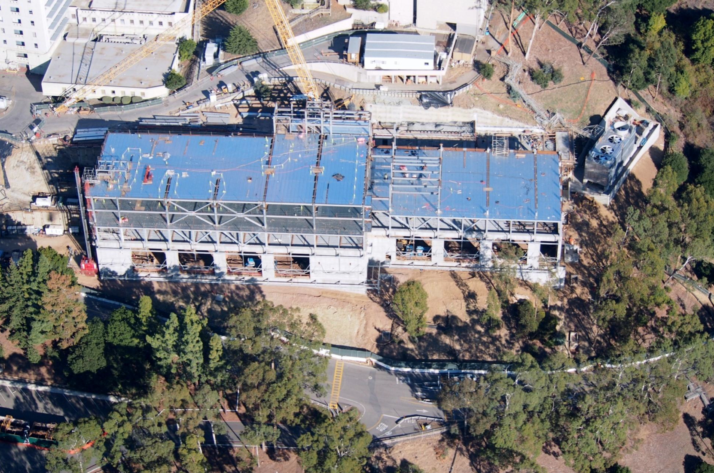
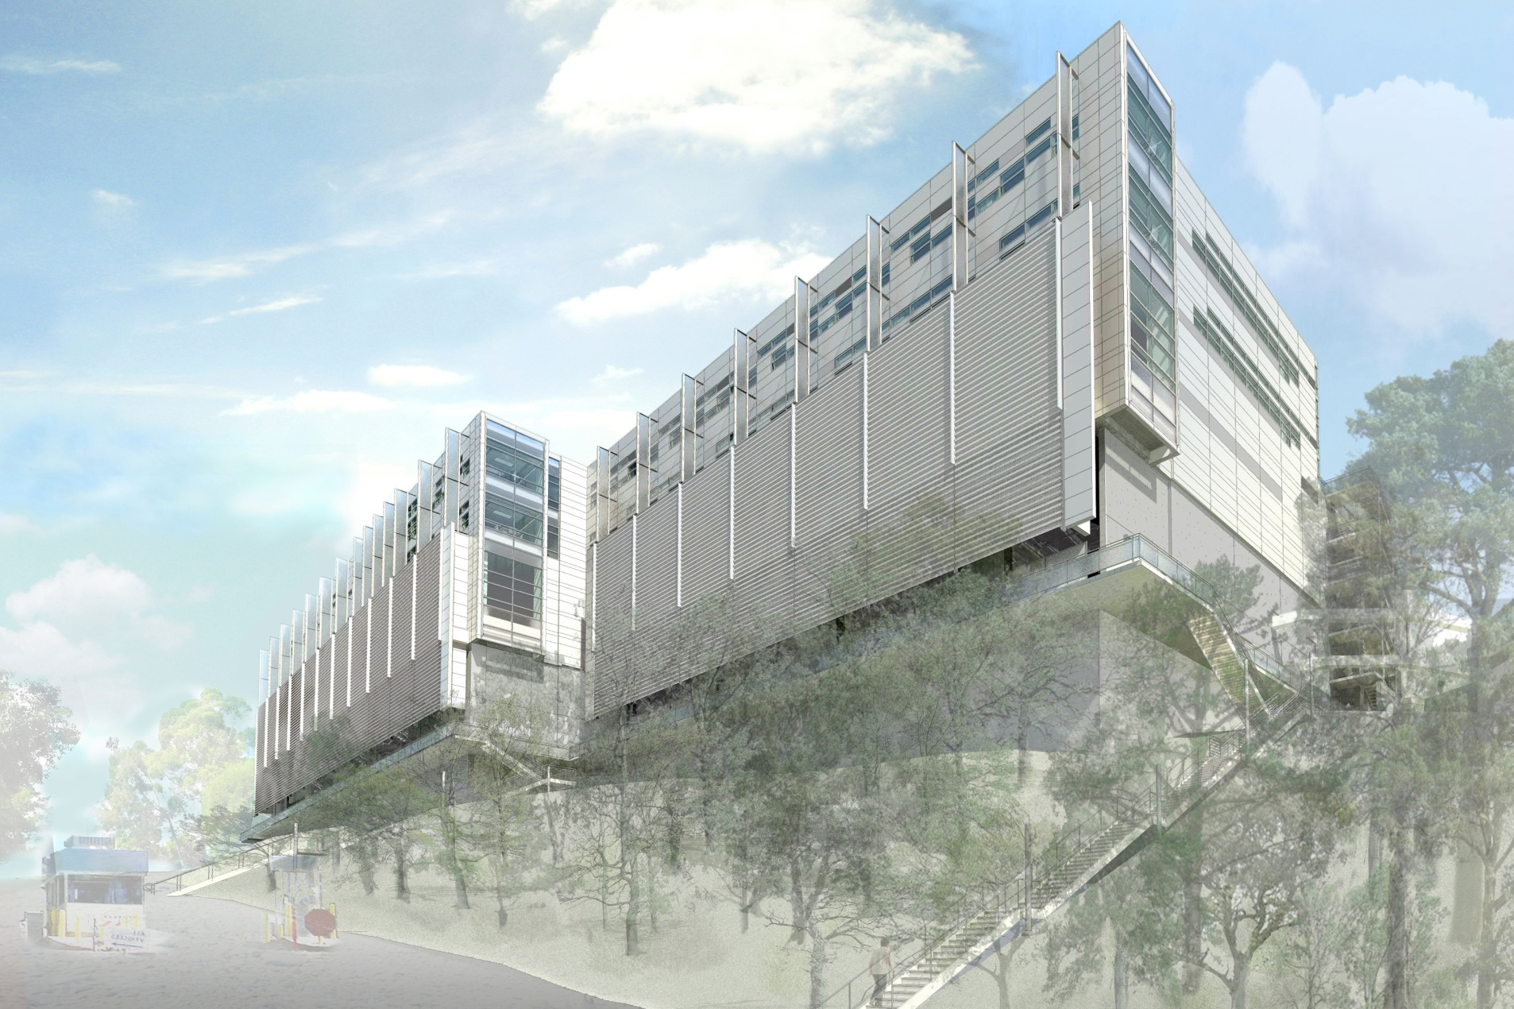
And we’ll be moving this Fall.

Slide 31
Thank you.
greg@es.net

