Slide 1
ESnet perfSONAR Update
Brian Tierney
Jason Zurawski
2014 Winter ESnet Site Coordinators Committee (ESCC) Meeting
February 25th 2014
With contributions from S. Balasubramanian, G. Bell, E. Dart, M. Hester, B. Johnston, A. Lake, E. Pouyoul, L. Rotman, and others @ ESnet

Slide 2
Overview
3.3.2 Release Overview
Plans for 3.4 and Beyond
Demonstration of LS Graphical Interface
Review of NTP Amplification Report in perfSONAR
Dashboard Review
ESCC Training on perfSONAR

Slide 3
What is perfSONAR?
perfSONAR is a tool to:
Set network performance expectations
Find network problems (“soft failures”)
Help fix these problems
All in multi-domain environments
These problems are all harder when multiple networks are involved
perfSONAR is provides a standard way to publish active and passive monitoring data
This data is interesting to network researchers as well as network operators

Slide 4
A small amount of packet loss makes a huge difference in TCP performance
Throughput vs. increasing latency on a 10Gb/s link with 0.0046% packet loss
No packet loss
Reno (measured)
(see http://fasterdata.es.net/performance-testing/perfsonar/troubleshooting/packet-loss/)
H-TCP
(measured)
Reno (theory)
On a 10 Gb/s LAN path the impact of low packet loss rates is minimal
On a 10Gb/s WAN path the impact of low packet loss rates is enormous
Implications: error-free paths are essential for high-volume data transfers

Slide 5
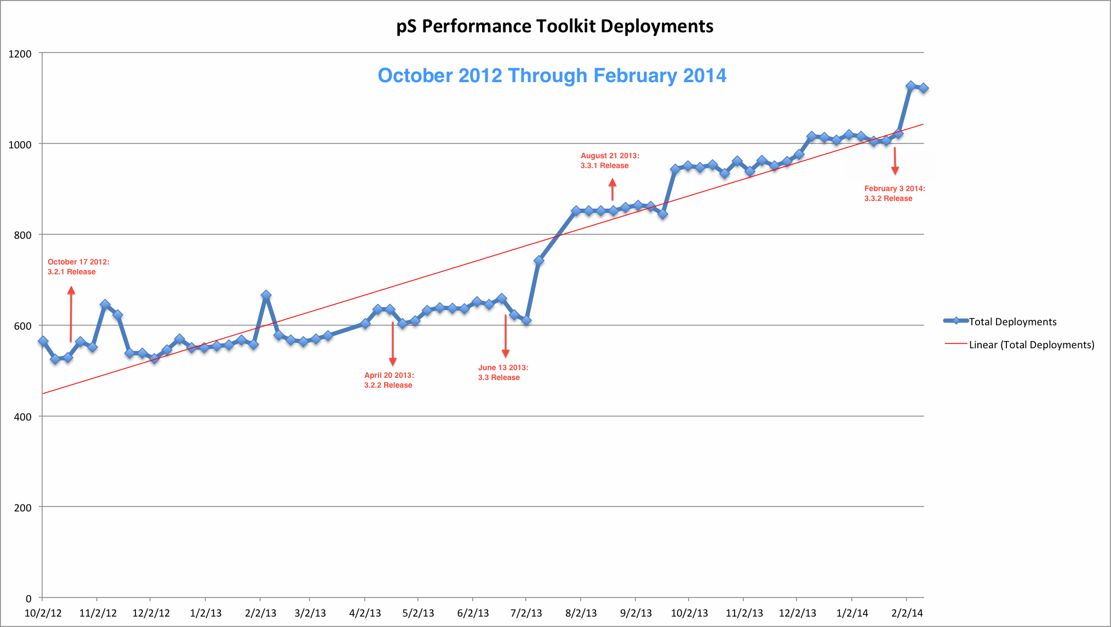
Toolkit Deployment (Note: There is now enough critical mass to be really useful)

Slide 6
perfSONAR Update
perfSONAR-PS 3.3.2 just released
Includes a few bug fixes, and some security enhancements
iptables now on by default
fail2ban host IDS
updated versions of bwctl, iperf3, and nuttcp
http://psps.perfsonar.net/toolkit/releasenotes/pspt-3_3_2.html

Slide 7
Iperf3: https://code.google.com/p/iperf/
iperf3 is a new implementation from scratch, with the goal of a smaller, simpler code base, and a library version of the functionality that can be used in other programs.
Some new features in iperf3 include:
reports the number of TCP packets that were retransmitted and CWND
reports the average CPU utilization of the client and server (-V flag)
support for zero copy TCP (-Z flag)
JSON output format (-J flag)
“omit” flag: ignore the first N seconds in the results
More at: http://fasterdata.es.net/performance-testing/network-troubleshooting-tools/iperf-and-iperf3/

Slide 8
Sample iperf3 output
iperf3 -c 10.28.0.43
Connecting to host 10.28.0.43, port 5201
[ 4] local 10.28.0.11 port 53389 connected to 10.28.0.43 port 5201
[ ID] Interval Transfer Bandwidth Retr Cwnd
[ 4] 0.00-1.09 sec 2.50 MBytes 19.2 Mbits/sec 0 446 KBytes
[ 4] 1.09-2.09 sec 18.8 MBytes 157 Mbits/sec 0 3.46 MBytes
[ 4] 2.09-3.09 sec 325 MBytes 2.73 Gbits/sec 154 74.9 MBytes
[ 4] 3.09-4.09 sec 430 MBytes 3.60 Gbits/sec 1356 39.1 MBytes
[ 4] 4.09-5.09 sec 419 MBytes 3.52 Gbits/sec 0 40.6 MBytes
[ 4] 5.09-6.09 sec 434 MBytes 3.64 Gbits/sec 0 41.9 MBytes
[ 4] 6.09-7.09 sec 454 MBytes 3.80 Gbits/sec 0 42.9 MBytes
[ 4] 7.09-8.09 sec 444 MBytes 3.73 Gbits/sec 0 43.8 MBytes
[ 4] 8.09-9.09 sec 477 MBytes 4.00 Gbits/sec 0 44.5 MBytes
[ 4] 9.09-10.09 sec 468 MBytes 3.93 Gbits/sec 0 45.0 MBytes
- - - - - - - - - - - - - - - - - - - - - - - - -
[ ID] Interval Transfer Bandwidth Retr
[ 4] 0.00-10.09 sec 3.39 GBytes 2.89 Gbits/sec 1510 sender
[ 4] 0.00-10.09 sec 3.32 GBytes 2.83 Gbits/sec receiver

Slide 9
New bwctl features
Bwctl now lets you run any of the following between any 2 perfSONAR nodes:
iperf3, nuttcp, ping, owping, traceroute, and tracepath
Sample Commands:
bwctl -c psmsu02.aglt2.org -s elpa-pt1.es.net -T iperf3
bwping -s atla-pt1.es.net -c ga-pt1.es.net
bwping -E -c www.google.com
bwtraceroute -T tracepath -c lbl-pt1.es.net -l 8192 -s atla-pt1.es.net
bwping -T owamp -s atla-pt1.es.net -c ga-pt1.es.net -N 1000 -i .01

Slide 10
2 models for perfSONAR deployments:
Toolkit Model
Each perfSONAR Toolkit is a testing island
The Configuration GUIs are focused on configuring the tests that this host should perform
The Graphing GUIs only display results for tests that this host is performing
(Virtual) Organization Model
Each perfSONAR Toolkit is a part of a group, or multiple groups, of hosts
Needs to look at the performance of the system as a whole
Needs to ensure the individual instances are performing appropriate tests

Slide 11
perfSONAR Mesh Configuration
Central description of the “Mesh”
Contains descriptions of the organizations, sites and hosts involved
Contains the set of tests to be performed by each host
Each Toolkit is configured to download the central description, and perform the tests that the host has been told to perform
Regularly, regrab the Mesh description, and update the set of tests to be performed
Benefits
Allows for centralized configuration
Enables GUIs that better understand the mesh
Gives users, and administrators insight into what the mesh should be doing

Slide 12
Overview
3.3.2 Release Overview
Plans for 3.4 and Beyond
Demonstration of LS Graphical Interface
Review of NTP Amplification Report in perfSONAR
Dashboard Review
ESCC Training on perfSONAR

Slide 13
perfSONAR Roadmap https://code.google.com/p/perfsonar-ps/wiki/RoadMap
perfSONAR node Cost Reduction: Support both latency testing and throughput testing on the same host
Extensibility and Ease of Use: Adding REST APIs for all components will make it much easier for others to extend perfSONAR.
Documentation overhaul
Additional Troubleshooting Capabilities: e,g.: ability to collect and store TCP retransmit information. Better GUIs are needed as well, but we still need to find a good GUI developer.
Enhanced NOC support: ability to do custom email alerts.
Enhanced Release Management: utilize automated build/test systems such as OSG uses
Release Roadmap
3.3.2: Bug Fix release, Feb 3, 2013
3.4: Next major release that includes deliverables 1, 2, and part of 4: April 2014
3.4.1 Bug fix release: May 2014
3.5 Next major release, early Fall 2014

Slide 14
perfSONAR collaboration has been re-invigorated
ESnet, Internet2, and Indiana University all committing 1.5 FTE effort to the project
perfSONAR-MDM (EU effort) will be folded into perfSONAR-PS
NSF-sponsored perfSONAR workshop in DC last week

Slide 15
Overview
3.3.2 Release Overview
Plans for 3.4 and Beyond
Demonstration of LS Graphical Interface
Review of NTP Amplification Report in perfSONAR
Dashboard Review
ESCC Training on perfSONAR

Slide 16
Lookup Service Directory Search: http://stats.es.net/ServicesDirectory/

Slide 17
Overview
3.3.2 Release Overview
Plans for 3.4 and Beyond
Demonstration of LS Graphical Interface
Review of NTP Amplification Report in perfSONAR
Dashboard Review
ESCC Training on perfSONAR

Slide 18
Review of NTP Amplification Report in perfSONAR
Google “NTP Amplification” if you haven’t heard of this
http://www.itnews.com.au/News/372033,worlds-largest-ddos-strikes-us-europe.aspx
Reports started surfacing last year. Hit lots of R&E providers recently. Basic synopsis:
“Protocol abuse”
NTP software didn’t need patching, configuration did to tighten up acceptable use
Lots of devices at risk – Routers, Switches, Servers, the pSPT
Criticism was swift when mischief surfaced – we want to level set on the response and ask for feedback for future incidents.

Slide 19
Review of NTP Amplification Report in perfSONAR
Reminder on pSPT Functionality and Architecture:
CentOS Linux Build (v6) with perfSONAR tools injected
Relies on upstream packages and configurations for most of this product (exception is things that we package and test)
Package and build infrastructure similar to what is used upstream
We test with network penetration tools and scanners (e.g. nessus, appscan) before each release
Community support mechanism – all announcements regarding CVEs or other operational warnings go via mailing lists.
“yum update” is the primary means of updating software, or burning new CD ISOs for LiveCD/USB users.
Rudimentary security countermeasures on the machine itself (iptables, fail2ban). While this is an ‘appliance’, the project does expect users to follow BCPs for securing in your environment

Slide 20
Review of NTP Amplification Report in perfSONAR
Timeline for pSPT Project:
Received notice [Late 2013] via non-traditional means (e.g. not via CentOS upsteam CVE) that NTP amplification was an issue
Updated the community via mailing lists [early 2014] that this abuse was possible, and laid out some solutions:
Edit key configuration files (works for both flavors of pSPT – LiveCD instance would not survive a reboot)
Next release would have these fixes be ‘automatic’, but there was no reason to wait
Stop NTP or Take offline (last resorts)
Released 3.3.2 [Feb 2014] with automatic fixes
Reached out to pSPT users at sites found to be running old instances, or those that failed NTP vulnerability check [Feb 2014]

Slide 21
Review of NTP Amplification Report in perfSONAR
Summary of criticism:
Notice went out on pSPT related lists – was this sufficient? If not, where else should it go? Did the proper people get the correct notice?
Software fix was slow to come out. This is true, other factors delayed the release. The ‘temporary’ fix of editing the configuration would have still worked and was suggested to all very early. Was this sufficient?
Suggested changes for future events:
Better word of mouth campaign for people being on mailing lists?
Protocol abuse of something like NTP/DNS, etc. is hard to nail down. Are there enough countermeasures in the software to protect?
Do we need better BCPs for deployments (covering hardware, software, network setup, security posture, etc.)?
Others?

Slide 22
Overview
3.3.2 Release Overview
Plans for 3.4 and Beyond
Demonstration of LS Graphical Interface
Review of NTP Amplification Report in perfSONAR
Dashboard Review
ESCC Training on perfSONAR

Slide 23
Dashboard Review
For those that don’t know the URL:
http://ps-dashboard.es.net/index.cgi?dashboard=ESnet
Review of recent activities in this space:
Intra-ESnet mesh may show more yellow, we are tuning some QoS parameters on our hosts to make this look better.
Software bug with MySQL is hurting some of the OWAMP tests – hosts will go ‘orange’ from time to time
“Small sites” – added ASCR this last year, still tuning it. SRS shows up red often, working on a network solution for that ☺
“Large Facilities” – this is a list of DOE and non-DOE resources known to participate in big science (e.g. XSEDE, SC Centers). Many are doing well in testing, some need work

Slide 24
Dashboard Review (cont.)
Cont.
Working with PNNL on their host – buffering issues that are now well known and will be fixed near the end of the year
PPPL getting a new host installed to test recent connectivity upgrades
LLNL and LANL are working through some firewall issues and DMZ design issues
JLAB recently upgraded to 10G – had some hiccups on the host, all is well now
SLAC had a wedged host earlier this year, all is well now.
No major updates for ANL, BNL, ORNL – hosts are working well.
International testing – European and Asia/Pac meshes are colorful. Issues here include firewalls blocking tests, and speed mismatches (e.g. 10G to 1G) that may make things appear poor

Slide 25
Dashboard Review (cont.)
Cont.
Added a mesh for ‘US Regional Networks’ so we can test to the providers for many schools that have DOE research presence. The results have been very good in this space. Helped some identify problems the were unaware of (capacity, packet loss, etc.)
Working with GA folks on transfers to China. Special mesh for this purpose – and it shows packet loss and low throughput. Ongoing effort.
Future Work:
We make a weekly review of the dashboard based on hosts we add (or people write us to add) and will be reaching out when we see problems and or dead machines
If you want to be a more active part of this, or have host changes, drop us a note (engage@es.net)

Slide 26
Overview
3.3.2 Release Overview
Plans for 3.4 and Beyond
Demonstration of LS Graphical Interface
Review of NTP Amplification Report in perfSONAR
Dashboard Review
ESCC Training on perfSONAR

Slide 27
ESCC Training on perfSONAR
Request form July: more training in how to use perfSONAR for ESCC reps and people on campus. Goal would be video conf/webinar format.
Did not forget this was requested – too many top priorities ☺
Suggested approach:
1 hour webinars (longer makes it harder to focus)
2-3 offered total
Topics:
1) Basic perfSONAR installation and configuration
2) Using perfSONAR to debug problems
3) Setting up maddash
Scheduling – doodle poll to go out to ESCC list after this meeting ends
Target is for March/April/May times for these webinars
Will use readytalk for content sharing and audio, recordings will be made available. This is the solution that has worked best for previous webinars (video + content sharing + recording is challenging)

Slide 28
ESnet perfSONAR Update
Questions/Comments/Criticisms?
Brian Tierney - bltierney@es.net
Jason Zurawski - zurawski@es.net
http://psps.perfsonar.net

