Slide 1
6D ionization cooling demonstration
P. Snopok, IIT/Fermilab
Vacuum RF 6D cooling mini-workshop
September 18, 2013

Slide 2
6D ICE goals
Description: Development of experimental concepts and hardware specifications necessary to validate the feasibility of 6D ionization cooling.
Bench test:
  Cooling channel: will be based on the choices made as part of the Initial Baseline Selection process in D&S by FY15. One of the key options is a Vacuum RF cooling channel cell, latter stage with 650 MHz RF is preferred, but can be challenging given the muon beam we are likely to have.
  Hardware: component development will take place through the TD effort. Targeting component availability by conclusion of Phase II (FY18).
  Systems Demonstration:
    Test of 6D cooling cell components.
    Integration issues.
    Developing detailed specifications for the tests.

Slide 3
6D ICE goals (contd.)
Develop an instrumentation plan for characterizing the performance of a 6D cooling channel:
  Instrumentation techniques.
  Performance evaluation vs intensity (current efforts are based on the nuSTORM beam).
Evaluate the necessity for a beam demonstration:
  We cannot launch a demonstration unless we have a clear path to success.
  Any demonstration is likely to be expensive, overall requires a very careful cost-benefit analysis.
  Except for a few cases (nuSTORM), impacts on working facilities are likely.
Is there a route that would provide hardware that could immediately address experimental needs?

Slide 4
Deliverables
Feasibility Phase I through FY15:
  Development of a plan for a MAP 6D cooling bench test.
  Close coordination with D&S and TD activities.
  Development of a suite of experimental options.
  Report during FY15.
Feasibility Phase II through FY18:
  Detailed evaluation of potential beam demonstrations.
  Setup for the 6D bench test.
  Possible proposal at the conclusion of the Feasibility Assessment.

Slide 5
Muon beam options
“Beyond MICE” experiment utilizing the existing infrastructure:
  the scene is set,
  depends on the MICE timeline,
  Impact on ISIS,
  low muon intensities.
nuSTORM:
  “spent” beam, little overhead,
  little/no disruption to the running neutrino program,
  relatively high muon beam intensity.

Slide 6
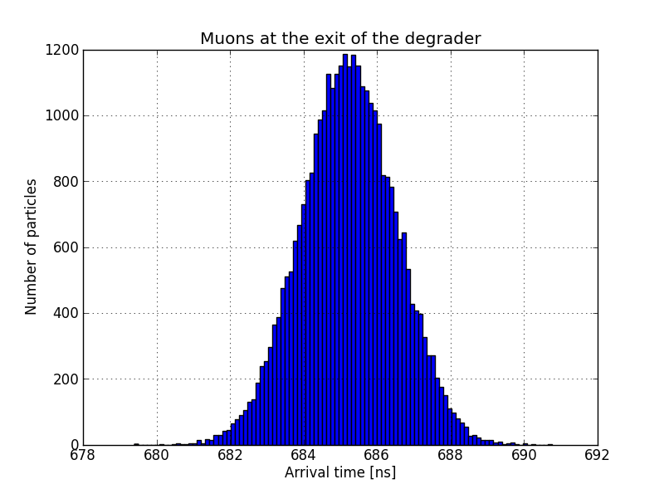
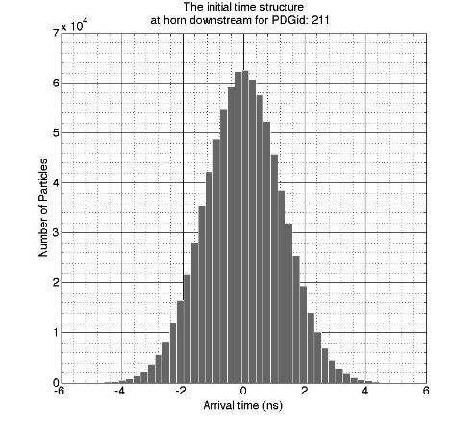
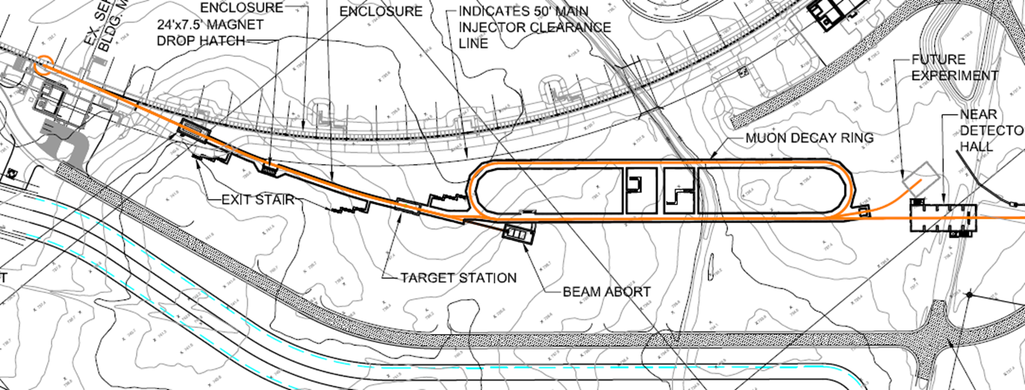
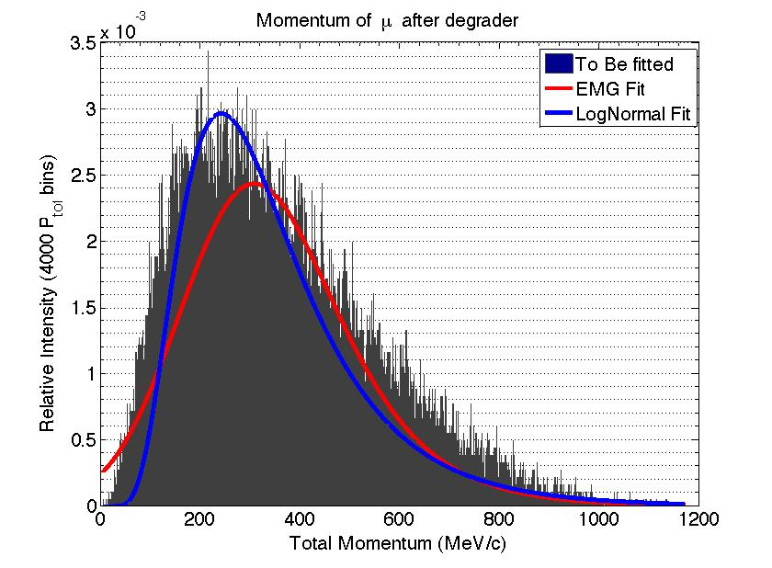
Muon beam @ nuSTORM
Simulations by Ao Liu

Slide 7
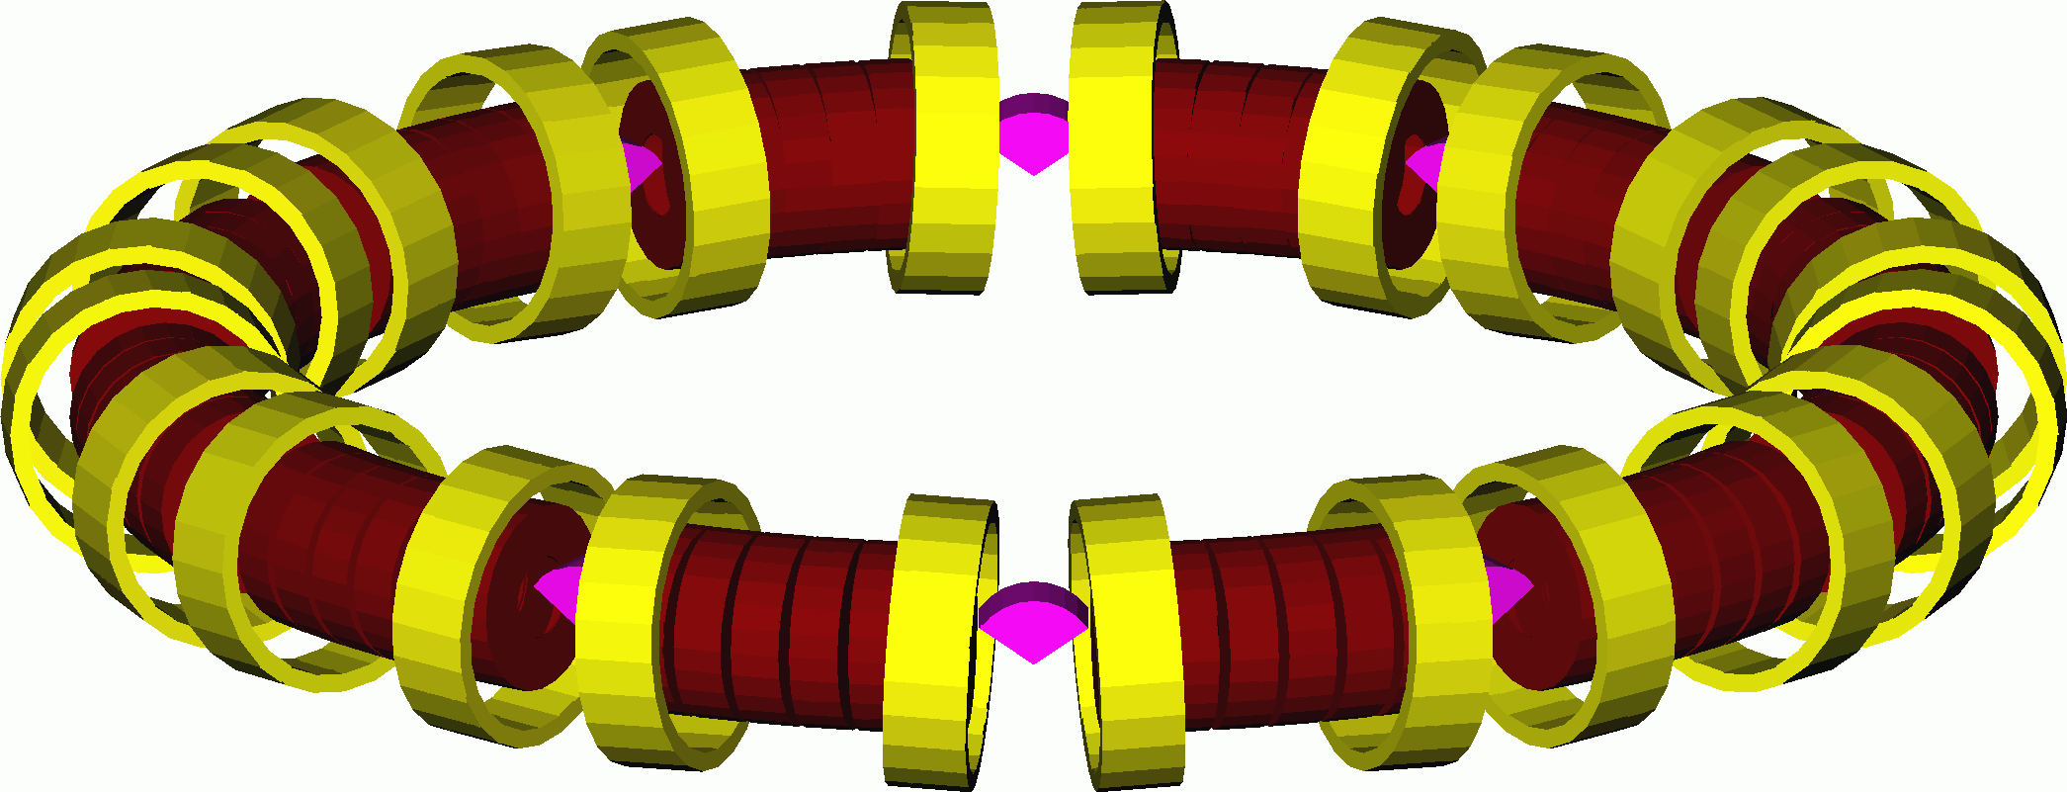
Cooling cells
Two cells of a basic 201.25 MHz RFOFO cooling channel.
No matching section.
Aperture is limited to 25 cm (for beam size calculation).
9.4% transmission within aperture cuts.

Slide 8
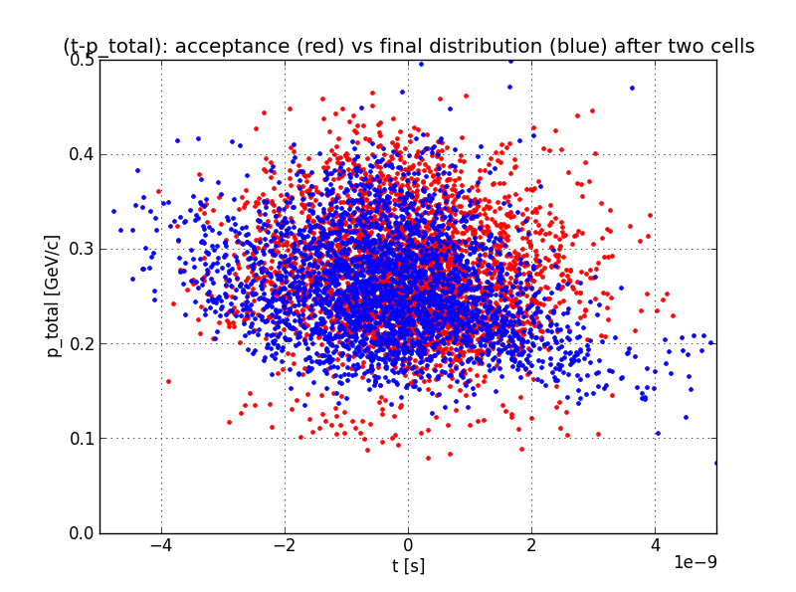
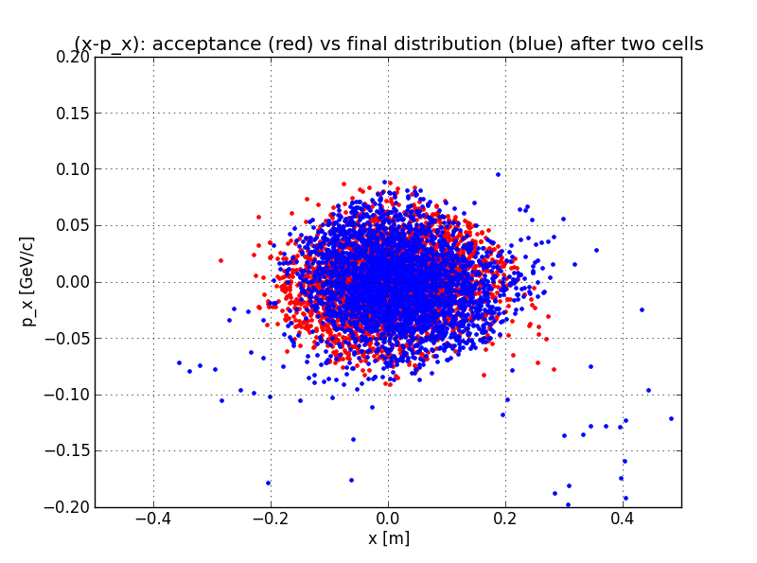
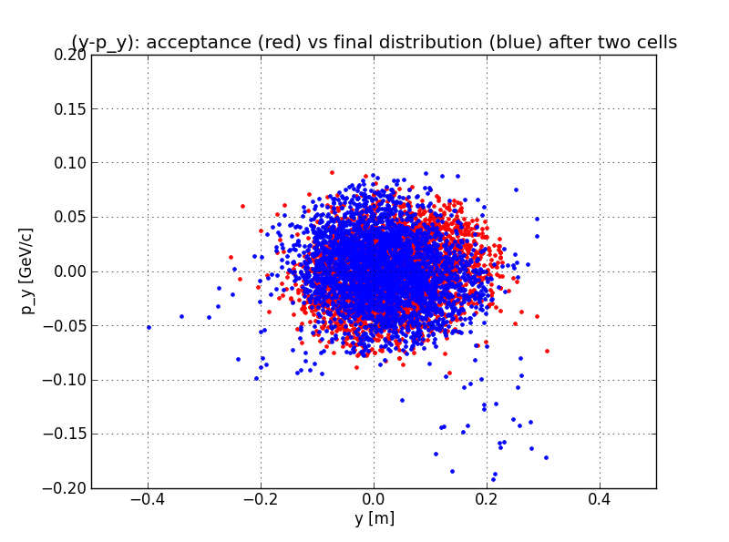
Distribution before and after
(ΔT-P_{total})
(x-p_{x})
(y-p_{y})
Acceptance (red) and distribution
after two cooling cells (blue)
No observable cooling in transverse or longitudinal direction, but no heating either.
Matching section is required.
The result will be worse with a 325 MHz cell.

Slide 9
nuSTORM beam structure
80-85 bunches @ 53 MHz (18.8 ns)
About 1.33 sec apart
10¹⁰ muons per pulse in the range (0,300) MeV/c
How to match to the experiment?
  53x6 = 318 MHz, 53x12 = 636 MHz, 53x15 = 795 MHz
More cooling cells vs more precise diagnostics?
Longitudinal diagnostics: single-particle vs multi-particle?
Background is not an issue (simulated by Ao Liu)

Slide 10
Example: Use nuSTORM beam
(Slide by Katsuya Yonehara)
Spectrometer
RF buncher
or 6D cooling
6D cooling
Add RF
Phase rotator
x-y slit
Front end
• x-y & E matching
• 6D detector
Middle
Back end
x-y slit
• RF buncher: Capture muons in an RF bunch
Possibly, it can be a 6D cooling lattice with
zero-crossing RF system w/o cooling material
• Add RF phase rotator in front of a spectrometer
Increase number of useful muons in a 6D cooling

Slide 11
Summary
The above discussion is not unique to the nuSTORM beam
6D ICE detectors should be relatively independent of the cooling channel choice
Once we have decided on the Vacuum RF 6D cooling scheme + bench test cell, the simulations can be redone with that particular channel (and corresponding matching section) in mind.

