Slide 1
Frontier Capabilities Working Group Summary
Mark Palmer
for the Study Group Conveners
High Energy Physics Advisory Panel Meeting
September 5, 2013
The National Science Foundation

Slide 2
Outline
Study Group Structure
Underground detector facilities (M. Gilchriese)
Accelerator-based facilities (W. Barletta)
Underground Detector Facility Overview
a Summary
Accelerator Capabilities Overview
a Summary
In advance: My acknowledgments particularly to Bill and Gil,
as well as the sub-group conveners and various contributors to
the Frontier Capabilities Group

Slide 3
Study group Structure

Slide 4
Underground Detector Capabilities
Convener: Murdoch Gilchriese (LBNL)
Sub-groups
NAF1: Underground facilities to support very large detectors for neutrino physics, proton decay and other science requiring detectors on the multi-kiloton scale
K. Heeger (Wisconsin), K. Scholberg (Duke), H. Sobel (UC-Irvine)
NAF2: Underground facilities for dark matter experiments, neutrinoless double beta decay experiments, underground accelerators for nuclear astrophysics or other physics, low background assay of materials, and related topics
P. Cushman (Minnesota), J. Klein (Pennsylvania), M. Witherell (UCSB)
Underground facilities in support of instrumentation development in both working groups
P. Cushman (Minnesota), M. Gilchriese (LBNL)
Neutrinos and Society (primarily detectors for non-proliferation monitoring and geo-antineutrino detection)
A. Bernstein (LLNL)

Slide 5
Accelerator Capabilities
Convener: Bill Barletta (MIT, USPAS)
Sub-groups
Proton Colliders
M. Battaglia (UCSC), M. Klute (MIT), S. Prestemon (LBNL), L. Rossi (CERN)
Lepton Colliders
M. Klute (MIT), M. Battaglia (UCSC), M. Palmer (FNAL), K. Yokoya (KEK)
Intensity Frontier Protons
J. Galambos (ORNL), M. Bai (BNL), S. Nagaitsev (FNAL)
Intensity Frontier Electrons and Photons
G. Varner (Hawaii), J. Flanagan (KEK), J. Byrd (LBNL)
Accelerator Technology:
G. Hoffstaetter (Cornell), W. Gai (ANL), M. Hogan (SLAC), V. Shiltsev (FNAL)

Slide 6
Underground Detector facility Summary

Slide 7
Underground Detector Capabilities
Underground facilities/capabilities are essential for the support of the world-wide experimental program
Direct dark matter experiments
Neutrinoless double-beta decay (0νββ) experiments
Atmospheric, long-baseline, reactor, solar, supernova…. neutrino experiments
Proton decay
Connections to astrophysics, nuclear and earth science, and detectors for non-proliferation
US participation
Roughly 1,000 US scientists participating in underground experiments (including US-led Antarctica effort)
~30-50% future growth?

Slide 8
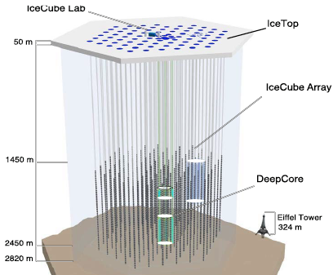
Existing/Planned Facilities
Space Requirements
No technical showstoppers in creating and outfitting underground/ice space for planned activities on the 10-20 year timescale
World-wide “general purpose” space expected to double by end of decade
Depth
Current
Proposed
Unique US-led
Facility
Volume (m³)

Slide 9
Underground Capabilities: Experiments I
Dark Matter
G2 experiments can be accommodated by existing/planned facilities
Most G2 experiments outside US, but strong US participation and (in many cases) leadership
G3 experiments
~5-10x volume of G2
Depth requirements not clear, but depth of major G2 facilities probably OK
No present US underground hall is sufficiently large & deep
Not yet ready to develop facility plans for a large directional experiment
0νββ
Several experiments under construction (all but 1 outside US) with strong US involvement in many
Next Generation Experiments (ton-scale)
Space available in existing/planned facilities, but competing with G2/3 DM exp’ts
Depth requirements depend on technology – more information likely on 2-year timescale
US plan – large participation in one new experiment (some participation possible in others)
Not clear whether an existing US facility could host such an experiment
Longer term – path to >ton-scale experiments not clear (new space/facilities?)

Slide 10
Underground Capabilities: Experiments II
Long Baseline νs, Nucleon Decay and Atmospheric νs
International effort proposed for CP violation search (ν beams/massive detectors)
Atmospheric neutrinos + large underground detector a potentially gives sensitivity to all currently unknown oscillation parameters
Underground detectors could simultaneously support the search for nucleon decay, atmospheric neutrinos and other physics
a Plan for HyperK and LBNO – a lost opportunity if not achieved with LBNE
Low-Energy νs in Large Detectors
Opportunities for physics/astrophysics from supernova ν burst
SN capability typically free with an underground detector (surface detector very difficult)
Bursts are rare (~30 yr intervals) a must gather as much information as possible
Diverse flavor sensitivity important (eg, LNBE ν_{e} sensitivity) – lost with surface detector
Future solar ν detector requires large underground detector
Observation of MSW transition region and searches for new physics
Measurement of CNO νs and resolution to the solar “metallicity problem”
Other physics opportunities exist (diffuse supernova, geological,…)

Slide 11
Underground Capabilities: Experiments III
Reactor and Other νs
Detectors for Reactor Experiments
At >100m baseline require hundreds of mwe overburden
Strong US involvement in recent overseas experiments
Future Reactor Experiments
Overseas efforts directed towards medium (~50km) baselines
Funding commitments from host countries (RENO-50, JUNO)
Potential US involvement but no US facilities
Potential for Synergies with Non-Proliferation Activities
kT-scale water detectors for non-proliferation
Example: Detector with 1600 mwe at Fairport Mine (near Cleveland, former IMB site)
Potential for New Sources
Cyclotrons, intense sources or modular reactors may enable new oscillation experiments in the US and around the world

Slide 12
Underground Capabilities: Infrastructure & Access
Infrastructure
Global Underground Facilities Needs
Required for materials assay, storage and, in some cases (eg, radiopure Cu) production
Assay needs: world-wide requirements outstrip existing capabilities a more required
Required for small prototype testing, experiments and R&D a only way to validate background performance of new technologies
US Facilities
Current infrastructure space appears sufficient if maintained
Past agency investments along with leveraging state, university, private and non-proliferation funds could make it cost effective to maintain the current infrastructure
Will require improved coordination among the US labs to realize this potential
Access
Access to facilities varies around the world
Domestic competition (not fully open) n Proposals and PAC-like structure (as with accelerator labs)
Important to move towards open, competitive access as experiments grow in size
International Balance
Governments: Ideally each major country (or region) would support a major facility capable of hosting forefront experiments
Not clear whether international support could be maintained if one country chose to take a major role in the research without supporting a facility

Slide 13
Underground Capabilities: Summary
Significant expansion in non-US underground capabilities is expected by the end of this decade
It is critical that US scientists continue to be supported in order to take advantage of future international and domestic underground facilities
Key goals for the US Planning Process:
Put LBNE underground
Realize it's full science potential!
Makes it an anchor of possible future domestic underground capabilities at SURF
Maintain the leading roles held by the US in many of the future dark matter, 0νββ and a large variety of ν experiments.
Improved coordination and planning of underground facilities (overseas and domestic) is required to maintain this leading role, including the use of US infrastructure
Maintaining an underground facility that can be expanded to house the largest dark matter and 0νββ experiments would guarantee the ability of the US to continue its strong role in the world-wide program of underground physics

Slide 14
Accelerator-Based Facility Summary

Slide 15
The HEP Accelerator “Big Questions”
The Following Questions Are Inherently Long Term
How would one build a 100 TeV scale hadron collider?
How would one build a lepton collider at >1 TeV?
How would one generate 10 MW of proton beam power?
Can multi-MW targets survive? If so, for how long?
Can plasma-based accelerators achieve energies & luminosities relevant to HEP?
Can accelerators be made 10x cheaper per GeV? Per MW?

Slide 16
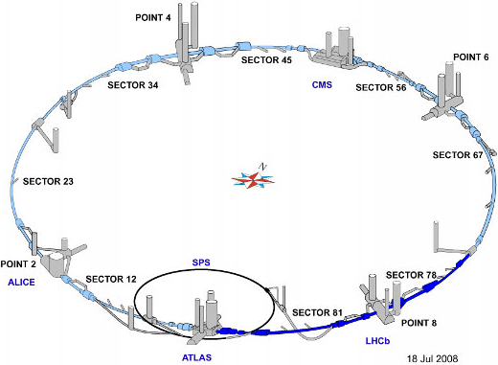
Energy Frontier Proton Colliders I
The Key Questions
What luminosity is possible for the LHC?
Strategies for increased integrated luminosity
Avoid impaired data and degradation of the detectors
What energy can be achieved in the LHC tunnel?
What is the future for the Energy Frontier Hadron Colliders beyond the LHC?
What are the challenges of a 100 TeV collider?
What is the accelerator R&D roadmap for LHC and post-LHC capabilities?
The Near-Term Priorities – Full Exploitation of the LHC
Continue a strong LHC Accelerator R&D Program a Hi Lumi LHC Construction Project
Develop the technologies required for a High Energy LHC a Achieve Engineering Readiness
Next generation Nb₃Sn magnets (~15T scale)
Advanced beam control technology
Represents the most critical near-/mid-term development effort for higher energy hadron colliders
However, the high energy reach of the LHC is limited…
without magnet engineering materials beyond Nb₃Sn (high temperature SC development being pursued)
with challenges in managing synchrotron radiation
a Focused engineering is not a substitute for innovative R&D

Slide 17
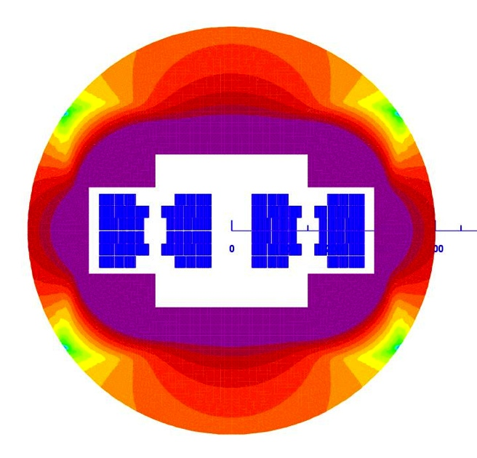
Energy Frontier Proton Colliders II
Long-Term Options Beyond the LHC
Extensive interest was expressed at Snowmass in a 100 TeV pp collider
US-led VLHC study (~2001) still valid a updated with a Snowmass whitepaper
Interest at CERN (coupled to TLEP study)
US participation in a new design study would help inform plans for future technology R&D a Participation in such a study is recommended
Accelerator R&D Roadmap: LHC Upgrades a post-LHC
Advanced magnets
New engineering conductors (e.g., small filament HTS)
Improved temperature margin, stress management techniques, magnet protection, and structural materials
Beam dynamics
Effects of marginal synchrotron radiation damping
Beam physics of the injection chain
Control of beam halo
Noise & ground motion effects
Machine protection & beam abort dumps (multi-GJ beams)
Interaction Region design & technology options
NOTE: Strong technology overlap with muon / intensity machines
HE-LHC Magnet Concept

Slide 18
Energy Frontier Lepton & Photon Colliders I
The Key Questions
Can ILC & CLIC designs be improved using new technologies?
Can they be constructed in stages? what is a staging plan?
What would be the parameters of a Higgs factory as a first stage?
Higgs factories
Could a Higgs factory be constructed in the LHC tunnel?
What would be parameters of a photon collider Higgs factory
Could one build a µ+µ- collider as a Higgs factory?
Could one design a multi-TeV µ+µ- collider?
What is the accelerator R&D roadmap?
Excitement & boundary conditions are driven by the Higgs discovery
The Japanese Initiative – Proposal to Host the ILC
The Japanese initiative is welcomed
With the release of the TDR by the ILC Global Design Effort, the ILC technical design is ready for a decision
Major US contributions to and leadership roles in machine physics & technology: SRF, high power targetry (e+ source), beam delivery, damping rings, and beam dynamics
Importance of an upgrade path to higher energy (> 500 GeV) & luminosity (> 10³⁴ cm⁻²s⁻¹) has been emphasized
The US accelerator community is capable of contributing… As supported by the physics case and as part of a balanced program The US can offer an experienced & ready team

Slide 19
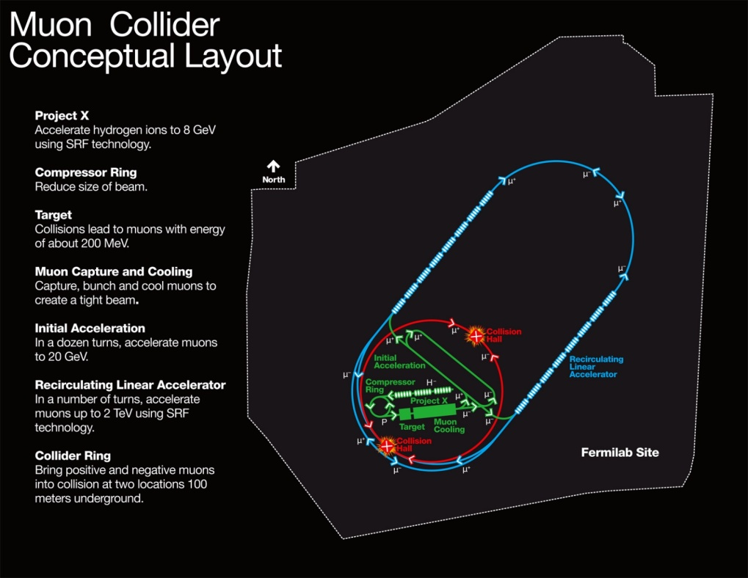
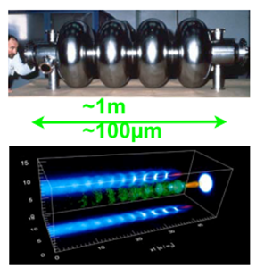
Energy Frontier Lepton & Photon Colliders II
Alternative Higgs Factory Approaches
e⁺e⁻ ring in a very large tunnel (50-100km circumference)
Significant extrapolation, but from large experience base
Energy reach & luminosity are very strongly coupled
Largest luminosity at Z peak, falling rapidly √s increases
Tunnel could support a 100 TeV proton collider option
Muon collider – Feasibility assessment underway
Options for Higgs Factory (s-channel H production) a 10 TeV collider - on Fermilab site
Photon collider
Options for add-on to a linear collider and for a standalone facility presented
Builds on US expertise in high power lasers (overlap with laser wakefield accelerator needs)
Muon Collider Concept
on Fermilab Site
HF Concepts span a broad range of technical readiness
Accelerator R&D Roadmap: Research For a Compact Multi-TeV Collider
Motivated by lower cost, smaller footprint, and higher energy capability
Support the integrated US R&D program toward demonstrating muon collider feasibility (MAP)
Enable completion of the feasibility assessment near the end of this decade
Closely connected with intensity frontier & intense neutrino sources
Strong magnet synergies with LHC energy upgrades
Stay involved in high gradient, warm linac approach (CLIC)
Practical energy reach: wakefield control, accelerating gradient
Industrialization path to be developed
Continue R&D in wakefield accelerators (plasmas & dielectric)
Fruitful physics programs with high intellectual content
Feasibility issues: Positron acceleration, multi-stage acceleration, control of beam quality, plasma instabilities at 10’s of kHz rep rate
All variants require an integrated proof-of-principle test
Maximizing RF Efficiency is Crucial!

Slide 20
High Intensity Proton Sources I
The Key Questions
What secondary beams are needed for IF experiments?
What proton beams are needed to generate these?
> 1 MW , flexible timing structure
Can these be made by existing machines?
What new facilities are needed to deliver 1) ?
What accelerator / target R&D is needed to realize 4?
Approach to Setting Priorities – Intensity Frontier a Diversity
Survey of anticipated particle physics requirements for secondary beams (i.e. neutrino, kaon, muon, neutron,…)
19 secondary beam requests filled out by experiment advocates
Derived primary proton beam characteristics
Common characteristics of required beams
High average power (> 1 MW)
Flexible time structure
Compared with existing proton beam characteristics
20 existing proton beam lines + 14 planned upgrades
a Conclusion: Next generation of intensity frontier experiments will require proton beam intensities & timing structures beyond the capabilities of any existing accelerators

Slide 21
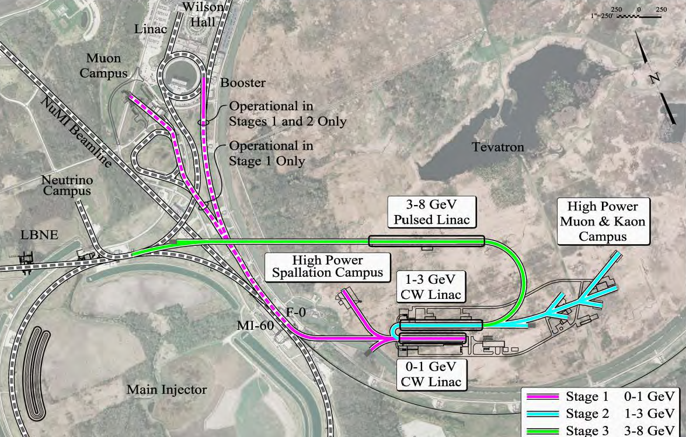
High Intensity Proton Sources II
Project X – Can Provide a World-Leading Facility for Intensity Frontier Research
Based on a modern multi-MW SCRF proton linac
Flexible “on-demand” beam structure
Could serve multiple experiments over broad energy range
Supports 0.25 – 120 GeV
Platform for future muon accelerator facilities: IF/ν Factory (NuMAX) & EF/Muon Collider
Complete, integrated concept Reference Design Report
arXiv:1306.5022
R&D program underway to mitigate risks in Reference Design
Undertaken by 12 U.S. & 4 Indian laboratories and universities
a Construction could be initiated in the last half of this decade
Capabilities with Narrower Experimental Scope
DAEδALUS: Decay At Rest anti-neutrinos – short baseline ν oscillations
3 multi-MW H₂⁺ cyclotrons/target stations located ~2-20km from experiment large hydrogenous detector
First stage: IsoDAR – compact cyclotron 15 m from Kamland
International collaboration with strong industry connection
nuSTORM: Neutrinos from STORed Muons
Supports sterile neutrino & neutrino cross-section experimental program using existing accelerator technology - also muon accelerator R&D
Muon storage ring sends well-characterized beams to near & far detectors at 50 m & 1900 m
Potential first step towards a long baseline neutrino factory capability

Slide 22
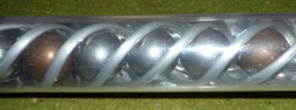
High Intensity Proton Sources III
Intensity Frontier Accelerator R&D Issues
High quality, high current injection systems
Low emittance, high current ion sources
Effective beam chopping
Space charge control
SCRF acceleration (Project X, muons)
Multi-MW cyclotrons DAEδALUS
Radiation resistant magnets
Very high efficiency extraction
& Understanding and controlling beam loss
Efficient collimation
Beam dynamics simulations of halo generation
Large-dynamic-range instrumentation
High Power Target Design
High Power Targetry – A Particularly Challenging R&D Issue
Displacements & gas production are the main underlying damage mechanisms
Particulars depend on primary beam characteristics, material, …
Can not simply scale from nuclear power experience
Targets are difficult to simulate
Radiation effects need validating (inhomogeneous, time-varying)
Thermo-mechanical models complex
Poorly understood failure criteria (classical limits may be too conservative)
Need controlled, instrumented in-beam tests & Need a source before you can test materials
Takes a long time to build up data (accelerated testing)
Requires a structured R&D program a International RADIATE collaboration has been formed

Slide 23
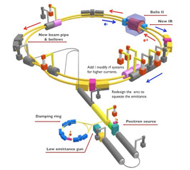
High Intensity Electron and Photon Beams I
The Key Questions
What additional accelerator capabilities at heavy flavor factories are required to realize the full range of physics opportunities?
What new or existing accelerator-based facilities provide opportunities for dark sector / axion searches ?
What are new physics opportunities using high power electron and photon physics?
What accelerator and laser R&D is required to realize the physics opportunities in these areas?
Capabilities Desired For Heavy Flavor Factories
Super B-Factory (SuperKEKB):
Important US contributions to design by both labs & universities
Participation in commissioning & machine studies desirable
Luminosity upgrades (needs physics case)
Polarized beams (refine physics case)
Technical feasibility
Tau-charm Factory beyond BEPC-II
What kind of facility would be interesting? (needs physics case)
What luminosity is needed? Is polarization necessary?
Factory machines require BOTH high intensity & low emittance beams
a Many areas of overlap with LC damping ring & light source R&D efforts
History of fruitful international collaborations/cooperation

Slide 24
High Intensity Electron and Photon Beams II
Opportunities for HEP Using FEL Facilities
“Flashlight through a wall” experiments using high-intensity photon beams in strong magnetic fields
JLab/MIT: Dark Light axion search
Search parameters are unconstrained
Use existing facilities
keV level searches can use X-ray FELs
More speculative: Generating low emittance muon beams from intense positron beams
Accelerator Development Roadmap for e⁺e⁻ Intensity Frontier Machines: Exploit synergy with light sources
Beam stability & control
Examples: Electron cloud & fast ion instabilities
Coherent Synchrotron Radiation issues with short bunches
High-rate injection
High top-up rate to compensate for low lifetimes
Timing jitter, and attendant energy jitter
Low-emittance beam issues
Beam instrumentation
Presents an ongoing opportunity for collaboration across a broad accelerator community

Slide 25
Accelerator Technology Test Beds I
The Charge
Identify broad range of test capabilities existing or needed
Category 1: Provides testing beam physics / accelerator components to manage technical risks in planned projects
Category 2: Integrates proof-of-practicality tests
Category 3: Provides tests of physics feasibility of concepts / components
Identified Capabilities
35 existing facilities were identified
Beam / no-beam
US & overseas

Slide 26
Hadron Colliders: LHC Lumi & Energy Upgrades, VLHC
Technical Challenges | Existing Capabilities | Planned Capabilities
High performance SC wire | Critical industry couplings
High Field SC magnets | LBNL, FNAL, BNL, CERN
SR and photon stops | Electron storage rings
Collimation | LHC, RHIC, FNAL-MI
Injectors - SCRF | SNS (limited) | PXIE@FNAL
Injectors – Space charge | FNAL-Booster, AGS, PS | ASTA@FNAL
Beam cooling (optical, coherent) |  | ASTA@FNAL, RHIC Cool
Injector studies need new, dedicated facilities
Lepton Colliders: ILC and Beyond
Risk Reduction Areas | Existing Capabilities | Planned Capabilities
ILC: SRF-system no beam | JLab, Cornell, Industry
ILC: SRF system with beam | DESY, KEK, Cornell, LLNL | ASTA@FNAL
ILC: FF, Damping Rings, e+ Production | KEK, Cornell, LLNL
Practicality/Feasibility Tests | Existing Capabilities | Planned Capabilities
CLIC NCRF 2-beam | CERN
Muon Colliders – technical components | MuCool Test Area (MTA@FNAL)
Muon Colliders – 4D/6D ionization Cooling | MICE@RAL | nuSTORM
Wakefield accelerators – acceleration demo/staging | SLAC, LBNL, ANL | Upgrades to existing facilities
Wakefield accelerators – luminosity / beam control |  | Needs integrated testbed
Energy reach beyond the ILC will need new test capabilities

Slide 27
Intensity Frontier Accelerators: Includes Project X, DAEδALUS, Neutrino Factory
Technical Challenges | Existing Capabilities | Planned Capabilities
Project X: H⁻ source & chopping | SNS | PXIE@FNAL
Project X: CW SC RF (low beta) | Atlas@ANL | PXIE@FNAL
Project X: Pulsed SC RF, space charge |  | ASTA@FNAL
DAEδALUS: H₂⁺ source | LNS Catania
DAEδALUS: Multi-MW cyclotrons | PSI, RIKEN, ORNL, Best
Neutrino Factory | See Muon Collider
Instabilities, collimation, extraction | FNAL, RHIC
Dedicated high power targetry |  | Critical Need
A new generation of IF machines needs new test facilities
Intensity Frontier Accelerators: Flavor Factories and Electron-Ion Colliders
Technical Challenges | Existing Capabilities | Planned Capabilities
Beam instabilities, Interaction region optics | Existing Rings
IP designs, collimation | BNL, CERN
Non-standard beam-beam |  | Needed
Intense polarized e⁻ source | JLab, BNL, Cornell
CW SRF (β = 1) | Cornell, JLab, BNL, KEK | CERN
Heavy ion sources | MSU, LBNL
Good test facility basis for technical design of HEP machines

Slide 28
Accelerator Capabilities: Summary
A broad range of accelerator-based capabilities has been reviewed
Key goals for the US Planning Process:
Fully exploit LHC capabilities and its upgrade path
Complete its physics program
Support the R&D for the next steps
The Japanese initiative to host a linear collider as a Higgs Factory is welcome
The US accelerator community is capable of making significant contributions
A clear upgrade path to higher energy and luminosity is necessary
The next generation of Intensity Frontier experiments require proton intensities and timing structures which are beyond current capabilities
Project X can provide a world-leading facility to satisfy these needs
Facilities with more narrowly defined scope may also have a role to play
Intensity Frontier colliders and photon sources have strong synergies with other parts of the accelerator community (eg, light sources)
Support for key R&D is required
Participate in planning for a 100 TeV Collider
Continue the R&D efforts toward a more compact multi-TeV lepton collider capability: Muon Collider, LC technologies (warm RF, wakefield)
Dedicated test facilities will be required to develop future HEP capabilities

Slide 29
Thank YOu

