Slide 1
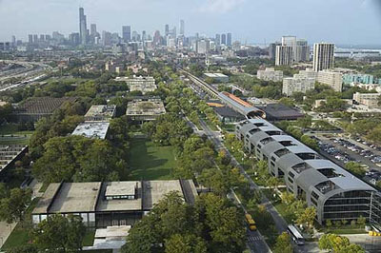
Muon Accelerators for the Next Generation of High Energy Physics Experiments
Mark A. Palmer
Director, U.S. Muon Accelerator Program
September 9, 2013

Slide 2
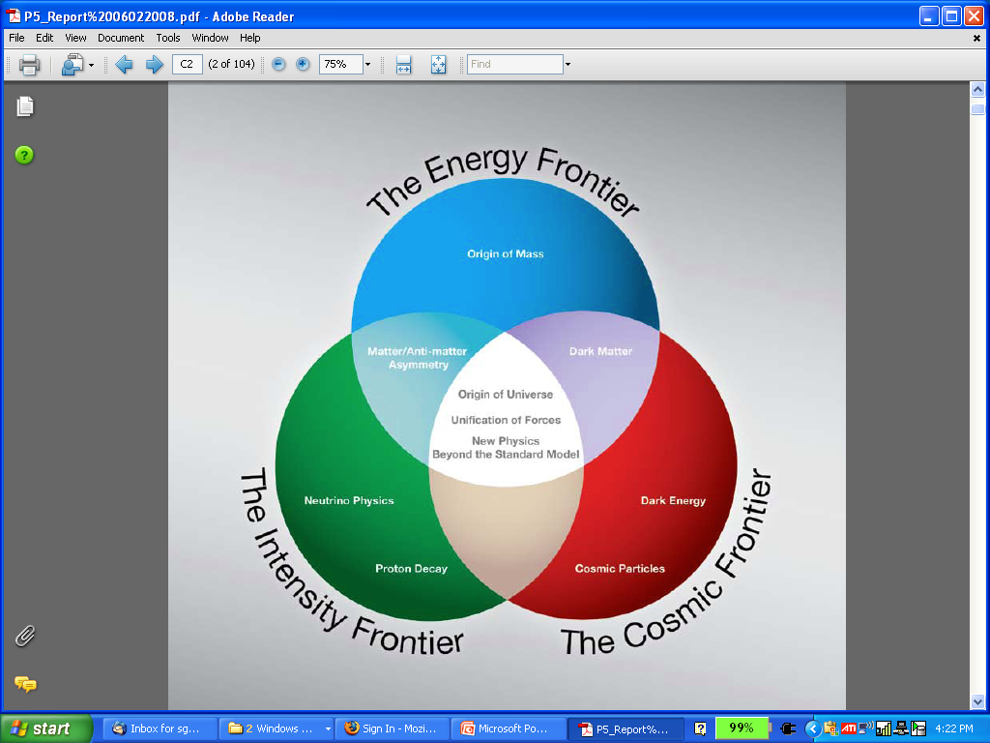
The Aims of the U.S. Muon Accelerator Program
  Muon accelerator R&D is focused on developing a facility that can address critical questions spanning two frontiers…
  The Intensity Frontier:
  with a Neutrino Factory producing well-characterized ν beams for precise, high sensitivity studies
  The Energy Frontier:
  with a Muon Collider capable of reaching multi-TeV CoM energies
  and
  a Higgs Factory on the border between these Frontiers
The unique potential of a facility based on muon accelerators is physics reach that SPANS 2 FRONTIERS

Slide 3
Outline
Introduction
Physics Motivations for a Neutrino Factory and Muon Collider
Muon Collider and Neutrino Factory Synergies
R&D Challenges and the MAP Feasibility Assessment
Concluding Remarks

Slide 4
Introduction

Slide 5
Why a Muon Collider?
First – why a lepton collider?
  In proton (or proton-antiproton) collisions, composite particles (hadrons), made up of quarks and gluons, collide
    The fundamental interactions that take place are between individual components in the hadrons
    These components carry only a fraction of the total energy of the particles
    For p-p collisions, the effective interaction energies are O(10%) of the total center-of-mass (CoM) energy of the colliding protons
    Thus a 14 TeV CoM energy at the LHC probes an energy scale
    E < 2 TeV
  Electrons (and positrons) as well as muons are fundamental particles (leptons)
    Leptons are point-like particles
    Their energy and quantum state are well understood during the collision
    When the leptons and anti-leptons collide, the reaction products probe the full CoM energy
    Thus a few TeV lepton collider can provide a precision probe of the full energy range of fundamental processes that are discovered at the LHC

Slide 6
Muon (μ⁺μ⁻) Colliders vs Electron-Positron Colliders (I)
Now – why a muon collider?
s-Channel Production
  When 2 particles annihilate with the correct quantum numbers to produce a single final state. Examples:
  e⁺e⁻ g Higgs OR μ⁺μ⁻ g Higgs
  The cross section for this process scales as m² of the colliding particles, so:
  Thus a muon collider offers the potential to probe the Higgs resonance directly
    The luminosity required is not so large
    A precision scan capability is particularly interesting in the case of a richer Higgs structure (eg, a Higgs doublet)

Slide 7
Muon (μ⁺μ⁻) Colliders vs Electron-Positron Colliders (II)
Synchrotron Radiation
  In a circular machine, the energy loss per turn due to synchrotron radiation can be written as:
  where ρ is the bending radius
  If we are interested in reaching the TeV scale, an e⁺e⁻ circular machine is not feasible due to the large energy losses
  Solution 1: e⁺e⁻ linear collider
  Solution 2: Use a heavier lepton – eg, the muon

Slide 8
Muon (μ⁺μ⁻) Colliders vs Electron-Positron Colliders (III)
Beamstrahlung
  When electrons and positrons collide, the interaction of the particles in one beam with the electromagnetic fields of the other beam results in the radiation of photons (synchrotron radiation) a beamstrahlung
  This broadens the energy distribution of colliding particles and lowers the fraction of collisions that are near the nominal center-of-mass (CoM) energy
  The beamstrahlung effect is
  essentially negligible for a muon
  collider
  a most luminosity is produced
  near the nominal CoM energy
Implications for a Higgs Factory
  With negligible beamstrahlung,
  it may be possible to directly
  probe the width of the Higgs
  Expected width of a standard
  Higgs is ~4.5 MeV
  126 GeV muon collider lattices with
  ΔE/E ∼ 3×10⁻⁵ (3.8 MeV) have been designed
Beamstrahlung in
any e+e- collider
δE/E ∝ γ²

Slide 9
Circular Colliders vs Linear Colliders
Circular machines offer a number of advantages
  Many crossings at an interaction point
    Luminosity multiplier
    For a TeV-scale muon collider, expect to have O(1000) crossings for each bunch
  Multiple detectors can be used
    Luminosity multiplier
    Improved systematics understanding of the detectors
  The additional integrated luminosity from multiple crossings allows larger transverse emittances than are needed for a linear collider. Machine tolerances become much easier
  Acceleration can utilize multiple passes through the RF system
  Overall, the beam and wall power for a circular machine can be significantly less than that for a linear collider

Slide 10
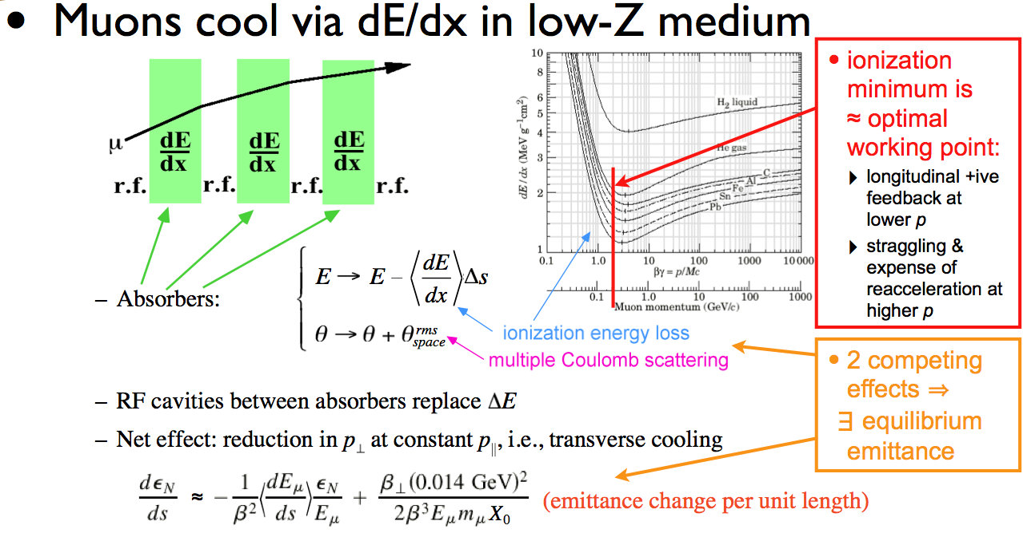
Ionization Cooling

Slide 11
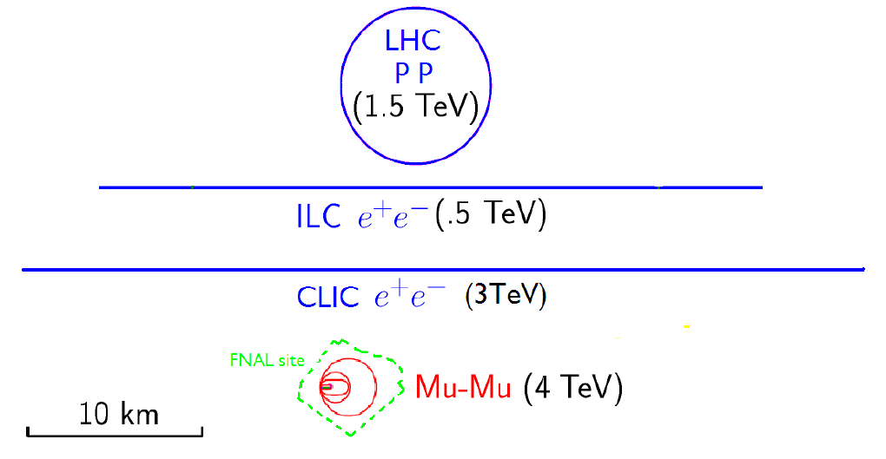
Facility Scales
The footprint of a muon collider can be much smaller than other facilities
  Provides for a more flexible site choice
  Has the potential to provide cost savings in a fully engineered design

Slide 12
Luminosity
The principle parameter driver is the production of luminosity at a single collision point
where
N is the number of particles per bunch (assumed equal for all bunches)
f_{coll} is the overall collision rate at the interaction point (IP)
σ_{x} and σ_{y} are the horizontal and vertical beam sizes (assumed equal for
all bunches)
H_{D} is the luminosity enhancement factor
Ideally we want:
  High intensity bunches
  High repetition rate
  Small transverse beam sizes
Linear Collider Form
Notes:
Disruption enhancement factor has a value around 1.5 for the ILC

Slide 13
ILC Parameters at the Interaction Point
The parameters at the interaction point have been chosen to
provide a nominal luminosity of 2×10³⁴ cm⁻²s⁻¹. With
  N = 2×10¹⁰ particles/bunch
  σ_{x} ~ 640 nm ⇔ β_{x}* = 20 mm, ε_{x} = 20 pm-rad
  σ_{y} ~ 5.7 nm ⇔ β_{y}* = 0.4 mm, ε_{y} = 0.08 pm-rad
  H_{D}~ 1.7
An average collision rate of ~14kHz is required.
Beam sizes at the IP are determined by the strength of the final focus magnets and the emittance (phase space volume) of the incoming bunches.
  A number of issues impact the choice of the final focus parameters. For example, the beam-beam interaction as two bunches pass through each other can enhance the luminosity, however, it also disrupts the bunches. If the beams are too badly disrupted, safely transporting them out of the detector to the beam dumps becomes quite difficult. Another effect is that of beamstrahlung which leads to significant energy losses by the particles in the bunches and can lead to unacceptable detector backgrounds. Thus the above parameter choices represent a complicated optimization.

Slide 14
Muon Collider Luminosity
For a muon collider, we can write the luminosity as:
For the 1.5 TeV muon collider design, we have
  N = 2×10¹² particles/bunch
  σ_{x,y} ~ 5.9 μm  β* = 10 mm, ε_{x,y}(norm) = 25 μm-rad
  n_{turns}~1000
  f_{bunch}=15 Hz (rate at which new bunches are injected)
But this is optimistic since we’ve assumed N is constant for ~1000 turns when it’s actually decreasing. The anticipated luminosity for this case is ~1.2×10³⁴ cm⁻²s⁻¹.

Slide 15
Challenges for a μ⁺μ⁻ Collider
Create pions from a MW-scale proton beam
striking a target
To avoid excessive power requirements, must efficiently capture the produced pions
  Capture of both forward and backward produced pions loses polarization
The phase space of the created pions is very large!
  Transverse: 20π mm-rad
  Longitudinal: 2π m-rad
Emittances must be cooled by factors of 10⁶-10⁷ to be suitable for multi-TeV collider operation
  ~1000x in the transverse dimensions
  ~40x in the longitudinal dimension
  The muon lifetime is 2.2 μs lifetime at rest

Slide 16
Cooling Options
Electron/Positron cooling: use synchrotron radiation
a For muons ΔE~1/m³ (too small!)
Proton Cooling: use
  A co-moving cold e- beam
  a For muons this is too slow
  Stochastic cooling
  For muons this is also too slow
Muon Cooling: use
  Use Ionization Cooling
  a Likely the only viable option
  Optical stochastic cooling
  Maybe, but far from clear

Slide 17
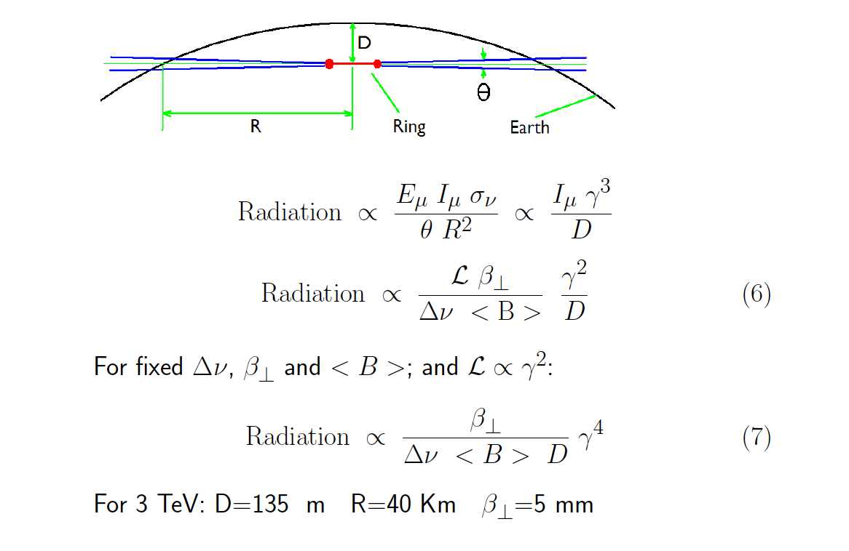
Neutrino Radiation
R. Palmer

Slide 18
THE PHYSICS MOTIVATIONs

Slide 19
The Physics Motivations
Physics potential for the HEP community using muon beams
  Tests of Lepton Flavor Violation
  Anomalous magnetic moment a hints of new physics (g-2)
  Can provide equal fractions of electron
  and muon neutrinos at high intensity for
  studies of neutrino oscillations –
  the Neutrino Factory concept
  Offers a large coupling to the “Higgs mechanism”
  As with an e⁺e⁻ collider, a μ⁺μ⁻ collider would offer a precision probe of fundamental interactions – in contrast to hadron colliders

Slide 20
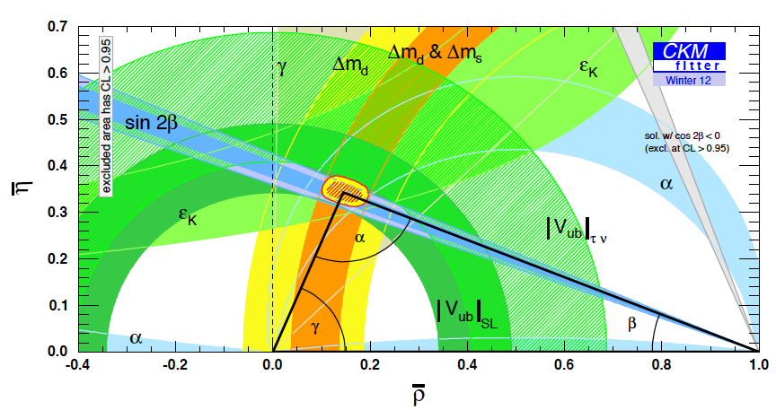
The Physics Needs: Neutrinos (I)
In the neutrino sector it is critical to understand:
  δ_{CP}
  The mass hierarchy
  θ₂₃ = π/4, θ₂₃ < π/4
  or θ₂₃ > π/4
  Resolve the LSND and other short baseline experimental anomalies [perhaps using beams from a muon storage ring (νSTORM) in a short baseline experiment]
  And continue to probe for signs new physics
P. Huber

Slide 21
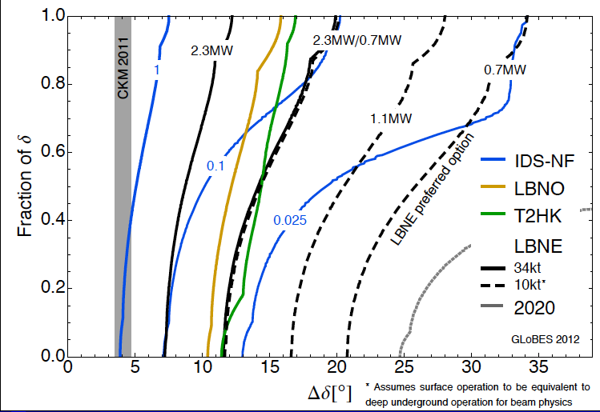
The Physics Needs: Neutrinos (II)
CP violation physics reach of various facilities
Can we probe
the CP violation
in the neutrino
sector at the
same level as in
the CKM Matrix?
0.025 IDS-NF:
700kW target,
no cooling,
2×10⁸ s running time
10-15 kTon detector
P. Coloma, P. Huber, J. Kopp, W. Winter – article in preparation

Slide 22
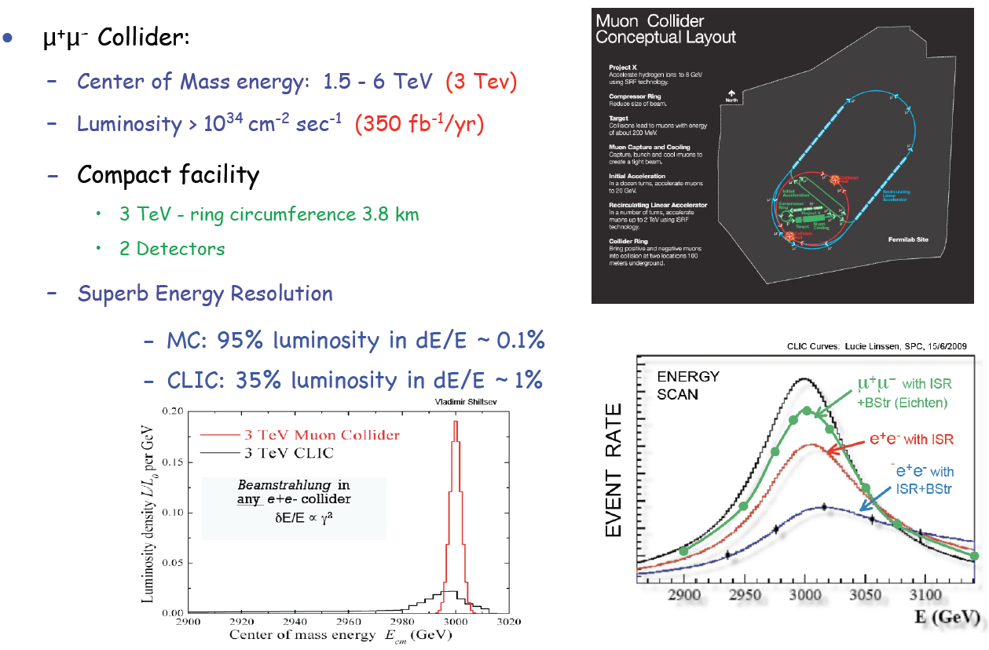
The Physics Needs: Colliders
E. Eichten

Slide 23
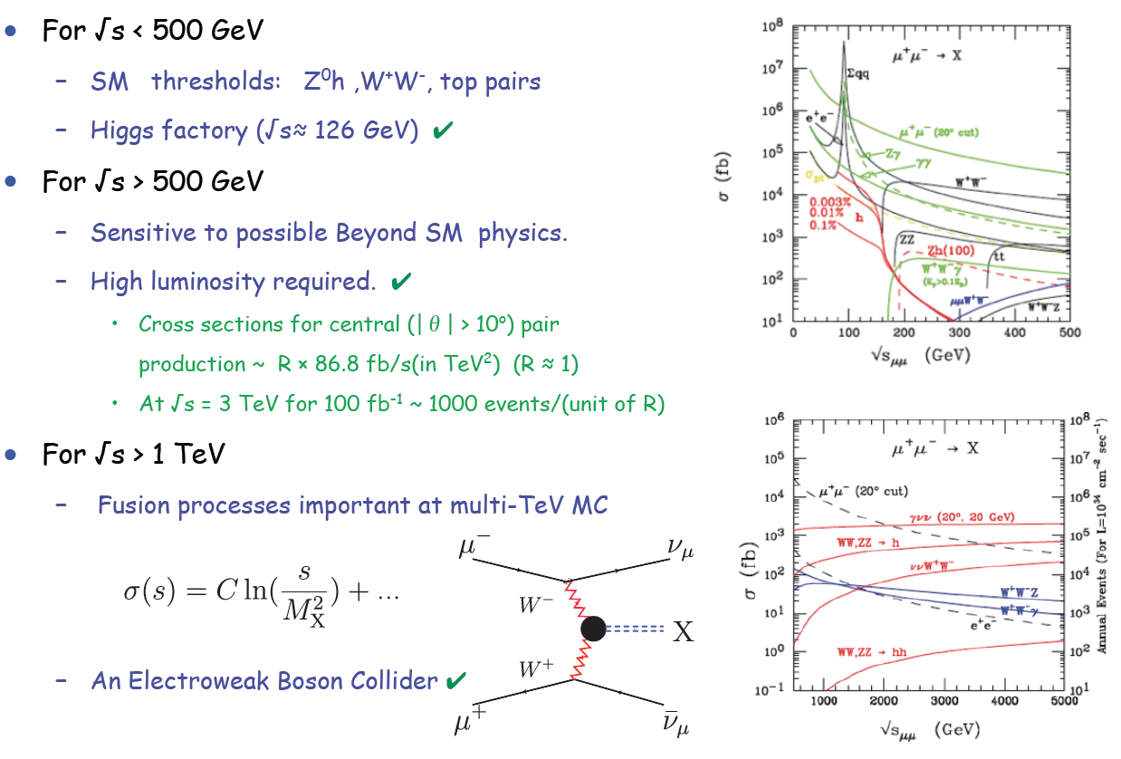
Muon Collider Reach
E. Eichten
A 10 TeV μ⁺μ⁻ collider has similar discovery
reach as a 100 TeV pp machine!

Slide 24
Muon Collider Concept
Muon Collider Block Diagram
Proton source:
For example PROJECT X at 4 MW, with 2±1 ns long bunches
Goal:
Produce a high intensity μ beam whose 6D phase space is reduced by a factor of ~10⁶ from its value at the production target
Collider: √s = 3 TeV
Circumference 4.5km
L = 3×10³⁴ cm⁻²s⁻¹
μ/bunch = 2x10¹²
σ(p)/p = 0.1%
ε_{⊥N} = 25 μm, ε_{//N}=72 mm
β* = 5mm
Rep. Rate = 12 Hz

Slide 25
Muon Collider and neutrino factory synergies

Slide 26
The U.S. Muon Accelerator Program

Slide 27
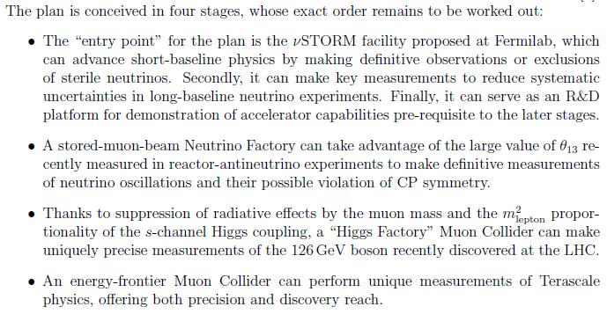
A Staged Muon-Based Neutrino and Collider Physics Program

Slide 28

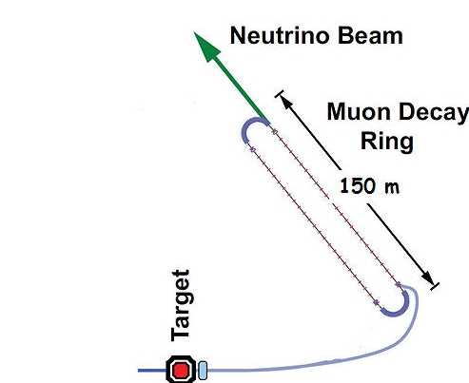
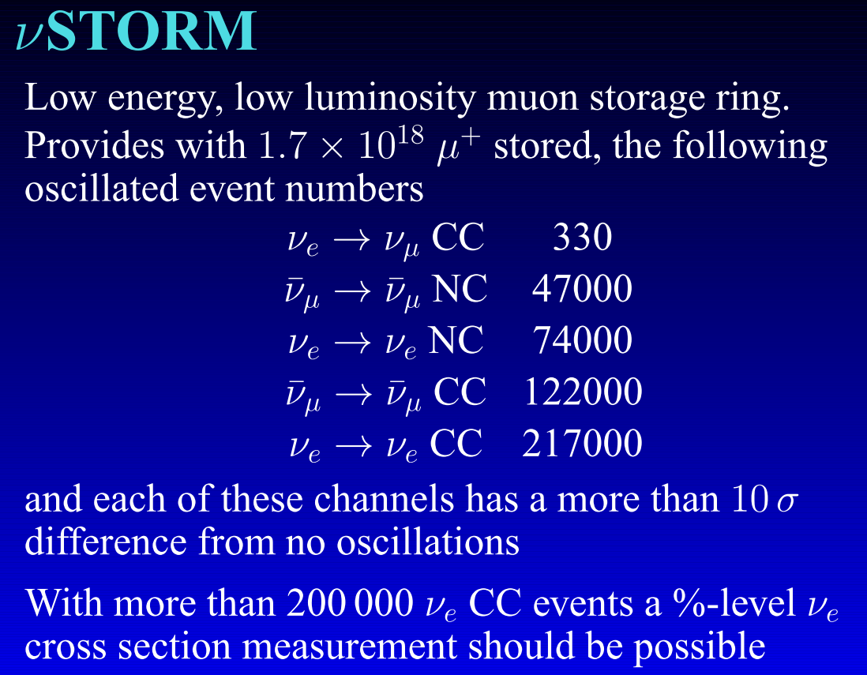
Neutrinos from Stored Muons
(Fermilab P-1028)
An entry-level NF?
A.Bross
NuFACT12
DOES NOT
Require the
Development of
ANY
New Technology
3.8 GeV/c
stored μ
10-100kW
nuStorm Proposal: http://arxiv.org/abs/1308.6822

Slide 29
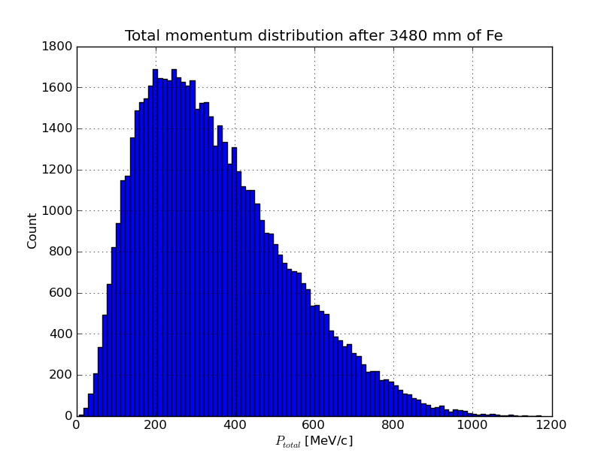
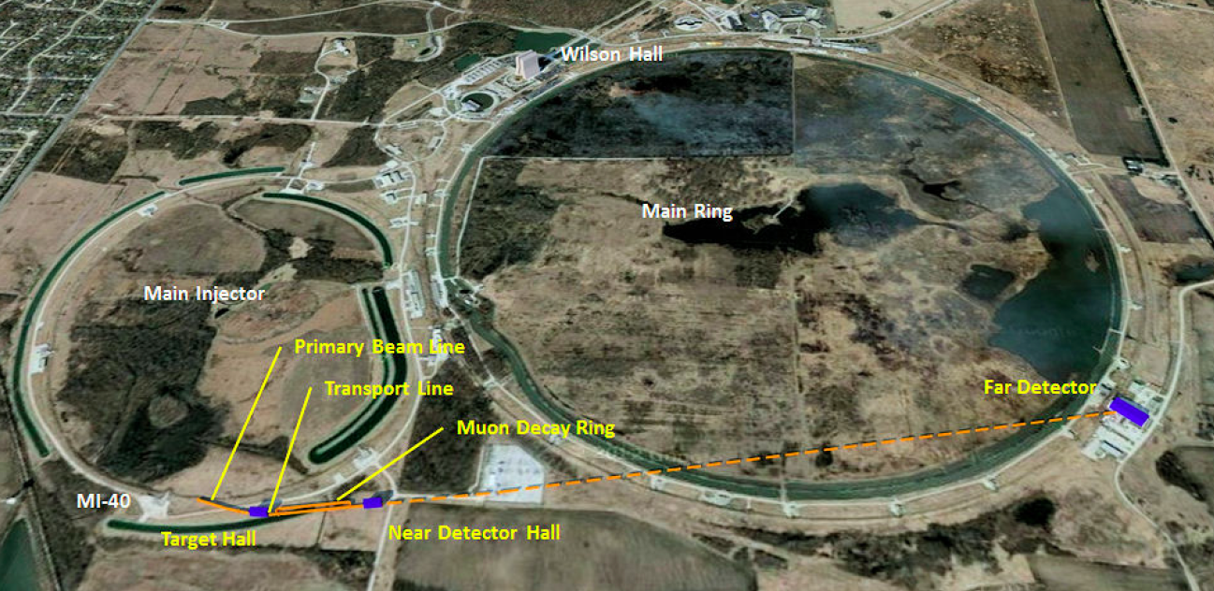
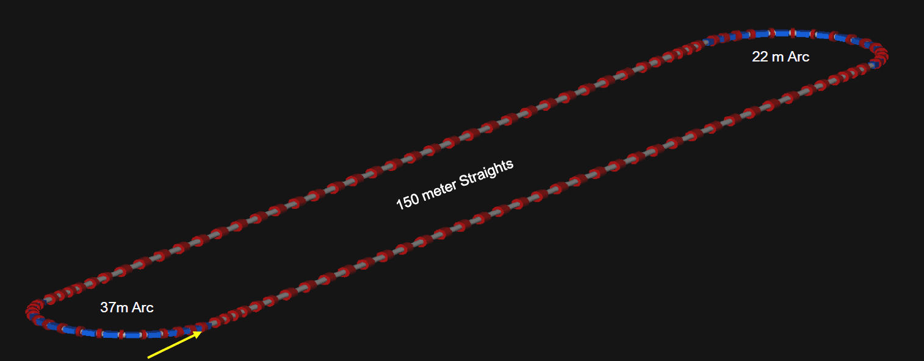
νStorm as an R&D Platform
A high-intensity pulsed muon source
100<p_{μ}<300 MeV/c muons
  Using extracted beam from ring
  10¹⁰ muons per 1 μsec pulse
Beam available simultaneously with physics operation
  Sterile ν search
  ν cross section measurements needed
  for ultimate precision in long baseline measurements
νSTORM also provides the
opportunity to design, build and test decay ring instrumentation (BCT, momentum spectrometer,
polarimeter) to measure and
characterize the circulating muon flux.

Slide 30
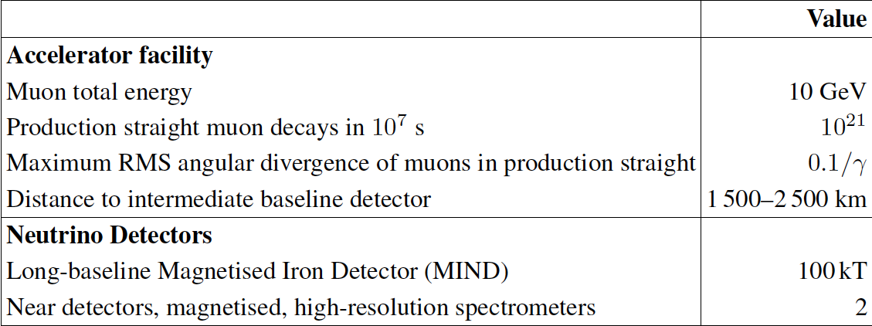
IDS-NF baseline Neutrino Factory
K.Long
NuFACT12

Slide 31
How Could a Staged ν Factory (NuMAX) to SURF Perform?
What if we send beam from a ~5GeV muon storage ring to LBNE?
1 MW, no muon cooling
a 3 MW, w/cooling
a 4 MW, w/cooling
What if we were able to have a magnetized LAr detector?
Or a MIND detector w/3× the mass
Gray bands represent range of possible
detector performance per arXiv:0805.2019
Plots courtesy of P. Huber
Plots assume
100 kt-years

Slide 32
A Staged Plan with NuMAX at Fermilab
We want to provide
the option to get here

Slide 33
Neutrino Factory Staging (MASS)
Preliminary Staging Plan Based on
Project X Stage 2
For reference

Slide 34
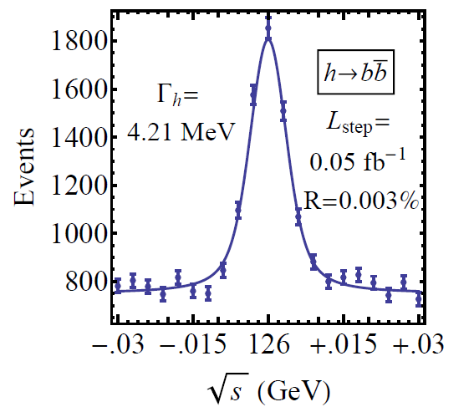
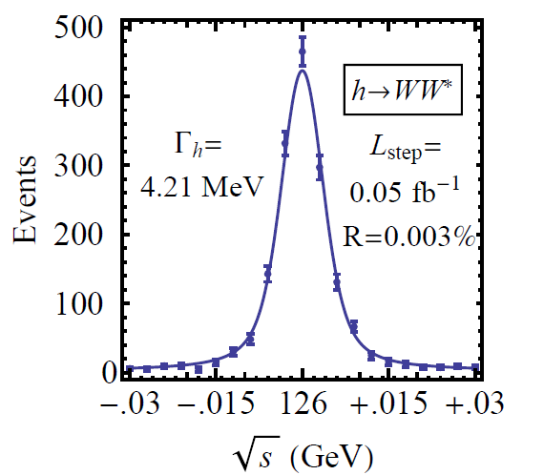
126 GeV Higgs Factory
s-channel coupling of Muons to HIGGS with high cross sections:
Muon Collider of with L = 10³² cm⁻²s⁻¹ @ 63 GeV/beam (~15,000 Higgs/year)
Competitive with e+/e- Linear Collider with L = 2. 10³⁴ cm⁻²s⁻¹ @ 126 GeV/beam
Sharp resonance: momentum spread of a few × 10⁻⁵
Precision energy measurement provided by g-2 effect and residual polarization in muon beams
Han and Liu
hep-ph 1210.7803
Reduced cooling:
ε_{⊥N} =0.3π⋅mm⋅rad,
ε_{||N} =1π⋅mm⋅rad
Major advantage for Physics of a μ⁺μ⁻ Higgs Factory: possibility of direct measurement of the Higgs boson width (Γ~4MeV FWHM expected)

Slide 35
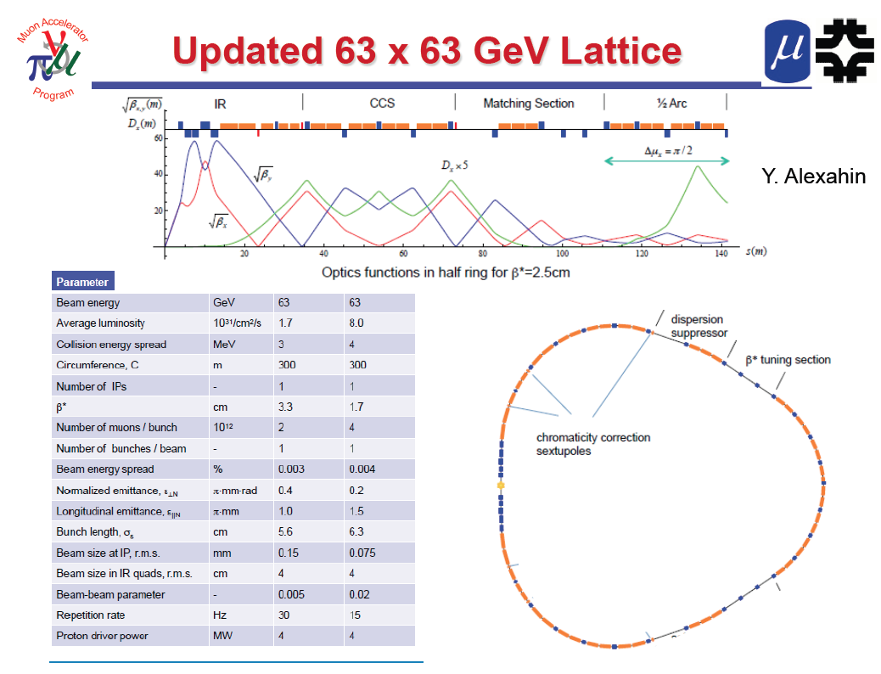
One IP in
the latest
design

Slide 36
Multi-TeV Collider – 1.5 TeV Baseline
Y. Alexahin
Parameter | Unit | Value
Beam energy | TeV | 0.75
Repetition rate | Hz | 15
Average luminosity / IP | 10³⁴/cm²/s | 1.1
Number of IPs, N_{IP} | - | 2
Circumference, C | km | 2.73
β* | cm | 1 (0.5-2)
Momentum compaction, α_{p} | 10⁻⁵ | -1.3
Normalized r.m.s. emittance, ε_{⊥N} | π⋅mm⋅mrad | 25
Momentum spread, σ_{p}/p | % | 0.1
Bunch length, σ_{s} | cm | 1
Number of muons / bunch | 10¹² | 2
Number of bunches / beam | - | 1
Beam-beam parameter / IP, ξ | - | 0.09
RF voltage at 800 MHz | MV | 16
Larger chromatic function (Wy) is corrected first with a single sextupole S1, Wx is corrected with two sextupoles S2, S4 separated by 180° phase advance.

Slide 37
Wall Plug Power Estimates
Estimate assumes
a base 70MW
Facility Power
requirement as in
LC analyses.
300 MW
Muon Collider

Slide 38
Luminosity Production Metric
Muon
Collider
Luminosity
Metric:
N_{det} × L_{avg} / P_{tot}

Slide 39
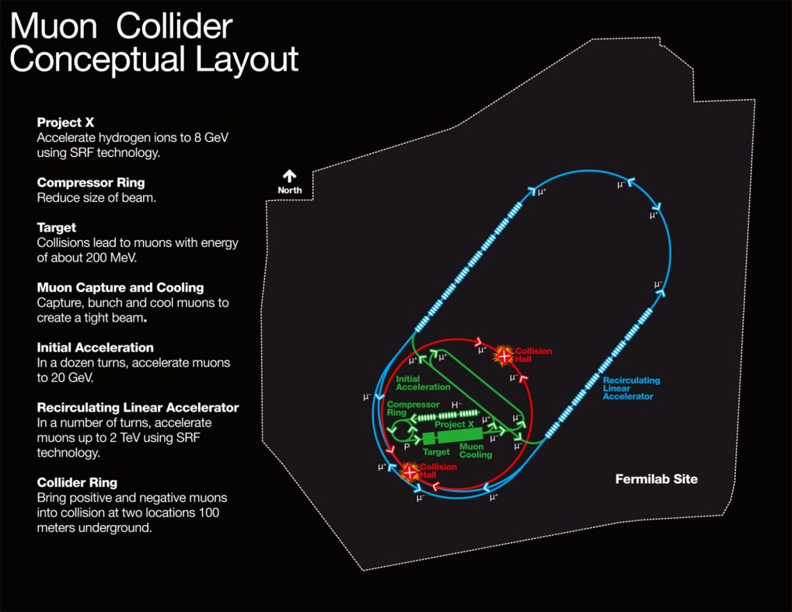
Muon Collider Parameters
Exquisite Energy Resolution
Allows Direct Measurement
of Higgs Width
Success of advanced cooling
concepts a several × 10³²
Site Radiation mitigation with depth and lattice design: ≤ 10 TeV

Slide 40
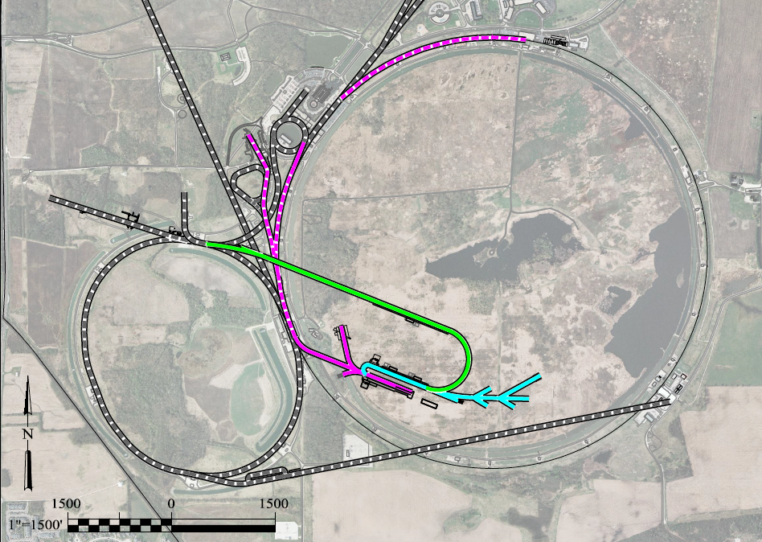
A Muon Accelerator Facility for Cutting Edge Physics on the Intensity and Energy Frontiers
Based on Project X Stage II
A TeV-scale Collider
at Fermilab
To SURF
LBNE
RLA to 63 GeV +
300m Higgs Factory
Buncher/
Compressor
Rings
NF Decay Ring:
νs to SURF
Front End+4D+6D
Linac + RLA to ~5 GeV
Project X
Stage II
Project X
Stage I
A 6 TeV collider
of the same size
as the Tevatron ring
ft
νSTORM + Muon Beam
R&D Facility
ft
40

Slide 41
MAP Timeline a Provide Informed Decision Points
 | 2010 |  | ~2020 |  | ~2030
Muon Accelerator R&D Phase
Proton Driver Implementation – Project X @ FNAL
Intensity Frontier
Energy Frontier
MAP Feasibility Assessment
Advanced Systems R&D
Muon Ionization Cooling Experiment (MICE)
Indicates a date when an informed decision should be possible
Pr X Stage I
Pr X Stage II
Pr X Stage III & IV
IDS-NF RDR
At Fermilab, critical physics production could build on Stage II of Project X
Proposed Muon Storage Ring Facility (νSTORM)
Evolution of Long Baseline ν Factory
Collider Conceptual ➔ Technical Design
Collider Construction ➔
Physics Program

Slide 42
THE R&D CHALLENGES and
The MAP Feasibility Assessment

Slide 43
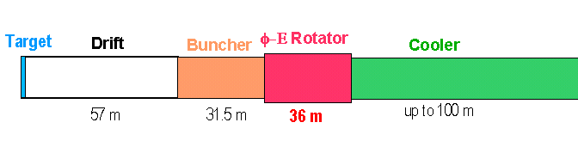
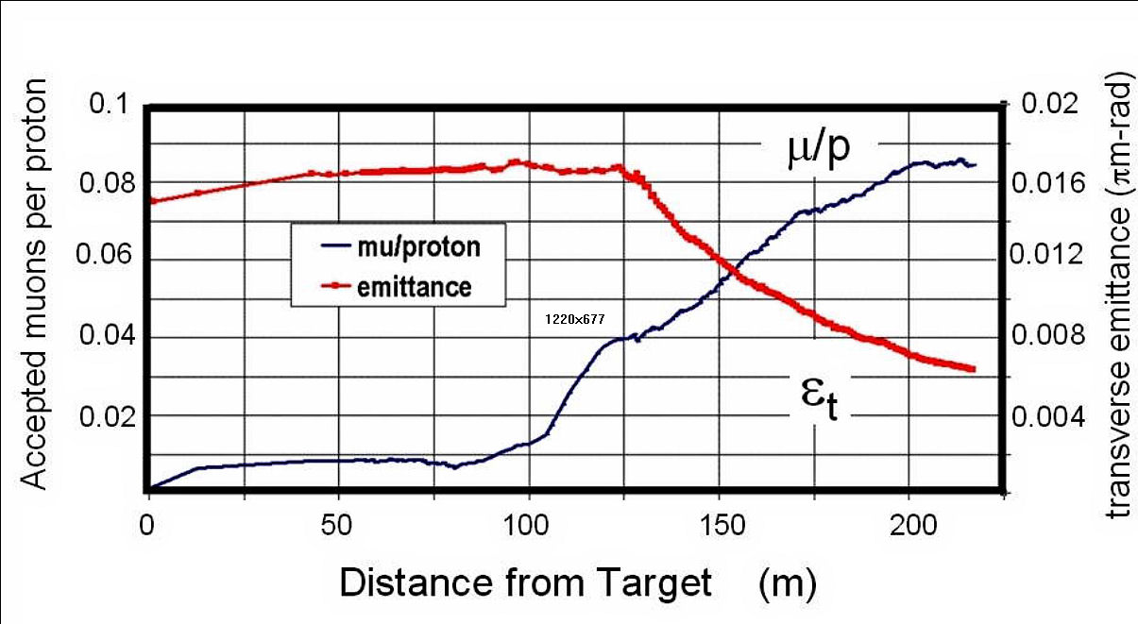
Technology Challenges – Tertiary Production
Neuffer
A multi-MW proton source, e.g., Project X, will enable
O(10²¹) muons/year to be produced, bunched and cooled to fit within the acceptance of an accelerator.

Slide 44
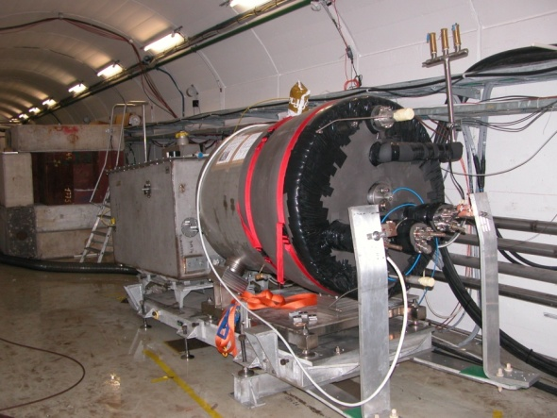

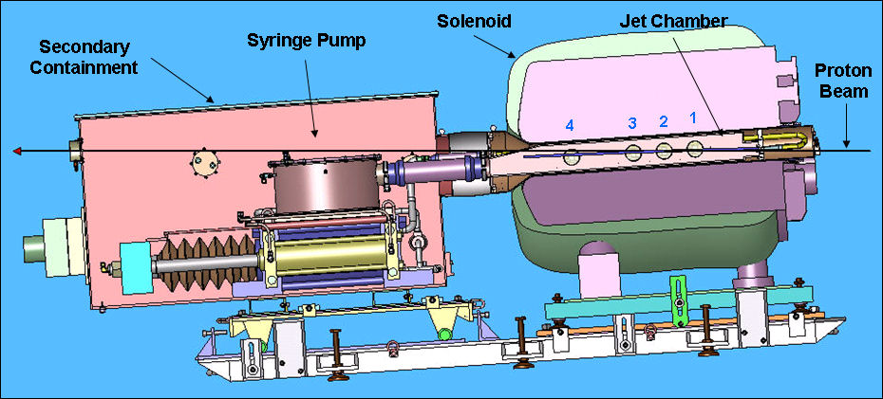
Key Technologies - Target
The MERIT Experiment at the CERN PS
  Demonstrated a 20m/s liquid Hg jet injected
  into a 15 T solenoid and hit with a
  115 KJ/pulse beam!
  Jets could operate with beam powers up to
  8 MW with a repetition rate of 70 Hz
MAP staging aimed at initial 1 MW target
1 cm
Hg jet in a 15 T solenoid
with measured disruption length ~ 28 cm

Slide 45
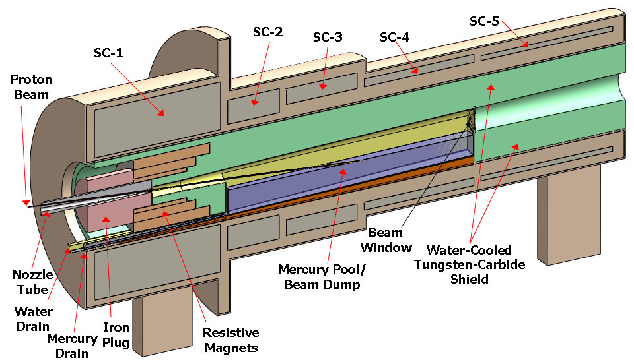
TechnoIogy Challenges – Capture Solenoid
A Neutrino Factory and/or Muon Collider Facility requires challenging magnet design in several areas:
  Target Capture Solenoid (15-20T with large aperture)
  E_{stored} ~ 3 GJ
  O(10MW) resistive
  coil in high radiation
  environment
  Possible application
  for High Temperature
  Superconducting
  magnet technology

Slide 46
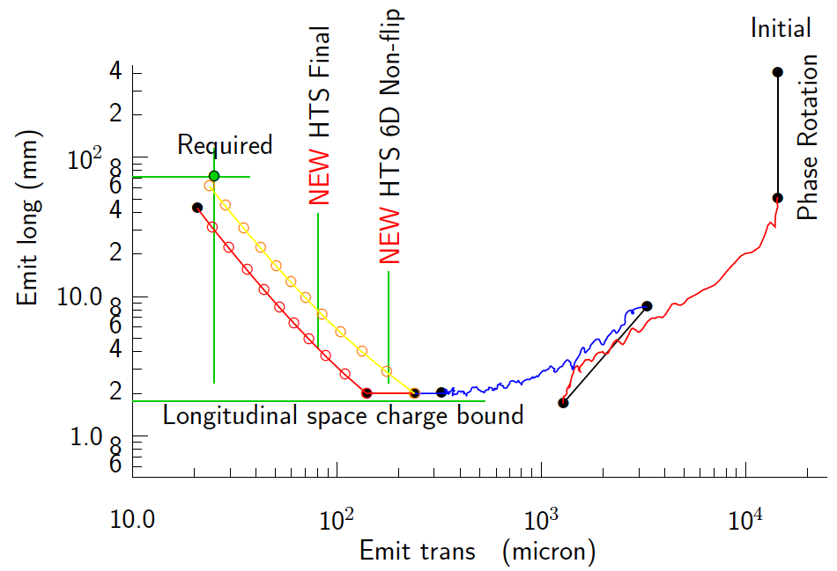
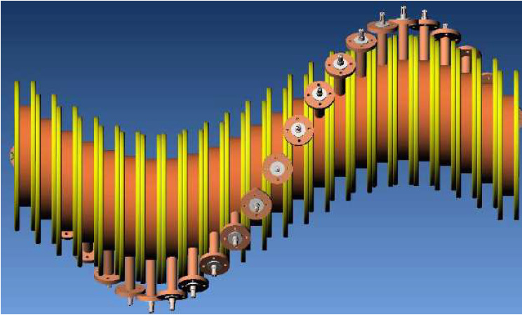
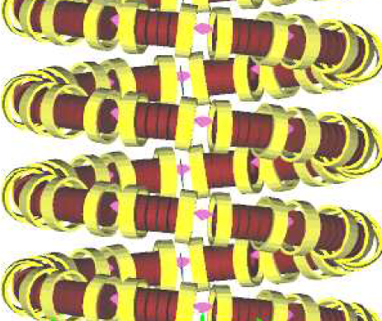
Technology Challenges - Cooling
Development of a cooling channel design to reduce the 6D phase space by a factor of O(10⁶) → MC luminosity of O(10³⁴) cm⁻² s⁻¹
R. Palmer
Emittance Reduction
via Ionization Cooling
Some components beyond state-of-art:
  Very high field HTS solenoids (≥30 T)
  High gradient RF cavities operating in multi-Tesla fields
The program targets critical magnet and cooling cell technology demonstrations within its feasibility phase.
Cooling
Channel
Concepts
HCC
Guggenheim

Slide 47
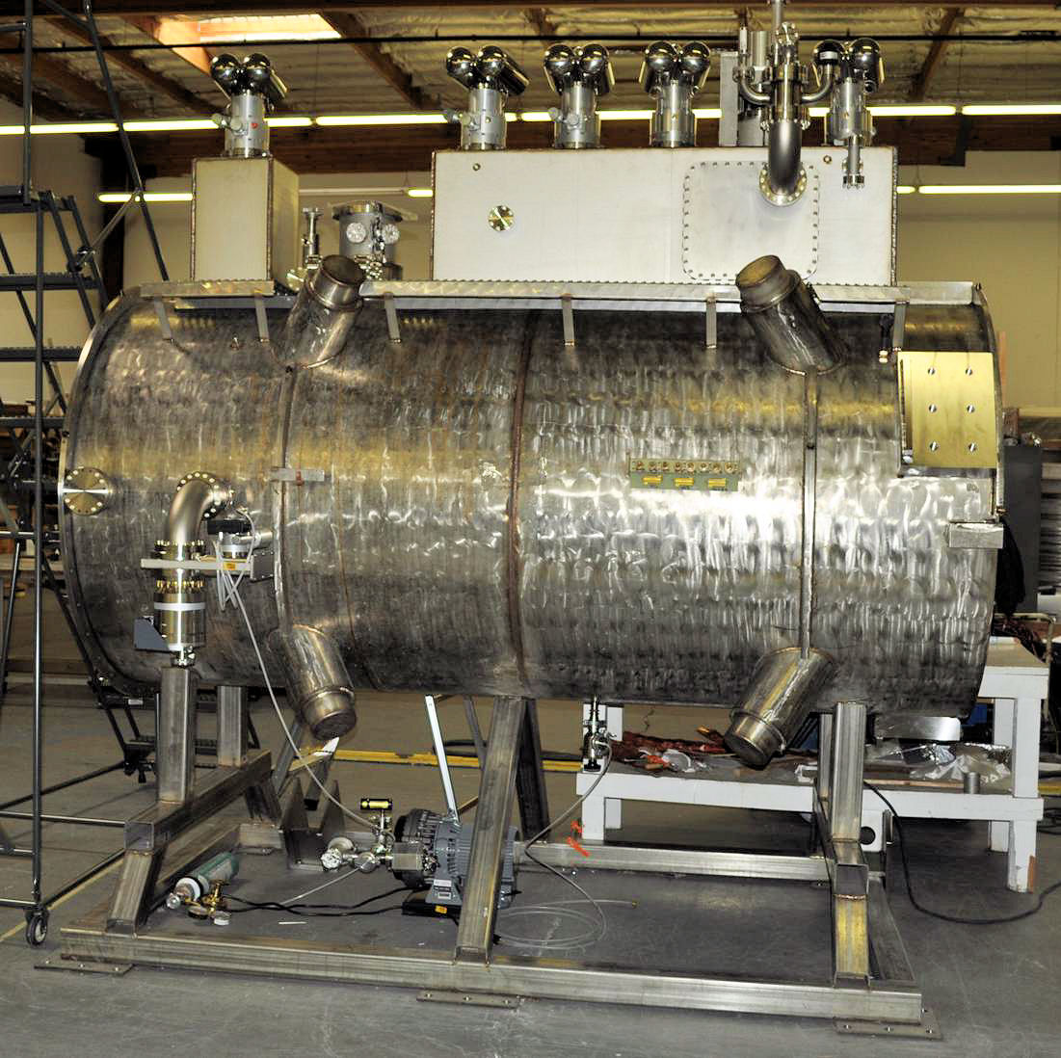
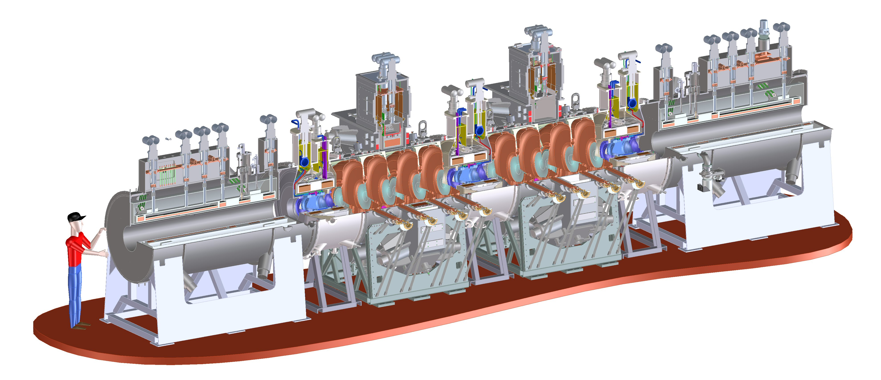
Technology Challenges - Cooling
Tertiary production of muon beams
  Initial beam emittance intrinsically large
  Cooling mechanism required, but no
  radiation damping
Muon Cooling a Ionization Cooling
    dE/dx energy loss in materials
    RF to replace p_{long}
MICE
  The Muon Ionization
  Cooling Experiment:
  Demonstrate the
  method and validate
  our simulations
RF-Coupling
Coil (RFCC)
Units
Spectrometer
Solenoids

Slide 48
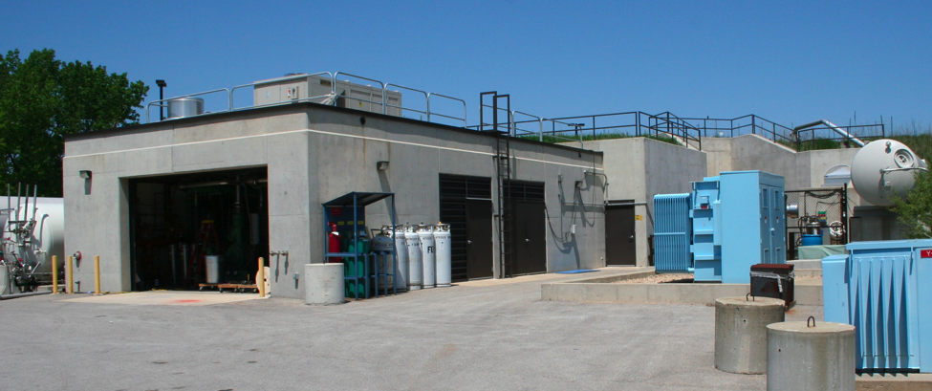
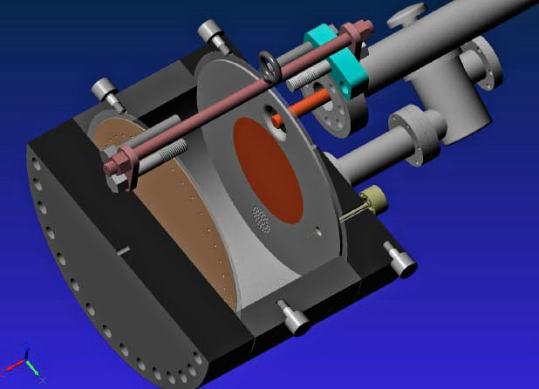
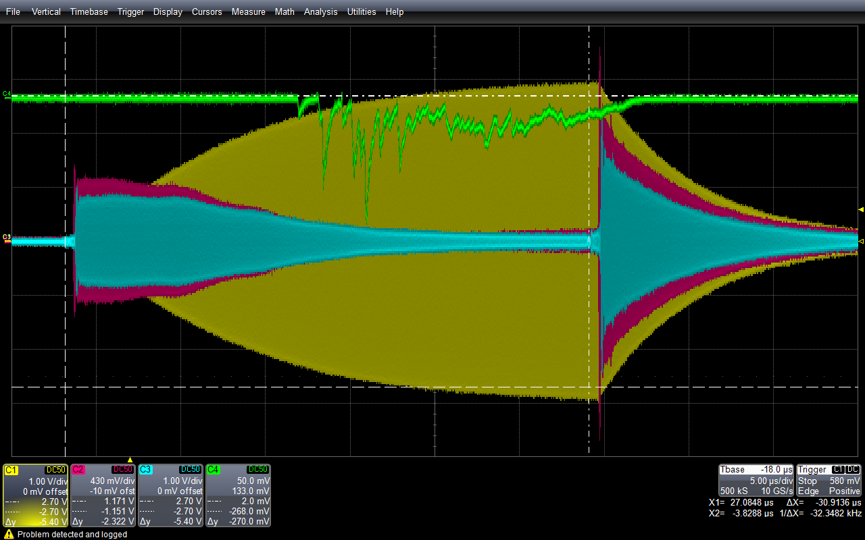
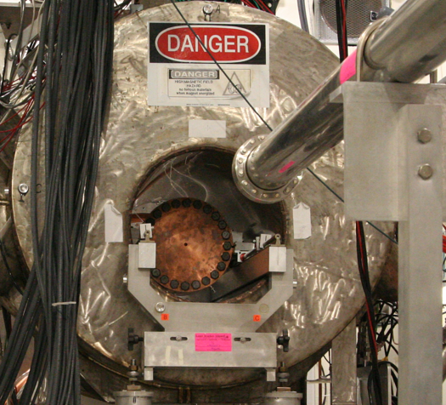
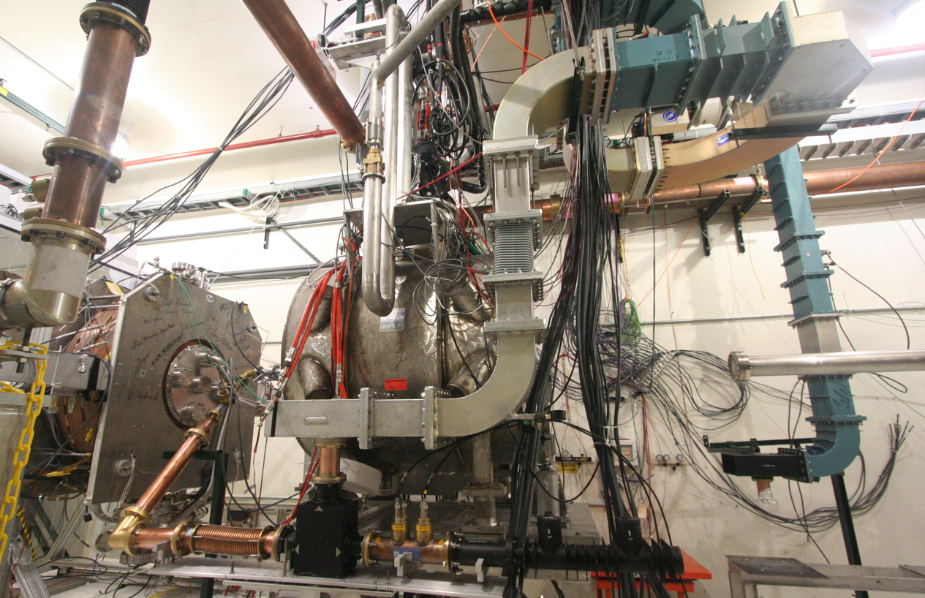
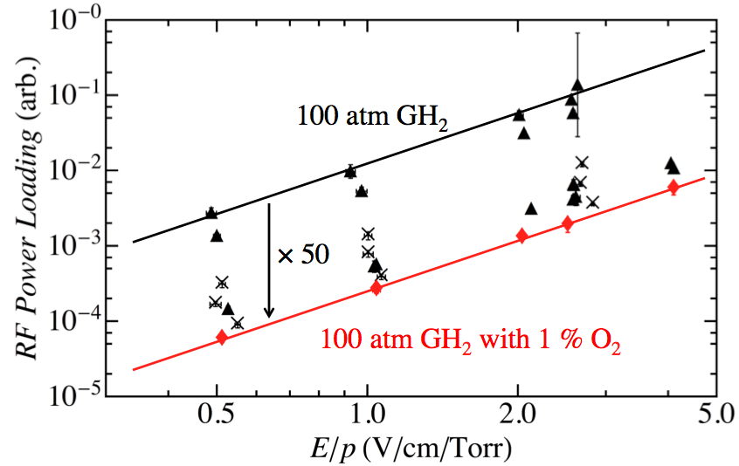
Elements of the R&D Program
MuCool Test Area
Entrance of MTA
exp. hall
Vacuum
RF Cavity
Compressor + refrigerator room
400 MeV
H⁻ Beam
20 MV/m in 3 Tesla
MTA Hall
Gas-Filled RF cell
201 MHz cavity
SC magnet
400 MeV H⁻ beam

Slide 49
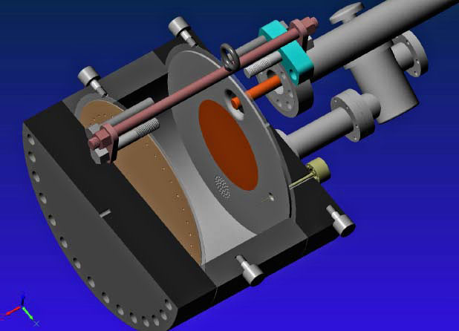
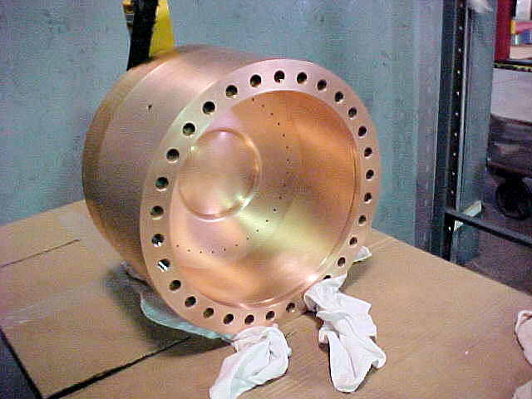
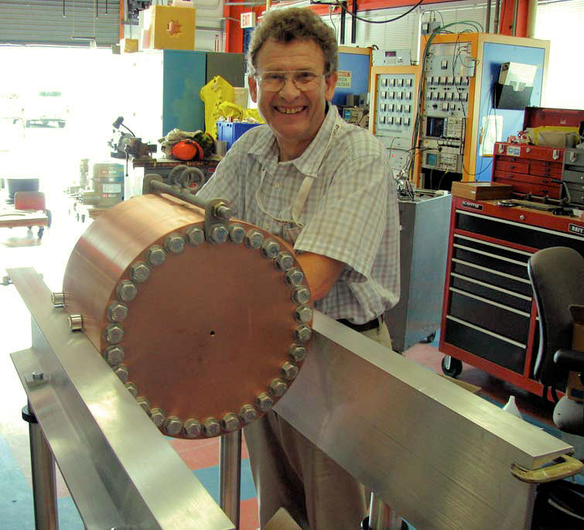
Recent Progress – Vacuum RF
All-Seasons
Cavity
(designed for both
vacuum and high
pressure operation)
Vacuum Tests at B = 0 T & B = 3 T
  Two cycles: B₀ a B₃ a B₀ a B₃
No difference in maximum stable operating gradient
  Gradient ≈ 25 MV/m
Demonstrates possibility of successful operation of vacuum cavities in magnetic fields with careful design
Also progress on alternative cavity materials

Slide 50
Recent Progress - High Pressure RF
Gas-filled cavity
  Can moderate dark current and breakdown currents in magnetic fields
  Can contribute to cooling
  Is loaded, however, by beam-induced plasma
Electronegative Species
  Dope primary gas
  Can moderate the loading effects of beam-induced plasma by scavenging the relatively mobile electrons
1% Dry Air (0.2 % O2) in GH2
Pure GH2
1% Dry Air
(0.2 % O2)
in GH2 at
B = 3 T
Beam on
~50× change in
RF dissipation
5/22/12
E₀ = 25 MV/m
50
E₀ = 25 MV/m

Slide 51
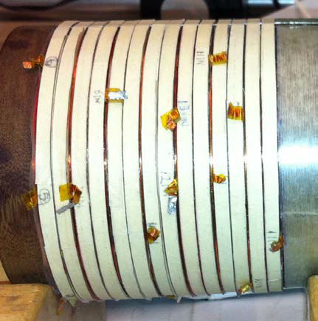
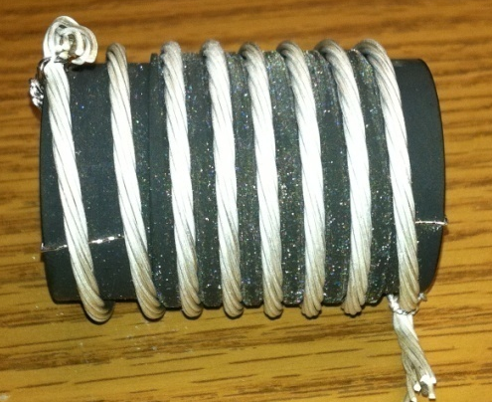
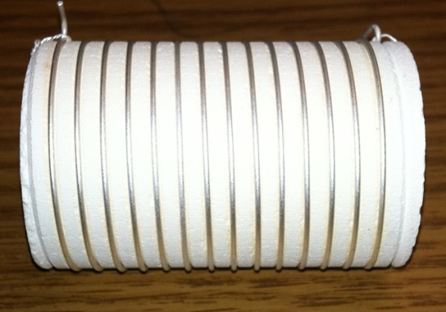
Recent Progress - High Field Magnets
Progress towards a demonstration of a final
stage cooling solenoid:
Demonstrated 15+ T (16+ T on coil)
  ~25 mm insert HTS solenoid
  BNL/PBL YBCO Design
  Highest field ever in HTS-only solenoid (by a factor of ~1.5)
Developing a test program for operating HTS insert + mid-sert in an external solenoid a >30 T
BSCCO-2212 Cable -
Transport measurements show that FNAL cable attains 105% J_{c} of that of the single-strand
Multi-strand cable utilizing chemically compatible alloy and oxide layer to minimize cracks

Slide 52
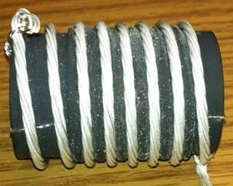
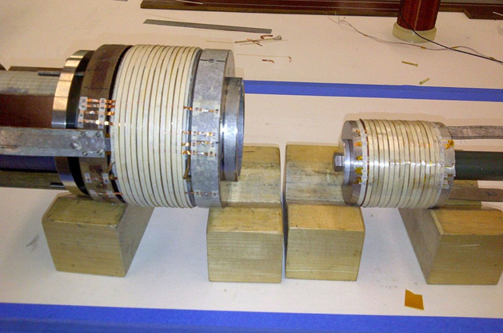
Cooling Channel R&D Effort
Successful Operation of 805 MHz “All Seasons” Cavity in 3T Magnetic Field under Vacuum
MuCool Test Area/Muons Inc
World Record
HTS-only Coil
15T on-axis field
16T on coil
PBL/BNL
Demonstration of High Pressure RF Cavity in 3T Magnetic Field with Beam
Extrapolates to
μ-Collider Parameters
MuCool Test Area
Breakthrough in HTS Cable Performance with Cables Matching Strand Performance
FNAL-Tech Div
T. Shen-Early Career Award
The Path to a Viable
Muon Ionization
Cooling Channel
1% Dry Air (0.2% O2) in GH2
Pure GH2
1% Dry Air
(0.2 % O2)
in GH2 at
B = 3T
~50X reduction in
RF power dissipation
E₀ = 25 MV/m

Slide 53
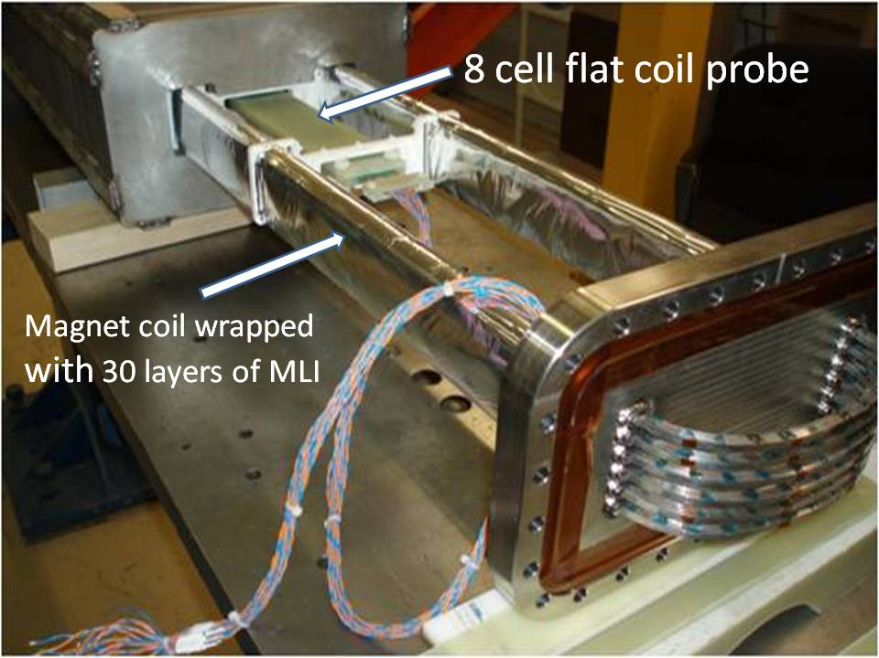
Technology Challenges - Acceleration
Muons require an ultrafast accelerator chain
a Beyond the capability of most machines
Solutions include:
  Superconducting Linacs
  Recirculating Linear Accelerators (RLAs)
  Fixed-Field Alternating-Gradient (FFAG) Machines
  Rapid Cycling Synchrotrons (RCS)
  RCS requires
  2 T p-p magnets
  at f = 400 Hz
  (U Miss & FNAL)
EMMA – FFAG
JEMMRLA Proposal:
JLAB Electron Model of
Muon RLA with Multi-pass
Arcs

Slide 54
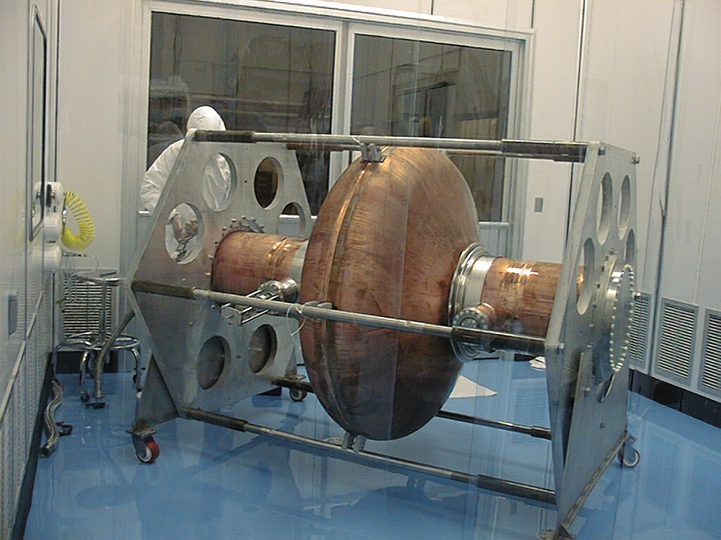
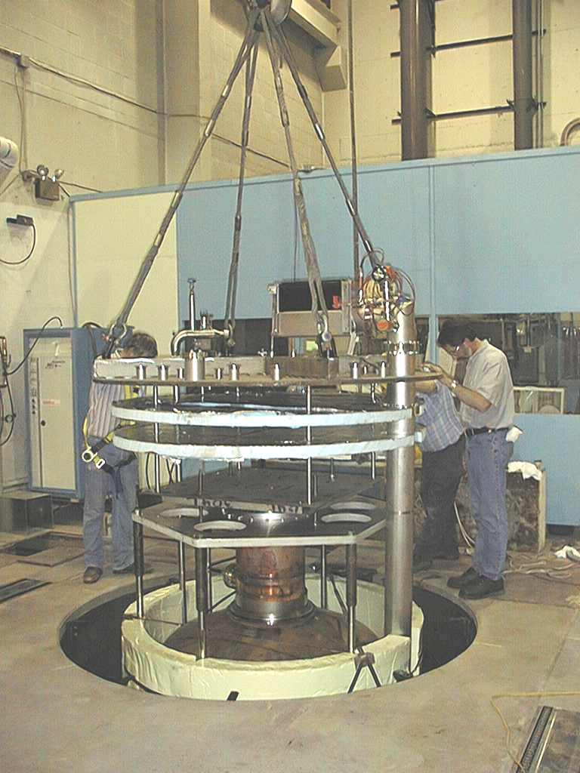
Superconducting RF Development
201 MHz SCRF R&D
Major dia.: 1.4 m
Cavity going into test pit
in Newman basement
(Cornell University)
400mm BT
Cavity length: 2 m
Pit: 5m deep X 2.5m dia.

Slide 55
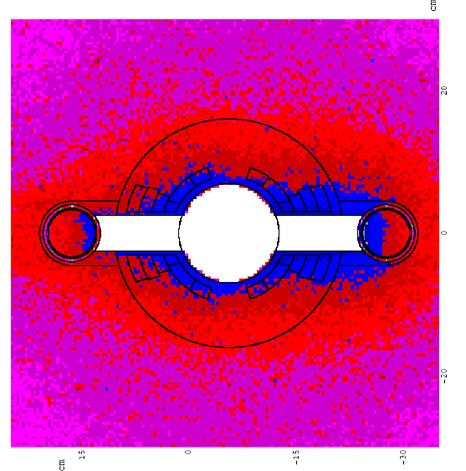
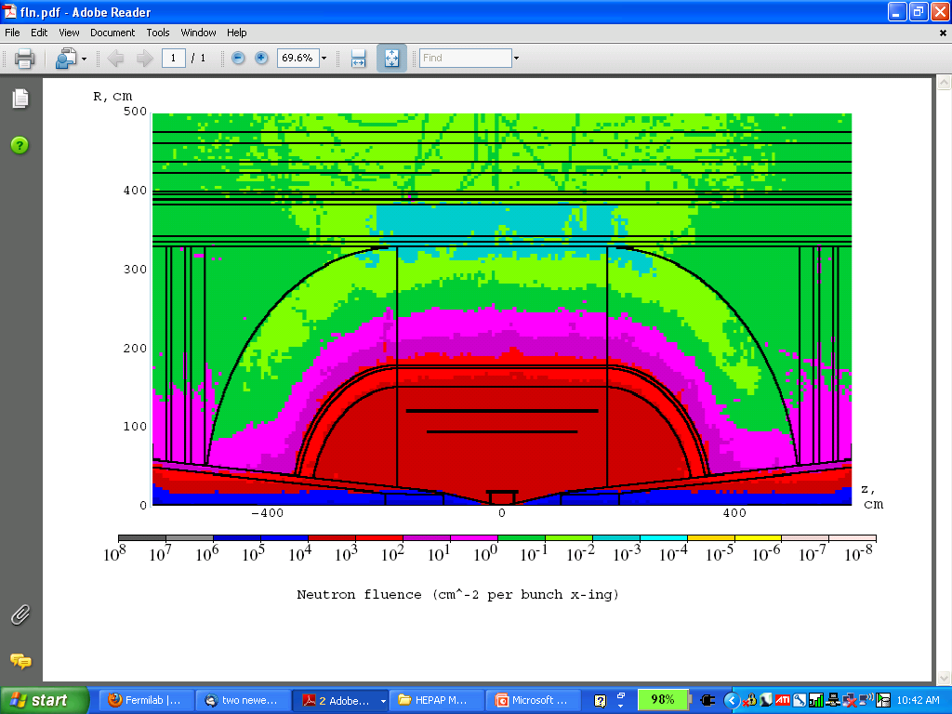
Technology & Design Challenges – Ring, Magnets, Detector
Emittances are relatively large, but muons circulate for ~1000 turns before decaying
  Lattice studies for 126 GeV,
  1.5 & 3 TeV CoM
High field dipoles and
quadrupoles must operate
in high-rate muon decay
backgrounds
  Magnet designs under study
Detector shielding & performance
  Initial studies for 1.5 TeV, then 3 TeV and
  now 126 GeV
  Shielding configuration
  MARS background simulations
MARS energy deposition map for 1.5 TeV collider dipole

Slide 56


Backgrounds and Detector
Much of the background is soft and out of time
Nanosecond time resolution can reduce backgrounds by three orders of magnitude
Requires a fast, pixelated tracker and calorimeter.
Non-ionizing background ~ 0.1 x LHC
But crossing interval 10μs/25 ns 400 x
 | Cut | Rejection
Tracker hits | 1 ns, dedx | 9x10⁻⁴
Calorimeter neutrons | 2 ns | 2.4x10⁻³
Calorimeter photons | 2 ns | 2.2x10⁻³
GeV/c
ns

Slide 57
Concluding Remarks

Slide 58
Some Thoughts…
The unique feature of muon accelerators is the ability to provide cutting edge performance on both the Intensity and Energy Frontiers
  This is well-matched to the direction specified by the P5 panel for Fermilab
  The possibilities for a staged approach make this particularly appealing in a time of constrained budgets
  νSTORM would represent a critical first step in providing a muon-based accelerator complex
World leading Intensity Frontier performance could be provided with a Neutrino Factory based on Project X Phase II
  This would also provide the necessary foundation for a return to the Energy Frontier with a muon collider on U.S. soil
A Muon Collider Higgs Factory
  Would provide exquisite energy resolution to directly measure the width of the Higgs. This capability would be of crucial importance in the MSSM doublet scenario.
  The first collider on the path to a
  multi-TeV Energy Frontier machine?

Slide 59

Conclusion
Through the end of this decade, the primary goal of MAP is demonstrating the feasibility of key concepts needed for a neutrino factory and muon collider
a Thus enabling an informed decision on the path forward for the HEP community
Muon Collider Concept
A challenging, but promising, R&D program is underway!

Slide 60
Muon Accelerator Program Contacts
MAP Web-Site: http://map.fnal.gov/
MAP Management Team:
Mark Palmer, Director: mapalmer@fnal.gov
Robert Ryne, L1 Manager for Design and Simulation:
rdryne@lbl.gov
Alan Bross, L1 Manager for Technology Development:
bross@fnal.gov
Daniel Kaplan, L1 Manager for Systems Demonstrations:
kaplan@iit.edu
Ron Lipton, L1 Manager for Detectors and Physics:
lipton@fnal.gov
US HEP Community Planning Effort
Jean-Pierre Delahaye, Muon Accelerator Staging Study
jpd@slac.stanford.edu

Slide 61
Acknowledgments
I would personally like to thank Steve Geer, Mike Zisman, Bob Palmer as well as the MAP L1 & L2 managers for their help in familiarizing me with the program since I took over as director a year ago
The MAP Effort -
Labs: ANL, BNL, FNAL, JLAB, LBNL, ORNL, SLAC,
IHEP-Beijing
Universities: CMU, Chicago, Cornell, ICL, IIT, Princeton,
SUNY-Stony Brook, UC-Berkeley, UCLA, UC-Riverside, UMiss, VT
Companies: Muons, Inc; Particle Beam Lasers

