Slide 1
Update – Pion Production
Fermilab
Accelerator Physics Center
Sergei Striganov
nuSTORM Workshop
Fermilab
November 21, 2013

Slide 2
OUTLINE
Input parameters update
MARS model verification update
Target parameters update
Target in horn update
Conclusion
2

Slide 3
Input parameter update -I
Very narrow proton beam (σ=0.15 mm) was used for previous (WS 2012) calculations. More realistic proton beam size is about 1 mm
Best results were obtained for gold target inside horn. Experts do not recommend to use heavy target inside horn. Carbon with very high density (3.52 g/cm3) was considered for (WS 2012). Graphite with low density 1.8 g/cm3 is more widely used for pion production. Inconel and tungsten looks like more realistic target material than gold.
3

Slide 4
Input parameter update -II
Proton beam energy was 60 GeV in last year study. Yields with 120 GeV proton beam should be studied now.
Magnetic field inside horn material and pion/proton interaction with inner/outer conductors should be taken into account
Horn current should not exceed 230 kA (300 kA in last year study)
MARS code prediction of 5 GeV/c pion production at 120 GeV should be verified against data
4

Slide 5
MARS verification
We are going to calculate yield of pion within small momentum bin around 5 GeV/c produced by 120 GeV/c protons on thick target using MARS model. How well MARS model agrees with experiment in this region?
We have a lot of applicable data for light target (Be, C)
There are only few proper measurement for heavy nuclei
5

Slide 6
MARS verification - II

Slide 7
MARS verification - III
Red line – MARS model at 19.2 GeV/c,
blue line – MARS model at 450 GeV/c

Slide 8
MARS verification - IV
Red line – MARS model at 19.2 GeV/c,
blue line – MARS model at 450 GeV/c

Slide 9
Simulation procedure
For given material and beam size we need to determine optimal target length, radius and position inside horn.
From previous study we know that optimal target radius is about 3 sigma of proton beam.
Two optimization parameters are considered for positive pion with momentum 5±0.5 GeV/c: number of particles inside 20 cm radius (most of pion in this momentum range) and pions inside admittance = 0.2 cm rad. David Neuffer estimates this as smallest value in ring. For fixed admittance we determine values of Twiss parameters β and α which corresponds to maximal number of pions.
This yields correspond to maximal and minimal estimates of captured pions numbers.

Slide 10
Phase distribution at 1 cm after target
Ɛ=2 mm: yield = 0.099
r< 20 cm: yield = 0.194
Ɛ=2 mm: yield = 0.164
r< 20 cm: yield = 0.235
Ɛ=2 mm: yield = 0.175
r< 20 cm: yield = 0.241

Slide 11
Target material dependence: no gain from very heavy target?

Slide 12
Target radius@length dependence: opposite radial dependence for heavy and light targets!

Slide 13
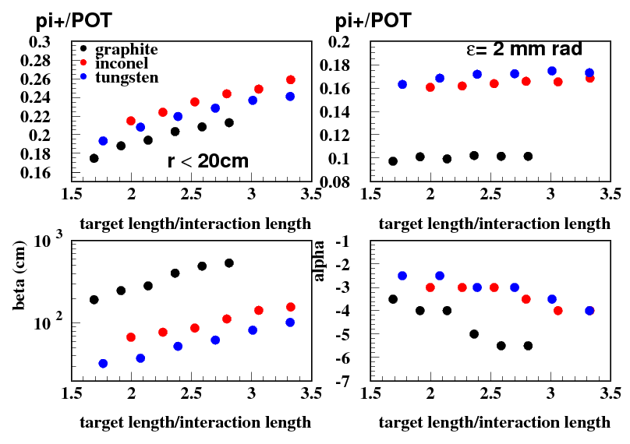
120 GeV proton, 5 +-0.5 GeV/c pion, 3 mm target radius

Slide 14
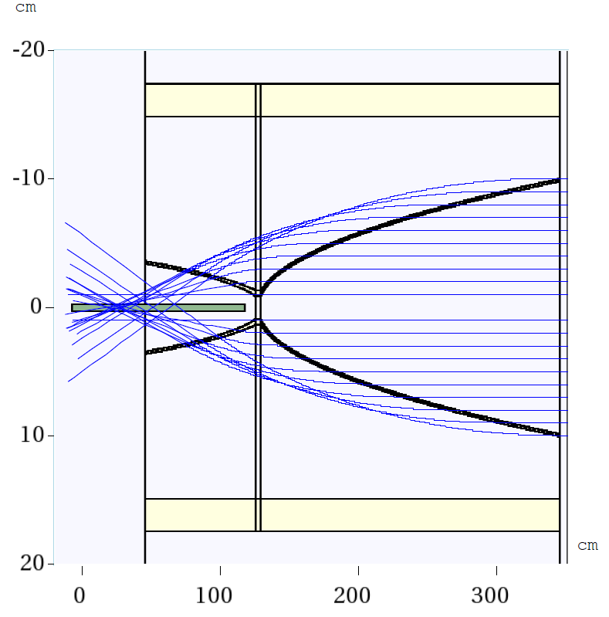
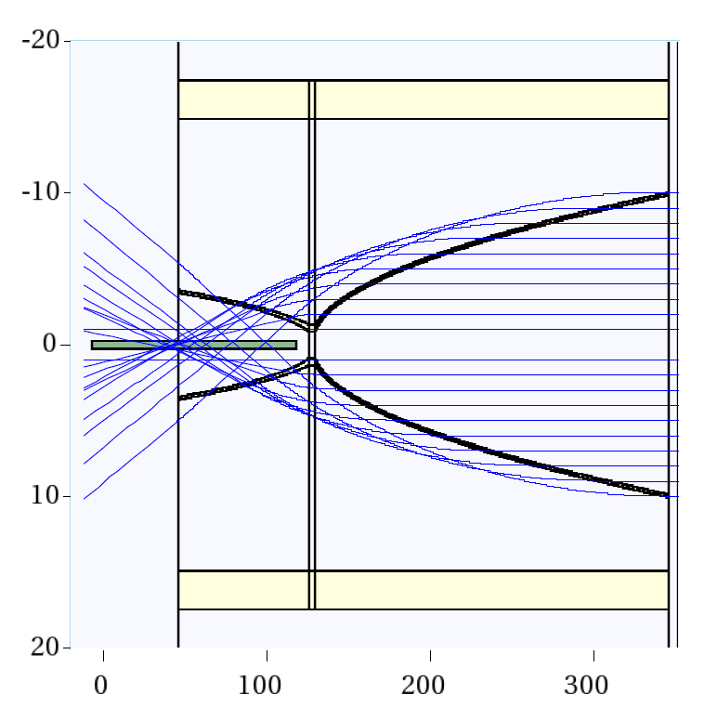
Target position inside horn: send negative 5 Gev/c pion from opposite direction to find horn focus for different magnetic field
185 kA – NuMI default
230 kA – reasonable upgrade

Slide 15
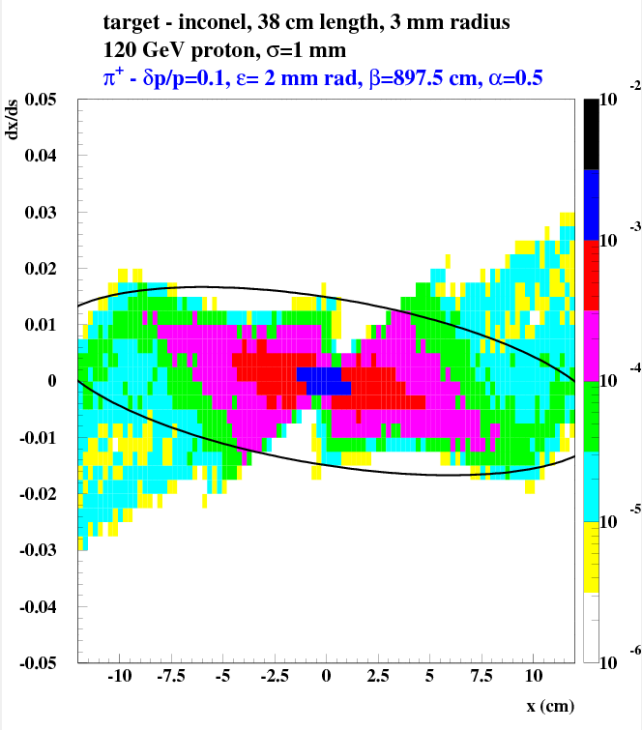
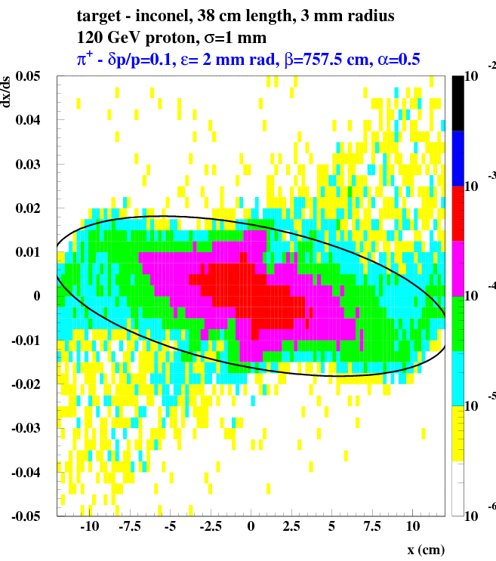
Realistic and simplified horn description: simplified - magnetic field only, “realistic” - interaction with conductors and field in conductors taken into account.
simple: yield=0.122 pi+/POT
“realistic”: yield=0.114 pi+/POT

Slide 16
95 cm graphite target.
Dependence of pion beam parameters on target center shift from upstream horn end. dp/p=10%

Slide 17
50 cm inconel target.
Dependence of pion beam parameters on target center shift from upstream horn end. dp/p=10%

Slide 18
29 cm tungsten target.
Dependence of pion beam parameters on target center shift from upstream horn end. dp/p=10%

Slide 19
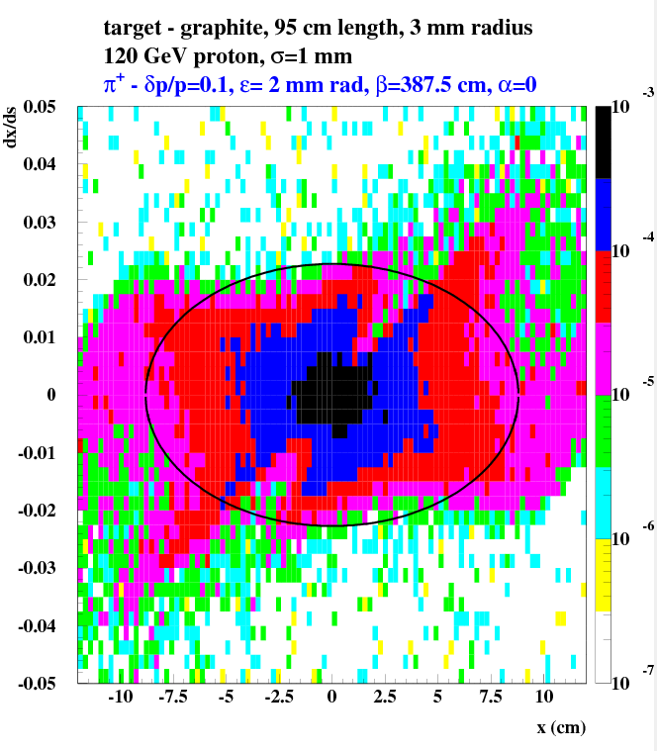
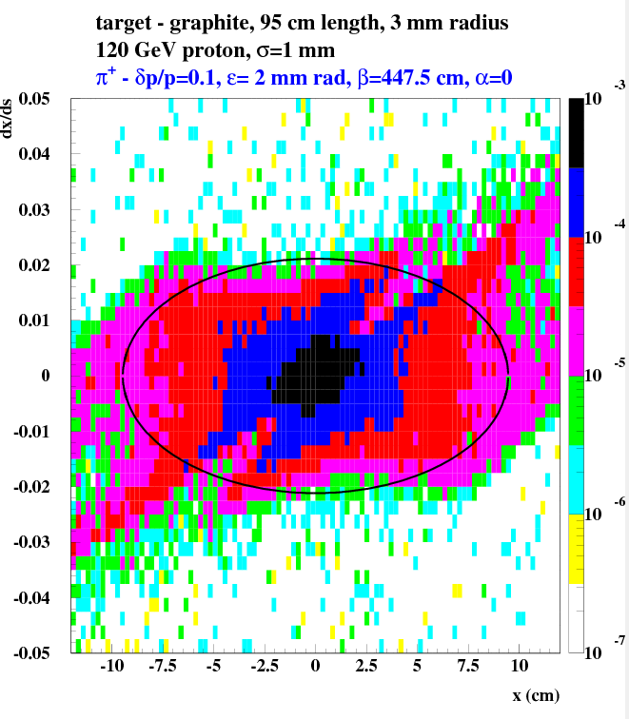
Phase distribution after horn – graphite target
After NuMI horn:
Ɛ=2 mm: yield = 0.085
r< 20 cm: yield = 0.137
1 m after NuMI horn:
Ɛ=2 mm: yield = 0.085
r< 20 cm: yield = 0.133

Slide 20
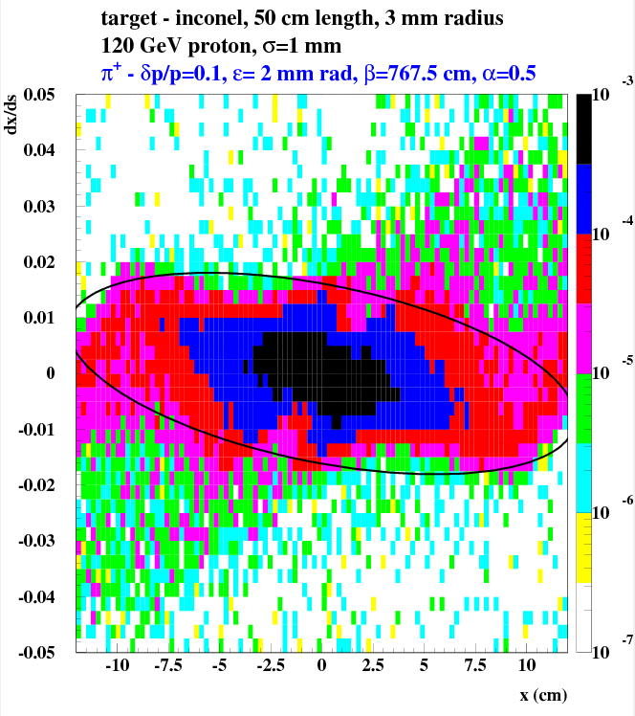
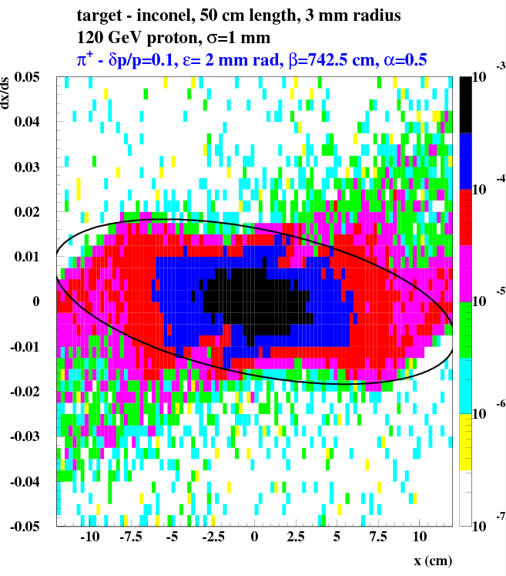
Phase distribution after horn – inconel target
After NuMI horn:
Ɛ=2 mm: yield = 0.122
r< 20 cm: yield = 0.162
1 m after NuMI horn:
Ɛ=2 mm: yield = 0.120
r< 20 cm: yield = 0.157

Slide 21
CONCLUSION
Dependence of 5 GeV/c pi+ yield on target length, radius, material and position inside horn was studied. Beam energy – 120 GeV, beam radius – 1mm. Horn current- 230 kA. Optimal target size and position were determined for inconel, tungsten and graphite.
Yield rises with target length. But slope is very small. Dependence on target position inside horn is rather weak. Dependence of yield on target radius is opposite for heavy and light targets.
Number of pions inside of 20 cm radius is about 0.13 pi+/POT for 95 cm carbon target and dp/p=10%. It rises on about 20% for 50cm inconel target, but only 10% larger for 29 cm tungsten target.
Number of pions inside of 2 mm rad admittance is about 0.085 pi+/POT for graphite and dp/p=10%. It is about 40% larger for inconel and 30% larger for tungsten. Simulations confirm, that yield is linearly raised with dp/p (at least up to 20%)
Switch to “realistic” horn model slightly decreases predicted yield, but change in shape of distribution is not so marginal.
Inclusive MARS model agrees well with data on carbon and beryllium in nuSTORM range of interest. MIPP and NA61/SHINE measurements for medium and heavy nucleus will be published during following one/two years. It could clarify precision of MARS prediction for such target.

Slide 22
BACKUP slides

Slide 23
CONCLUSIONS of nuSTORM 2012 Workshop
We could get about 0.11 π+/POT and 0.09 π-/POT with 5 ± 10% GeV/c momentum from gold target at 60 GeV into 2000 mm mrad acceptance with ideal capture. Yield for carbon is about 2 times lower at this energy.
We could get about 0.006 π+/POT and 0.0035 π-/POT with 3 ± 10% GeV/c momentum from gold target at 8 GeV into 2000 mm mrad acceptance with ideal capture. Yield has weak dependence on target material at this energy.
Pion capture using lithium lens looks like problematic due to large radius of pion beam.
Pion capture using horn looks like reasonable. Without optimization of inner surface shape it is possible to get 0.082 π+/POT with 5 ± 0.5 GeV/c momentum using existing NuMI horn at 300kA current.
Measurements of charged pion production from heavy target are in 30% agreement with MARS prediction. New measurements of MIPP and NA61/SHINE will help to specify absolute normalization of above simulation.
Could we use large Z target inside horn at 60 GeV?
Could we optimize horn shape to get better transmission factor? Very low energy horn with conical shape (Beams-doc-724) provides transmission factor about 0.9, but β = 2000 cm looks like too large.

Slide 25
Target radius
20 cm gold target
95 cm graphite target

