Slide 1
nuSTORM Workshop -- Updates on pion beamline
Ao Liu*
^{11/21/2013}

Slide 2
Modified Pion Beamline From Last Time
The pion beamline consists of the pion transport beamline, the beam combination section (BCS), and the decay straight section shared by π and μ.
First bending dipole
BCS
Horn downstream end

Slide 3
Optimizing the pion beamline
Determine the design momentum of the pion beamline;
Determine the momentum spread of the pion beam we take from the horn.
In what momentum range we want to keep the pions after the horn focusing?
How many of the pions from this momentum range will decay to a usable muon? (3.8±10% GeV/c)

Slide 4
Optimizing the pion beamline (cont’d)
Decay from a pion with relativistic factor γ:
is the probability density function of the muon momentum distribution from this decay;
and
are the maximum and minimum muon momentum
from the pion decay.
is the muon momentum in the rest frame of the
pion. ( is a constant)

Slide 5
Optimizing the pion beamline (cont’d)
Assume the pion momentum distribution probability density function is linear after the horn.
Then the muon momentum distribution is
The upper and lower limits of this integral are:

Slide 6
Optimizing the pion beamline (cont’d)
The probability density is then
For example, when the n=0.1, P₀ is 5 GeV/c and a=0: (A flat pion momentum distribution)

Slide 7
Optimizing the pion beamline (cont’d)
Notice this flat top

Slide 8
Optimizing the pion beamline (cont’d)
Determine n and P₀:
3.8±10% GeV/c should be within the flat top range;
need to take the transport efficiency of pions into account
which depends on both n and P₀
The maximum number of μ we can have is
where is the number of pions within the pion momentum range of [(1-m)P₀, (1+m)P₀].

Slide 9
Optimizing the pion beamline (cont’d)
a=-3e-7, b=2.5e-3 in this case (38 cm inconel, after horn)

Slide 10
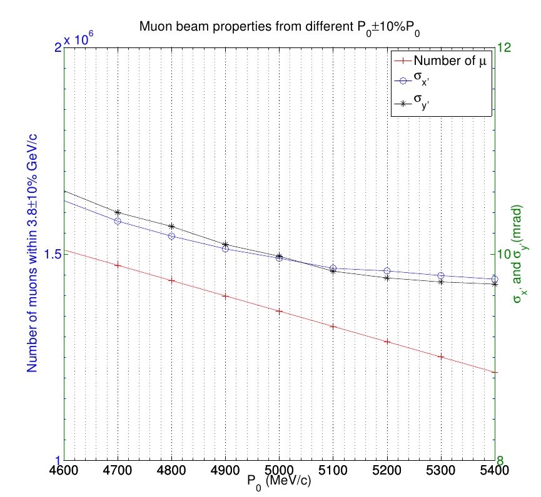
Cont’d
First fix P₀ then n:
Assuming the momentum acceptance of the pion beamline does not depend on P₀ (usually described by ±x% )
Number of muons within
3.8±10% GeV/c
decreases with larger
P₀; muon angular
divergence decreases
with larger P_{0.}
5 GeV/c is a good balance

Slide 11
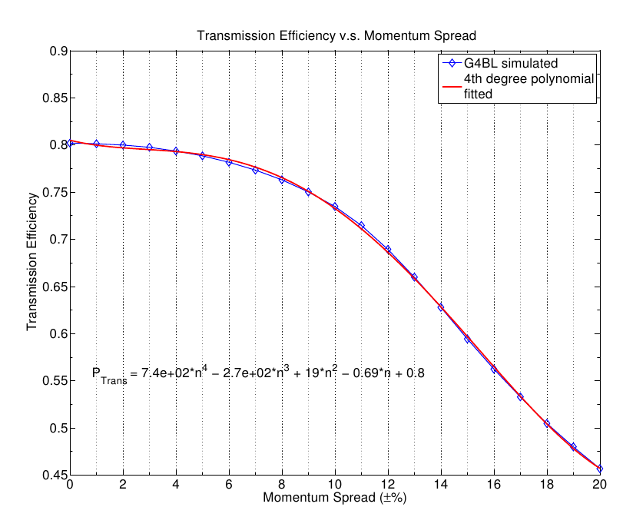
Cont’d
Now the formula becomes,
where the subscript “end” means at the end of the pion beamline and is the transport efficiency when momentum spread is n.
Didn’t take account of the
phase space acceptance
(real number should be
proportional to the formula)
Can be well fitted using a 4th
degree polynomial and used in
the formula.

Slide 12
Cont’d
The estimated production rate V.S. the G4BL simulated
Well matched. (Both for Inconel and Graphite)
Maximum value found at n=0.18.

Slide 13
Short conclusion
P₀=5 GeV/c, n=0.18 gives the best yield of muons within the correct momentum range;
We can optimize the number further by changing the horn configuration to increase the number below:
Reminder: N_{tot} is the number of pions in [(1-m)*5, (1+m)*5] GeV/c at the downstream end of the horn. m is an arbitrary number which is larger than 0.18 and smaller than 1.
a and b are the linear coefficients of the momentum distribution density function of the pions, at the same location.

Slide 14
To Optimize the Horn
Genetic algorithm
Works extremely well if the optimization of a problem is
Highly nonlinear, non-analytic;
Multi-objective (MOGA), which means you want to optimize several functions or goals at the same time;
Does not depend on initial guesses like Newton methods do.
Has been applied to accelerator physics for years. Real-valued GA is useful in optimizing the physical properties of a beamline, even the cost, etc.
Use GA to:
Minimize the distance of fitted TWISS parameters at the downstream end of the horn to the feasible TWISS range. (Always non-negative. If within the feasible range, it’s 0)
Maximize the previous function and the number of pions in the phase space acceptance (2000 μm)

Slide 15
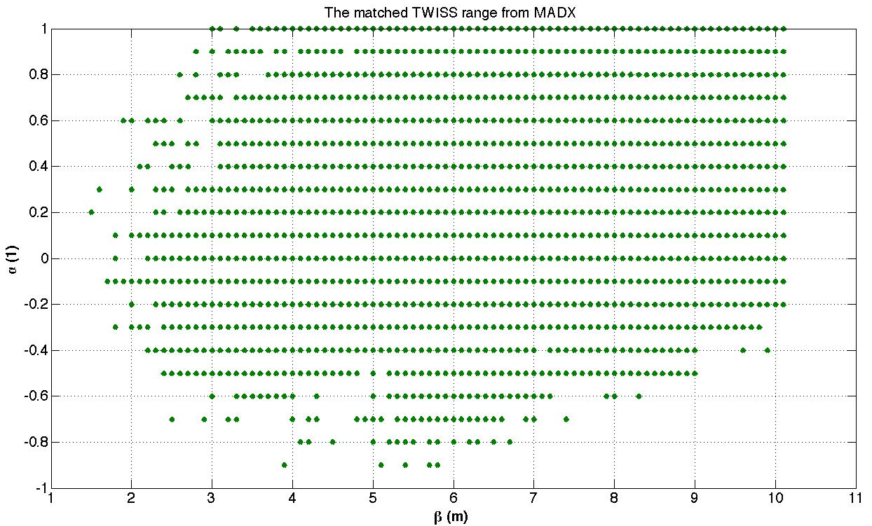
Feasible TWISS range that can be matched under our constraints
Constraints added in MADX:
Maximum gradient limit in quadrupoles.
Limit the β_{max} in the beamline;
Roughly 21 meters between the horn and 1st dipole (could possibly be removed.)
Running a scan (2100 combinations of α and β)
Questionable missing dots close to the boundaries. (algorithm convergence problem and/or floating errors)

Slide 16
pyGAmpi
A python code to run Genetic Algorithm using MPI.
Version: 1.0.0
Goals: To solve various kinds of problems.
Different combinations of parameters give different outputs;
(Different horn inner conductor shapes, currents, target positions give different pion yield at the downstream end of the horn.)
Some of these outputs need to be minimized, some maximized;
(Like shown in the previous slides. )
Constraints on the parameters;
(e.g. The longitudinal length of the horn should be no shorter than the position of the neck.)
etc.
Can be run on NERSC’s hopper or edison systems. (Edison preferred. Much faster if you are running Python or other DSL codes.)
Both MOGA and SOGA implemented.

Slide 17
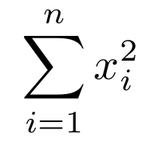
pyGAmpi (Cont’d)
Example:
SOGA. Minimize the of . n=10
Theoretical minimal occurs when
Population size: 1000; Maximum generation 500;
First generation minimum sum among the 1000 individuals was 23e4; last generation minimum sum among the individuals dropped to 2e-2 (after 480 generations and 10 mins).
The mutation probability changes in every generation, according to the paper of Dr. K. Deb, the famous author of the GA introduction textbook; the crossover probability is yet argued about within the GA community, which I used the well accepted values from Dr. K. Deb, too. According to the current code performance, it could be further studied.

Slide 18
Application of pyGAmpi on our horn studies
Main code (on compute nodes), the calling code (on the login node) is under construction;
Each iteration:
The calling code checks if the algorithm has met the stopping criteria;
If not, it checks the most recent running log and generate a job file to be submitted. This job runs the main code and all the g4bl routines;
The main code is called with arguments, which tell the code to check the current generation and write the indexes to be run using G4BL next time in the running log.

Slide 19
Horn Modeling in CST
Horn preliminary modeling in CST-EMS was done, the B-field in between the outer and inner conductor satisfies the formula well (1/r rule), however there are still some inconsistencies in the conductors. (See the next slide)

Slide 20
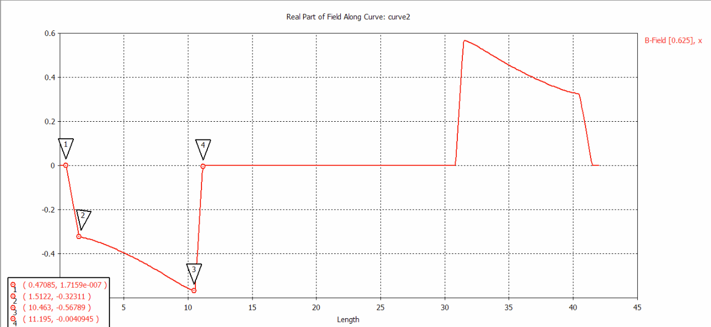
Horn Modeling in CST
Outer conductor thickness = 1cm
(0 and 1)
Inner conductor
thickness = 0.3 cm
(11 and 11.3)

Slide 21
Moving on
Combine the results from the horn performance study (“pure-field” model) with Sergei’s simulation (“realistic” model).
Model the new results in CST again.

