Slide 1
Fermilab Limited Scope Accelerator Readiness Review Plan
Technical Breakout Session 3B
Safety Configuration Management (SCM)
Gary Lauten, Chuck Worel

Slide 2
Safety Configuration Management
Main Injector enclosure safety system required no changes for the increase of beam intensity
Radiation monitors (Chipmunks & Radiation Monitor Cards) were installed in Main Injector service buildings based on Interlock Change Request & Radiation Monitor Change / Request forms generated by the RSO due in the case to this increase in beam intensity
Chipmunks & Radiation Monitor Cards are part of the standard Radiation Safety Interlock System used throughout the lab
All Radiation Safety Interlock Systems are tested using an approved test procedure at six month intervals
The ADRSO reviews test results and periodically performs an independent review of test schedules, and provides completed test results to the ESH&Q Section.

Slide 3
Safety Configuration Management
Chipmunk radiation monitors are calibrated annually.
Changes to the Radiation Safety Interlock System are performed according to procedure ADSP-10-0103 Radiation Interlock Modification Procedure.
The ADRSO initiates the interlock change request.

Slide 4
Safety Configuration Management
Permanent shielding including labyrinths:
-Accelerator Start-up documents include a sign-off sheet that certifies all shielding is in place. It is signed by the Department Head, the ADRSO, and the AD Head.
-Permanent shielding is earthen berms.
-All proposed excavations (JULIEs) are reviewed and approved by the ADRSO. -To preserve the integrity of the berms, Fermilab has a JULIE process wherein AD areas are excluded from the JULIE waiver process.
-No excavations that would compromise the shielding during beam operations are permitted. -Excavations that compromise the berm shielding require beam to be disabled. The AD RSO applies configuration controls to prevent beam operations while the berm shielding is compromised. This configuration control is documented in the configuration control log. -Shielding must be restored to equivalent or better elevations before beam operations can be resumed. Berms are inspected visually, and Alignment and Metrology Group (AMG) may be requested to take survey elevation data and provide this data to the ADRSO. The ADRSO will confirm that the berm shielding is acceptable before removing configuration controls to resume beam. -Labyrinths for the accelerator beam lines are typically permanent structures and cannot be altered. NuMI Absorber room has a concrete block labyrinth, but it is not moved.

Slide 5
Safety Configuration Management MI-30 berm excavation to repair sump line

Slide 6
Safety Configuration Management
Movable Shielding:
-Movable shielding is installed in NuMI. It consists of a large stack of concrete blocks that can be moved, that shields the roll up door area downstairs at the bottom of the NuMI MI-65 elevator shaft. It is chained and locked with an AD Radiation Safety padlock. A sign is also posted that states “Do not move or disturb shielding, contact AD Radiation Safety.”
-The shield stack is typically moved away from the roll up door during long shutdowns to allow access in and out of the NuMI Target Hall to the elevator shaft. Contractors are needed to move the massive stack. -The shield stacks are chained and locked with an AD Radiation Safety padlock. Before removing the padlock and chain, the ADRSO effects configuration control on an appropriate device to prevent beam operations. It is documented in the Configuration Control log that a configuration control has been applied, and why, and what must occur before removing the configuration control. Large equipment and components are then moved through the open roll up door. -Before resuming beam operations after a shutdown, a walkthrough is completed and all configuration locks are verified to be in place.

Slide 7
Safety Configuration Management NuMI MI-65 Roll Up Door Shield Stack

Slide 8
Safety Configuration Management
Penetration shielding:
-There are many penetrations for Main Injector. Penetrations may have polyethylene beads, sand, or steel/concrete plugs for site risers, utility and electrical penetrations, and LCW water pipes.
-Shielding requirements for penetrations are determined by the shielding assessment. -Some penetrations have shielding that is chained in locked in place, such as MI-60 rooms 117 and 118 penetrations. -Most penetrations are controlled administratively.

Slide 9
Safety Configuration Management
Radiation fencing:
-Radiation area fences are inspected typically twice annually. The fence postings are verified and replaced or restored as necessary.
-Postings are determined by the shielding assessment.

Slide 10
Safety Configuration Management
Radiation Safety Interlock System:
-Interlocks are tested at 6 month intervals.
-Completed test results are given to the ADES&H Department Head for review and concurrence (sign-off), then given to the ADRSO for logging in the completed tests into an ADRSO database.
-The ADRSO then gives the test results to the ESH&Q section for records retention.

Slide 11
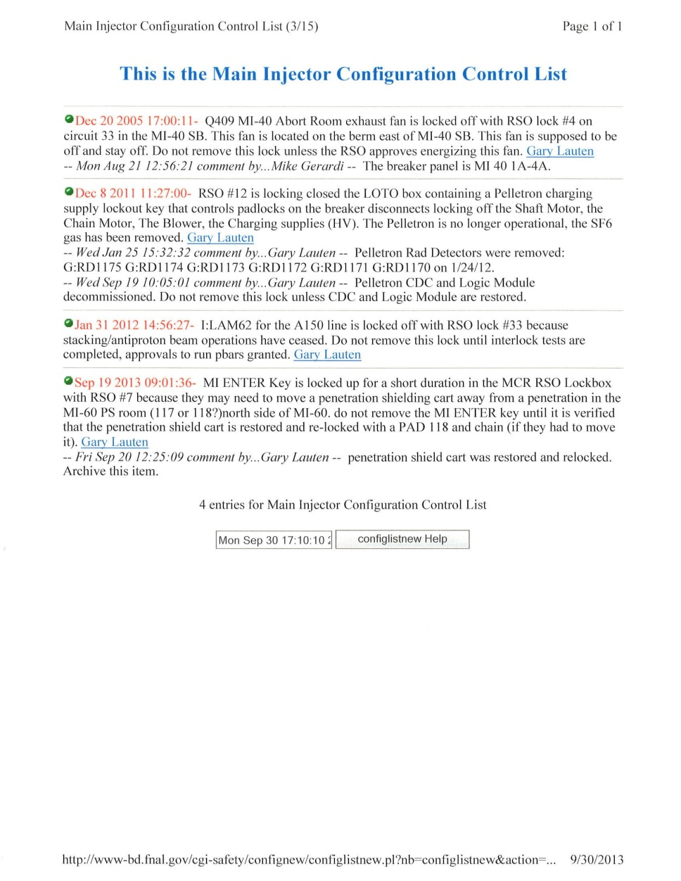
Safety Configuration Management Example page of ADRSO Configuration Control log

