Slide 1

Accelerator Readiness Review
October 2013
ARR Process and Plan
John Anderson Jr.
AD ESH Department Head

Slide 2
Outline
Scope
Charge Questions
Facility Operational Status
CRADs and LOIs
  Criteria Review and Approach Documents
  Lines of Inquiry
ARR Plan
ARR Schedule
Questions
Tuesday, October 1, 2013 Slide 2
Notes:
Set font to

Slide 3
Scope
Modifications to
  Main Injector (MI)
  Recycler
  Neutrinos at the Main Injector (NuMI) areas
Support 700 kW Operations for the NuMI Experimental Areas
Tuesday, October 1, 2013 Slide 3
Notes:
Set font to

Slide 4
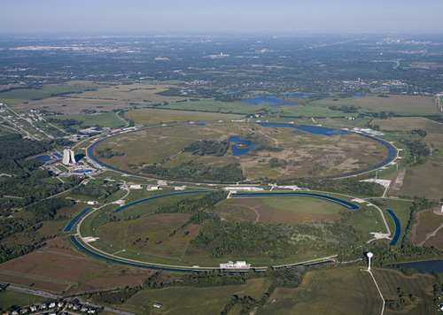
Tuesday, October 1, 2013 Slide 4
Notes:
Set font to

Slide 5
Charge Questions
Are the necessary safety program elements of the Contractor Requirements Document for DOE O420.2C, Safety of Accelerator Facilities, in place?
  A Contractor Assurance System that maintains an internal assessment process;
  A Facility Configuration Management Program that is related to accelerator safety; and
  Credited controls and appropriate administrative processes related to accelerator safety (e.g. training, procedures, etc.).
Has the laboratory developed a process for ensuring safe operations?
Tuesday, October 1, 2013 Slide 5
Notes:
Set font to

Slide 6
Charge Questions
Are the necessary credited controls, accelerator hardware, beamline controls and monitoring systems, trained personnel, and administrative processes in place and adequate to support the Main Injector, Recycler, and NuMI areas at beam power within the proposed “high power ASE”?
Tuesday, October 1, 2013 Slide 6
Notes:
Set font to

Slide 7
Facility Status
Facility is currently operating under ASE Revision 3
  MI & NuMI Beam power limit of ~514 kW
“High Power” ASE
  700 kW Operations (actually is 743 kW)
ASE limits in protons/hour
  MI Operating Limit 1.39 x 10¹⁷ protons per hour
  NuMI Operating Limit 1.46 x 10¹⁷ protons per hour
Increase beam power ~40%
Tuesday, October 1, 2013 Slide 7
Notes:
Set font to

Slide 8
CRADs and LOIs
CRADs and LOIs developed to facilitate the review
Required Documentation
Contractor Requirements Document (CRD) in
DOE O 420.2C Safety of Accelerator Facilities
  Safety Assessment Document (SAD)
  Accelerator Safety Envelope (ASE)
  Unreviewed Safety Issues (USI) process
  Accelerator Safety and the Fermilab Contractor Assurance System (CAS)
  Safety Configuration Management (SCM)
Tuesday, October 1, 2013 Slide 8
Notes:
Set font to

Slide 9
CRADs and LOIs
Accelerator Systems
  Accelerator Operator Training and Qualification Program
  Accelerator Operations Procedures
  Work Planning and Control Related to Accelerator Safety
  Radiological Safety for 700 kW Operations
  Credited Controls (CC)
Tuesday, October 1, 2013 Slide 9
Notes:
Set font to

Slide 10
ARR Plan
Plenary Sessions
  Overview of Fermilab Programs
Technical Breakout Sessions
  Explore each CRAD through LOIs
  Two Parts
    Overview presentation on how CRAD is implemented
    Performance part
      Discussion with employees
      Systems demonstrations
      Implementation
Site visits
  MI-60 and MI-65 Service Buildings
  Main Control Room (MCR)
  Booster & Linac Galleries
Tuesday, October 1, 2013 Slide 10
Notes:
Set font to

Slide 11
ARR Schedule
Tuesday, October 1, 2013 Slide 11
Notes:
Set font to

Slide 12
ARR Schedule
Tuesday, October 1, 2013 Slide 12
Notes:
Set font to

Slide 13
ARR Schedule
Tuesday, October 1, 2013 Slide 13
Notes:
Set font to

Slide 14
ARR Schedule
Tuesday, October 1, 2013 Slide 14
Notes:
Set font to

Slide 15
Questions
?
Tuesday, October 1, 2013 Slide 15
Notes:
Set font to

