Slide 1
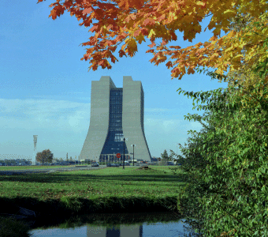
Overview of FESHCom Subcommittees
Don Cossairt, Radiation Protection Manager,
ESH&Q Section October 1, 2013

Slide 2
What is FESHCom?
Fermilab has long had an integrated ESH&Q Committee Structure.
Centerpiece: FESHCom: Fermilab ES&H Committee
Chaired normally by the Chief Operating Officer with the ESH&Q Director serving as Secretary.
FESHCom meets monthly with an agenda announced in advance.
FESHCom membership is comprised of 14 “citizen” members along with the chairs of 16 subcommittees.
FESHCom and all subcommittees have at least one assigned DOE-FSO Participant
Brief Summary of Charter:
The Fermilab ES&H Committee has the responsibility for reviewing safety and security policies and programs and for reporting its findings and recommendations to the Laboratory Director. In carrying out this responsibility, the Fermilab ES&H Committee coordinates the activities of its subcommittees, reviews ES&H or security policies of general Laboratory-wide significance, and reviews the aspects of Laboratory activities which may be of concern to the public. The Fermilab ES&H Committee responds to requests from and suggests topics for review to the Laboratory Director, the Laboratory ES&H Section Head, division/section/center heads, and members of the Committee.

Slide 3
FESHCom Subcommittees
There are 16 FESHCom Subcommittees.
All subcommittee chairs report to FESHCom every 4 months.
All subcommittees submit an annual self-assessment report that feeds into the lab-wide self-assessment.
Where appropriate, subcommittees work on joint projects.
Charters are written and give detailed requirements.
Subcommittee are responsible for maintaining specific FESHM Chapters to be current.
Members are appointed by the FESHCom Chair, some with rotating terms generally 3 years in length and subject matter experts (SMES), for indefinite terms.
List of Subcommittees, with brief explanatory notes, if needed:
Cryogenic Safety: The Cryogenic Safety Subcommittee provides guidance and support to the Laboratory concerning all engineering systems operating with flammable and non-flammable fluids whose normal boiling point is below –150 C (123 K). This body had many panels that do engineering reviews of specific systems. Oxygen deficiency hazards are included.
Emergency Management: The Emergency Management Subcommittee provides guidance and support to the Laboratory concerning the oversight of the emergency management program, policies and procedures that provide the foundation for the Fermilab Comprehensive Emergency Management Program (CEMP).

Slide 4
FESHCom Subcommittees
List of Subcommittees, with brief explanatory notes, if needed:
Electrical Safety: The Electrical Safety Subcommittee provides guidance to the Laboratory for the overall specification and content of the Fermilab Electrical Safety Program. Their charter includes items incorporated in experimental apparatus and also AC power distribution systems.
Environmental Protection: The Environmental Protection Subcommittee provides guidance to the Laboratory concerning the implementation of Fermilab’s Environmental Management System (EMS).
Ergonomics: The Ergonomics Subcommittee provides guidance to the Laboratory concerning the ergonomic issues that may exist and assisting employees with incorporating ergonomic principles into their day to day activities.
Fire Hazard: The Fire Hazard Subcommittee Subcommittee provides guidance to the Laboratory relating to fire safety, life safety aspects of facilities and processes and experiments and flammable and compressed gas systems operated at temperatures above -90°C (-150°F) and fire hazard policies at Fermilab.
Industrial Hygiene Subcommittee and Laser Safety Committee: The Industrial Hygiene Subcommittee provides guidance to the Laboratory concerning Fermilab’s Industrial Hygiene policies, the Industrial Hygiene portions of the Fermilab ES&H Manual, and the Work Smart standards relevant to Industrial Hygiene.
Injury/Illness Prevention: The Injury Illness Prevention Subcommittee is responsible for providing guidance to the Laboratory concerning the prevention of injuries. Activities include reviewing accidents and accident reports for the purpose of ensuring a complete investigation, sharing of information and identification of any lab-wide lessons learned.

Slide 5
FESHCom Subcommittees
List of Subcommittees, with brief explanatory notes, if needed:
Mechanical Safety: The Mechanical Safety Subcommittee is responsible for recommending guidelines to the Laboratory concerning fabrication, testing, installation, and use of mechanical systems for experimental and laboratory applications.
Quality Assurance: The Quality Assurance Subcommittee provides guidance to the Laboratory concerning the Quality Assurance Program (QAP) including implementation of policies, procedures, reporting, and compliance to requirements.
Senior Safety Officer: The Senior Safety Officer (SSO) Subcommittee provides guidance to the Laboratory concerning general safety activities. Each line organization is represented by a Senior Safety Officer whose appointment is made by the Division/Section/Center Head and approved by the ESH&Q Director. SSOs at Fermilab are full-time ESH staff employed by their individual organizations.
Subcontractor Safety: The Subcontractor Safety Subcommittee provides guidance to the Laboratory concerning the safety of subcontractors working at Fermilab. This includes construction and service work being done under fixed-price, Time and Material (T&M) or blanket subcontracts.
Traffic Safety: The Traffic Safety Subcommittee provides guidance to the Laboratory concerning enhancements and improvements to the Laboratory concerning the safety of pedestrians, cyclists and motorists on the Fermilab site.
Radiation Safety: The Radiation Safety Subcommittee is responsible for providing guidance to the Laboratory concerning implementation and improvement of the Fermilab radiation protection program. Radiological consequences of events at accelerators are addressed!

Slide 6
FESHCom Subcommittees
Two Subcommittees Directly Tied to Accelerator Safety Order Implementation
Shielding Assessment Review: The Shielding Assessment Review Subcommittee is responsible for reviewing the results of each shielding assessment for methodology, completeness, and compliance with the Fermilab Radiological Control Manual.
Safety Assessment Document Review: The Safety Assessment Document Review Subcommittee is responsible for reviewing the results of each safety assessment document chapter for completeness and compliance with the Fermilab ES&H Manual Chapter 2010.

Slide 7
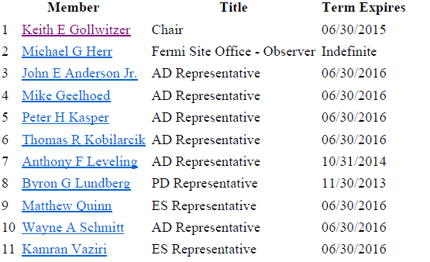
FESHCom Subcommittees
Shielding Assessment Review Subcommittee
Shielding Assessment Review Subcommittee Membership: The membership is broad-based and includes people experienced with shielding calculations as a practical matter.

Slide 8
FESHCom Subcommittees
Shielding Assessment Review Subcommittee
Detailed Charter Provisions
The subcommittee will meet on an as needed basis to review shielding assessments submitted for approval.
The subcommittee reviews shielding assessments for methodology, completeness, and compliance with the Fermilab Radiological Control Manual.
The subcommittee submits a brief report to the ESH&Q Director recommending acceptance or rejection for cause of the assessment in its then existing state based on the consensus of the committee.
The ESH&Q Director documents the acceptance of the shielding assessment, if justified.
In practice (See FRCM Chapter 8):
Proponents of a given “module” of the accelerator conduct and document a shielding assessment of designs and facilities using SMEs in the Accelerator Division, the Accelerator Physics Center, and ESH&Q.
The assessment is submitted to the subcommittee for review.
Often a presentation of these results is necessary and there is commonly a great deal of back and forth.
If possible shielding verifications are reported.
The results of the shielding assessment are typically incorporated into the Safety Assessment Document.

Slide 9
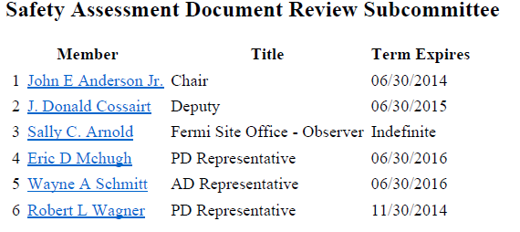
FESHCom Subcommittees
Shielding Assessment Document Review Subcommittee
Safety Assessment Document Review Subcommittee Membership: The membership is broad-based and includes people experienced considerable ES&H experience

Slide 10
FESHCom Subcommittees
Safety Assessment Document Review Subcommittee
Detailed Charter Provisions:
The subcommittee will meet on an as needed basis to review safety assessment document chapters submitted for approval.
The subcommittee reviews safety assessment documents for compliance with FESHM Chapter 2010.
The subcommittee submits a brief report to the ESH Director recommending acceptance or rejection for cause of the assessment in its then existing state based on the consensus of the committee.
In Practice
Draft chapters are distributed by the Chair to members for review and comment.
Consolidated comments are provided to the authors of the chapter.
The subcommittee meets as needed to resolve conflicts, if any, that remain.
Once subcommittee comments are satisfied, the document is forwarded on to the ESH&Q Director with a recommendation for approval. This includes the ASE since all ASEs are supported by analysis provided in the SAD.
The ESH&Q Director, if any agreement, forward the chapters to the Laboratory Director for approval.
Upon approval, the relevant SAD chapters are forwarded to the DOE-FSO manager for concurrence with the SAD and approval of the ARR.

Slide 11
?

