Slide 1
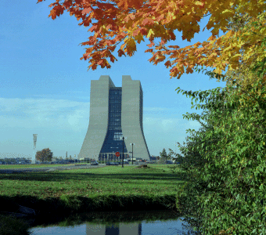
Industrial Hazard Mitigation FRCM and FESHM
Don Cossairt, Radiation Protection Manager,
ESH&Q Section October 1, 2013

Slide 2
Industrial Hazards Mitigation at Fermilab
DOE Order 420.2C and associated Guidance Documents are, by design, focussed on the unique hazards of accelerators.
O420.2C states:
The Accelerator Safety Order does establish some accelerator-specific requirements, the reason we are together this week.
In the above, it assumes other ESH requirements will supplement the accelerator-specific requirements.
We meet those “other” requirements at Fermilab.
In my earlier talk I discussed the role of the Fermilab ES&H Manual (FESHM) including the Fermilab Radiological Control Manual (FRCM) as applied to standards for prompt radiation.
Here the rest of the contents of FESHM and FRCM will be introduced to you for “background” information.

Slide 3
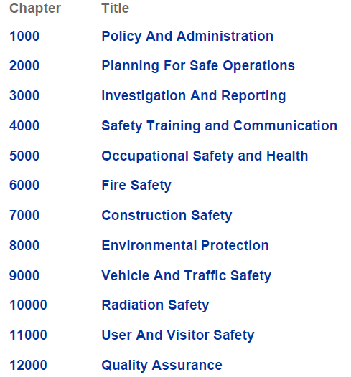
FESHM High Level Topics
I will not talk about every FESHM or FRCM chapter! Here are the somewhat cryptic FESHM major topic sections:

Slide 4
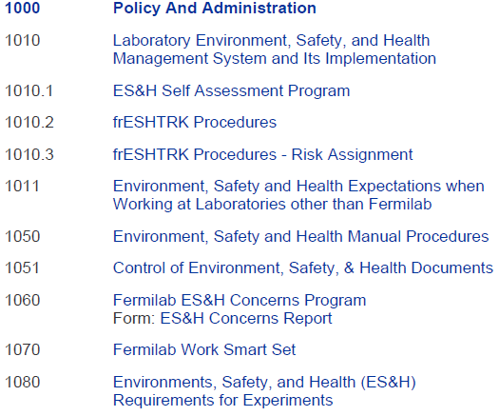
1000 Series

Slide 5
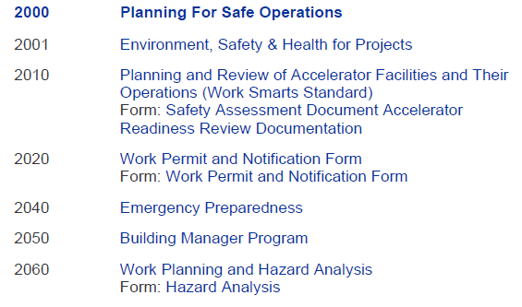
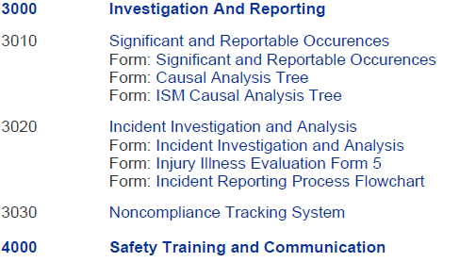
2000, 3000, and 4000 Series

Slide 6
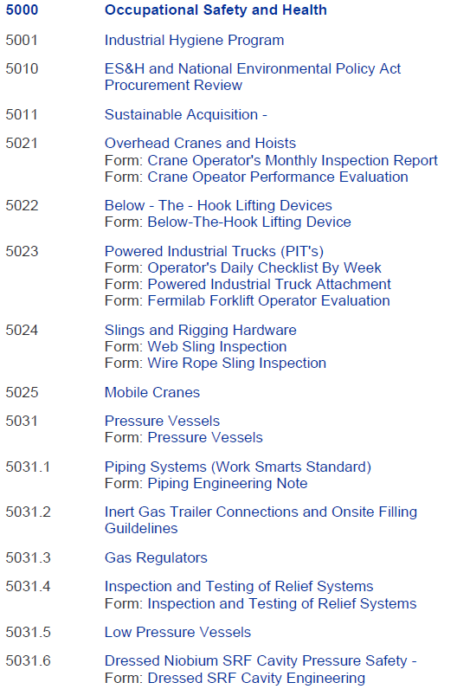
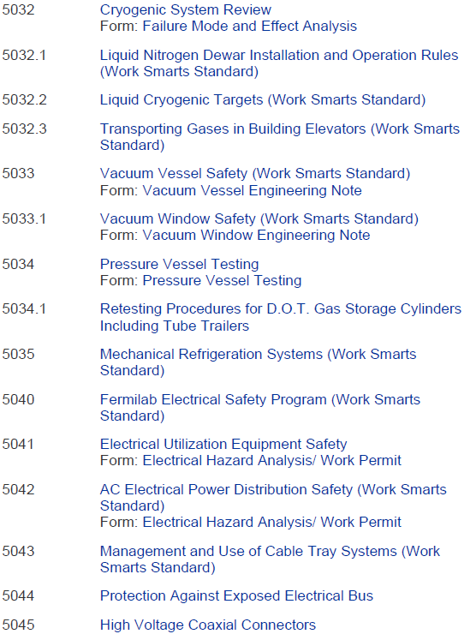
5000 Series – The BIG Section

Slide 7
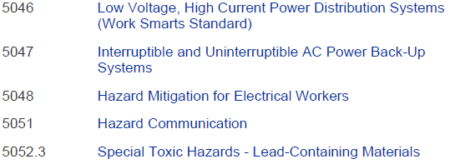
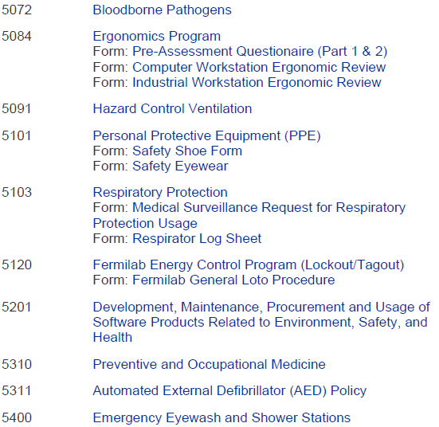
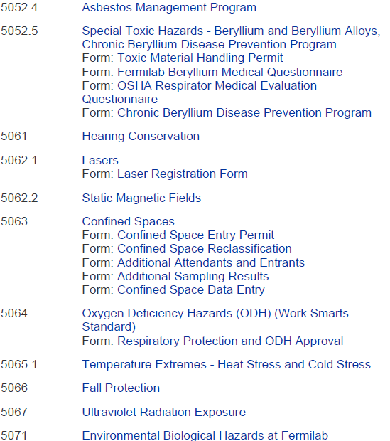
5000 Series – The BIG Section

Slide 8
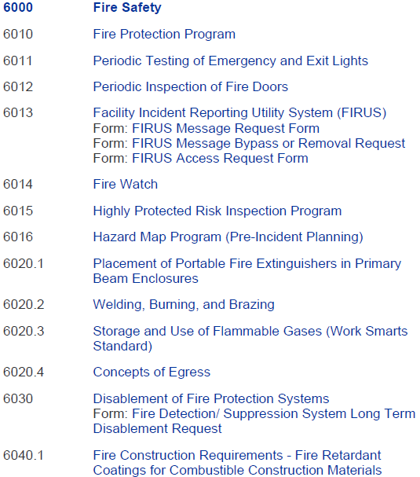
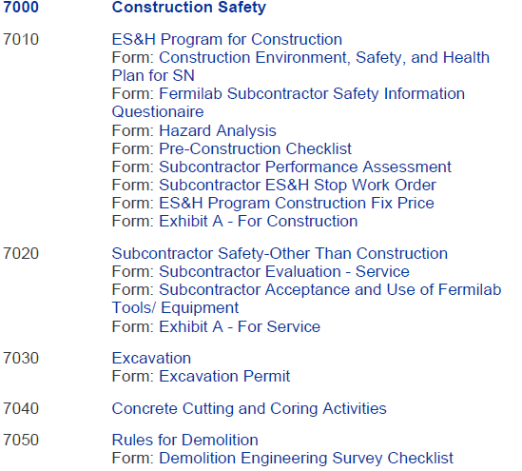
6000 and 7000 Series

Slide 9
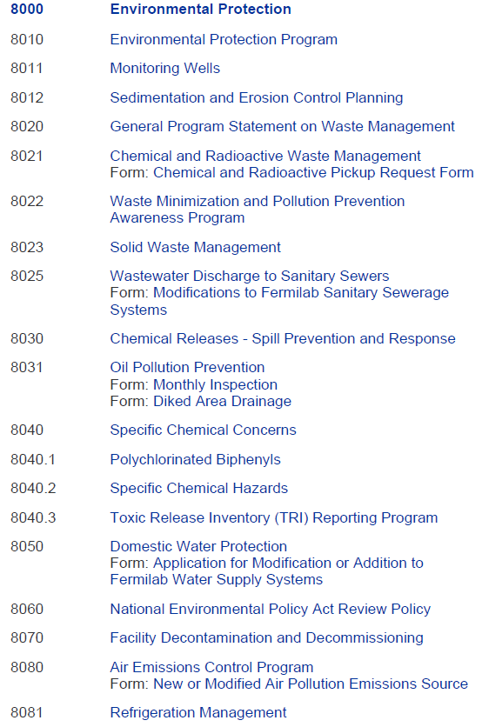
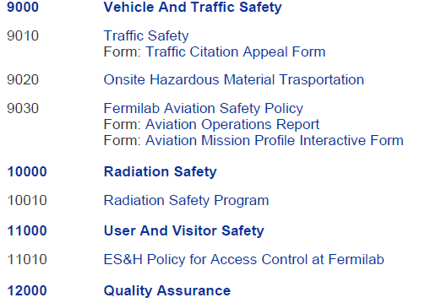
8000, 9000, 10000, 11000, & 12000 Series

Slide 10
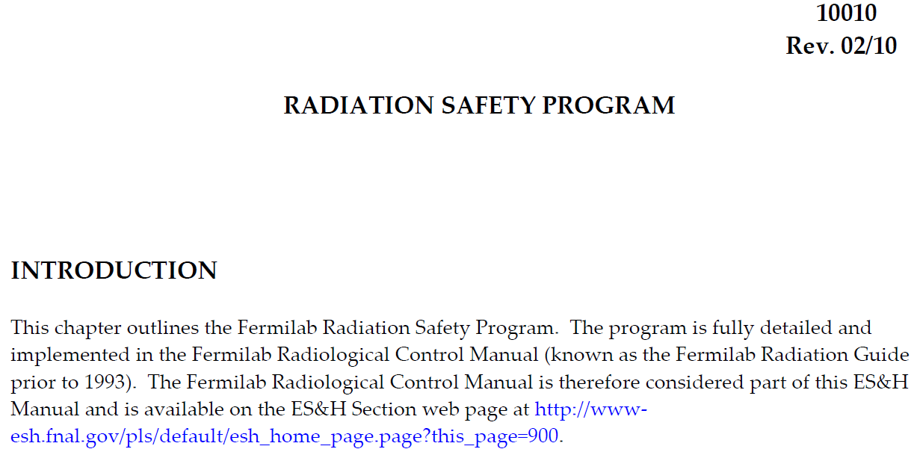
FESHM 10010 Unveiled
The full FESHM Chapter on Radiation Safety Program

Slide 11
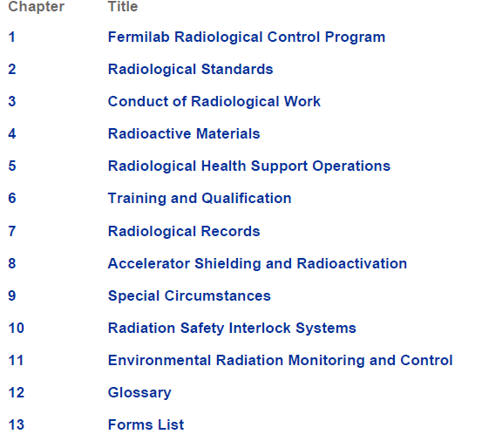
FRCM Table of Contents

Slide 12
Conclusions
Fermilab’s program for Integrated Safety Management Systems (ISMS) is reflected in the breadth of contents in FESHM and FRCM.
All work processes and their hazards are covered.
FESHM and FRCM chapters are written by SMEs that are also familiar with any “peculiarities” that might be accelerator-specific.
As discussed in a previous talk, the development and maintenance of FESHM/FRCM chapters is aligned with the work of the FESHCom subcommittees.
Accelerator-specific requirements are integrated with the industrial safety and environmental protection programs.

Slide 13
?

