Slide 1
Fermilab Limited Scope
Accelerator Readiness Review (ARR)
October 1 -3, 2013
Technical Breakout Session 2A
Radiological Safety for 700 kW Operations

Slide 2
Increased Beam Power
Change in operating parameters (per approved shielding assessments):
Recycler Ring:
Operating Intensity: 1.5x10¹³ p/pulse → 8.33x10¹³ p/pulse @ 8 GeV
Cycle Time: 1.33 seconds/pulse
2.25x10¹⁷ p/hr (80 kW)
Main Injector:
Operating Intensity: 5.00x10¹³ p/pulse → 5.16x10¹³ p/pulse @ 120 GeV
Cycle Time: 1.87 seconds/pulse → 1.33 seconds/pulse
9.63x10¹⁶ protons/hr → 1.39x10¹⁷ protons/hr
513 kW → 743 kW
NuMI: 513 kW → 778 kW

Slide 3
Shielding Evaluation
Shielding thickness determined:
via Monte Carlo modeling (e.g., MARS15)
Derived from Generic Shielding Criteria via known scaling laws:
Δt = -(TVL)log[(E’/E)^{0.8} (I’/I) (T/T’)]
Note: labyrinths and penetrations are scaled slightly differently since dose rates are dominated by changes in geometry, rather than passive shielding
“Incremental Shielding Assessment”

Slide 4
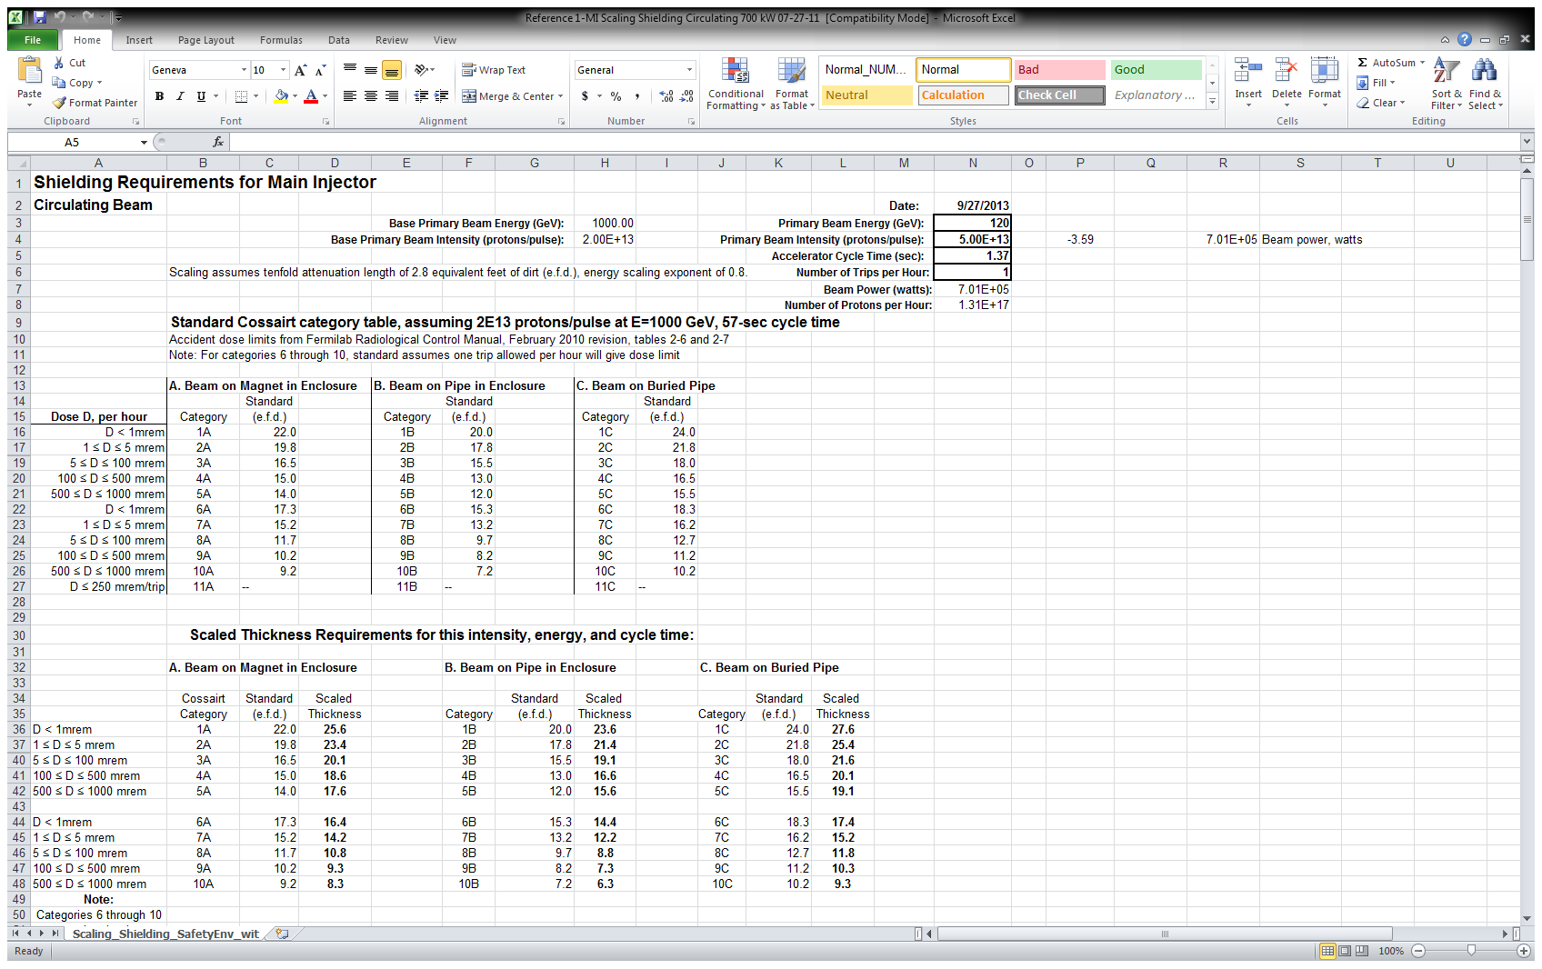
Scaling sheet for MI

Slide 5
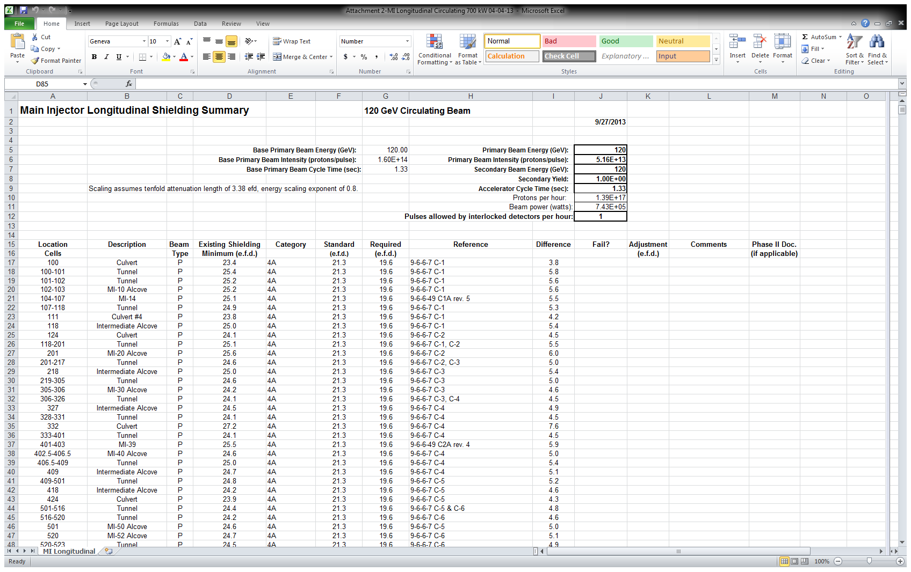
Longitudinal Summary for MI

Slide 6
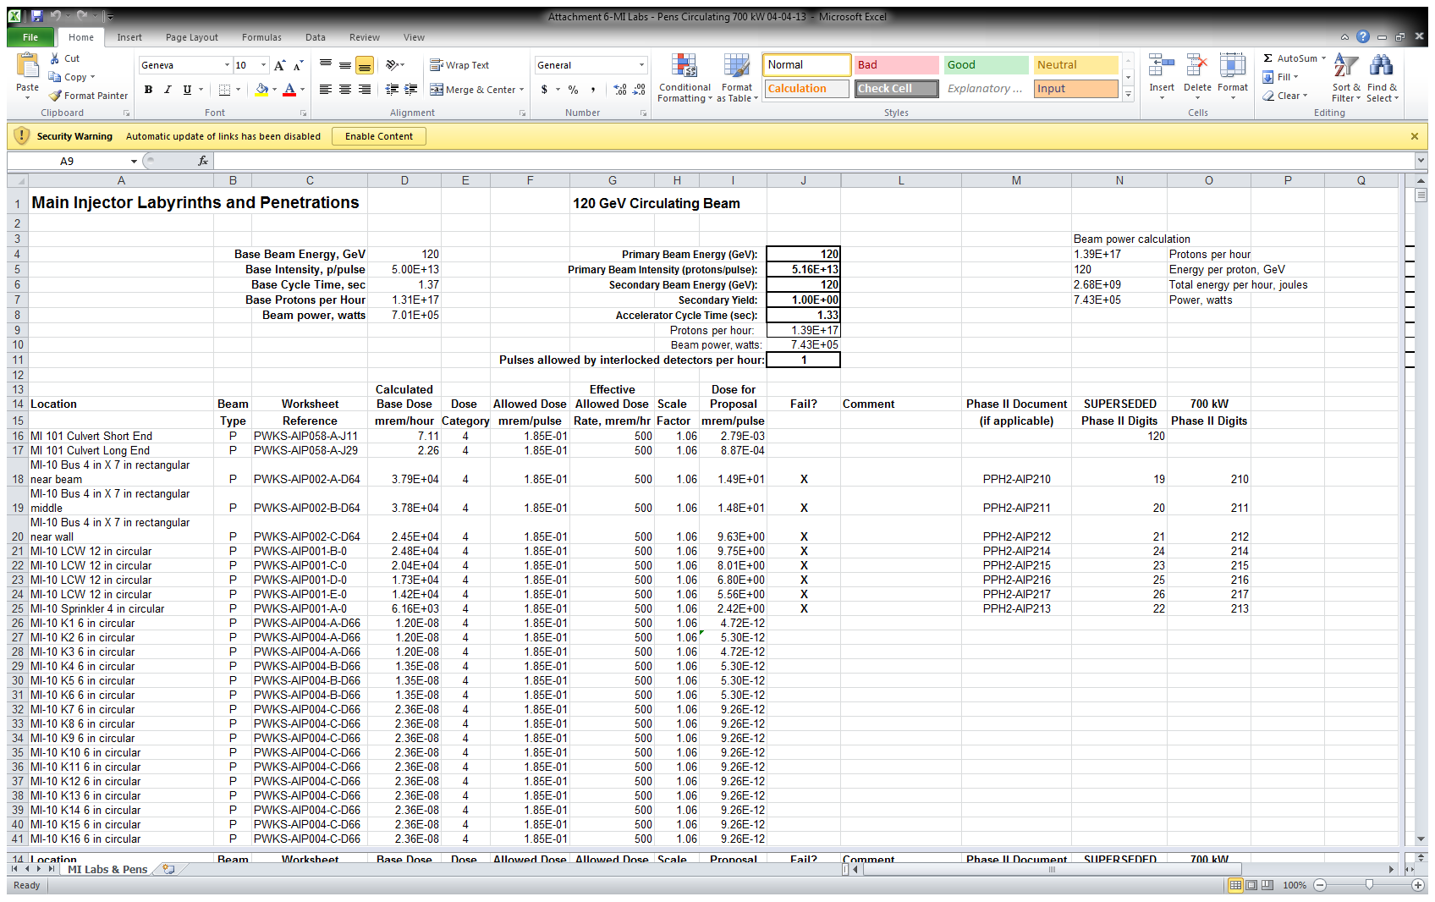
Labyrinth/Penetration Summary for MI

Slide 7
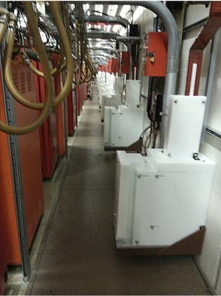
Example of Additional Shielding Needed for 700 kW Operations
20 RF bus penetrations at MI-60 gallery

Slide 8
Operational/Environmental Impacts
Residual activity
  Scaled from previous measurements/surveys
Releases to air and water
  air release estimates based on annual proton beam loss rates since direct measurement below detection threshhold
  surface/ground water estimates assume losses at discrete (e.g., extraction, injection, and abort) locations
Prompt air-scattered radiation (‘skyshine’)
Not relevant at NuMI or RR/MI tunnels due to thick shielding

Slide 9
Verification Studies
Shielding effectiveness studies will soon be performed
Plan currently being developed

